Slide 1


Creating a safe and supportive environment for ourselves and our children
Presented by Peter Bachman, LCSW-C

Slide 2
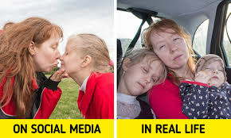
There’s so much!
We want the best for our kids, and there are so many voices telling us how and what to do.
There’s a sense that if we only did more, or did better, we would have this parenting thing all figured out.
Our lives are stressful, our kids’ lives are busy and often more stressful than we’d like, and we want to protect them.
But how do we balance protecting them with letting them fail? How do we navigate the hard stuff?
A lot of parenting ends up doing the opposite of what you feel like doing!

Slide 3
Safety in this discussion...

Slide 4
What does it really mean to “take care of ourselves?”
Even though it may not seem like it in intense moments, the more we can do to manage our own feelings the easier it is to access our own wisdom.
The 3 S's:
Self-Awareness
Self-Regulation
Support

Slide 5

Self-awareness
How we parent is strongly impacted by our own experience growing up. Take a moment to reflect on what it was like growing up in your household. Was it calm, predictable, safe? Or was it unpredictable, volatile, unsafe?
As best you can, without judgment, consider what the impact of your experience was on how you are as a parent…Do you try to emulate the way your parents parented you? Do you try to do the opposite? Is it a combination?
If we can answer this question we can better understand why we may react the way we do and make a choice to respond, rather than react.
Any volunteers?

Slide 6
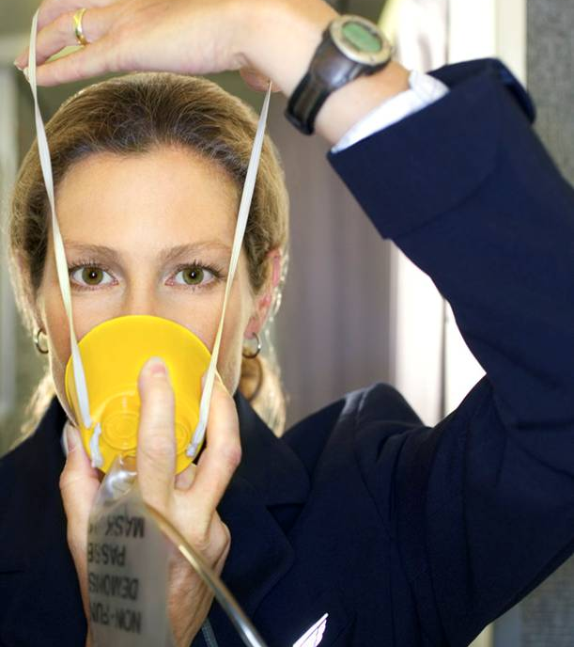
Self-regulation
It’s helpful to know our triggers, but how do we manage the intense thoughts and emotions that so often accompany stress?
Take a moment to consider a stressful situation with your child…do any physical sensations arise?
What do you do when this sensation comes around? Most of us try to push it away; is there a way to notice it? Welcome it? Befriend it?
This practice is called mindful parenting; it’s important to remember it’s a practice…
This Photo by Unknown Author is licensed under CC BY-NC-ND

Slide 7

Support
Often we have a spouse, partner, or supportive co-parent to help us in difficult moments, though it’s quite challenging sometimes to see them as support sometimes. There are LOTS of potential reasons for this.
Do you have a supportive co-parent? If so, what are the ways in which that person helps? If not, what gets in the way?

Slide 8
Previously Submitted questions:
How can we get our daughter to stop biting her lip? We have tried various methods, including explaining the consequences of biting her lip. We are looking for more effective ways to help correct this behavior.
How do you get teenagers to eat, sleep, and do all homework?
What advice do you have about discussing inappropriate content on the internet between parents and children?
Encouragement versus pressure around sports/activities. Wanting to expose child to new things and balancing the pushback of “no I don’t want to” or “I’m not good at that”
Comparison to peers. When child says so and so is good at that I’m bad at that. Helping them believe in themselves, at the level they currently are at.
I'd love some advice on how to handle sibling rivalry especially between kids that are strong willed and don't like to give in to each other (they will compromise well with other kids)

Slide 9

Questions, specific situations to discuss?

Slide 10

