Slide 1

Capital Improvement Project – bond Update –
Hastings-on-Hudson UFSD
Latest developments in capital improvement project

Slide 2
Team Introductions

Slide 3
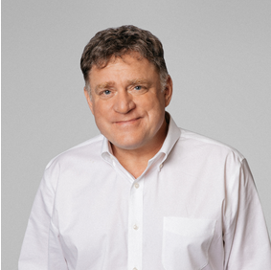
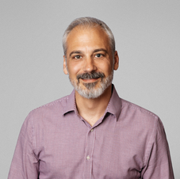
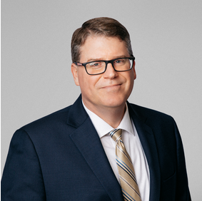
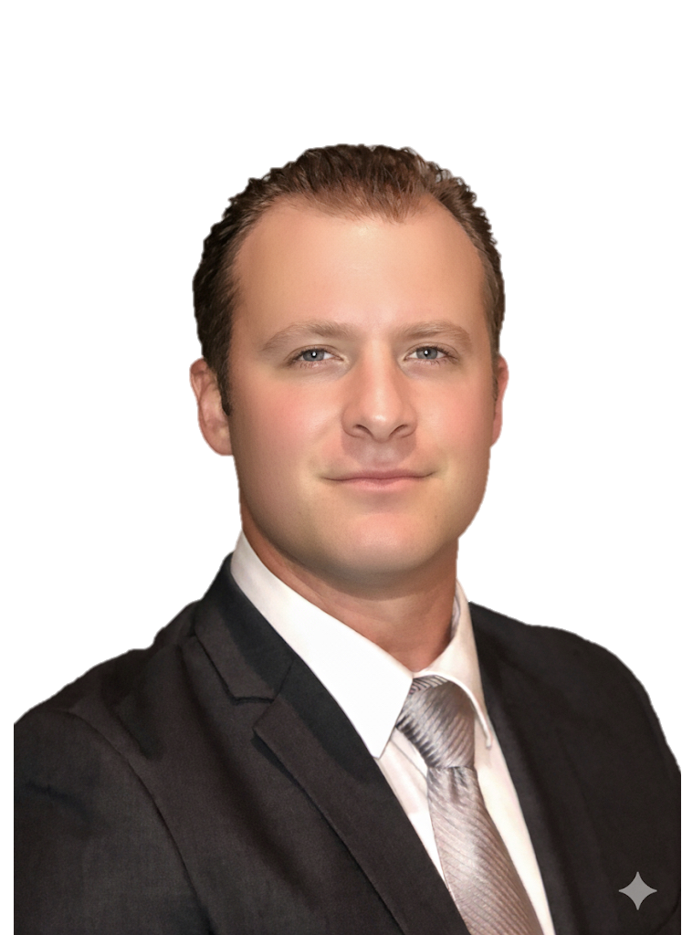
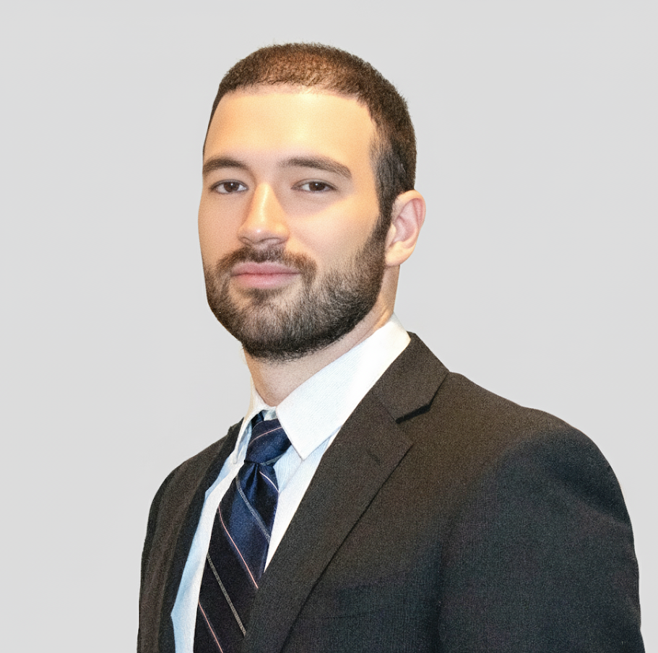

construction management team
Chris Pearson
  SVP | Preconstruction
Teddy Tsiboukis
  VP | Estimating
Kevin Sawyer
  VP | K-12 Construction
John Hansen
  Pre-construction Manager
Redi Gjecka
  Project Manager

Slide 4
Construction Manager – Key Roles & Responsibilities
Overall Goal:
To ensure the successful delivery of the District’s capital bond projects by serving as the central coordinator among all project stakeholders—including architects, engineers, and testing agencies—while maintaining strict adherence to schedule, budget, and regulatory compliance. Our role is to proactively manage design, bidding, construction, and closeout phases to achieve high-quality outcomes that meet the District’s educational and operational goals.

Slide 5
Construction Manager – Key Roles & Responsibilities
1. Design Phase
Provide cost estimates at each design stage.
Perform value engineering & constructability reviews.
Review bid documents for coordination and budget alignment.
3. Construction Phase
Oversee all contractors & site activities.
Maintain schedule, logs, and project documentation.
Manage communications, change orders, claims, and payments.
Ensure safety compliance and issue directives as needed.
2. Bidding Phase
Develop bid packages & project schedule.
Participate in pre-bid meetings; vet contractors.
Analyze bids & recommend awards.
4. Post-Construction
Manage punch list completion & close-out.
Collect as-built documents & warranties.
Oversee warranty work during the warranty period.
Continuous Responsibilities
Budget & cash flow tracking.
Monthly progress and financial reporting.
Compliance with NYSED regulations, safety standards, and district policies.
Community updates

Slide 6
How did we get here…

Slide 7
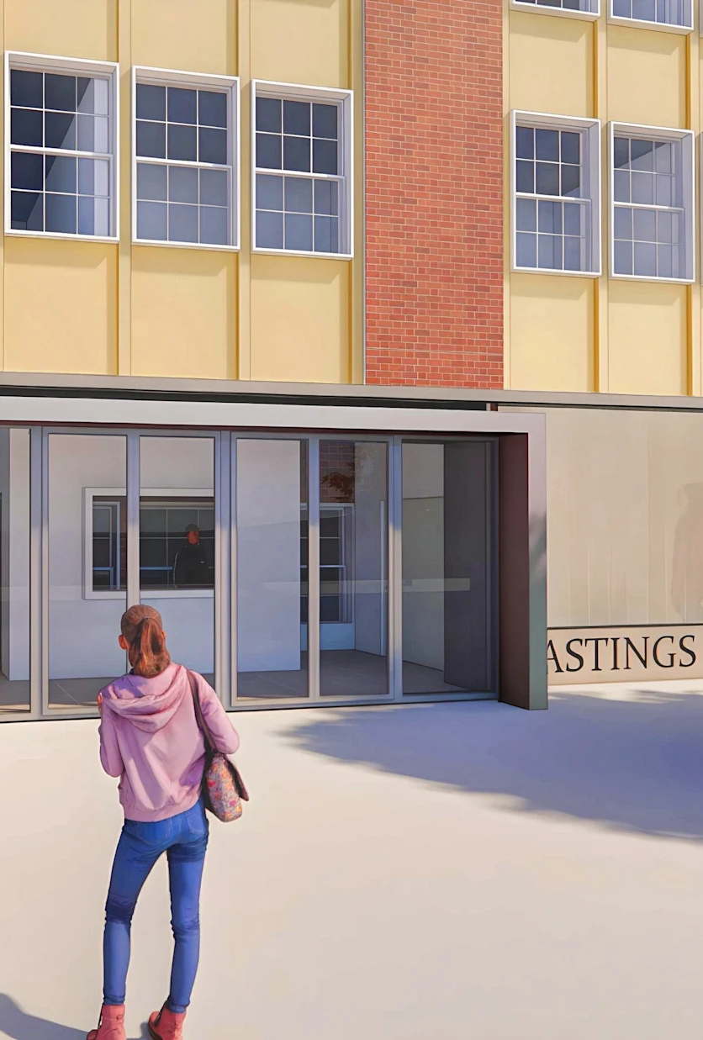
Capital Improvement Project Overview
Project Pre-Referendum Timeline
Referendum Presented to BoE
November 2024
SEQR PROCESS STARTED
January 2025
BOND VOTE PUBLISHED
April 2025
BOND VOTE
PASSED
June 2025
Voter Approval and Propositions
  The community passed all three Propositions totaling $38,475,500:
Building Conditions Survey (BCS) Items – District-wide replacement of outdated mechanical, electrical, and plumbing systems for code compliance, safety, and efficiency. $11,254,780
Farragut Complex Addition & Instructional Space – New classrooms and special ed spaces; cafeteria relocated via courtyard addition; new main entrance; code and accessibility upgrades. $19,049,461
Athletic Fields and Site Work at Burke Estate – Two new turf fields (multi-sport and softball) with related site work. $8,171,259
Notes:
The Hastings-on-Hudson Union Free School District has embarked on a comprehensive Capital Improvement Project aimed at modernizing and enhancing its educational facilities. This initiative reflects the district’s commitment to providing high-quality learning environments for students and staff. The project encompasses multiple propositions approved by voters, each targeting specific infrastructure and educational needs.

Slide 8
WHERE WE ARE NOW…

Slide 9
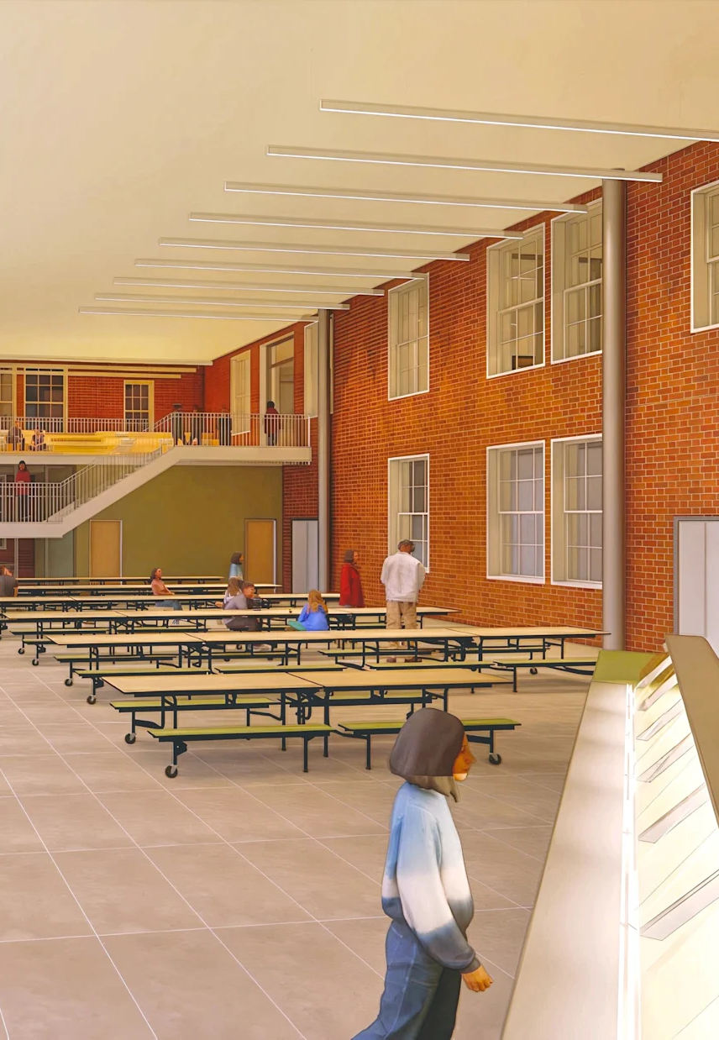
WHERE WE ARE NOW
Professional Services
    LAN Prop #1, #2 and #3 as Production Architect
    PBDW Prop #2 as Design Architect
    LA Group Prop #3 as Civil/ Site Services Engineer
    Triton Construction Construction Management Services
    Current Progression
  Advancing Designs from Conceptual Design to Schematic Design Drawings
      Engineers site walk-thru of mechanical systems (prop #1)
      User group meetings – Proposition #2 & Proposition #3
  Schematic Design Drawings Estimating - In Progress
  Set up regular High-Level discussions with Team (OACM Meetings)
  Financing – Developing Cash Flow for Borrowing
Notes:
The Capital Improvement Project is supported by a multidisciplinary team comprising representatives from the Hastings-on-Hudson UFSD, architectural firms, and construction management professionals. Triton Construction has officially joined the project as the Construction Manager, bringing extensive experience in educational facility upgrades. This slide introduces the core team members, including district officials, architects, and Triton representatives.

Slide 10
Where we are now (Schedule overview)
Start
6/18/25
Today
Finish
3/3/28
Half 2, 2025
Half 1, 2026
Half 2, 2026
Half 1, 2027
Half 2, 2027
Half 1, 2028
Burke Fields - Design Development, Permitting & Award
6/18/25 - 2/19/26
District-wide - Design Development, Permitting & Award
6/18/25 - 6/10/26
DESIGN & AWARD
Farragut - Design Development, Permitting & Award
6/18/25 - 8/26/26
Burke Field Upgrades - Construction
6/1/26 - 12/31/26
CONSTRUCTION
District-Wide Infrastructure - Construction
6/26/26 - 8/31/27
Farragut Additions - Construction
8/27/26 - 8/31/27
Farragut Renovations
9/1/27 - 1/3/28
Fields Closeout
1/4/27 - 3/4/27
CLOSEOUT
District-Wide Closeout
9/1/27 - 11/1/27
Farragut Closeout
1/4/28 - 3/3/28
*Subject to change as project develops.
Notes:
The Capital Improvement Project is structured around three key propositions that were approved by the community.

Slide 11
NEXT STEPS…
Notes:
Progress and Milestones

Slide 12
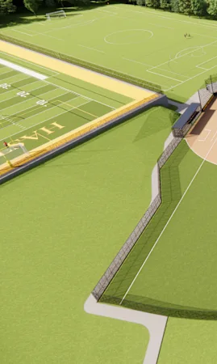
NEXT STEPS…
  Set up regular BOE/ Community project status update presentations
  Team presents update in community forums on Prop. 3 – by End of October/ Early November
  Team to present updated design on all projects in a future BOE meetings – Early November 2025 through remainder of project
  Establish a Master Budget and provide regular updates with more details
  Establish a Master Schedule and provide regular updates with more details
Notes:
Since the approval of the Capital Improvement Project, significant progress has been made.

Slide 13
QUESTIONS

