Slide 1

Wissahickon School District

Slide 2


Slide 3

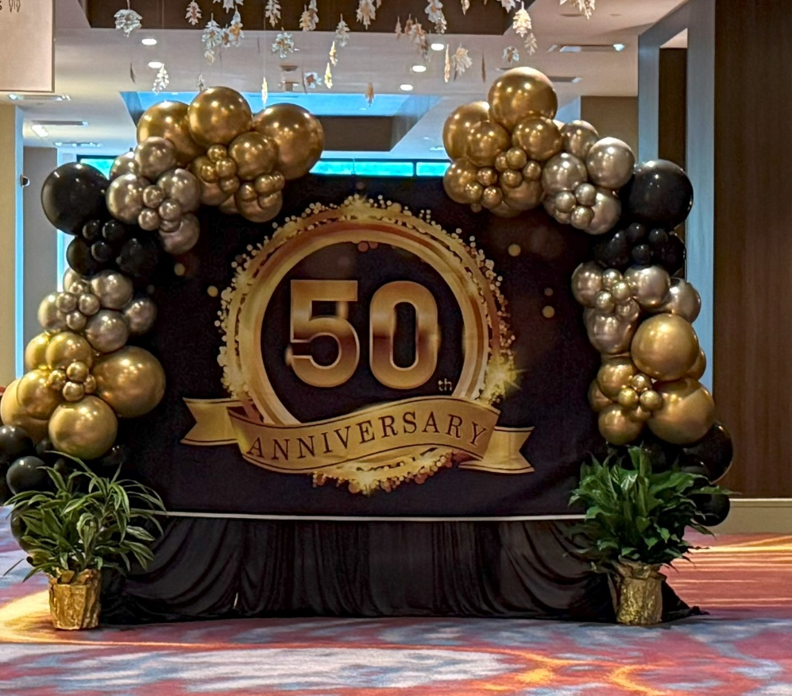
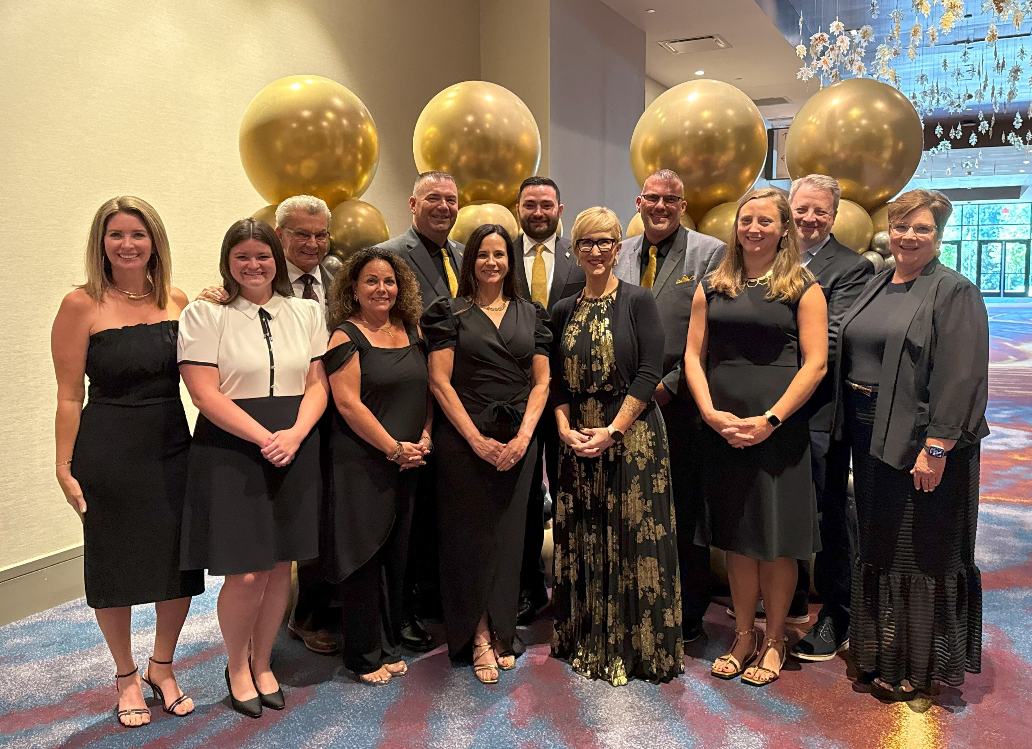
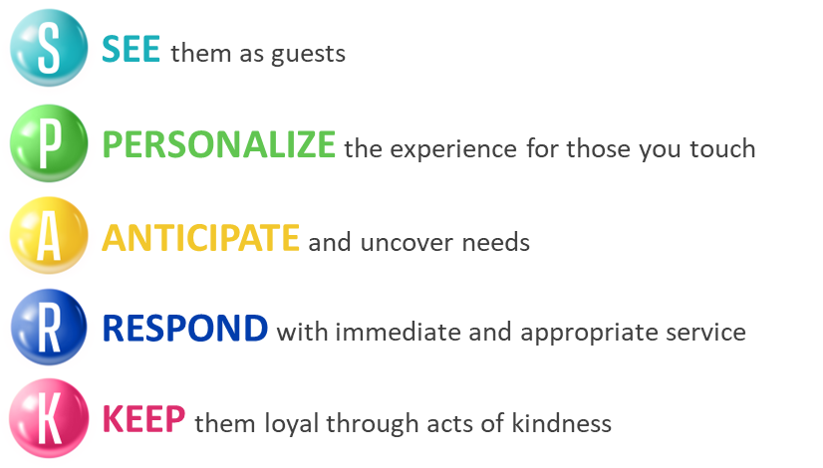

Slide 4

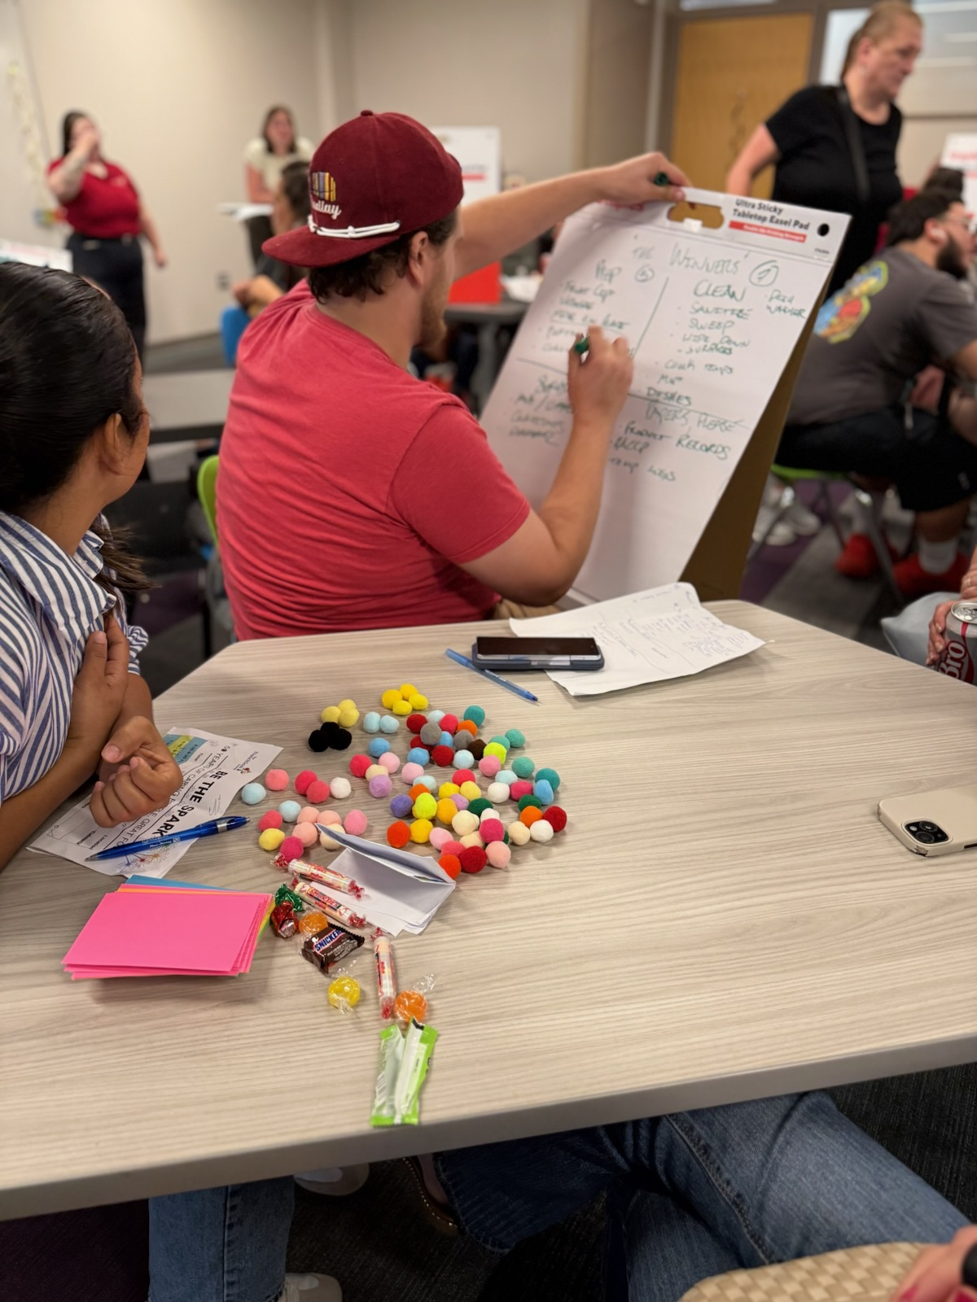

Slide 5

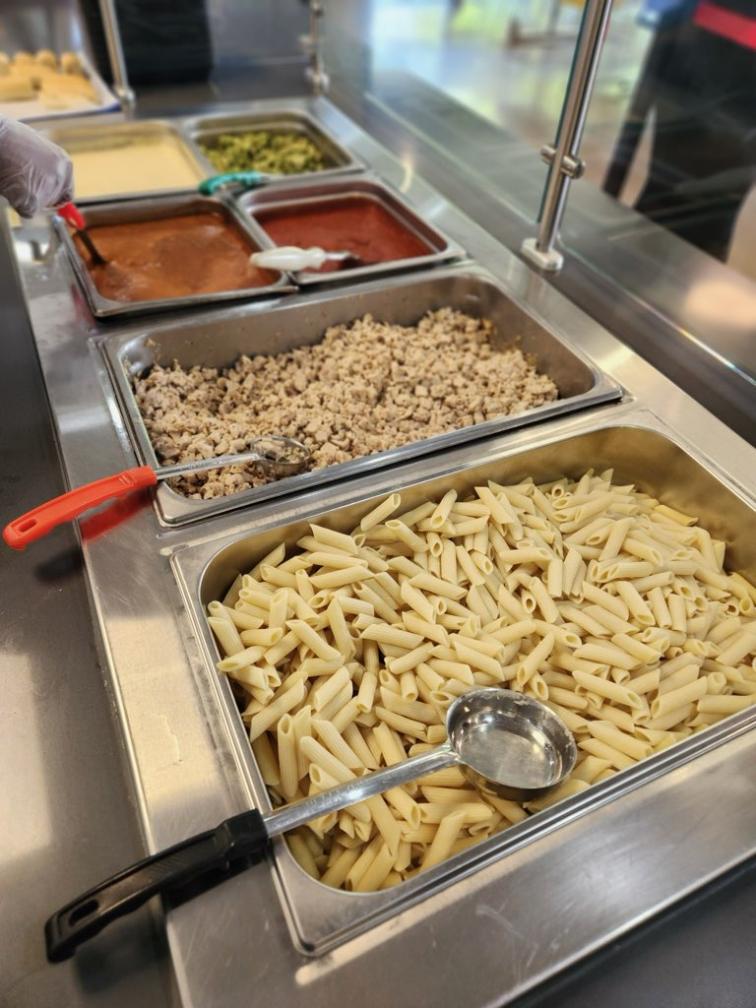
 | Budget | Actual
Breakfast | 17,440 | 18,550
Lunch | 43,920 | 43,996
Ala-Carte | 101,116 | 96,477.05

Slide 6

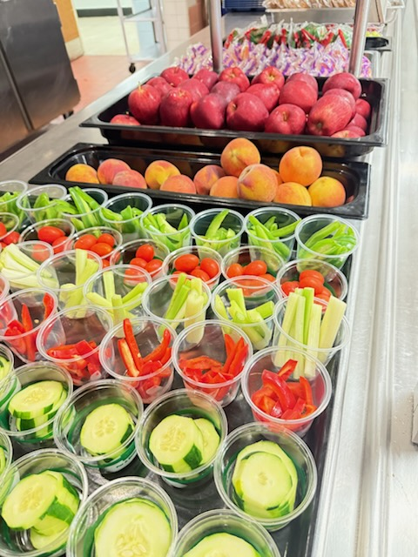
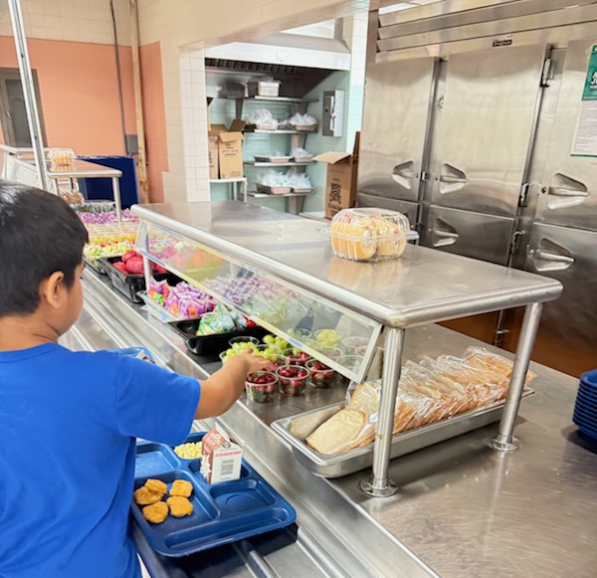
This 3-day event welcomes first-year full-time students to the cafeteria while making the experience fun and making them feel special. During this event students were oriented to the food service program, encouraged to participate in activities in the cafeteria, and they received small prizes as a reward for their participation.

Slide 7
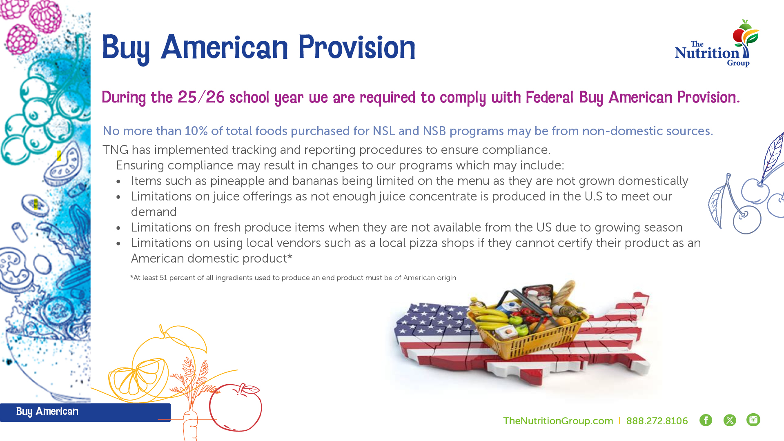

Slide 8


Slide 9






Slide 10


October is full of nutrition and fun events!
National School Lunch Week - 13th – 17th
  Each day lunch will feature a different country and the flavors
  that are popular in that culture
National Apple Day - 21st
  Students will enjoy various apple filled recipes
National Chocolate Day – 28th
  Starting the day with a double chocolate muffin
Halloween – 31st
  Breakfast and lunch take a spooky turn including spiderweb Dutch waffles, and mummy dogs
National School
Lunch Week
October 13th-17th

Slide 11


Slide 12

Cindy Hill
Director of Food & Nutrition
215.691.8112 Ext. 8082
Wissahickon@thenutritiongroup.biz
Damian Patterson
District Chef
267.770.0681
Wissahickon@thenutritiongroup.biz
Jesse Anzelone
Regional Manager
724.771.2184
jeanzelone@thenutritiongroup.com

