Slide 1
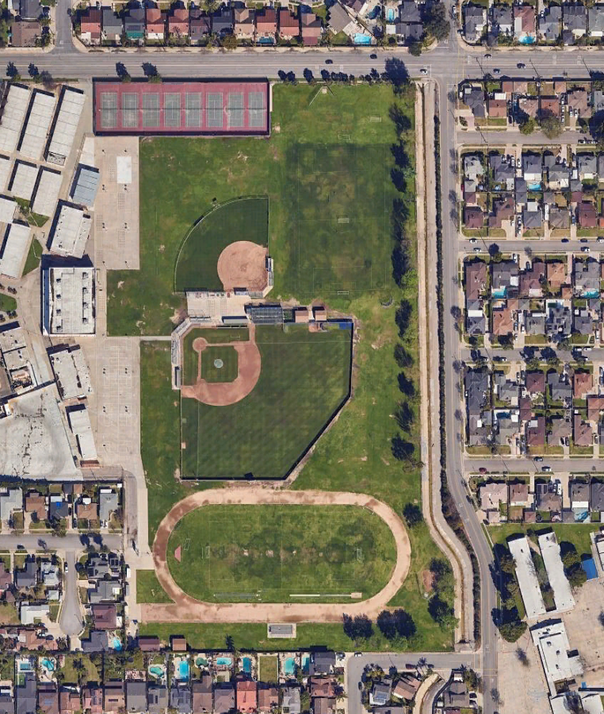
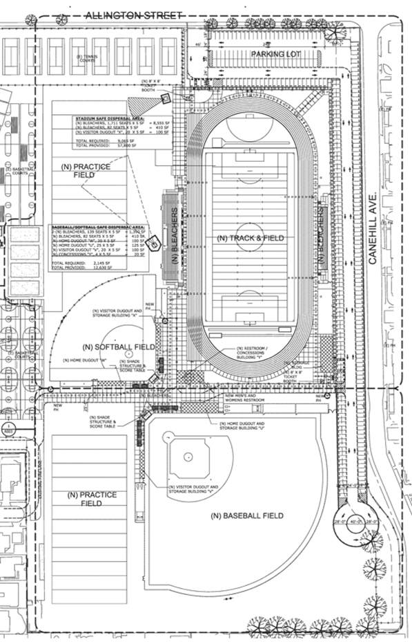
Mayfair Middle and High School Athletic Field Improvements Project
Bellfower Unified School District • Board of Education • Meeting • September 18, 2025
Michael Milroy • Project Manager • UltraSystems Environmental, Inc.

Slide 2
EXISTING CONDITIONS
Varsity football games currently held at Bellflower High School stadium

Slide 3

Proposed Project
New track and field (synthetic turf)
New stadium bleachers, capacity 1,711
New field lighting (stadium)
New baseball field: dugouts, bleachers,
New softball field
New practice fields (2)
New restroom and concession building
New ticket booths (2)
Palo Verde Lateral Storm Channel, next to east side of campus:
Convert to underground double box culvert
build surface parking lot (311 spaces) over culvert

Slide 4
CEQA PROCESS
California Environmental Quality Act: California Public Resources Code Sections 21000 et seq.
2025
March | April | May | June | July | August | September
Impact Analysis
Started technical studies
Air quality & greenhouse gas
Biological Resources
Cultural Resources
Noise
Traffic
Started Initial Study
Public Participation
and School Board Decision-making
Initial Study Circulated- public review- Aug. 11-Sept. 10
School Board
Hearing Sept. 18
Community Meeting August 28

Slide 5
Initial Study Findings
Impacts Less than Significant with Mitigation Incorporated
Biological Resources
Cultural Resources
Geology and Soils (paleontological resources)
Tribal Cultural Resources
Less than Significant Impact or No Impact
Aesthetics Mineral Resources
Agricultural Resources Noise
Air Quality Population and Housing
Energy Public Services
Greenhouse Gas Emissions Recreation Hazards and Hazardous Materials Transportation
Hydrology and Water Quality Utilities and Service Systems
Land Use Wildfire

Slide 6
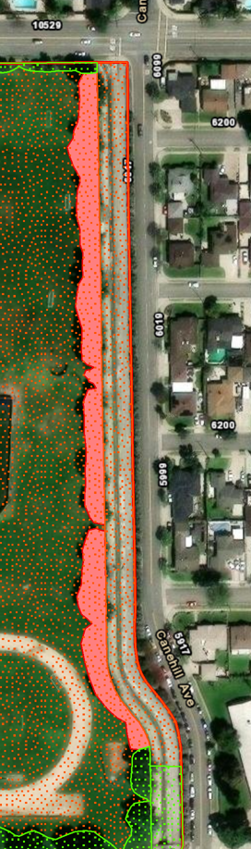
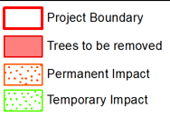
BIOLOGICAL RESOURCES:
LOCATIONS OF TREES TO BE REMOVED
35 Green Ash trees
Tree replacements:
Planting Plan:
39 trees
Over 400 shrubs
Impacts to nesting birds
significant without mitigation
Mitigation:
Pre-Construction Breeding Bird Survey

Slide 7
Noise Impacts: Operational: less than significant impact
No increase in use of facilities
except varsity football games transferred from Bellflower HS to Mayfair
No increase in enrollment
Events not scheduled during most noise-sensitive time of day (after 10:00 p.m.)

Slide 8
Transportation and related air quality and noise impacts
 | Attendees | Vehicles
Major Event
Proposed Conditions | 915 | 283
Existing Conditions (Bellflower High School Stadium) | 880 | 272
Net Increase | 35 | 11
Minor Event
Proposed Conditions | 60 | 40
Existing Conditions | 50 | 33
Net Increase | 10 | 7

Slide 9
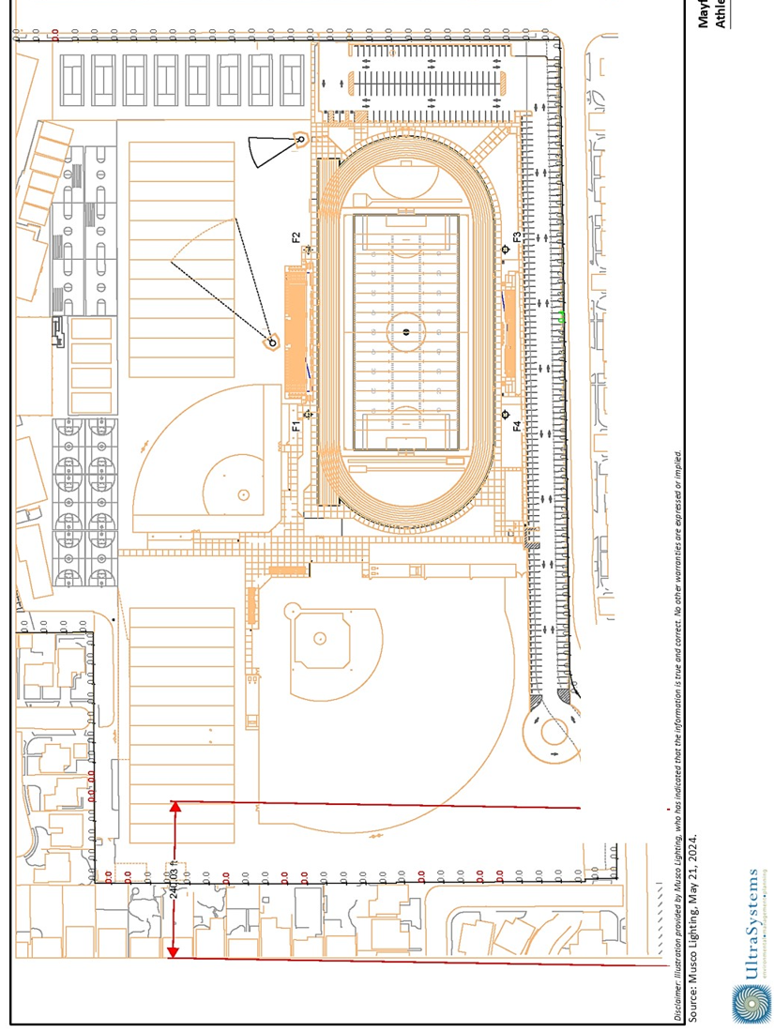
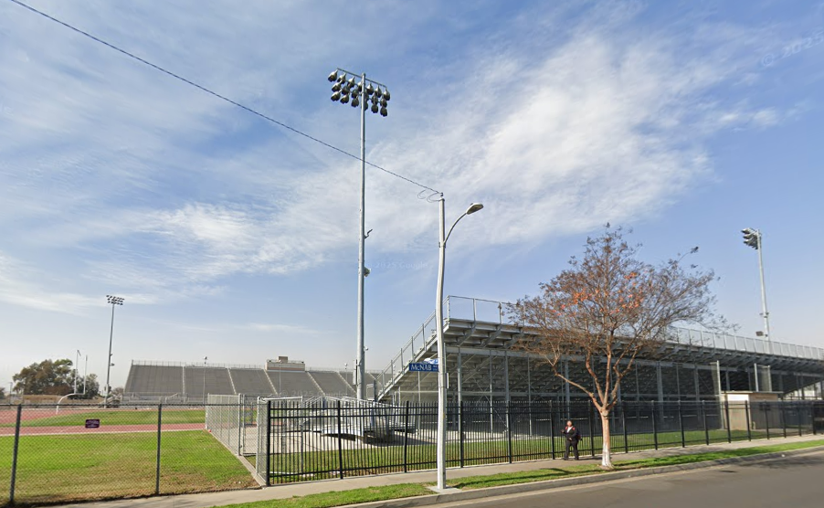
Spill Light Impacts: Field Lighting (track and field)
Highest spill light level 0.42 foot-candle on east site boundary along Canehill Avenue;
threshold of significance 0.8 foot-candle
Field lights, Bellflower High School stadium

