Slide 1









VHE GO Team
MEETING
8/21

Slide 2
Meeting Norms
  Only members of the team may participate in the discussion.
  Any members of the public present are here to quietly observe.
  We will be fully present.
  We will follow the agenda as noticed to the public and stay on task.
  We will focus on our governing role and school-wide outcomes.
  We will keep all students and staff in the forefront of all decision-making.
  We will be respectful of each other at all times.
  We will be open-minded.
  We invite and welcome the contributions of every member and listen to each other.
  We will respect all ideas and assume good intentions.
  We will approach differences of opinion with curiosity.

Slide 3
Public Comment
www.virginiahighlandelementary.com
“GO TEAM”> current school Year > Public Comment
Terry.Harness@apsk12.org

Slide 4
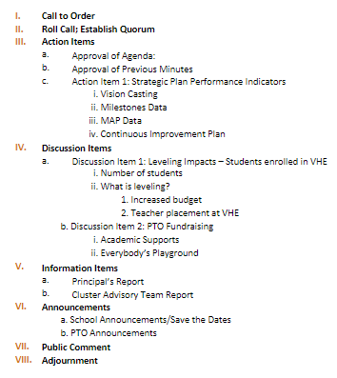
MEETING AGENDA

Slide 5


Vision Casting
Worked with the community (parents, students), teachers/staff and central office departments.
Used data to make informed decisions.

Slide 6
Take Aways
  Embracing our community & diversity within
  Providing students with a robust curriculum that was not taught in isolation but connected. (STEAM)
  Incorporating a process for students to think through problems that is consistent across all content
  Focusing on small class sizes to focus more on differentiated instruction and meeting kids where they are.
  Growing students

Slide 7
Vision
Our vision is to cultivate an authentic and relevant learning environment through an investigative approach, empowering all students to empathize, problem solve, explore, discover and innovate collaboratively.

Slide 8
Mission
Our mission is to nurture and empower our diverse student population while fostering critical thinking, creativity, and a deep understanding of others through STEAM education, ensuring that every student feels valued and supported.

Slide 9
MEETING AGENDA

Slide 10
Milestones Data
3rd - 5th Overall

Slide 11
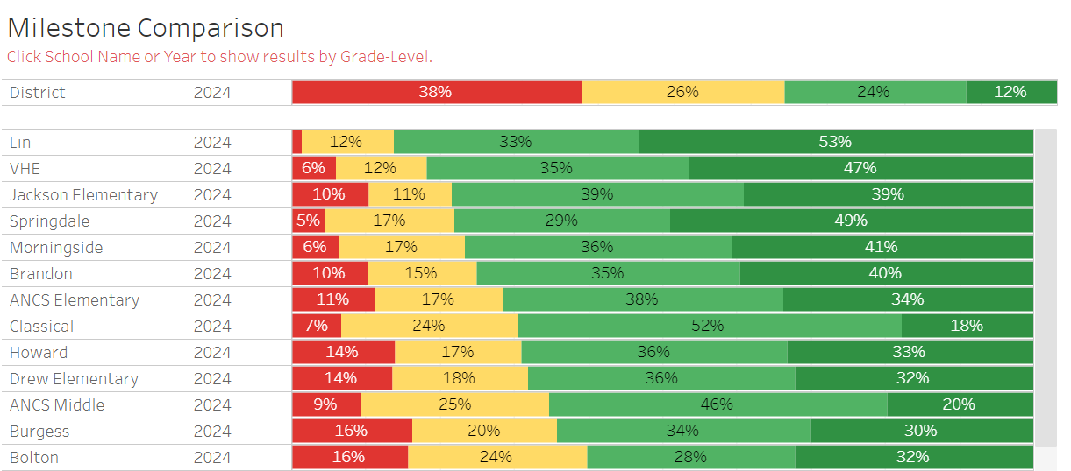
Milestones Data - 3rd - 5th Overall

Slide 12
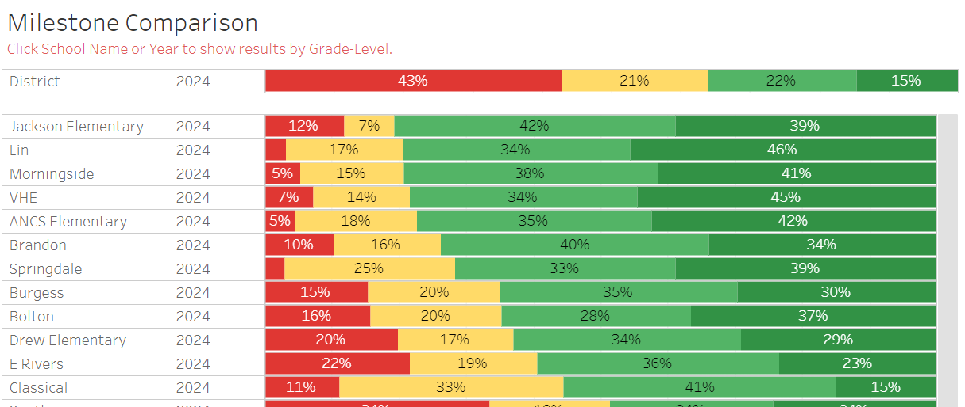
Milestones Data - 3rd Reading

Slide 13
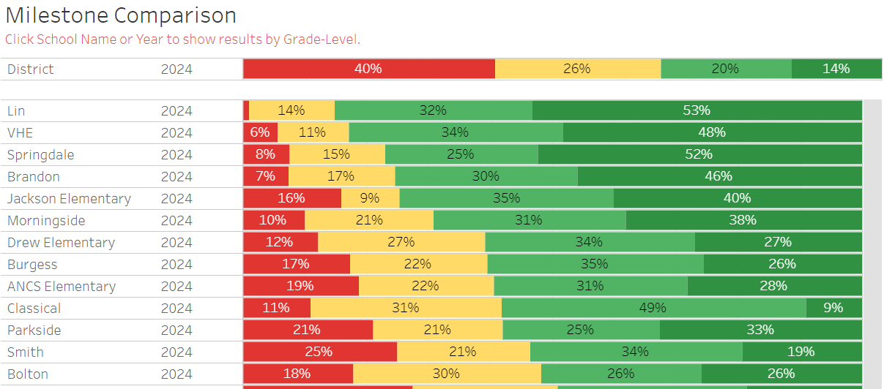
Milestones Data - 4th Reading

Slide 14
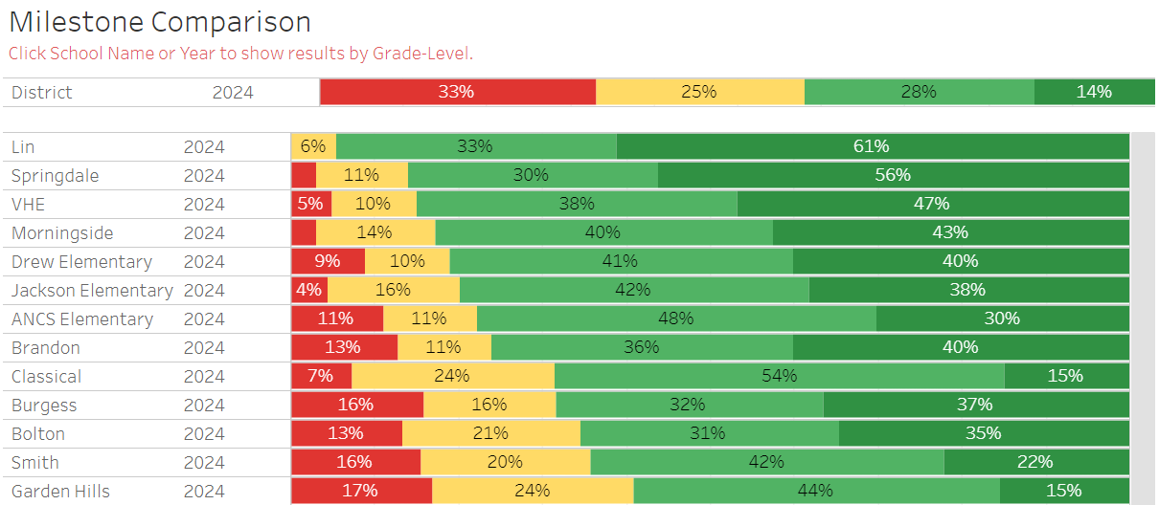
Milestones Data - 5th Reading

Slide 15
Milestones Data
Growth

Slide 16
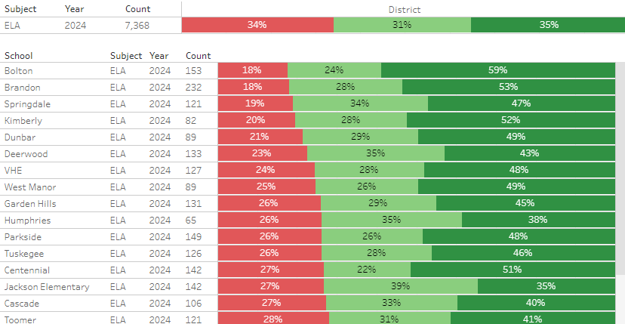

Milestones Growth - 3rd - 5th

Slide 17
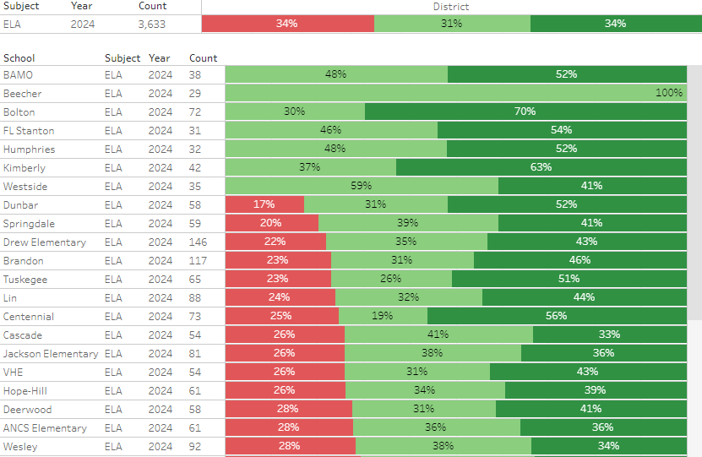
Milestones Growth - 5th Reading

Slide 18
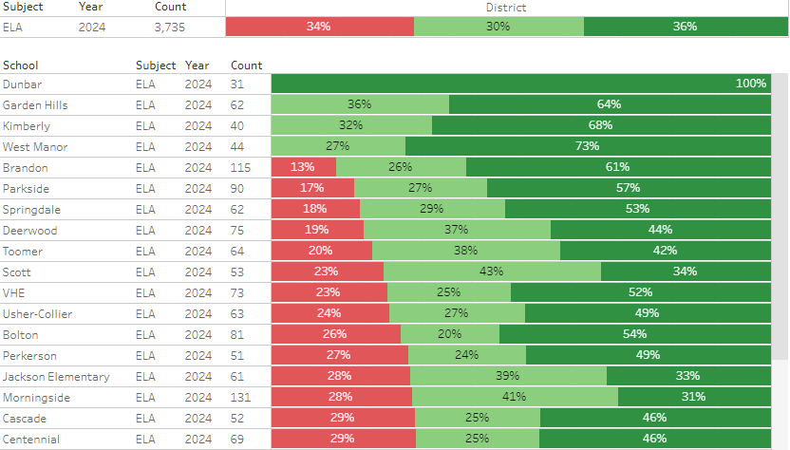
Milestones Growth - 4th Reading

Slide 19
Leveling
Enrollment
What should we do?

Slide 20
Leveling Impacts
Projected Enrollment - 559
Current Enrollment - 626*
*add 20 Pre-K students - 646 Total Students at VHE

Slide 21
Leveling Impacts
67+

Slide 22
Leveling Impacts
Change at base weight per student - $5334/student
$357,378.00

Slide 23
Leveling Impacts
$357,378.00
  Money added to budget
  Teacher Provided

Slide 24
What should we do?
  What grade levels are impacted the most?
  Are student supports impacted?
    IRR, ESOL, EIP, Gifted, Specials

Slide 25
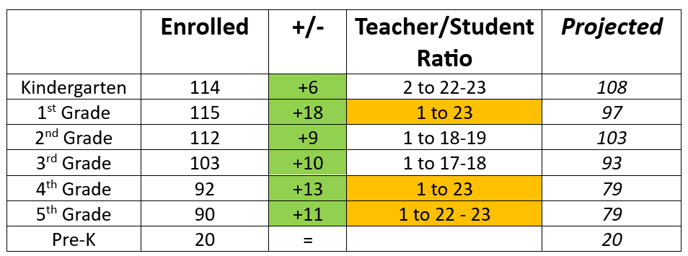
What should we do?

Slide 26
Initial Thoughts
1. Add 1 homeroom class to 1st grade
  1 to 19
2. Add teacher to 4th & 5th grades
  Add a 5th teacher to each grade level
    4th Grade – 1 to 18-19
    5th Grade – 1 to 18
What would this mean?
1. Homeroom teacher changes for some students. Lottery to decide who would go into new 1st grade classroom.

Slide 27
Initial Thoughts
1. Was there an increase in our........
  Special Education - 17 total +2
    3 IRR, 2 SPED PARA
  ESOL - 17 vs. 20 last year
  EIP - Waiting on MAP Scores
  Gifted - 134 total; 5 more 4th & 5th
  Specials - How does a new class impact?
What would this mean?
  If no major changes in SPED, or ESOL - we would not move these students to another class. The schedule is set.
  Increased numbers in gifted may require an additional teacher.
  Increased numbers in specials classes may necessitate the support of a paraprofessional.

Slide 28
MEETING AGENDA

