Slide 1
Applying for Financial Aid
Susan Ant, FAAC®
Director of Financial Aid and Scholarships
studentservices@normandale.edu, 952-358-8100

Slide 2
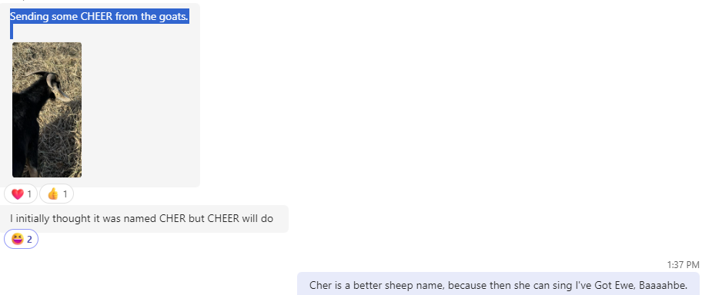

FUN-ancial aid

Slide 3

Applying for Financial Aid
Free Application for Federal Student Aid (FAFSA)
U.S. Citizens & Permanent Residents
Minnesota residents regardless of federal immigration status.
MN Dream Act
Whichever Financial Aid application you use, it needs to be completed once every school year. 2026-27 application is for Fall 26, Spring 27 & Summer 27
Applications open October 1!

Slide 4
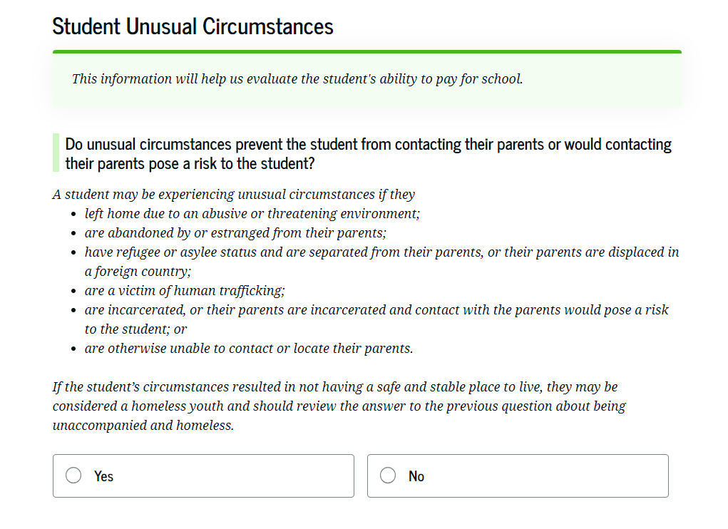
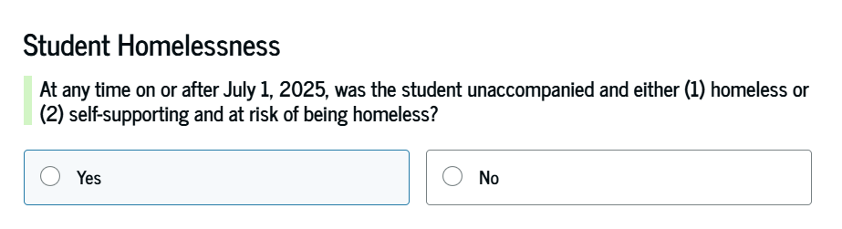
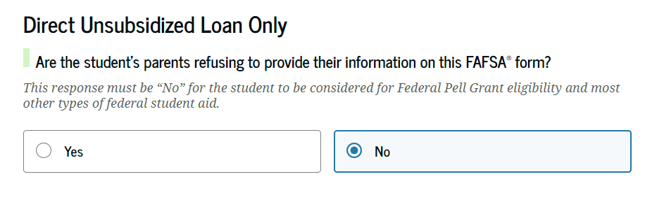
Dependency Status
Students who are under 24 (born after December 31,2002) years of age are considered dependent (include parent information) unless:
Married
Graduate or professional student
Veteran or Active-duty military
Children or legal dependents
Orphan, ward of the court, foster care
Emancipated minor or legal guardianship
Homeless or self-supporting and at risk of homelessness

Slide 5
Unusual Circumstances
Conditions that justify an institution making an adjustment to a student’s dependency status
  Cannot contact parent or contact poses risk to student
Student does not provide parental data on FAFSA
    Considered provisionally independent
Student follows institution’s process for dependency override determination

Slide 6
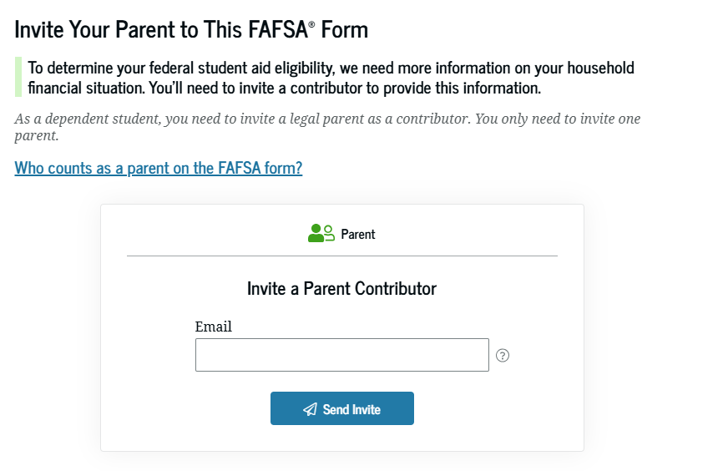
Parent Information
Who is considered a legal parent?
Legal parents are biological or adoptive (regardless of gender), or as determined by the state (for example, if the parent is listed on the birth certificate). Grandparents, foster parents, legal guardians, widowed stepparents, aunts, uncles, and siblings are not considered parents on this form unless they have legally adopted the student.
Which parent should include information?
If the student’s parent was never married and does not live with the student’s other legal parent, or if the parent is widowed and not remarried, that parent should only provide their own information in the Parent section, and the Other Parent section should be skipped.
If the parents are divorced or separated, answer the questions about the parent who provides the greater portion of the student’s financial support, even if the student does not live with them. If this parent is remarried as of today, answer the questions about that parent and the stepparent.
If the student’s widowed parent is remarried as of today, answer the questions about that parent and the stepparent.
Notes:
Students who are considered dependent must include parent information.
Who is considered a parent (not guardian or other family member)
If parents are separated or divorced, parent who provides the most financial support (this includes housing, food, etc). If equally divided, then parent with the most financial resources.
It is not based on tax dependency
If that parent is remarried, you will include step parent as well.

Slide 7
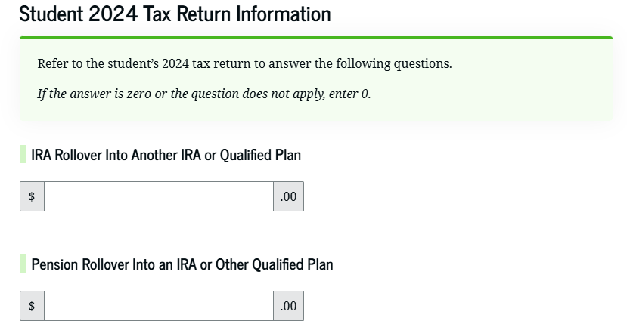
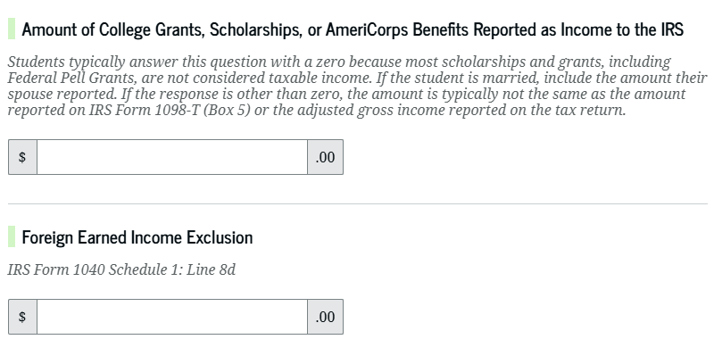
2024 Income Information
2024 income information:
  Taxed income: Federal 1040 Income Tax Return, W-2s, 1099s or other records of earnings
  Untaxed income: tax-exempt interest, untaxed portions of IRA dist/pensions
  Benefits received (EITC, housing assistance, Medicaid, SNAP, SSI, TANF, WIC,

Slide 8
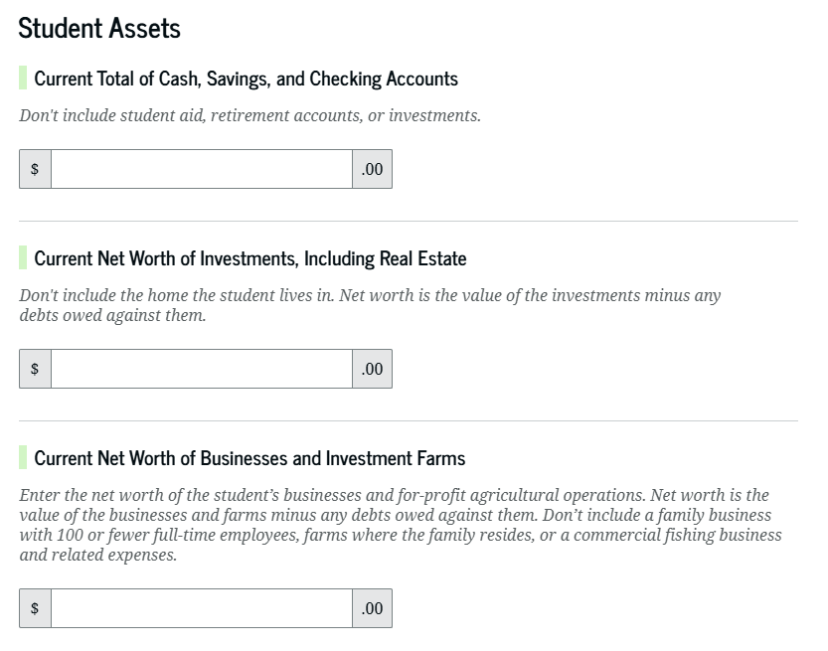
Current Assets
Asks of both students and parents
Total of cash/savings/checking
Stocks, bonds, Coverdell/529 accounts
Child support received
Business or farm value if over 100 employees (market value of land, buildings, machinery/equipment, inventory less any debts against
Does not include primary residence, life insurance, or qualified retirement plans.
Notes:
The list below is information that you should have available before you complete either the FAFSA or the MN Dream act application.
The income information that is put on the financial aid application is what we call prior prior year income. So, when you apply for financial aid for the fall of 2022, you will use 2020 income.
Even if your income has changed since 2020, please use that income on your financial aid application.
Unlike income, the asset information is based on current amounts. For savings and checking balances, I recommend that you use the amount that you carry in your accounts from month to month, after all bills are paid.
For assets, qualified retirement accounts, such as 401K, 403B and IRA, are not counted as assets. You also do not count your primary residence.
Business or farm values are only included if you have 100 or more employees.
All values should be the net worth of the asset.
529 plans, if held by the student or parent, are reported in the parent asset section. If a 529 plan is held by someone other than the student or parent who is completing the FAFSA, it is not considered as an asset. However, when it is used to pay for college, that amount will be counted as untaxed income for the student on the following FAFSA.
There are a few common errors that are made on financial aid applications:
Social Security Numbers
Divorced/widowed/remarried parental information
Income earned by parent/stepparent
Untaxed income
U.S. income taxes paid
Household size
Number of household members in college
Real estate and investment net worth

Slide 9

Special Circumstances
Student should contact each institution’s financial aid office for more information
Unusual uncovered medical/dental expenses
Secondary school tuition
Extraordinary dependent care costs
Parent or spouse death
Loss of employment or income
Divorce

Slide 10
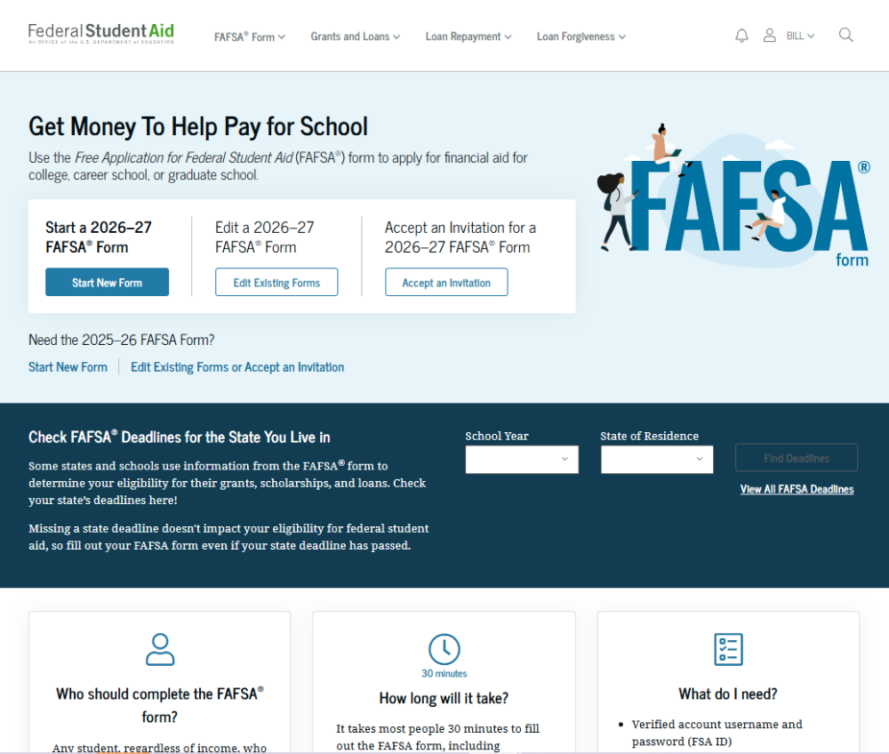
Studentaid.gov

Slide 11
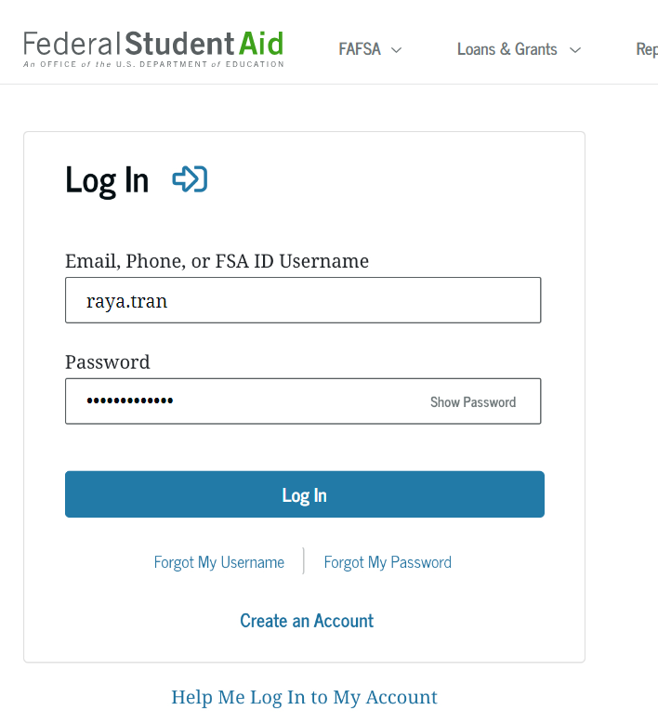
Create Federal Student Aid account
Student and at least one parent must create
Unique to each individual
Notes:
Student and at least one parent will need to create an FSA ID.
Do this now while we are waiting for December 1 start date (unless already have one)

Slide 12

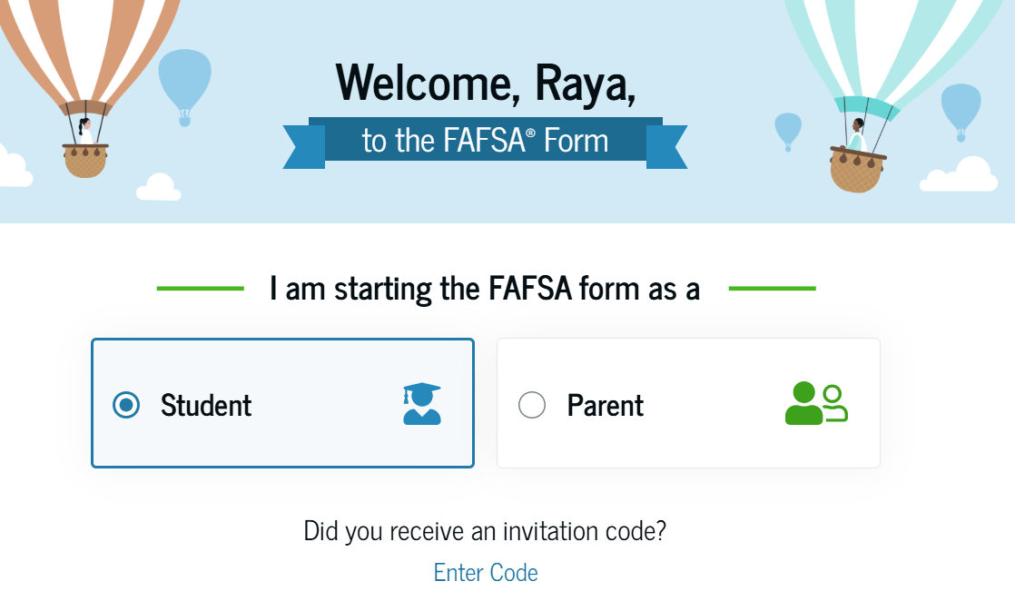
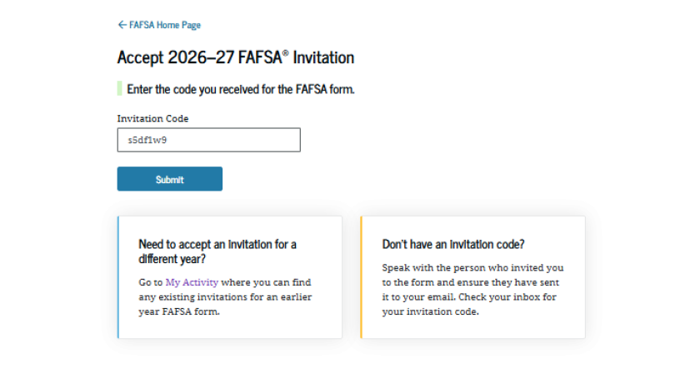
Parents=Contributors
Accept email invitation or use invitation link or invitation code to complete parent portion of student’s FAFSA
Parents must use FSA ID to access FAFSA

Slide 13

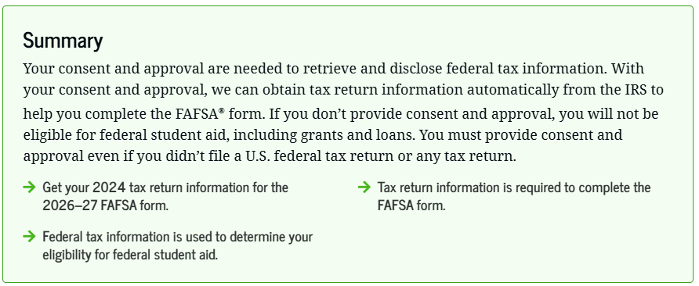
Consent Required

Slide 14
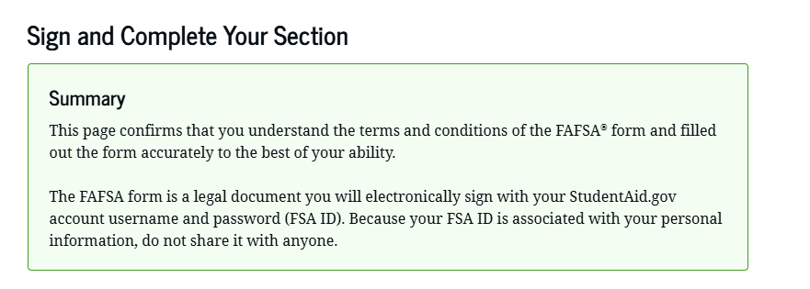
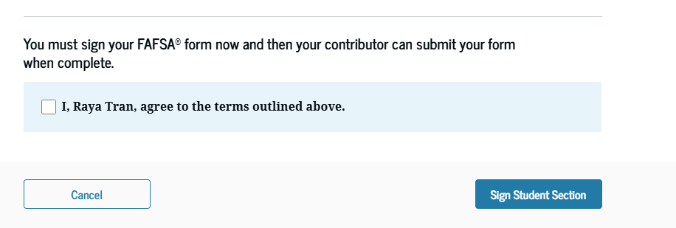
Sign and submit!

Slide 15
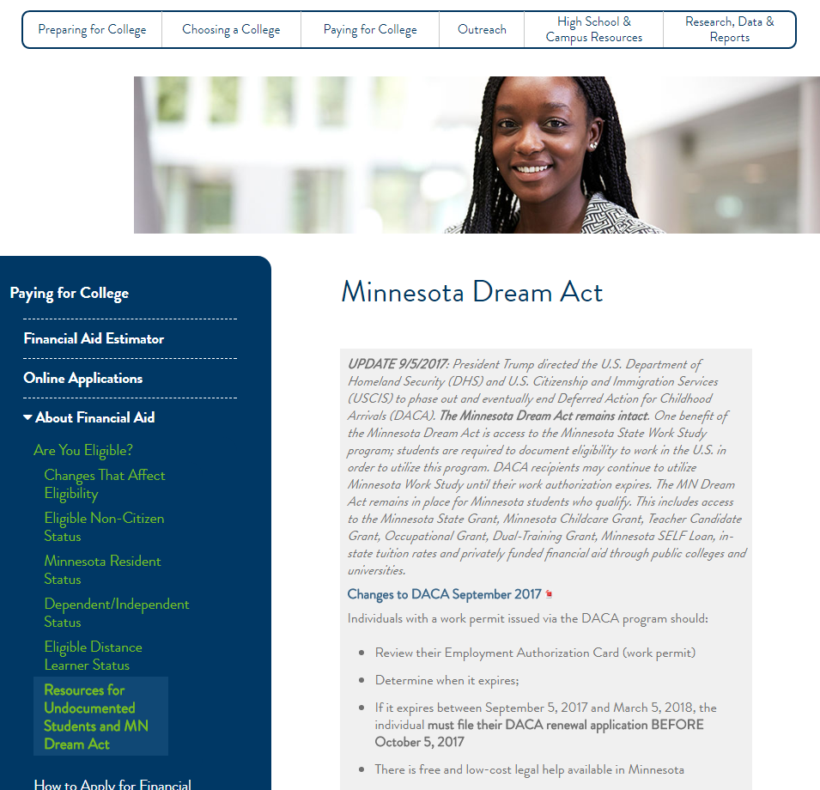
Minnesota Dream Act Application
Qualifying undocumented students eligible for:
  In-state tuition rates and private scholarships at state schools
  State financial aid programs such as MN State Grant, Child Care Grant, Work Study (if student has work permit), SELF Loan
Notes:
The Minnesota Dream Act application is requests the same information as the FAFSA. However, there are a few key differences.
This application and all processing happens through the Minnesota Office of Higher Education.
They verify 100% of the applications they receive. This means that you will have to send copies of documentation, such as your HS diploma and 2020 taxes or W2s to them to verify what was put on the application.
After the application is complete, students are eligible for MN state aid programs only. These include the MN State Grant, MN Child Care Grant, and for students who have work authorization, State Work Study funding. MN Dream Act students are not eligible for federal grants or federal direct loan programs.
The MN Dream Act application cannot be saved, so make sure you have all information needed before you start your application.

Slide 16
Minnesota Dream Act application
Submit the required documents to MOHE after submitting
  MN high school transcripts showing attendance at a MN high school for at least 3 years (do NOT have to be certified copies)
  MN high school diploma (or transcript showing the student graduated) or copy of GED earned in MN (does NOT have to be certified copy)
  Copy of Selective Service card
  Copies of 2024 Federal 1040 Income Tax Returns
  Other documents as requested by MOHE
Notes:
The Minnesota Dream Act application is requests the same information as the FAFSA. However, there are a few key differences.
This application and all processing happens through the Minnesota Office of Higher Education.
They verify 100% of the applications they receive. This means that you will have to send copies of documentation, such as your HS diploma and 2020 taxes or W2s to them to verify what was put on the application.
After the application is complete, students are eligible for MN state aid programs only. These include the MN State Grant, MN Child Care Grant, and for students who have work authorization, State Work Study funding. MN Dream Act students are not eligible for federal grants or federal direct loan programs.
The MN Dream Act application cannot be saved, so make sure you have all information needed before you start your application.

Slide 17
Next Steps
Less than 20% of FAFSA applications are selected for VERIFICATION - not an audit or that you’ve done anything wrong
Check with the Financial Aid Office before you make corrections to your FAFSA
Does your college/university require other forms such as the Profile? https://profileonline.collegeboard.com
Notes:
For schools that are requesting the Profile, they may have specific deadlines that are before the FAFSA. Work with each school to find out.

Slide 18
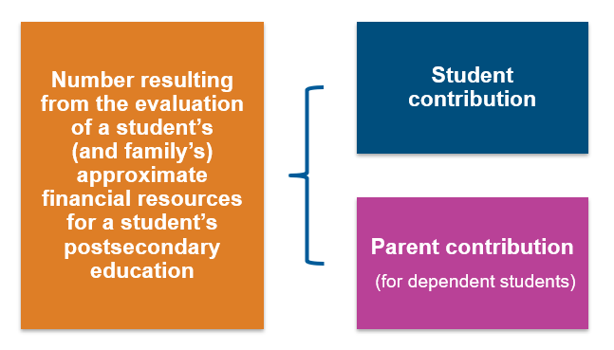
How Aid is Determined
Cost of attendance (COA)
– Student Aid Index (SAI)
= Financial need
Tuition and fees
Housing and food (living expenses)
Books, course materials, supplies, and equipment
Miscellaneous personal expenses
Transportation
Notes:
There isn’t an average award, because the amount is based on your financial need.
Your SAI remains the same for each college, but the COA will vary. Example Normandale COA =$25,000 while Augsburg is $58,000. $10,000 SAI student will have a $15,000 need while it will be $48,000 at Augsburg. They will also have other resources to cover the need. (Net price calculator)
Negotiating price is difficult, but if there are circumstances that need to be considered should share with your top choice colleges.

Slide 19
Types of Financial Aid
Gift Aid
(Free Money)
Need-Based Grants
Self-Help Aid (Earned Money)
Student Employment/ Work-study
Loans (Borrowed Money)
Student Loans (Federal, Private)
Merit-based Scholarships
Parent Loans (Federal)
Notes:
A lot of questions about scholarships – can apply directly with the schools and also outside sources. Will likely be included in meeting your financial need.
You’ll still want to apply for FAFSA at least the first year because there may be institutional grants that you don’t know about.
Federal student loans are from the FAFSA, this is the preferred borrowing option
The PLUS loan is another option for financing the balance – pay over 10 years. Many colleges also have payment plans that can make payment easier.

Slide 20
Parent PLUS Changes
New borrowers on or after July 1, 2026:
  Annual loan limit: $20,000 per dependent student
  Aggregate loan limit: $65,000 per dependent student
Legacy borrowers may borrow at previous loan limits for the shorter of:
  3 academic years; or
  Time for student to complete program

Slide 21
State Aid Programs
MN State Grant/MN Dream Act Grant
Postsecondary Child Care Grant
Minnesota Indian Scholarship
MN GI Bill
Fostering Independence Grant
North Star Promise Scholarship
Be aware of deadlines!
Notes:
North Star Promise – the only application needed is the FAFSA or MN Dream Act. The colleges will determine your eligibility based on that information.

Slide 22

Resources
Federal Student Aid
  www.studentaid.gov
Minnesota Office of Higher Education
  https://www.ohe.state.mn.us/
Minnesota Goes to College!
  College Knowledge Month and FAFSA completion events
Net Price Calculator
Scholarship searches – check with your high school, www.fastweb.com
Financial Aid Completion events
Notes:
Don’t forget to look for other sources of scholarships. Your high school is a good source of some smaller, local scholarships, and there are national search engines like www.fasteb.com.

Slide 23
Tips and Tricks
Create your FSA ID prior to starting the FAFSA (if you do not already have one)
Check and make sure that you have entered name, SSN, date of birth, and addresses correctly
Use the help feature as you go through the questions
The last screen will be a summary of your answers – make sure to review closely
You can delete the FAFSA if you need to
Help is available through chat, phone and email. There may be long wait times
If you are completing the MN Dream Act, you will have to use their portal to submit related documents.

Slide 24
Thank you!
Susan Ant, Director of Financial Aid and Scholarships
Normandale Community College
studentservices@normandale.edu, 952-358-8100

