Slide 1
Welcome to SEAC!
Albemarle County Special Education Advisory Committee
September 9, 2025

Slide 2

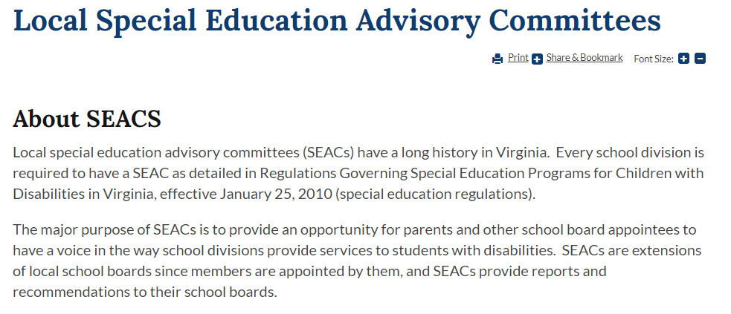
https://www.doe.virginia.gov/data-policy-funding/virginia-board-of-education/board-committee-meetings/state-special-education-advisory-committee-sseac/local-special-education-advisory-committees

Slide 3
Local Special Education Advisory Committee (SEAC)
“A local advisory committee for special education, appointed by each local school board, shall advise the school board through the division superintendent.”
8 Va. Admin. Code § 20-81-230(D)

Slide 4
SEAC Membership Requirements
A majority of the committee shall be parents of children with disabilities or individuals with disabilities.
The committee shall include one teacher.
Additional local school division personnel shall serve only as consultants to the committee.
8 Va. Admin. Code § 20-81-230(D)(1)

Slide 5
Albemarle SEAC Membership - Bylaws
Maximum of 30 voting Members
Must be residents of Albemarle County
Members approved by Director of Special Education, at the direction of the Superintendent and School Board
Goal: One voting member representing each school, with additional space for up to 5 at-large and community representatives
  Up to 2 representatives per school (primary and alternate)
Minimum 2/3rds of members shall be parents of children requiring special education services
Special Education Administrator for Albemarle County (or designee) serves as consultant, but has no vote

Slide 6
Current SEAC Vacancies
(No Representatives)
Agnor Elementary School
Crozet Elementary School
Greer Elementary School
Red Hill Elementary School
Walton Middle School
Post High
Community Representatives (3 slots available)

Slide 7
SEAC Leadership Team for 2025-2026
Co-Chairs: Jessica Allen and Chris Seaman
Vice Chair: Dee Curry
Co-Secretaries: Nicole Group and Sam Peacoe

Slide 8
SEAC Functions
Advise the local school division of needs in the education of children with disabilities;
Participate in the development of priorities and strategies for meeting the identified needs of children with disabilities;
Submit periodic reports and recommendations regarding education of children with disabilities to the division superintendent for transmission to the local school board
Assist the local school division in interpreting plans to the community for meeting the special needs of children with disabilities for educational services;
Review the policies and procedures for the provision of special education and related services prior to submission to the local school board; and
Participate in the review of the local school division's annual plan
8 Va. Admin. Code § 20-81-230(D)(2)

Slide 9
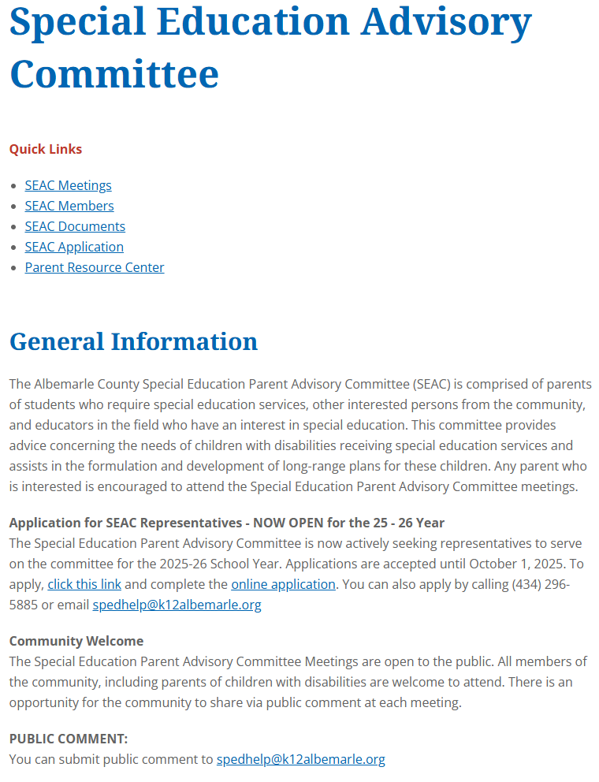
SEAC Website
https://www.k12albemarle.org/our-departments/special-education/special-education-advisory-committee

Slide 10
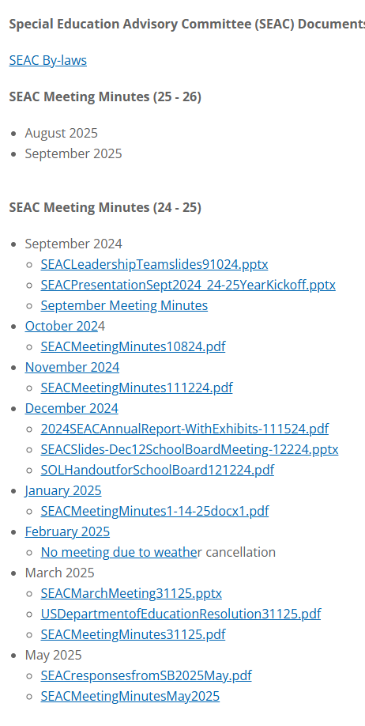
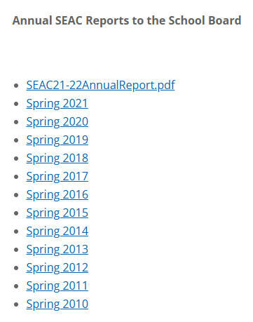
SEAC Website - Documents
https://www.k12albemarle.org/our-departments/special-education/special-education-advisory-committee/docs

Slide 11
SEAC Meetings
Open to the public
Monthly meetings (normally second Tuesday of each month at 6:30 pm)
In-person (up to 2 virtual per year for illness/disability or out-of-town travel) – please give at least 24 hours notice
Quorum to do business: 1/3 of members
Meeting minutes (attendance, agenda items, votes)
Public comment period (in person and electronic)

Slide 12
SEAC Meeting Schedule, 2025-2026
Future Meetings:
Tuesday, Oct. 7
Tuesday, Nov. 11
Tuesday, Dec. 9
Thursday, Dec. 11 – School Board Meeting (SEAC Annual Report)
Tuesday, Jan. 13
Tuesday, Feb. 10
Tuesday, Mar. 10
Tuesday, Apr. 14
Tuesday, May 12

Slide 13
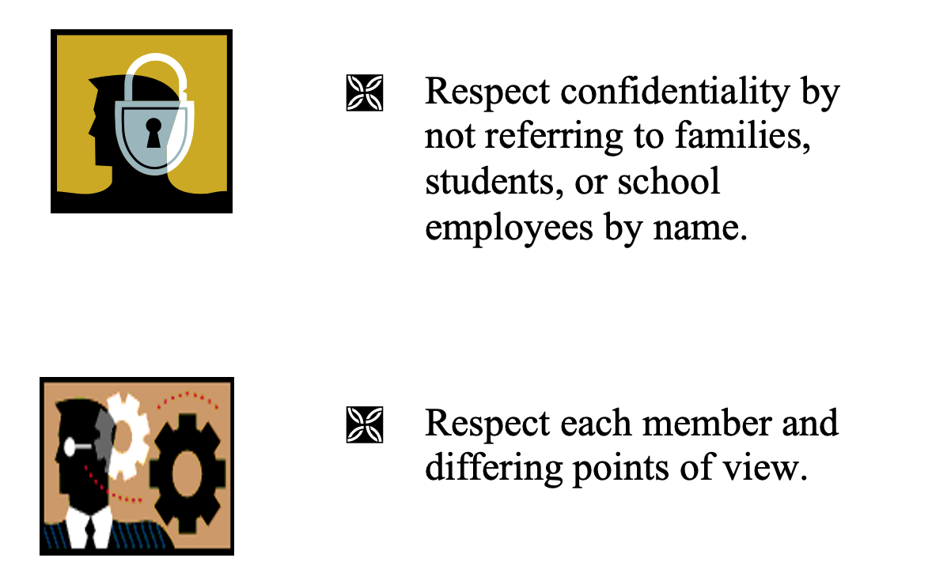
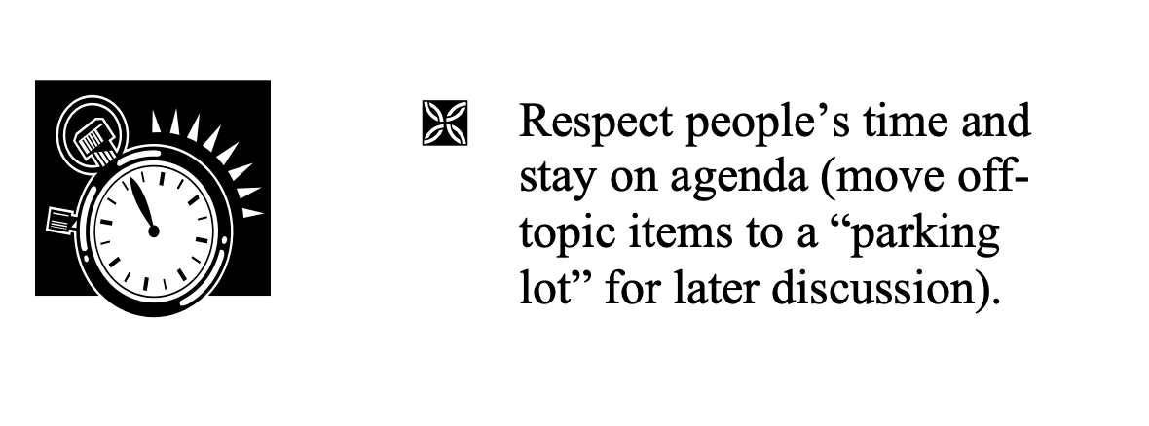
Team Rules

Slide 14
Fall Events / Timeline
SEAC Family Survey – distributed Sept. 15 or 22
Discussion of items for annual report – Oct. 7 meeting
Draft of annual report circulated to SEAC members by Monday, Nov. 3
Vote on SEAC annual report – Nov. 11 Meeting
Presentation to School Board – December 11

Slide 15
Spring Items
School Division Budget for 2026-2027
Annual Special Education Plan and Application for Federal Funding
Collaboration with UVA Law’s Community Solution Clinic –
Report on Discipline for Students with Disabilities
Other issues/items to be determined by SEAC

Slide 16
Ongoing
Engaging with your school community
Advising school division and providing input
Policy review and input

