Slide 1
Standards-Based Reporting
Zionsville Middle School and Zionsville West Middle School

Slide 2
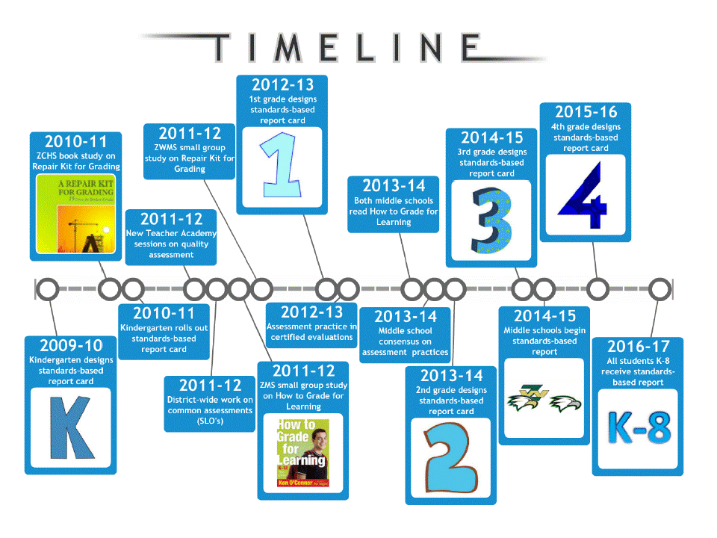

Slide 3
Thoughtful Discussion
What should a grade for a course represent?
What is the purpose of student grades?
Are our grades giving students feedback or vague labels representing broad averages?
Does the grade from one teacher reflect the same level of learning as a grade from another?
Are some things mixed into a grade that don’t belong?
What kind of feedback is most effective?
If a student doesn’t master something at first, should he or she be given more practice and another try at mastery? How many?
How can we hold all students fully accountable for learning and meeting our course standards?

Slide 4

Grading Practices
Using Ken O’Connor’s 15 Fixes for Broken Grades, adopted these norms:
    No zeroes for missing or late work
    Allow students to retake assessments
    No extra credit
    Behavior not included in grade (dishonesty, attendance, late work)
    Exclusion of formative (practice) assessments from final grade

Slide 5
What is Standards-Based Reporting?
SBR includes: "Systems of instruction, assessment, grading, and academic reporting that are based on students demonstrating understanding or mastery of the knowledge and skills they are expected to learn as they progress through their education. In a school that uses standards-based approaches to educating students, learning standards—i.e., concise, written descriptions of what students are expected to know and be able to do at a specific stage of their education—determine the goals of a lesson or course, and teachers then determine how and what to teach students so they achieve the learning expectations described in the standards. (http://edglossary.org/standards-based/)
Reporting on what students know and are able to do relative to specific academic standards rather than course names or general subject area titles
ZCS teachers have chosen our “power standards” within each course/academic area which are essential for the understanding and application of course content

Slide 6
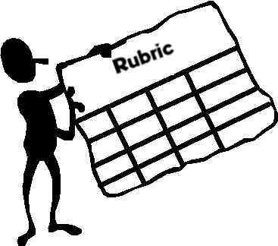
Purpose
To clearly communicate what students are learning in each course
To accurately report each student’s progress toward mastering each standard
To communicate what a student has learned well and to assist students (and parents) in improving their performance
To continue communicating about students’ work habits, but separately from academic progress

Slide 7

College and Career Readiness Standards
Takes responsibility to be prepared for class activities
Completes assignments on time
Follows classroom rules and procedures
Interacts with adults and peers in a respectful manner
Ratings:
  ME - Meets expectations
  NI - Needs improvement

Slide 8
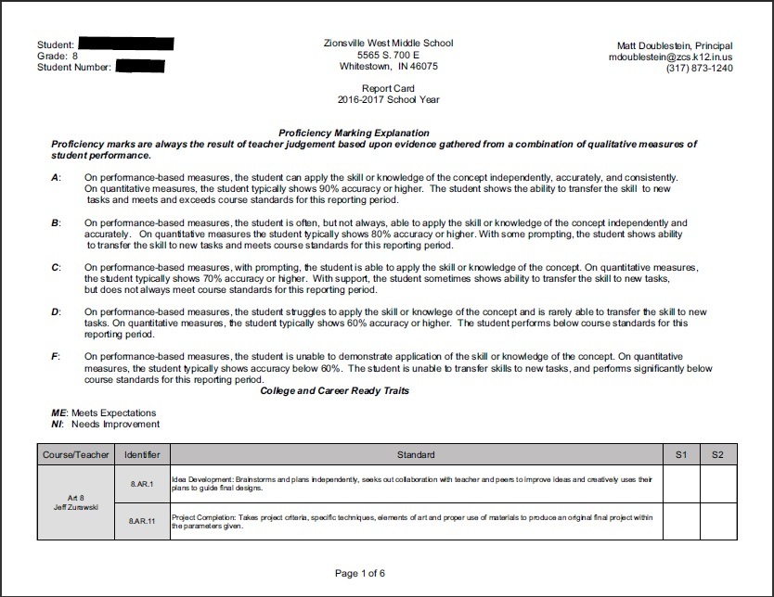
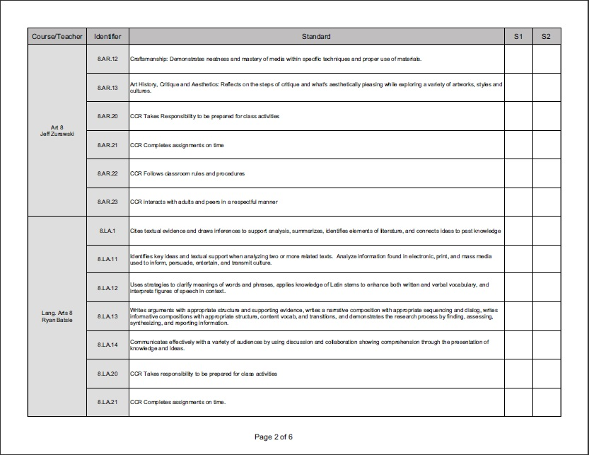
The Report

Slide 9
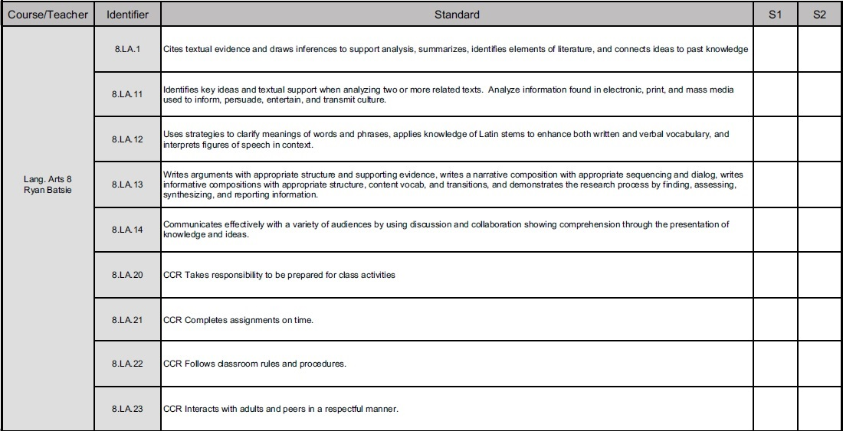

Slide 10
District Vision for Assessment
ZCS Academic Priority #1:
Assessment of Learning:
All ZCS students will experience assessment practices by their teachers that give them feedback for better learning and a clear sense of what they know and are able to do.

Slide 11
Questions?

