Slide 1
Learner Led Virtual Tour

Slide 2
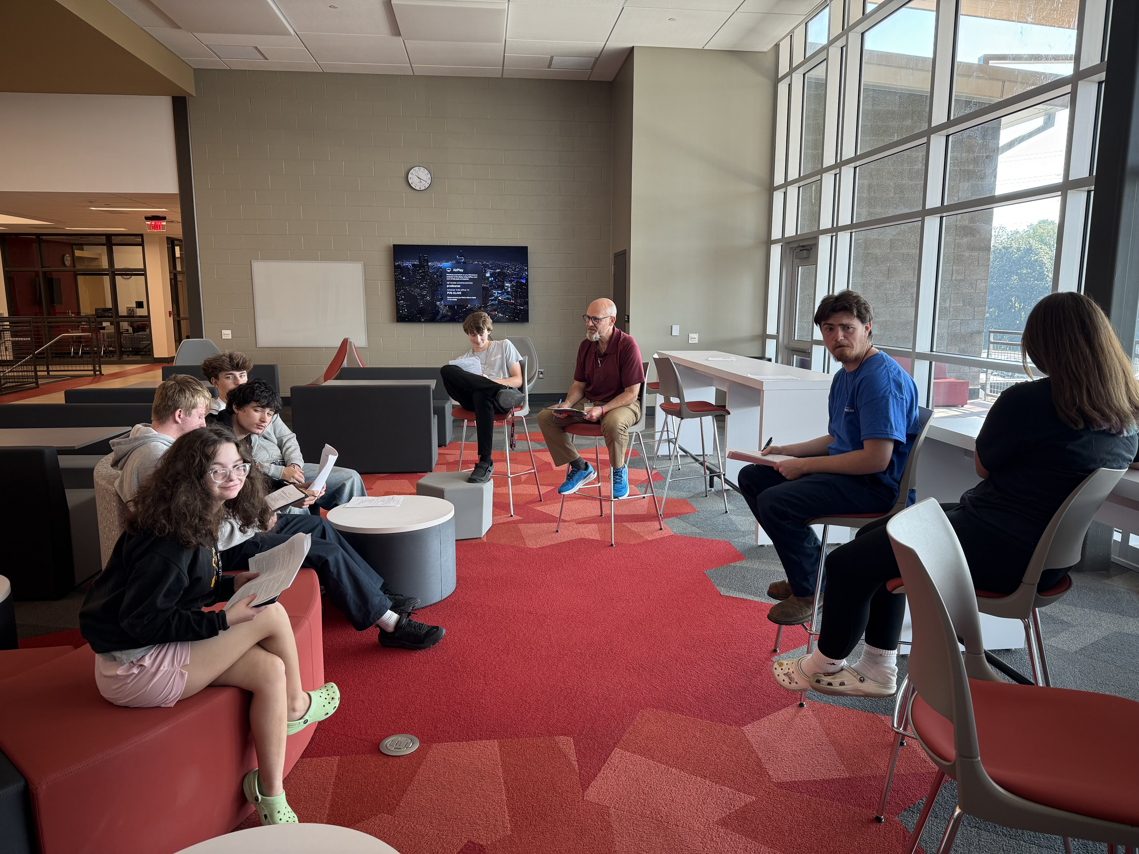
High school collaboration area

Slide 3
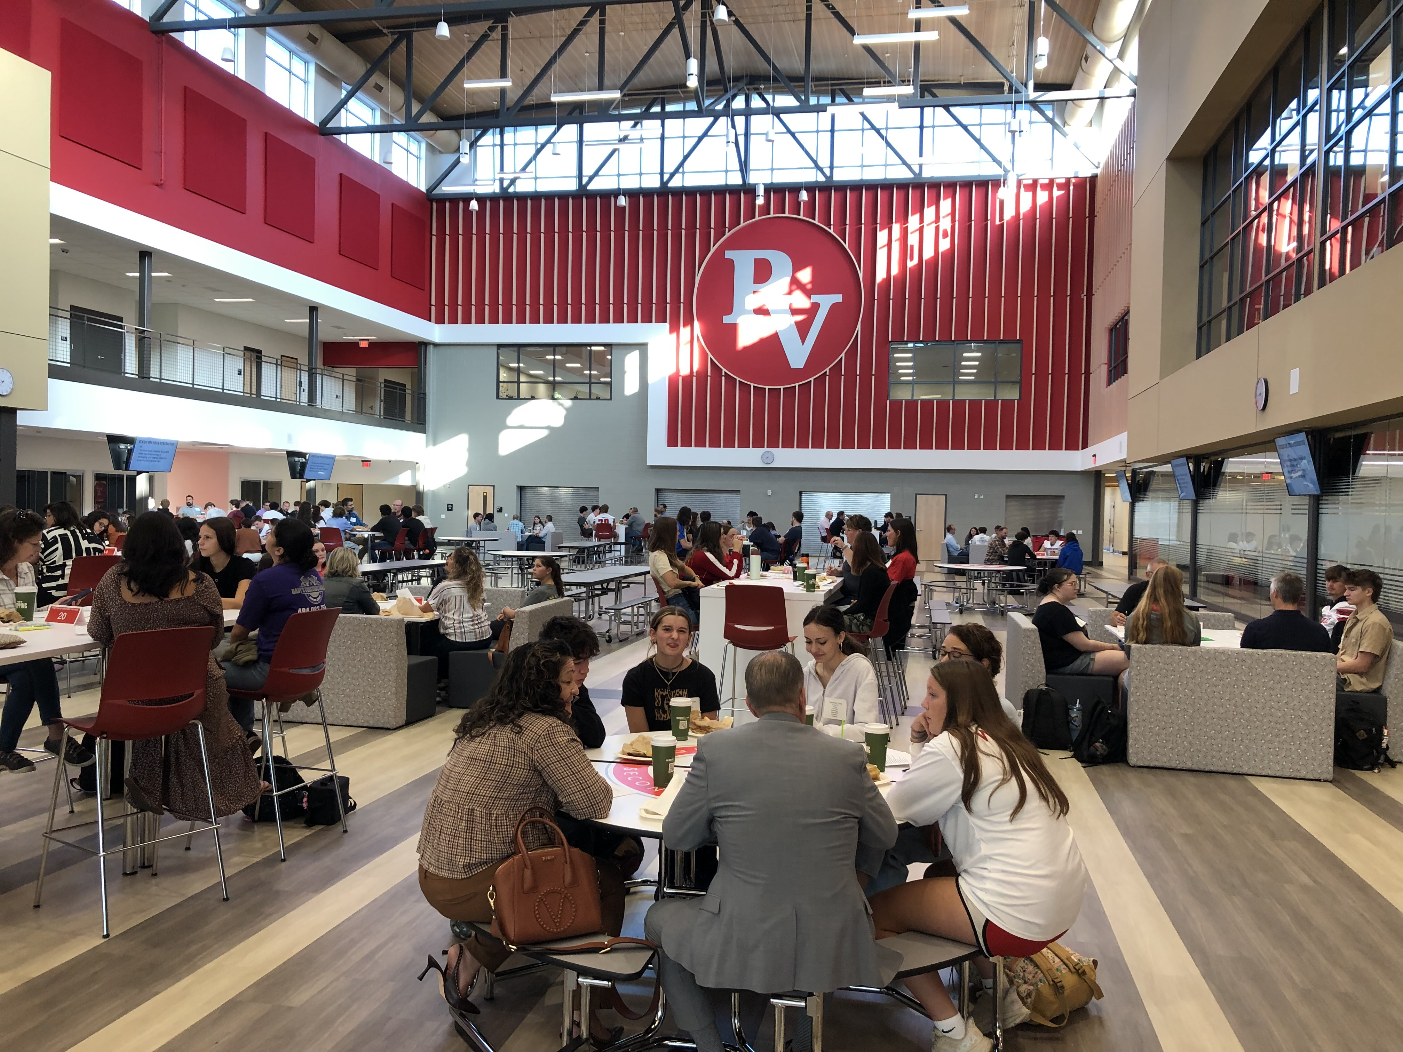
commons

Slide 4
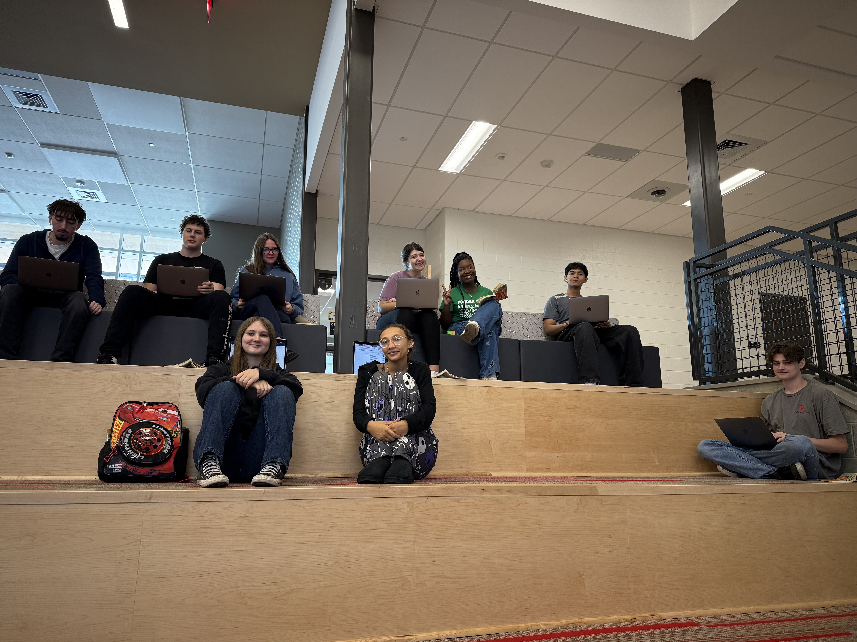
Learning stairs

Slide 5
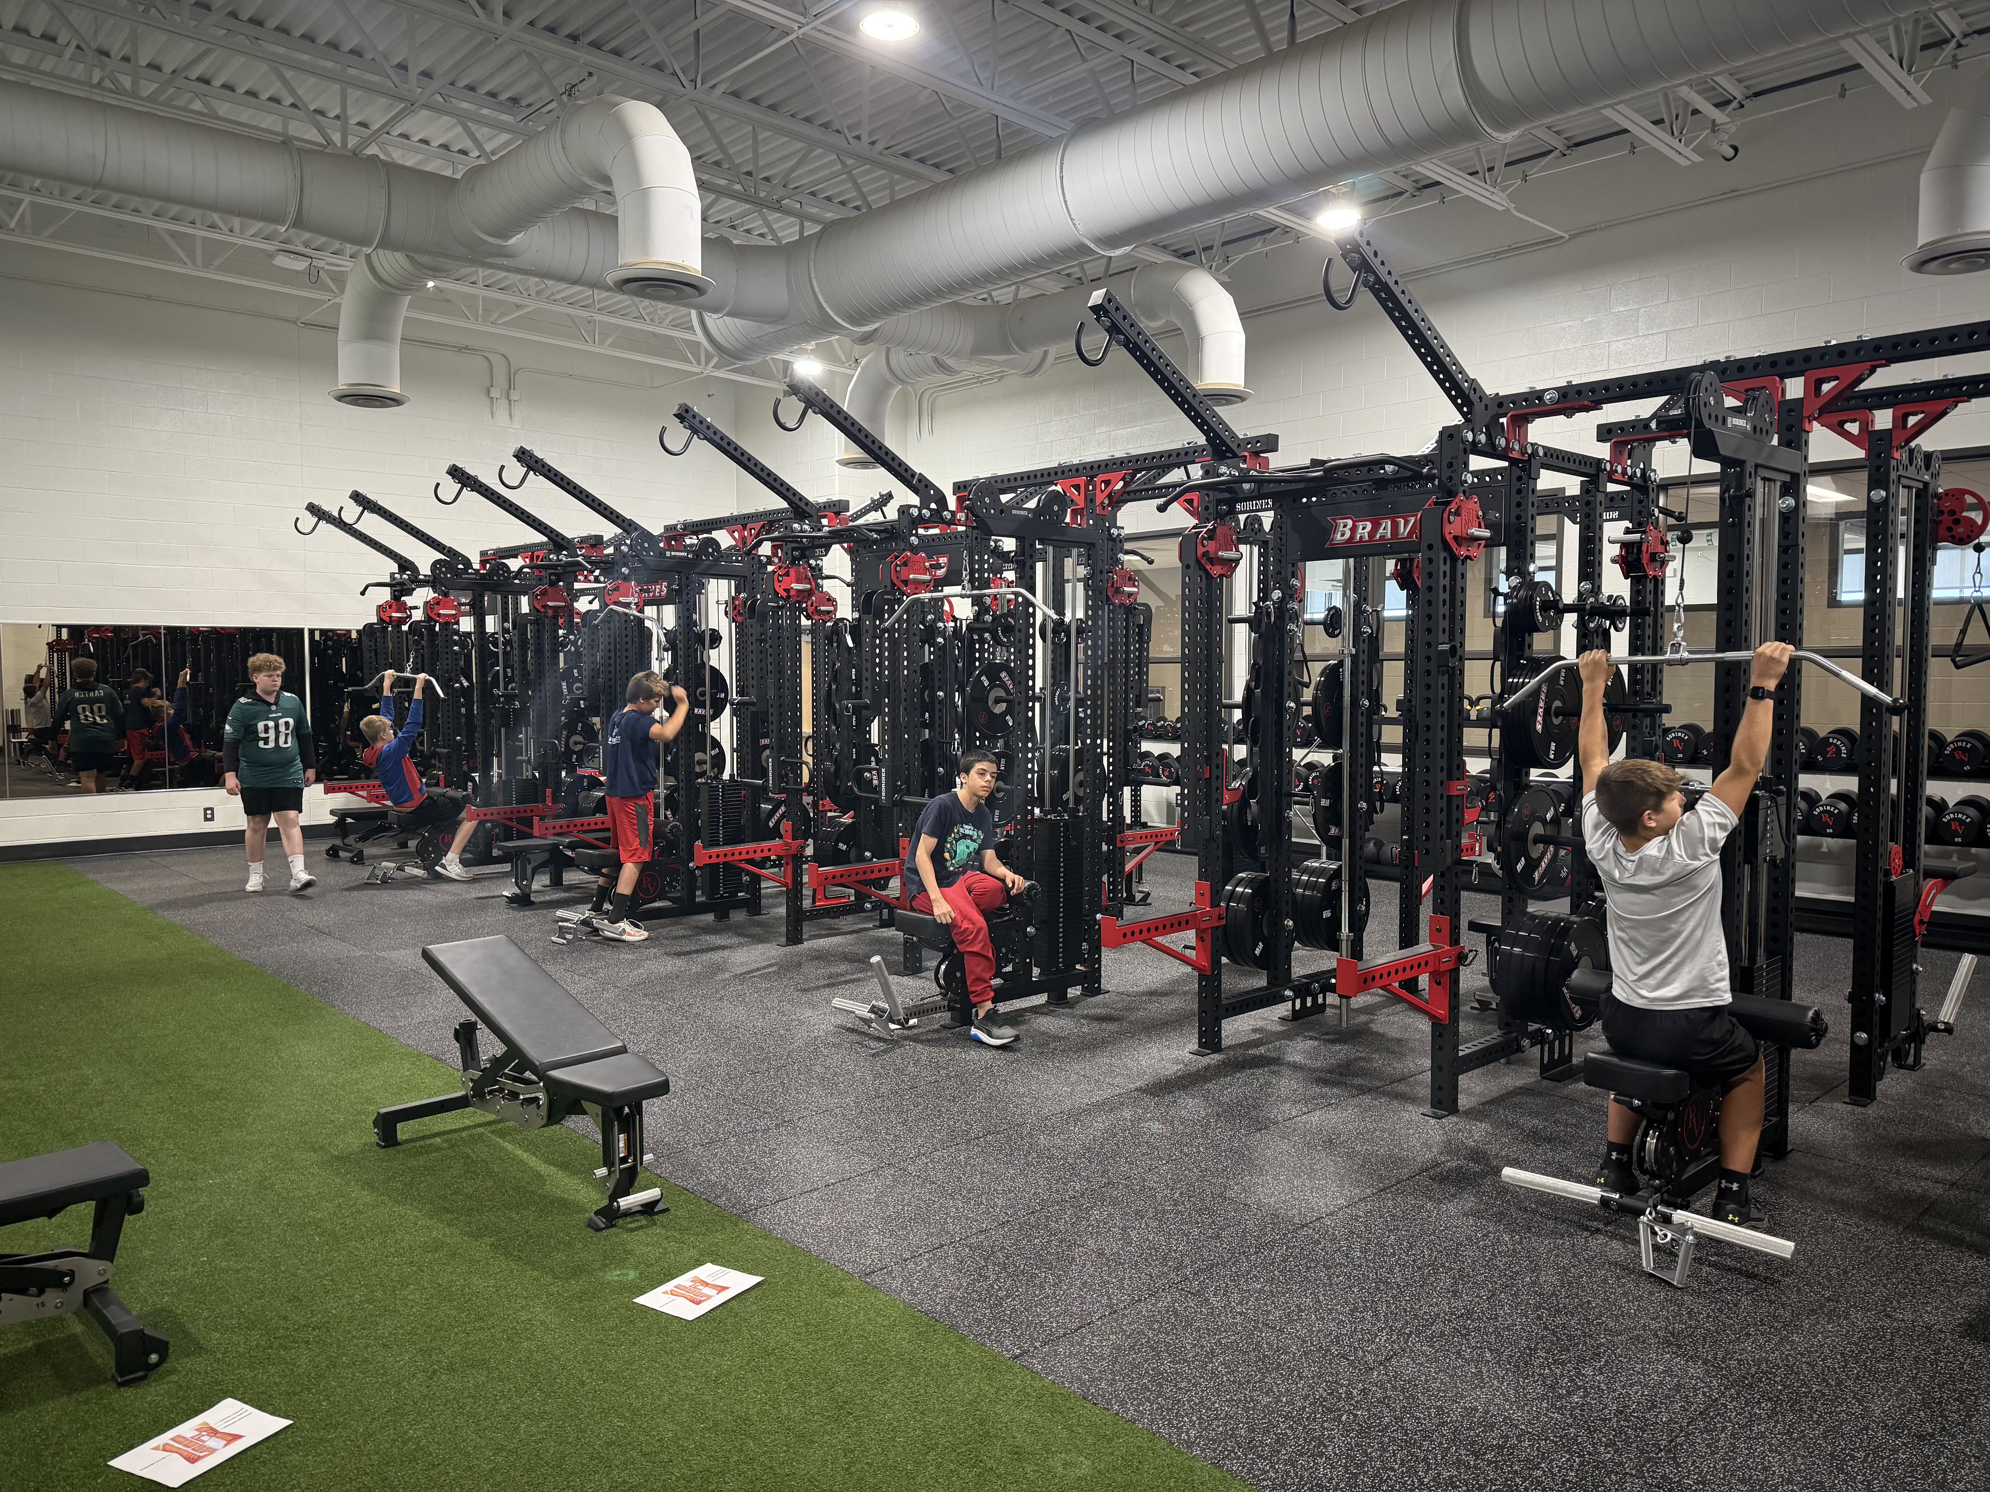
Strength & conditioning room

Slide 6
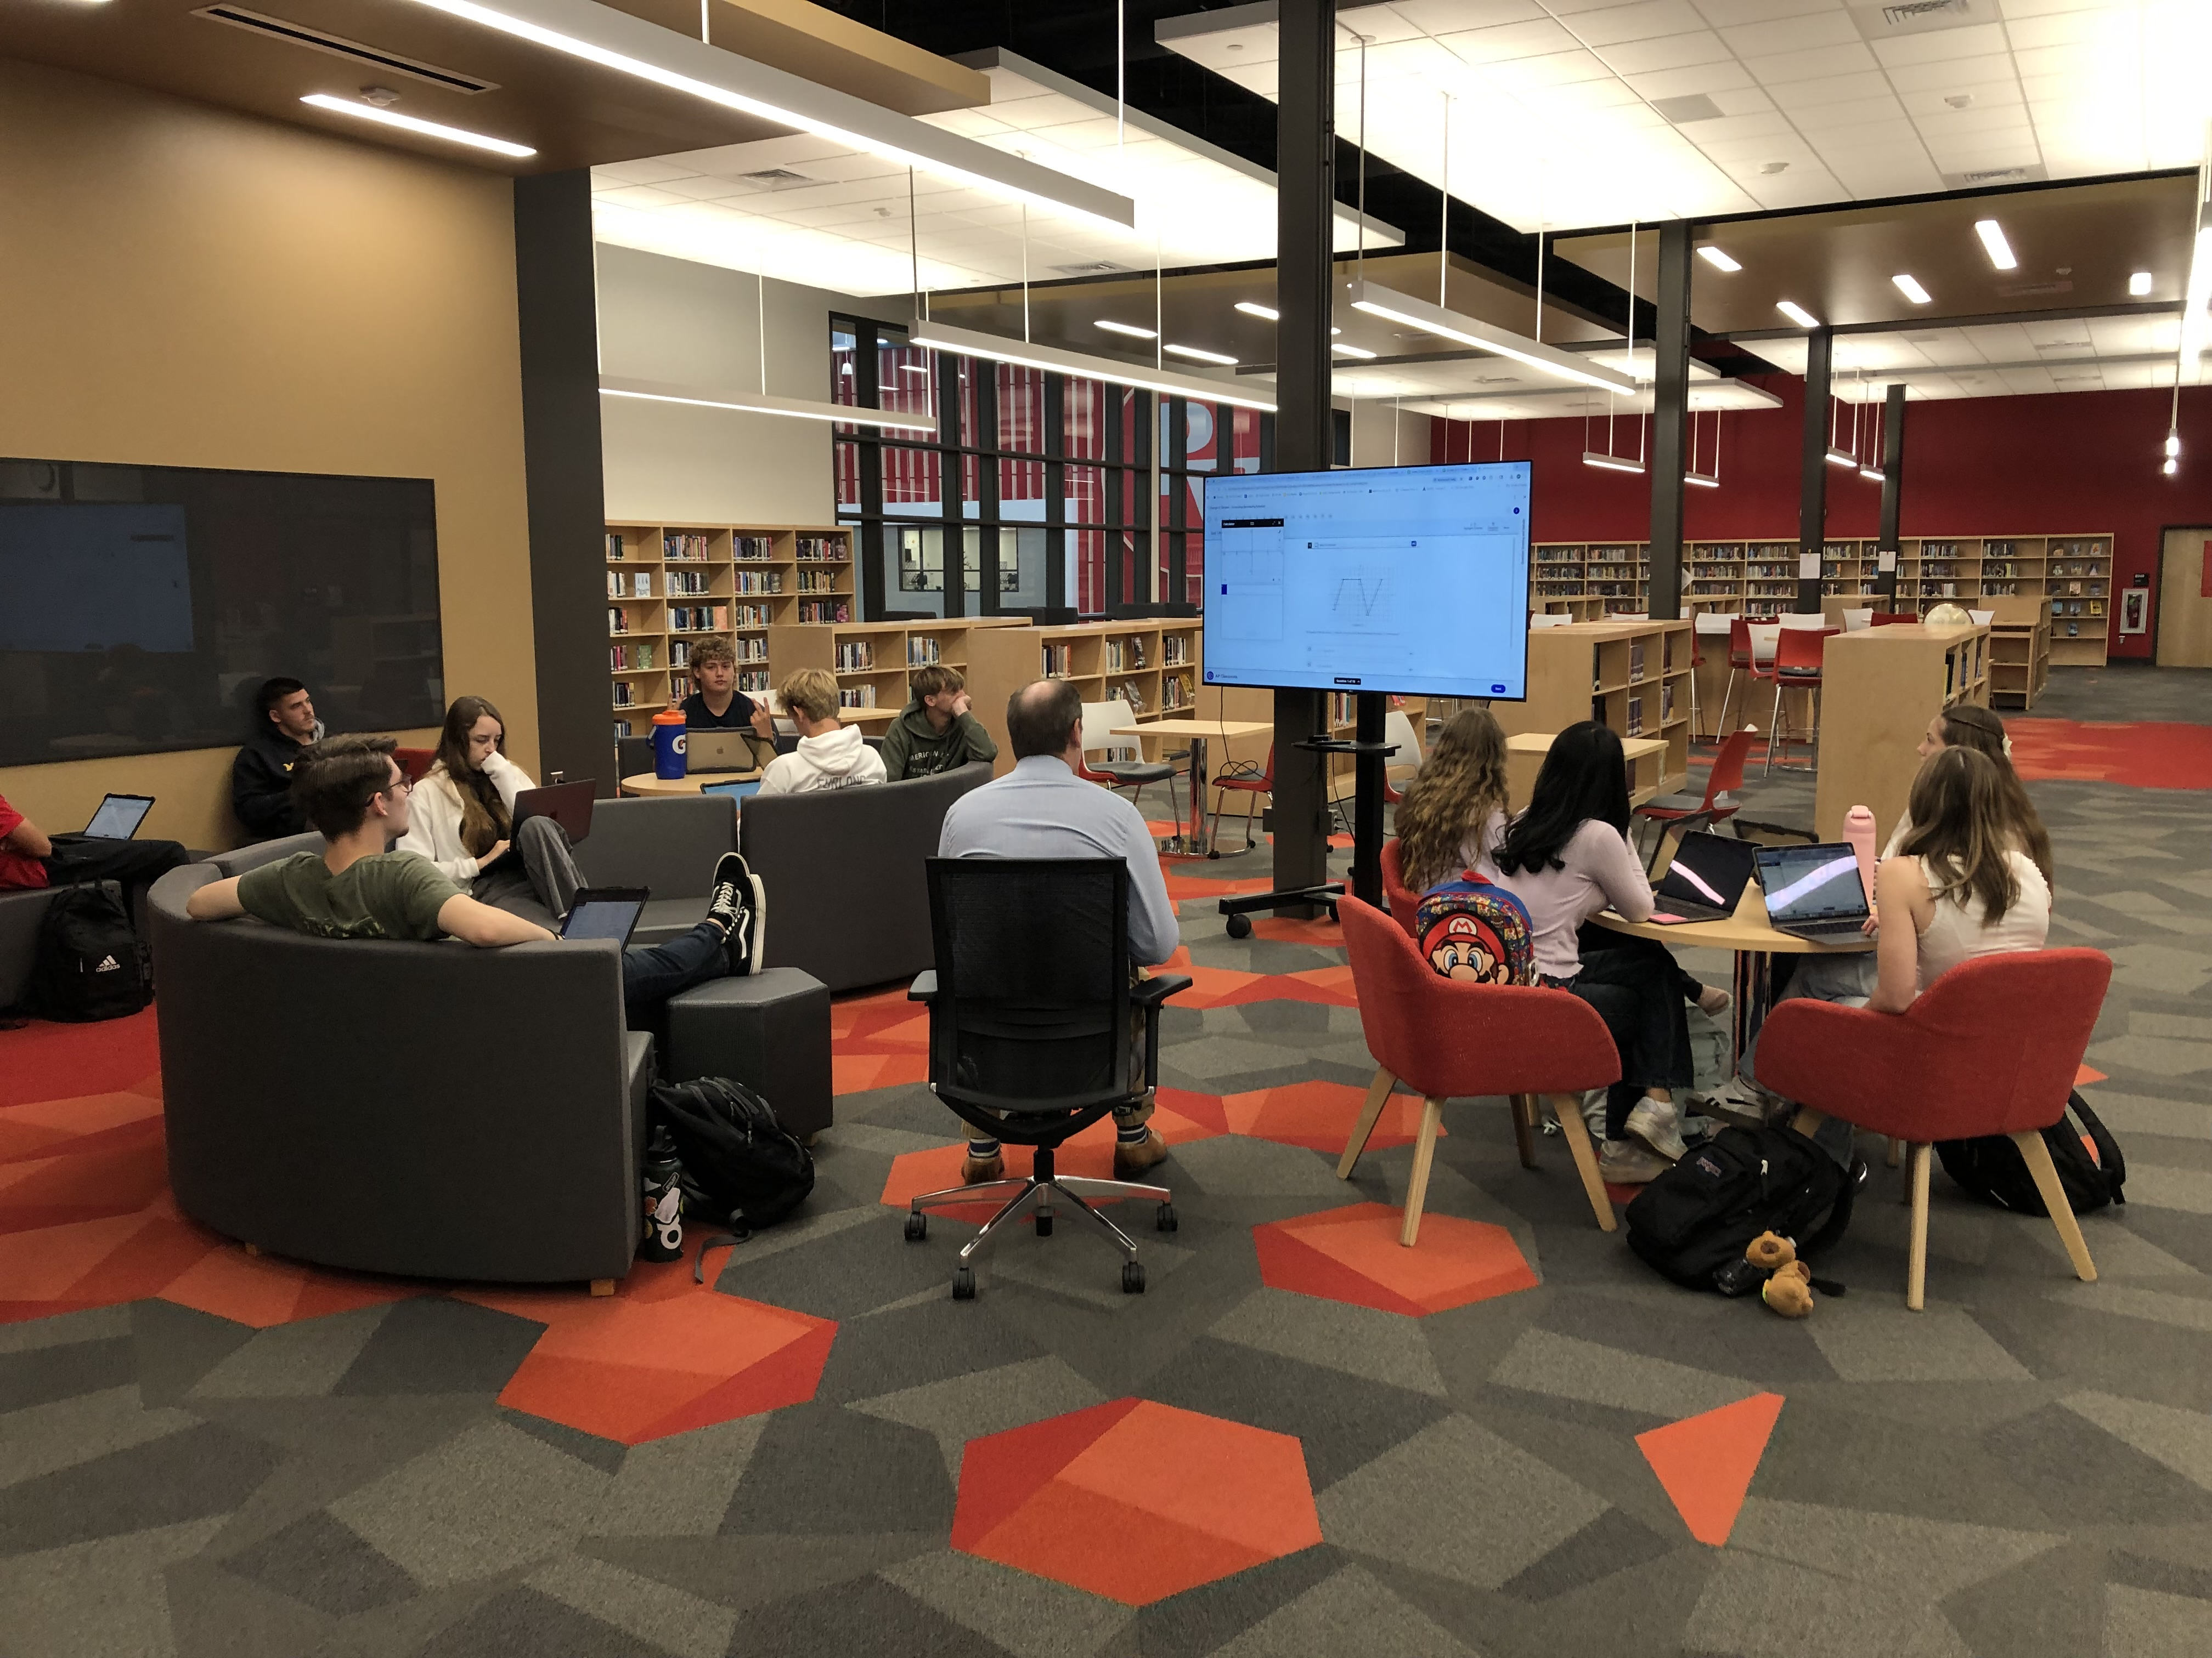
Media center

Slide 7
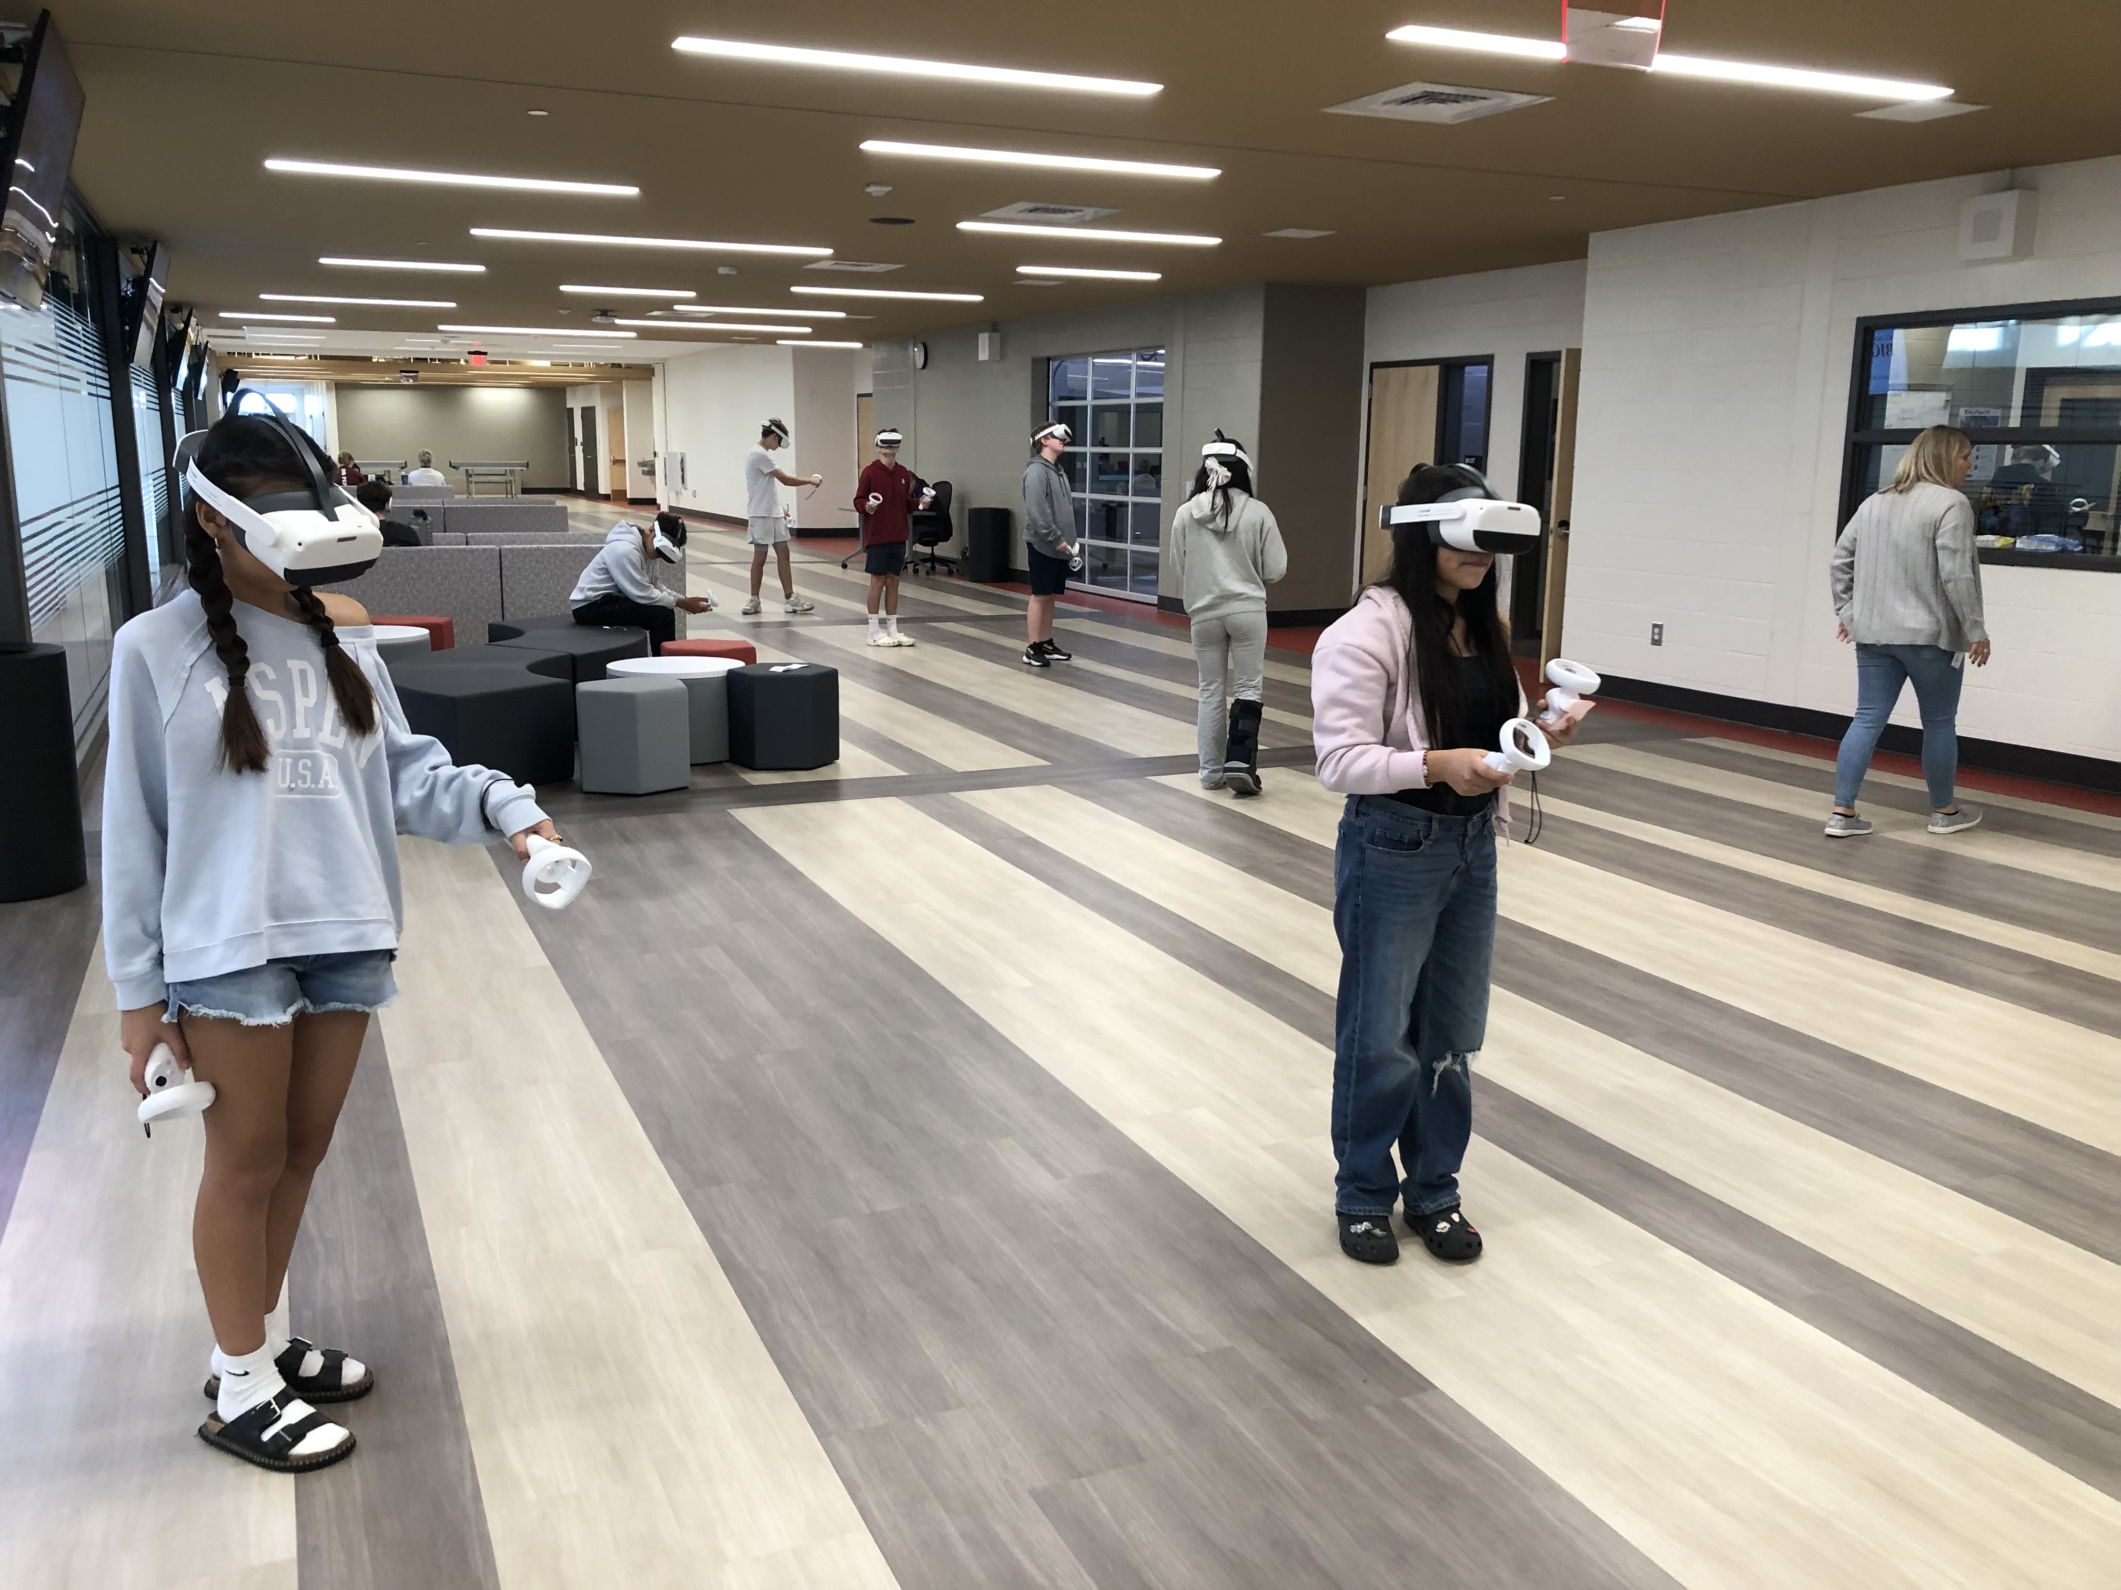
MCL area

Slide 8
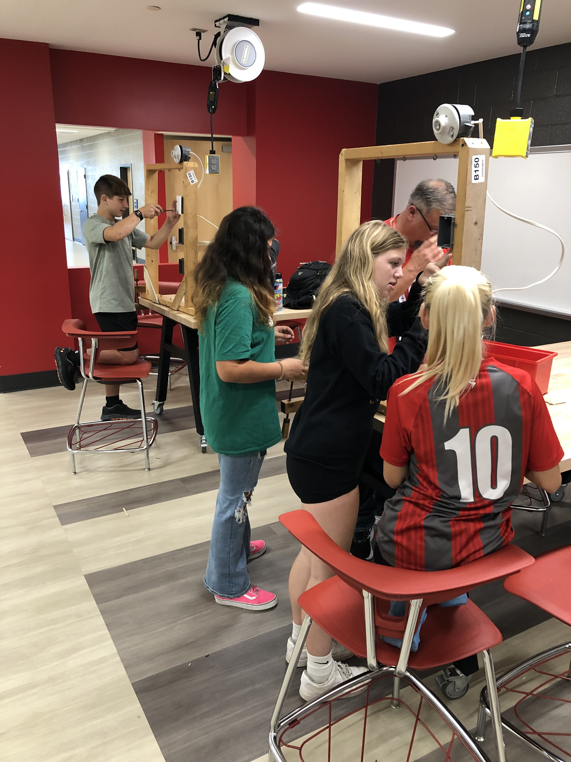
STEM Collaboration area

Slide 9
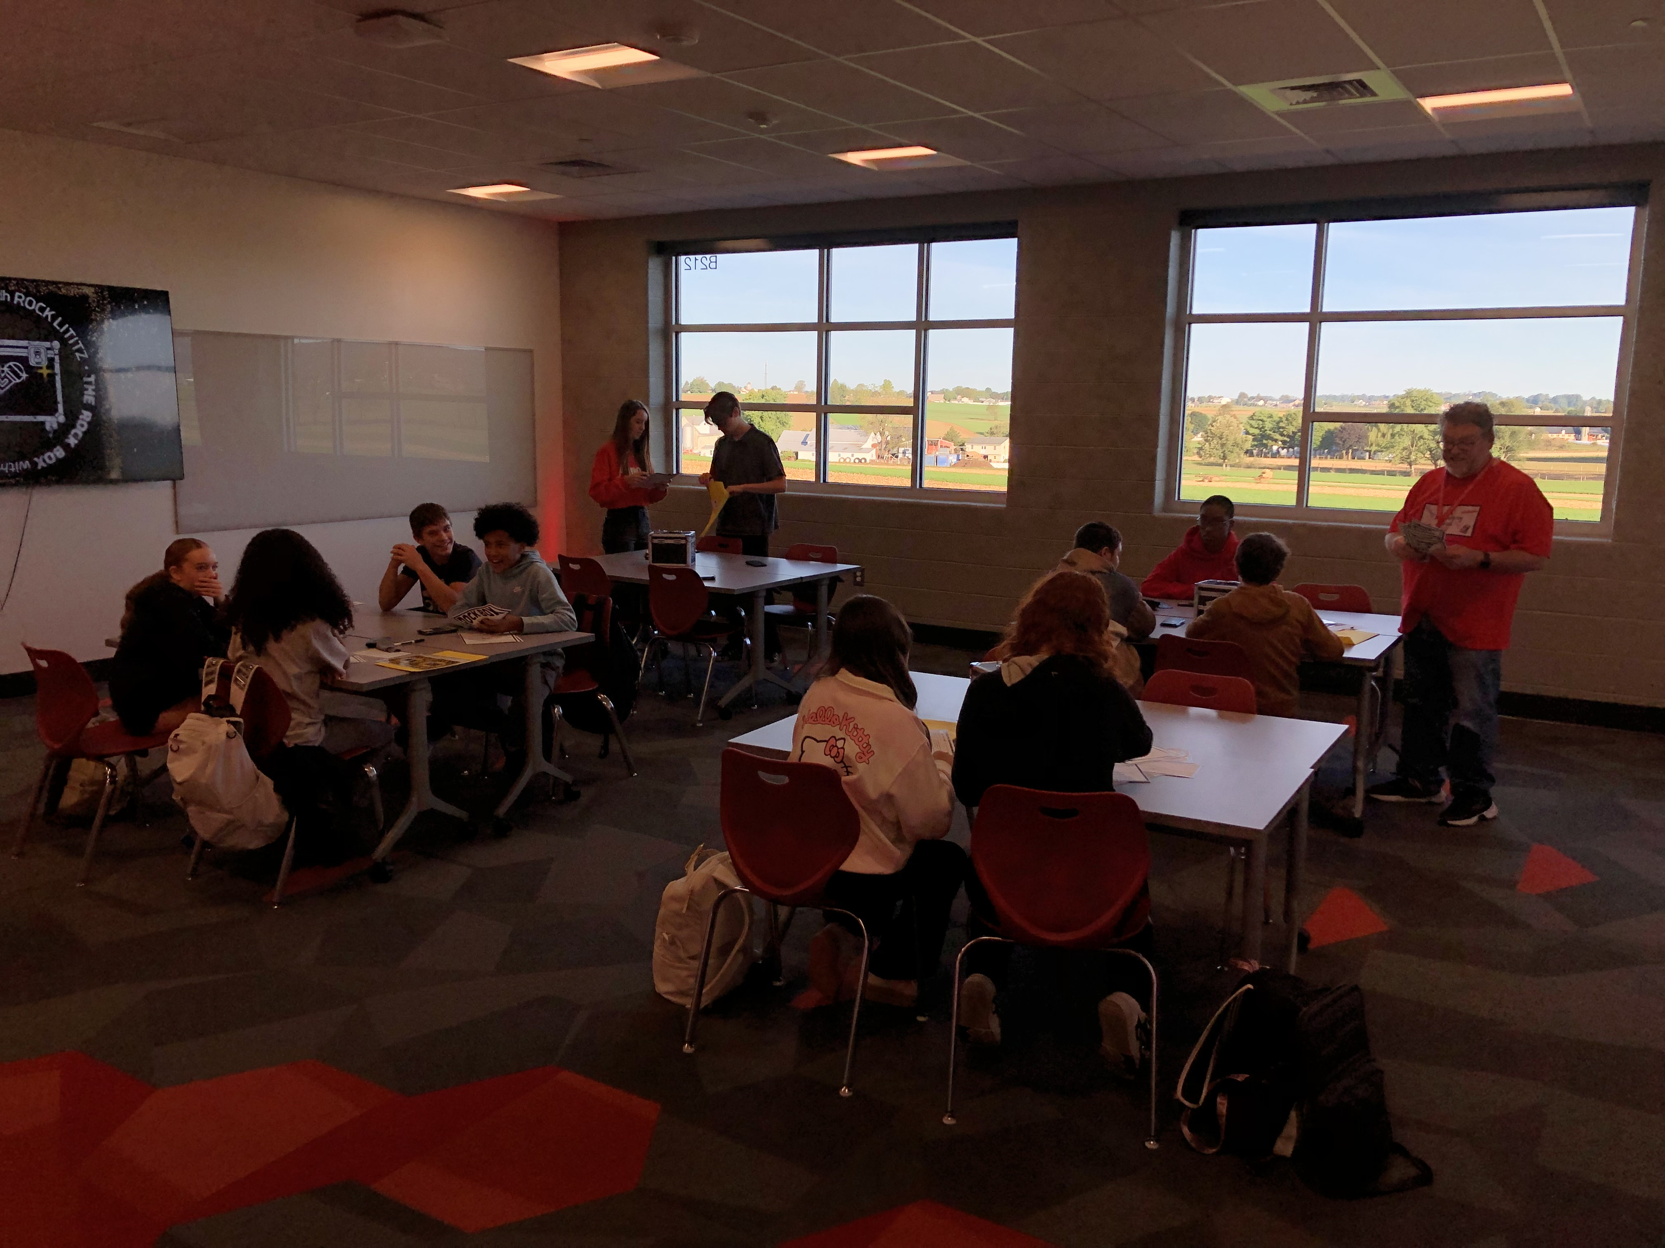
Middle school collaboration area

Slide 10
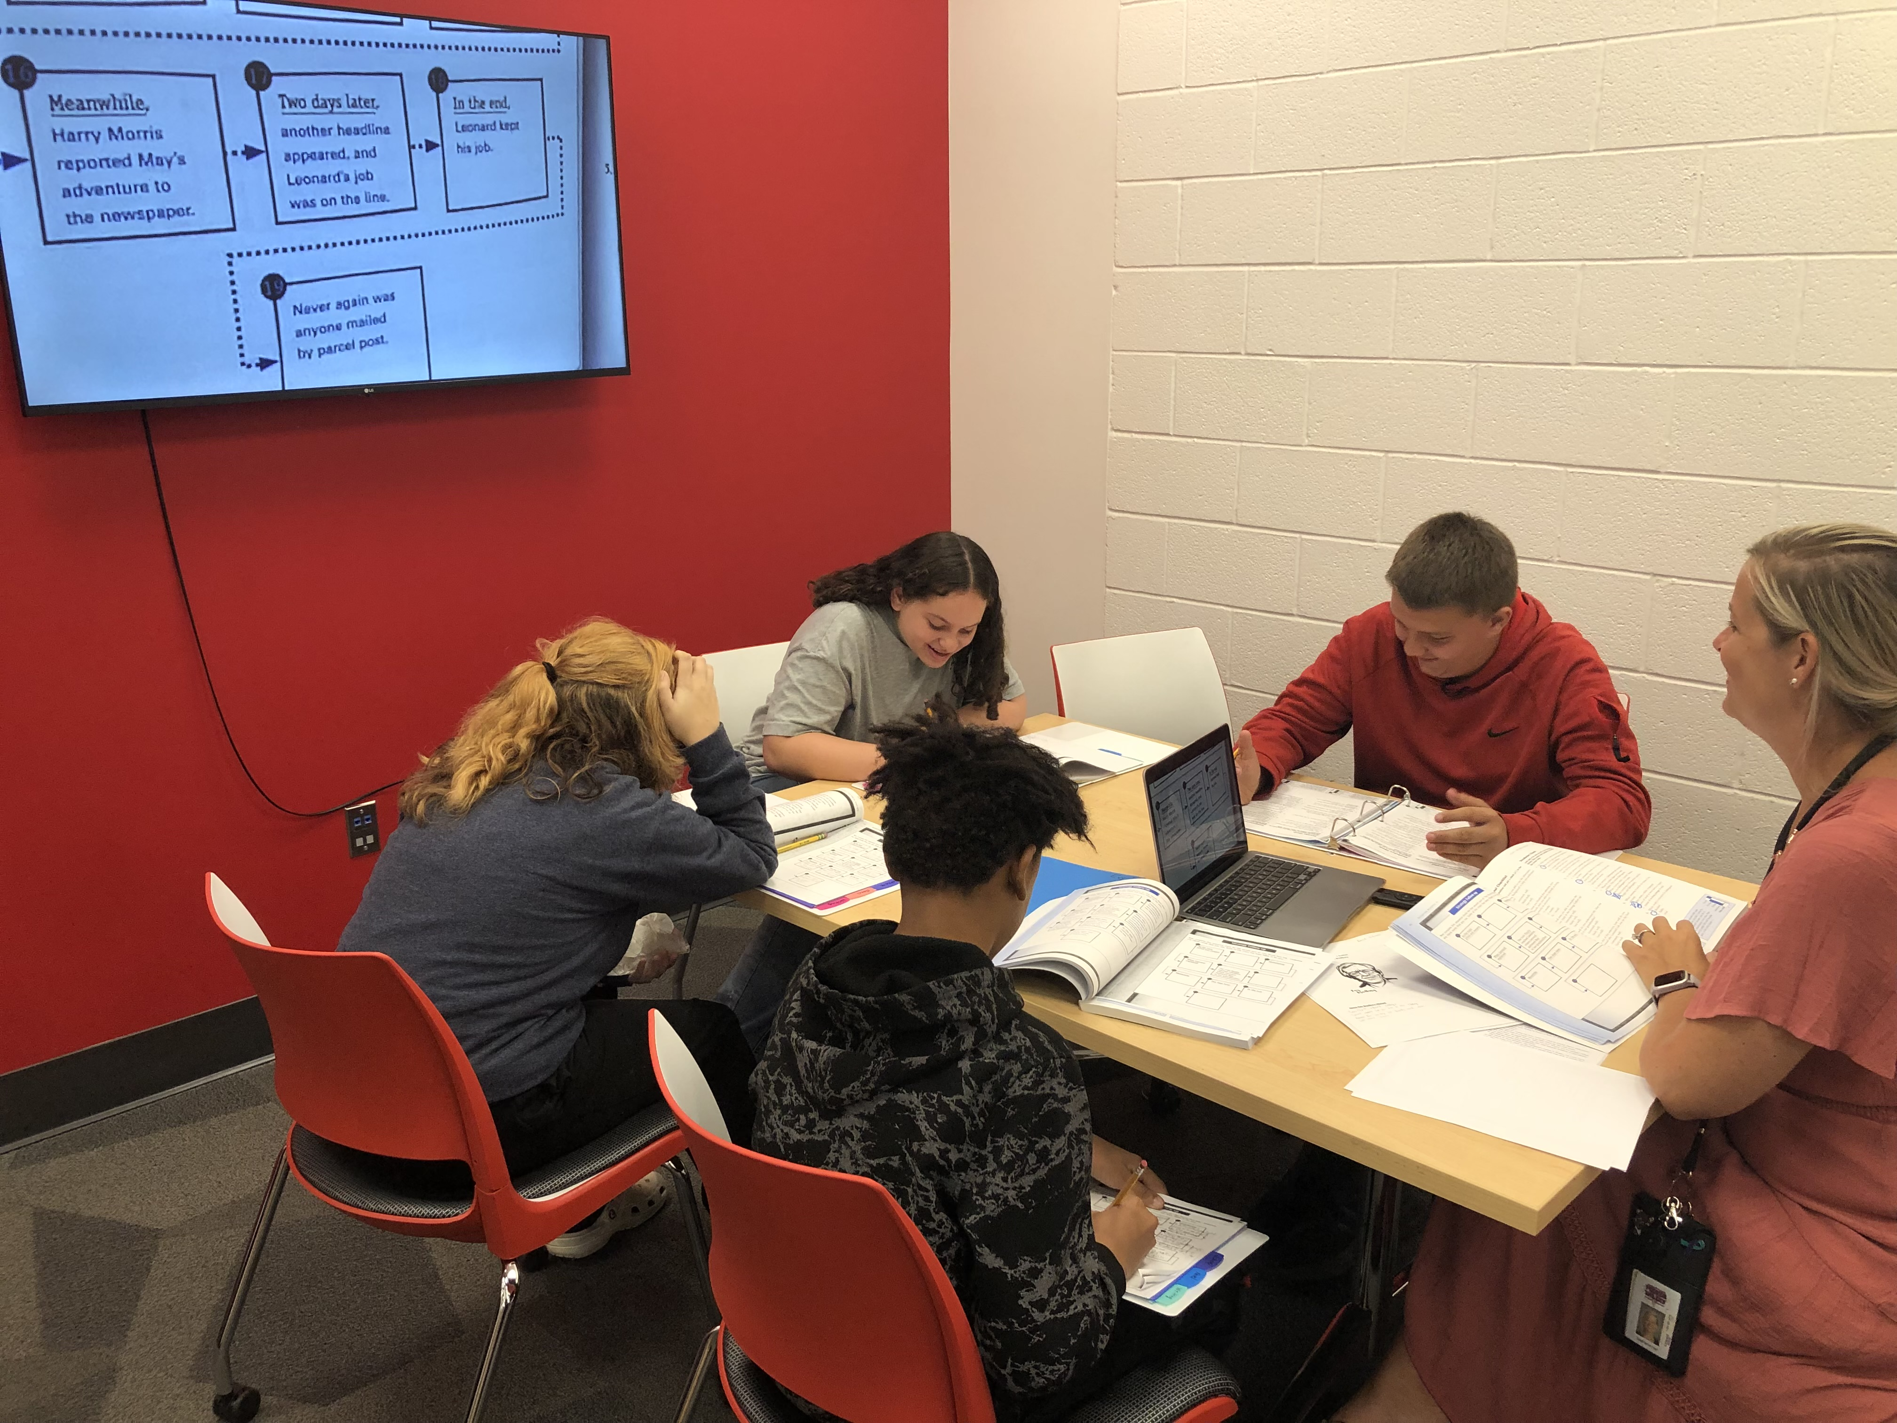
Media center conference room

Slide 11
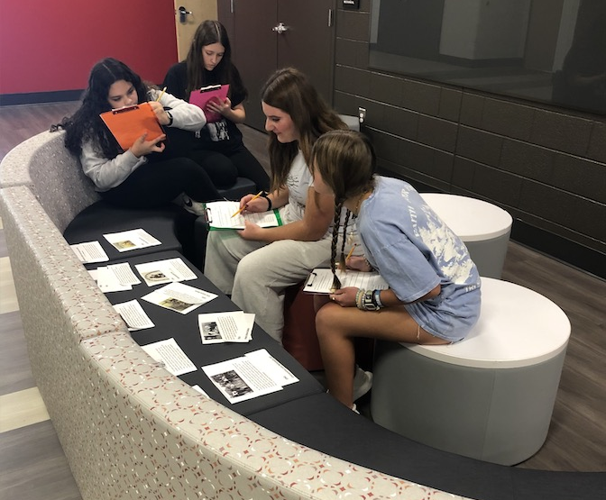
Example of hallway collaboration space

Slide 12
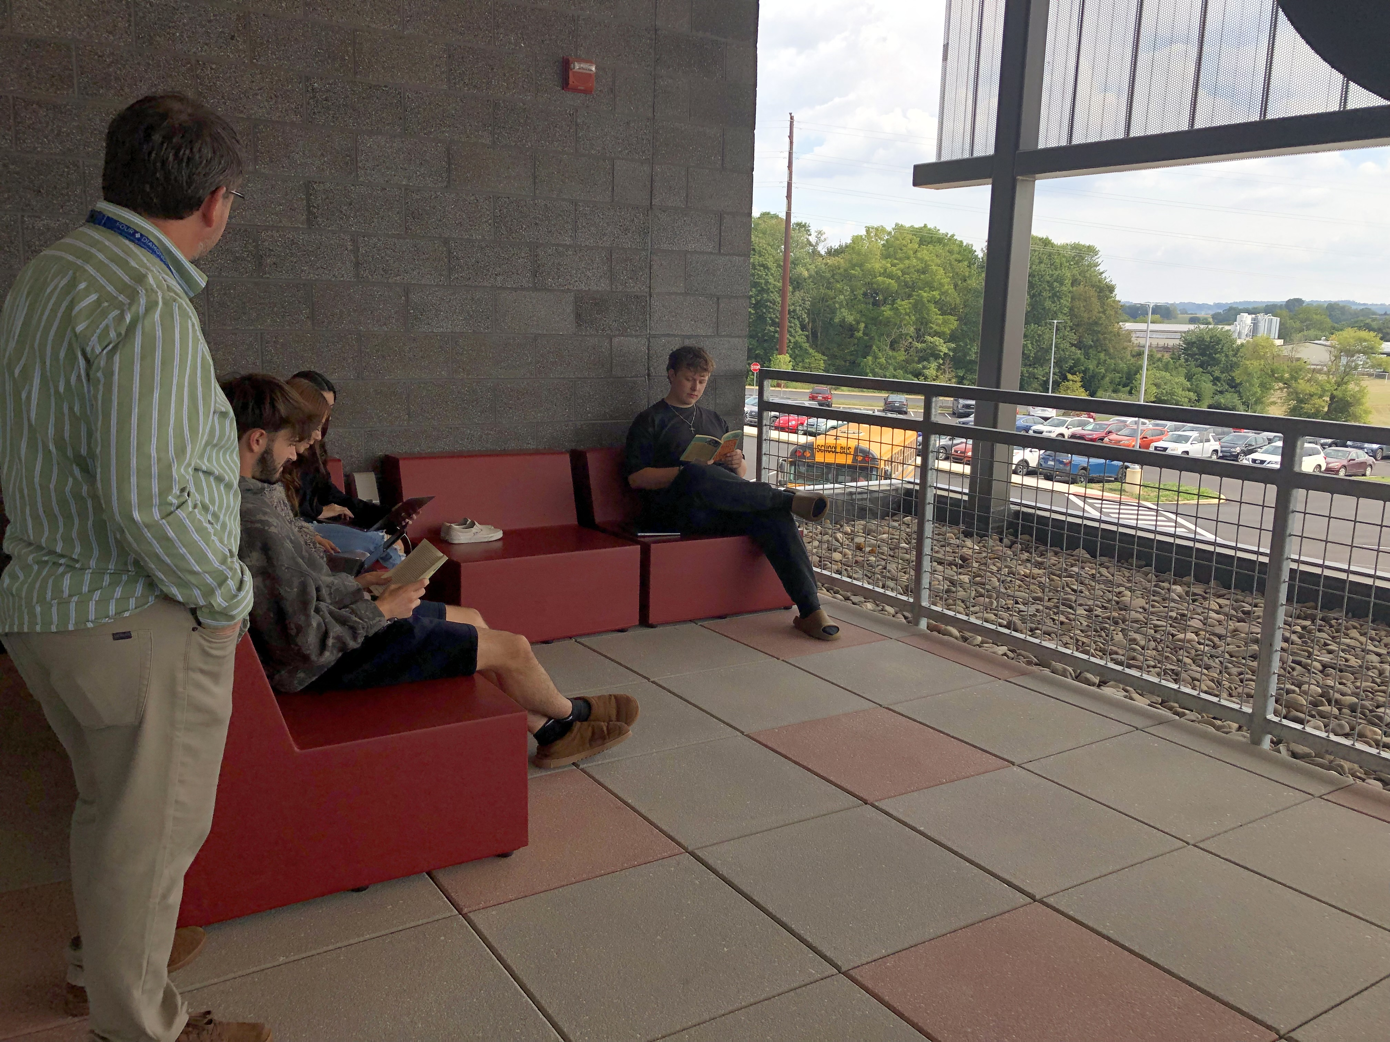
Valley view lounge

