Slide 1





9TH GRADE​
Parent/Guardian​
INFORMATIONAL

Slide 2

Agenda
TUSD Requirements/
A-G requirements
Earning High School Credits
Aeries
Resources
College/Career Options

Slide 3







Counseling Team
Ms. Butler
Ms. Boranian-Jackson
Ms. Sharma
Ms. simas
Mr. Speer
A-Dh
Di- Gr/ AVID
Gu- Le/SEA
Li-Ral
Ram-Z

Slide 4
Counseling Team
Ms. Butler
Ms. Boranian-Jackson
A-Dh
Di- Gr/ AVID
Ms. Sharma
Ms. simas
Mr. Speer
Gu- Le/SEA
Li-Ral
Ram-Z

Slide 5


EARNING HIGH SCHOOL CREDITS
  Students take 6 classes each semester​
  Pass each class at the semester to earn credits. Passing Grade is a D -
  Each semester class is worth 5 credits​
  Classes are a year long!​
  Students should earn 30 credits per semester to stay on track for graduation​

Slide 6

How are credits earned in high school?​
  Students earn credits each semester (2 semesters in a school year)​
  Each semester is worth 30 credits /5 credits for each class (same 6 classes all year; August-May)​
  60 credits for each school year
1st ​QUARTER​ | 2ND QUARTER | Final​ Exams​ | Fall Semester​ Grades/Credits​posted on ​transcript​ | 3RD QUARTER | 4TH QUARTER | Final​ Exams​ | Spring Semester Grades/Credits posted on transcript​

Slide 7
GPA SCALE
Grade | Non-weighted | Weighted
A | 4 | 5
B | 3 | 4
C | 2 | 3
D | 1 | 2
F | 0 | 0

Slide 8

HIGH SCHOOL SPORTS ELIGIBITY
  Students must earn a 2.0 grade point average​ to participate in high school sports and no more than 1 F
  Grades for eligibility are checked at:
1st quarter, 1st semester, 3rd quarter, and 2nd semester.
  A student may be added or dropped at these times.​
  2nd semester grades count for Fall of the following school year​

Slide 9
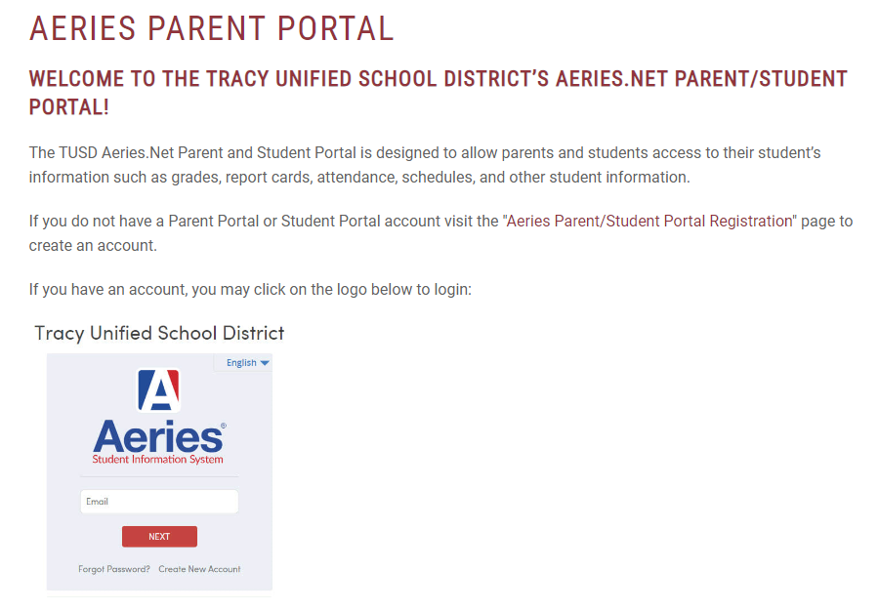

Aeries

Slide 10
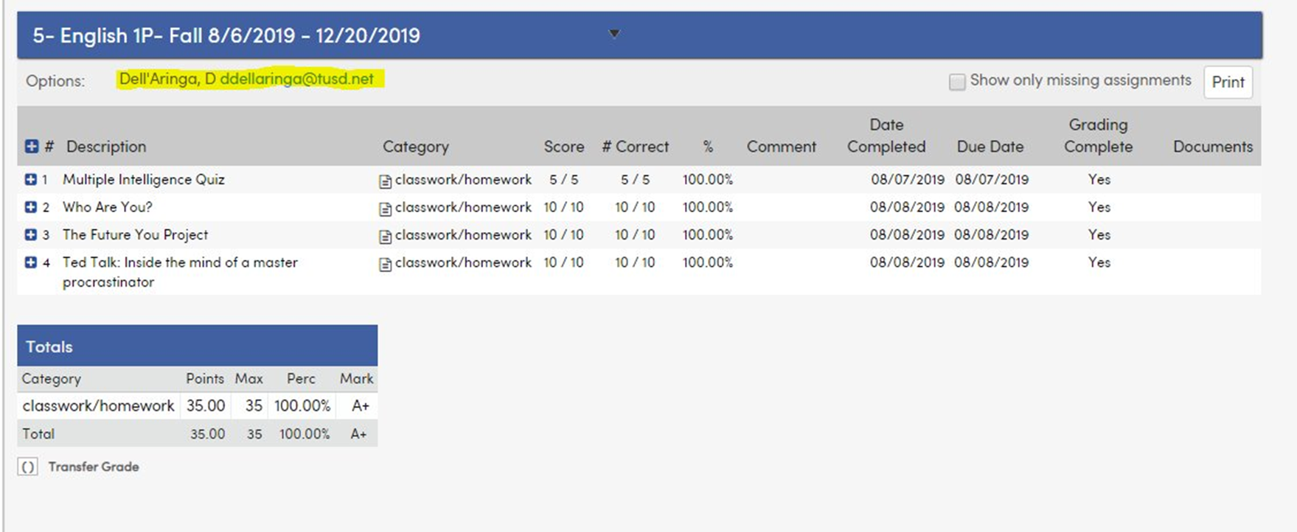
Emailing the Teachers

Slide 11




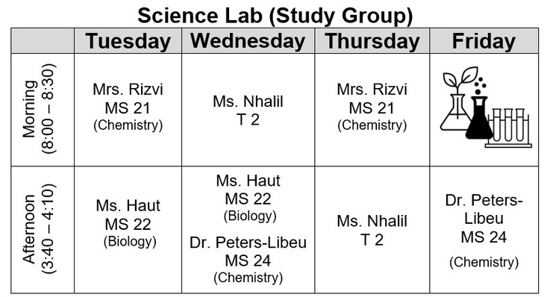
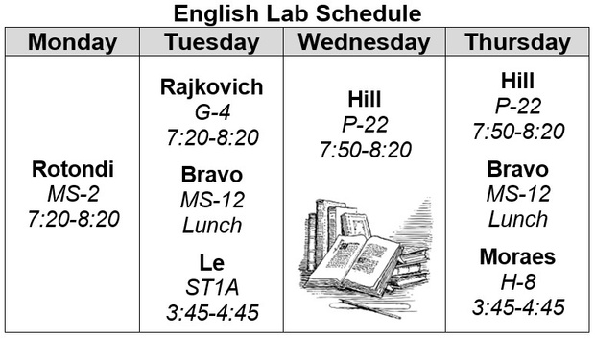


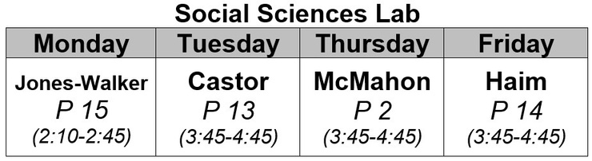
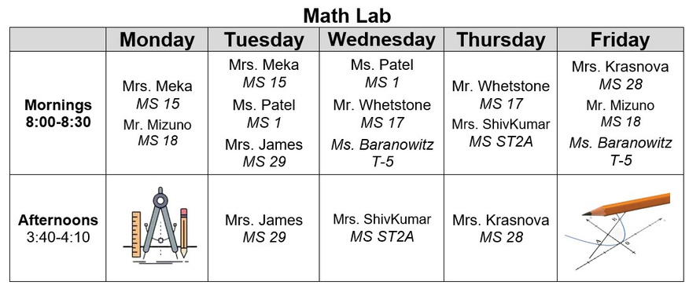
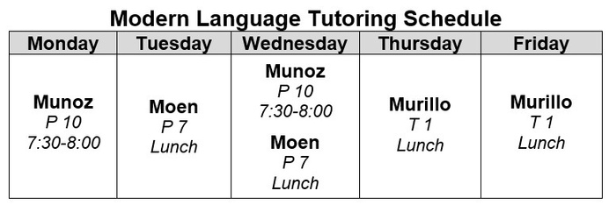
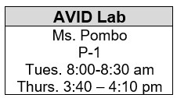
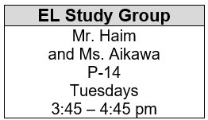
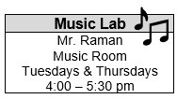
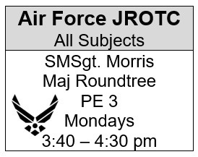

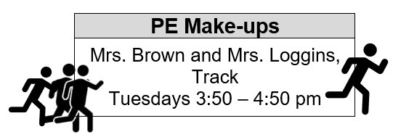
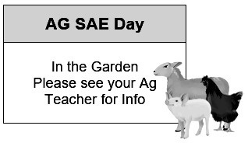
“The strength of the pack is the wolf, and the strength of the wolf is the pack.”
2024-2025
Rev 08/20/24
-Rudyard Kipling

Slide 12

Graduation/A-G Requirements
Graduation Requirements from WHS with diploma​ | A-G Requirements for CSU/ UC ​
3 years of History/Social Science​ | 2 years of History/Social Science​
4 years of English​ | 4 years of English​
2 years of Math ​(must pass a year of Algebra)​ | 3 years of Math​(up to Algebra 2) ​ Recommend 4 years​
3 years of Science ​(must include Biology, Chemistry or Physics, 3rd year science)​ | 2 years of Science (Life & Physical)​ Recommend 3 years​
1 year of World Language​ OR ​1 year of Fine Art​ | 2 years of World Language ​Recommend 3 years​& ​1 year of Fine Art​
2 years of PE & 70 Elective Credits​ | 1 year of College Prep Elective​
Grade must be C- or better

Slide 13






Plans After High School
Community College
University
Apprenticeship
Trade/Technical School
Employment
Military

Slide 14

California Colleges

Slide 15




Resources
Mental Health Counseling
Advising
Labs
Boys and Girls Club
Career Center
Parent Square

Slide 16






Have your student be involved!
Sports
Leadership
Clubs
JROTC
FFA
VAPA

Slide 17
Things to Remember:
Email teachers when concerns arise
Complete classwork and homework! Check Aeries frequently.
Have students attend labs when needed
Enter the appropriate information with the points above.
Get involved on campus
If your student is absent, it is their responsibility to ask for work.
Visit college campuses early
High School is about having fun!

Slide 18

THANK
YOU
West High Counseling
Instagram: @WestHigh_Counseling

