Slide 1

Glencoe Health
Sexually Transmitted Diseases

Slide 2
Sexually Transmitted Diseases
Sexually Transmitted Diseases (STDs) are highly communicable infections that are contracted through sexual contact.
BIG IDEA
New Vocabulary
asymptomatic
Glencoe Health Sexually Transmitted Diseases and HIV/AIDS

Slide 3
Sexually Transmitted Diseases
What Are STDs?
Main Idea
Anyone who has sexual contact with another person risks contracting a sexually transmitted disease.
Sexually transmitted diseases are also called sexually transmitted infections (STIs).
Glencoe Health Sexually Transmitted Diseases and HIV/AIDS

Slide 4
Sexually Transmitted Diseases
What Are STDs?
Sexually transmitted diseases (STDs) are communicable diseases that can be easily transmitted from one person to another through sexual contact.
Glencoe Health Sexually Transmitted Diseases and HIV/AIDS

Slide 5
Sexually Transmitted Diseases
What Are STDs?
Another term for sexually transmitted diseases is sexually transmitted infections (STIs).
Glencoe Health Sexually Transmitted Diseases and HIV/AIDS

Slide 6
Sexually Transmitted Diseases
What Are STDs?
Several of the most common STDs are often asymptomatic. Because they have no signs of a disease, some people do not realize they are infected and do not seek treatment.
New Vocabulary
asymptomatic
Individuals show no symptoms, or the symptoms are mild and disappear after the onset of the infection.
Glencoe Health Sexually Transmitted Diseases and HIV/AIDS

Slide 7
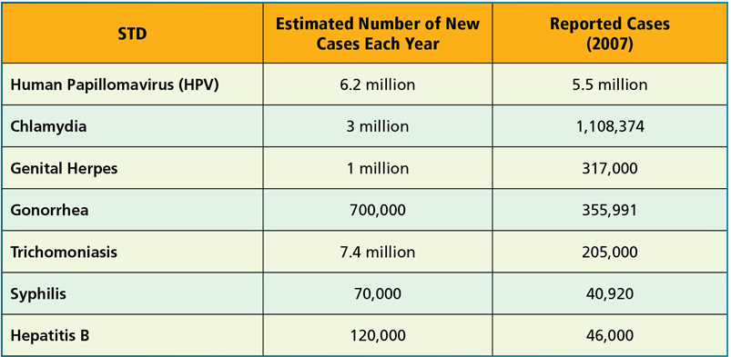
Sexually Transmitted Diseases
What Are STDs?
Source: CDC, Division of STD Prevention, 2000, 2004, 2005
Glencoe Health Sexually Transmitted Diseases and HIV/AIDS

Slide 8
Sexually Transmitted Diseases
Common STDs
Main Idea
There are approximately 25 different STDs, six of which are considered the most common.
Genital HPV infections, chlamydia, genital herpes, gonorrhea, trichomoniasis, and syphilis are the six most common STDs.
Glencoe Health Sexually Transmitted Diseases and HIV/AIDS

Slide 9
Sexually Transmitted Diseases
Genital HPV Infections
Genital HPV infections are caused by human papillomavirus (HPV) and can cause genital warts.
Some HPV infections can cause cervical cancer. A vaccine treatment is now available for protection against HPV.
Glencoe Health Sexually Transmitted Diseases and HIV/AIDS

Slide 10
Sexually Transmitted Diseases
Chlamydia
Chlamydia is a bacterial infection that produces no symptoms.
If left untreated, chlamydia can cause pelvic inflammatory disease (PID) in females and infertility in males.
Glencoe Health Sexually Transmitted Diseases and HIV/AIDS

Slide 11
Sexually Transmitted Diseases
Genital Herpes
Genital herpes is an incurable STD caused by the herpes simplex virus.
Herpes simplex 1 generally causes
cold sores in or
near the mouth.
Herpes simplex 2 typically causes recurring blisters on
the genitals or rectum.
Glencoe Health Sexually Transmitted Diseases and HIV/AIDS

Slide 12
Sexually Transmitted Diseases
Gonorrhea
Gonorrhea is a bacterial STD that usually affects mucous membranes.
Left untreated, gonorrhea can cause severe health problems, such as infertility and permanent damage to the body’s joints.
Glencoe Health Sexually Transmitted Diseases and HIV/AIDS

Slide 13
Sexually Transmitted Diseases
Trichomoniasis
Trichomoniasis is an infection that can cause symptoms that include irritation of and discharge from the genitals.
Females with trichomoniasis are also more likely to contract HIV if they are exposed to it.
Glencoe Health Sexually Transmitted Diseases and HIV/AIDS

Slide 14
Sexually Transmitted Diseases
Syphilis
People infected with syphilis develop sores on the genitals.
If left untreated, the infection can cause a skin rash, damage to internal organs, dementia, and death.
Glencoe Health Sexually Transmitted Diseases and HIV/AIDS

Slide 15
Sexually Transmitted Diseases
The STD Epidemic
Main Idea
Accurate health information and responsible behavior will help fight the STD epidemic.
The CDC estimates that each year, 19 million people are infected with an STD. Almost half are under the age of 24.
Glencoe Health Sexually Transmitted Diseases and HIV/AIDS

Slide 16
Sexually Transmitted Diseases
The STD Epidemic
The incidence of STDs are reported to public health authorities so that they can track an outbreak of an epidemic.
An epidemic is an occurrence of a disease in which many people in the same place at the same time are affected.
Glencoe Health Sexually Transmitted Diseases and HIV/AIDS

Slide 17
Sexually Transmitted Diseases
The STD Epidemic
embarrassment or fear
Many STD cases are undiagnosed and untreated because of:
lack of symptoms
misinformation
notification policies
Glencoe Health Sexually Transmitted Diseases and HIV/AIDS

Slide 18
Review Sexually Transmitted Diseases
After You Read
Reviewing Facts and Vocabulary
What is a sexually transmitted disease?
An infection spread from person to person through sexual contact.
Glencoe Health Sexually Transmitted Diseases and HIV/AIDS

Slide 19
Review Sexually Transmitted Diseases
After You Read
Reviewing Facts and Vocabulary
Name four common STDs.
Answers can include: genital HPV infection, chlamydia, genital herpes, gonorrhea, trichomoniasis, syphilis.
Glencoe Health Sexually Transmitted Diseases and HIV/AIDS

Slide 20
Review Sexually Transmitted Diseases
After You Read
Reviewing Facts and Vocabulary
In the United States, approximately how many people are infected with an STD each year?
About 19 million people.
Glencoe Health Sexually Transmitted Diseases and HIV/AIDS

Slide 21
Glencoe Health
End of
Sexually Transmitted Diseases and HIV/AIDS
Sexually Transmitted Diseases

