Slide 1

Glencoe Health
Preventing and Treating HIV/AIDS

Slide 2
Preventing and Treating HIV/AIDS
BIG IDEA
HIV/AIDS is preventable and treatable,
but is incurable.
New Vocabulary
antibody
rapid test
antibody screening test
Glencoe Health Sexually Transmitted Diseases and HIV/AIDS

Slide 3
Preventing and Treating HIV/AIDS
Preventing HIV/AIDS
Main Idea
There are many actions you can take to avoid contracting HIV/AIDS.
The CDC estimates that about 25 percent of the people in the United States who are infected with HIV do not know they are infected.
Glencoe Health Sexually Transmitted Diseases and HIV/AIDS

Slide 4
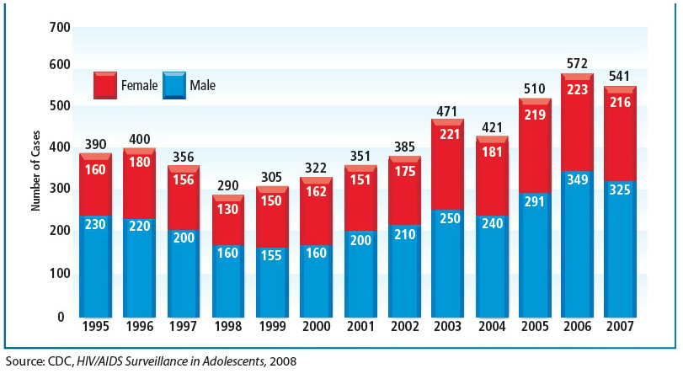
Preventing and Treating HIV/AIDS
Preventing HIV/AIDS
HIV/AIDS Among Teens
When a pregnant female drinks,
so does her fetus.
Glencoe Health Sexually Transmitted Diseases and HIV/AIDS

Slide 5
Preventing and Treating HIV/AIDS
Preventing HIV/AIDS
The following healthful behaviors will help protect you from infection:
✓
Practice abstinence.
✓
Do not share needles, knives, and razors.
✓
Avoid situations where drug and alcohol use might compromise your decision-making.
✓
Use refusal skills when you feel pressured to engage in risky behaviors.
Glencoe Health Sexually Transmitted Diseases and HIV/AIDS

Slide 6
Preventing and Treating HIV/AIDS
Diagnosing HIV/AIDS
Main Idea
Several tests are used to diagnose HIV/AIDS.
If someone believes that he or she may
have been exposed to HIV, the person
must be tested.
Glencoe Health Sexually Transmitted Diseases and HIV/AIDS

Slide 7
Preventing and Treating HIV/AIDS
Diagnosing HIV/AIDS
Typically, a blood sample or an oral specimen from between the inside of the cheek and
the gum is collected and sent to a laboratory
for analysis.
At most testing sites, qualified personnel are available to answer questions, make referrals, and explain results.
When a pregnant female drinks,
so does her fetus.
Glencoe Health Sexually Transmitted Diseases and HIV/AIDS

Slide 8
Preventing and Treating HIV/AIDS
Types of Laboratory HIV Tests
After collected samples are sent to a laboratory, technicians screen them for HIV antibodies.
A person’s body does not naturally have HIV antibodies: they are produced only in the presence of an infection.
New Vocabulary
antibody
A protein that acts against an antigen.
When a pregnant female drinks,
so does her fetus.
Glencoe Health Sexually Transmitted Diseases and HIV/AIDS

Slide 9
Preventing and Treating HIV/AIDS
Types of Laboratory HIV Tests
A rapid test can be used in situations where the infected person might not come back to learn the results of the test.
New Vocabulary
rapid test
An HIV test that produces results in only 20 minutes.
Glencoe Health Sexually Transmitted Diseases and HIV/AIDS

Slide 10
Preventing and Treating HIV/AIDS
Types of Laboratory HIV Tests
Enzyme immunoassay (EIA) is a test that screens for the presence of HIV antibodies in the blood. If the enzyme immunoassay (EIA) test results are positive, then the EIA test is repeated.
Glencoe Health Sexually Transmitted Diseases and HIV/AIDS

Slide 11
Preventing and Treating HIV/AIDS
Types of Laboratory HIV Tests
The Western blot test is a test that detects HIV antibodies and confirms the results of earlier EIA tests. It is used only after EIA tests produce positive results.
Glencoe Health Sexually Transmitted Diseases and HIV/AIDS

Slide 12
Preventing and Treating HIV/AIDS
Types of Laboratory HIV Tests
If the results of the two EIA tests and the Western blot test are all positive, a person is diagnosed with HIV/AIDS.
Many health departments and HIV/AIDS information and counseling centers will pay
for the cost of these tests.
When a pregnant female drinks,
so does her fetus.
Glencoe Health Sexually Transmitted Diseases and HIV/AIDS

Slide 13
Preventing and Treating HIV/AIDS
Additional Tests
RNA Test
How many copies of the virus are circulating in the blood.
CD4 Test
How many white blood cells are in a sample of blood.
When a pregnant female drinks,
so does her fetus.
Glencoe Health Sexually Transmitted Diseases and HIV/AIDS

Slide 14
Preventing and Treating HIV/AIDS
Additional Tests
Home testing kits that are approved by the FDA are available in pharmacies and other stores.
Some tests require that the person provide a spot of dried blood which is mailed to a laboratory for analysis. Other tests can provide results at home.
When a pregnant female drinks,
so does her fetus.
Glencoe Health Sexually Transmitted Diseases and HIV/AIDS

Slide 15
Preventing and Treating HIV/AIDS
Benefits of Early Diagnosis
Early detection enables a person to:
begin proper medical care early to slow the progress of the virus.
avoid behaviors that could spread HIV to others.
gain peace of mind when the results are negative.
Glencoe Health Sexually Transmitted Diseases and HIV/AIDS

Slide 16
Preventing and Treating HIV/AIDS
Treating HIV/AIDS
Main Idea
Medications can slow the growth of HIV/AIDS, but there is no cure.
Drugs have been developed that slow the growth of HIV and treat the opportunistic infections that occur in individuals who do not have healthy immune systems.
Glencoe Health Sexually Transmitted Diseases and HIV/AIDS

Slide 17
Preventing and Treating HIV/AIDS
Treating HIV/AIDS
To slow the growth of the AIDS virus, people take a combination of drugs, a treatment known as highly active antiretroviral therapy (HAART).
When a pregnant female drinks,
so does her fetus.
Glencoe Health Sexually Transmitted Diseases and HIV/AIDS

Slide 18
Review Preventing and Treating HIV/AIDS
After You Read
Reviewing Facts and Vocabulary
How is HIV detected?
An EIA and Western Blot test detect the presence of antibodies; an RNA test detects the virus.
Glencoe Health Sexually Transmitted Diseases and HIV/AIDS

Slide 19
Review Preventing and Treating HIV/AIDS
After You Read
Reviewing Facts and Vocabulary
What test is used to confirm a diagnosis of HIV?
The Western Blot test
Glencoe Health Sexually Transmitted Diseases and HIV/AIDS

Slide 20
Review Preventing and Treating HIV/AIDS
After You Read
Reviewing Facts and Vocabulary
HIV/AIDS home testing kits may not be trustworthy. What should you do to make sure the results are accurate?
Check that the test is approved by the FDA.
Glencoe Health Sexually Transmitted Diseases and HIV/AIDS

Slide 21
Glencoe Health
End of
Sexually Transmitted Diseases and HIV/AIDS
Preventing and Treating HIV/AIDS

