Slide 1

Glencoe Health
HIV/AIDS

Slide 2
HIV/AIDS
HIV is the virus that causes AIDS, a disease that weakens the body’s immune system and may have fatal consequences.
BIG IDEA
New Vocabulary
acquired immune deficiency syndrome (AIDS)
human immunodeficiency virus (HIV)
Glencoe Health Sexually Transmitted Diseases and HIV/AIDS

Slide 3
HIV/AIDS
What is HIV/AIDS?
Main Idea
HIV/AIDS weakens the body’s immune system.
HIV/AIDS has become one of the deadliest diseases in human history.
Glencoe Health Sexually Transmitted Diseases and HIV/AIDS

Slide 4
HIV/AIDS
What is HIV/AIDS?
More than 32 million people around the world have died from acquired immune deficiency syndrome (AIDS), including more than 675,000 Americans.
New Vocabulary
acquired immune deficiency syndrome (AIDS)
A disease in which the immune system is weakened.
Glencoe Health Sexually Transmitted Diseases and HIV/AIDS

Slide 5
HIV/AIDS
What is HIV/AIDS?
AIDS is caused by the human immunodeficiency virus (HIV).
New Vocabulary
human immunodeficiency virus (HIV)
A virus that attacks the immune system.
Glencoe Health Sexually Transmitted Diseases and HIV/AIDS

Slide 6
HIV/AIDS
What is HIV/AIDS?
When the HIV virus enters the body, it finds and destroys the white blood cells that fight disease. In the final stages of an HIV infection, the immune system is destroyed, and AIDS develops.
Glencoe Health Sexually Transmitted Diseases and HIV/AIDS

Slide 7
HIV/AIDS
What is HIV/AIDS?
Health care officials view HIV/AIDS as a pandemic, a global outbreak of infectious disease.
The seriousness of this pandemic is greatly increased because many of the people who are infected do not know it.
Many experts and scientists consider HIV/AIDS to be the most serious public health problem facing the world.
Glencoe Health Sexually Transmitted Diseases and HIV/AIDS

Slide 8
HIV/AIDS
Understanding HIV/AIDS
Main Idea
HIV/AIDS is transmitted in a variety of ways.
HIV is transmitted among humans only when one person’s infected blood, semen, or vaginal secretions come in contact with another
person’s broken skin or mucous membranes.
Glencoe Health Sexually Transmitted Diseases and HIV/AIDS

Slide 9
HIV/AIDS
Understanding HIV/AIDS
during sexual intercourse
HIV spreads in three ways:
by sharing needles
from mother to baby
Glencoe Health Sexually Transmitted Diseases and HIV/AIDS

Slide 10
HIV/AIDS
Giving and Receiving Blood: Is It Safe?
Health care professionals in the United States always use sterile needles to draw blood. In addition, all donated blood has been tested for HIV since 1985.
According to the CDC, “The U.S. blood
supply is among the safest in the world.”
Glencoe Health Sexually Transmitted Diseases and HIV/AIDS

Slide 11
HIV/AIDS
How HIV Affects the Immune System
HIV attacks the body’s immune system by destroying lymphocytes, specialized white blood cells that perform many immune
functions, such as fighting pathogens.
AIDS attacks the body’s killer T cells, which help stimulate B cells to produce antibodies.
Glencoe Health Sexually Transmitted Diseases and HIV/AIDS

Slide 12
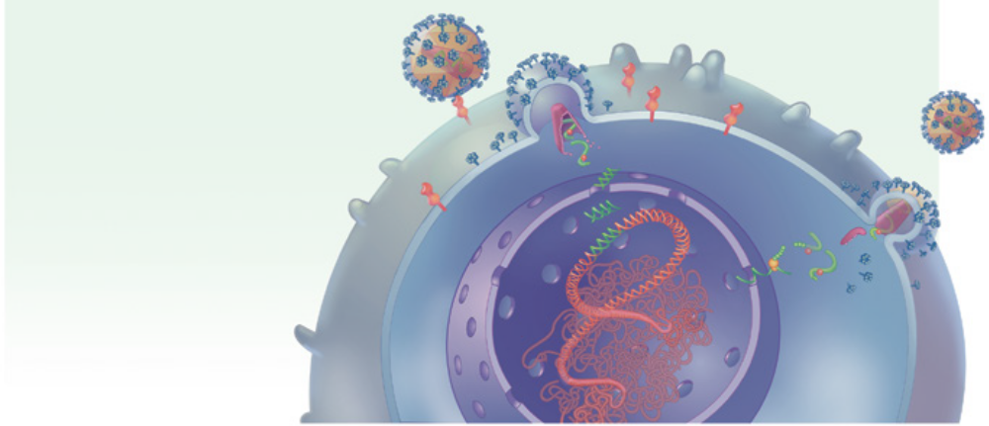
HIV/AIDS
How HIV Affects the Immune System
How HIV Attacks Cells
HIV attaches to cell surface.
Virus core enters cell and goes to nucleus.
Virus makes copy of its genetic material.
New virus assembles at cell surface.
New virus breaks away form host cell.
2
5
1
4
3
Glencoe Health Sexually Transmitted Diseases and HIV/AIDS

Slide 13
HIV/AIDS
How HIV Affects the Immune System
HIV infection moves through identifiable stages before progressing to AIDS:
Acute Infection Stage: Begins within two to four weeks
of infection. A person may become sick with a severe flu-like illness. Virus is reproducing rapidly in the body.
Clinical Latency Stage: The HIV virus continues to reproduce in the body. This stage is sometimes referred to as the asymptomatic stage because the person may not feel ill.
AIDS: When the helper T-cells drop to less than 200, or one of several AIDS-opportunistic infections are present.
Glencoe Health Sexually Transmitted Diseases and HIV/AIDS

Slide 14
Review HIV/AIDS
After You Read
Reviewing Facts and Vocabulary
How does HIV affect the human immune system??
When HIV enters the body, it finds and destroys the white blood cells that fight disease. In the final stages of an HIV infection, the immune system is destroyed, and AIDS develops.
Glencoe Health Sexually Transmitted Diseases and HIV/AIDS

Slide 15
Review HIV/AIDS
After You Read
Reviewing Facts and Vocabulary
What are two ways that you can protect yourself from contracting HIV/AIDS?
Abstinence and by not sharing needles.
Glencoe Health Sexually Transmitted Diseases and HIV/AIDS

Slide 16
Review HIV/AIDS
After You Read
Reviewing Facts and Vocabulary
Why do the body’s antibodies fail to protect people from HIV?
Once HIV is confined within a cell, it is safe from attack by antibodies. The virus reproduces itself inside the T cells and eventually destroys them.
Glencoe Health Sexually Transmitted Diseases and HIV/AIDS

Slide 17
Glencoe Health
End of
Sexually Transmitted Diseases and HIV/AIDS
HIV/AIDS

