Slide 1


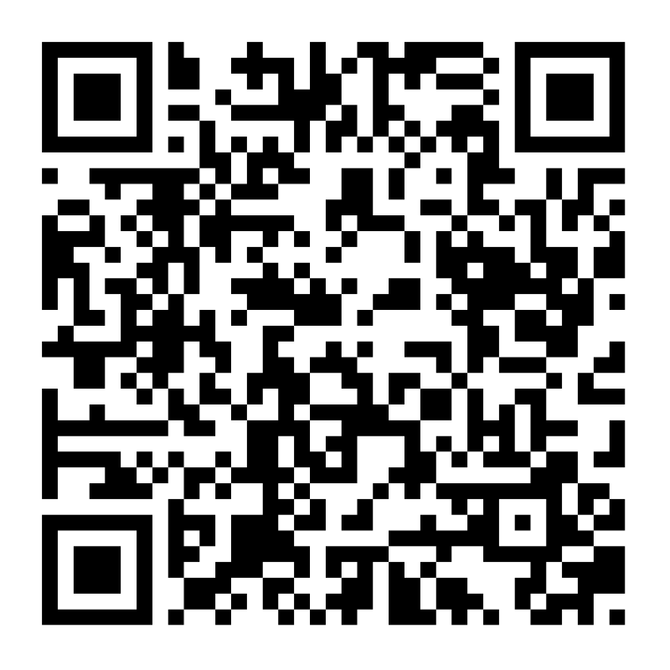

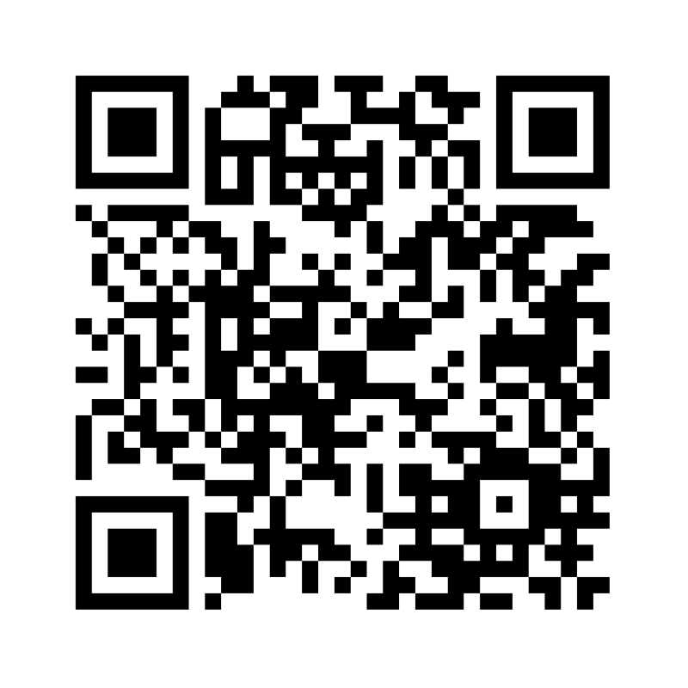
Want to be involved in where fundraising dollars go when it comes to your child’s educational experience?
Interested in making a connection with school leadership?
Love being a part of the school community?
Follow us on
Facebook
Visit our website
& sign up for newsletter
Download our
Mobile App
What does the PTO support?
During the 2024/2025 school year, the PTO spent over $35,000 on extra curriculars, equipment, and school updates including:
Field trip transportation
In-school assemblies
Teacher appreciation
Grade-level movie nights
Afterschool programs
Ipads
Furniture
Classroom rugs
(Proposed) track

Slide 2
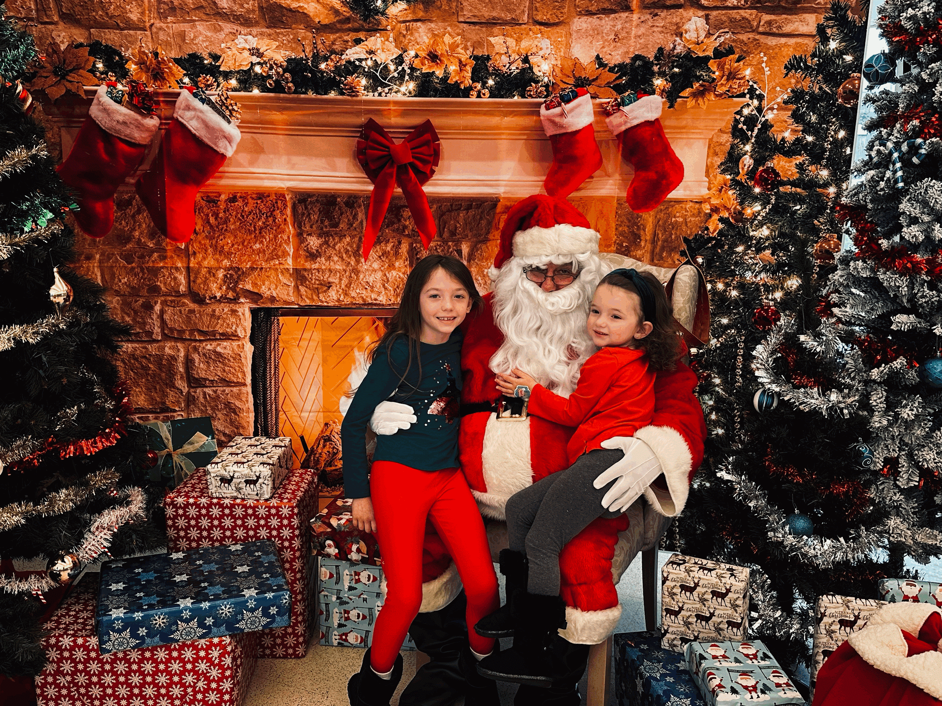
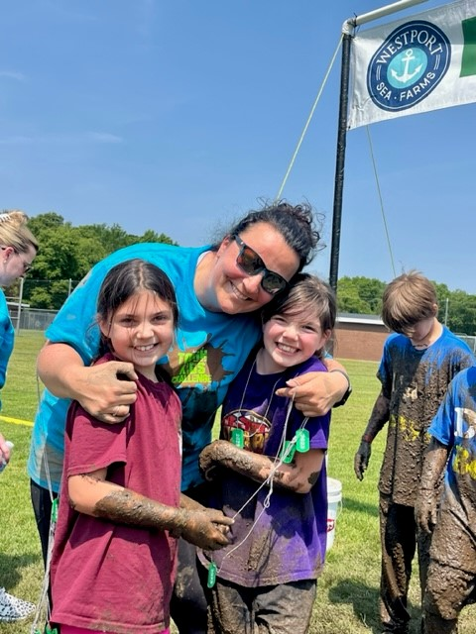
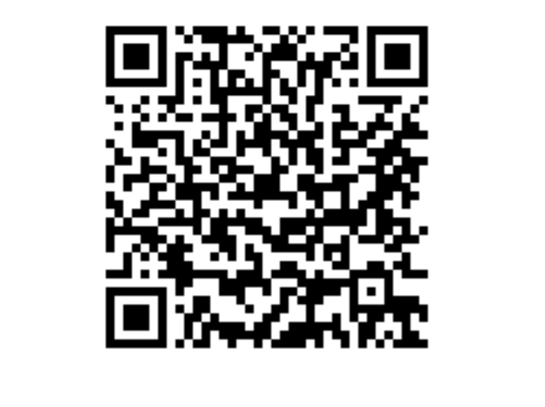
2025-2026 Calendar of Events
OCT 18: Fall Festival Yard Sale & Fair
DEC 6: Holiday Fair
We are looking at a whole new lineup
of events this year, so stay tuned!
Ways You Can Help:
Volunteer at Events
Attend Meetings
Collect Sponsorships
Collect raffle items
Donate talent
Follow the Facebook or PTO webpage for updates
Let us know area business that may be able to help
Without you, the PTO can’t sustain our level of fundraising!
SIGN UP FOR OUR NEWSLETTER
2025/2026
MEETING SCHEDULE:
SEP 16 (6:00-7:30 only this week)
OCT 15 , NOV 18,
JAN 13,
FEB 4, MAR 3,
APR 15, MAY 12
6:30 pm at WES
ONE AND DONE?
Interested in making a one-time
donation to the WES-MAC PTO?
SCAN THE QR CODE HERE
“Many hands make light work”

