Slide 1
Paying for College:
A Financial Aid Workshop
Fall 2025

Slide 2
Who is South Carolina Student Loan?
Created in 1973, the South Carolina Student Loan Corporation was created to provide programs of financial assistance to South Carolina students and their families.
We are a private, nonprofit 501(c)3 Corporation located in Columbia, SC.
Power:ED is our philanthropy that awards grants to nonprofits and state-based programs that help remove educational barriers for students. To date, Power:Ed has awarded 103 grants totaling over $5.1M and has impacted an estimated 147,000+ South Carolinians through its grantmaking.
Fall 2025

Slide 3
Four Ways to Pay for College
Grants – Money that is given to you
Scholarships – Money that is given to you because of academic achievement, talent, skill, or financial need
Work – Money you earn from a job on or off campus
Loans – Money you borrow and must repay
FALL 2025

Slide 4
HELPFUL WEBSITES

Slide 5
South Carolina
CHE.SC.GOV/SCCANGO
Students
  Guidance by grade level
Parents
  Planning/Paying for college
Events
  College Application Month
  College Goal SC
  College Decision Day
FALL 2025

Slide 6
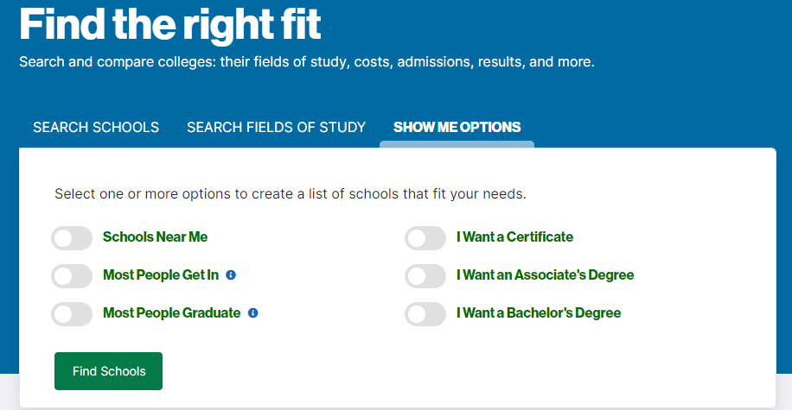
Federal Student Aid
www.studentaid.gov
Create a studentaid.gov account also known as FSA ID (both student and at least one parent)
Must be created at least 3 to 5 days before completing the FAFSA
Complete the FAFSA
www.collegescorecard.ed.gov
Search and compare colleges (major, costs, admissions, results, etc.)
Search fields of study
Create a school list to meet your needs
FALL 2025

Slide 7
Cost of Attendance (COA)
COA represents the total estimated expenses necessary to attend an educational institution for a specific academic year.
Tuition and Fees
Living Expenses (Varies based on living on-campus, off-campus or commuting from home)
Meal Plans
Books and Supplies
Transportation
Miscellaneous Expenses
Loan fees
FALL 2025

Slide 8
FAFSA

Slide 9
Completing the FAFSA
What is the FAFSA?
  An application that allows you to apply for federal student aid, which is the largest source of financial aid to help pay for college.
Who should apply?
  Everyone, regardless of income
When should you apply?
  Every year you will attend college
  Release date October 1st, 2025
  FAFSA Deadline June 30th , 2026
  Any corrections or updates must be submitted by September 12, 2026.
Where to apply?
  www.studentaid.gov and click on ‘Create Account’
  Be sure to apply for the next academic school year: 2026 - 2027
FALL 2025

Slide 10
Federal Student Aid ID
FSA ID replace the PIN and allows you to manage all documents related to Federal Student Aid (FAFSA, Master Promissory Note, applying for repayment plans, completing loan counseling and more).
Who needs to apply for an FSA ID:
  Student
  Parent
You* will need:
  SSN
  Cell phone or
  Email address
  *Only one SSN can be connected to a cell phone or email address.
FALL 2025

Slide 11
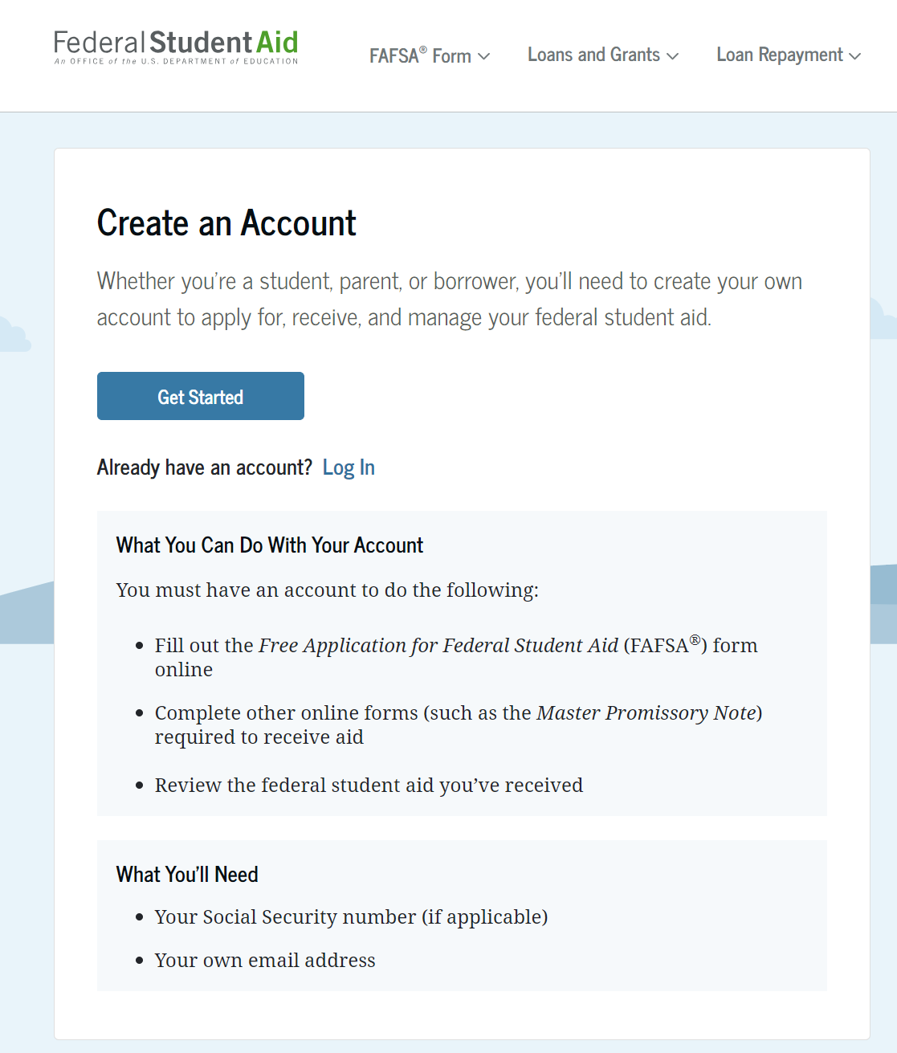
Create FSA ID
Enter your Personal Information.
Create Account Information
Contact Information
Communication Preferences
Challenge Questions
Confirm & Verify
Enable Two-Step Verification
FALL 2025

Slide 12
How does the FAFSA work?
A form of need analysis
Determines the Student Aid Index (SAI)
Use ALL 2024 income (taxed and untaxed)
Student and parent(s) income
Total assets are considered in calculation
Send to 20 colleges/universities
FREE!!
FALL 2025

Slide 13
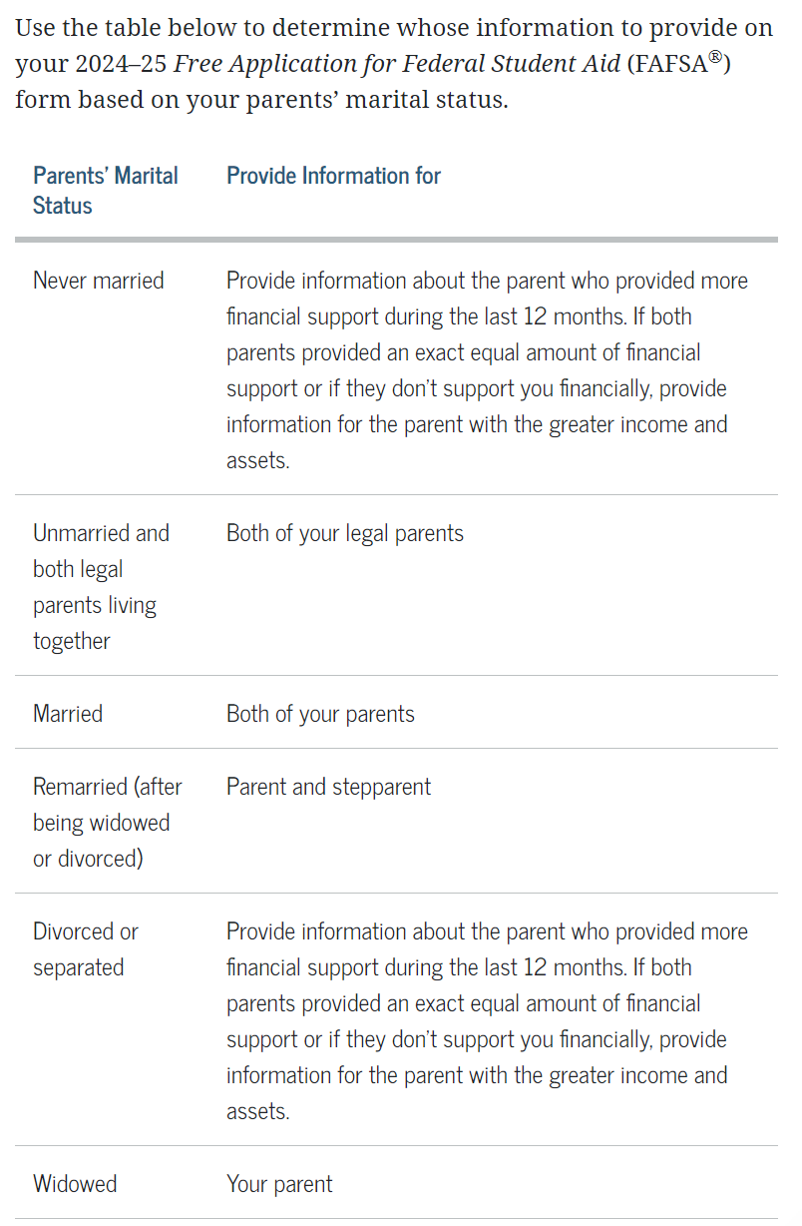
Income on the FAFSA?
Student and Parent income and asset information
Dependency questions
Who is considered a parent?
  A legal parent includes a biological parent, an adoptive parent, or a person that the state has determined to be your parent (for example, when a state allows another person’s name to be listed as a parent on a birth certificate). Grandparents, foster parents, legal guardians, older brothers or sisters, widowed stepparents, and aunts and uncles aren’t considered parents unless they’ve legally adopted you.
Divorced/separated parents?
  If parent has remarried, step-parent information must be reported
Parent Wizard: studentaid.gov/fafsa-apply/parents
FALL 2025

Slide 14
FAFSA Results
FAFSA Submission Summary
  It summarizes the information you provided on your FAFSA form.
  Review all information to ensure everything is complete and accurate
  Make correction as soon as possible
FAFSA is sent to the colleges listed
  Typically, once you've been accepted a financial aid award letter is created for you
  Financial Aid Award Letters will list all aid available to cover the cost of attendance for that specific institution and may include federal direct loans.
  You can approve or decline any portion of your aid.
FALL 2025

Slide 15
Things Change
FAFSA for the 2026 – 2027 school year uses the 2024 income.
Employment terminated
Furloughed
Hours cut back.
Income may have been reduced
Change in parent’s marital status
A parent becomes sick or disabled
Death of a parent
FALL 2025

Slide 16
Summary: What Should You Do?
Prepare to complete the FAFSA.
  Create an FSA ID via studentaid.gov (Student AND Parent)
  Collect documents
    Start term Fall 2026 will use 2024 federal tax returns
  Wait till you receive your Student Aid Report (SAR) – 3 to 5 days after filing – and then;
  Contact your school’s financial aid office and explain that your family has experienced a decrease in income. They will explain their process and what documentation needed to consider your situation.
FALL 2025

Slide 17
Federal
Programs

Slide 18
Federal Programs
Pell Grant
Supplemental Educational Opportunity Grant (SEOG)
Iraq and Afghanistan Service Grant
TEACH Grant
Federal Work Study
Direct Loan
FALL 2025

Slide 19
Federal PELL Grant
Must file FAFSA
Based on Need
Award based on enrollment status, FT, PT or Less than half-time
Undergraduate study only
Maximum of 12 semesters
Maximum award - $7,395
FALL 2025

Slide 20
Federal Supplemental Education Opportunity Grant (FSEOG)
Must file FAFSA and receive Pell Grant
Must have exceptional financial need
Limited funds – not at available at all schools
Maximum award - $4,000 a year (Depending on school)
FALL 2025

Slide 21
Iraq and Afghanistan Service Grant
Eligibility:
  The child of a parent or guardian who died in the line of duty while either (a) serving on active duty as a member of the U.S. Armed Forces on or after September 11, 2001; or (b) actively serving as and performing the duties of a public safety officer AND
  Less than 33 years old as of the January 1 prior to the award year for which the applicant is applying
Must complete the FAFSA and not be eligible for the PELL Grant
Maximum award - $7,395
FALL 2025

Slide 22
Teacher Education Assistance for College and Higher Education (TEACH Grant)
Eligibility
  Enrolled at a school that participates in the TEACH Grant Program
  Enrolled in a TEACH-Grant-eligible program
  meet certain academic achievement requirements (generally, scoring above the 75th percentile on one or more portions of a college admissions test or maintaining a cumulative GPA of at least 3.25).
  Agree to teach in a critical subject or in a critical geographical area
  For at least four years within eight years of completing the program for which the TEACH Grant was awarded.
Maximum award - up to $4,000 per year
How to apply:
  Check with the financial aid office at your institution for availability and application procedures.
  May not show on award letter unless you ask
*Failure to teach requires repayment under terms of an Unsubsidized Direct Loan.
FALL 2025

Slide 23
Federal College Work-Study
Must file FAFSA
Based on need
Limited funds
Students work up to 20 hours/week - earn a paycheck
Usually on campus
FALL 2025
Notes:
Studies show students who participate in work study opportunities have better grades
Lauch pad to career opportunities (higher education, or career interest)

Slide 24
Other Employment
Institutional Employment
  Does not require FAFSA
  Depends on the workforce needs of the school
Cooperative Education
  Student alternates semesters of coursework with semesters of full-time employment in a field related to major
FALL 2025

Slide 25
State Programs

Slide 26
State Programs
SC Commission on Higher Education
Palmetto Fellows Scholarship
LIFE Scholarship
Hope Scholarship
SC Lottery Tuition Assistance
SC Need-Based Grant
SC Technical College System
SC WINS
SC Tuition Grant
FALL 2025

Slide 27
General Eligibility for State Programs
  Be a South Carolina resident at time of high school graduation and college enrollment;
  Be a U.S. citizen or a permanent resident (green card);
  Be enrolled as a degree-seeking student at an eligible South Carolina public or private institution;
  Certify that he/she has never been convicted of any felonies and has not been convicted of any alcohol or other drug-related misdemeanor convictions within the past academic year (excluding Lottery Tuition Assistance Program)
  Verify that he/she does not owe a refund or repayment on any Federal or State financial aid and not be in default on any Federal loans
FALL 2025

Slide 28
General Eligibility - Continued
Award Amounts:
  Cannot exceed the cost-of-attendance; excluding Lottery Tuition Assistance (LTAP), which can only be used toward the cost-of-tuition
  Half awarded during the fall and half during the spring (LTAP may be awarded during the summer).
  Generally, can receive funds from only one program during an academic year
FALL 2025

Slide 29




Available for attendance at two & four-year institutions in South Carolina
Palmetto Fellows Scholarship
Maximum Award
$6,700 during Freshman Year
$7,500 per year Sophomore through Senior Year
Must apply during Senior year of high school
Deadline for early applications is April 15th
Deadline for final applications is June 30th
Guidance Counselors will help with the application process

Slide 30
Palmetto Fellows Scholarship*
Initial Eligibility
Top 6% rank in either 10, 11, or 12 grade
1200 or higher SAT (math and critical reading), 25 or higher ACT, and
3.50 cumulative GPA on Uniform Grading Scale
OR
1400 or higher SAT (math and critical reading), 31 or higher ACT, and
4.00 cumulative GPA on Uniform Grading Scale
*Continued Eligibility: 3.0 GPA or greater and at least an average of 30 credit hours per academic year at your home institution.
*Cannot use AP, IB, Dual Enrollment, or CLEP hours towards credit hour requirement.
FALL 2025

Slide 31
LIFE Scholarship
Initial requirements at a 4-year school:
Any two of these three:
            3.0 or higher cumulative GPA
Top 30% of high school class
1100+ SAT (math and critical reading) or 22+ ACT
Initial requirements at a 2-year school:
  3.0 or higher cumulative GPA
  Maximum award - up to $5,000 towards the cost of attendance
*Continued Eligibility Requirements:
  3.0 GPA or greater and at least an average of 30 credit hours per academic year.
  Can use AP, IB, Dual Enrollment, or CLEP hours towards credit hour requirement.
*Earn LIFE Scholarship while in college
  3.0 GPA or greater and at least an average of 30 credit hours per academic year.
FALL 2025

Slide 32
Enhanced Awards for
Palmetto Fellows & LIFE Recipients
Maximum Award:
  $2,500 per year beginning in the Sophomore year
Eligibility Criteria:
    Declare a major in Mathematics, Science or Health related fields *
  Have earned at least 14 credit hours of math or science courses during the Freshman year (including AP courses taken during High School).
  New Academic Areas:
  Accounting: current sophomores, juniors, and seniors need to have earned 14-credit hours in math/science during their first academic year to receive the enhancement.
  Education: must be considered an education major and sign a contractual agreement to work one year in a South Carolina public school for each year they receive the enhancement. If a student accepts an education enhancement, they must repay the funds either with their time (service agreement) or money (enhancement funding becomes a loan).
  *A complete list of eligible majors and courses can be found on the SC Commission on Higher Education’s website, www.che.sc.gov
FALL 2025

Slide 33
SC Hope Scholarship
Freshman year only (2 consecutive terms)
Only at Four-year institutions in South Carolina
Maximum award - up to $2,800 towards the cost of attendance.
This includes $2,500 towards tuition and an additional $300 for textbooks.
Eligibility Requirements:
    3.0 GPA at time of high school graduation
    Must not be a recipient of a LIFE Scholarship, Palmetto Fellows Scholarship, or Lottery Tuition Assistance.
FALL 2025

Slide 34
Lottery Tuition Assistance (LTAP)
Available for students attending SC Technical Colleges, USC Regional Campuses and Spartanburg Methodist College
Maximum award - $95 per credit hour, up to $1,140 per semester for full-time attendance (This amount changes slightly each semester)
Tuition only
Eligibility Criteria:
  Must file the FAFSA
  U.S. Citizen or permanent resident
  Legal resident of SC
  Must be degree seeking and enrolled in a minimum of 6 credits
FALL 2025

Slide 35
SC Need-Based Grant
Maximum Award:
  Up to $3,500 annually if enrolled full-time and up to $1,750 annually if enrolled part-time for a maximum of eight full-time equivalent terms.
  College determines the exact award amount
Eligibility Criteria:
  Must file the FAFSA form
  U.S. Citizen or permanent resident
  Legal resident of SC
  Must be needs based on the results of the FAFSA (consistent with Pell Grant eligibility)
FALL 2025

Slide 36
SC Workforce for Industry Needs Scholarship (SC WINS)
Eligibility Requirements: (Any of 16 SC Technical Colleges)
  Be a South Carolina resident
  Be enrolled in an eligible program
  Meet one of the following criteria:
    Be employed,
    Take a financial literacy course offered at the technical college, or
    Complete 100 hours of voluntary time contributing to a nonprofit or public service organization
What’s covered:
  Remaining tuition, fees, and course-related expenses after other scholarships or grants have been applied (up to $5,000 per academic year)
Student responsibility:
  Maintain a 2.0 GPA each academic year
FALL 2025

Slide 37
SC Tuition Grants
Eligibility Criteria:
SC Residents
Attending a SC Independent (private) college or university
Enrolled in at least 12 credit hours each semester.
First time Freshman Academic Eligibility Criteria
  Must have a high school diploma or its equivalent (GED or Adult Education Diploma) and be fully admitted as a degree-seeking student based on the college’s academic requirements for admission
Returning students Academic Eligibility Criteria
  Must continue to meet Satisfactory Academic Progress at the college
Students must file FAFSA annually and include a SC Private College
Annual Application Deadline – August 1
Maximum award - $5,000
FALL 2025

Slide 38
SC Independent (Private) Colleges & Universities
Erskine College - Due West
Furman University - Greenville
Morris College - Sumter
Newberry College - Newberry
North Greenville University - Tigerville
Presbyterian College - Clinton
Southern Wesleyan University - Central
Spartanburg Methodist College - Spartanburg
Voorhees College - Denmark
Wofford College – Spartanburg
Allen University – Columbia
Anderson University – Anderson
Benedict College - Columbia
Bob Jones University - Greenville
Charleston Southern University - Charleston
Claflin University – Orangeburg
Clinton College – Rock Hill
Coker College - Hartsville
Columbia College - Columbia
Columbia International University -Columbia
Converse University - Spartanburg
www.scicu.org
FALL 2025

Slide 39
SC Teaching Fellows Program
To recruit talented high school seniors into the teaching profession and help them develop leadership qualities.
Apply online at: www.cerra.org opens Oct 1.
Up to $6,000 per year of a maximum of four years.
The Teaching Fellows Program is available at:
    Anderson University
    Charleston Southern University
    Clemson University
    Coastal Carolina University
    College of Charleston
    Columbia College
    Francis Marion University
    Lander University
    Newberry College
    North Greenville University
    USC Aiken
    USC Columbia
    USC Upstate
    Winthrop University
FALL 2025

Slide 40
Scholarships

Slide 41

Scholarships
Don’t give out your social security number, bank or credit card information.
Don’t spend money to make money.
Never believe the scholarship offers a "guaranteed“ award.
FALL 2025

Slide 42
Scholarships Tips
& Considerations
Civic and Community Organizations
Parent’s Employer
Lemons into Lemonade
Institutional Scholarships
Continue to search and research while you are in college
Small $$$ adds up
FALL 2025

Slide 43
Scholarship Search Engines
SC Student Loan College Planning Center: southcarolina.inviteeducation.com
CCCF: https://www.yourfoundation.org/grants-scholarships/scholarships/
Going Merry: www.goingmerry.com
Scholarships.com: www.scholarships.com
Fast Web: https://www.fastweb.com/
FALL 2025

Slide 44

$5K College Giveaway
A random drawing:
  $5,000 – Quarterly Drawing
  Months Drawn:
      September, December, March, and June
Go to: scstudentloan.org/noeffort
College students, High School Juniors and Seniors, and their Parents are eligible to enter
One entry per person every month.
FALL 2025

Slide 45
Loans

Slide 46
Federal Direct Loans
Made in the student's name
Subsidized Loan
Must file FAFSA
Need-Based Loan
Interest paid by government while in school and grace period
6-month grace period prior to repayment
Interest rate: Fixed 6.39%
Loan fee: 1.057%
Unsubsidized Loan
Must file FAFSA
Not need-based
Interest NOT paid
6-month grace period prior to repayment
Interest rate: Fixed 6.39%
Loan fee: 1.057%
Annual Loan Limits (Combination of Subsidized and Unsubsidized):
First Year $5500
Second Year $6500
Third Year and up $7500
FALL 2025

Slide 47
Federal Direct Loan Program
Forgiveness for Teachers
  Five years of teaching service at a low-income school anywhere in US
    $5,000 in forgiveness
    Math, Science and Special Education teachers - $17,500 in forgiveness
Public Service Loan Forgiveness (PSLF)
    Income driven repayment payment
  120 on time payments, remaining balance is forgiven
To Apply
  Contact your loan servicer – details at www.studentaid.gov
FALL 2025

Slide 48
SC Teachers Loan Program
SC Residents Only
Education Majors
FAFSA not required
Graduate in the top 40% of high school class
2025-2026: SAT score of 1008 (ERW and Math) or ACT score of 18
8
Loan forgiveness for teaching in a critical geographic and/or subject area in South Carolina
Annual Loan Limits are based on grade level:
Freshman and Sophomores $2,500 – Juniors and up $7,500
Cumulative limit $27,500
FALL 2025

Slide 49
Federal Direct PLUS Loan
Loan Made to the Parent of an Undergraduate Student
Approval based on creditworthiness (standards relaxed)
FAFSA normally not required (some schools may require)
Loan limits cannot exceed ‘cost of attendance’
Payments begin 60 days after final disbursement of the loan or 6 months after the student exits school
Interest rate: 8.94%* fixed, unsubsidized
Fees: 4.228%**
Your school may provide instructions on how to apply in the award letter
Starting July 1, 2026, Federal PLUS loan borrowing limits will be significantly capped: Parent PLUS loans will be capped at $20,000 per year and $65,000 total per student.
* Federal Direct PLUS loan interest rate is effective for new loans made on or after 7/1/2025.
** Federal Direct PLUS loan origination fees are effective on all Direct PLUS loans first disbursed on or after 10/1/2020.
FALL 2025

Slide 50
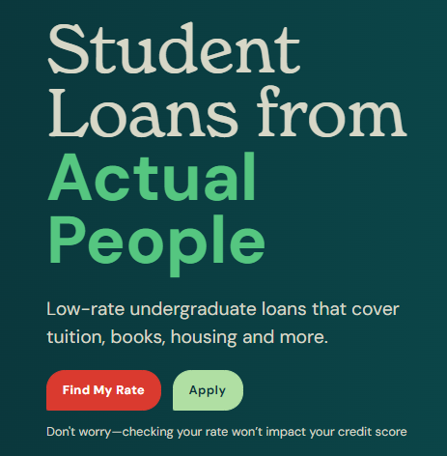
In-School Loan
SC Student Loan’s Private Loan
A better alternative to Federal Direct PLUS Loans
Students and/or Parents can borrow
Offers:
  Find My Rate: https://www.scstudentloan.org/undergraduate-loans
  On-line application with instant decision
  Fixed and variable rates available
  Student rates as low as 6.750%*, Parent rates as low as 5.250%*
  No Application or Origination Fees
Parent Loan: APR rates from 5.253% - 10.079%. Low rate shown includes a .25% reduction for bank draft. Rates based on credit and terms.
Undergraduate Loan: APR rates from 6.886% - 12.481%. The APR varies with interest rate, loan amount, and repayment term approved. Low rate shown includes a .25% reduction for bank draft. Rates based on credit and terms.
FALL 2025

Slide 51
In-School Loan: CTP
SC Comprehensive Transition Programs (CarolinaLIFE, ClemsonLIFE, REACH Program, LIFE Program, Winthrop Think College Program, & Pacer LIFE)
Benefits:
  Find My Rate before you apply
  On-line application with instant decision
  Fixed and variable rates available
  Parent rates as low as 5.250%*
  No Application or Origination Fees
Families should
Complete the FAFSA (PELL, FSEO, and Work-Study)
Check colleges website for institutional scholarships
Visit thinkcollege.net for scholarships
* APR rates from 5.253% - 10.079. Low rate shown includes a .25% reduction for bank draft. Rates based on credit and terms.
FALL 2025

Slide 52
BOLDTM Career Pathway Loan
BOLD™ is different…
Counseling provided prior to borrowing followed by mentorship
Non-credit based
Fixed rate is based on level of education and employer’s needs
Outcome-driven
Shared repayment with employers gaining work needs
The Process is Simple (we will guide you through it):
Contact us for eligibility information
Sign an agreement with your chosen employer
Complete the loan application
Receive your certificate or degree
Begin work and have your loan forgiven by employer payments!
FALL 2025

Slide 53
BOLDTM Career Pathways
Employers:
  AnMed
  Carolina Pines Regional Medical Center
  Commission on Higher Ed (CHE)
  Conway Medical Center
  First Priority EMS
  McLeod Health
  Reidville Fire Department
  Tidelands Health
FALL 2025

Slide 54
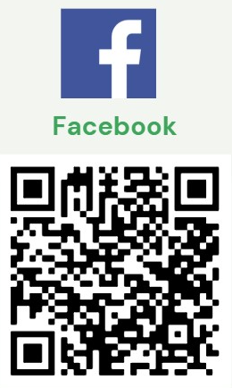
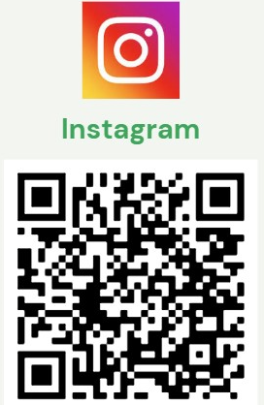
Follow us on Social Media!!

Slide 55
Thank you!
Jonathan Rhodes
Outreach Manager
Upstate Region
O: 803-673-3387
jrhodes@scstudentloan.org
ShaQuana Bracey
Outreach Manager
Pee Dee & Midlands Regions
O: 839-849-4946
sbracey@scstudentloan.org
Jennifer Van Cleave
Outreach Manager
Lowcountry & West Midlands Regions
C: 803-807-0445
jvancleave@scstudentloan.org
Destra Capers
Director of Marketing & Outreach
Virtual Schools
O: 803-612-5070
dcapers@scstudentloan.org
FalL 2025

