Slide 1
Red Bank Catholic High School
Freshman
Parent Presentation
2025/2026

Slide 2
GUIDANCE DEPARTMENT
Catherine Scaramuzzino-Director of Guidance
Emma Stark-Counselor
Ted Jarmusz-Counselor
Katherine Buckman-Counselor
Nicole WALL-SAC/ Senior Counselor
Sister Regina Callahan-Freshman Advisor
Jeanne Toomey- Freshman Advisor
Leslie Galvin - Freshman Advisor
Kristie Bergin-Social Worker
Tina Brendel- Registrar
Danielle Cioffi- Guidance Secretary

Slide 3

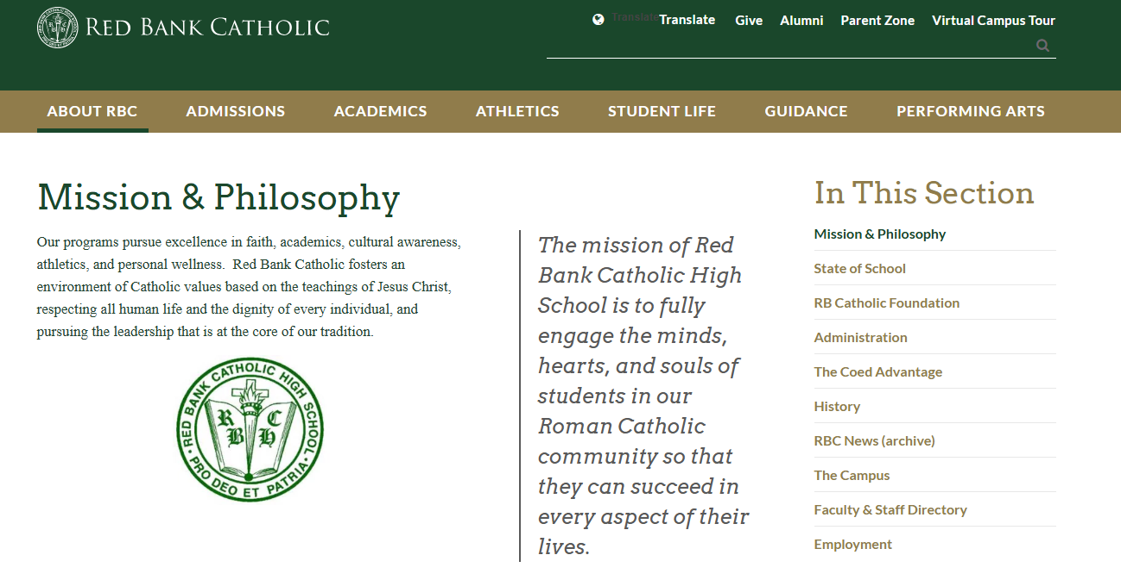

Slide 4
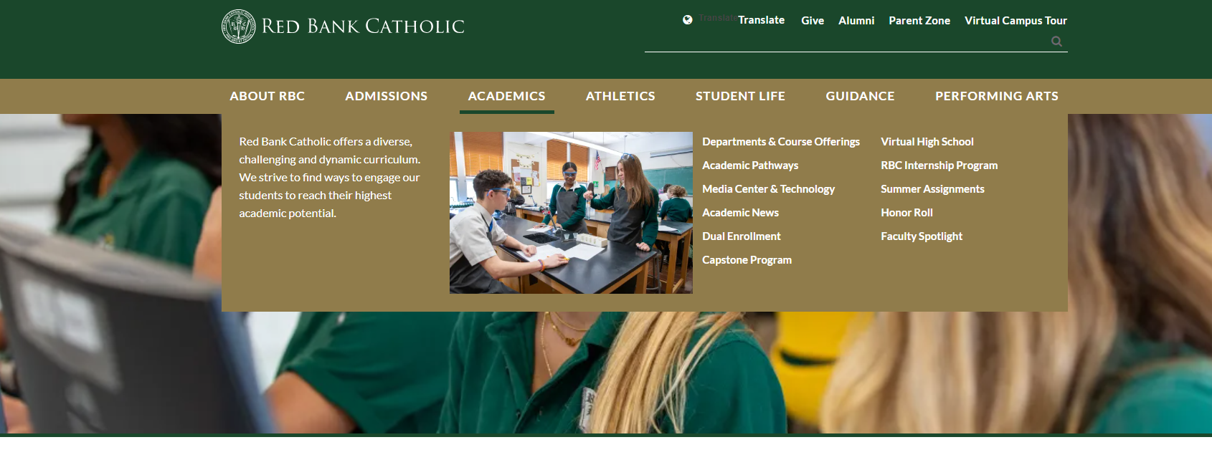
Academics Tab on Website

Slide 5
Agenda
Freshman Transition
Grades/GPA/Transcript
Honor Roll Requirements
Establish Relationship with Teachers
Extra Help Available- 0/9 Periods
Standardized Testing
Athletics/NCAA/Scholar Athletes
Extracurricular Activities/Community
National Honor Society
Pathways and Concentrations
Academic Opportunities

Slide 6
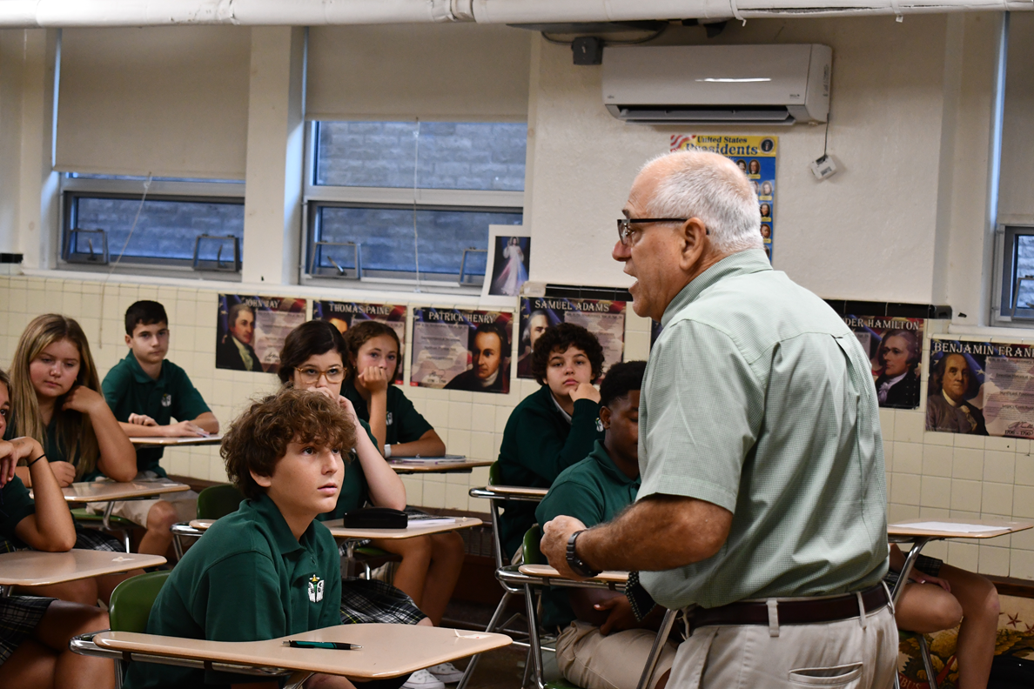
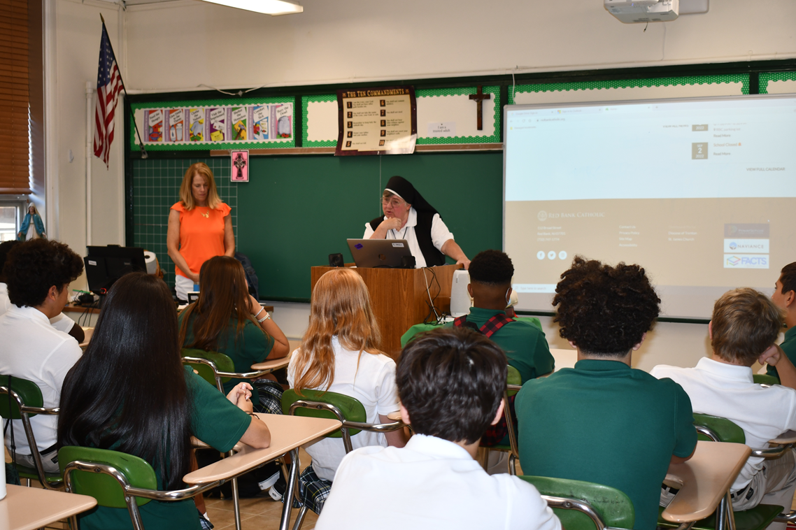
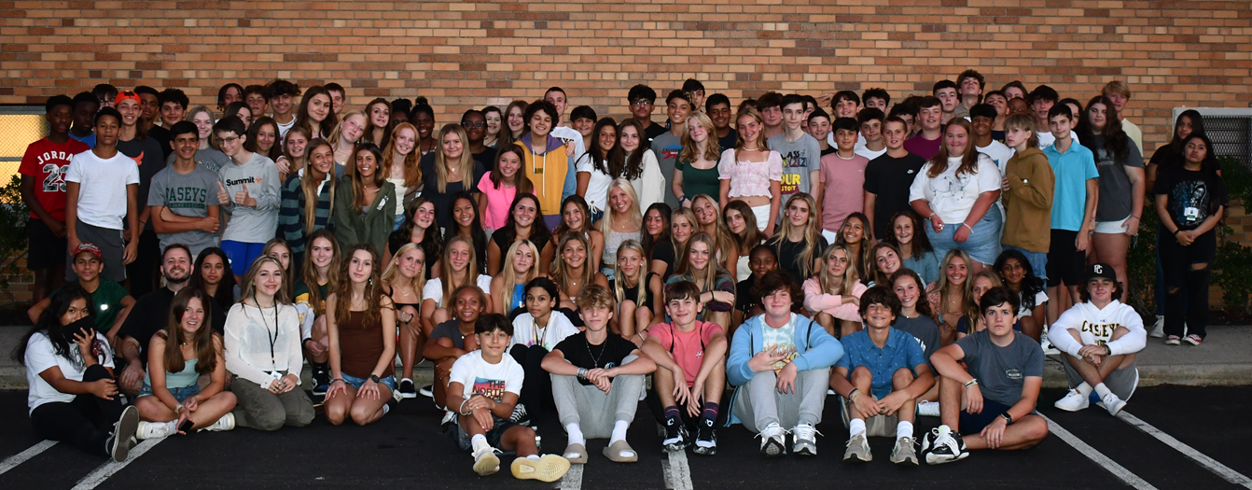
A Day in the life of a Freshman

Slide 7
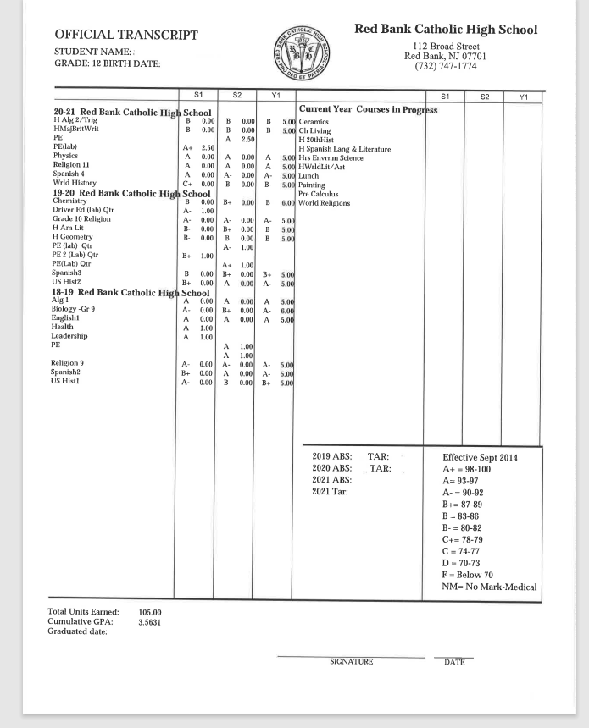
Example RBC Transcript

Slide 8
College Process
Freshmen Year
  Freshman Class Advisor meet with students every three weeks to follow-up on transition, joining clubs, grades, study habits, using planner, resume building, etc.
  Naviance- students take Learning Style Inventory which highlights their learning style, best study practices, etc. Review career possibilities
  The importance of grades, attendance, community service
  Encourage resume building

Slide 9
College Process
Sophomore Year
  Assigned a counselor (alphabetically by last name)
  Counselor meets sophomores first quarter and then throughout on need or follow-up basis
  There are ongoing conversations about course selections, rigor of schedule. Discuss student’s involvement with activities, NHS possibility, Community Service, etc.
  Sophomores take a Career Inventory- offer insight to the student’s results- pair their interests with future course selections
  Also offer a personality inventory which provides insight into the student’s personality and possible career choices and college planning
  Naviance- resume building, Career Interest Survey
  Sophomore Individual Parent/ Student meetings- March, April, and May- review schedules, career interest, activities, resume building, etc.

Slide 10
College Process
Juniors
  Junior Parent Meeting in December
  Junior Individual Parent/ Student meetings (45 minutes) in December, January and February- planning senior schedule, college counseling, standardized test schedule, future plans, etc.
  Step on the gas for college searches by size location, majors, etc.
  Naviance- college planning, scattergrams, colleges, Personality Inventory, stress resume building.
  We encourage college visits.

Slide 11
College Process
Seniors
  Senior Parent Meeting in September
  Senior Individual Parent/ Student meetings (45 minutes) in September/ October- college application process
  Seniors live in guidance!
  Naviance- Use scattergrams to show Reach, Target and Safety schools, Red Bank Catholic acceptance history, relationships with certain colleges, etc.
  Meet with college admissions counselors- over 140 colleges visit Red Bank Catholic.

Slide 12
Course Selection
Refer to Curriculum Guide on RBC website.
Competitive colleges want competitive transcripts.
Colleges want to see a rigorous program and that you have challenged yourself, but they also want to see achievement.
Once you commit to challenging courses you should do everything possible to stay on that track.
Take challenging courses in subjects in which you feel confident...know your limits.
You can apply for Honors & AP classes during scheduling as long as you meet the pre-requisites for these classes. Refer to Curriculum Guide.

Slide 13
Extra Help!!
Room 315- Staffed with English and Math Teachers during Lunch.
Cafeteria Help in Morning.
National Honor Society Peer Tutoring
0/9 Period- students see their freshman advisor or counselor to sign up.
MOST IMPORTANT, GO TO YOUR TEACHER

Slide 14
HOW TO MAKE AN APPOINTMENT WITH YOUR FRESHMEN ADVISOR:
Log into your Schoology account
Click “Groups”
Select the “Grade 9/Guidance Group”
On the left side, click “Resources”
Open the “Guidance Links and Documents” folder
Click “Request an appointment with your guidance counselor”
Select your counselor from the list
Fill out the form
Check back in your emails for a reply from your counselor
USE THE EMAILED REPLY FROM YOUR COUNSELOR AS YOUR PASS TO LEAVE CLASS AND BE ADMITTED INTO THE GUIDANCE OFFICE!

Slide 15
GET INVOLVED
Extracurricular
Clubs
Outside Activities
Volunteer/Community Service

Slide 16
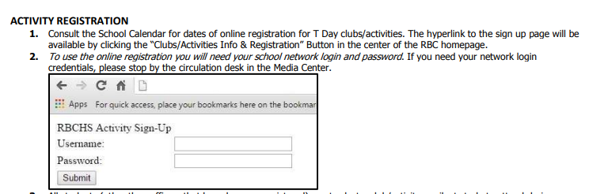
Programs, Clubs and Activities
16

Slide 17
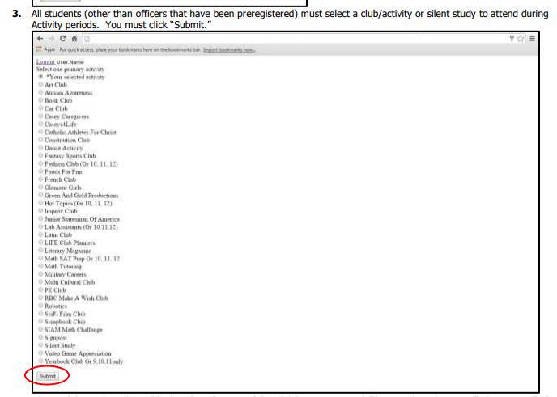
Programs, Clubs and Activities
17

Slide 18
Programs, Clubs & Activities
ART CLUB 11TH & 12TH ONLY) ACADEMIC TEAM
CASEY CAREGIVERS CAMPUS MINISTRY CLUB
CASEYS CREATING CHANGE CHICK-FIL-A LEADER ACADEMY
CASEYS FOR A CURE ENVIRONMENTAL CLUB
CASEYS4LIFE GLAMOUR GIRLS
CASEYS SPIRIT CLUB LITERARY MAGAZINE CLUB
CATHOLIC ATHLETES FOR CHRIST MOCK TRIAL
CHESS CLUB RIDGE ROAD RUN ALLIANCE
CONSTITUTION CLUB STUDENT COUNCIL
CROCHET FOR CHARITY FRENCH CLUB
DEBATE TEAM GARDEN CLUB
ENGINEERING CLUB
JUNIOR STATESMEN OF AMERICA
LAB ASSISTANTS (GR. 10,11,12)
LITERARY CLUB
MILITARY CAREERS
MISSIONS CLUB
PHYSICAL EDUCATION CLUB
SIGNPOST CLUB
STRETCHING, BREATHING, RELAXATION CLUB (GR 9, 10)
VIDEO GAME ENGINEERING (GR. 11 AND 12 ONLY)

Slide 19
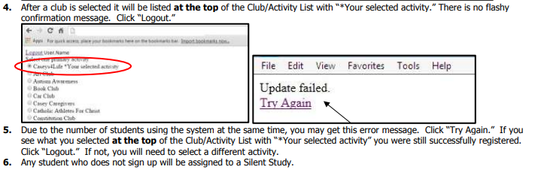
Programs, Clubs and Activities
19

Slide 20
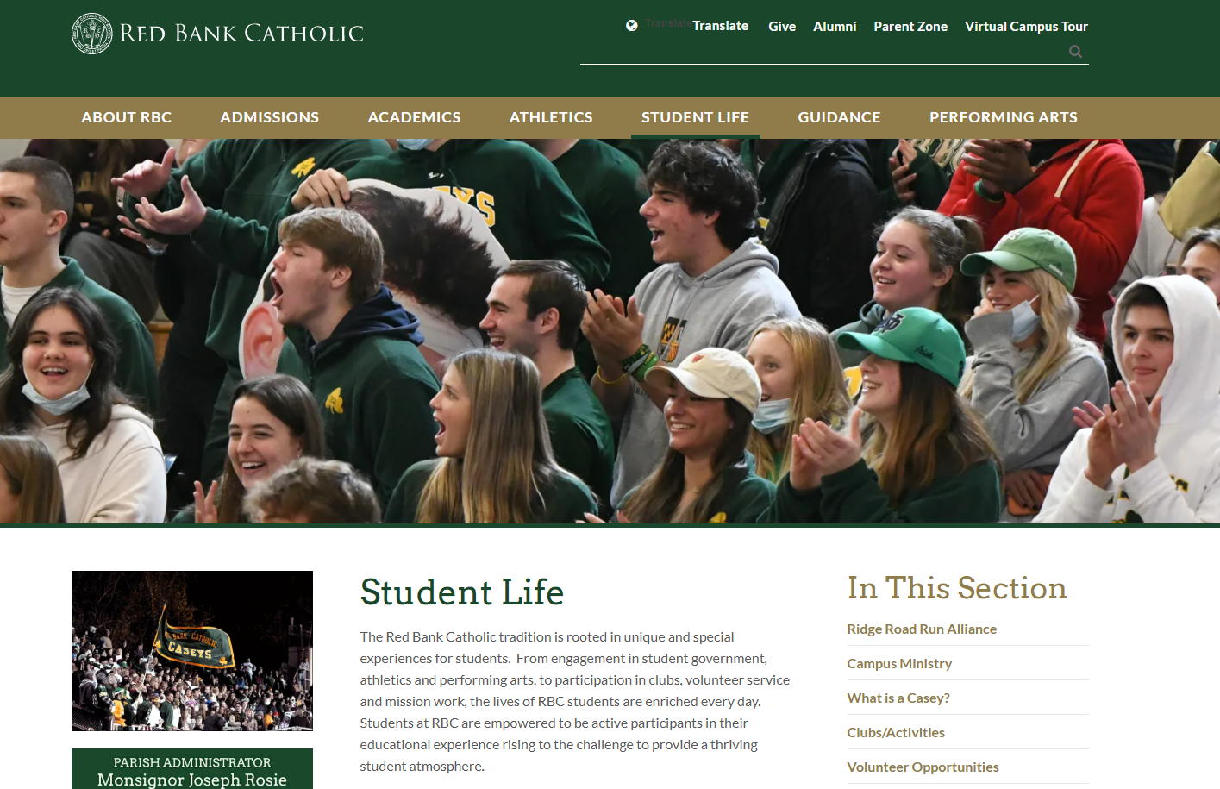

Slide 21
Volunteer Opportunities
Read*Write*Now
Navesink Elementary School/732-291-0289
Summer reading program for pre-k students
Lunch Break
Red Bank/732-747-8577
The Kitchen at St. Mark’s Food Pantry
Keansburg/732-495-5227/Nancy Mester or Doreen Minutella
Project Paul Food Pantry
Keansburg/732-787-4887
RALLYCAPSPORTS
Middletown area/732-391-2282
Rallycapsports.org
Monmouth Medical Center
Long Branch/732-923-6670
Monmouth County SCPA
Eatontown/732-542-0040
Associated Humane Society
Tinton Falls/732-922-0100
Monmouth Day Care Center
Red Bank/732-741-4313/Heidi Zaentz
Big Brothers, Big Sisters
Eatontown/732-54-2224/Debi Heptig
Habitat for Humanity
Long Branch/732-728-0441 (must be 16 years old)

Slide 22
Volunteer Opportunities
Brighton Gardens Assisted Living Facility
Middletown/732-275-0790/Pearl Kauffman
St. Anthony’s Church
English as a Second Language Program
Red Bank/732-747-0813
Middletown Public Library
Middletown/732-671-3700 x. 358
Monmouth County Library
Shrewsbury/732-842-5995
Riverview Medical Center
Red Bank/732-530-2253
Best Day Foundation
Various beaches this summer/beach activities for children with disabilities
Bestdayfoundation.org
Poricy Park
Middletown/732-842-5966/Carol Kealy
Holiday Express
Warehouse help needed throughout the year
Tinton Falls/732-544-8010
Aslan Youth Ministries
Tutoring-Summer Day Camps-Winter Ski Trips
Red Bank/Neptune/Long Branch
Aslanyouth.org (click on programs)

Slide 23
ATHLETICS
  Boys’ Sports Girls’ Sports
  Football Cheerleading
  Cross Country Cross Country
  Soccer Tennis
  Baseball Gymnastics
  Wrestling Field Hockey
  Track Soccer
  Ice Hockey Volleyball
  Swimming Basketball
  Baseball Indoor Track
  Tennis Swimming
  Golf Softball
  Lacrosse Lacrosse
  Volleyball Golf
  Dance Team

Slide 24
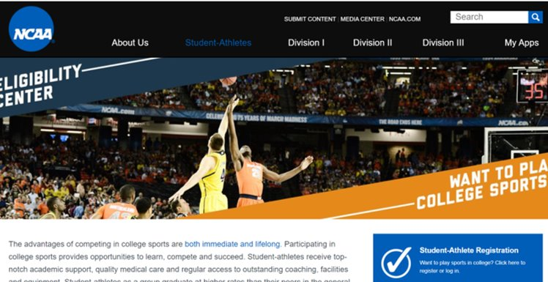
NCAA
GPA and Grades are important
NO Standardized testing
NO Sliding scale for 25-26

Slide 25
What can you do on Naviance
Learning Style Inventory
Resume
Career Interest Profile
Career Searches
Personality Inventory
E-mail
Compare colleges
Links to selected third-party resources
View scatter-grams specific to RED BANK CATHOLIC students

Slide 26
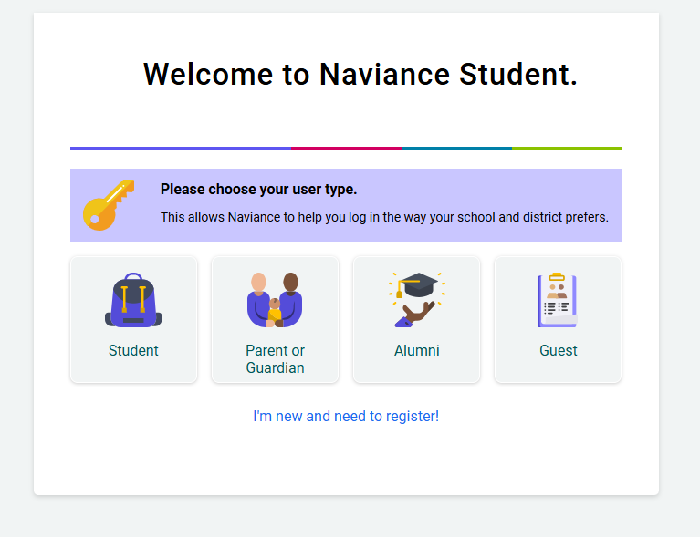

Slide 27
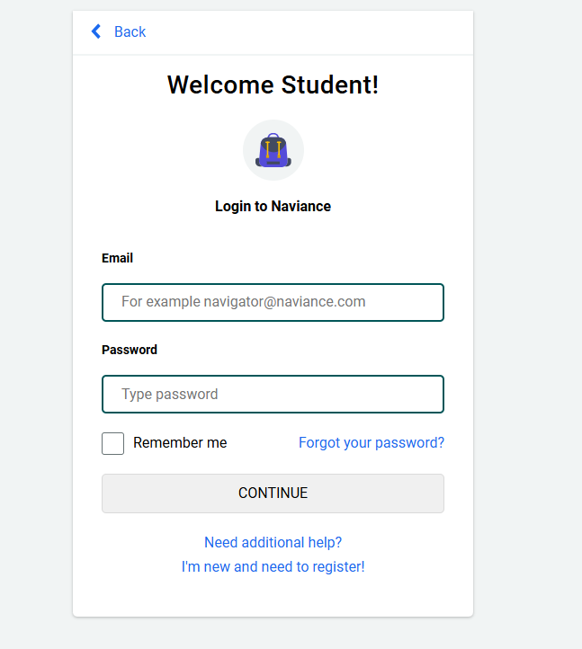
Naviance Login

Slide 28
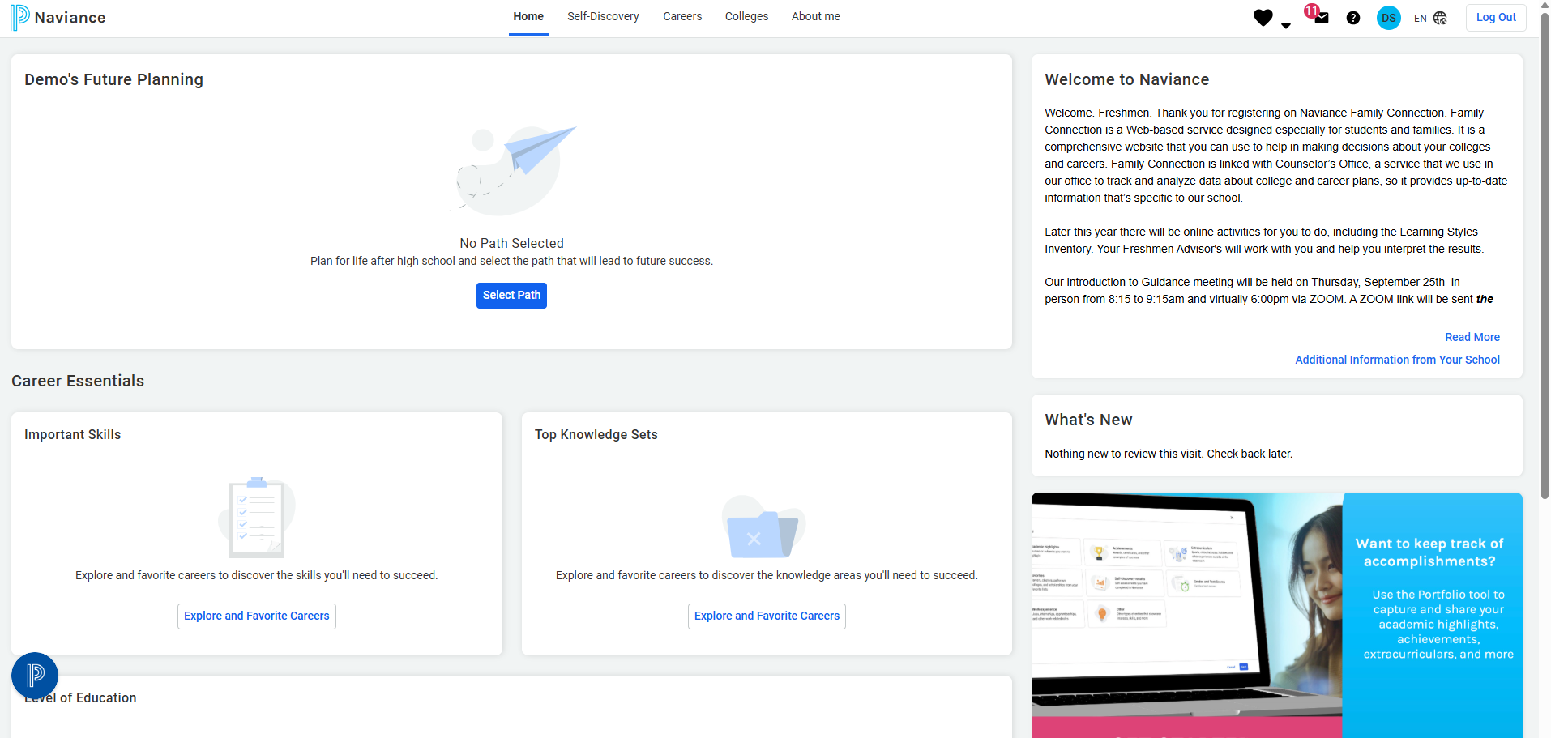
Naviance Dashboard

Slide 29
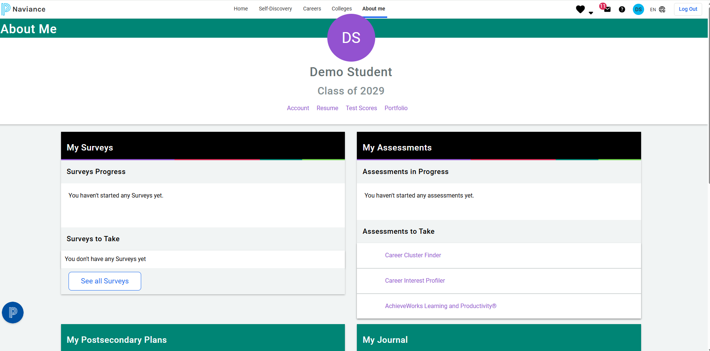
About Me

Slide 30
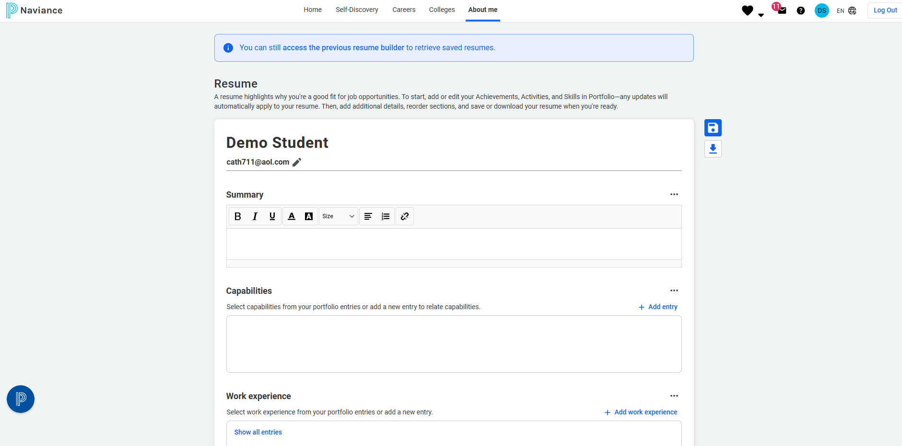
RESUME

Slide 31
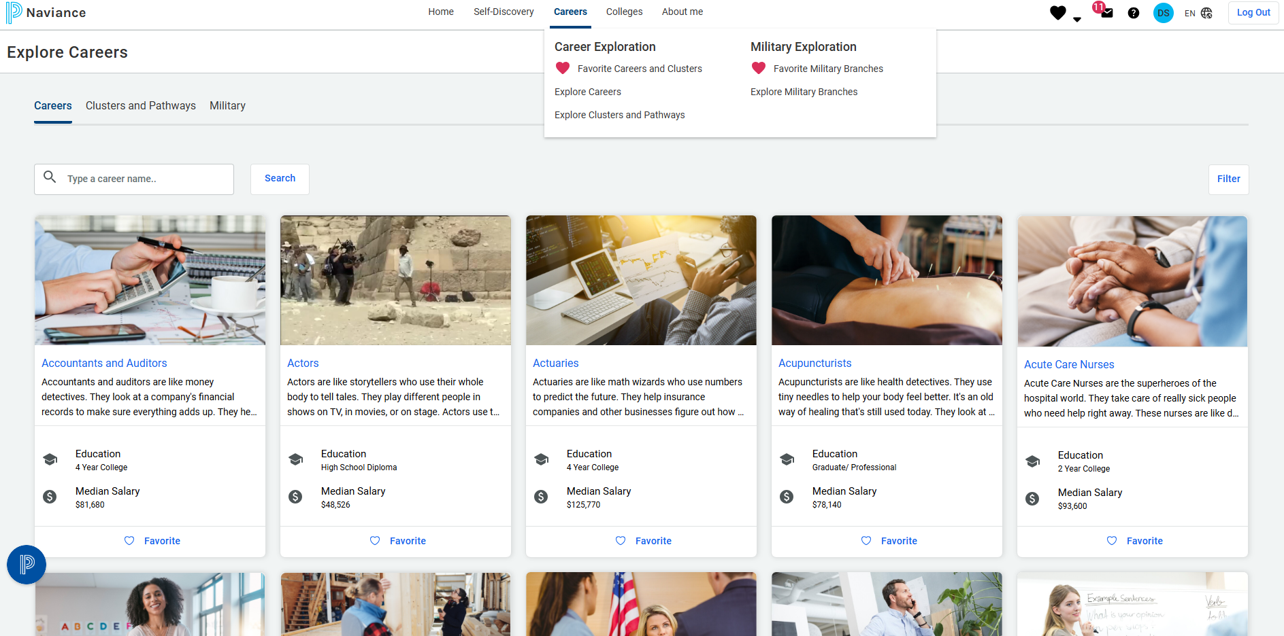
Favorite Careers and Clusters

Slide 32
How does it help?
Shared resource linking home to school
On-line tool for collaboration among counselors, students, and parents
Accurate, complete records about student choices from our school
Realistic assessments of your child’s chances of admission at colleges where prior graduates have applied
Career exploration
Course planning

Slide 33

Schoology

Slide 34
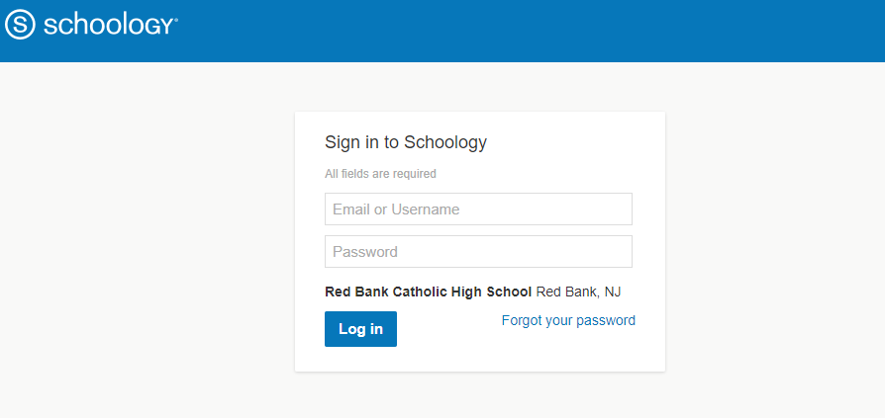
How to make an appointment with your counselor:

Slide 35
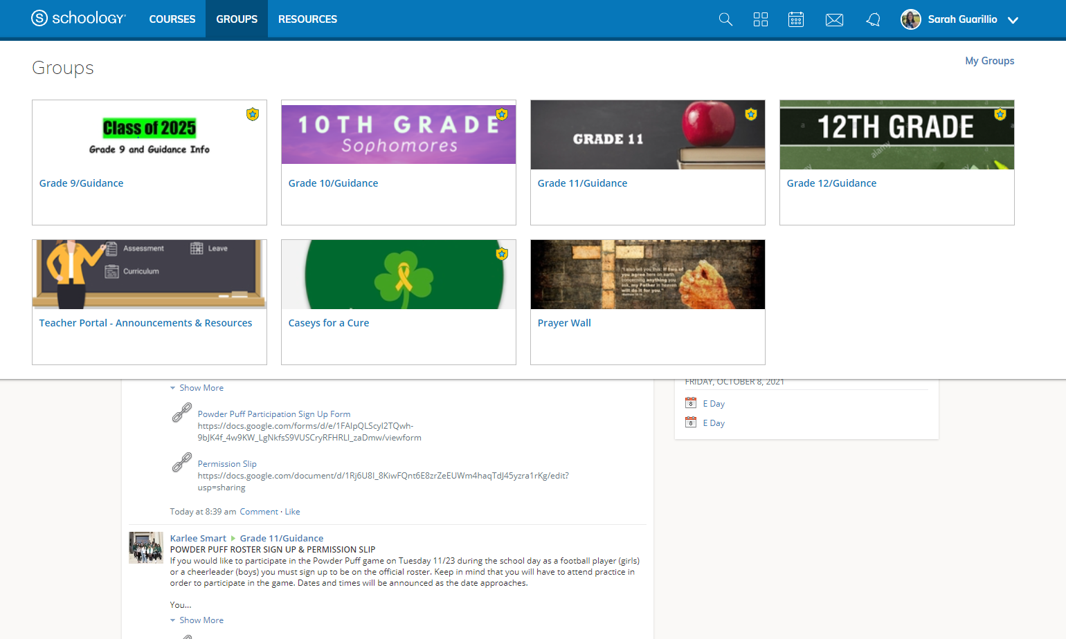

Slide 36
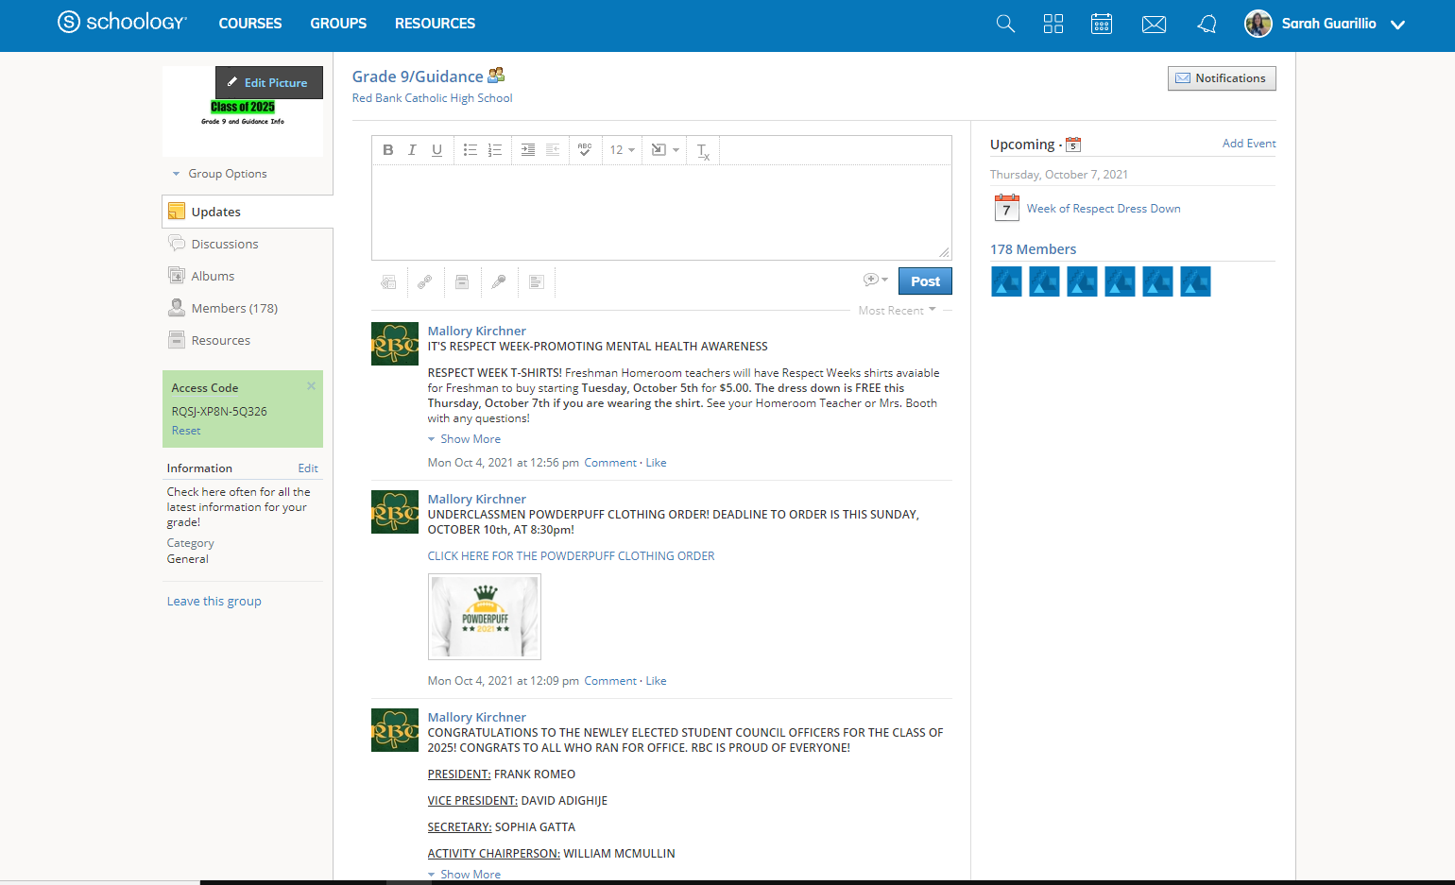

Slide 37
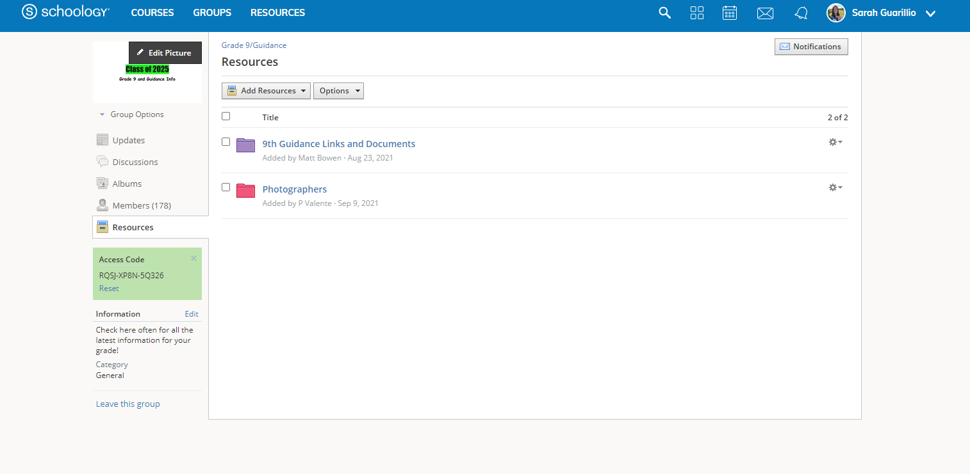

Slide 38
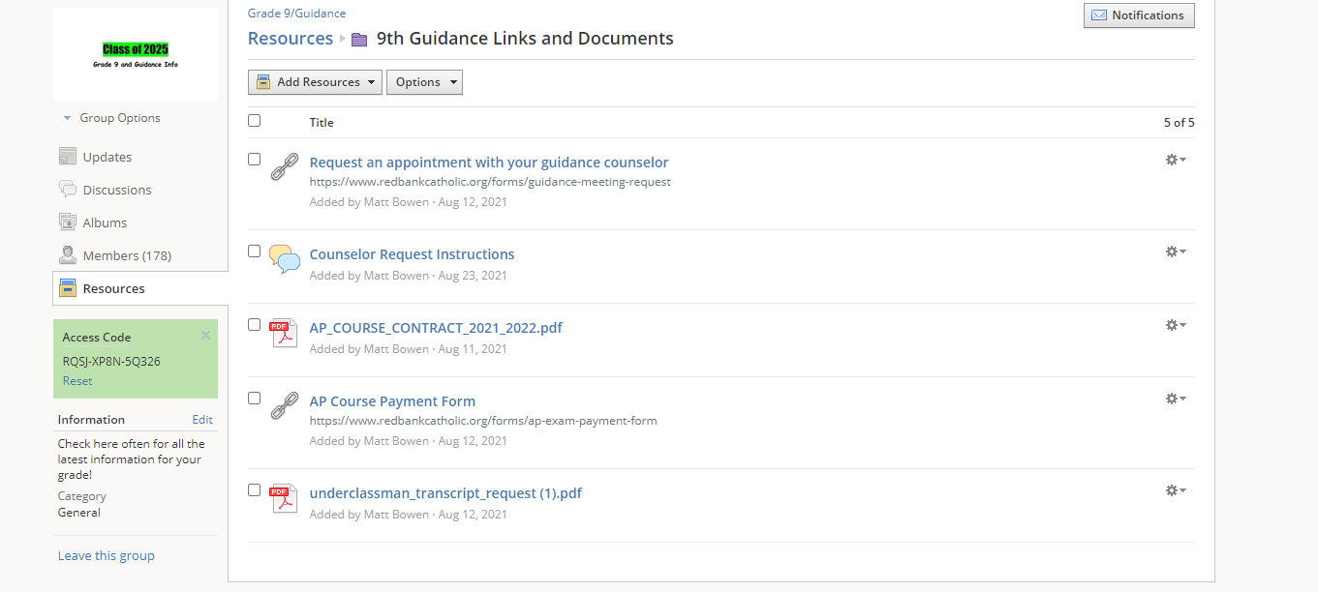

Slide 39
Scholarship Opportunities
RaiseMe College Scholarships | For High School Achievements‎
Search Scholarships | Cappex.com
Going Merry: Find Scholarships Online for Free
Scholly – Scholarship Search Tool and College Scholarship Finder App
Scholarship list on Naviance

Slide 40
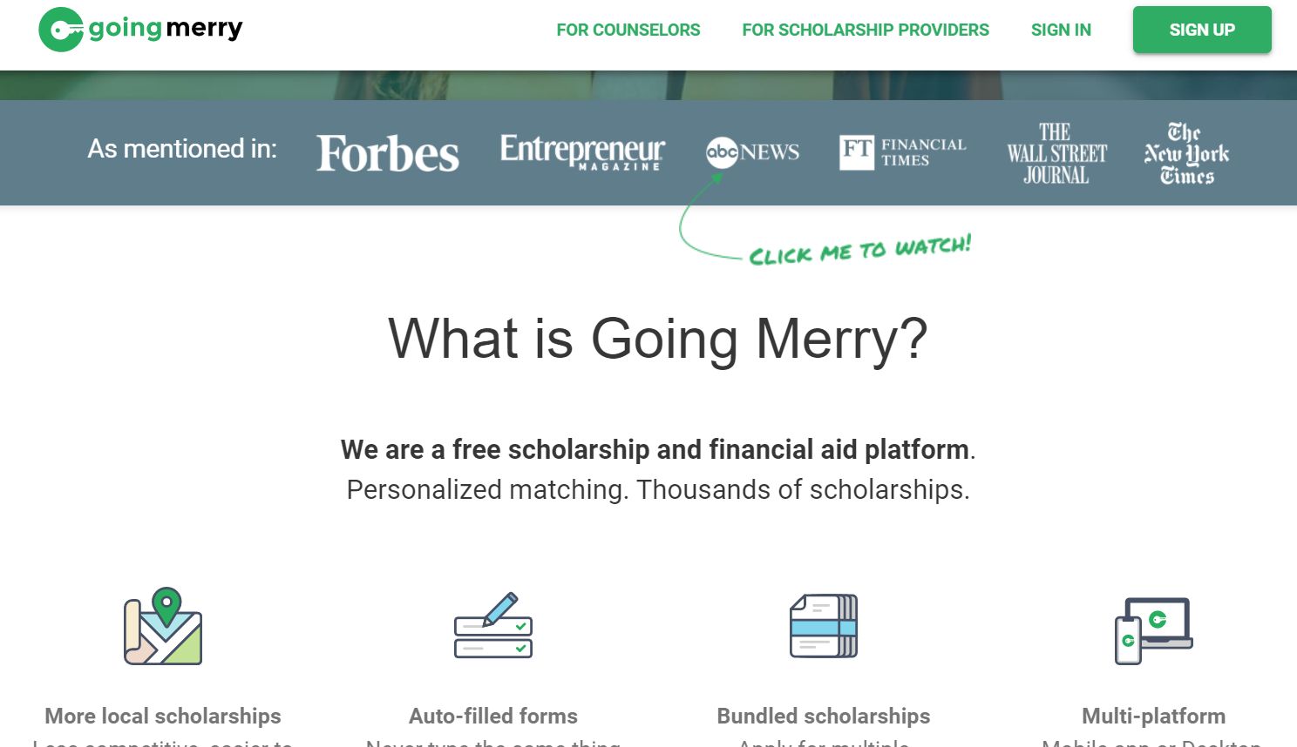

Slide 41
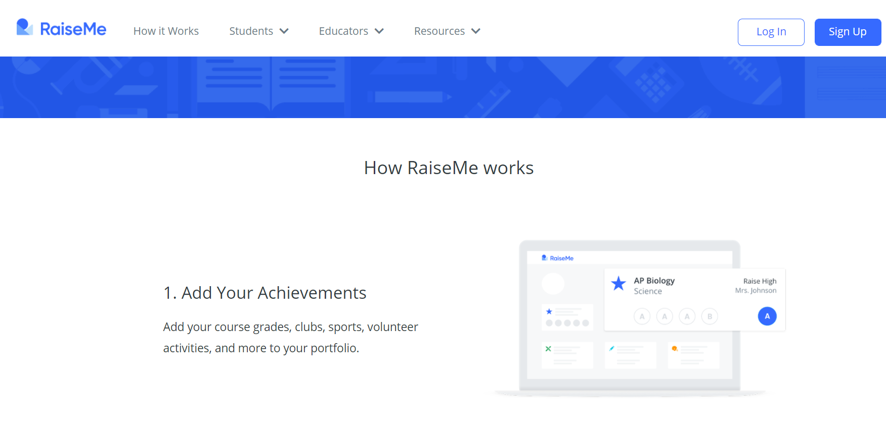

Slide 42
Pathways and Concentrations
Criminal Justice and Law
Health and Medical Science
Business Concentration and Entrepreneurship
Humanities & Social Science
Engineering and Design
Fine & Performing Arts
Social Sciences
Environmental

Slide 43
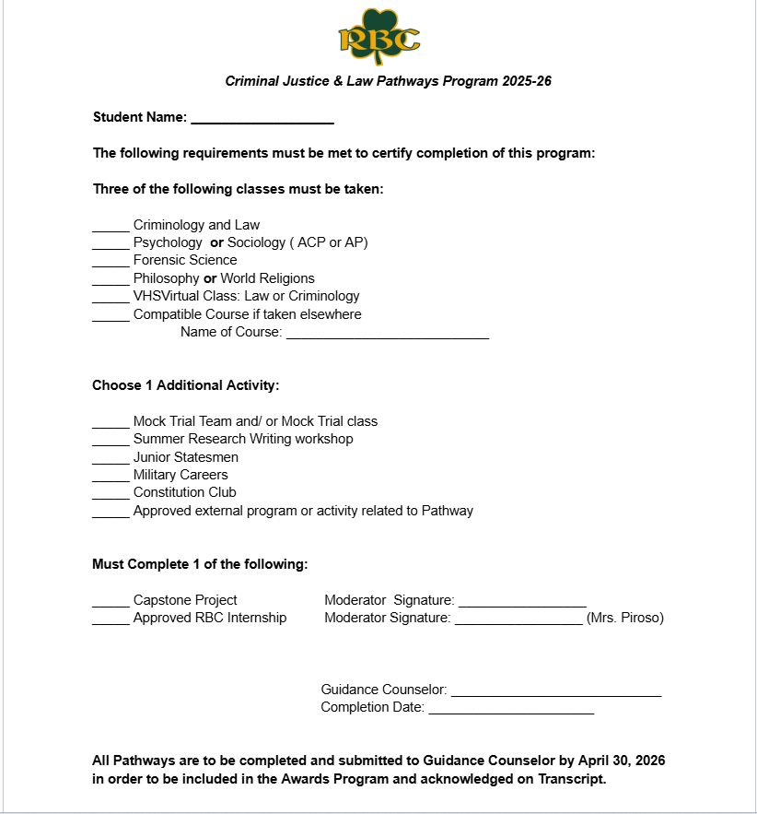
Sample Checklist for Criminal Justice
& Law Pathways Program

Slide 44
Upcoming Opportunities at RBC
Dual Enrollment Available – Junior & Senior Year
We partner with Seton Hall University, University of Delaware, Rowan University & Stockton University.
Capstone Research Projects- Students partner with teachers to engage in a research project.
Internships- Junior & Senior Year

Slide 45
Standardized Testing Dates
Both are held in school
CoGat-October 8, 2025
IOWA- March 13, 2026

Slide 46
Social Media for Teens: Pros and Cons
Pros:
  -It’s good for their education
  -It’s a great way to learn new skills
  -It can teach them about money
  -It enhances creativity
  -It makes them think more
Cons:
  -It gets addicting
  -Teens sometimes think it defines them
  -It can bring unwanted attention
  -It can be too focused on appearance
  -Cyberbullying happens

Slide 47
Questions???
For more information, contact the Guidance Department.

