Slide 1



Slide 2
ELPAC Assessment Planning and Training

Slide 3
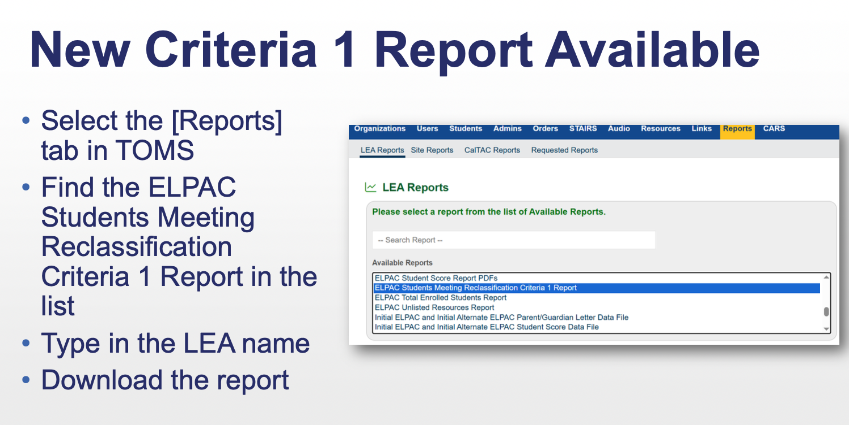
Notes:
New Criteria Report Available in TOMS
· We have a new report for you called the ELPAC Students Meeting Reclassification Criteria 1 Report.
· Active students who score a 4 on the Summative ELPAC or a 3 on the Summative Alternate ELPAC are eligible to begin the Reclassification process.
· This new report assists you in identifying your active students who have met Criteria 1. (Reminder! Only active students in TOMS will appear.)
· To find the report, log into TOMS, and select the 2025-26 administration year. Then select the [Reports] tab and the report is listed there in alphabetical order.
o Once you select the report, type in your LEA name, and you can download the report spreadsheet once it populates.
o The report columns will include basic information about your LEA and the student and then will provide the status for the student on each of the four domains of the Summative ELPAC or the Summative Alternate ELPAC, if this is the test they have been assigned.
· Only students who are enrolled in CALPADS for 2025-26 will appear on this report. Therefore, just a reminder to use your student score data file as another source of this information for inactive students.
· LEAs will use their established locally approved reclassification process to determine if the student has met each of these criteria. Consult the guidance on reclassification for dually identified students for your English learner students who have an active individualized education program.

Slide 4
LEAs will use their established locally approved reclassification process to determine if the student has met each of these criteria. Consult the guidance on reclassification for dually identified students for your English learner students who have an active individualized education program.
Notes:
New Criteria Report Available in TOMS
· We have a new report for you called the ELPAC Students Meeting Reclassification Criteria 1 Report.
· Active students who score a 4 on the Summative ELPAC or a 3 on the Summative Alternate ELPAC are eligible to begin the Reclassification process.
· This new report assists you in identifying your active students who have met Criteria 1. (Reminder! Only active students in TOMS will appear.)
· To find the report, log into TOMS, and select the 2025-26 administration year. Then select the [Reports] tab and the report is listed there in alphabetical order.
o Once you select the report, type in your LEA name, and you can download the report spreadsheet once it populates.
o The report columns will include basic information about your LEA and the student and then will provide the status for the student on each of the four domains of the Summative ELPAC or the Summative Alternate ELPAC, if this is the test they have been assigned.
· Only students who are enrolled in CALPADS for 2025-26 will appear on this report. Therefore, just a reminder to use your student score data file as another source of this information for inactive students.
· LEAs will use their established locally approved reclassification process to determine if the student has met each of these criteria. Consult the guidance on reclassification for dually identified students for your English learner students who have an active individualized education program.

Slide 5


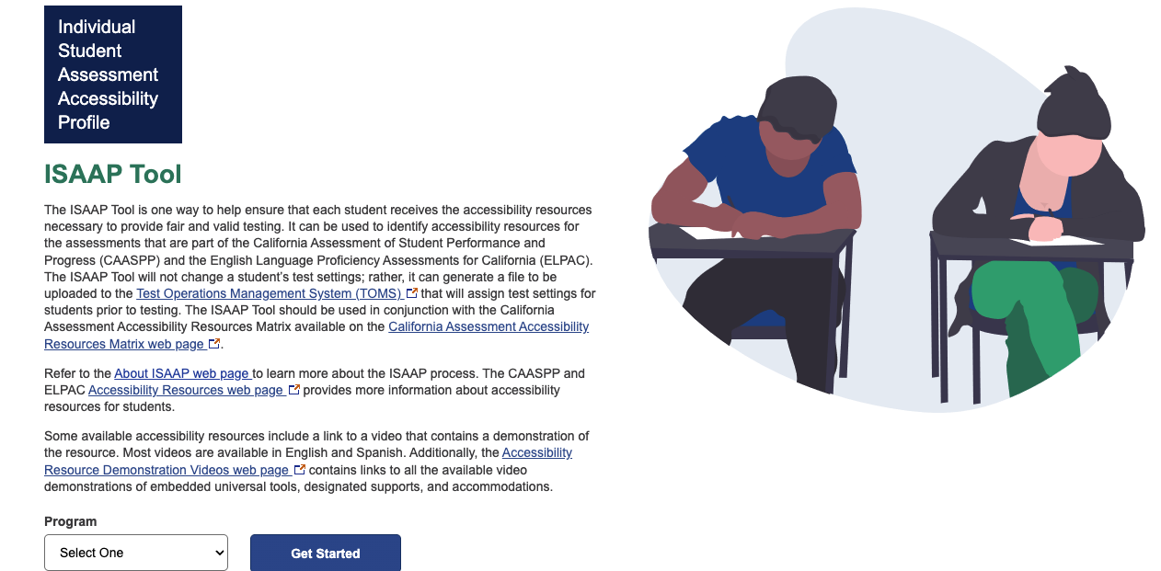
Tools for IEP Teams: Dually Identified Students
Notes:
Link: https://isaap.ets.org/

Slide 6
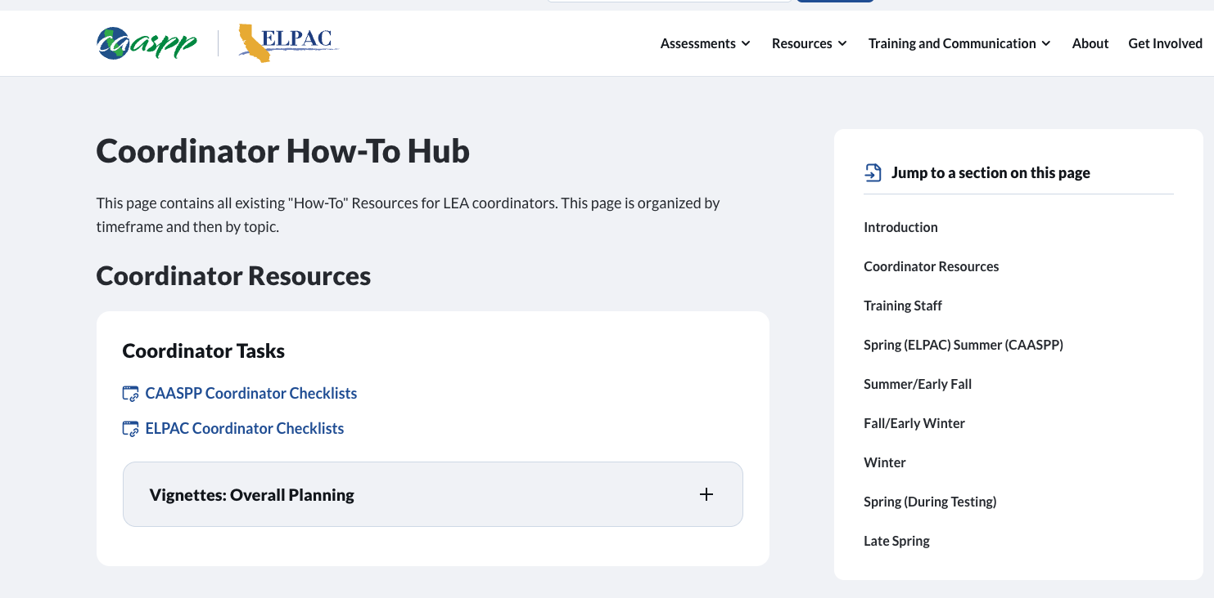
Coordinator How-To Hub
24-25 NEW!
https://www.caaspp-elpac.org/training-and-communication/training/coordinator-how-to-hub
Notes:
Link: https://isaap.ets.org/

Slide 7
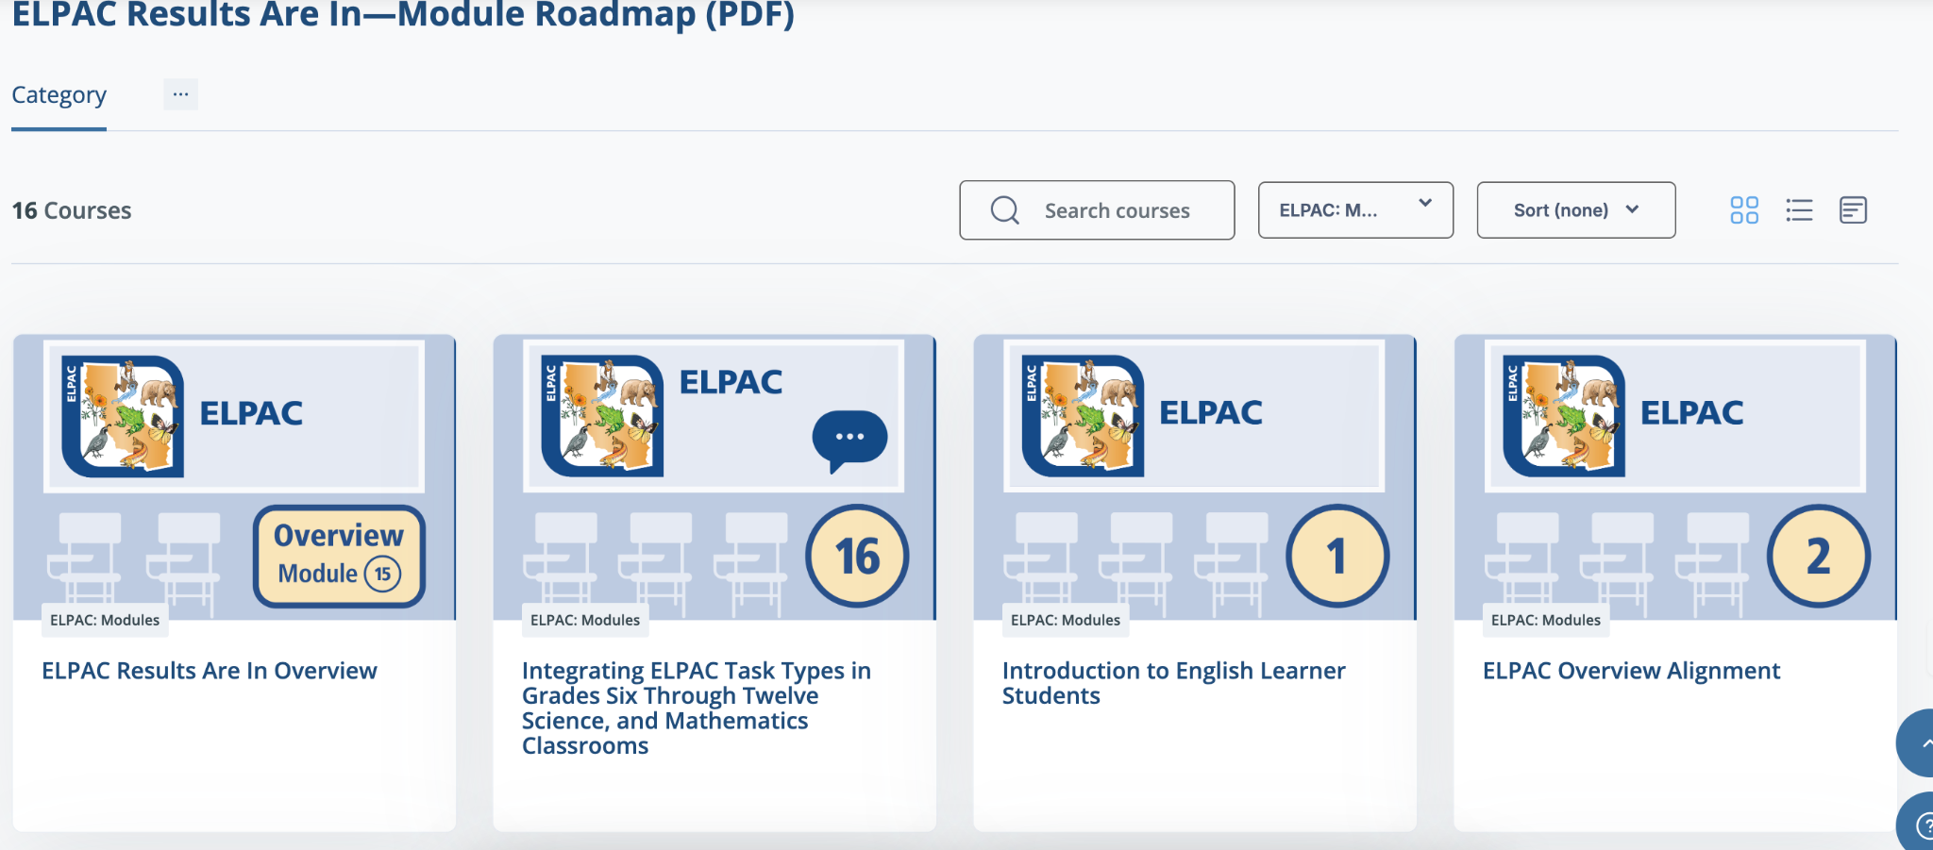
Moodle: ELPAC Results Are In, Now What?
24-25 NEW!
https://moodle.caaspp-elpac.org/course/index.php?categoryid=12

Slide 8
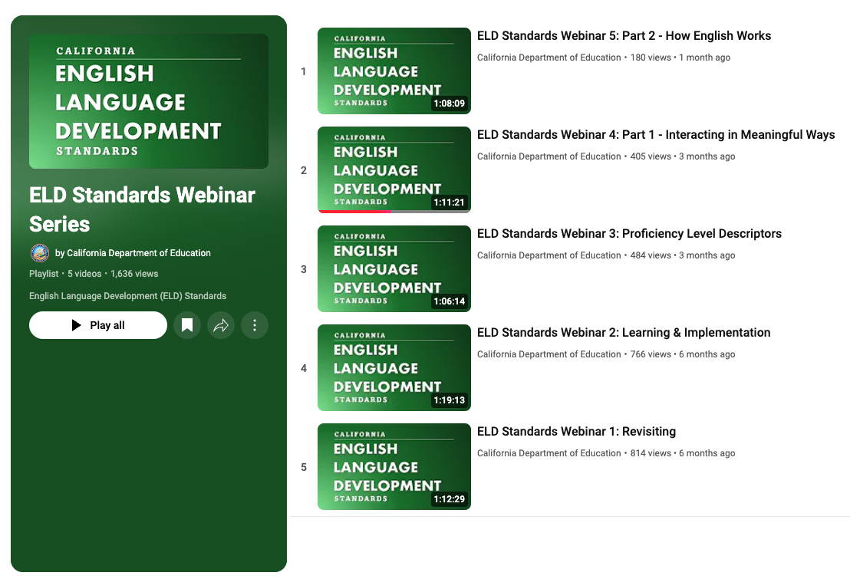
California English Language Development Standards Webinar Series
24-25 NEW!
CA ELD Standards Webinar Series
Notes:
California English Language Development Standards Webinar Series
The CDE MSD, in collaboration with the Region 15 Comprehensive Center, hosted a monthly webinar series to revisit the California English Language Development Standards (CA ELD Standards). The webinars included detailed presentations on the Proficiency Level Descriptors, Part I, Part II, and Part III of the standards, and how the standards can be used to provide high-quality integrated and designated ELD instruction for EL students. The webinar recordings playlist is available at CA ELD Standards Webinar Series as well as in the ELD Standards tab on the CDE ELD Standards web page.

Slide 9
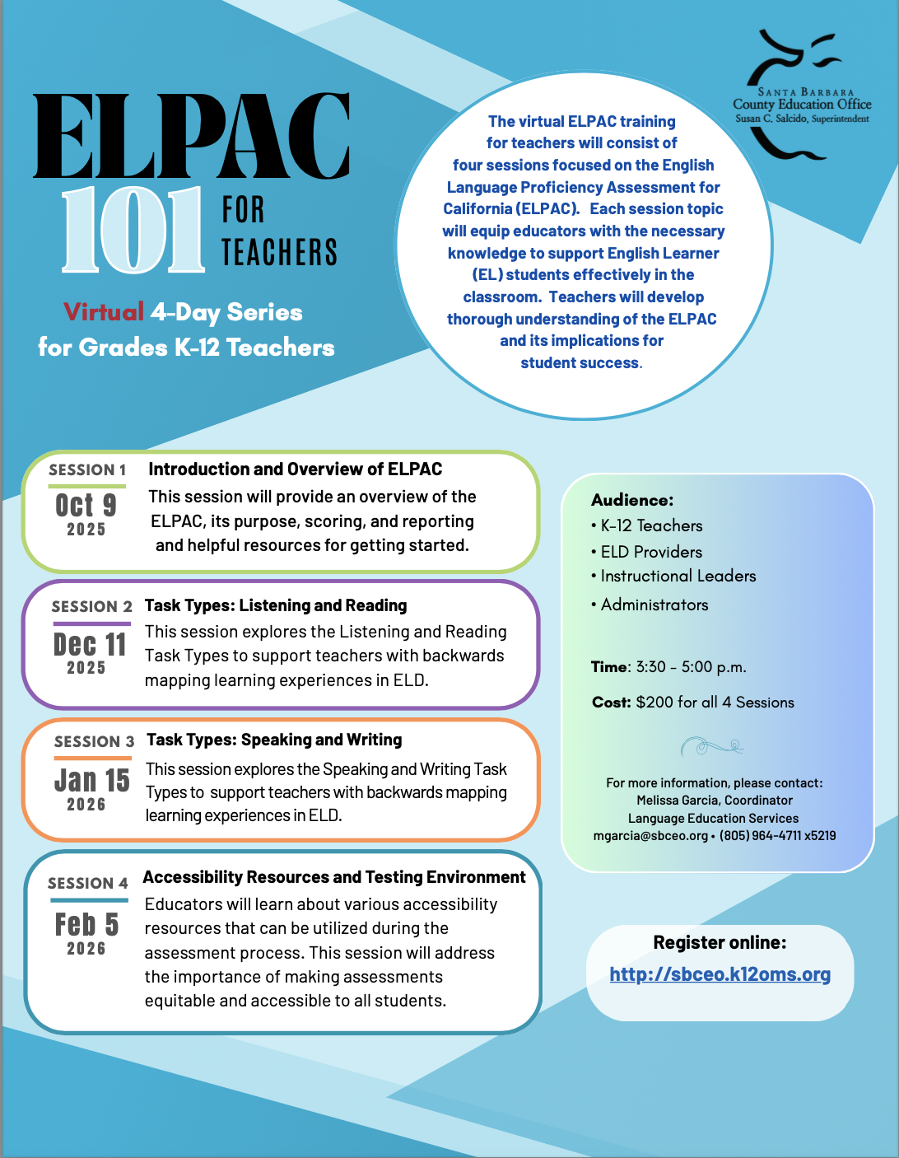
ELPAC 101 For Teachers
Virtual Learning Series
October 9th
December 11th
January 15th
February 5th
(3:30pm-5:00pm)
Notes:
Flier Link:https://resources.finalsite.net/images/v1746721068/sbceoorg/a91sfvx1aou1yoayp86d/ELPAC101forTeachers-Flyer.pdf

Slide 10
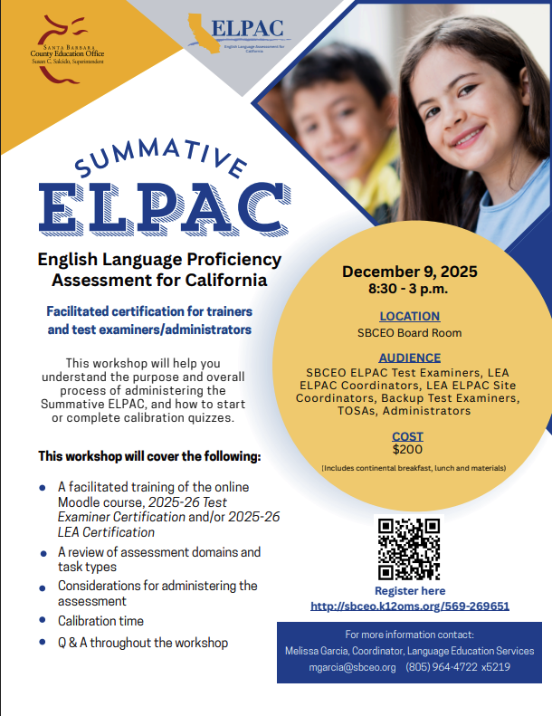
Summative ELPAC Facilitated Certification
December 9th, 2026
8:30-3:30
In-Person
Notes:
Flier Link:https://resources.finalsite.net/images/v1746721068/sbceoorg/a91sfvx1aou1yoayp86d/ELPAC101forTeachers-Flyer.pdf

Slide 11
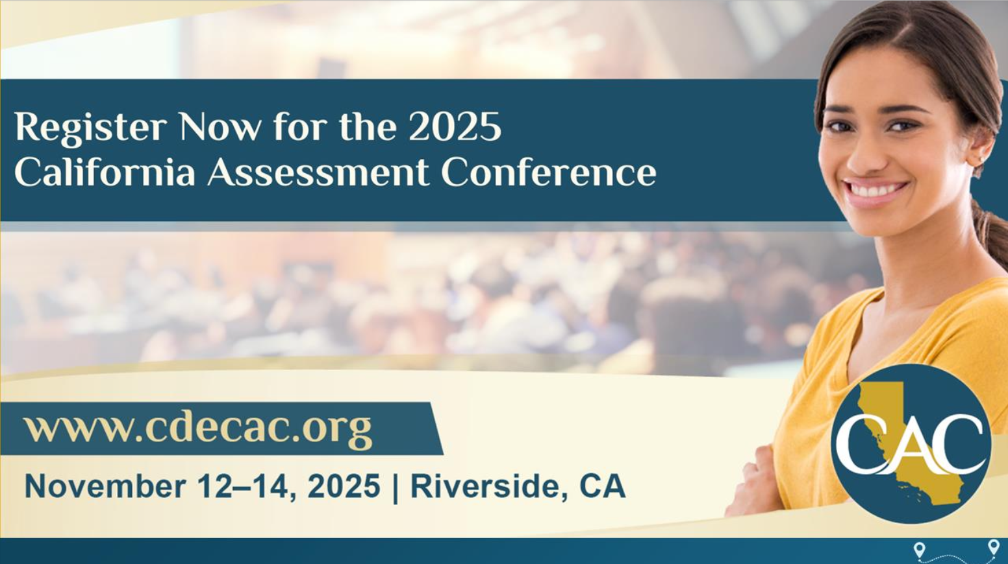
To register, visit the CAC website at https://www.cdecac.org/.
Notes:
Register now for the California Assessment Conference
· The 2024 California Assessment Conference is a unique opportunity for classroom educators to explore the connections between classroom instruction and assessment and learn how other California educators use assessment tools and strategies to improve teaching and learning. ​
· To register, visit the CAC website at https://www.cdecac.org/.

Slide 12
ELPAC
Reminders and Highlights

Slide 13
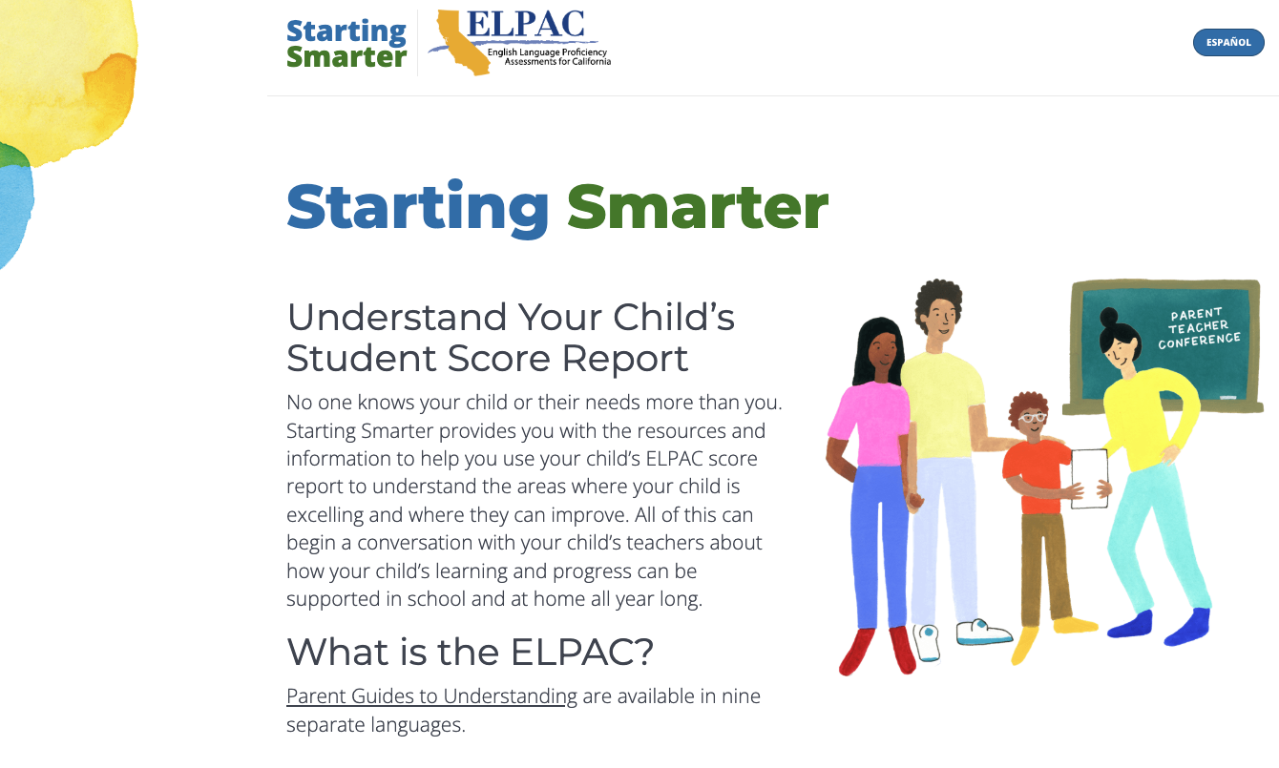
Videos Explaining Students’ Score Reports
Reminder
https://elpac.startingsmarter.org/

Slide 14
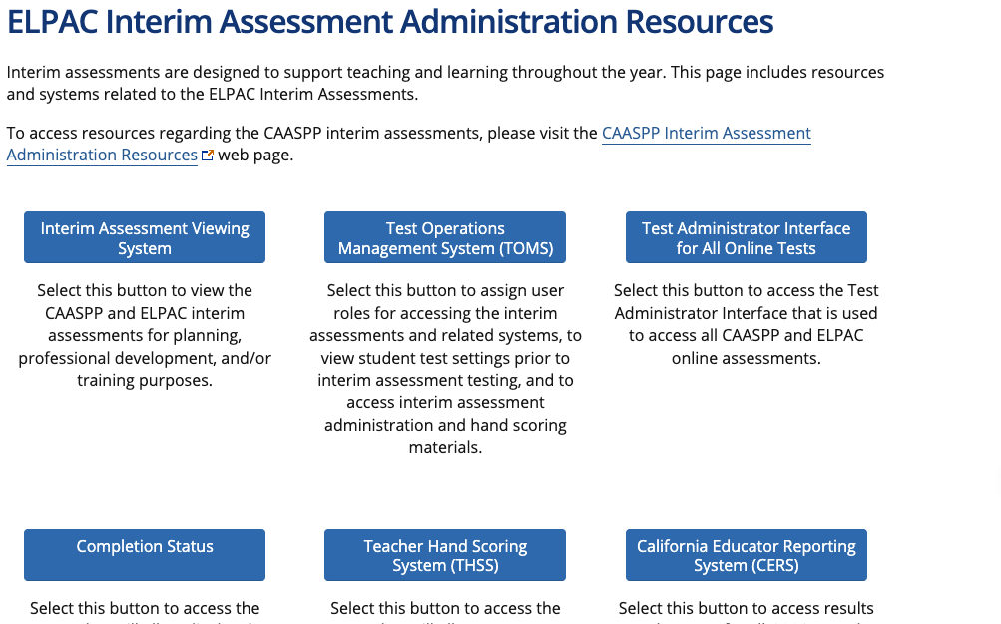
ELPAC Interim Assessments Update
See student progress
Standardized or non-standardized
Requires teachers have:
  TOMS accounts
  CERS accounts
25-26
Two forms for each grade available
https://www.elpac.org/resources/elpac-interim-resources/
Notes:
two forms:
Requires teachers have
TOMS accounts
CERS accounts
Districts should work closely with sites to ensure educators have the access and training necessary to use the interim assessments to their fullest potential.

Slide 15
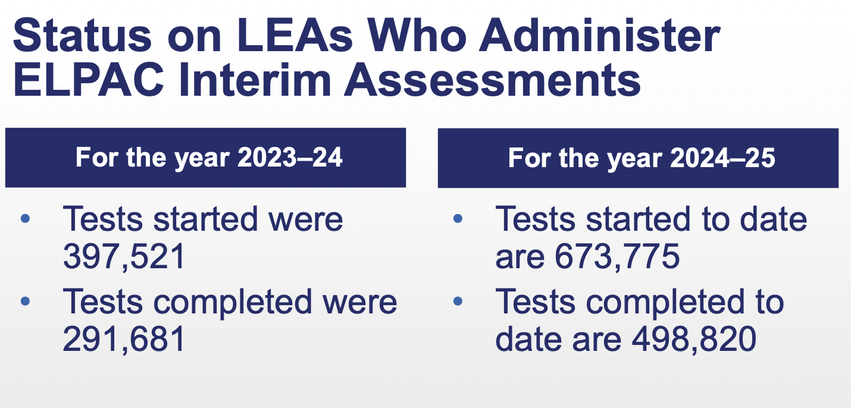

Slide 16
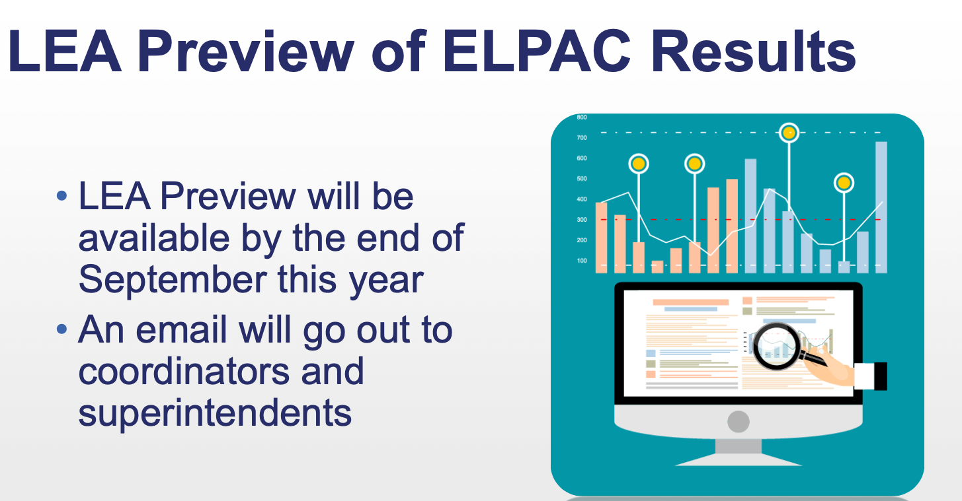
Notes:
LEA Preview of ELPAC Results
· LEA Preview will be available by the end of September this year!
· An email will go out to coordinators and superintendents so stay tuned.

Slide 17



25-26 Batalla de los Libros
May 14th, 2026
8:30-12:30
In-Person
Audience:
4th-7th
Participating LEAs can use Batalla de los Libros to develop a
CDE approved Biliteracy Pathways Recognition.
Notes:
Update SBCE Website
Link from SBCEO
Update PD Slide Deck

Slide 18
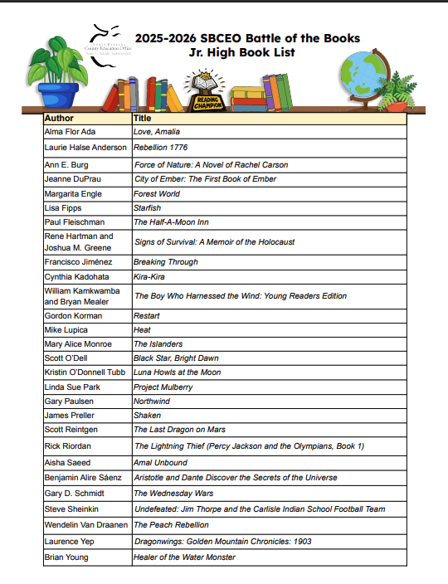
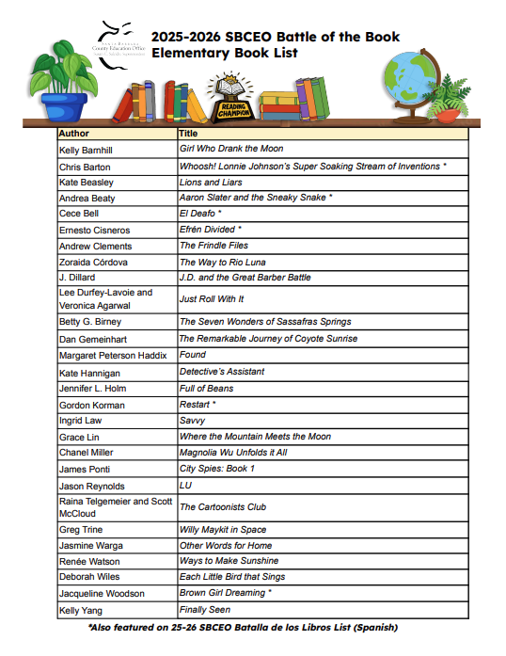
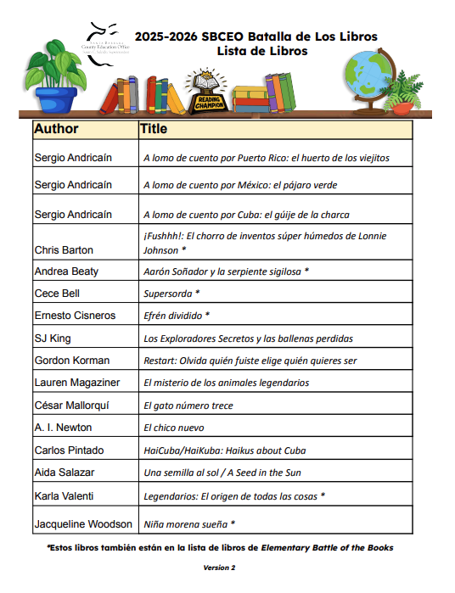
The 2025-2026 Battle of the Book Lists are Ready for you!
Melissa Garcia
Notes:
25-26 BOTB Elemtary List: https://resources.finalsite.net/images/v1747934695/sbceoorg/lugdlzelqhplylwadctf/2025BOTBElemList.pdf
25-26 Batalla de los Libros: https://resources.finalsite.net/images/v1752016236/sbceoorg/hr7pps0q1ad2tfxgivdd/2025BatallaList-FinalVersion.pdf
25-26 BOTB Junior High List: https://resources.finalsite.net/images/v1747932335/sbceoorg/shpvubfojbgnkfskromv/2025JrHighList.pdf
Learn more at:
https://www.sbceo.org/programs/ets/events/battle
https://www.sbceo.org/programs/ets/events/batalla

Slide 19

Save the Dates for 2026 In-Person Battles
Junior High BOTB: April 16, 2026
North County Elementary BOTB: April 23, 2026
South County Elementary BOTB: April 30, 2026
Batalla Elementary BOTB: May 14, 2026
Melissa Garcia

