Slide 1
Frontline Professional Growth
Certified Employee Evaluations

Slide 2
Overview
Frontline Professional Growth Access
Evaluation Purpose
Danielson Framework Model
Evaluation Overview
Evaluation Criteria
Evaluation Process & Timeline
Evaluation Components
Employee Evaluation Groups
Evaluation Ratings & Rubric
Plan for Professional Growth
Plan of Improvement
Frequently Asked Questions

Slide 3
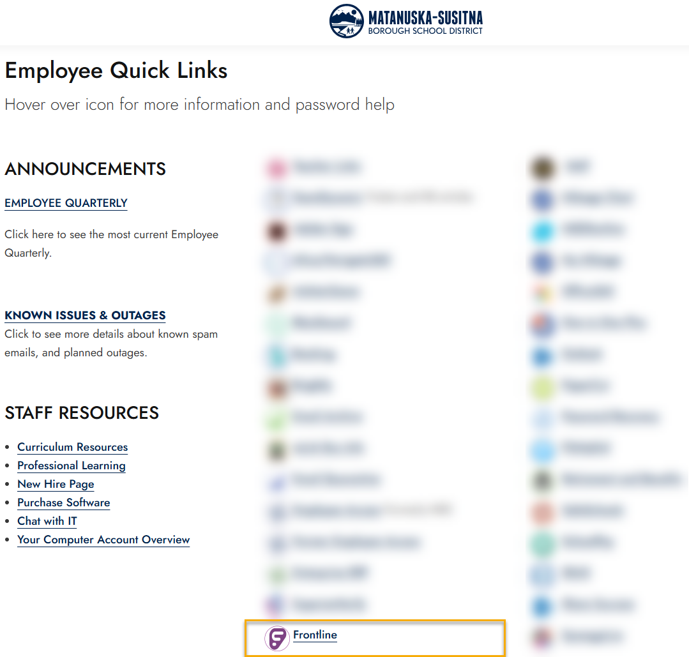
Frontline Professional Growth Access
Matanuska Susitna Borough School District Website
Employee Quick Links
Login Information:
  Username: ab012345
  Password: Network/Computer Password

Slide 4
Evaluation Purpose
The purpose of the Certified Employee Evaluation is to provide a process that:
  Gives feedback to employees regarding their observed performance during the evaluation cycle;
  Establishes a common language and expectation regarding performance;
  Promotes professional excellence and continuous improvement to facilitate student learning and growth;
  Affords structed assistance to employees;
  Offers a basis for making a decision about continued employment
  Facilitates the alignment of Professional Development with educator needs

Slide 5
Danielson Framework Model
The Matanuska Susitna Borough School District has aligned and adopted the Danielson Framework with the established Alaska Standards:
  An understanding of how students learn and develop
  The educator teaches with respect to students’ individual and cultural characteristics
  Knows and understands the content area and how to effectively teach it
  The educator facilitates, monitors, and assesses student learning
  Creates and maintains an engaging learning environment for all students
  Works as a partner with parents, families, and the community to regularly collaborate and promote student learning
  The educator participates and contributes to the teaching profession maintaining a high standard of professional ethics

Slide 6
Evaluation Overview
To access your evaluation, select My Info and My Evaluation
  Scheduled Components – Components that must be completed during the evaluation cycle (pre-observation, observation, etc.)
  PROGRESS– Notification when a part of the process needs your attention. Click on the components you must complete
  STATUS– Track the components of the evaluation process that are underway
  Complete – Items that have been marked complete by you and your building administrator

Slide 7
Evaluation Criteria
The framework is a definition of what effective teaching looks like an defines what teachers should know and be able to do in the exercise of their profession. The rubric provides a common language among professionals in education.
“So, what is good teaching? If you were to walk into a classroom right now, what might you see or hear that would convince you that you’re in the presence of an expert teacher? That is, what would make you think ‘If I had a child this age I’d want them in this room?’”
- Charlotte Danielson

Slide 8
Evaluation Criteria
Domain 1: Planning & Preparation
1a. Knowledge of content and pedagogy
1b. Knowledge of students
1c. Selecting instructional goals
1d. Knowledge of resources
1e. Designing coherent instruction
1f. Assessing student learning
Domain 2: The Classroom Environment
2a. Creating an environment of respect and rapport
2b. Establishing a culture for learning
2c. Managing classroom procedures
2d. Managing student behavior
2e. Organizing physical space
Domain 3: Instruction
3a. Communicating with students
3b. Using questioning and discussion
3c. Engaging students in learning
3d. Using assessment in instruction
3e. Demonstrating flexibility and responsiveness
Domain 4: Professional Responsibilities
4a. Reflecting on teaching
4b. Maintaining accurate records
4c. Communicating with families
4d. Participating in professional community
4e. Growing and developing professionally
4f. Showing professionalism
Domain Criteria

Slide 9
Evaluation Process & Timeline
Educator Self-Reflection
Informal Observation(s)
Formal Observation
Summative Evaluation Conference
Beginning of the Year Conference

Slide 10
Evaluation Process & Timeline
NON-TENURED EVALUATION TIMELINE | EVALUATION STEPS
SEPTEMBER 30 | EDUCATOR SELF-REFLECTION RUBRIC
OCTOBER 15 | BEGINNING OF THE YEAR CONFERENCE
OCTOBER 15/FEBRUARY 28 | INFORMAL OBSERVATION #1
NOVEMBER 15/MARCH 30 | INFORMAL OBSERVATION #2
DECEMBER 1/APRIL 15 | FORMAL OBSERVATION
DECEMBER 10 | MID-YEAR REVIEW CONFERENCE
MAY 1 | FORMAL OBSERVATION CONFERENCE

Slide 11
Evaluation Process & Timeline
TENURED EVALUATION TIMELINE | EVALUATION STEPS
SEPTEMBER 30 | EDUCATOR SELF-REFLECTION RUBRIC
OCTOBER 15 | BEGINNING OF THE YEAR CONFERENCE
DECEMBER 15 (RECOMMENDED) | INFORMAL OBSERVATION
JANUARY 30 (RECOMMENDED) | FORMAL OBSERVATION
FEBRUARY 15 | FORMAL OBSERVATION CONFERENCE

Slide 12
Evaluation Components
Self-Reflection
The Self-Reflection rubric is designed to support staff self-assessment and reflection on professional practice beyond the general global judgments that may occur without intention and diligent review and analysis. This will be used as the foundation during the Beginning of the Year Conference and assist the educator and administrator in establishing evaluative focus throughout the evaluation cycle.

Slide 13
Evaluation Components
Beginning of the Year Conference
The Beginning of the Year Conference allows the certified staff member and the administrator an opportunity to discuss expectations through the evaluation cycle. Expectations should reflect the anticipated growth in the classroom and identity goals to maximize educator effectiveness. Artifacts and additional components will be identified at the conference, along with any additional components beyond what is required.

Slide 14
Evaluation Components
Artifacts
Artifacts provide evidence of performance on various components of the dreamwork and are essential for staff to demonstrate their skills in specific areas. Required artifacts during the evaluation cycle will be discussed at the Beginning of the Year Conference. The administrator’s assessment of the artifacts will be discussed and reviewed during the summative conference at the end of the evaluation cycle.

Slide 15
Evaluation Components
Informal Observation
Informal Observations may include observable behaviors or circumstances outside of the traditional classroom setting. Informal Observations are recommended to last for a duration between five and fifteen minutes and may be unannounced. These observations will be documented with the date and time and shared with the educator during the summative conference.

Slide 16
Evaluation Components
Formal Observation
One Formal Observation is required to be completed during the evaluation cycle. The Formal Observation must be scheduled in advance and must be for a duration of not less than thirty minutes. Feedback on the Formal Observation must be provided to the educator within two working days.

Slide 17
Evaluation Components
Mid-Year Review
The Mid-Year Review Conference will serve as a feedback session for all non-tenured staff members. The administrator evaluating the educator will complete the Mid-Year Review assessment which will include a compilation of completed observations and submitted artifacts.

Slide 18
Evaluation Components
Summative Evaluation Conference
The Summative Evaluation Conference will include all components during the evaluation cycle to form a Summative Evaluation. The educator will be provided a copy of the Summative Evaluation form which will include a rating of unsatisfactory, basic, proficient, or exemplary on each required component. Educators are provided with two working days to sign the Summative Evaluation and a total of five working days to write and submit a written respond to the evaluation if desired. If the educator refuses to sign the evaluation, the administrator will notate this on the form and finalize without acknowledgement. An educator who fails to provide a written response within five days forfeits any right to submit a written response. Written responses will be retained with the final summative evaluation and held in the employee’s personnel file.

Slide 19
Evaluation Components
Evaluation Waiver
A tenured employee who after their fifth year of employment receives a rating of “exemplary” in at least one component with no components rated below proficient will be considered to have exceeded the District’s performance standards and will be eligible to be evaluated once every two years. To continue to be eligible, the employee must have achieved a rating of “exemplary” on at least one component with no components rated below proficient on their most recent evaluation. No later than October 30th of the skip year, the employee must complete and submit the Evaluation Waiver form. The decision to use the evaluation waiver requires mutual consent of both the educator and the evaluating administrator, upon the request of either party, an annual evaluation must be completed.

Slide 20
Employee Evaluation Groups
Evaluation Category Group | Matanuska Susitna Borough School District Position Examples
Teacher | Teachers in Regular Education, Special Education, Music, Art, Physical Education, etc.
Instructional Specialist | Instructional Coach, ELL Teacher, TOSA, Resource Specialist, Athletic Director, Correspondence Teacher
Library Media Specialist | School Librarians, Media Specialist
School Counselor | School Counselors
School Nurse | School Nurses
School Psychologist | School Psychologists
Therapeutic Specialist | Occupational Therapist, Physical Therapist, Speech Language Pathologist, Audiologist, etc.

Slide 21
Evaluation Ratings
Unsatisfactory – Requires Immediate Intervention
Professional practice at the unsatisfactory level shows evidence of not understanding the concepts underlying individual components. This level of practice is ineffective and inefficient and may represent practice that is harmful or detrimental.
UNSATISFACTORY
BASIC
PROFICIENT
EXEMPLARY

Slide 22
Evaluation Ratings
Basic – Improvement Needed
Professional practice at the basic level shows evidence of knowledge and skills required, but performance is inconsistent over a period of time due to lack of experience, expertise, and/or commitment.
UNSATISFACTORY
BASIC
PROFICIENT
EXEMPLARY

Slide 23
Evaluation Ratings
Proficient – Expectations Consistently Met
Professional practice at the proficient level shows evidence of thorough knowledge of all aspects of the profession. This is successful, accomplished, professional and effective practice.
UNSATISFACTORY
BASIC
PROFICIENT
EXEMPLARY

Slide 24
Evaluation Ratings
Exemplary – Far Exceeds Expectations
Professional practice at the exemplary level is that of a master professional who practices and operates at the quantitively different level from those of other professional peers. Ongoing reflective practice is demonstrated through the highest level of expertise and commitment to all learning, professional growth, and collaborative leadership.
UNSATISFACTORY
BASIC
PROFICIENT
EXEMPLARY

Slide 25
Evaluation Ratings
Domain Rating Guidelines
Exemplary
50% of Components Rated Exemplary
No Components Rated Basic
Proficient
No More than One Component Rated Basic
No Components Rated Unsatisfactory
No Components Rated Unsatisfactory
Basic
No Components Rated Unsatisfactory
Unsatisfactory
One or More Components Rated Unsatisfactory

Slide 26
Evaluation Ratings
Domain Rating – Level of Support
Evaluation Waiver
One Exemplary Rating
No Basic Ratings
No Unsatisfactory Ratings
Plan of Improvement
One Unsatisfactory Rating
Plan for Professional Growth
Two or More Basic Ratings
No Unsatisfactory Ratings

Slide 27
Evaluation Ratings
Common Descriptors for Rating Levels
Unsatisfactory | Basic | Proficient | Exemplary
No Not Not Clear Unaware Does not Respond Poor Not Congruent Little Low Inadequate | Some Attempts To Limited Moderate Uneven Inconsistent Rudimentary Emerging | Consistent High Quality Timely Accurate Appropriate Clear Effective High Expectations Aligned Solid Smoothly Productive | Highly Effective Entirely Appropriate Adaptable Fully Aligned Extensive Highly Developed Extensive Routinely

Slide 28
Evaluation Component Rubric
Required Components
Domain 1: Planning and Preparation | 1b. Knowledge of Students 1e. Designing Coherent Instruction 1f. Designing Student Assessments
Domain 2: The Classroom Environment | 2a. Creating an Environment of Respect and Rapport 2c. Managing Classroom Procedures 2d. Managing Student Behaviors
Domain 3: Instruction | 3b. Using Questioning and Discussion Techniques 3c. Engaging Students in Learning 3d. Using Assessment in Instruction
Domain 4: Professional Responsibilities | 4b. Maintain Accurate Records 4c. Communicating with Families 4f. Showing Professionalism

Slide 29
Plan for Professional Growth & Plan of Improvement
There are two types of structured assistance plans for certified staff members: a Plan for Professional Growth and a Plan of Improvement. The purpose of the plan is to document performance concerns and clearly state what the employee must accomplish to meet District performance expectations.
Plan for Professional Growth
Option Provided in Regulation
Plan of Improvement
Required under State Statute
Recommended When Two or More Components are Rated Basic
Required After One or More Components are Rated as Unsatisfactory
After Plan for Professional Growth Components Continue to be Rated as Basic

Slide 30
Plan for Professional Growth
A Plan for Professional Growth is recommended for any staff member, tenured or non-tenured, who receive two or more components rated as “Basic” but may be implemented for any employee who receives a rating of “Basic” in one ore more components when no component is rated as “Unsatisfactory”, unless the District is recommending non-retention of the educator.
  The Administrator shall schedule a conference with the educator to develop a plan.
  The employee may be accompanied by a representative of the Association or a person of their choice.
  The purpose of the conference will be set develop a plan for professionally growth which shall set clear and specific performance expectation on how the employee’s performance can be improved.
  The plan shall include a timeline to be followed including scheduled meeting to review progress and specific assistant and support/resources.
  For tenured staff, the Plan for Professional Growth must last no less than 60 workdays and no more than 120 workdays unless shortened by mutual agreement.
  For non-tenured staff, the Plan for Professional Growth must last no less than 30 workdays and the duration of the plan shall be determined by the evaluator.

Slide 31
Plan of Improvement
A Plan of Improvement is required to be implemented for any staff member, tenured or non-tenured, who received at least one component rating of “Unsatisfactory”. However, an administrator may recommend non-retention according to State Statute or Board Policy.
  The Administrator shall schedule a conference with the educator to develop a plan.
  The employee may be accompanied by a representative of the Association or a person of their choice.
  The purpose of the conference will be set develop a plan for professionally growth which shall set clear and specific performance expectation on how the employee’s performance can be improved.
  The plan shall include a timeline to be followed including scheduled meeting to review progress and specific assistant and support/resources.
  The administrator retains final authority to determine the various components to be included in the plan.
  For tenured staff, the Plan for Professional Growth must last no less than 90 workdays and no more than 180 workdays unless shortened by mutual agreement.
  For non-tenured staff, the Plan for Professional Growth must last no less than 30 workdays and the duration of the plan shall be determined by the evaluator.

Slide 32
Frequently Asked Questions
Where can an educator learn more about the Danielson Framework model?
  Supplemental training materials are available to be check out from the Office of Teaching & Learning to include resource materials and books about the evaluation system fundamentals.
How are the evaluation components determined?
  There are twelve required components in the evaluation model. Per administrator discretion, they may require an educator to be evaluated on any of the remaining ten components. These must be identified at the Beginning of the Year Conference.
Is a non-tenured teacher required to complete a Self-Reflection and Beginning of the Year Conference more than one time per year?
  No, a non-tenured teacher is only required to complete one component of each at the beginning of the evaluation cycle.
What is an Artifact?
  Artifacts provide evidence of performance on various components. These could include examples of lesson plans, social contracts, grade reports, etc.
How many Artifacts should an educator submit?
  Each required component must have at least one Artifact or observation evidence identified. An Artifact may count for more than one component.
What if my administrator or I miss a deadline according to the evaluation timeline?
  A date may be extended if mutually agreed upon by the administrator and the educator.

