Slide 1


Slide 2


Slide 3


Slide 4
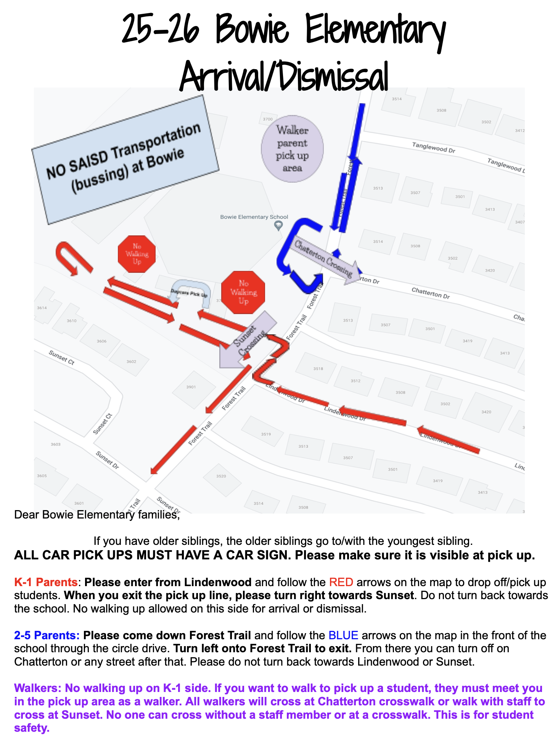


Slide 5
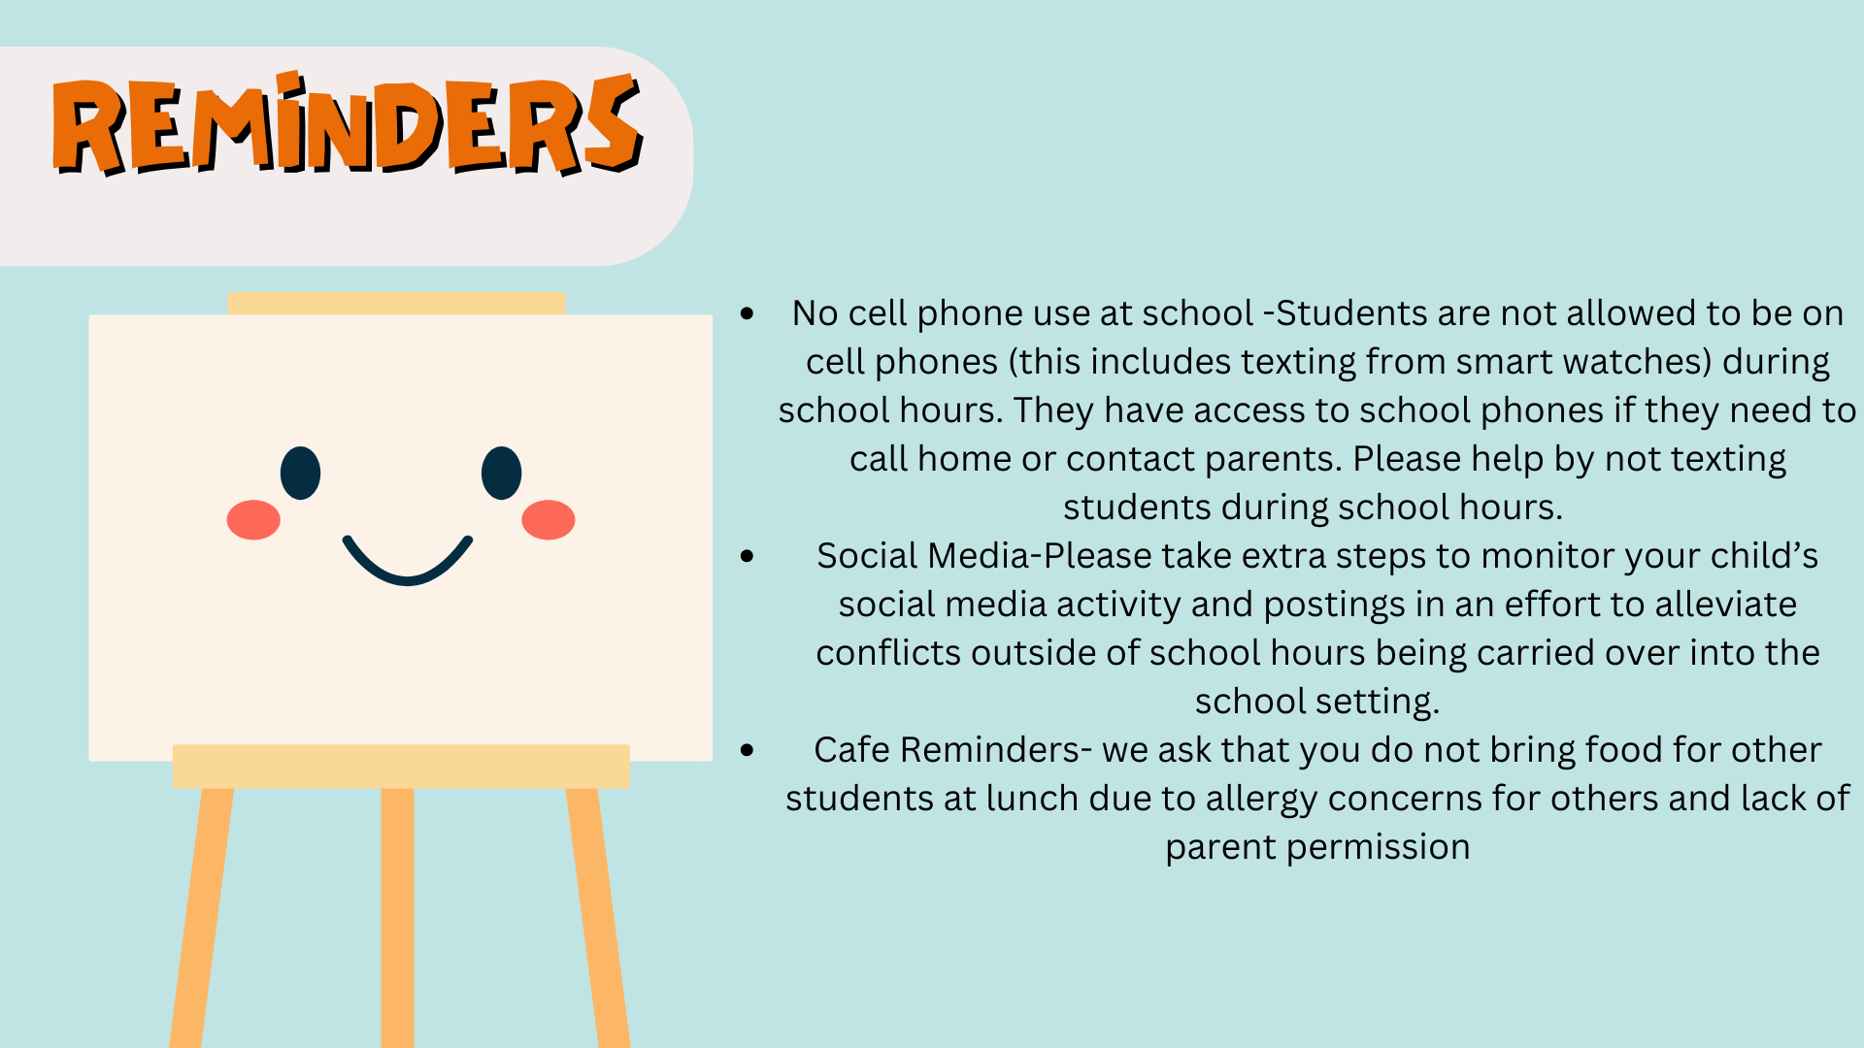

Slide 6
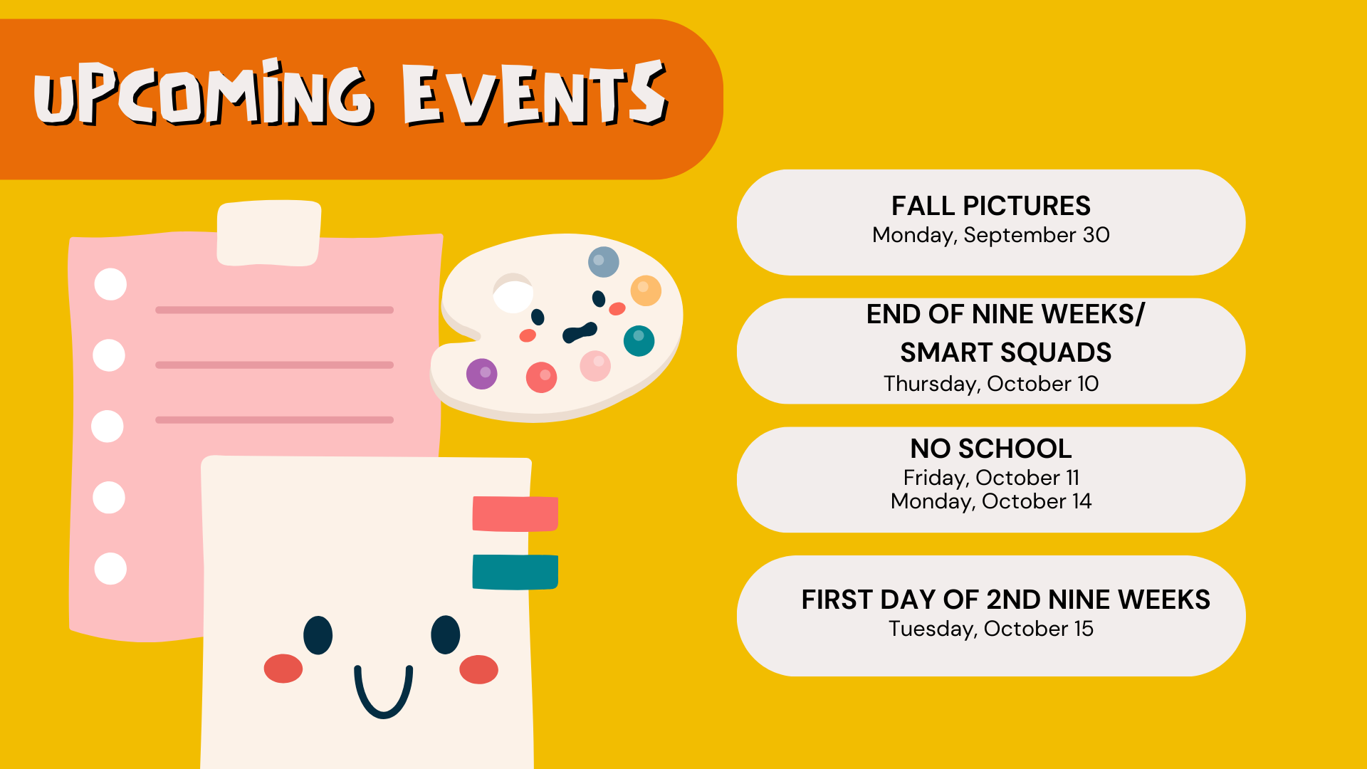
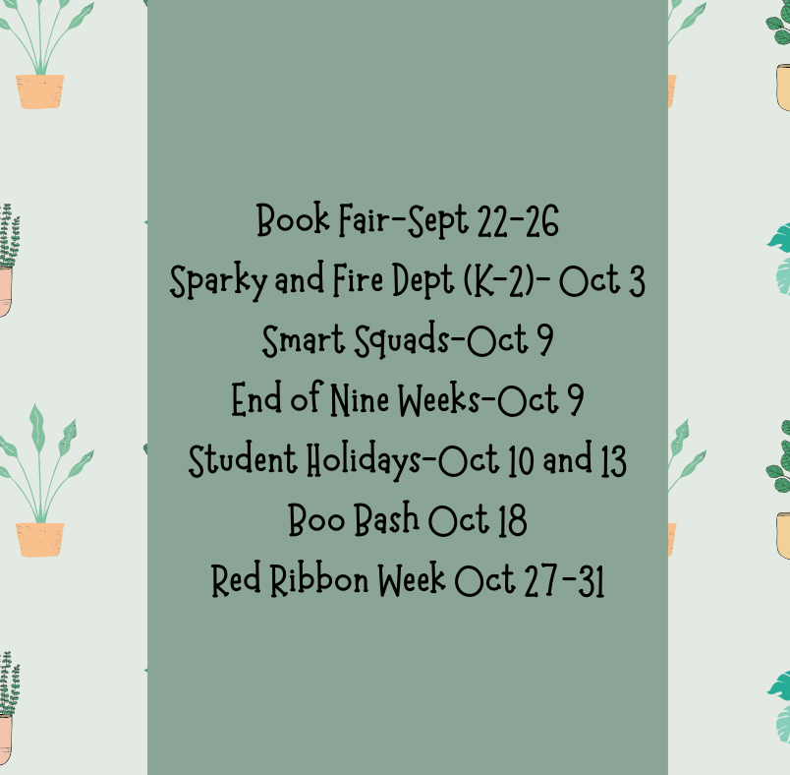
Notes:
Check monthly newsletters for events and information

Slide 7
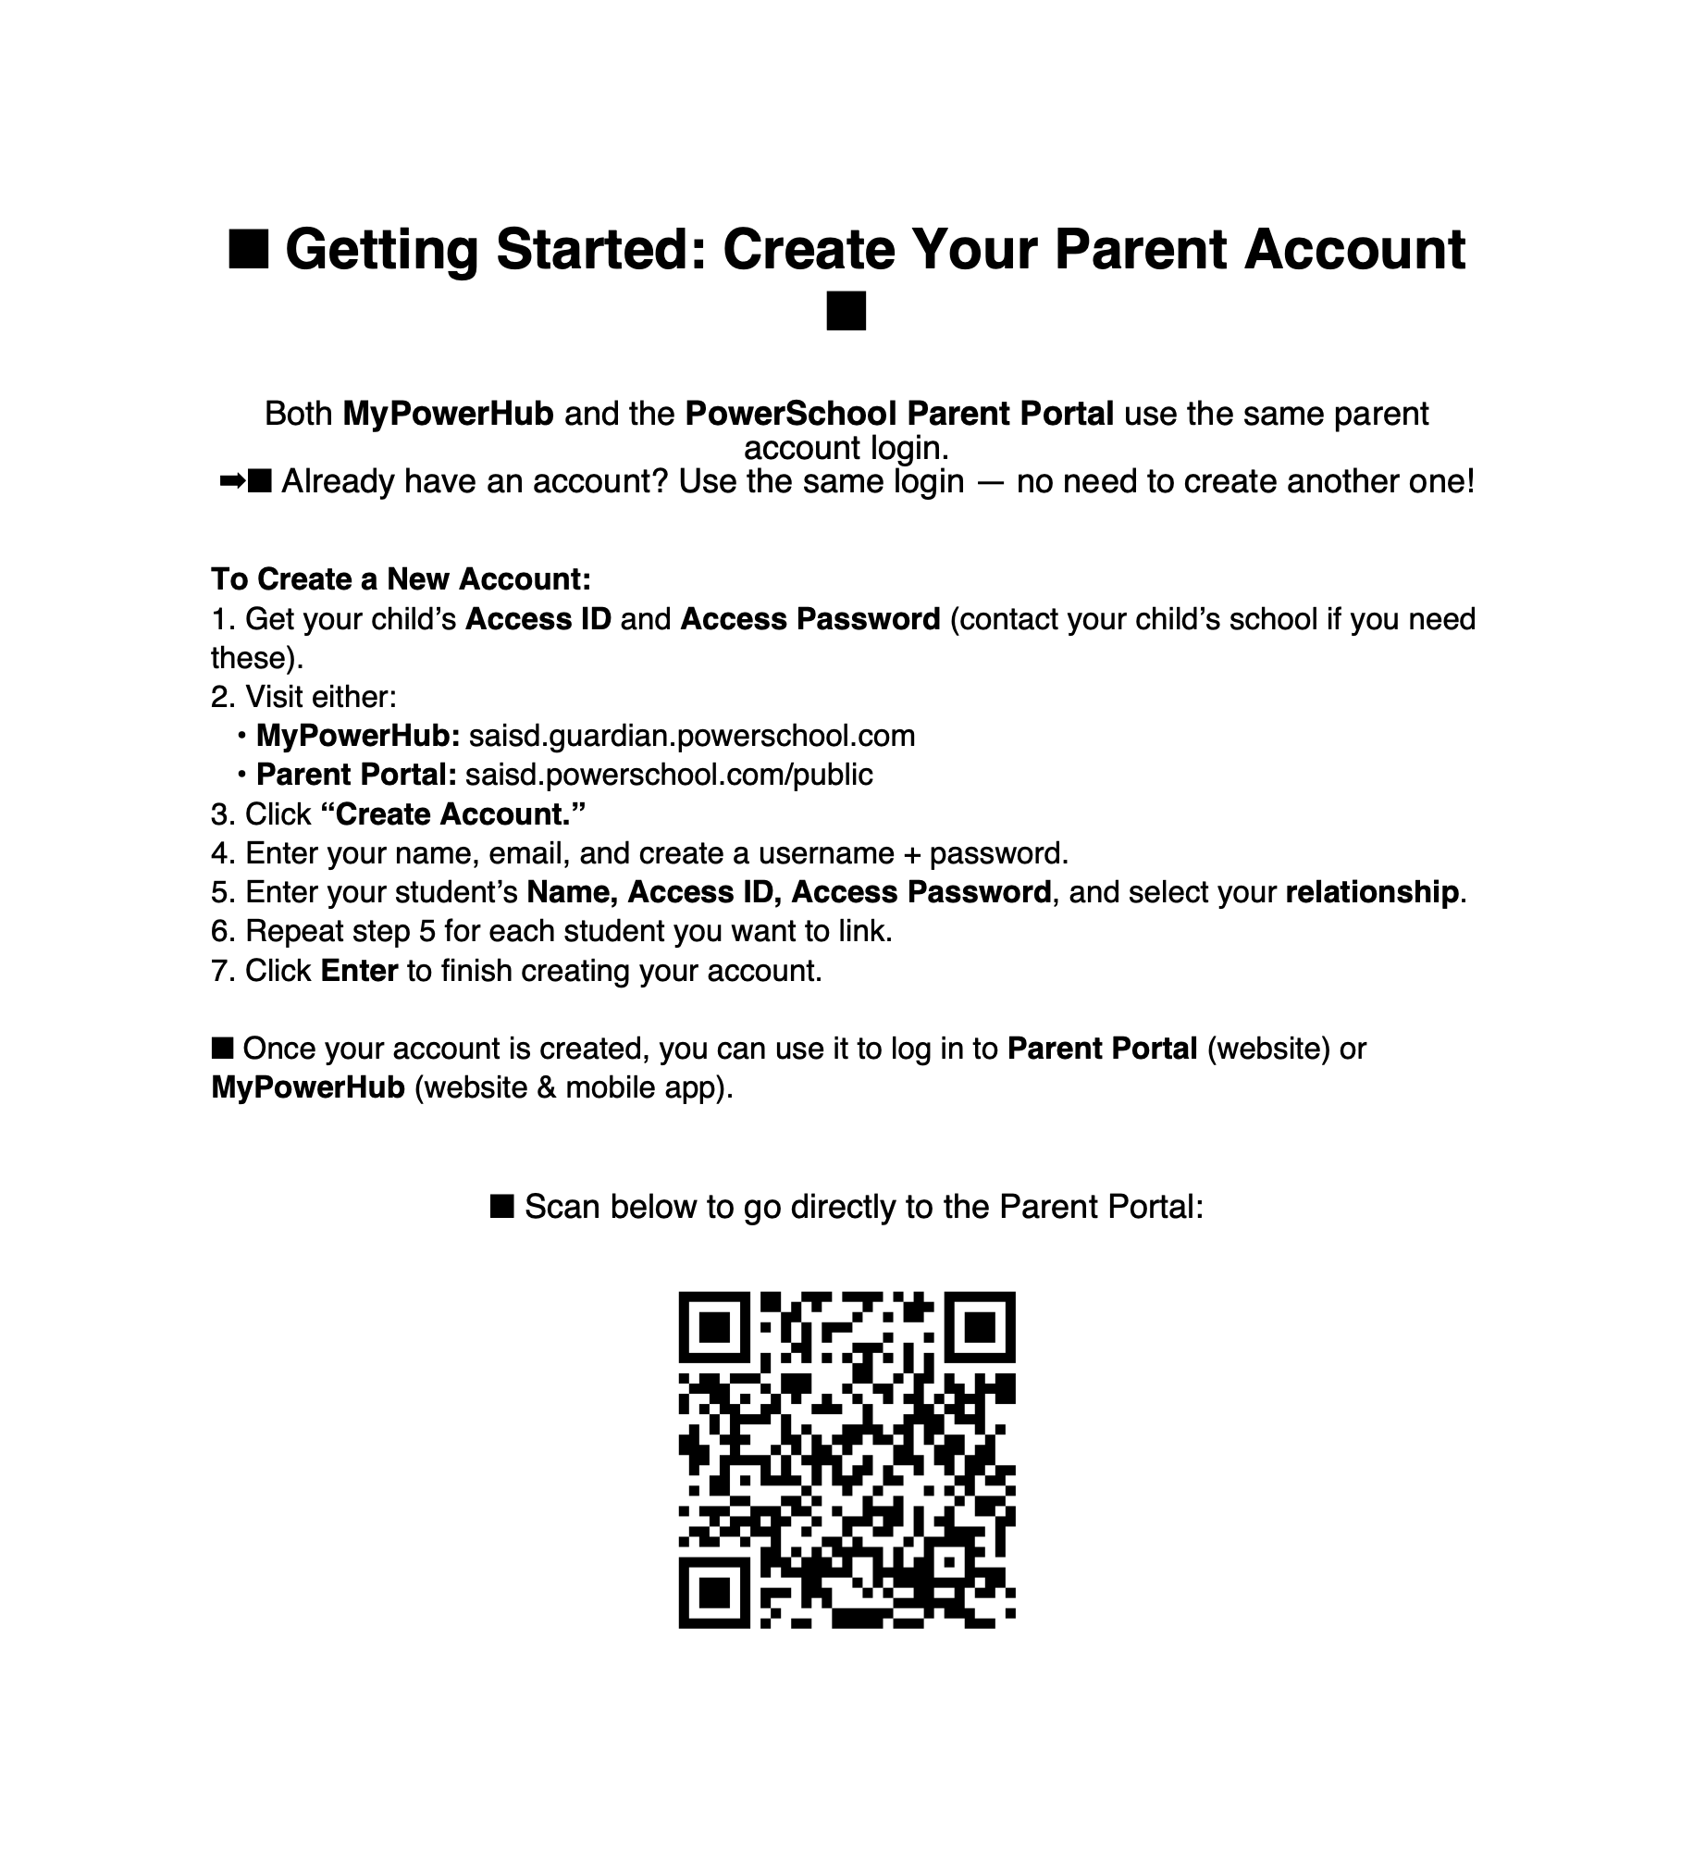

Sign up for My PowerHub and PowerSchool Parent Portal and stay connected!

Slide 8


Slide 9

Bowie Elementary 2025-2026

Slide 10
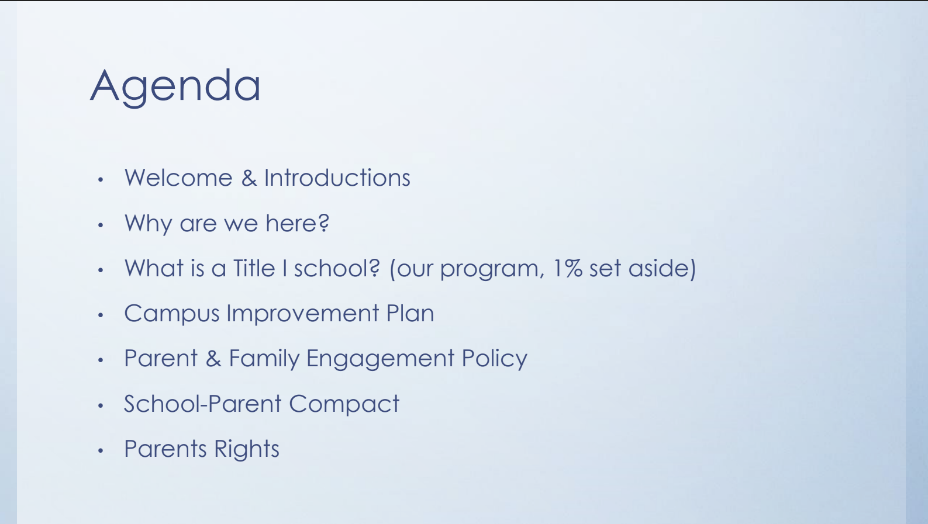
Notes:
Welcome to the Annual Title 1 Meeting
Parent family engagement-family tree lighting, boo bash, stem night, strong father’s, patriot picnic, music programs, grade level events

Slide 11
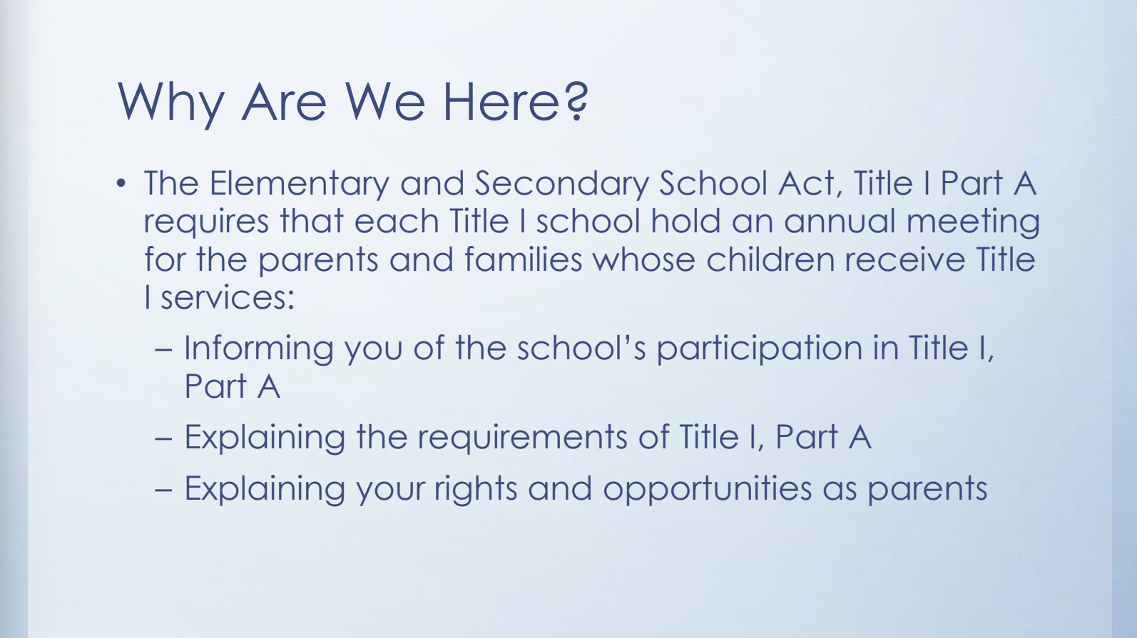

Slide 12
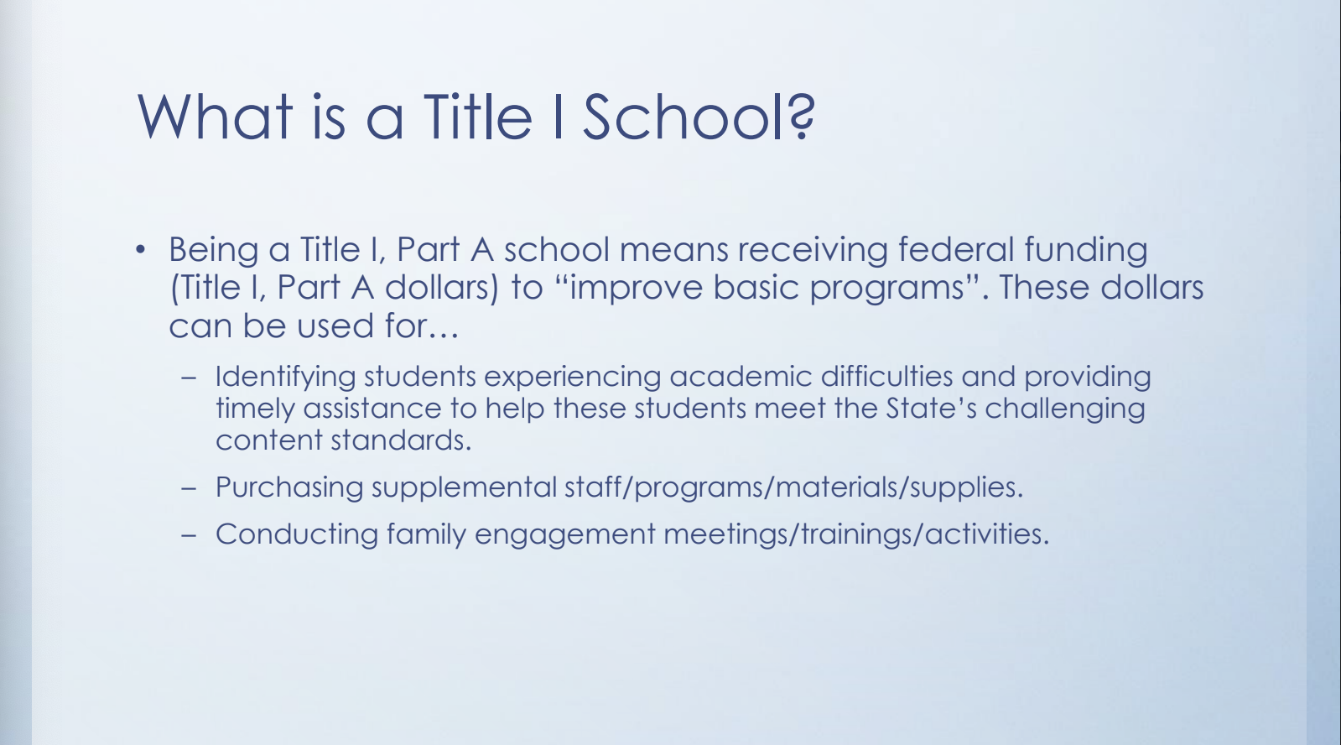

Slide 13


Slide 14
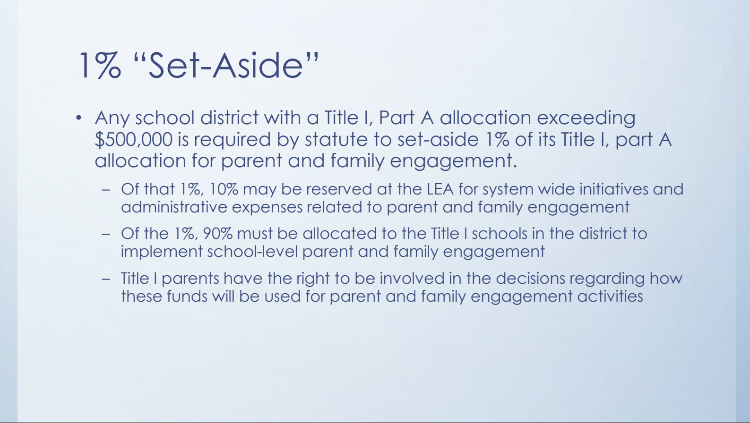

Slide 15
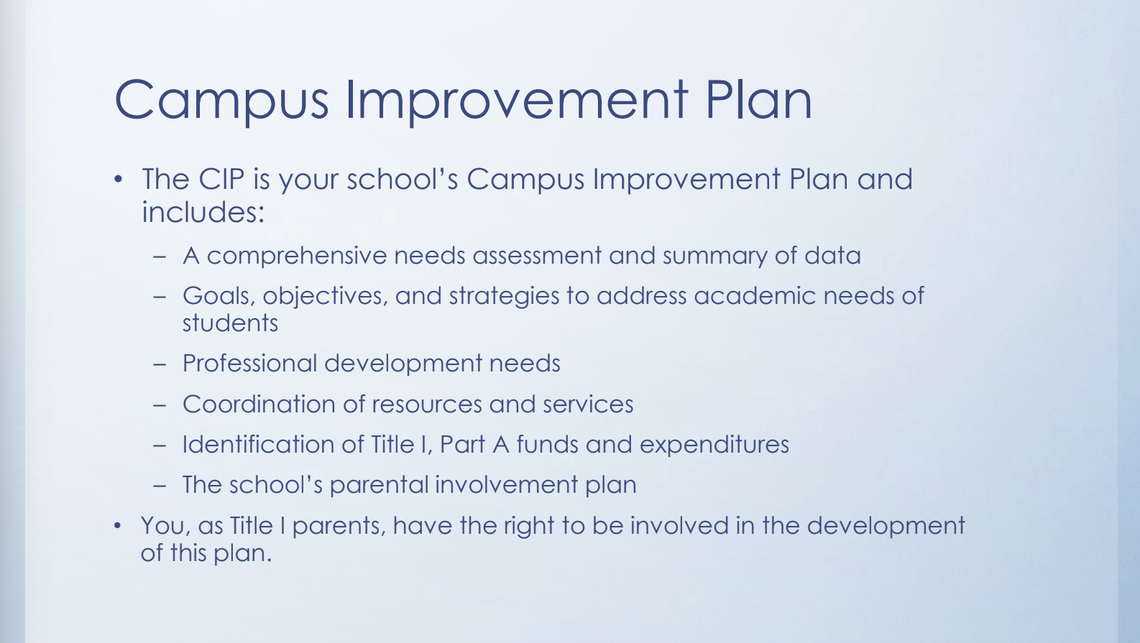

Slide 16
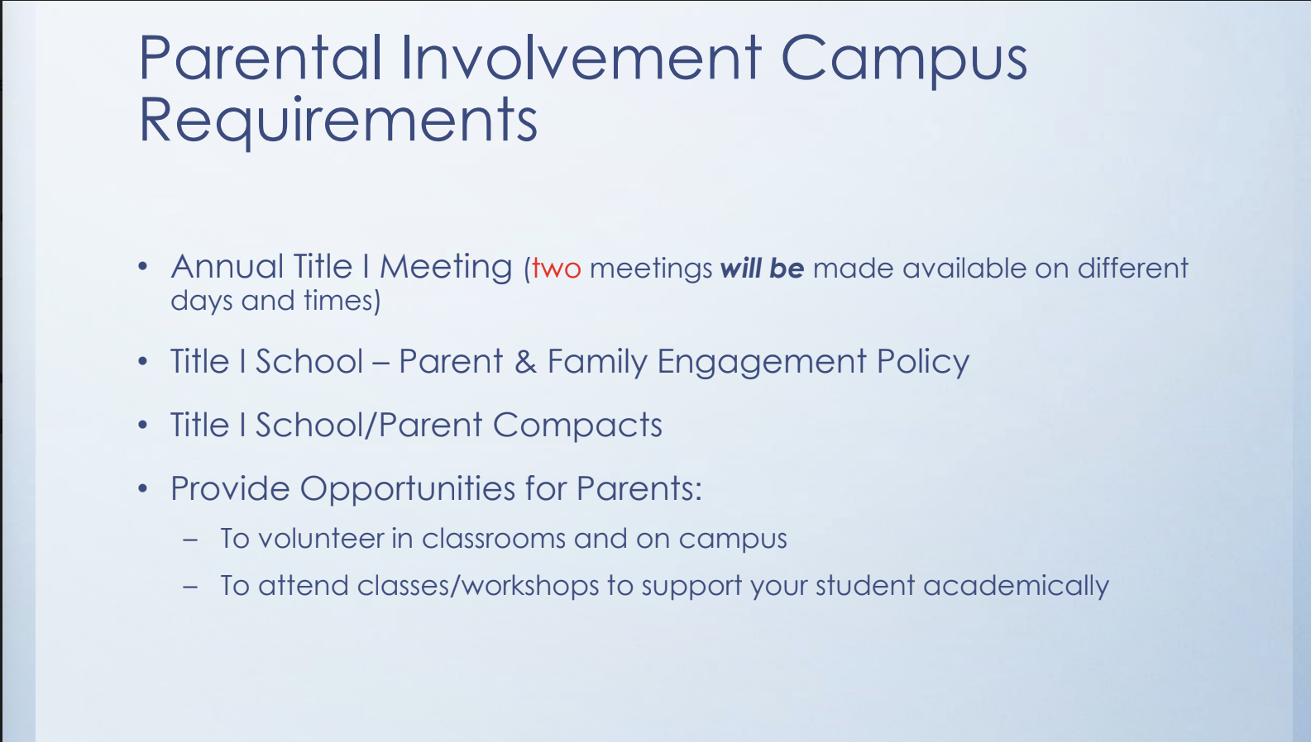
Notes:
Plans for 22-23 school year

Slide 17
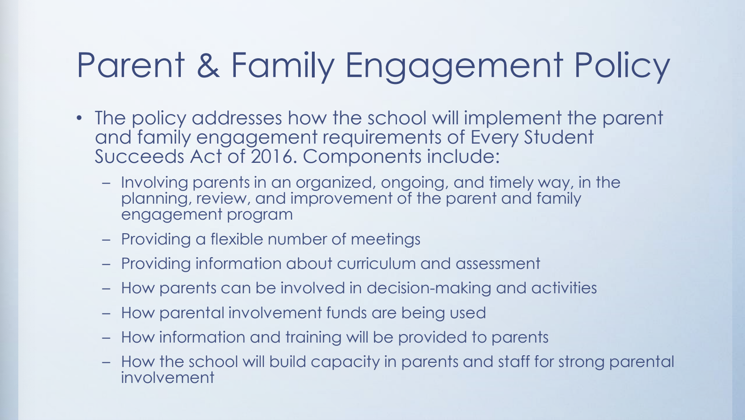

Slide 18

Notes:
We have printed copies and they are posted on the webpage

Slide 19


Slide 20
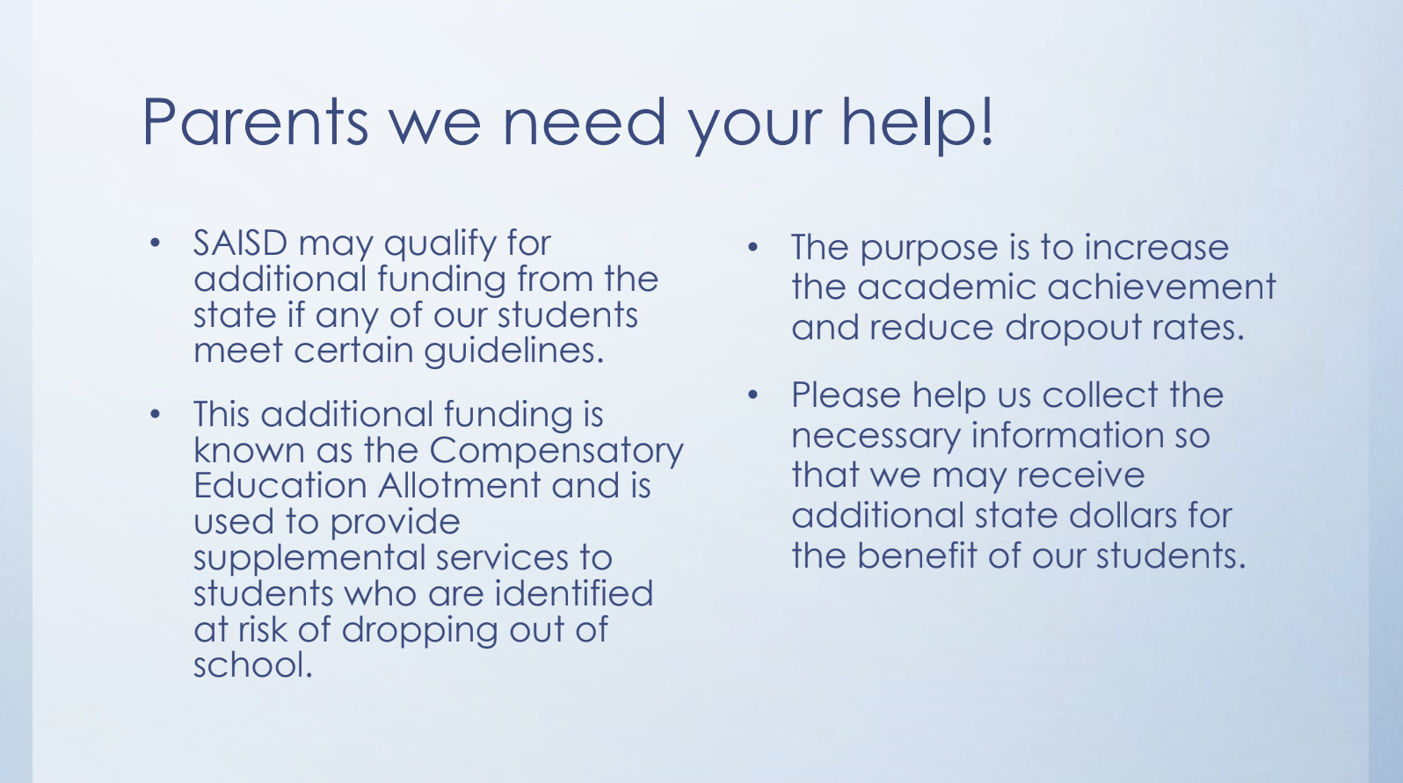
Notes:
PTO
VIPs
Attend events
Free and reduced lunch

Slide 21
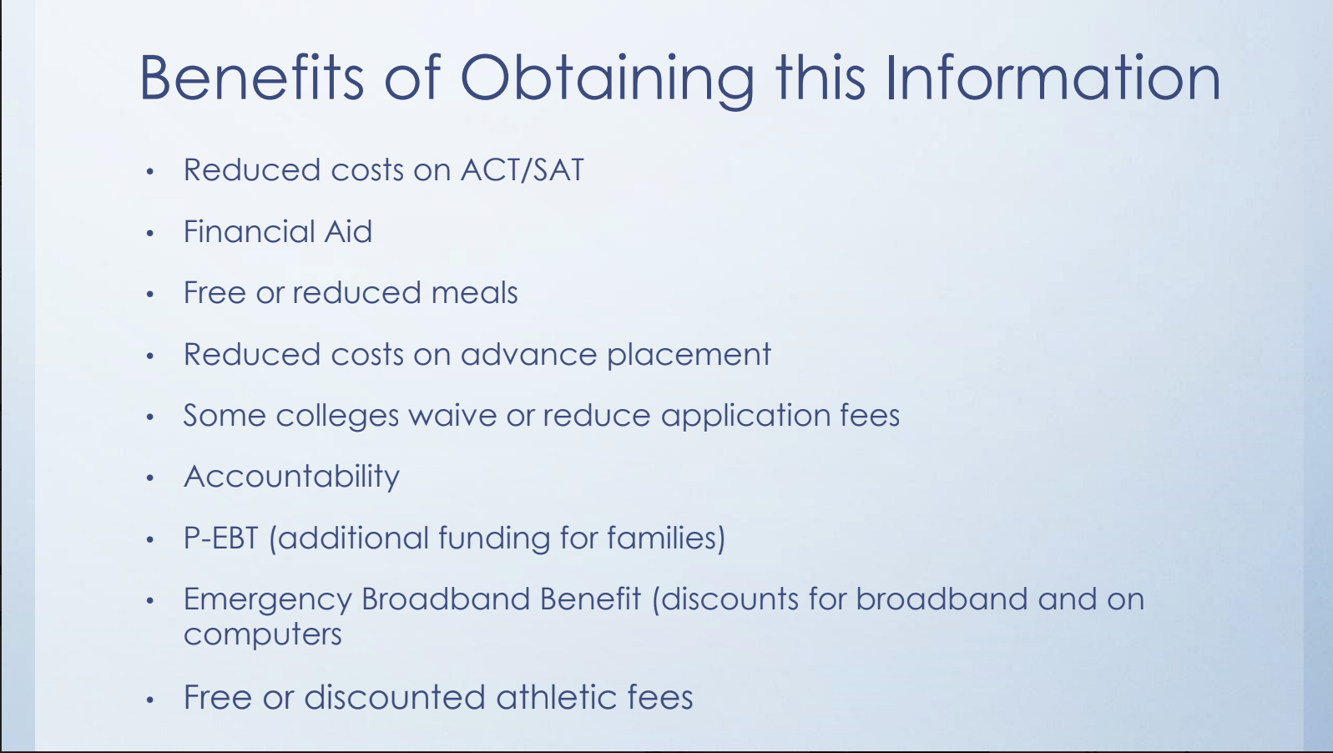

Slide 22

Notes:
Natalie is in cafe to assist with applying

Slide 23

Connect with Us
Notes:
PatriotHub Link

Slide 24

Notes:
Sign Up for those interested in being on the site base team

Slide 25


