Slide 1

Welcome Families

Slide 2
IMS PTSA
General Member Meeting
August 28, 2025

Slide 3
Welcome
Introductions

Slide 4
Your 2025-2026 PTSA Board Members
President: Jennifer Crespi | president@imsptsa.org
President-Elect: Mellissa Hill | presidentelect@imsptsa.org
Secretary: Lynette Dufton | secretary@imsptsa.org
Treasurer: Louise Farrell | treasurer@imsptsa.org
Assistant Treasurer: Mara McCune | treasurer@imsptsa.org
Co-VP Advocacy: Kim Florence and Laura Oberto| advocacy@imsptsa.org
Co-VP Communications: Sarah Hollenbeck and Adrienne Peterson| communications@imsptsa.org
Co-VP Community Building & Events: Lisa Kalschuer and Tricia Jaffe| community@imsptsa.org
Co-VP Belonging and Voice: Ruka Wolf and Caroline Caraballo | belonging@imsptsa.org
Co-VP Enrichment: Michele Ling and Yen-Ling Lee | enrichment@imsptsa.org
Co-VP Fundraising: Samantha Rubenfield and Meghan Banta | fundraising@imsptsa.org
Co-VP Operations: Jessie Bronson and Charlene Matukaitis | operations@imsptsa.org
Co-VP SSALD: Lisa Paladin and Gwynna Norman| SSALD@imsptsa.org
Co-VP Staff Appreciation: Jill Sharpe | staffappreciation@imsptsa.org

Slide 5
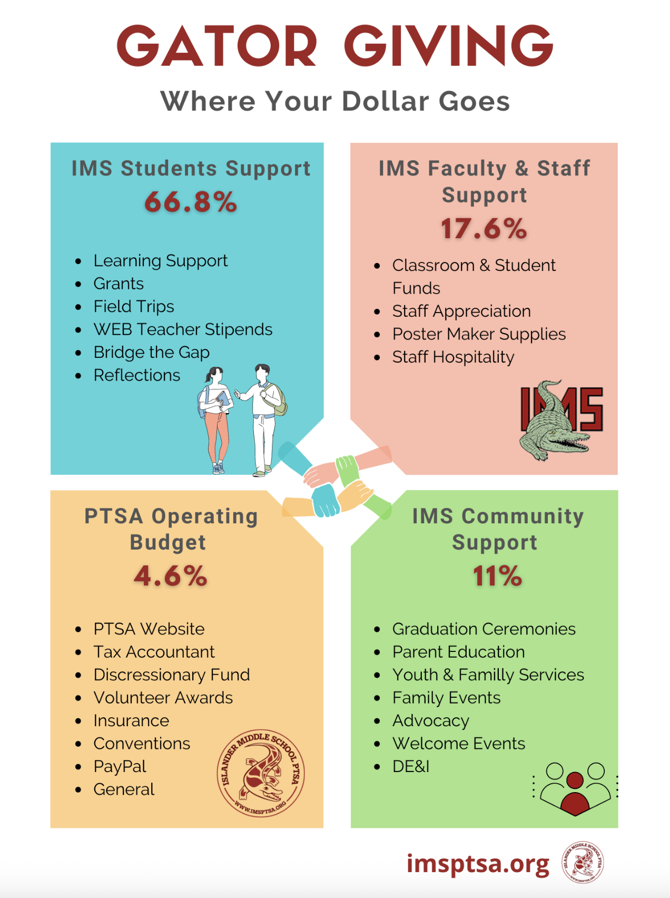
The IMS PTSA’s annual
campaign plays a crucial role in funding and enhancing the programs, events, and grants that the school cannot fully support through the district budget alone.
Every contribution goes directly supports IMS throughout this school year.
Every family that donates at least $275 to the Gator Give campaign will be entered into a drawing to win a reserved parking spot at IMS!
Gator Give

Slide 6
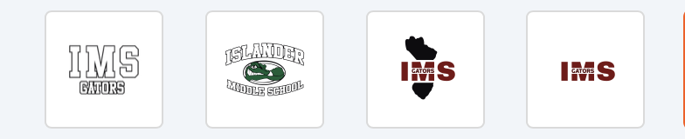
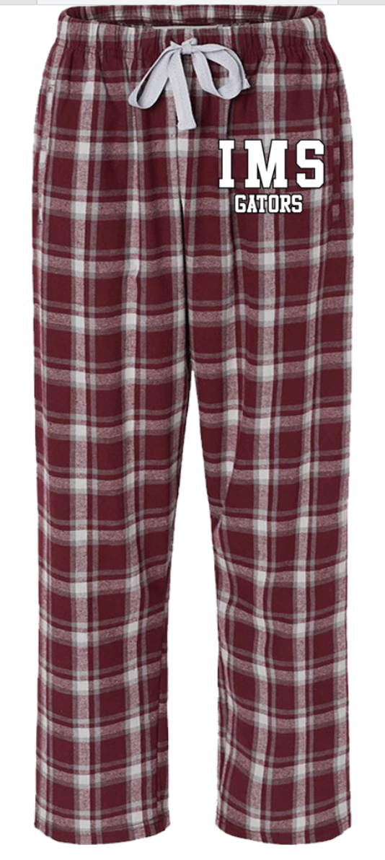
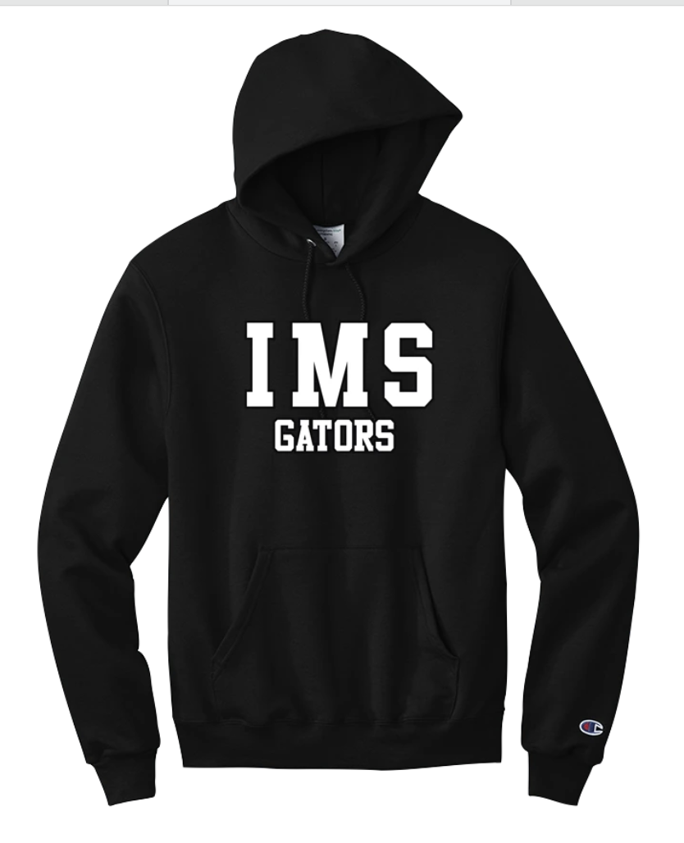
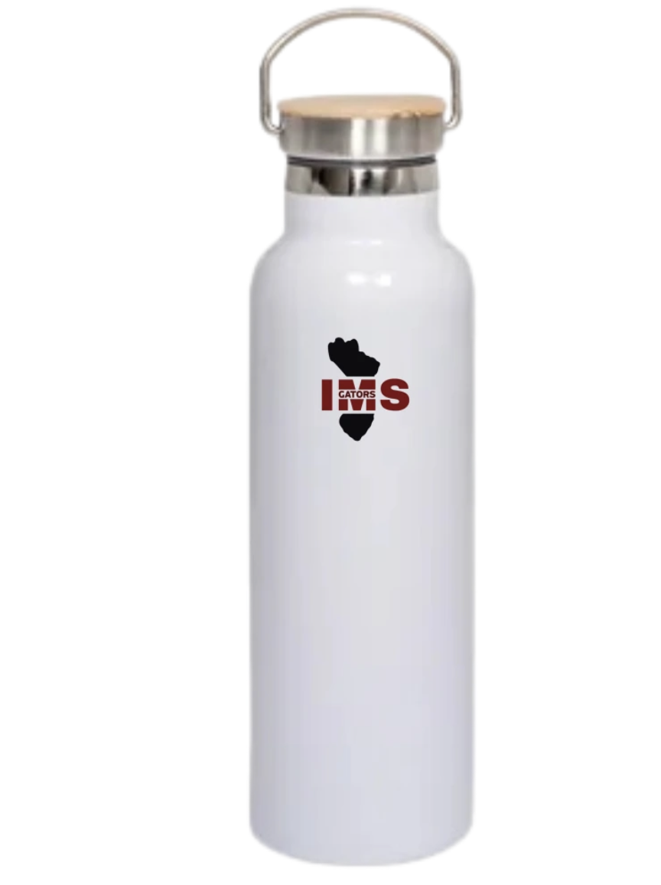
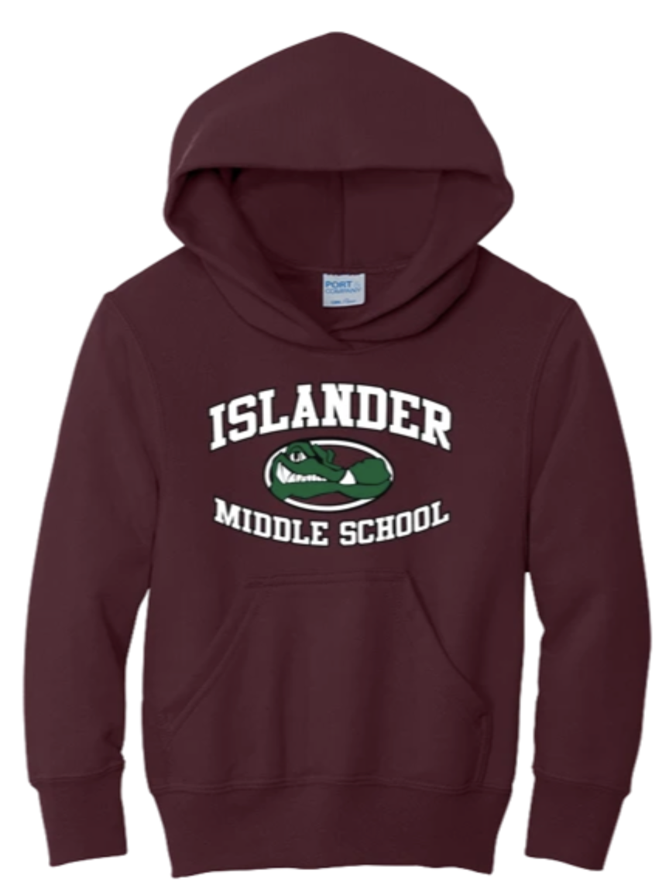
Show Your Gator Pride
https://imsgators.snap.store/

Slide 7

Upcoming Events & Programs
6th Grade & New Family Pizza Night
Thurs., Sept. 4, 5:30 pm
$5 per person
IMS Curriculum Night
Thurs., Sept. 18, 6:00 pm
6-6:20pm (optional parent presentation with Admin/Counselors)
6:30 Class Rotations Start!
See your child’s teachers in action, sign up to be a room parent, get to class before the bell rings!

Slide 8


Staff Amazon Wishlists Coming Soon!
We are hosting a dedicated tab on our PTSA website where families can view and shop
Staff Amazon Wishlists!

Slide 9
Meeting Business
Vote on 2025-26 Standing Rules
  Changes: WSPTSA Registered agent address changed, National PTA dues increased by $1, changed DEI to Belonging and Voice, changed by laws to reflect change with WSPTA about check signers (Board of Directors must approve check signers from any role on board appointed or elected).
Vote to approve May 15, 2025 meeting minutes
  The minutes from the May 15, 2025 membership meeting were distributed.
    Are there any corrections?
Review and vote on proposed 2025-26 Budget

Slide 10
Budget Review
Grants: $60k to fund a dyslexia reading support program trial and $40k to support teacher requests. Theses programs are supported by our reserves.
Proposed Total Revenue fundraising, memberships, pass-through costs | $114,445
Proposed Total Operating Expenditures stipends, events, programs, overhead | ($100,415)
Proposed Net Income Before Grants | $14,030
Proposed Grant Expenditures | ($100,000)
Proposed Net Income After Grants | ($85,970)

Slide 11
Introductions
IMS School Counselors: Dru Klein (A - G), Janet Goldstein (H - O), Jayna Dash (P - Z)
Mercer Island Youth and Family Counselors: Kate Howell and Katie Spencer
Nurse: Vicky Mai
Registrar: Marcy Berejka
Front Desk: Alison Monen
Attendance: Erin McGuire
Security Liaison: Mindi Oberg
Coaches: Kat Kuszak, Emily Mills and Maria Fontana
PTSA President: Jennifer Crespi
PTSA President Elect: Mellissa Hill
Administrators: Mary Jo Budzius, Katie Gallagher, and Vicki Sherwood
Notes:
Miller

Slide 12

Wise Words from Ted Lasso
‘Taking on a challenge is a lot like riding a horse, isn’t it? If you’re comfortable while you’re doing it, you’re probably doing it wrong.’
‘I hope that either all of us or none of us are judged by the actions of our weakest moments, but rather by the strength we show when and if we’re given a second chance.’
Pair & Share
Which quote do you think connects most with middle school?
Why?

Slide 13

MISD Mission, Vision & Values
Core Values Students are the priority. We believe in: supporting the whole child, inclusive and equitable learning settings, ensuring our school community is safe and supportive and providing a rigorous and challenging learning.
Vision Inspiring our students to be lifelong learners as they create their futures.
Mission Mercer Island School District will foster learning by engaging students to think critically, solve problems creatively, and work collaboratively.
Notes:
Budzius

Slide 14
At IMS, our educational approach blends high expectations with deep support for the social,
emotional, and academic development of our students.
We are committed to equipping students with the metacognitive skills and learning strategies they need to thrive not just in school, but in life.
In an ever-changing world, helping students become expert learners is one of the most powerful
and lasting things we can do.
Notes:
Budzius

Slide 15
Expert Learners
● Engage in learning with ownership and purpose
● Set goals and monitor their progress
● Reflect on feedback and use it to grow
● Take initiative and make choices in their learning
● Apply learning in meaningful and creative ways
● Transfer skills across contexts to deepen understanding.

Slide 16
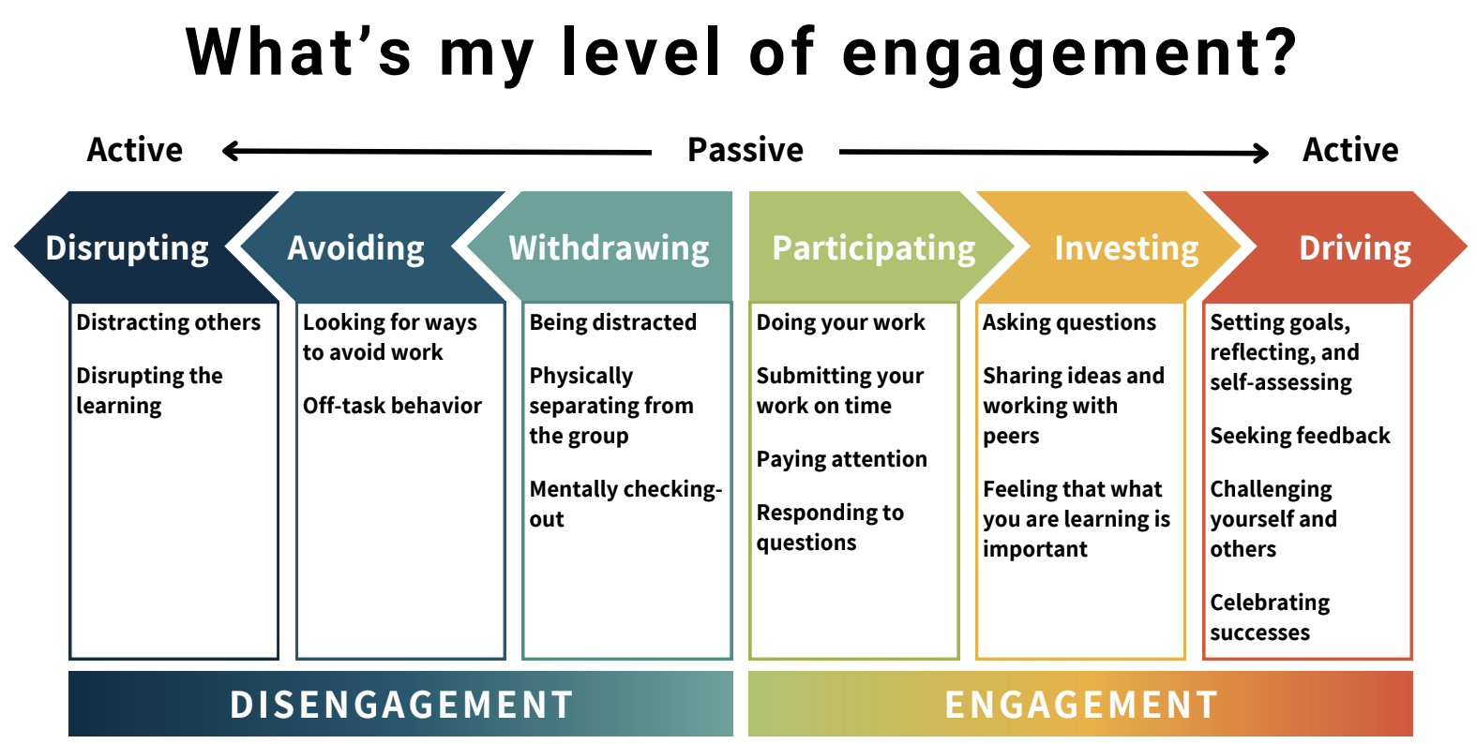

Slide 17
Parent Data - EES Survey
Essential Characteristic | EES Survey | Data Point | Year/ Percentage | Trend
High Standards and Expectations | Family Survey | My student is challenged with a rigorous course of study at this school | 2022 47% 2023 45% 2024 47% 2025 55% | ↑
 | Family Survey | Struggling students receive early intervention and additional help at this school | 2022 54% 2023 51% 2024 52% 2025 55% | ↑
 | Family Survey | Teachers Accommodate My Student's Individual Needs By adjusting instruction | 2022 49% 2023 44% 2024 44% 2025 53% | ↑
 | Family Survey | I am given opportunities to discuss my students progress at school | 2022 44% 2023 39% 2024 40% 2025 43% | ↔
High Levels of Collaboration and Communication | Family Survey | This school communicates with me about my student's progress | 2022 42% 2023 46% 2024 48% 2025 45% | ↓
 | Family Survey | I am encouraged to collaborate with my student's teachers about my student's learning | 2022 42% 2023 32% 2024 33% 2025 41% | ↑
Notes:
Budzius

Slide 18
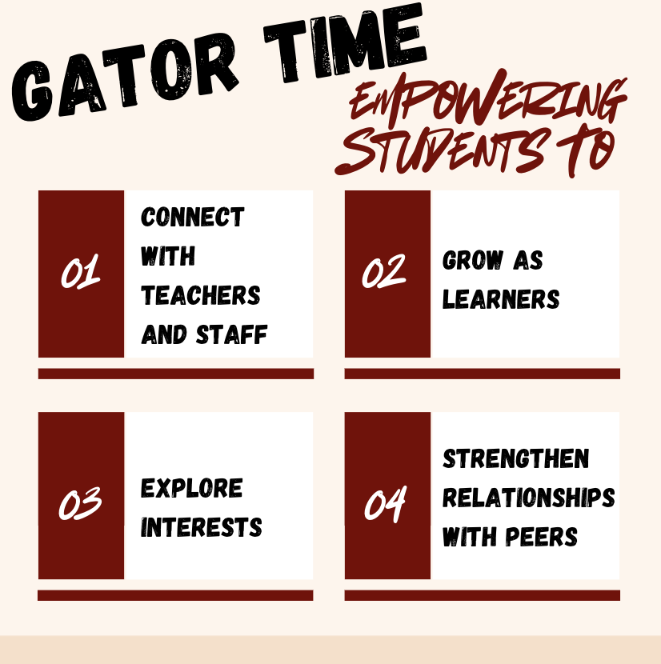
Gator Time
Monday, Tuesday, Thursday and Friday - Starting Sept. 11th
At the end of the day (2:25 - 2:50)
Notes:
Miller

Slide 19
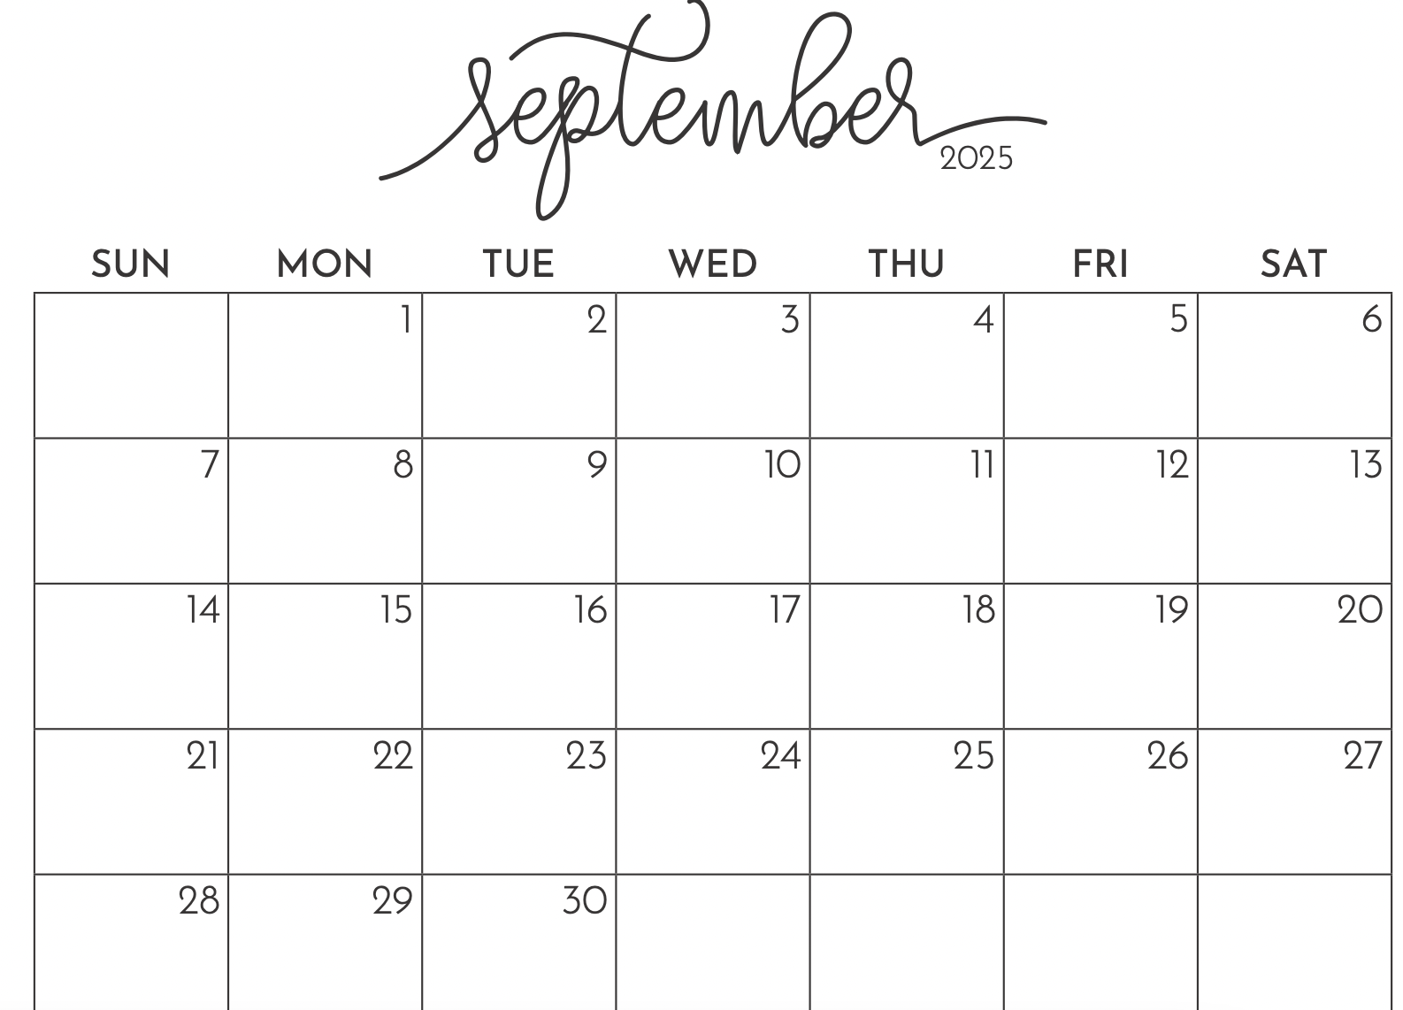
Gator Time Start -Up Schedule
GT Begins/Students return to a teacher on their schedule
Per. 1
Per. 2
Per. 3
Per. 4
Trial Run 1
Per. 5
Trial Run 2
Per. 6
iReady Extended Schedule
iReady Extended Schedule
First 4 Week Rotation

Slide 20
An Inside Look at Gator Time
Teachers (1.0 fte) | Paraprofessionals | Students
PLC | Host a Choice Activity | Choice or Connection, or Extended Support
Connection (8 students minimum) | Host a Choice Activity | Choice or Connection, or Extended Support
Host a Choice Activity | Host a Choice Activity | Choice or Connection, or Extended Support
Host a Choice Activity | Host a Choice Activity | Choice or Connection, or Extended Support
Day 1
Day 2
Day 3
Day 4

Slide 21
Choice Options = Trial Run & First 4 Weeks
Independent Reading
Board/Card Games
Drawing
Gym Activity
Foosball
Chess
LEGO Building
Gym Activity
Collaborative HW
Walk the Track
Coloring/Drawing
Independent HW (Quiet)
Orchestra
Digital Group Games
Nintendo
Choir
Band
Creative Writing

Slide 22

Room Parents
Our goal is to continue to nurture a collaborative and inclusive environment where families feel involved and informed. We are asking classroom teachers to recruit a room parent at curriculum night.
The Room Parent will help with
Recruiting support from other parents for the teacher as needed for things like bulletin boards, small group and/or one to one help in the classroom, fieldtrip volunteers, Amazon Wish Lists coordination, etc.
Encouraging family involvement in the school community.
Room parents will act as a liaison between the teacher and classroom parents.
Notes:
Katie

Slide 23
School Supplies
Our Goal is to have students lighten the load that they carry in their backpacks.
We are asking that students only carry:
A Charged iPad
Lined paper and some means to organize the paper and organizational tool (3 ring binder with dividers, pocket folders, etc.)
Pens/Pencils
Yondr Pouch (if applicable)
Therefore, we are looking for teachers to work with their Room Parent to create an Amazon Wish List of supplies to be housed in the classroom. (Rulers, Pens, Highlighters, Sticky Notes, Note Cards, Colored Pencils, Scissors, Composition Notebooks, folders, etc.)
Notes:
Katie

Slide 24
Student Health and Wellness
All students must be compliant with WA State immunization requirements.
  Required Immunizations for School
Access your student’s immunization records through the https://myirmobile.com/
All over the counter medications like Tylenol, Ibuprofen, Zyrtec, require a Medication Authorization Form with a physician signature. Even if your student is carrying them in their backpack.
Medication Authorization Form
IMS Health Room Phone numbers:
  Nurse’s Office: 206-275-5961
  Health Room: 206-275-5839
  District Cell: 206-902-7037
Notes:
Vicky Mai

Slide 25
Puberty
Personal hygiene video - a great video that explains what happens to teens’ sweat glands as they go through puberty
Period Care Pack Items
-Extra underwear
-Pads, tampons, liners, or menstrual cup
-Baby wipes
-Plastic bag
-Leggings or back up pants (optional)
-Tampons/Pads free in all bathrooms
Notes:
Vicki Mai

Slide 26
Absentee Policy and Communication
The Islander Middle School Attendance Policy can be found on the IMS Website (https://ims.mercerislandschools.org/), About Us Tab.
If your student will be absent, late to school, or need to leave early please contact the Absentee Line:
  Call or email the IMS Attendance Secretary by 8:20 am on the day of the absence. Leave a message informing her of the absence. Provide your child’s name, grade, date and reason for the absence.
Erin McGuire - IMS Attendance Secretary
Email - Erin.mcguire@mercerislandschools.org
Phone: 206-236-3400
Notes:
Katie

Slide 27
Clubs and Activities
Currently TBD as we get started this year
Club/Activities (possible examples may include)
  Creative Writing Club
  Dance Club
  Destination Imagination
  Drill Team
  Drama Club
  Dungeons & Dragons Club
  Girls Group Lunch
  Golf Club
  Newspaper Club
  Open Gym
  QUILTBAG
  Robotics Club
  Running Club
  Sources of Strength
  Ultimate Frisbee
Sports 2025/26
  Cross-Country (August, September/October)
  Esports
  Track (May/June)
  Ultimate Frisbee
  Volleyball- 7th and 8th grade girls (August/September/October)
  Wrestling (October/November/December)
Notes:
Katie

Slide 28
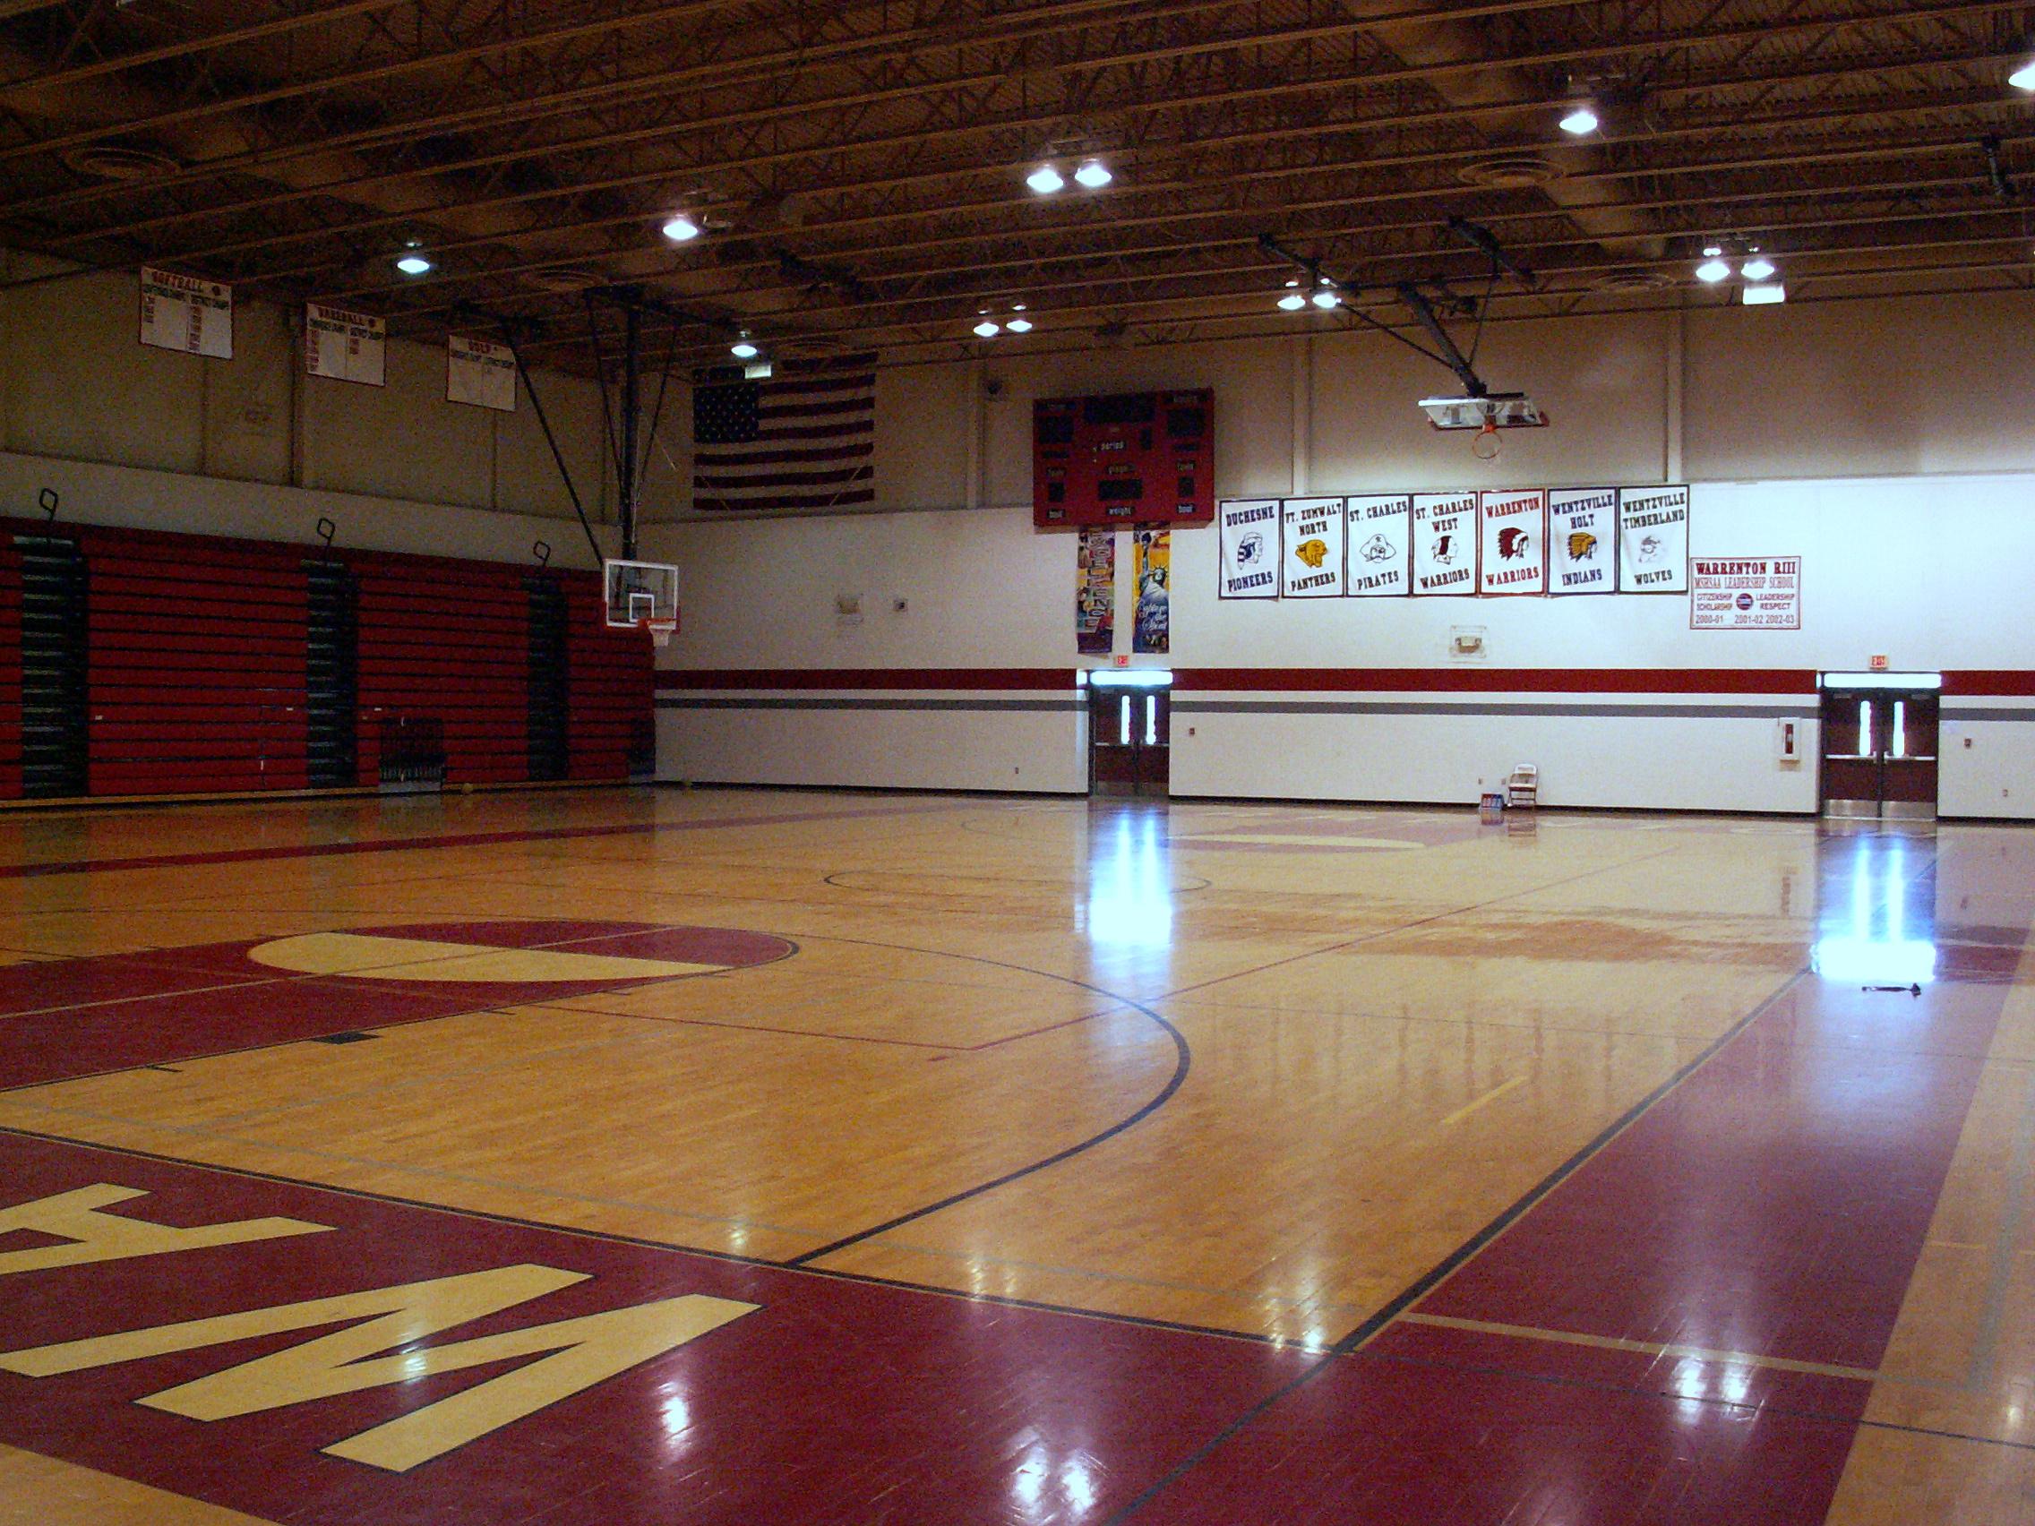
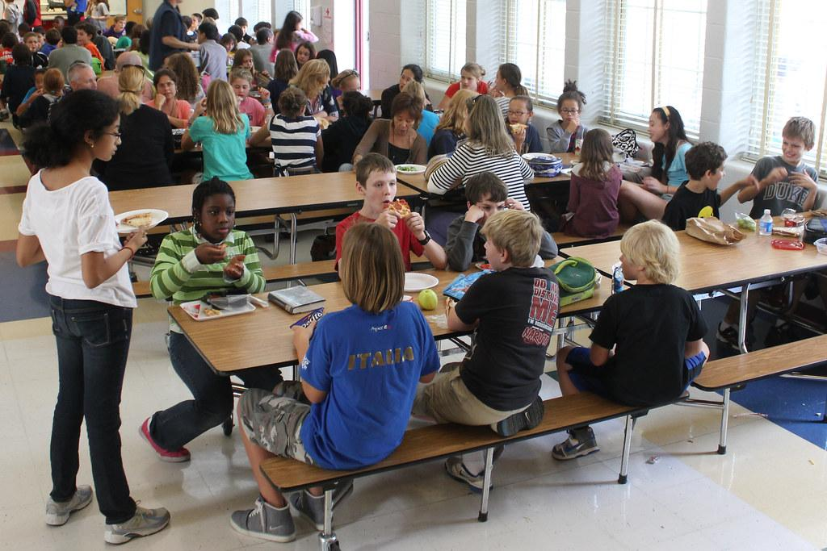
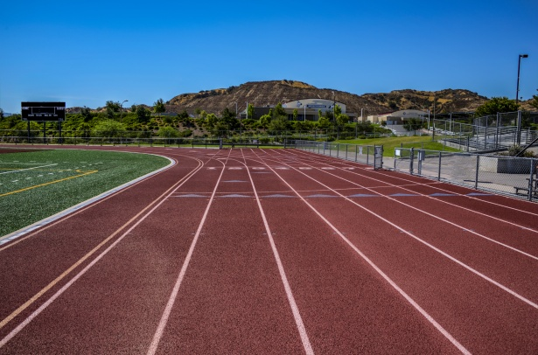
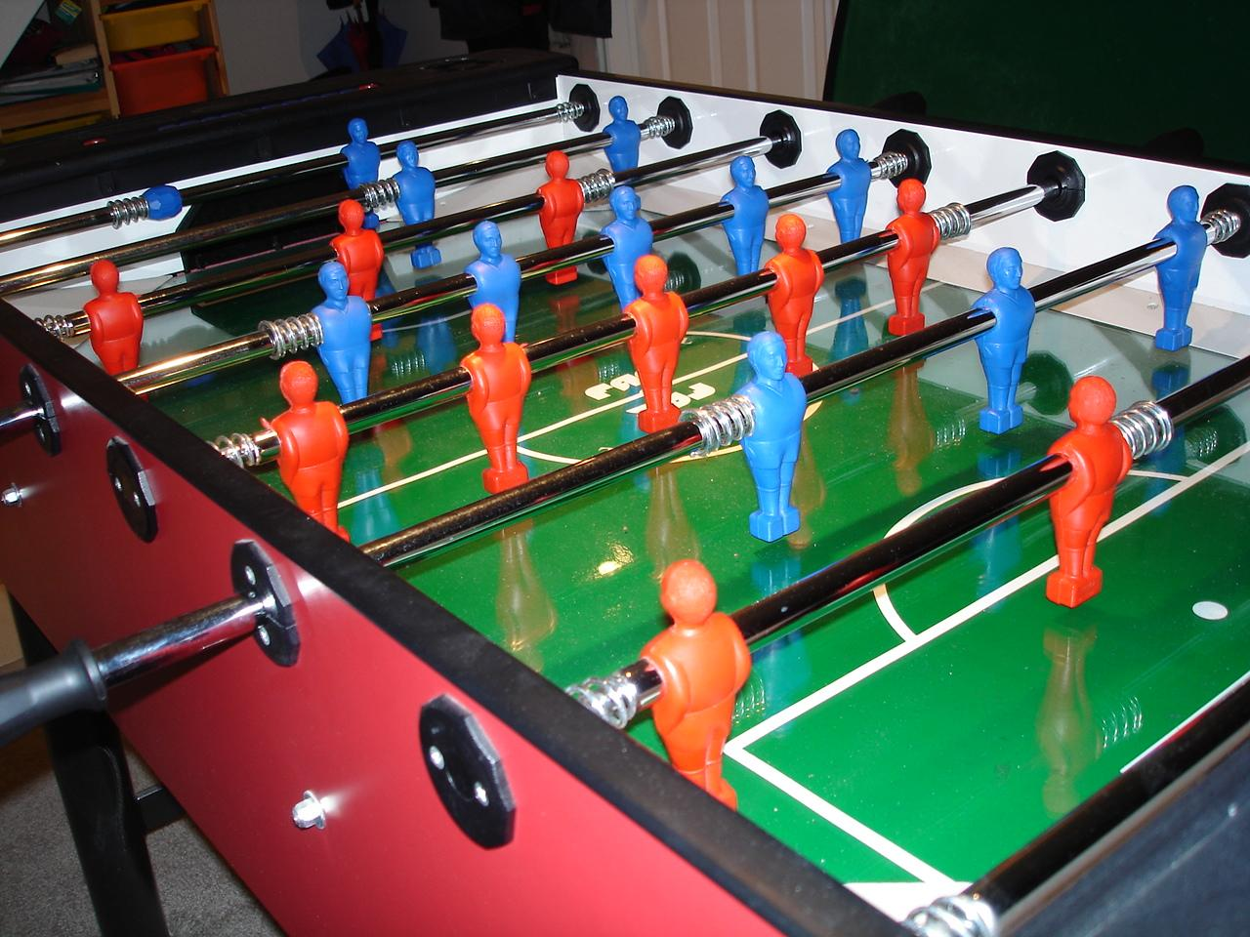
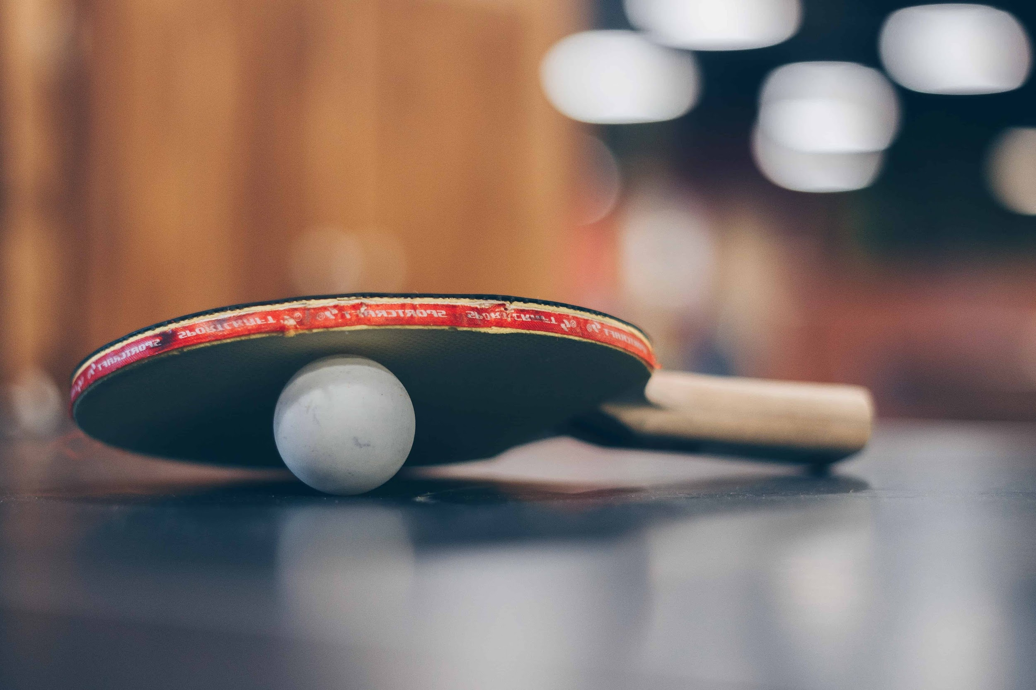
Lunchroom Protocols
Be Respectful, Be Responsible and Be Safe
Notes:
Mary Jo

Slide 29
Technology for 2025/26
  All students have iPads.
  The priority for iPads is academic - both during school and at home.
  Students may download apps from the school-monitored catalog, called Self Service
  Do not sync iPads with personal Apple accounts.
  We encourage parents to make rules regarding the iPad for home.
  For more comprehensive information and support with your student’s technology, please visit the MISD Tech website and/or our MISD Tech Youtube channel
For tech support email ims.techs@mercerislandschools.org
Notes:
Vicki

Slide 30
Personal Devices Policy
(Phones/Watches/Headphones)
If a student plans to carry a cell phone, smartwatch and/or ear buds during the school day, that student must bring a Yondr pouch to school with them each day.
At the conclusion of the student day
Students will have the opportunity to unlock their bag as they leave campus or before attending after school clubs, sports or activities. Unlocking stations will be located around campus.
Late Arrival/Early Release - Students arriving late or leaving early will pouch/unpouch their phones in the main office as part of their check-in/check-out process.
As students enter the school buildings and no later than 8:20 am, they will
Put their phone (and/or) watch in “Do Not Disturb” mode.
  Do not disturb on iPhone
  Do not disturb on Android
They will place phone, watch, and/or ear buds in the pouch.
They will lock the pouch
There will be a first period Yondr bag check. (7th and 8th Grade families- many students have lost or broken pouches a replacement is $25.)
The Yondr bag will remain locked and in their bag while the student is “on campus”.
Notes:
Katie

Slide 31
FAQ’s related to our new tech policy
What if I need to contact my child during the day?
You can email them via their school account
You can contact the main office and someone can get a message to them
My child forgot their lunch/instrument etc. How do I get it to them?
You are welcome to send them an email and let them know when you plan to drop it off. Then, they can swing by the front office during passing period or ask their teacher for permission to go and get it.
I am worried about my child’s ability to interact during lunch. Any suggestions?
We have small, supported lunch groups daily with our counseling team
We have low stakes opportunities during lunch like open gym, foosball, ping pong, access to the Library
Students will still have access to their ipads during lunch and/or they are welcome to read a book
Counselor are available to talk to individual students and parents to discuss additional strategies
My child has anxiety and sometimes needs support during the day. How can I help from home?
Remind your student that they can always access their Counselor via Schoology or they can stop by their office
They can ask their teacher to take a break in the Zen Den
They can take a quick walk and/or get a drink of water to regroup
We encourage you to strategize in the evenings and prepare your child with ways to cope that feel good/accessible to them
With teacher permission, they can listen to music on their ipad (The Bridge)
Notes:
Aaron

Slide 32
WEB
Where Everybody Belongs
Objectives:
To empower 8th graders as role models for 6th graders
To develop leadership skills in students on our campus
To allow successful older students to pass on positive traditions to younger students
To transition 6th grade students in a cohesive, fun and positive way
To help create an even more supportive and positive atmosphere at IMS
WEB is a national program that IMS has been a part of for 14 years.
Notes:
Dru Klein

Slide 33
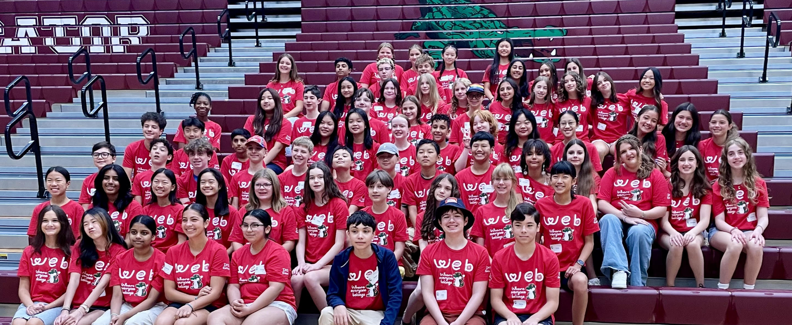
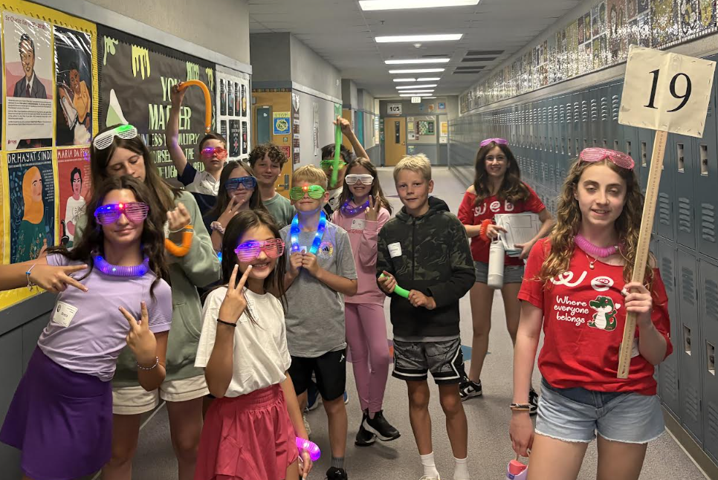
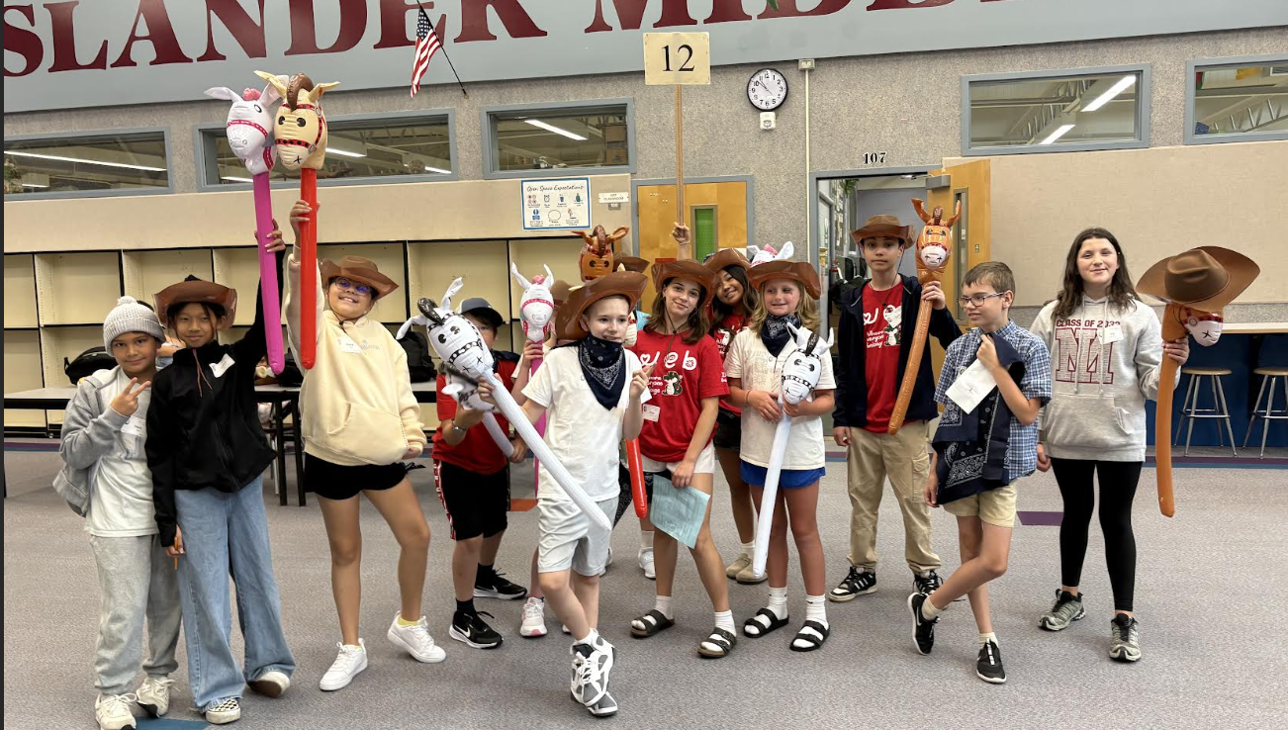
WEB First Day of School
Notes:
Dru

Slide 34

Upcoming Dates
September 4th - 6th Grade/New Family Pizza
September 13th - Application for Tier 1 Team Due Date (Parent Advisory Council)
September 15th - Photo Make Up Day
September 18th - Curriculum Night
October 16 - School Board Site Visit
October 16 - 1st Tier 1 Team Meeting (PAC)
Notes:
Budzius

Slide 35
2025 Curriculum Night
  All School Curriculum Night - September 18th
  6:00 pm to 8:00 pm
Admin/Counselor Optional Opening Session 6:00-6:20
Repeat Information from today
Reminders:
Wear comfortable shoes
Know that parking will be super challenging
Purpose to hear from teachers
Room Parent Sign-Up Opportunity
Notes:
Budzius

Slide 36
Parent Involvement Opportunities. . .
PTSA
Feb. 8, May 9
Tier 1 Team (Parent Advisory Committee)
Oct. 16, Nov. 20, December 18, February 5, March 19, April 23, May 21
Application - Due Date Sept. 13th
Notes:
Budzius

Slide 37
Stay in the “know”
PTSA Blasts and Newsletter
IMS Website
IMS Weekly Updates
Monthly Spotlight
Notes:
Aaron

Slide 38
Who do I go to for help?
Start with the person closest to the issue . . .
If it’s a classroom problem, begin with the teacher.
If it’s a social-emotional, attendance, multi-class issue, or anything else- begin with the counselor.
Notes:
Katie

Slide 39
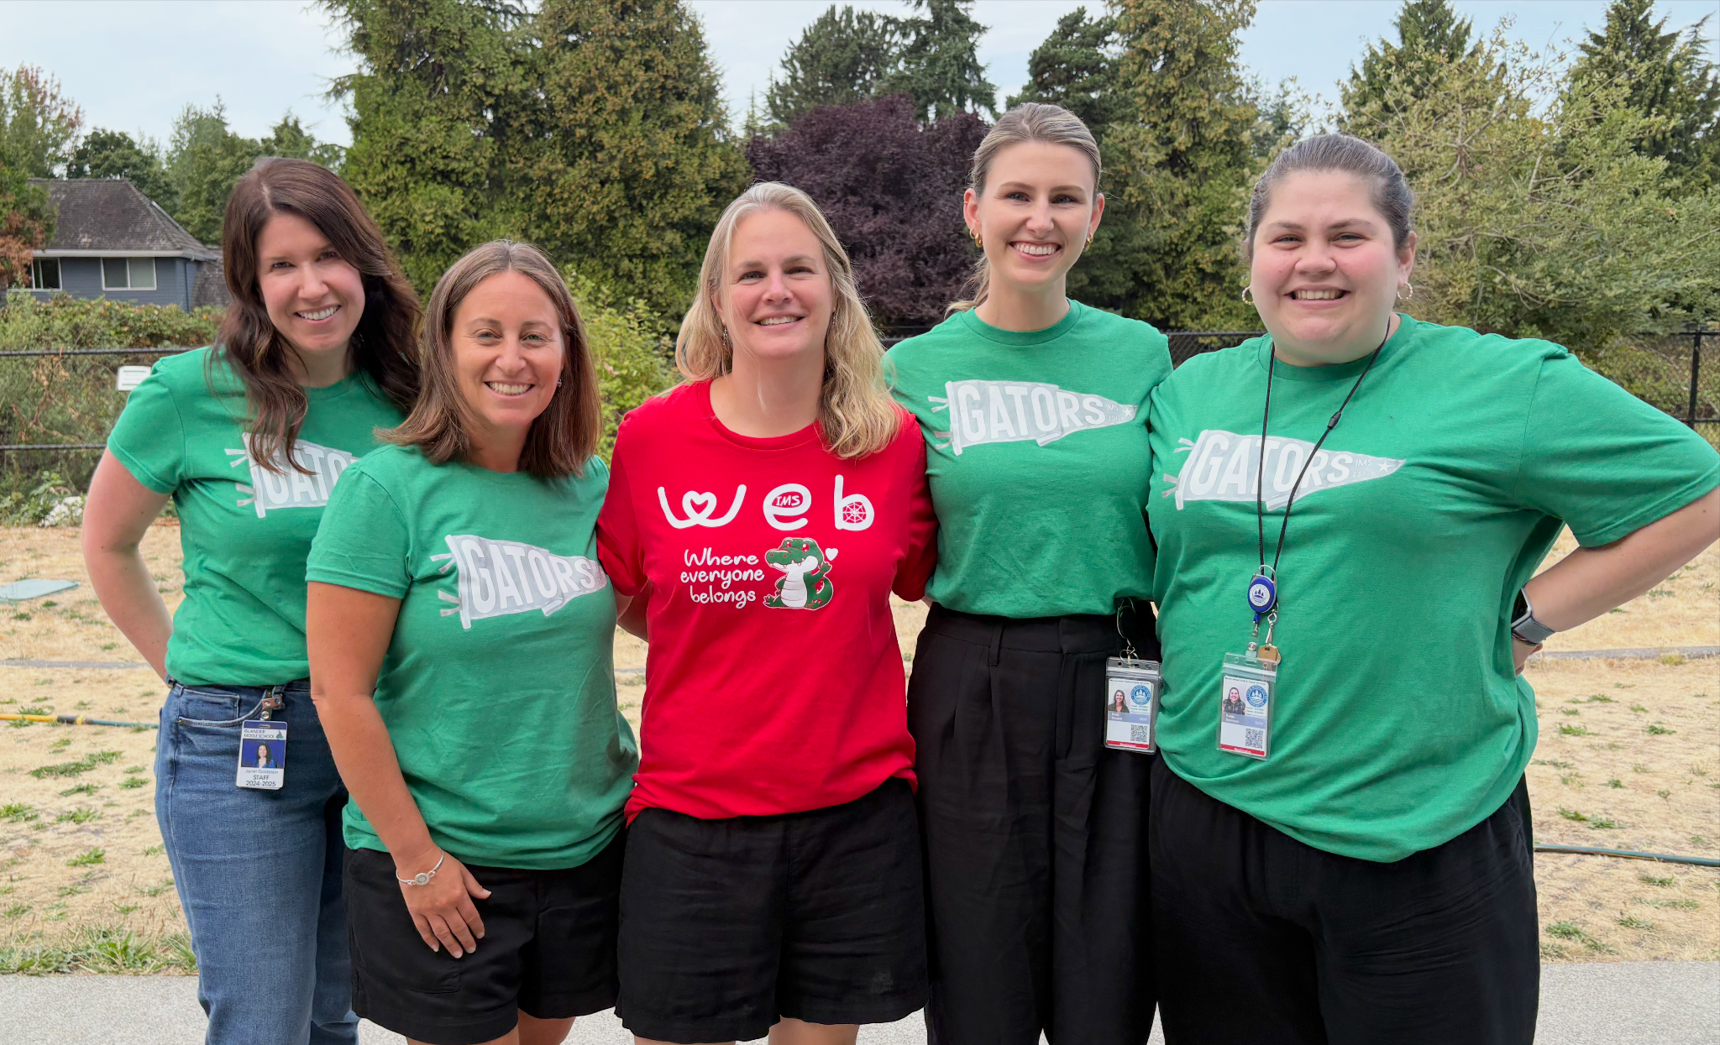
How do I connect with a Counselor?
You are always welcome to call or email us!
(Happy to answer any and all questions, even if you’re not sure who else to ask)
Students are encouraged to chat with us in the hallways or during lunch, stop by our offices, send us a Schoology message or email us anytime! They can also ask their teachers to come see us.
Notes:
Dash

Slide 40
New Staff at IMS
NEW STAFF
Notes:
Budzius

Slide 41
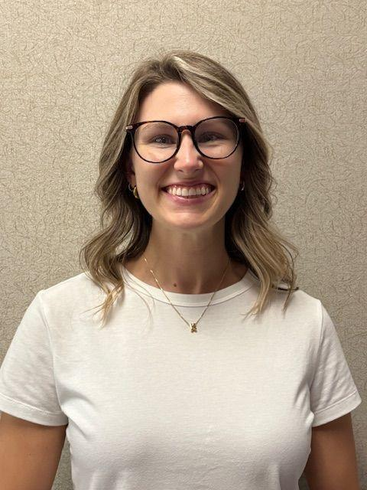
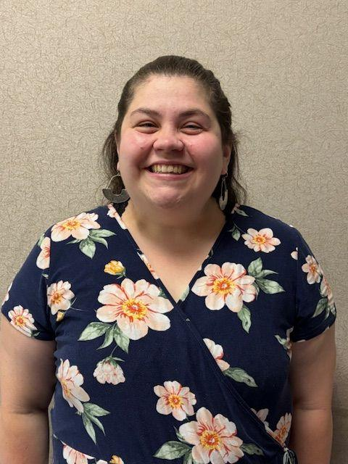
MIYFS Counselors
Kate Howard
Katie Spencer

Slide 42
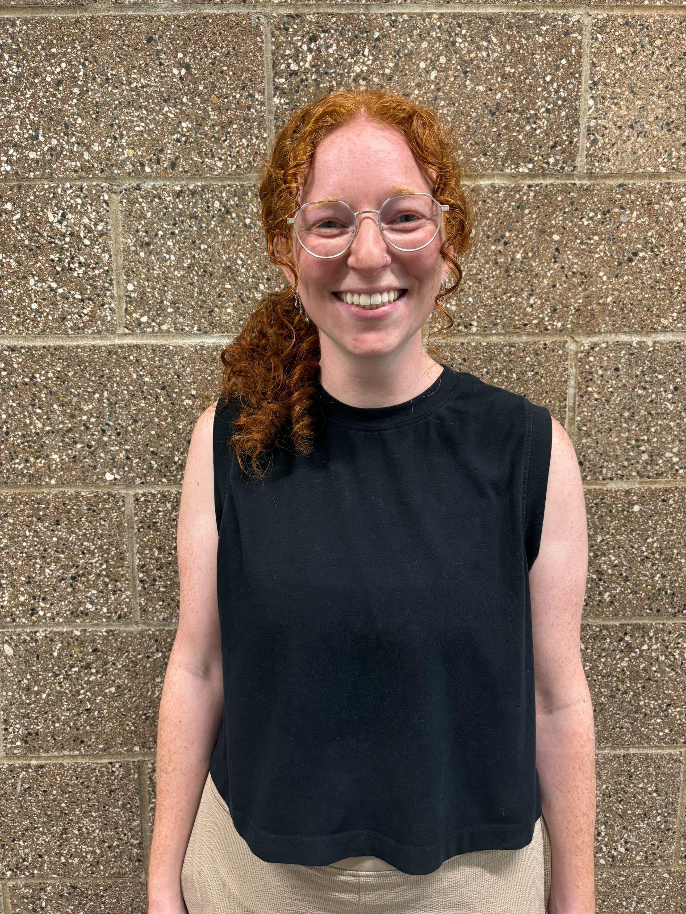
Rachel Bendik - Art Teacher
Notes:
Mary Jo

Slide 43
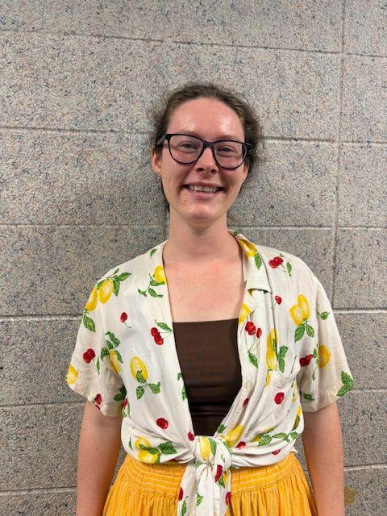
Kate Scully- Social Studies
Notes:
Mary Jo

Slide 44
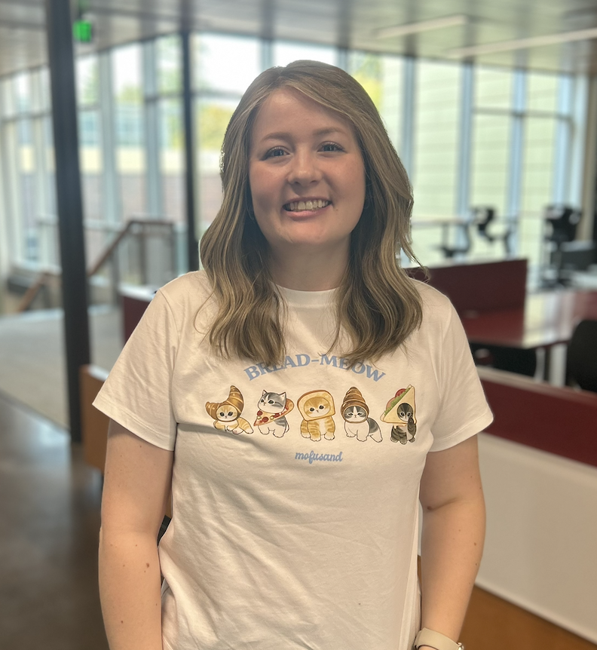
Gabby Hasenyager- Science Teacher

Slide 45
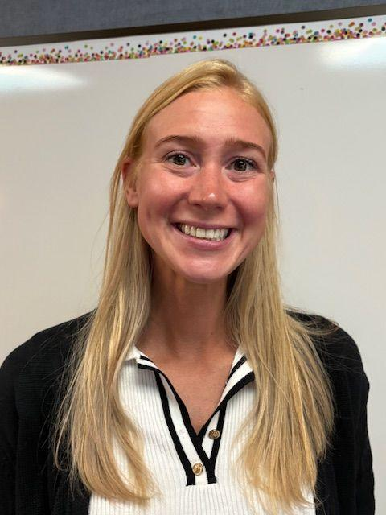
Summer Sturtevant- LA Teacher
Notes:
Katie

Slide 46
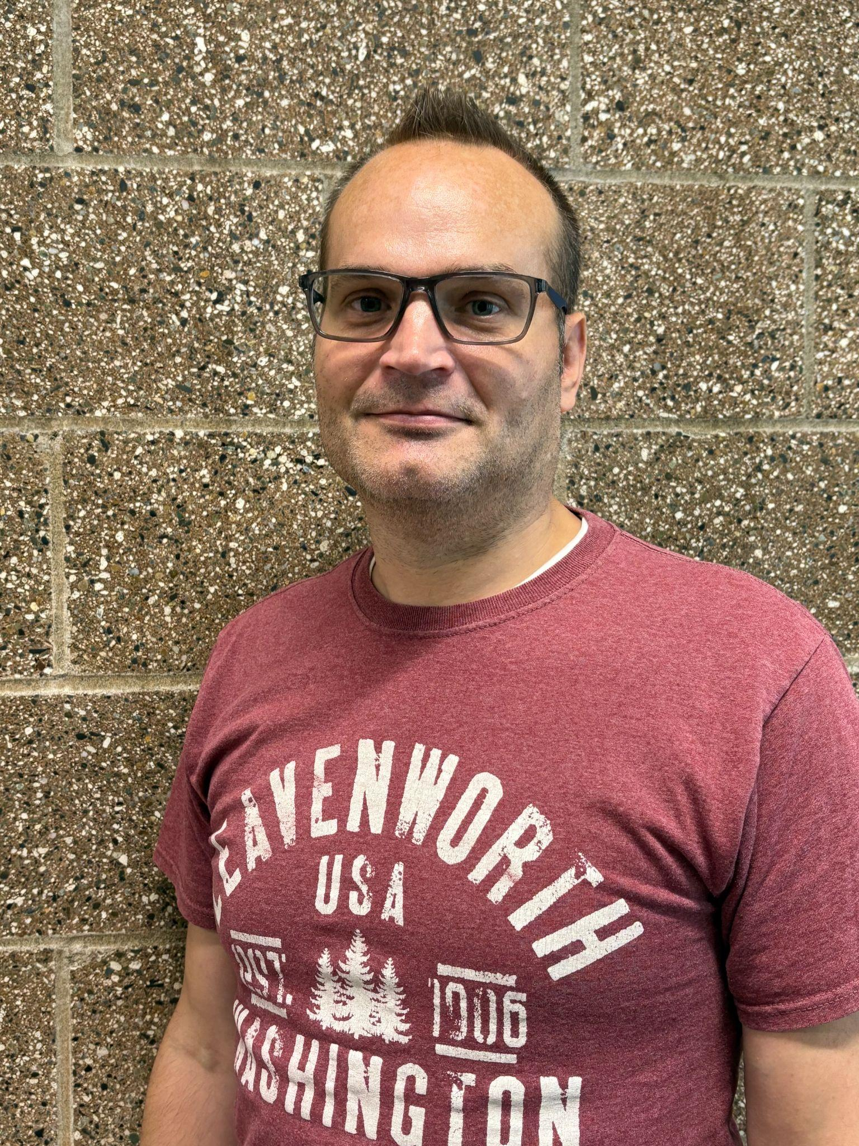
Michael Hughes- Programming and Robotics
Notes:
Katie

Slide 47
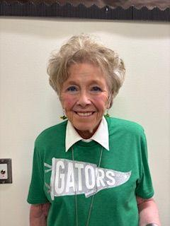
Vicki Sherwood, Associate Principal
Notes:
Vicki

Slide 48
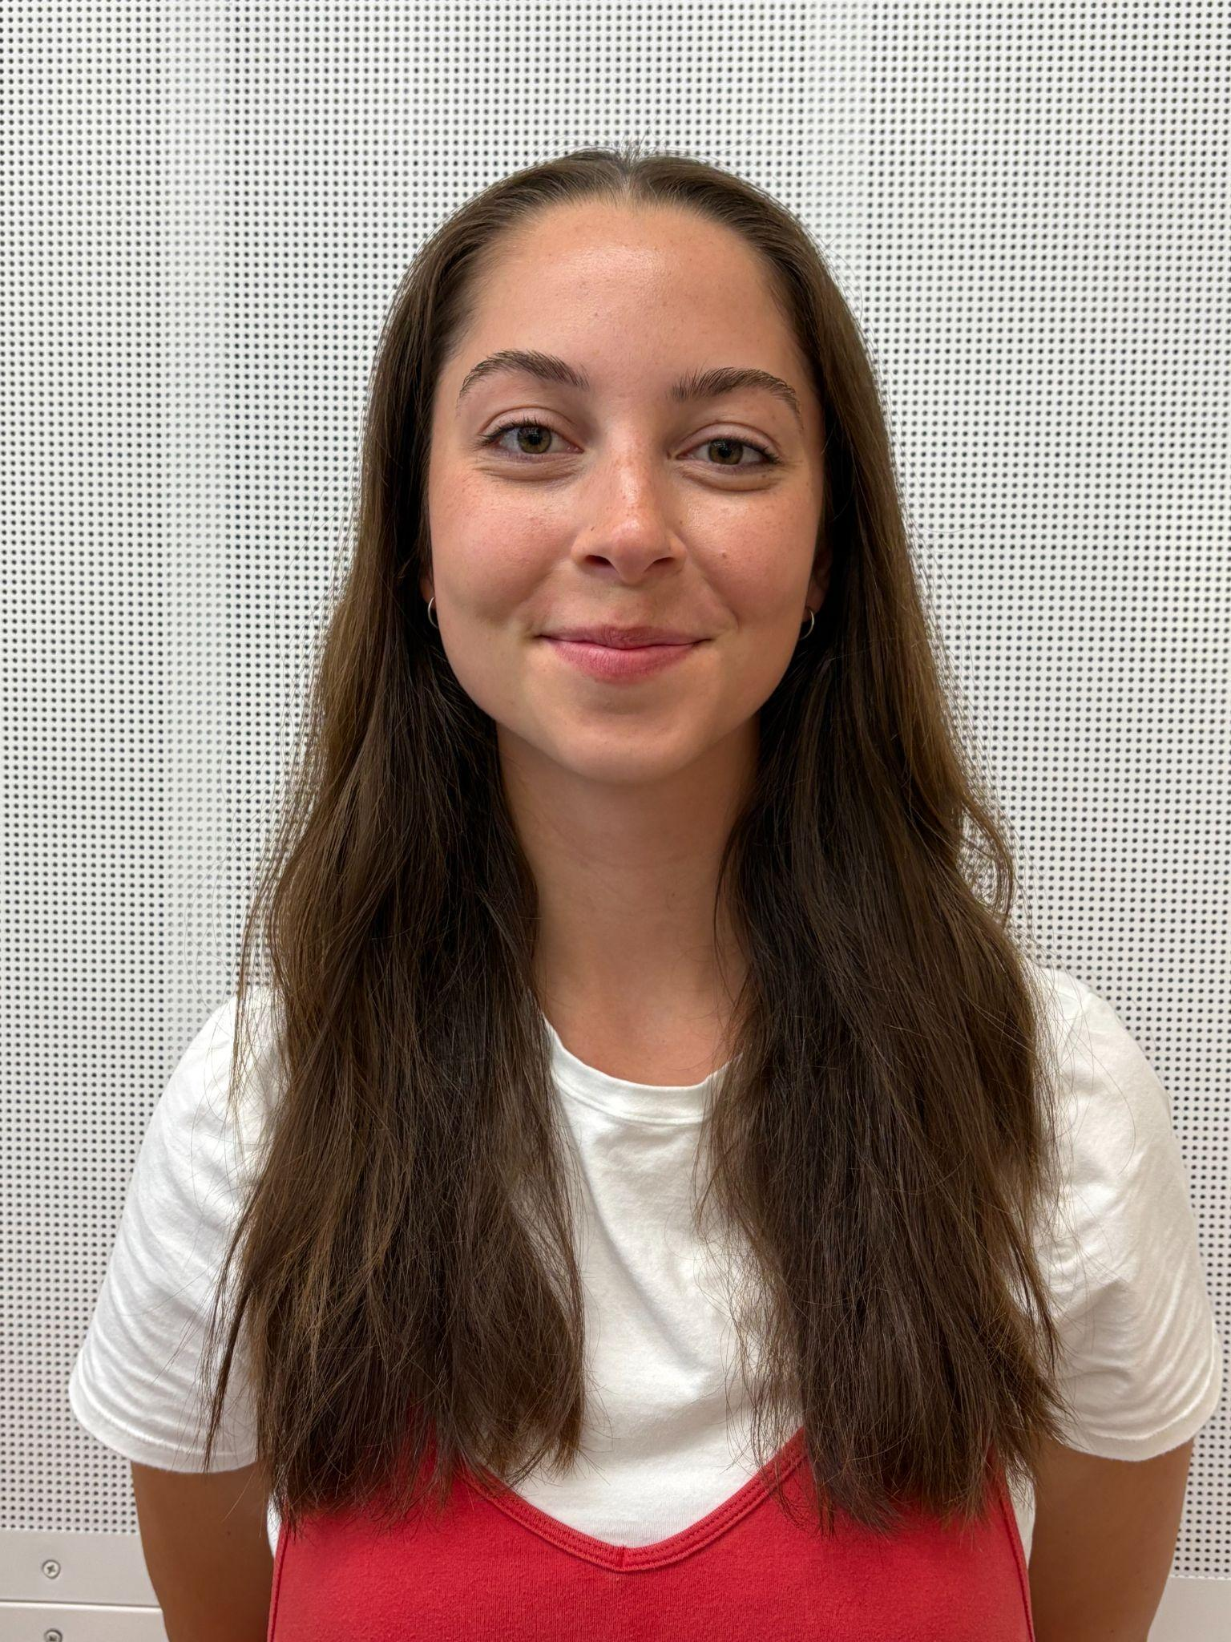
Kayla Arciniega, Band Teacher
Notes:
Katie

Slide 49
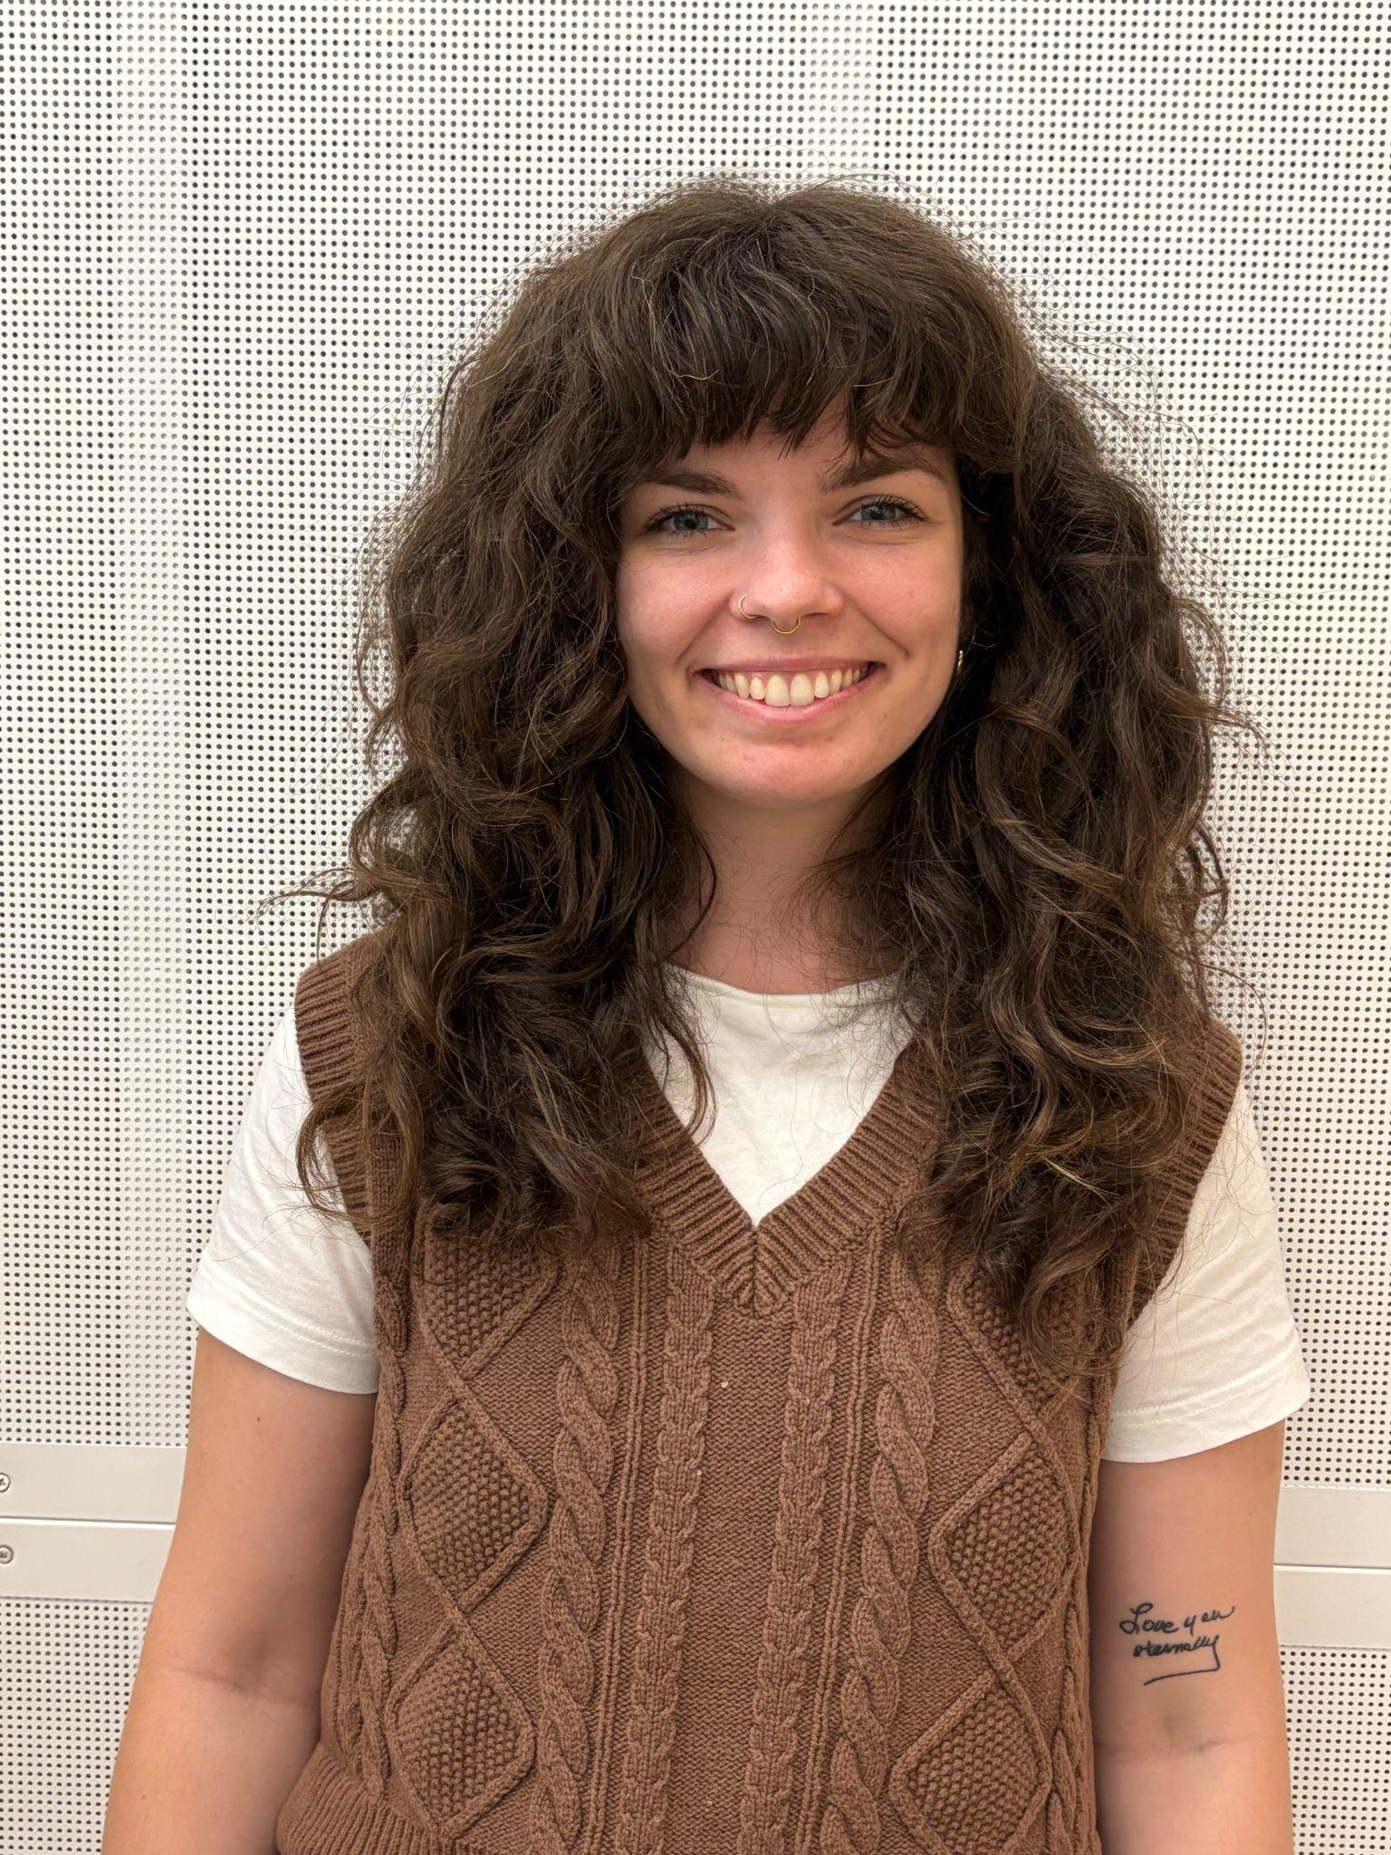
Catherine Cook, Band Leave Replacement Teacher
Notes:
Katie

Slide 50
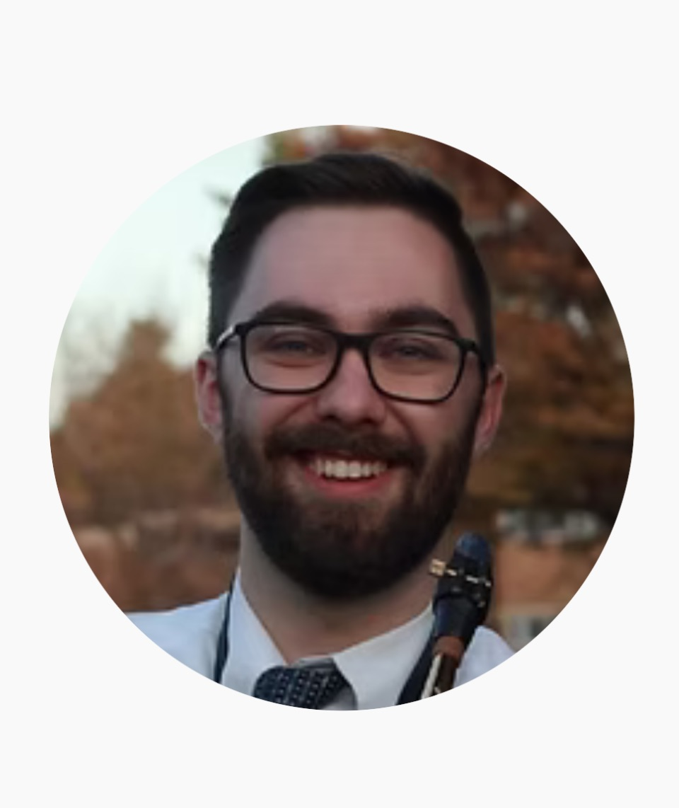
Jacob Krieger, Band Teacher

Slide 51
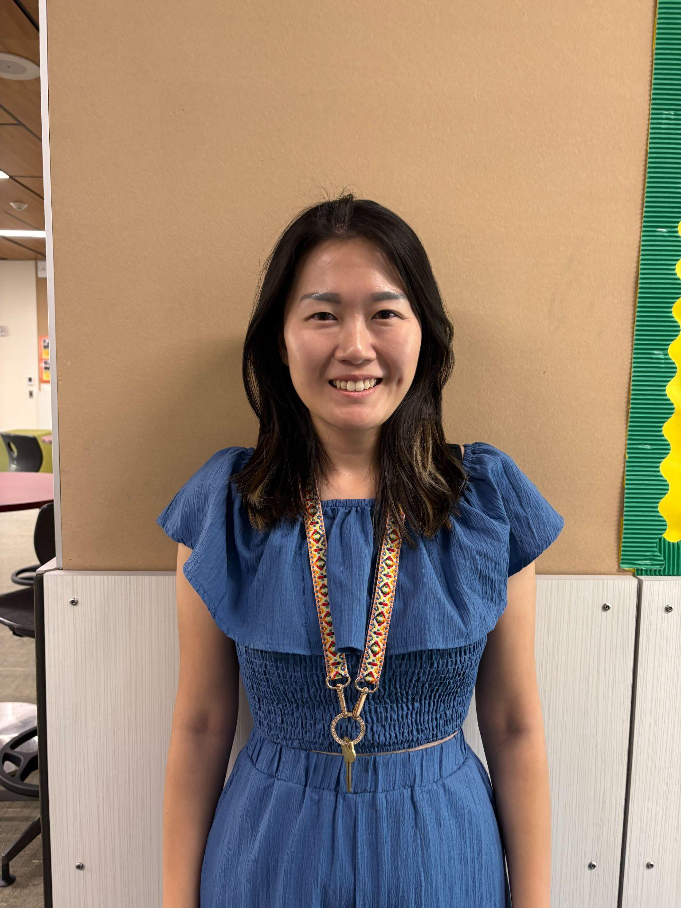
Kristal Lee, Psychologist

Slide 52
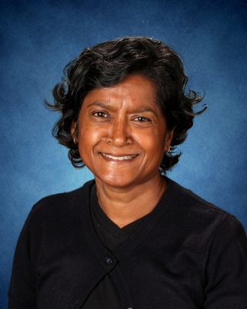
New Paraeducator Staff
Karen Ramsahai, Reading Support Paraprofessional
Notes:
Katie

