Slide 1

BUSINESS SPONSORSHIP OPPORTUNITIES
Please contact Shannon Leib at the Central Dauphin School District
at 717-545-4703, x 70217 for more information.

Slide 2
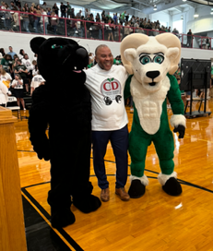
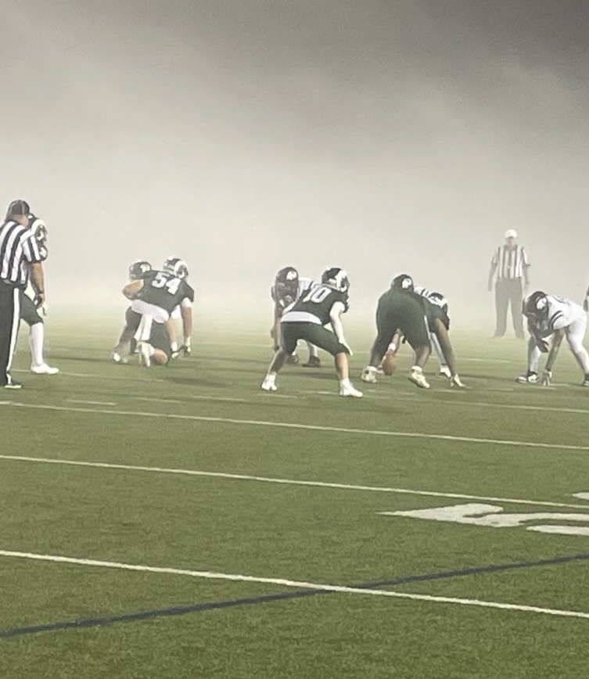
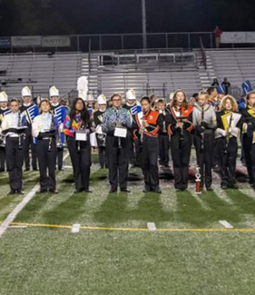
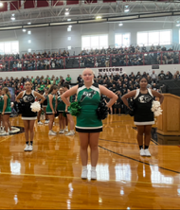
The Central Dauphin School District is pleased to offer businesses and organizations throughout the community, the opportunity to partner with the district through digital advertising and sponsorships. Funds raised through these partnerships will support programs for our students.
Welcome

Slide 3
About Us
Central Dauphin School District is a dynamic, suburban community of over 95,000 residents with a total student membership of approximately 12,000 students. It is located northeast of the city of Harrisburg within the County of Dauphin in south central Pennsylvania. The school district is the 8th largest school district in the Commonwealth and is the largest of the 10 school districts located in the county. Encompassing an area of 118.2 square miles, the district is comprised of three boroughs (Dauphin, Paxtang and Penbrook) and four townships
(Lower Paxton, Middle Paxton, Swatara and West Hanover).
Students attend one of 13 elementary schools, four middle schools and two high schools,
and are transported from urban, suburban and rural areas.

Slide 4
Facts & Figures
Landis Field
Gymnasiums
Accolades
Capacity: 8,000
Average Football Attendance: 2,700
Events Hosted: Big 33 Football, District Championships,
Band Competitions
CD High and CD East High
Main Gymnasium –
2000 seats per gymnasium
State Championships
Individual State Championships
State Runner Ups
District Titles
Mid Penn Championships

Slide 5

LANDIS FIELD SPONSORSHIP PACKAGE
Landis Field – Home to the CD High Rams and East High Panthers
Package - Field Fence Sign
On field fence signage (20 available).
$1,000 plus cost of sign per year.
Sign will be placed on the fence between both 30 - yard markers.

Slide 6
GYMNASIUM SPONSORSHIP PACKAGE
Central Dauphin High School & Central Dauphin East High School Gymnasiums
Package Includes
Game Day Sponsorship – Winter through Spring - $2,000 plus cost of sign
Static Signage on gymnasium wall
Announcer recognition during the athletic contest

Slide 7
Please contact Shannon Leib at the Central Dauphin School District at 717-545-4703, x70217 for more information.
Please contact the Central Dauphin School District at 717-545-4703 for more information.

