Slide 1


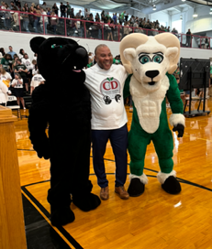
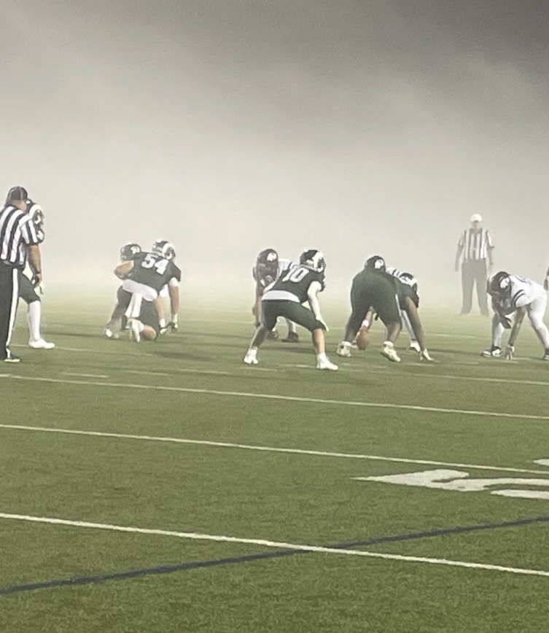
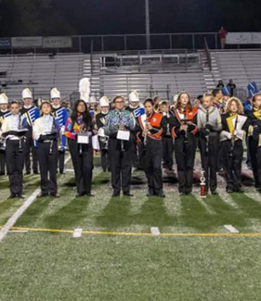
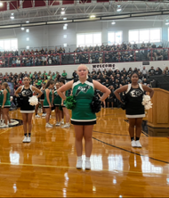

BUSINESS SPONSORSHIP
OPPORTUNITIES
CENTRAL DAUPHIN SCHOOL DISTRICT
The Central Dauphin School District is pleased to offer businesses and organizations throughout the community, the opportunity to partner with the district through advertising and sponsorships. Funds raised through these partnerships will support programs for our students.
LANDIS FIELD SPONSORSHIP PACKAGE
Landis Field – Home to the CD High Rams and East High Panthers
Package - Field Fence Sign
On field fence signage (20 available).
$1,000 includes cost of sign
Sign will be placed on the fence between both 30 - yard markers.
GYMNASIUM SPONSORSHIP PACKAGE
Central Dauphin High School & Central Dauphin East High School Gymnasiums
Package Includes
Game Day Sponsorship – Winter through Spring - $2,000 includes cost of sign
Static Signage on gymnasium wall
Announcer recognition during the athletic contest
Please contact Shannon Leib at the Central Dauphin School District
at 717-545-4703, x 70217 or sleib@cdschools.org for more information.

