Slide 1


PARENT
ANNUAL TITLE I
MEETING
2025-2026
Mimosa Elementary

Slide 2

STAFF
PARENTS/GUARDIANS
COMMUNITY MEMBERS
WELCOME

Slide 3

OBJECTIVES
  Understand what makes our school a Title I school including requirements, funding, and associated programs
  Understand school-provided resources such as curriculum, assessment, parent resources, and staff contact information
  Understand Family Engagement at our school

Slide 4


WHAT IS A TITLE I SCHOOL?
  The largest federally funded educational program
  Provides supplemental funds to districts to assist schools with the highest student concentrations of economic hardship
  A school receiving federal funds for Title I students
  Every Student Succeeds Act (ESSA) includes provisions that will help to ensure success for students and schools

Slide 5





HOW DOES OUR SCHOOL SPEND TITLE MONEY?
Personnel
Parent Resource Center
Instructional Materials
Professional
Learning

Slide 6




HOW IS TITLE I PARENT AND FAMILY ENGAGEMENT MONEY SPENT?
PARENT LIAISON
PARENT WORKSHOPS
PARENT RESOURCE CENTER MATERIALS
Notes:
Need your input for resource room materials

Slide 7



SCHOOLWIDE
PROGRAM
A Title I Schoolwide program is a detailed improvement strategy designed to upgrade the entire educational program in a Title I school.
The primary goal is to ensure that all students demonstrate proficient and advanced levels of achievement on state academic standards.
HOW DOES OUR SCHOOL PARTICIPATE
IN THE TITLE I PROGRAM?

Slide 8


SCHOOLWIDE
REQUIREMENTS
  Provide high-quality curriculum and instruction
  Required to hold an Annual Title I Meeting
  Family Engagement
  Professional Development
  Parent’s right to know
  Annual Evaluations

Slide 9


SCHOOLWIDE PROGRAM
PAST & PRESENT
We will have Schoolwide Goals after we have input meetings from all stakeholders:
Parents - Staff - Students
Notes:
Literacy – community engagement including parents! Best Community School in Georgia

Slide 10



STATE REPORT CARD
2024-2025 Data will be available in
September of 2025

Slide 11



CURRICULUM
State standards are provided by the Georgia Department of Education
SCAN THE QR CODE FOR CONTENT/GRADE LEVEL SPECIFIC CURRICULUM INFORMATION

Slide 12

UNIVERSAL SCREENING & DIAGNOSTIC
  Determines a student’s overall academic performance level
  Identifies students who may benefit from additional services or supports
  Identifies student strengths and weaknesses
  Pinpoints specific learning needs to guide academic curricular and instructional decisions
  Monitors student growth
Grades K - 8
Amira
Grades K-3

Slide 13

GA MILESTONES
Administered on the computer
Grade​ | End of Grade (EOG) Milestones​
3rd – 4th Grade​ | ELA, Math​
5th Grade​ | ELA, Math, Science​
Score in four categories: Beginning, Developing, Proficient, or Advanced
Evaluates learning at the end of a long-term instructional period (e.g., end of course or grade)

Slide 14




OTHER ASSESSMENTS
STANDARDIZED CRITERION-REFERENCED ASSESSMENTS
STANDARDIZED NORM-REFERENCED ASSESSMENTS
  Evaluates learning at the end of a long-term instructional period (e.g., end of course or grade)
  Determines whether each student has achieved proficiency on a set of required skills and concepts
  Should not be used as a grade except as required by state law (EOC- counting 20% of student’s final grade)
  Evaluate students on broad areas of knowledge
  Serve to classify or rank students on a continuum of achievement compared to their peers
  Not used as a grade
English Language Learners
Kindergarten
Select Special Education Students
Grades 2, 4, 7, & 9-12

Slide 15
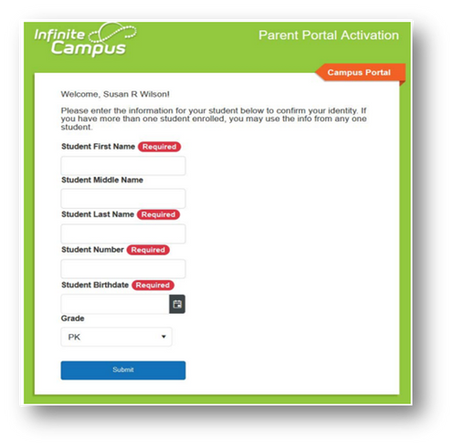
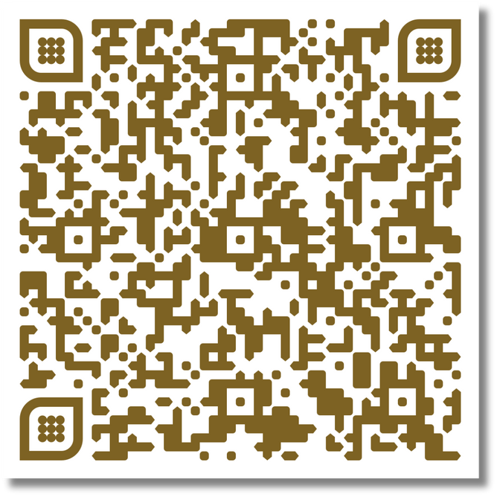
CHECKING PROGRESS
Infinite Campus – Parent Portal is the Fulton County Schools system to connect parents and students to student information. All parents must register to begin accessing Campus Parent
  All current parents will receive an email to register
  All parents new to Fulton will receive an email within 24 hours of enrollment
To register you must provide the following information
  Student First Name, Last Name
  Student Birthdate
  FCS Student ID Number ( Same as Student Login )
  Grade Level
SCAN THE QR CODE FOR INFINITE CAMPUS INFORMATION

Slide 16
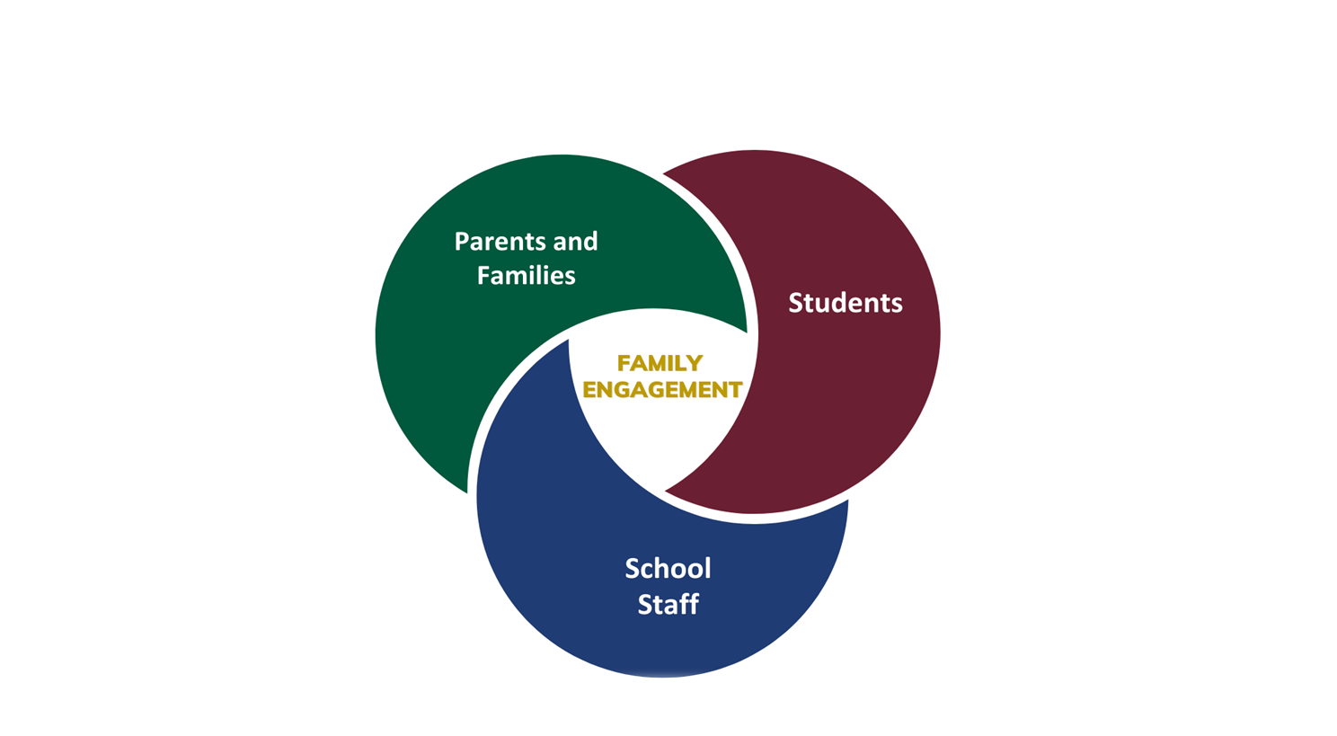
PARENT AND FAMILY ENGAGEMENT
  Title I schools must ensure all parents and families have opportunities to:
  Be involved in their children’s education
  Share in decision-making
  Jointly develop the following documents:
    School-Family Compact
    Parent and Family Engagement Plan (PFEP)
    District Parent and Family Engagement Plan
    Title I also requires staff, families, and students to jointly develop the school compact

Slide 17

SCHOOL - FAMILY COMPACT

Slide 18


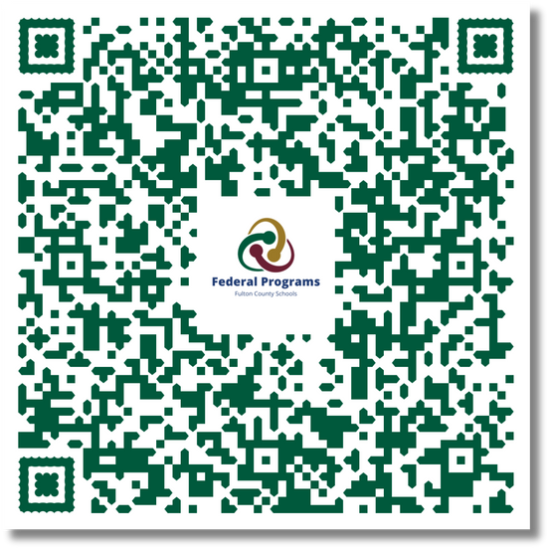
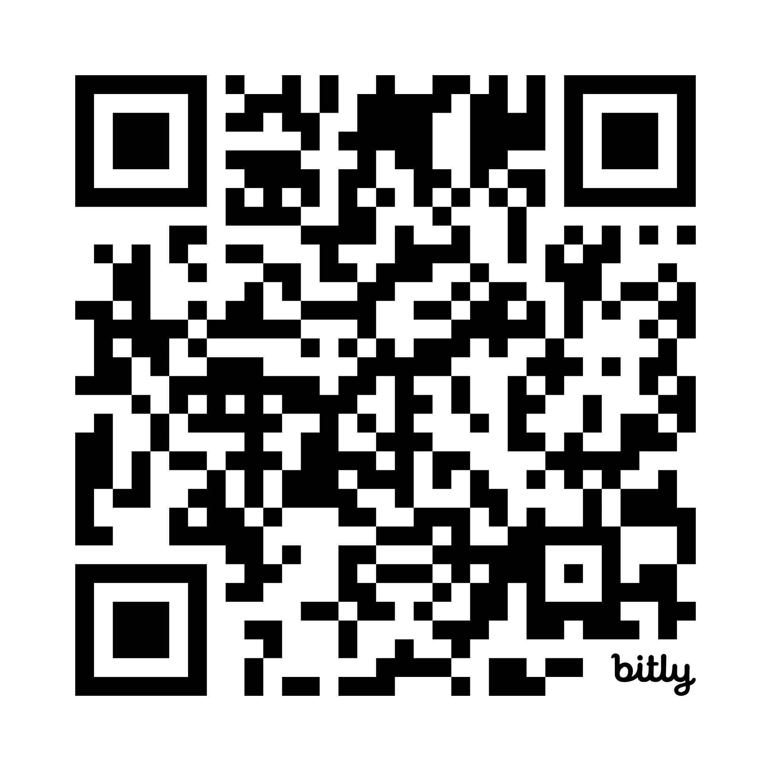
DISTRICT & SCHOOL PARENT AND FAMILY ENGAGEMENT PLAN
DISTRICT PARENT AND FAMILY
ENGAGEMENT PLAN
SCHOOL DOCUMENTS

Slide 19

PROFESSIONAL QUALIFICATIONS
CODE OF CONDUCT
  Parent’s right to know (pg.48)
  In the 2025-2026 FCS Code of Conduct and Discipline Handbook
  Electronic signature for acknowledgment of receipt form for handbook:
https://www.fultonschools.org/codeofconduct

Slide 20

FAMILY ENGAGEMENT IN
OUR SCHOOL
  Mimosa’s opportunities for family engagement, volunteer opportunities, and parent decision-making meetings are listed below and are shared monthly in the Newsletter and posted on the website:
School Governance Council Meets Monthly with dates in the Monthly Newsletter – August 26th
Parent Resource Room Open House – August 29th
^{Family Night – September 5th}
Supporting English Language Learners – September 15th
Volunteers Welcome Every Day in our PARENT RESOURCE ROOM!
Notes:
Each month you will see activities for the month ahead on the website and in the school newsletter.

Slide 21
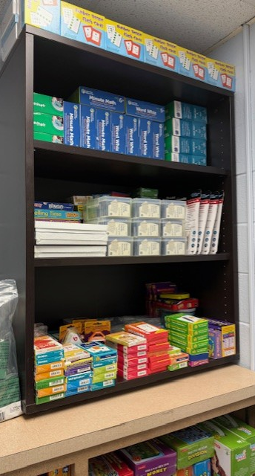
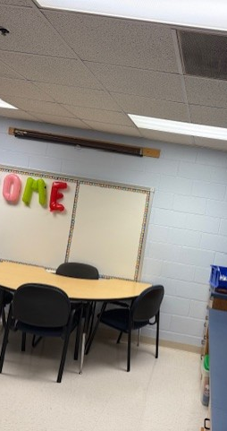
FAMILY RESOURCE CENTER
Parent Resource Center
In the 5th grade Hall – sign in at front office
Hours 7:45 – 2:30
Available Resources
Learning materials for all elementary age students in all subjects, board books and games for pre school age children.
Contact
Claudia Rogers - RogersC1@fultonschools.org
Robin Burke - burker3@fultonschools.org
Notes:
You are welcome here!

Slide 22


CONTACT US
Website
Phone Number
470-254-4540
https://mimosa.fultonschools.org
Social Media
Principal Email Address
https://www.facebook.com/
MimosaElementary/
holcombem1@fultonschools.org
Parent Liaison Email Address
iBurkeR3@fultonschools.org

Slide 23
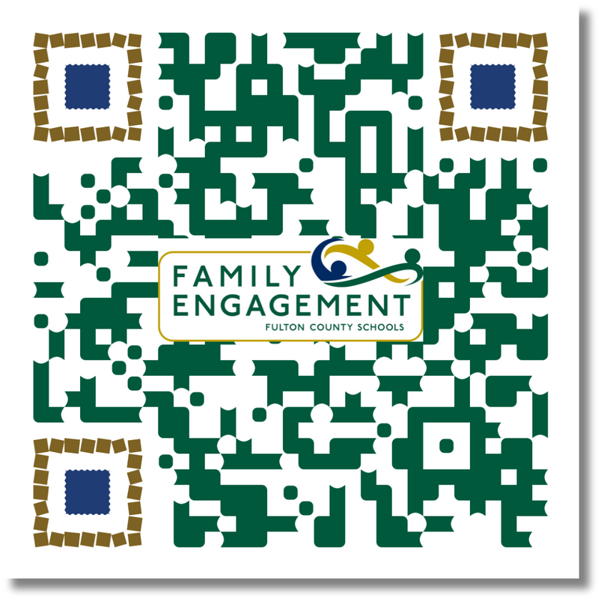


THANK YOU
THIS SURVEY IS TO EVALUATE THE EFFECTIVENESS OF THE MEETING
HTTPS://BIT.LY/EVALUATION_FE
SCAN FOR SURVEY

