Slide 1
CITY Center for Collaborative Learning
Monthly Financial Report
FY26 as of July 31, 2025

Slide 2
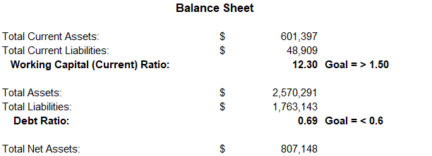
Executive Summary & Highlights
The organization entered FY26 in a solid financial position. Working capital is very strong, with current assets of $593K against current liabilities of only $49K, yielding a current ratio of 12.1—well above the benchmark of 1.5.
This provides ample liquidity for short-term obligations.
At the same time, the debt ratio stands at 0.69, higher than the desired threshold of 0.60, reflecting that long-term debt remains a significant portion of the balance sheet. Total liabilities are $1.76M compared to total assets of $2.56M, leaving net assets at $799K.

Slide 3
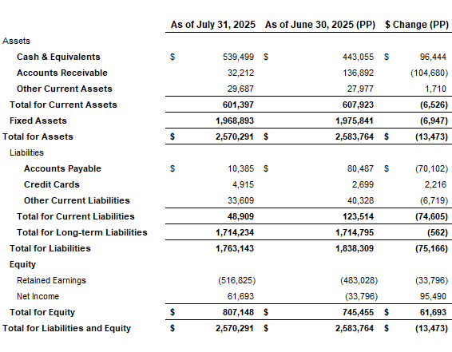
Statement of Financial Position
Cash & Equivalents increased by $96K from June, improving short-term liquidity.
Accounts Receivable decreased by $105K, reflecting strong collection activity.
Accounts Payable fell sharply from $80K in June to just $10K in July, showing timely settlement of obligations.
Equity strengthened with a net income of $54K for the month, bringing total net assets close to $800K.

Slide 4
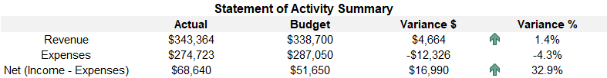
Current Performance vs YTD Budget
Total Income for July was $343K, slightly above budget by $4.4K(1.3%) and Expenditures totaled $274K, at $12K (4.3%) below budget.

Slide 5
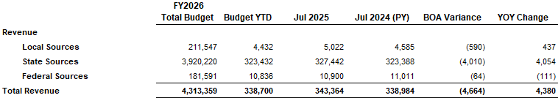
Revenue - Key drivers and Variances
State revenue was essentially on target at $327K.
Local sources came in just under budget at $4.4K
Federal sources were nearly flat with budget and prior year.

Slide 6
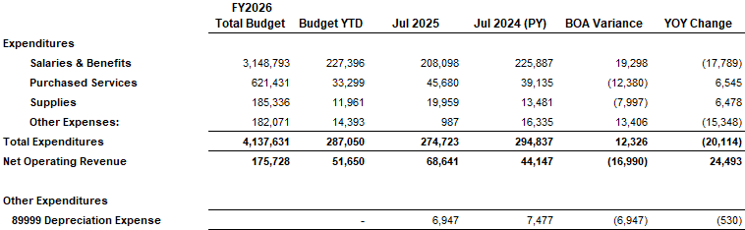
Expenses - Key drivers and Variances
.
Salaries & Benefits came in $19K over budget but $18K under from last year.
Purchased services were the largest area of savings, $12K under budget, though higher than last year by $7K.

Slide 7
Net Results
The organization generated a net operating surplus of $68.6K, exceeding budget by $17K (33%). After accounting for depreciation, the change in net assets was $61.6K, $25K higher than the prior year’s July result.

Slide 8
Key Takeaways for the Board
  CCCL is starting FY26 with strong cash flow and positive net results.
  Liquidity is excellent
  Budget performance is favorable.

