Slide 1


Please silence your cell phones!
Thank you for being considerate to the people around you.

Slide 3
Your Presenters
Sarah Goodrich
Assistant Director Financial Aid
East Stroudsburg University
Evelyn Disla-Hernandez
Higher Education Access Partner
PA Higher Education Assistance Agency (PHEAA)
Evelyn.disla@pheaa.org
Assisting:
Carbon, Lehigh, Monroe, Montgomery, Northampton, and Pike Counties
Notes:
To be revised by each Access Partner

Slide 4

Topics
Financial Aid 101
  Financial Aid Basics
  Types and Sources of Aid
Five steps to Financial Aid
Applying for Aid
What Happens Next?
Final Thoughts
Questions

Slide 5
What Is Financial Aid?
Pg. 5
Financial aid consists of funds provided to students and families to help pay for postsecondary educational expenses.
Gift Aid
Self-Help
Work-Study
Loans
Grants/Scholarships
Federal Student Loans, PLUS, Private Loans

Slide 6
Basic Principles
Paying is the joint responsibility of the student and parent(s), to the extent possible
Eligibility criteria may apply in order to receive/maintain financial aid, such as:
  Student must maintain satisfactory academic progress
  Additional criteria may be required based on the type and source of aid
Student should play an active role in the process
  Talk with the student about goals/plans (review educationplanner.org & mysmartborrowing.org)
  Take advantage of college fairs & school visits (ask about cost and available aid)
Some students may not qualify for all forms of aid. There is no guarantee that you will receive any free money to pay for higher education
Must apply every year to be considered

Slide 7
Financial Aid – Gift Aid
Based on financial need or merit generally does not have to be repaid – Free Money
Scholarships and grants
  Grants - based on financial need subject to federal formula
  Scholarships - usually based on merit.
Federal government, state government, schools and colleges
Organizations, businesses, community, employers, FREE Internet search

Slide 8
Financial Aid – Self-Help Aid
Loans
  Loans are borrowed money. Must be paid back
Work-study awards: Earned money
  Wages earned and paid directly to the student for working, coordinated through the campus or state
Tuition reimbursement
  Employer sponsored education
US Military benefits
  Requires service commitment & satisfying criteria

Slide 9
Cost Of Attendance (COA)
Pg. 4
Cost of Attendance (COA):
Costs that the student can expect to incur during the school year
  Direct costs: billed by the school
  Indirect costs: not included in bill but may be incurred
  School costs include:
    Tuition and fees
    Housing and food
    Books, course materials, supplies, and equipment
    Transportation
    Personal expenses

Slide 10
Student Aid Index (SAI)
Pg. 22
Student Aid Index (SAI)
A measure of a family’s financial strength, namely its ability to pay for college. The SAI is calculated from a federal formula using information collected from the Free Application for Federal Student Aid (FAFSA)
The SAI can be as low as negative 1500 (-1500).
SAI values can be as high as 999,999.
It is not the amount a family is required to pay but instead helps the financial aid office determine how much financial support you may need.

Slide 11


Calculating Financial Need
Pg. 3
Schools and colleges receive FAFSA information and calculate financial need
Financial Aid Office (FAO) “packages” student based on financial need and available funding (varies from school to school)
Financial aid notification sent to student
COA
-SAI
-OFA
=NEED
School
cost $26,000
EFC – $3,000
Financial
Need $23,000

Slide 12
Financial Aid Made Simple
Pgs. 6, 17, 26
Look for FREE money first
Know your specific deadlines
Fill out the FAFSA
Compare schools financial aid offers carefully
Be sure you have the money you need
5 Steps to Financial Aid
a Step 1 Step 2 Step 3 Step 4 Step 5

Slide 13

Step 1: Look For Free Money First
Pgs. 5, 6, 27
Start searching early
Use free scholarship search sites
Don’t ignore scholarships with smaller award amounts
Available beyond the first year.
Wide variety of criteria
Will reduce your debt and need to borrow loans
Notes:
Community Service, Unique Achievements, Grades, Sports, Ethnicity, Religion, Heritage, Parent Occupations, High School Location, Students Major Selection

Slide 14
Step 1: Look For Free Money First
Pgs. 5, 6, 27
  National
    Most found on corporate websites, scholarship databases & HS guidance offices/webpages
    Lots of competition
  Local & Regional
    Check with HS Guidance office/webpage
    Businesses, churches, local foundations, etc. (stay on the lookout)
    Less competition
  Post-Secondary:
    Check the school’s financial aid & admissions pages on website
    Inquire with financial aid office about scholarships from alumni and endowment funds

Slide 15
Scholarship Search Tips
Start Early and Search Often
Create an Academic Resume:
  Academic success
  Extra Curricular Activities
  Community Involvement/Volunteerism
Create an Essay(s)- Write an essay, free from errors, that can be tweaked based on individual scholarships (be creative)
Secure Letter of Recommendations early
Pay attention to deadlines and understand the terms
FastWeb.com
EducationPlanner.org
FinAid.org
BigFuture.Collegeboard.org
Scholarshipamerica.org

Slide 16

Recognize Scholarship Scams
Application fees
  Even if the fee is minimal or “only to encourage serious students to apply”
“Guaranteed” scholarships
  No individual can honestly “guarantee” you’ll win free money
Solicitations
  “You’ve been selected…”
  “You are a finalist…”
  Bona fide companies won’t ask for a check or credit card payment upfront
Official-looking companies
  The logo may look like the U.S. Dept. of Education’s logo
  The company may talk about “federal” or “national” awards
Seminars
  Don’t get pressured into paying for services on the spot

Slide 17

Step 2: Know Your Deadlines
Applications for admission
Deadlines for scholarships
  Institutions, Outside Sources
Free Application for Financial Aid (FAFSA)
  Schools have priority deadlines
  Don’t have to have applied or been accepted to list a school on the FAFSA

Slide 18

PA State Grant Deadlines
Pg. 24
You must complete your FAFSA by the deadline to be considered for the PA State Grant.
May 1—If you plan to enroll in a degree program or a college transferable program at a 2-year private college or other college or university
August 1—If you plan to enroll in a community college; a designated Pennsylvania Open-Admission institution; a business, trade, or technical school; a hospital school of nursing; or a 2-year program that is not transferable to another institution

Slide 19

Step 3: The FAFSA is Your Connection to Funding
Pg. 20
The FAFSA is a federal form used to determine student eligibility for the following:
Federal programs
State programs
School programs

Slide 20

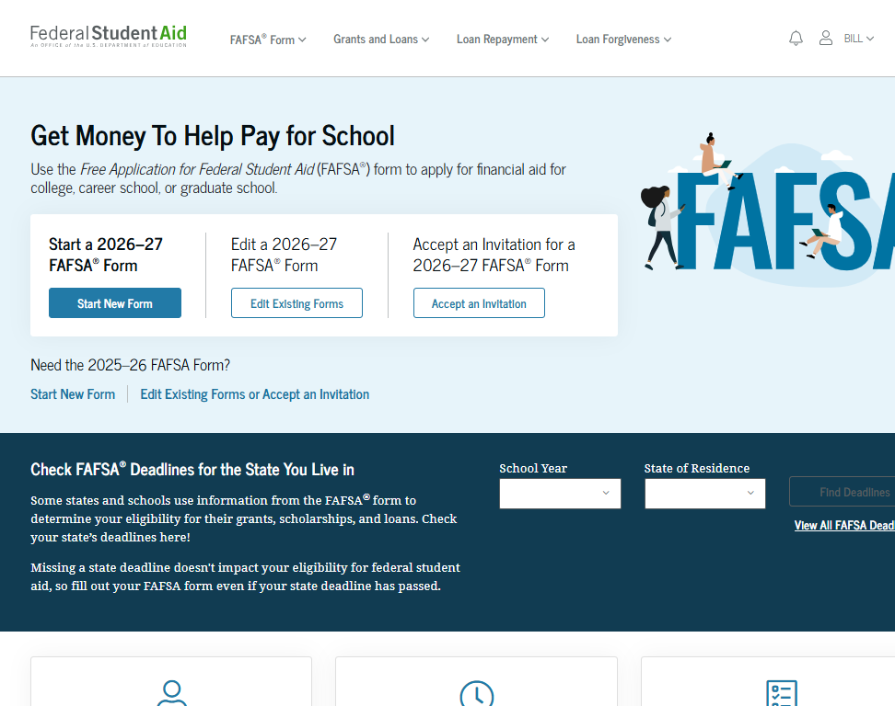
FAFSA (Free Application for Federal Student Aid)
Pgs. 20-23
The FAFSA is the primary federal form for financial assistance to attend a postsecondary school.
Must file a FAFSA each
year a student attends
school to be eligible.
File online—Fast, Secure,
SKIP LOGIC and Built-in Edits.
While filing the FAFSA online is preferred, a printable PDF version is available at StudentAid.gov.
StudentAid.gov/fafsa

Slide 21
Create Your StudentAid.gov Account
Pg. 21
The student applying for aid and all contributors providing information on the FAFSA need to create a StudentAid.gov Account at StudentAid.gov/fsa-id/create-account.
Create at least 1 day prior to completing the FAFSA
Legal signature for student and contributors.
Users without an SSN will be able to acquire a StudentAid.gov Account.
Social Security Number
Username
Email Address
Password
Mobile Phone
Security Questions
Enable Two-Step Verification

Slide 22







2026-2027 FAFSA Prep
Pgs. 20-23
Information Needed for FAFSA
Social Security Numbers
Email Addresses (Not high school email address)
2024 Federal Tax Returns and W-2’s
Current bank statements and records of other investment accounts (as of the FAFSA filing date)
Student & Contributor(s)
StudentAid.gov Accounts
Current Records of any stocks, bonds and other investments, including 529 for student for whom the FAFSA is being completed
Total child support from the most recently complete calendar year

Slide 23
FAFSA - Consent
Applicant and any required contributor on the FAFSA must provide consent.
They are consenting to:
Direct Data Exchange to import applicant, parent, parent and/or student spouse Federal Tax Information (FTI) to the FAFSA.
Redisclose FTI to state entities, institutions, and scholarship organizations.

Slide 24

For Dependent Students, Who Reports Info on the 2026-27 FAFSA (contributors)?
YES
Married parents living together
Biological parents living together
Divorced or separated parents:
  The parent that provided the most financial support to student over the past 12 months
  If equal, then student would invite the parent with the higher income and assets
Stepparent – If part of the student’s household
Adoptive parents
NO
Foster Parents
Legal Guardians
  By court order
Anyone else the student is living with

Slide 25

When Is A Student Automatically Considered “Independent”?
24 or older on Jan 1st of 2026
Married
Veteran (includes active-duty personnel)
Working on graduate level degree
Legally emancipated minor or in a legal guardianship with someone other than their parent or stepparent, as determined by a court in state of residence
Orphan, in foster care or ward of the court at
anytime since the student turned 13
Have legal dependents other than spouse
Student deemed homeless by proper authority
PA State Grant status can be different
Pg. 22

Slide 26
What is considered an asset?
  Report the current value at time of filing the FAFSA:
  Cash
  Checking
  Savings
  Stocks
  Bonds
  Certificates of deposit (CD)
  Bitcoin
  Mutual funds
  Net value of real estate
Value of 529 accounts for the student owned by the parent(s) of a dependent applicant or owned by the student applicant
Child support received for the most recently complete calendar year
  Not reported on FAFSA as an asset:
  Value of primary home
  Value of qualified retirement accounts
  Value of life insurance policies
  Value of personal property
  Value of 529 for any other family members (excluding applicant)

Slide 27
Student Unusual Circumstances
A student may be experiencing an unusual circumstance that prevents them from contacting their parents or contacting parents would pose a risk to student. This may include but is not limited to students who:
Left home due to an abusive or threatening environment;
Are abandoned by or estranged from their parents, and have not been adopted;
Have refugee or asylee status and are separated from their parents, or their parents are displaced in a foreign country;
Are a victim of human trafficking;
Are incarcerated, or their parents are incarcerated, and contact with the parents would pose a risk to the student; or
Are otherwise unable to contact or locate their parents and have not been adopted.

Slide 28
FAFSA Tips
Review asset questions
529 Plans for applicant must be reported as a parent asset
Assets do NOT include home, retirement or insurance
Some can skip asset questions
Ensure SSN accuracy on StudentAid.gov Account and FAFSA
Have federal tax and other related information to use as a reference – w-2’s
Don’t mix student and parent information – SSNs, Email addresses, phone numbers

Slide 29
After Filing
Pg. 22
In a few days, an email will be sent to the student regarding the processing of their FAFSA and their FAFSA Submission Summary.
Students should monitor the email account provided on the FAFSA and respond to requests from Federal Student Aid, PHEAA and the colleges.
Information will be shared with PHEAA and all college choices.
PHEAA will send you an email to instruct you on how to activate your GrantUs account and apply for the PA State Grant.

Slide 30

Other Forms You
May Need to Complete
Check with your school
College Scholarship Service (CSS) Profile
College Specific Form

Slide 31
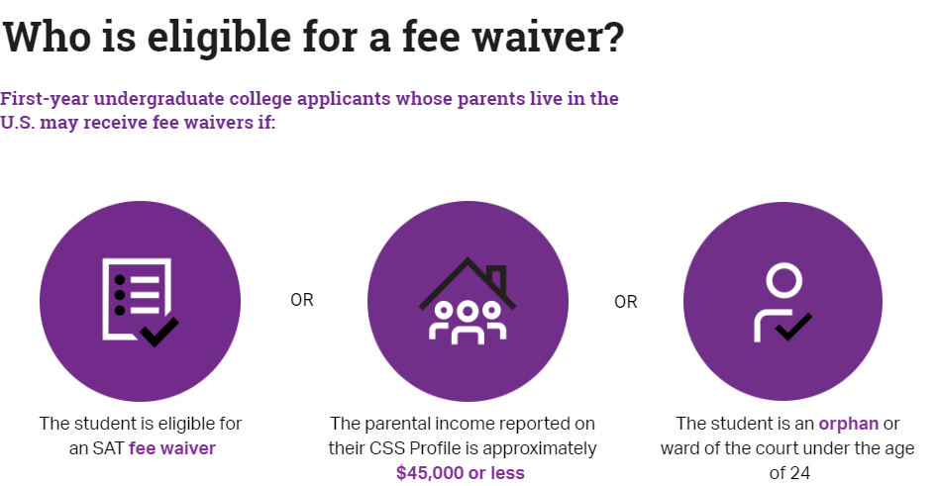
CSSProfile.CollegeBoard.org
Required at some institutions to award need based & institutional aid
Used in addition to the FAFSA, not a replacement
CSS Profile costs $25.00 + $16.00 for additional schools
Domestic undergraduate students may submit CSS Profile for free if:
OR
OR
The student is eligible for an SAT fee waiver
Family adjusted gross income is $100,000 or less
Student is an orphan or ward of the court under the age of 24

Slide 32



FAFSA is Filed… Now What?
Student completes the FAFSA
Schools receive FAFSA and calculate financial aid
Schools send Financial Aid Notifications to student

Slide 33
Special Circumstances
If things change…
Divorced or
separated parents
Stepparents
Adoptive parents
Foster parents
Legal guardians
Living with others
Recent death or disability
Reduced income

Slide 34
Financial Aid Notification
Pg. 3
Official notification from school about financial aid, terms and conditions
Lists the type and amount of aid to be received
Describes what must be done to accept or
reject any aid
Discloses students' rights, responsibilities and academic requirements

Slide 35

Step 4: Compare Schools’ Financial Aid Offers Carefully
Pg. 3
There is no required standard format
If you receive a scholarship, do you know if there are conditions for maintaining it?
Do you understand what is free money vs money that has to be paid back?
Bottom Line: What are your out-of-pocket costs?

Slide 36
Reviewing the Financial Aid Offer
How much of the financial aid is free money?
Which awards are based on need, and which are based on merit?
Are there any conditions on the free money? GPA requirement?
Will awards increase as tuition increases?
Will awards change from year to year?
Will loans be needed?

Slide 37
Comparing Financial Aid Offers
Pg. 4
Cost | $20,000 | $30,000 | $50,000
SAI | $ 3,000 | $ 3,000 | $ 3,000
Need | $17,000 | $27,000 | $47,000
Free Money | $ 6,000 | $ 8,000 | $18,000
Loans | $ 5,500 | $ 7,000 | $ 8,000
Work-Study | $ 0 | $ 2,000 | $ 3,000
TOTAL AID | $11,500 | $17,000 | $29,000
Gap = (Cost – Aid) | $ 8,500 | $13,000 | $21,000
Actual Cont. = (Cost – Free $) | $14,000 | $22,000 | $32,000

Slide 38
Federal Grant Programs
Pg. 12
Pell Grant—max award $7,395*
  Eligibility is the same for every postsecondary institution
Federal Supplemental Educational Opportunity Grant (FSEOG)—max award $4,000
  Eligibility determined by Financial Aid Office at each potential school
  Student must be enrolled at least half-time
  Awarded to most financially needy students
  *for the 2025-26 academic year

Slide 39

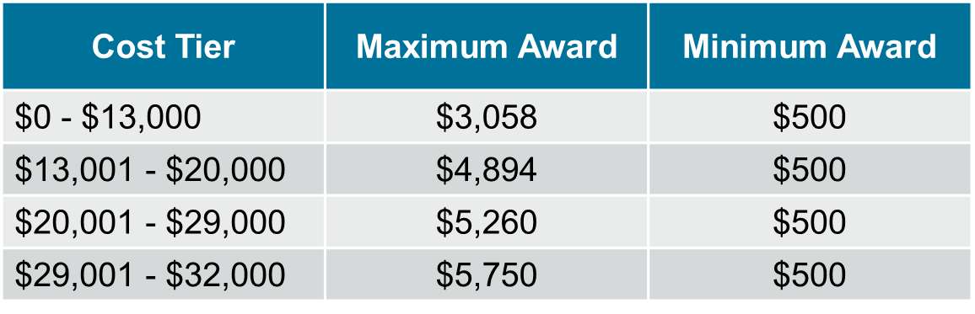
PA State Grant Program
Pgs. 7-8
In-state - max award $5,750 (full-time)
Award amount determined in part by the cost of the school
Reciprocal states:
Delaware, DC, Massachusetts, Ohio, Vermont, West Virginia
  Up to $600 for full-time students ($800 for veterans)
Must be at least half-time to be eligible
Notes:
Reciprocal states: Delaware, DC, Massachusetts, Ohio, Vermont, West Virginia

Slide 40
Other State Programs
Pg. 9
PA Active Volunteer Tuition & Loan Assistance Program
PA Blind or Deaf Higher Education Beneficiary Grant Program
Chafee Education and Training Grant Program
PA Fostering Independence Tuition Waiver Program
Grow PA Scholarship Grant Program
PA Mental Health Education Learning in Schools
PA Partnerships for Access to Higher Education Program
For details, see the PA Student Aid Guide, or visit pheaa.org
New Program!

Slide 41
Other State Programs
Pgs. 10-11
PA Postsecondary Educational Gratuity Program
PA Ready to Succeed Scholarship Program
PA State Work-Study Program
PA Student Teacher Support Program
PA Targeted Industry Program
PA National Guard Educational Assistance Program
PA National Guard Military Family Education Program
For details, see the PA Student Aid Guide, or visit pheaa.org.

Slide 42

Federal Work-Study
Pg. 12
You must have financial need in order to qualify for work-study
A work-study position is not guaranteed and may even require an interview
Work-Study income is not considered as income on the FAFSA

Slide 43
Subsidized
Pg. 13
Federal Direct Loan - Student
Unsubsidized
No interest charged to student while enrolled or in grace
Based on financial need
There is a 1.057%
fee deducted from
loan amount at disbursement
Interest will not be charged during the grace period, if the loan was first disbursed after June 30, 2014
Interest accrues in school
and grace
Any interest not paid during grace will be capitalized at repayment
There is a 1.057%
fee deducted from
loan amount at disbursement
Interest Rate: 6.39%

Slide 44
Federal Direct Loan Borrowing Limits
Pg. 14
Undergraduate Students |  |  | Graduate Students
Annual Limits | Dependent Students | Independent or dependent students whose parents are unable to borrow a PLUS Loan | Graduate or Professional Studies
First Year | $5,500 Total No more than $3,500 may be subsidized | $9,500 Total No more than $3,500 may be subsidized | $20,500 each academic year For graduate students $50,000 each academic year for professional students Graduate and professional students are no longer eligibility for subsidized loans
Second Year | $6,500 Total No more than $4,500 may be subsidized | $10,500 Total No more than $4,500 may be subsidized
Third Year and beyond | $7,500 Total No more than $5,500 may be subsidized | $12,500 Total No more than $5,500 may be subsidized
Aggregate Limits | $31,000 Total No more than $23,000 may be subsidized | $57,500 Total No more than $23,000 may be subsidized | $100,000 Graduate students $200,000 Professional students No more than $65,000 may be subsidized
Notes:
The aggregate lifetime limit for
all federal borrowing inclusive of
undergraduate is $257,500.

Slide 45

Federal Direct PLUS Loan
Pg. 16
In parent’s name for dependent’s student costs
Rates set every July 1st for the life of that year’s loan; fees are deducted from disbursement
  8.94% variable/fixed interest rate; 4.228% fees
MUST apply each year
Principal can be deferred while student is in school; Interest will continue to accrue
If denied - student is eligible for an additional $4,000 unsubsidized loan
Parents are limited to $20,000 per year with $65,000 as the aggregate limit per dependent!

Slide 46
Private/Alternative Loans
Pg. 18
From private lenders or financial institutions
In student’s name/co-signers usually required
Can borrow up to the Cost of Attendance
Based on credit scores and debt-to-income
Principal can be deferred while student is in school; Interest will continue to accrue
Terms vary by lender – compare before making choices
Read the Fine Print!

Slide 47


Pg. 19
Undergraduate and Graduate Loans
PA’s Low-Cost Way
to Pay for College!
Low, Fixed Rates
3.29 – 10.45%
1,2
^{APR}
Effective as of 6/5/25
Learn more at pheaa.org/PAForward
1) Annual Percentage Rate (APR) Calculations – The lowest APR is based on the following assumptions: A loan of $10,000 made in a single disbursement, a borrower who selected an Immediate Repayment Plan and a repayment term of 60 months, monthly payments of $181.11 and a final payment of $173.14, a fixed periodic interest rate of 3.57%, and total payments of $10,858.78. The borrower in this sample qualified for a 0.25% Direct Debit benefit for the entirety of the repayment period and a 0.50% Graduation benefit was applied 47 months into repayment.
The highest APR is based on the following assumptions: A loan of $10,000 made in a single disbursement, a borrower who selected an Interest Only Repayment Plan and a repayment term of 180 months, monthly payments of $87.42 for 52 months and monthly payments of $110.48 for the remainder of the repayment term, a fixed periodic interest rate of 10.49%, and total payments of $24,431.69. The borrower in this sample did not qualify for any interest rate discounts.
These APRs are estimates and may differ from the actual rates received.
2) The provided rate range includes Undergraduate, Graduate, and Parent loans and may change based on loan type, loan term, repayment plan, and applicable discounts (not all discounts apply to all loan products). See individual loan programs for more specific information. PHEAA uses applicant credit scores to determine eligibility and interest rates. Higher credit scores may mean an applicant is offered a lower interest rate.
Applicants, including co-signers, are subject to credit qualifications, completion of an application and credit agreement, and verification of application information.
PHEAA reserves the right to discontinue all programs or benefits without prior notice.
Notes:
Approved slide- student (grad and undergrad half time or greater)
Includes the full range of rates, inclusive of parent rates. Can be used for mixed audiences (parents and students).

Slide 48
Benefits of Paying Interest
Paying now will reduce what is capitalized!
Interest accrues on your unsubsidized student loan and Federal PLUS Loan:
  Every day, from the day the loan is disbursed until you make the last payment
  Even if your loan is not in repayment
Interest accrues on your subsidized student loan:
  Every day, from the day the repayment period starts until you make the last payment

Slide 49
ONLY consider Direct PLUS or private alternative loans after looking into all other sources of financial aid.
!

Slide 50

Step 5: Be Sure You Have The
Money You Need
Have you considered annual out of pocket costs beyond the first year?
Do you understand your actual costs?
Do you have a strategy for handling out of pocket costs?

Slide 51

Use Your Resources
pheaa.org
EducationPlanner.org
MySmartBorrowing.org
YouCanDealWithIt.com
PHEAA toll free: 1-800-692-7392
PHEAA’s Higher Education Access Corner Podcast (Available on Spotify, Amazon Music, iHeartRadio, and PHEAA’s YouTube channel, PHEAAStudentAid)
Federal Student Aid Info Center: 1-800-433-3243
StudentAid.gov – The one-stop shop site for all financial aid information.
StudentAid.gov/FAFSA – Direct link to the FAFSA

Slide 52
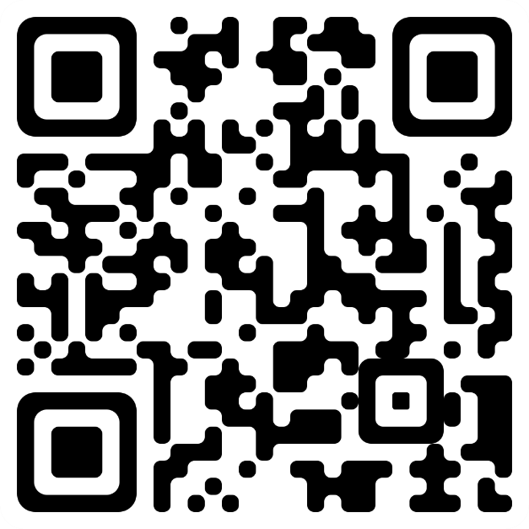
Stay Up to Date with PHEAA
Sign up for more information on our programs and services!
Would you like to learn more about funding you or your student’s higher education dreams? Sign up to get emails from PHEAA and we will send you information about loans, grants, and more!
Scan the QR to sign up!

Slide 53


What Can You Do Now?
Visit College Websites
Create StudentAid.gov Account & Complete the FAFSA
Utilize Net Price Calculators
collegecost.ed.gov
Explore Scholarships
Estimate Federal Student Aid
studentaid.gov/aid-estimator
Talk About What is Affordable

Slide 54





Social Media Outreach
Pg. 30
^{PHEAA}
^{American Education Services}
^{@PHEAAaid}
^{@aesSuccessorg}
^{@PHEAAaid}
^{PHEAA}

Slide 55
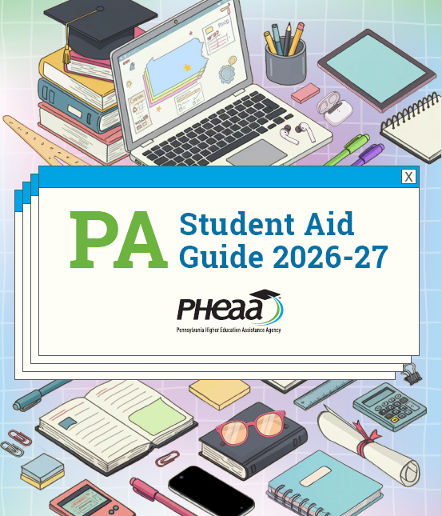
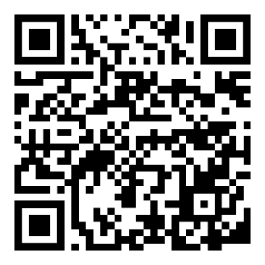
Student Aid Guide
The page numbers in top left of this presentation refers to where in the Student Aid Guide (SAG) you can review for more information.
To view the electronic version of the SAG, go to: https://www.pheaa.org/college-planning/student-aid-guide or scan the QR Code

Slide 56
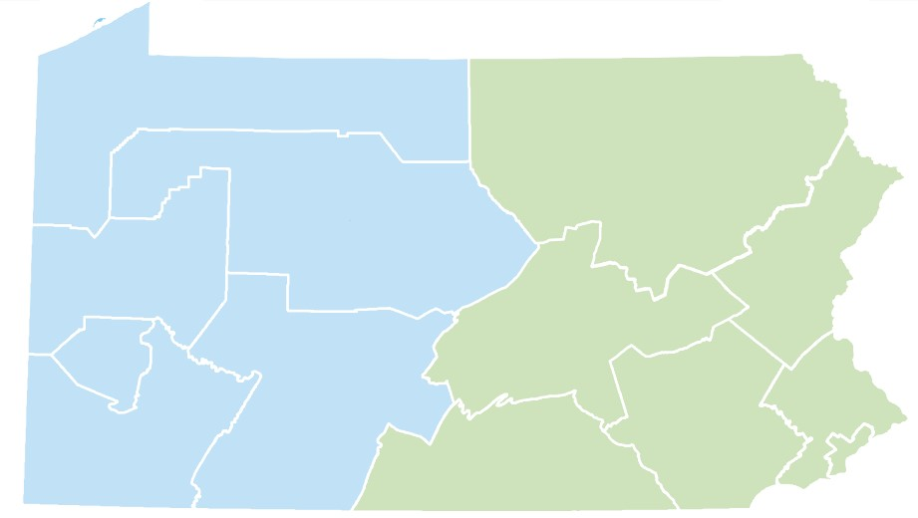


Your Presenter
Evelyn Disla-Hernandez
Higher Education Access Partner
PA Higher Education Assistance Agency (PHEAA)
Evelyn.disla@pheaa.org
Assisting:
Carbon, Lehigh, Monroe, Montgomery, Northampton, and Pike Counties
Notes:
To be revised by each Access Partner

Slide 57
Questions?

