Slide 1
PTA/PTO and Booster Club Sanctioning
Enter your Name and Organization & EMAIL in the Chat Box
September 16, 2025
https://www.tulsaschools.org/boosterclub

Slide 2
Sanctioning Guidelines
...and a reminder, if you haven’t done so yet,
Enter your Name, email and Organization in the Chat Box
https://www.tulsaschools.org/boosterclub

Slide 3
Why are we here?
Student achievement programs, Parent-Teacher Associations and Booster Clubs play a critical role in supporting/enabling student and school activities.
Our objectives for today:
To discuss school board policy and regulations related to sanctioned groups.
  Oklahoma law allows school boards to adopt policies that exempt specific organizations from the statutory controls of the school activity funds.
  District policy 5707 protects the sanctioned group as well as the district by setting out the requirements and expectations of each party, and insures a separation between the district and the organization.
Review financial reporting obligations
Take a closer look at athletic booster clubs

Slide 4
What are the two types of organizations?
Organizations must operate in accordance with one of two classifications:
Not Sanctioned
    Must operate through the district’s student activity fund
    Collect and deposit all revenue in the student activity fund
    All expenditures must be made through the student activity fund
Sanctioned
    Operates outside the student activity fund
    Board of Education authorizes all sanctioned organizations
    Must apply to be sanctioned on an annual basis

Slide 5
What else do I need to know?
Organization can NOT pay any district employee. All pay must go through the district’s payroll
Superintendent or board could request an audit by an independent accounting firm
District can request that the organization provide all financial records
Organization can not deposit any checks, warrants or money orders made payable to the District or individual school into the organization’s account
May not use the district’s tax ID number

Slide 6
What else do I need to know?
If the organization is abolished, ceases to exist or is no longer sanctioned, the remaining funds shall be deposited into the school’s Student Activity Fund
Applications are due by November 1st, but can be turned in anytime after July 1st (need that June 30th bank statement)
Submit application and related documents to Tristan Delvaux: sanctioning@tulsaschools.org

Slide 7
What if I have questions?
When in Doubt, ask your Principal
Or
Contact the TPS Treasury Office as 918.746.6210
Kristin Stephens, Chief Finance Officer stephkr@tulsaschools.org
Tristan Delvaux, Treasury Specialist sanctioning@tulsaschools.org
Joe Stoeppelwerth, Treasurer stoepjo@tulsaschools.org
Michael Brown, Asst. Treasurer brownmi6@tulsaschools.org
Mick Wilson, Exec Director of Athletics wilsomi2@tulsaschools.org
https://www.tulsaschools.org/boosterclub

Slide 8
Accounting Practices
TREASURER
...and a reminder, if you haven’t done so yet,
Enter your Name and Organization in the Chat Box

Slide 9
Role of the Treasurer
Your role is important with a lot of responsibility
It is critical that you keep accurate records
Poor record keeping creates operational problems and puts the reputation of the organization and yourself at risk

Slide 10
Duties of the Treasurer
Keep a full and accurate account of receipts and expenditures
Make timely deposits
Make disbursements as authorized by the organization
Present a financial statement at each meeting
Prepare or have prepared an annual financial reconciliation report

Slide 11
Tulsa Public Schools -XYZ Parent Organization
Statement of Revenues and Expenditures
 | Description | Income | Expenses | Balance
1-Sep | Ending Balance |  |  | 1,000.00
2-Sep | Fundraiser - T-shirt Sales | 480.00 |  | 1,480.00
3-Sep | Concession Sales | 200.00 |  | 1,680.00
4-Sep | Member Dues | 1,250.00 |  | 2,930.00
5-Sep | Reimburse Mr. Jones for car wash supplies. Receipts attached |  | 112.58 | 2,817.42
6-Sep | Concession stand supplies and candy- Sams |  | 314.21 | 2,503.21
9-Sep | Fundraiser - We Design T-Shirts |  | 325.00 | 2,178.21
10-Sep | Fundraiser-Car wash | 600.00 |  | 2,778.21
13-Sep | Concession Sales | 175.00 |  | 2,953.21
15-Sep | Donation- Pass the hat for uniforms | 75.00 |  | 3,028.21
19-Sep | Uniforms -Teamsports.com |  | 2,746.39 | 281.82
21-Sep | Donation - Mrs. Smith | 200.00 |  | 481.82
24-Sep | Concession Sales | 175.00 |  | 656.82
30-Sep | Bank Interest | .08 |  | 656.90

Slide 12
 | XYZ Parent Organization
 | Bank Reconciliation
 | For the Month Ending ______________________ | September 30, 202X
Ending Balance per bank statement |  |  | $ 481.90
Deposits in transit |  |  | $ 175.00
Outstanding checks |  |  | $ -
Reconciled Bank Balance @ month end |  |  | $ 656.90
Balance per checkbook @ month end |  |  | $ 656.82
Adjustments:
+ | Interest |  | $ 0.08
- | Bank charges |  | $ -
+/- | Other |  | $ -
Reconciled Checkbook Balance @ month end |  |  | $ 656.90

Slide 13
Recommended Procedures
Financial information should be up to date and organized
  The information should include receipts, source of receipts, expenditures including the payee’s information and a description of the purchase or service, along with beginning and ending balances
Checks should be signed by two officers
Checkbooks and funds should not be kept on district property
Officers should check the addition and subtraction on financial reports
Officers should also compare the beginning balance to the previous period ending balance

Slide 14
Money-Handling Procedures
The Treasurer should count the money while in the presence of the person turning in the money
The Treasurer should issue a receipt for all monies received
Deposit all money turned in daily
Money received should only be deposited in the Booster Club’s account
Do not keep money in an unlocked drawer, cabinet, vehicle or other unsecure place
Money received and not yet deposited should not be used for purchases, loans, advances, reimbursements, or for any other purpose

Slide 15
Final Tips
Make sure the incoming Treasurer is a signer on the account
Get user i.d’s, passwords, checkbooks and bank cards before the end of the year
Order reasonable number of items

Slide 16
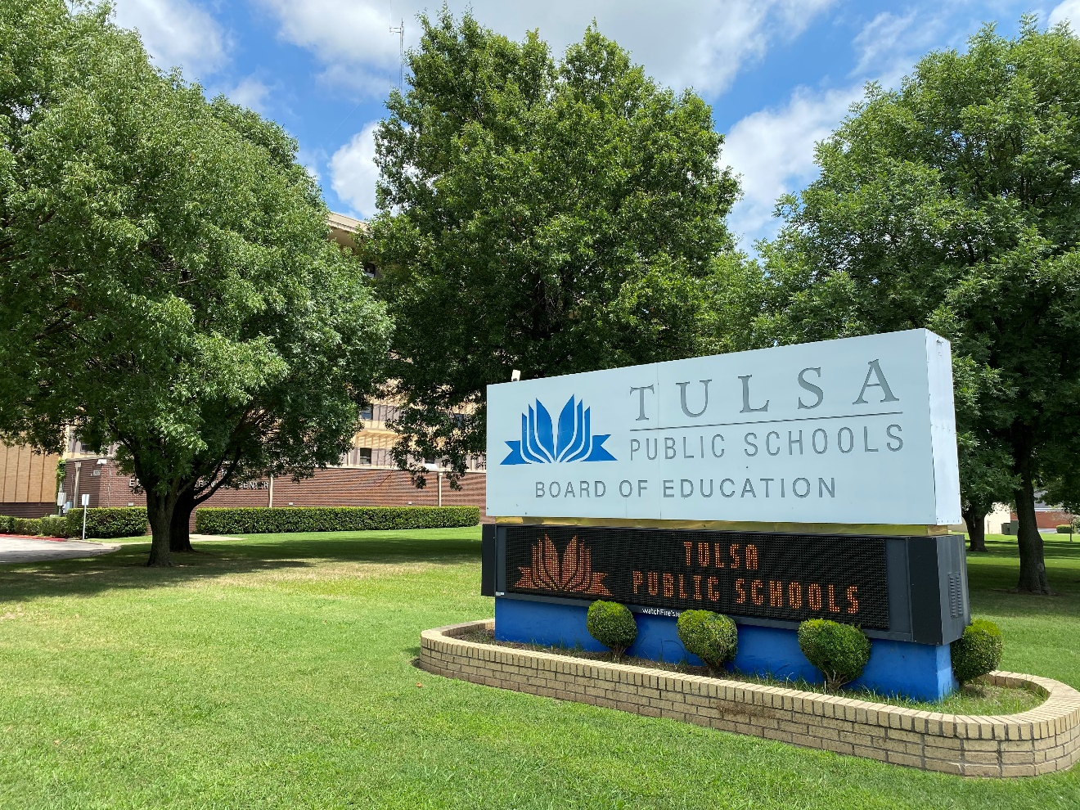
Tulsa Public Schools Booster Club Sanctioning Meeting 2025-26
Mick Wilson
Executive Director of Athletics & Activities
Krystel Markwardt
Deputy Director of Athletics

Slide 17



District Goal:
TO CREATE A POSITIVE AND
EFFECTIVE WORKING RELATIONSHIP
WITH OUR BOOSTER CLUBS

Slide 18
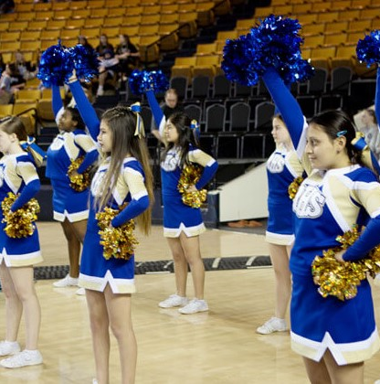
The Role of Booster Clubs
Supplementary financial support
Public relations
Fundraising
Special events (meals, trips, etc.)
Promote school pride & spirit
Adherence to TPS and OSSAA rules, regulations and policies.

Slide 19
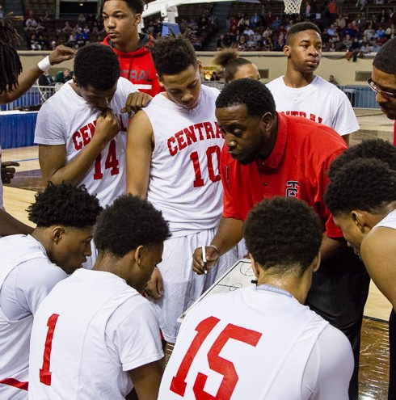
Communication
The first level of communication is with the head coach. The booster club should support the head coach and their vision for the program.
The site athletic director is the next level of communication. If there are questions that cannot be answered by the coach, please contact the athletic director.
If there are issues that cannot be worked out between the booster club and the athletic director, the next level of communication should be with the principal or the district athletic director.

Slide 20
Booster Club Funds
Booster clubs must be sanctioned by the Board of Education each year. Appropriate documents must be presented, and a current EIN number must be on file in the Finance office. Tax Exempt Organization / 501(c)(3)?
ALL FUNDRAISERS MUST BE APPROVED BY THE Principal, Site Athletic Director and the Deputy Director of Athletics.
Spending priorities for athletics programs will be determined by the site athletics director and the Head Coach with the approval of the building administration. The head coach should discuss program needs with the Athletic Director during their annual program evaluation.

Slide 21
Booster Clubs & Additional Coaches Compensation
Booster clubs MAY compensate coaches with additional funds for duties over and above what they are paid for by the district, per the negotiated agreement with TCTA (Tulsa Teachers Classroom Association).
For example: A softball coach runs a weight training program or maintains the field during the summer. This is not part of their required duties as a softball coach in TPS, therefore the Booster Club may pay the individual for time they spent working in the summer.
Booster Club must adhere to the following guidelines:
The Booster Club must be sanctioned through the office of the Chief Financial Officer
The Booster Club must have a meeting and approve the additional stipend amount
The payment from the Booster Club must be made to “TPS Athletics”
The check, the terms of the payment and the minutes from the meeting must be included in the information sent to the District Athletics Office at the ESC
The TPS Athletic Office will have a PO approved, place the item on the Board Agenda and will assist in routing payment to the appropriate individual through the TPS payroll office.

Slide 22
Additional Coaches Compensation Continued
Schools paying stipends to coaches that come directly from the Student Activity Fund account MUST send the request to the District Athletic Office, where a Board Agenda item will be created. The school must approve the RQ at the site, through their normal board of control, and complete the appropriate payroll sheet to be sent to the District Athletic office.
Please recognize that the total amount of the payment will have tax implications. Normal deductions will be a part of the payroll procedure.
Booster Stipend – Calculation of Gross Amount to Employee
Example
Amount received from Booster Club $6,000.00
Gross amount paid to employee $5,121.64
Employer Taxes and Retirement
Social Security 6.20% 317.54
Medicare 1.45% 74.26
Teacher Retirement 9.50% 486.56
Total 17.15% 878.36
Reconciliation
Gross amount paid to employee 5,121.64
Total Employer Taxes and Retirement 878.36
Amount received from Booster Club $6,000.00

Slide 23
Booster Clubs
May not require students to pay a membership or participation fee.
Must provide fundraising opportunities for all students when certain items may be needed for participation.
May provide a scholarship or financial assistance to a student in need.
May not require students to pay a private instructor fee (choreographer, strength/conditioning coach, etc.) or a tryout fee.

Slide 24
OSSAA Rule 9
What is OSSAA Rule 9?
Rule 9 Section 1
OSSAA recognizes that permitting member schools to recruit students as athletes would place undue emphasis on secondary school athletic activities, and might cause competitive imbalances among member schools, misdirection of scarce educational resources, and threats to the continued amateur standing of students. Accordingly, no member school or any person with athletics related interest for that school is permitted to recruit a student to select or transfer to that school, or to encourage or allow others to do so on its behalf, based on that student's skill, reputation, or experience in athletics.

Slide 25
OSSAA Rule 9 Continued
Rule 9 Section 7.C
Acknowledgment and Notice of Rule.
All officers, administrators, supervisors, and sponsors of any club or organization supporting any athletic activity at a member school must sign a written certification that they are familiar with this Rule, and that the members of the club or organization have been informed about this Rule.
You will receive the following form from your site athletics director.

Slide 26
OSSAA Rule 9 Form
Verification of Acknowledgment of Rule 9
Prohibition on Recruiting or Influencing for Athletic Purposes
Each coach or volunteer providing instruction, assistance, or supervision in an athletic activity for a member school must sign this form certifying that the coach or volunteer is familiar with the Rule.
The head coach in each athletic activity for each member school must sign this form certifying that students participating in an activity have been informed about the Rule, that the school may be sanctioned for violations of this Rule, and that student athletes may be subject to sanction, including the loss of eligibility, if they have enrolled at or transferred to a school that has engaged in recruiting, or allowed its employees or representatives to recruit in violation of the Rule, or if they participate in recruiting other student athletes to enroll in or transfer to the school.
All officers, administrators, supervisors, and sponsors of any booster club or organization supporting any athletic activity at a member school must sign this form certifying that they are familiar with the Rule, and that the members of the club or organization have been informed about this rule.
I hereby verify by signing below that I have read and acknowledge OSSAA Rule 9 in its entirety and agree to abide by the Rule as stated.
___________________________________________ ____________________________________
(signature) (title or position)
___________________________________________ ____________________________________
(signature) (title or position)
___________________________________________ ____________________________________
(signature) (title or position)
___________________________________________ ____________________________________
(signature) (title or position)
___________________________________________ ____________________________________
(signature) (title or position)
THIS FORM IS TO BE KEPT ON FILE AT EACH MEMBER SCHOOL AND PRESENTED FOR REVIEW UPON REQUEST BY THE OSSAA.

Slide 27

Pepsi Representative
Krystal Halford
Key Account Manager
Phone number:
  918-830-2688
  Email: Krystal.Halford@pepsico.com
  Customer Service:
  1-800-963-2424

Slide 28



BSN / NIKE
Rusty Zumwalt
Phone number: 918-640-7416
  Email: rzumwalt@bsnsports.com
  Jason Roberts
  Phone: 918-798-8646
  Email: jroberts@bsnsports.com
  FAN CLOTH
  https://www.fancloth.com/

Slide 29
Booster Club Sanctioning Meeting
Thank you supporting our students, coaches, and schools.
We appreciate YOU!

Slide 30
THANK YOU
and if you haven’t, reminder to put name and org in chat box
GRACIAS y antes de irse, si no lo ha hecho, indique su nombre y organización en el cuadro de conversación (chat box).

Slide 31
What if I have questions?
When in Doubt, ask your Principal
Or
Contact the TPS Treasury Office as 918.746.6210
Kristin Stephens, Chief Finance Officer stephkr@tulsaschools.org
Tristan Delvaux, Treasury Specialist sanctioning@tulsaschools.org
Joe Stoeppelwerth, Treasurer stoepjo@tulsaschools.org
Michael Brown, Asst. Treasurer brownmi6@tulsaschools.org
Mick Wilson, Exec Director of Athletics wilsomi2@tulsaschools.org
https://www.tulsaschools.org/boosterclub

