Slide 1



Please watch before starting
You have the opportunity to learn about 9 of the i-Ready reports in greater detail. Each has its own mini-course that will award you with 1 hour of CTLE credit once you complete the task and proof of completion form. You can add to the form each time you finish a course as it will save your previous responses. Please have all work completed and turned in by add date here.
Feel free to use the choice board pieces to help you keep track of the courses you’ve taken. (Make a copy of this presentation)This is not mandatory but may be helpful if you complete them over a longer period of time.
Complete this form once for Proof of Completion

Slide 2
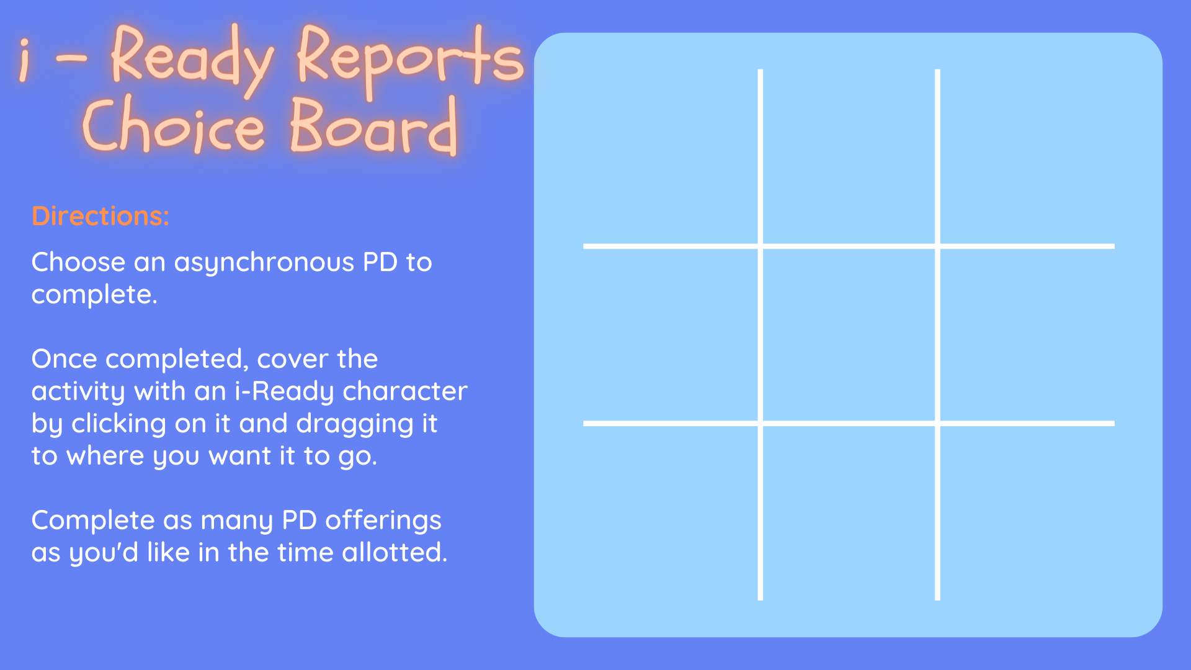
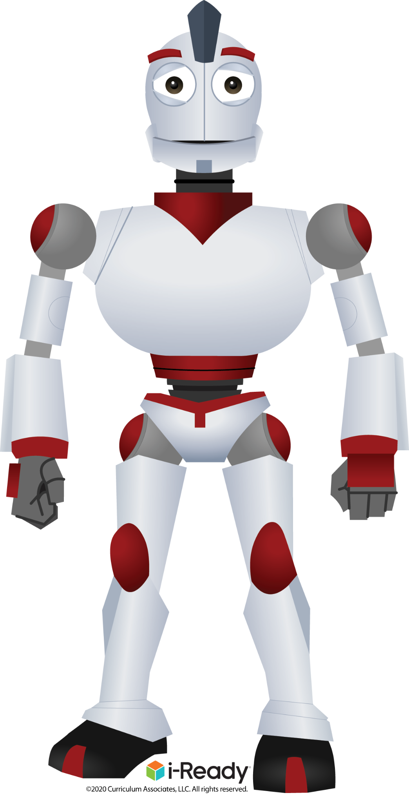





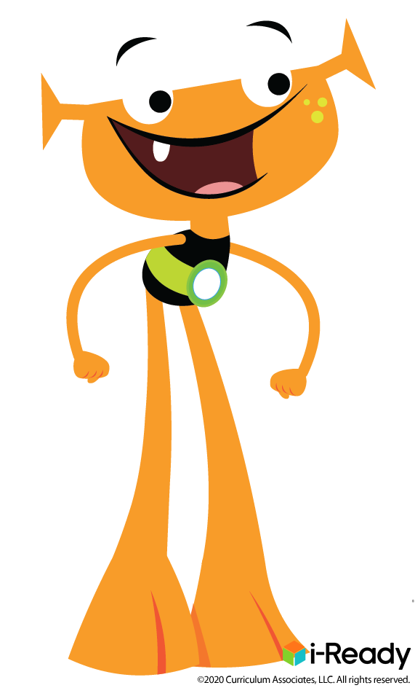

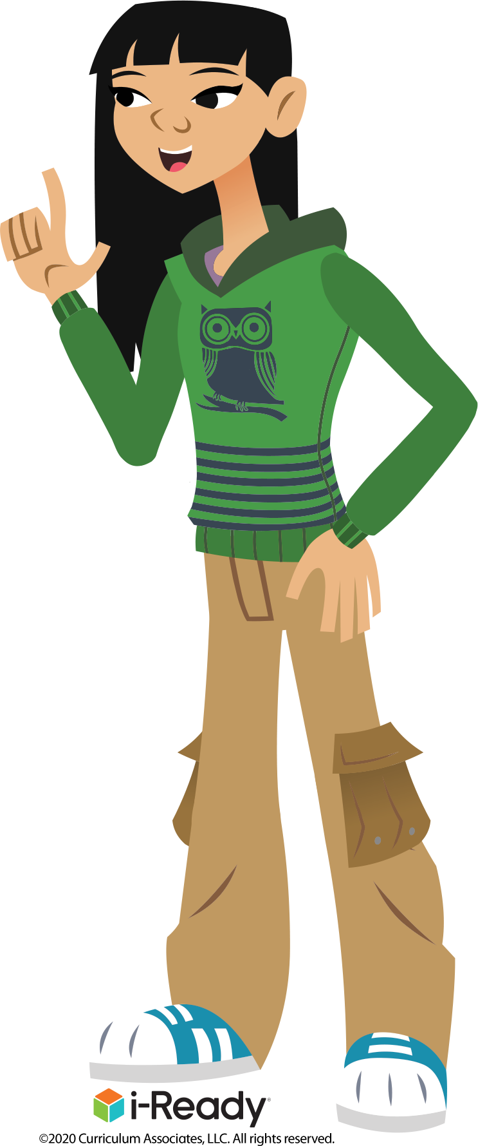
Diagnostic Results (class)
Diagnostic Growth
(class)
Learning Games
Historical
Results
(class)
Personalized Instruction
Summary
Prerequisite
Growth
Monitoring
Results
(class)
Grade
Level
Scaffolding
Instructional
Groupings

