Slide 1




DataMate
1018
Bishop and Cole - 10/18/24

Slide 2



What we will focus on today:
Logging in and creating a new test
Navigating the “test management”
Exploring the question bank

Slide 3
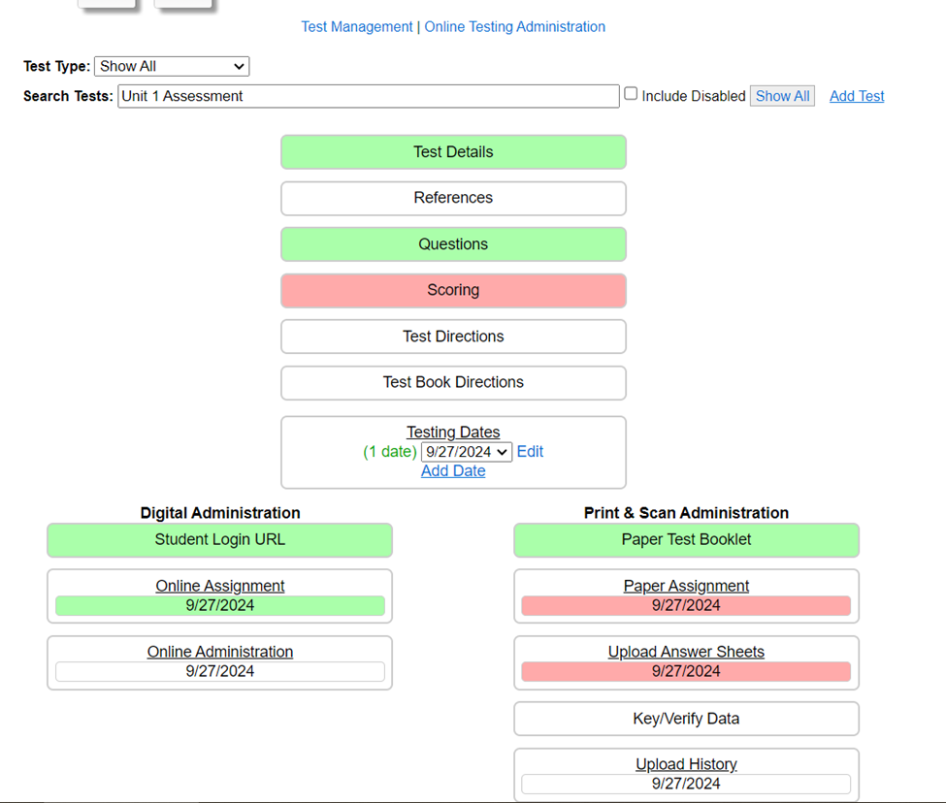

Test Management
Add questions
Put in scoring details
Print a test

Slide 4
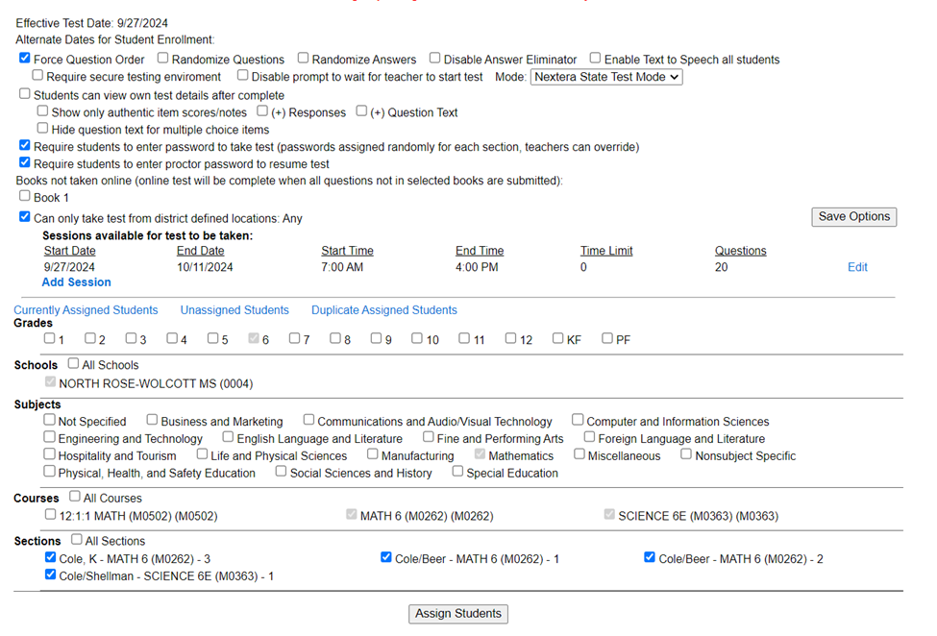
Test Details
Grade level
Nextera State Test Mode
Requiring a password
Assigning to classes

Slide 5
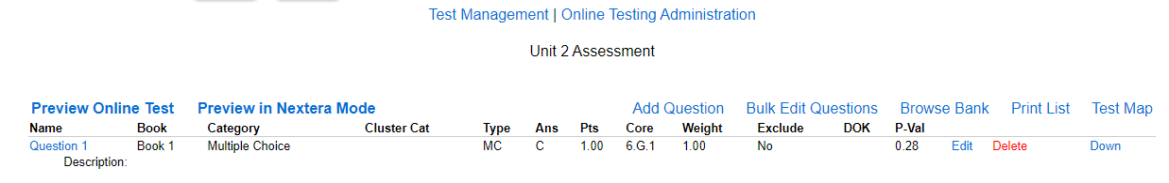
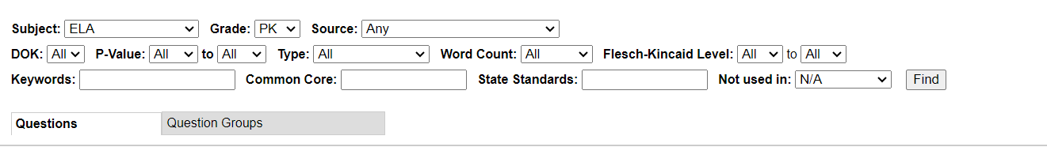
Questions…Browse Bank
Find State Test questions by standard, search by year of test, search for types of questions such as multiple choice or constructed response

Slide 6
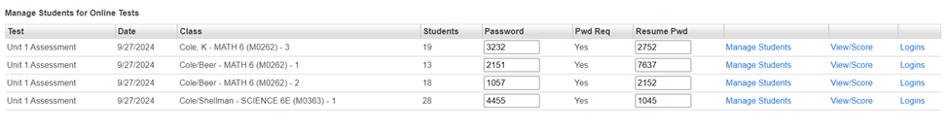
Manage Students
Make sure student rosters are accurate
View and score tests from this page

Slide 7
Time to start exploring
Have fun!

