Slide 1
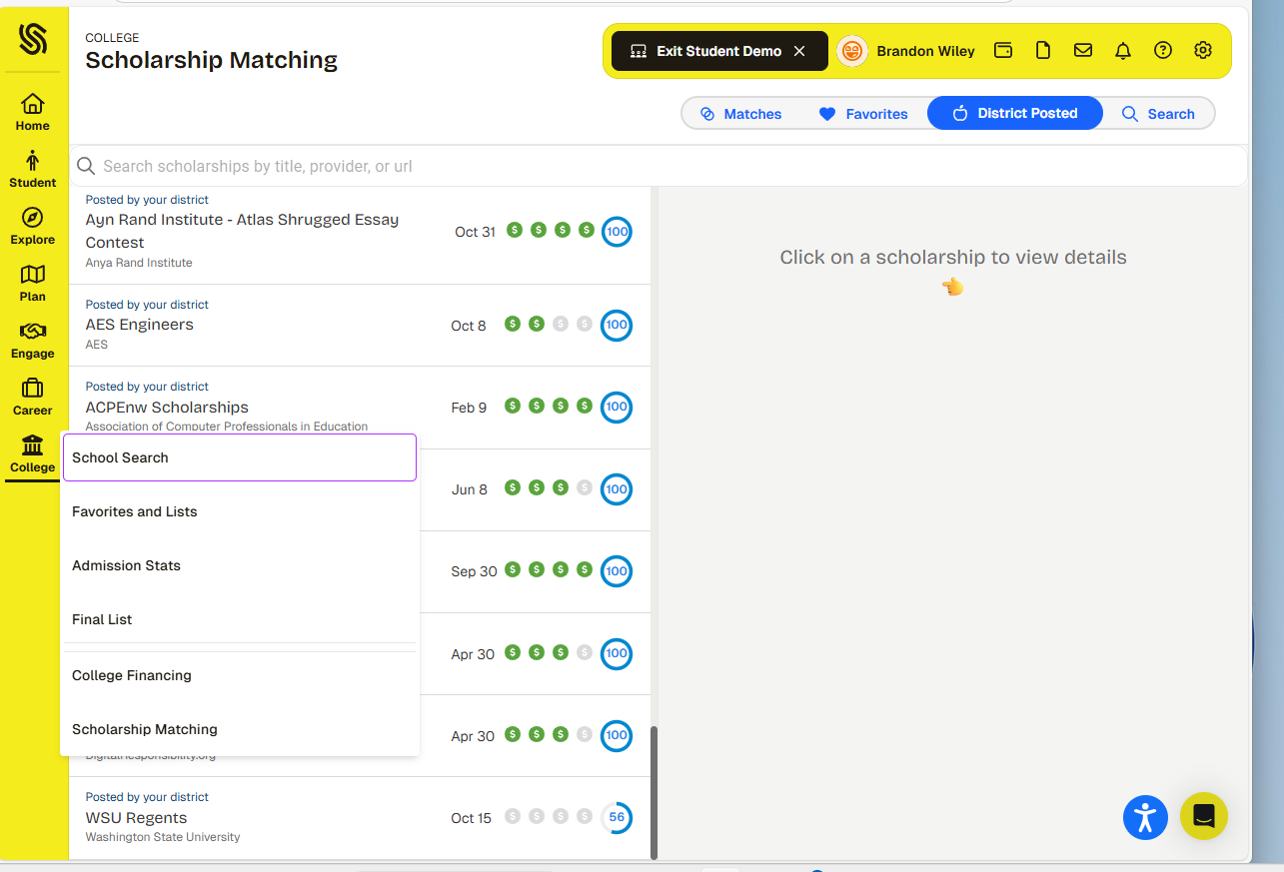
To find scholarships in Schoolinks:
Click on the College tab, then
Scholarship
Matching.
You will be asked to answer questions which will match you with scholarships.
Click on a scholarship to open. Then the
to favorite.
Click “District Posted”
to view our list of local scholarships.

