Slide 1
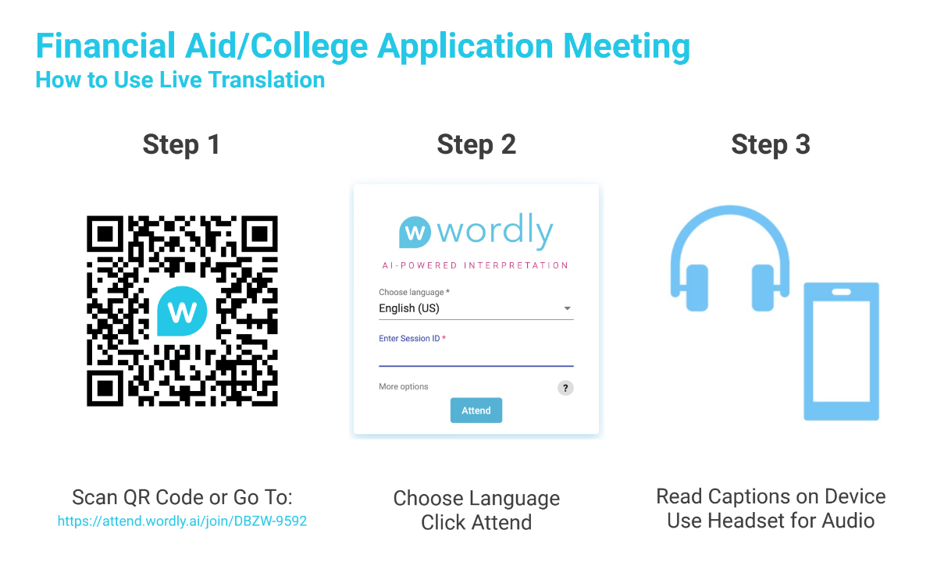
This event provided the audience the opportunity to hear the presenters in any language live through their cell phones. All large School Counseling events will have this feature. Bring headphones for the best experience.

Slide 2




Understanding
Financial Aid
Fall Open House
Ryan DePuy
Vice President
Undergraduate Admissions
rdepuy@iona.edu
October 9, 2021

Slide 3
Ted Talk Goals
Understand Where $$ Comes From
Understand The Process
Reduce Fear
Fall Open House
October 9, 2021

Slide 4



What is Financial Aid?

Slide 5


Slide 6



Types of Financial Aid
Merit-based
Participation-based
Need-based

Slide 7

Financial Aid Terms
Student Aid Index (SAI)
  Used to be Estimated Family Contribution (EFC)
Direct Cost (Tuition, fees, room, board)
Indirect Costs (travel, books, discretionary)
Cost of Attendance (Direct + Indirect)
Financial Need (COA – EFC = Need)
Total Offer/Award
Net Price (COA – Total Award)

Slide 8
Net Cost | Solve for “X”
$45,000 (COA)
    - $20,000 (Total Offer)
    = X (NET COST)

Slide 9
Types of Financial Aid
Merit-based
Participation-based
Need-based

Slide 10

Applying for Merit-Based Aid
Most Colleges and Universities consider students for merit-based awards at the time of application. You can ask!
Schools can utilize a combination of academic credentials, scores, or an academic index to evaluate students
Usually the largest piece of your financial aid
Helpful Hint: Pay attention to application deadlines!!!

Slide 11
Applying for Participation Aid
Award contingent on your involvement in an activity or program on campus
  Athletics
  Community Service
  Residential Status
  Honors
  Specialty Academic Programs
Potential additional applications, essays, and/or interviews for consideration

Slide 12
Applying for Need-based Aid
FAFSA
  Free Application for Federal Student Aid
  https://studentaid.gov/
  Mobile App
CSS Profile
  College Board Document

Slide 13


FAFSA
Anticipated Open 10/1 – 12/1, 2024
Tax information from the previous FY is used
Usually best if parents assist students through the process, or complete it on their behalf.
Helpful Hint: Make sure to use student information, student’s FAFSA

Slide 14
FAFSA Step-by-step
Create an account (FSA ID)
Start FAFSA @ fafsa.gov
Fill out the demographics section
List the schools
Answer dependency questions
Parent demographics
Supply financial information
    IRS Data Retrieval Tool
Sign
Finished!

Slide 15
CSS Profile
Opens Oct 1st of student’s senior year
Very similar to the FAFSA, though more complex
Complete 1x

Slide 16


Grants
Scholarships
Federal/State Money
  Pell
  TAP
  SEOG (Supplemental Educational Opportunity Grants)
  Subsidized or Unsubsidized Federal Loans
Results of Need-based aid

Slide 17
Student and Parent Loans
Federal Subsidized and Unsubsidized
  Fixed 6.53% Interest Rate Currently
PLUS Loan
  Loan for the parent of the dependent child
  9.08% Interest Rate (moving up!)
Alternatives
  Private lenders. Be sure to check the terms and conditions. Range 12% - 17% depending.

Slide 18
What Now?
Review your financial aid award letters.
Do the math!
Connect with Financial Aid Office with Questions
Keep a record/spreadsheet of award letters

Slide 19
Can I Negotiate?
Yes and No
Connect with Financial Aid Office to learn more about the standard appeal process and what it looks like at that school
Special circumstances/conditions appeal

Slide 20

Helpful Hints & Resources
Net Price Calculator (NPC)
Financial Aid & School Websites
Leverage your Admissions Counselor
  Ask schools about their aid process!
Always remember, aid varies:
  Student to Student
  School to School
  Year to Year

Slide 21
Understanding
Financial Aid
Fall Open House
Ryan DePuy
Vice President
Undergraduate Admissions
rdepuy@iona.edu
914-633-2275
October 9, 2021

