Slide 1
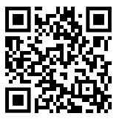
Please Sign In!
Welcome to Senior Information Night!
It is helpful if every member of your party signs in separately. Thank you!

Slide 2


flower mound high school
Senior
FALL GUIDANCE
September 2025

Slide 3
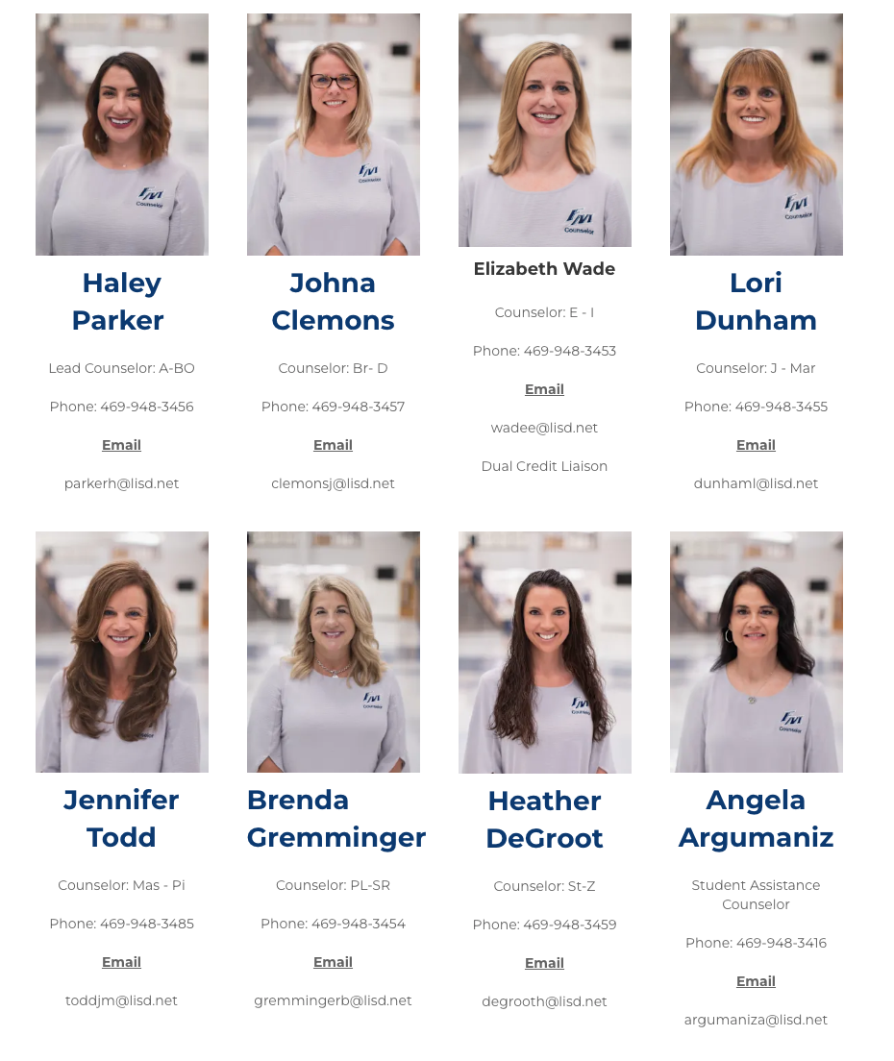
MEET
THE
COUNSELING
TEAM

Slide 4
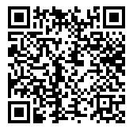
HAVE QUESTIONS?!
Please submit questions using the QR Code.
We will answer questions at the end of the presentation.

Slide 5

POST HIGH SCHOOL OPTIONS
Attend a 4-year university
Junior/Community College
Career/Technical School
Military Enlistment/ROTC Scholarship/Academies
Apprenticeship Programs
Gap Year
Join the workforce

Slide 6

COMMUNITY & TECHNICAL
Local Community Colleges
North Central Texas College
  https://www.nctc.edu/
Dallas College
  https://www.dallascollege.edu/
Collin College
  https://www.collin.ed
Technical and Trade Schools
Universal Technical Institute - Irving
  https://www.uti.edu/
Texas State Technical College - Waco
  https://www.tstc.edu/

Slide 7
MILITARY
ARMY
  https://www.goarmy.com/
MARINES
  https://www.marines.com/
NAVY
  https://www.navy.mil/
AIR FORCE
  https://www.airforce.com/
COAST GUARD
  https://www.gocoastguard.com/

Slide 8
COLLEGE
READINESS

Slide 9
Summer After Junior Year
Begin to narrow list of college choices
Begin looking at college applications when they are available for viewing
Research essay prompts and work on/complete college essays
Review your transcript to make sure you are on track for graduation requirements
Check course admission requirements for your schools of choice
Update your college spreadsheet: list of schools to which you are applying, due dates, application requirements, etc.
College visits and tours
Finalize your resume
Gather financial information – FAFSA opens in December
Create Common App account and familiarize yourself with the process
  Enter your counselor’s email address in “Recommenders”
  Use @lisd.net - DO NOT use @staff.lisd.net

Slide 10
RANK OPT OUT
Students have two windows of opportunities to remove class rank from the transcript:
May 15 - 30, 2025 (spring of junior year)
September 15 - 30, 2025 (fall of senior year)
Once the rank is removed from the transcript, it cannot go back on the transcript.
Parents must complete the request in FAMILY ACCESS in Skyward
Families will receive emails with dates and instructions as the windows approach.
*NOTE: Students in the top 10% WILL have rank posted on the transcript.
Have questions?
Submit using the QR Code

Slide 11
Common App Requests
Uploading Common App Documentation - school report, transcripts and counselor rec letter (if needed)
Use @lisd.net email when adding counselor as a recommender (not the @staff.lisd.net).
Timelines for transcripts -
  End of Junior Year - GPA is current
  After 1st nine weeks - includes Updated Rank
    Processing of Transcript will not be completed by October 15 deadlines (Junior Transcript)
    Processing of Transcripts can not be guaranteed by Nov 1 deadline (Junior transcript)
  All required materials will be fulfilled by the earliest college deadline.
    Be sure to give the counselors at least 2-3 weeks to complete request
    i.e. December 1st deadline - complete Common App request by 1st week of November (due to Thanksgiving break).

Slide 12
SENIOR YEAR TIMELINE WITH LINKS
12th Grade Future Planning Guide (comprehensive guide)
Keep track of due dates, admissions requirements, financial aid - using a spreadsheet like the one linked here is helpful!
Start college application process - Common App Website, Apply Texas Website or individual college application system
If needed, complete Counselor Recommendation Letter form
Request transcripts be sent to college(s) - if applicable! - Request a Transcript
Take entrance exams & scores to colleges - SAT/ACT - College Board Website & ACT Website
Take TSI if needed -College For All Texans
Visit college representatives during school lunches - College Rep Calendar
Notes:
Highlight the ones that are more important
https://docs.google.com/spreadsheets/d/1R_RnZQF_il_u48hg1HHNExOe9m5X5IvFKY2quEjfYvY/edit?gid=0#gid=0

Slide 13
SENIOR YEAR TIMELINE WITH LINKS
Submit applications ahead of due dates! Applications can be submitted prior to the transcript or letters of recommendation
Attend FAFSA meeting and complete FAFSA online - FAFSA Website
Begin applying for scholarships; national +college-based scholarships often have fall deadlines; local scholarships have spring deadlines - Scholarships Page on Counseling Site
By May 1st, let the college you’ve chosen know you plan to attend; let other colleges know you will not be attending
Send final transcript to college of choice - Request a Transcript
Have questions?
Submit using the QR Code

Slide 14
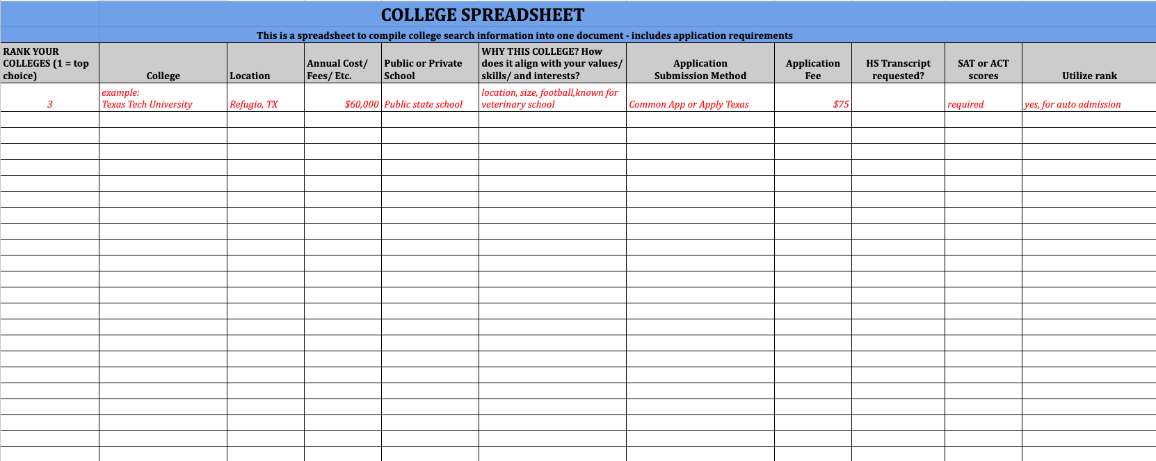
FMHS COLLEGE SPREADSHEET
Creating a spreadsheet to manage your searches, testing, and application information in ONE location is very helpful!

Slide 15
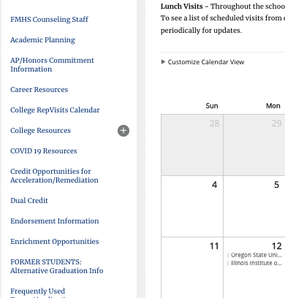
COLLEGE REPRESENTATIVES
Throughout the school year, college representatives from around the country visit FMHS during all 4 lunches.
On the FMHS counseling website, you’ll find the link to the calendar to see who’s coming and when!
College Rep Visits Calendar

Slide 16

UNT GO CENTER
The University of North Texas Office of Outreach has representatives from their GO Center who visit high school campuses in the area to meet with individual students to help promote attending college. Go Center representatives can assist our students with a variety of college questions from the application process to financial aid. They are available to meet with any student, not just students interested in attending UNT.
Students should be on the lookout for emails about Go Center visits and how to sign up!

Slide 17






SCHOLARSHIPS
Scholarship Search
https://fmhs.lisd.net/our-school/counseling/college-resources/scholarships-financial-aid

Slide 18
COLLEGE RESOURCE LINKS
FMHS Counseling Website
  https://www.lisd.net/domain/3027
LISD High School Academic Planning Guide
  High School Planning
Transcript Requests
  https://www.lisd.net/Page/27608
Counselor Recommendation Letter Form
  https://forms.gle/rXzDRPLaDnryPohK9
Common Application
  https://www.commonapp.org/
Apply Texas
  https://www.applytexas.org/

Slide 19
COLLEGE RESOURCE LINKS
TSI Assessment
https://tea.texas.gov/academics/college-career-and-military-prep/the-tsia-texas-success-initiative-assessment
SAT - College Board
  https://www.collegeboard.org/
ACT Exam
  https://www.act.org/content/act/en-texas.html
FAFSA Financial Aid
  https://studentaid.gov/h/apply-for-aid/fafsa
Texas OnCourse
  https://texasoncourse.org/
Scholarship Search
  https://fmhs.lisd.net/our-school/counseling/college-resources/scholarships-financial-aid

Slide 20
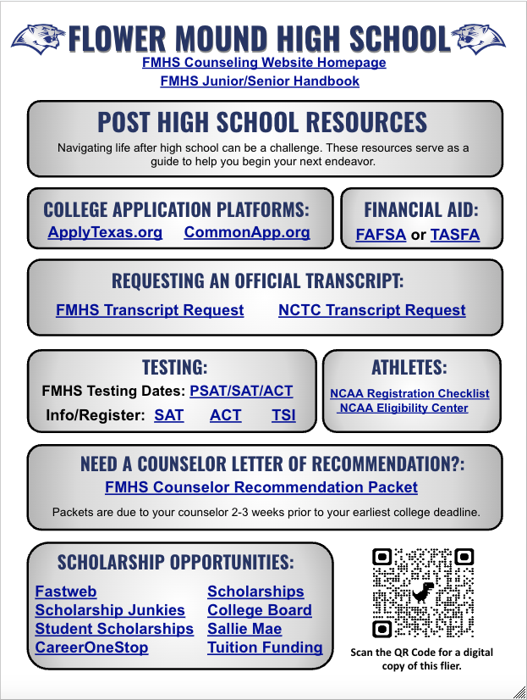
FMHS FUTURE PLANNING FLYER

Slide 21

SENIOR RESOURCE PAGE
FMHS Senior Information: https://fmhs.lisd.net/seniors
Graduation Date: May 30 at 6:00 p.m. - Frisco Star
Weekly FMHS Newsletters

Slide 22
QUESTIONS
Submitted Questions:
Will transcripts be sent through ApplyTexas? Students will need to request a transcript be sent directly to the college using the transcript request link - Request a Transcript
Is it better to do college visits before or after getting accepted? College visits are encouraged to help students determine if a school is the right fit. Visiting either before or after acceptance can support them in making a well-informed final decision.
Do we have to apply for TAFSA separately if applying for FAFSA? TAFSA is for students are who ineligible for FAFSA. We will have a FAFSA night in early December for more information.
Are senior courses included on the submitted transcript? Yes, senior classes are included on current transcripts.

Slide 23
QUESTIONS
Submitted Questions:
How do I know Rank was removed? Parents are able to opt out of rank through a Skyward form - only on the parent side. It takes 24 hours for rank to be removed. The counselor can confirm rank was removed and you can view student portfolio after 1st 9-week.
How do SAT scores get sent? You will request your SAT scores be sent through College Board.
College specific questions - we recommend reaching out to the college admissions representative - they are experts to their admissions requirements.
GPA - should we put weighted or unweighted? Whichever one is going to showcase your academic effort.

