Slide 1
Finance Advisory Committee
2024-25 Finance Advisory Committee
Budget and Fiscal Recommendations to Superintendent Hines
Staff:
Cody Christensen, Senior Accountant
Josiah Nebo, Asst. Director of Business Services
Patricia Magnuson, Director of Business Services
Parents/Community Members:
Lisa Wahlstrom
Matthew Ernst
Mitch Meyer
Students:
Charlotte Cox, High School Senior
Jaiden Leary, High School Senior
Prepared for 2.25.2025 School Board Meeting
Notes:
Patricia

Slide 2
Mission
St. Louis Park Public Schools sees, inspires, and empowers each learner to live their brilliance in an environment that centers student voice and experience to create racially equitable learning that energizes and enhances the spirit of our community.
Prepared for 2.25.2025 School Board Meeting
Notes:
Patricia

Slide 3
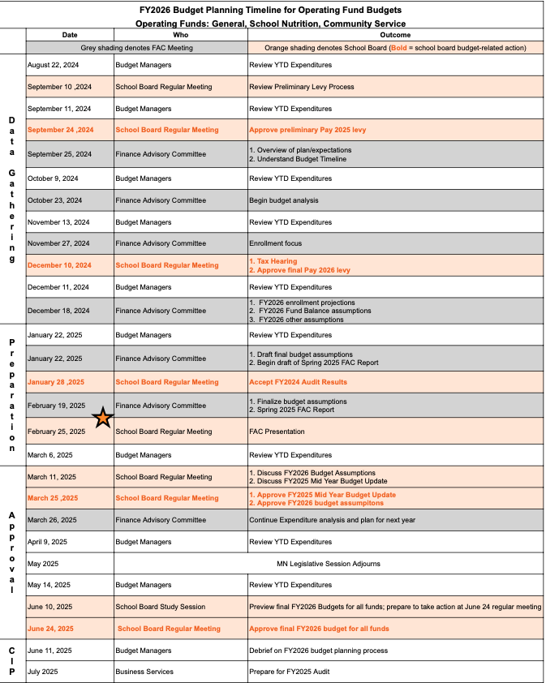

Slide 5
FAC Purpose
Advise administration and the SLP School Board on
economic and school finance issues, and
build community trust in district finances.
Prepared for 2.25.2025 School Board Meeting
Notes:
Josiah

Slide 6
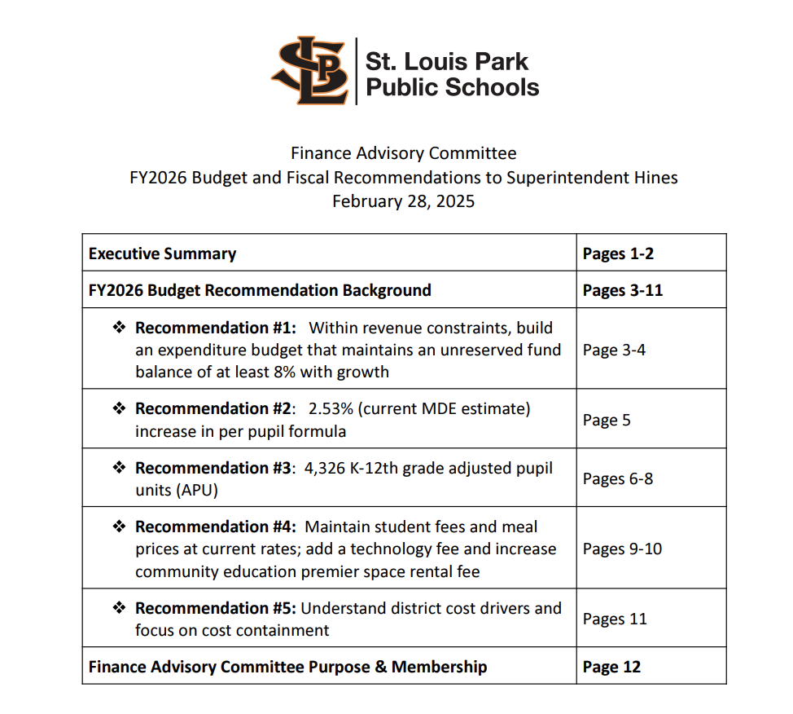
Notes:
Josiah

Slide 7
FAC Members
Community Members
1 | Matthew | Ernst | High School
2 | Barry | Fitzpatrick | Middle/High School
3 | Tim | Goldencrown | Park Spanish Immersion Elementary School
4 | Iman | Hatibu | Peter Hobart Elementary School
5 | Mitch | Meyer | Aquila
6 | Anna | Younger | Park Spanish Immersion Elementary School
7 | Lisa | Wahlstrom | Susan Lindgren; PK
Students
1 | Charlotte | Cox | high school senior
2 | Jaiden | Leary | high school senior
3 | Evan | Scott | high school junior
District Staff
1 | Michelle | Bryant | School Social Worker at Susan Lindgren
2 | Sue | Cantor | SPARK
3 | Cody | Christensen | Senior Accountant
4 | Patrice | Howard | Cabinet
5 | Patricia | Magnuson | Director of Business Services
6 | Josiah | Nebo | Assistant Director Business Services
7 | LaNisha | Paddock | High school Principal
8 | Scott | Peterson | Accountant
School Board
1 | Celia | Anderson | School Board (served during 2024)
2 | Anne | Casey | School Board (served during 2024)
3 | Abdihakim | Ibrahim | School Board (served during 2025)
4 | Taylor | Williams | School Board (served during 2025)
Prepared for 2.25.2025 School Board Meeting
Notes:
Josiah

Slide 8
Primary Factors Discussed and Considered
State Economy
Cost Structure
Student Enrollment
Prepared for 2.25.2025 School Board Meeting
Notes:
Cody

Slide 9
Budget Recommendations
Fund Balance Minimum
Per Pupil Funding Formula
Student Enrollment Projection
Local Fees
District Cost Drivers
Prepared for 2.25.2025 School Board Meeting
Notes:
Cody

Slide 10
Recommendation 1: Fund Balance Minimum
Develop an expenditure budget that ensures an unreserved fund balance of at least 8%.
Create a long-term strategy to gradually increase the fund balance to 12%-16%, which would equate to approximately two months' worth of expenditures.
Prepared for 2.25.2025 School Board Meeting
Notes:
Mitch - Lead
Lisa & Matthew

Slide 11
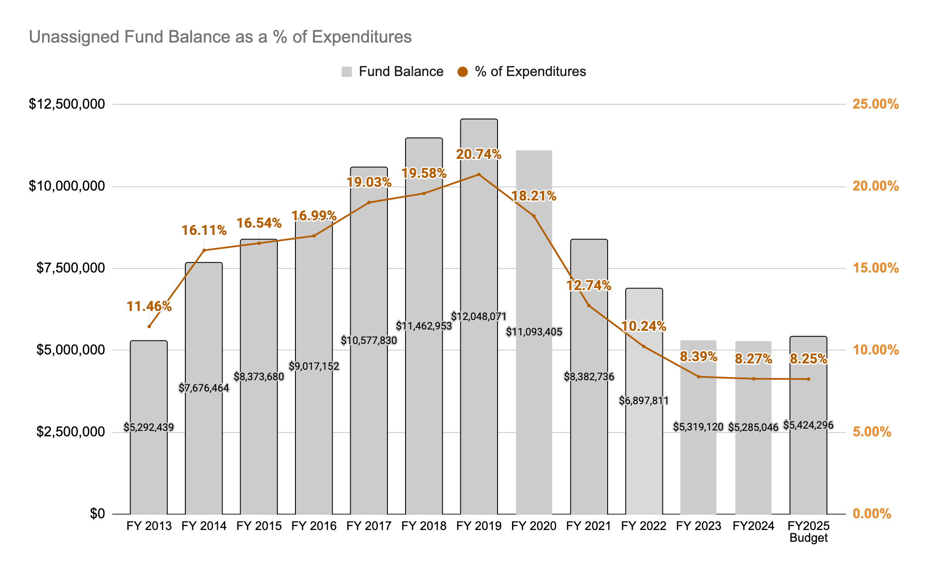
Internal Unassigned/UnrestrictedFund Balance Calculation
(excludes assigned balances for future budget deficits, donations/grants, severance ATPPS)
Prepared for 2.25.2025 School Board Meeting
Notes:
Mitch - Lead
Lisa & Matthew

Slide 12
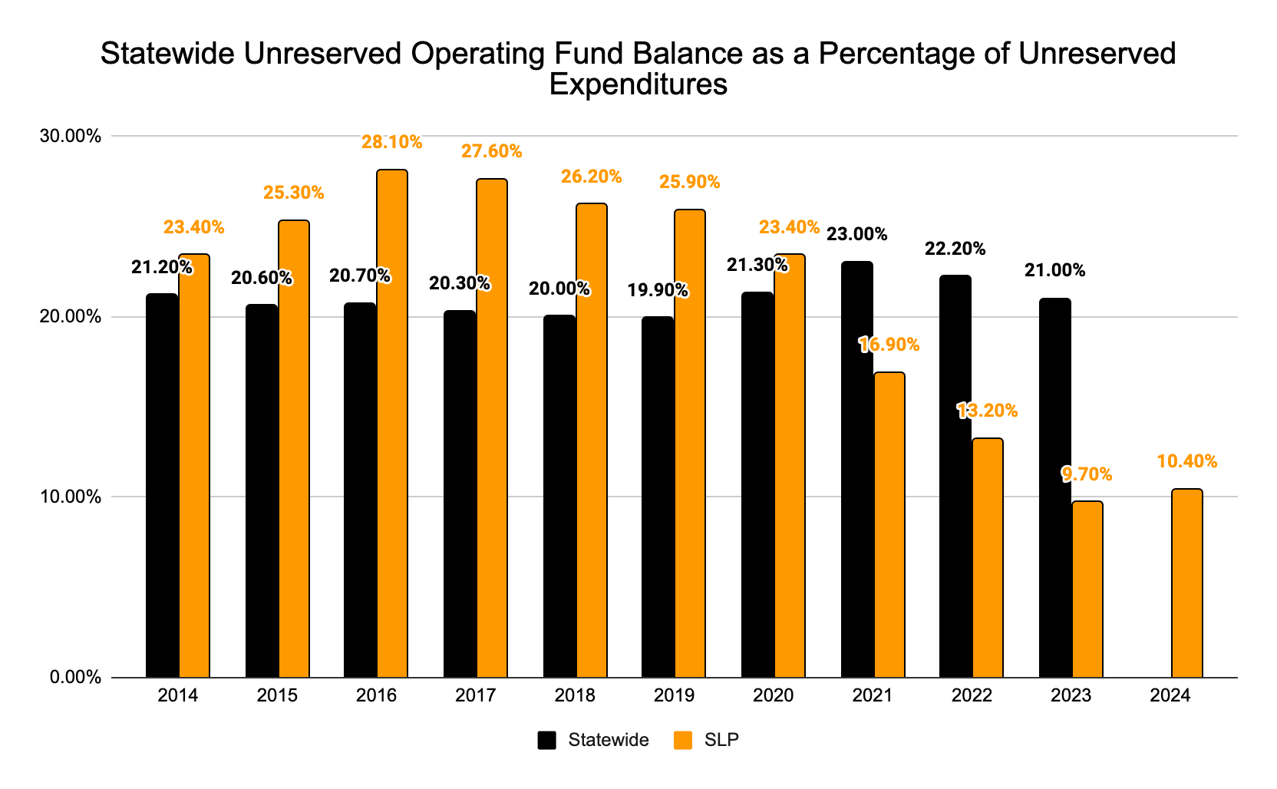
Statewide Unrestricted Fund Balance Calculation
(includes assigned balances for future budget deficits, donations/grants, severance ATPPS)
Prepared for 2.25.2025 School Board Meeting
Notes:
Mitch - Lead
Lisa & Matthew

Slide 13
Recommendation 2: General Education Funding Formula
2.53% increase in per pupil formula
Prepared for 2.25.2025 School Board Meeting
Notes:
Matthew - Lead
Lisa and Mitch

Slide 14
Recommendation 2: General Education Funding Formula
Year | Amount | Explanation
2013-14 | $5,302 | 1.5% increase
2014-15 | $5,831 | 1.5% increase + $25
2015-16 | $5,948 | 2.0% increase
2016-17 | $6,067 | 2.0% increase
2017-18 | $6,188 | 2.0% increase
2018-19 | $6,312 | 2.0% increase
2019-20 | $6,438 | 2.0% increase
2020-21 | $6,567 | 2.0% increase
2021-22 | $6,728 | 2.45% increase
2022-23 | $6,863 | 2.0% increase
2023-24 | $7,138 | 4.0% increase
2024-25 | $7,281 | 2.0% increase
2025-26 | $7,465 | 2.53% increase (current MDE est)
Prepared for 2.25.2025 School Board Meeting
Notes:
Matthew - Lead
Lisa and Mitch

Slide 15
Recommendation 3: Student Enrollment
4,326 K-12th grade adjusted pupil units (APU)
Focus to improve the student capture rates to maintain and increase enrollment
Prepared for 2.25.2025 School Board Meeting
Notes:
Lisa - Lead
Mitch & Matthew

Slide 16
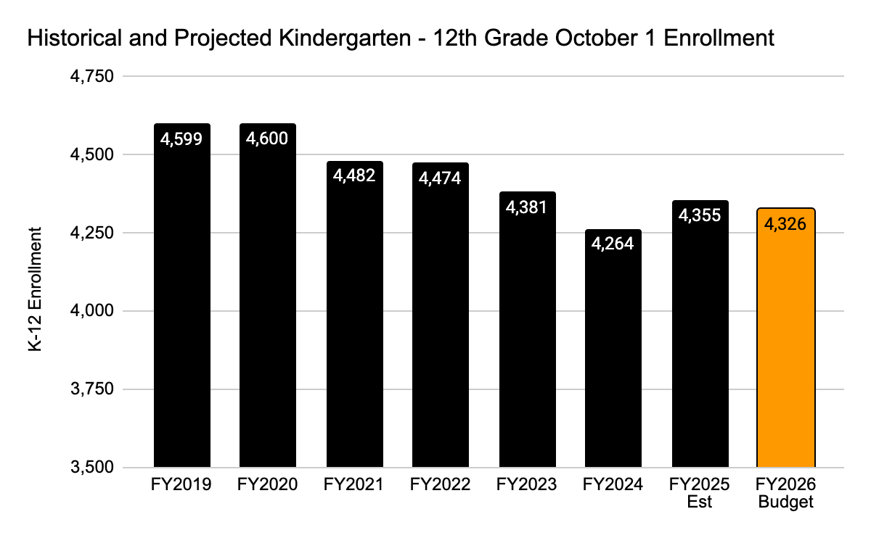
Recommendation 3: Student Enrollment
Prepared for 2.25.2025 School Board Meeting
Notes:
Lisa - Lead
Mitch & Matthew

Slide 17
Recommendation 3: Student Enrollment
 | Historical Fall Actual |  |  |  |  |  | Est | Budget
 | FY2019 | FY2020 | FY2021 | FY2022 | FY2023 | FY2024 | FY2025 | FY2026
Kindergarten | 332 | 391 | 302 | 351 | 298 | 323 | 334 | 302
Grade 1 | 351 | 329 | 384 | 309 | 345 | 282 | 331 | 331
Grade 2 | 333 | 338 | 319 | 365 | 294 | 345 | 300 | 339
Grade 3 | 355 | 334 | 325 | 319 | 364 | 283 | 339 | 294
Grade 4 | 357 | 346 | 322 | 315 | 316 | 339 | 300 | 341
Grade 5 | 360 | 347 | 345 | 312 | 303 | 317 | 351 | 304
Total Elementary | 2,088 | 2,085 | 1,997 | 1,971 | 1,920 | 1,889 | 1,955 | 1,911
Grade 6 | 356 | 358 | 323 | 330 | 320 | 310 | 321 | 357
Grade 7 | 322 | 357 | 340 | 331 | 322 | 315 | 329 | 328
Grade 8 | 340 | 333 | 338 | 331 | 316 | 313 | 324 | 328
Total Middle School | 1,018 | 1,048 | 1,001 | 992 | 958 | 938 | 974 | 1,013
Grade 9 | 392 | 370 | 374 | 399 | 361 | 326 | 339 | 346
Grade 10 | 390 | 380 | 366 | 383 | 393 | 354 | 338 | 342
Grade 11 | 337 | 378 | 356 | 352 | 364 | 375 | 363 | 334
Grade 12 | 374 | 339 | 388 | 377 | 385 | 382 | 386 | 380
Total High School | 1,493 | 1,467 | 1,484 | 1,511 | 1,503 | 1,437 | 1,426 | 1,402
Total K-12 | 4,599 | 4,600 | 4,482 | 4,474 | 4,381 | 4,264 | 4,355 | 4,326
Change |  | 1 | -118 | -8 | -93 | -117 | 91 | -29
 |  | 0.02% | -2.57% | -0.18% | -2.08% | -2.67% | 2.13% | -0.67%*
Prepared for 2.25.2025 School Board Meeting
Notes:
Lisa - Lead
Mitch & Matthew

Slide 18
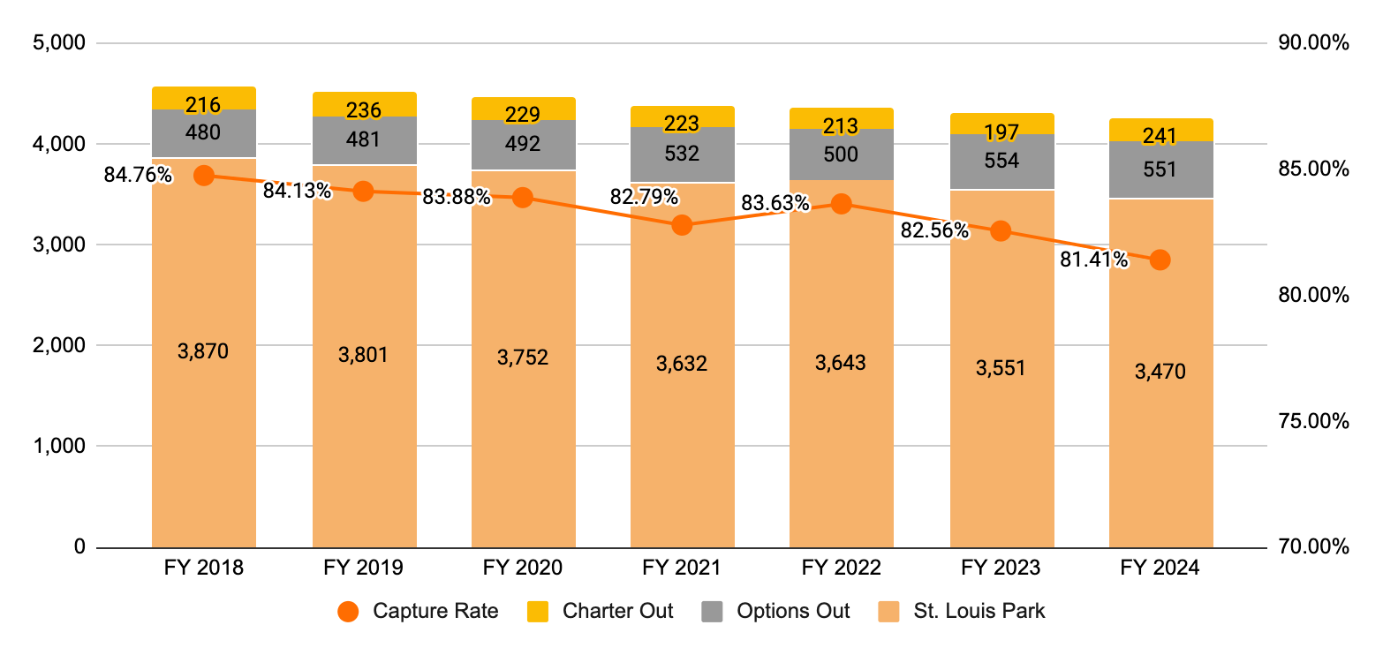
Recommendation 3: Student Enrollment
Focus significant effort to recruit and retain resident students to increase capture rate
Prepared for 2.25.2025 School Board Meeting
Notes:
Lisa - Lead
Mitch & Matthew

Slide 19
Recommendation 3: Student Enrollment
Beliefs about ways to attract and retain resident students
Persist in Improving Academic Outcomes
Promote Unique Strengths
  Preschool programs,which serve as a positive and inviting entry point for families into the district’s educational system.
  Small town in the city highlighting proximity to the city with the benefits of a smaller school setting
  Low elementary class sizes
  Engaged and connected teachers - teachers care about their students
  Modernized schools and cafeterias as a result of community support and investment
  Offerings of International Baccalaureate (IB), Advanced Placement (AP), and concurrent college enrollment at the high school
Increase Outreach to Families with Incoming Kindergarteners
Create High Expectations for Initial Family Experiences
Ensure Transparency in Student Access
Enhance Non-Academic Experiences
Prepared for 2.25.2025 School Board Meeting
Notes:
Jaiden/Charlotte - Lead
All

Slide 20
Recommendation 4: Local Revenue
Add a Technology Fee
Increase Community Education Space Rental Fees
Maintain Existing Student Fees and Meal Prices
Encourage Sports Boosters to Increase Funding
  Form a District-Wide Booster Club
  Focus Booster Support on Transportation
Prepared for 2.25.2025 School Board Meeting
Notes:
Jaiden/Charlotte - Lead
All

Slide 21
Recommendation 5: District Cost Drivers
Focus on understanding and addressing the key cost drivers
  ensuring alignment with historical and statewide trends.
Cost drivers for initial focus:
  Substitute Teachers and Substitute Paraprofessionals
  Printing
  Transportation
  Additional Pay Beyond Contracted Pay
Prioritize retaining classroom teachers and direct student-facing positions
  Ensure that investments in non-classroom positions, such as administrative roles, deliver a clear return on investment..
Prepared for 2.25.2025 School Board Meeting
Notes:
Jaiden/Charlotte - Lead
All

Slide 22
FAC Committee Member Reflections
Prepared for 2.25.2025 School Board Meeting
Notes:
Josiah - Lead
All

Slide 23
Questions
Prepared for 2.25.2025 School Board Meeting
Notes:
all

