Slide 1

Integrity
Pre K - 2
October 2025

Slide 2
Integrity
Define
Identify
Apply
We will define integrity.
We will identify ways to show integrity.
We will be able to show integrity in various scenarios.

Slide 3
INTEGRITY
Choosing to do the right thing, even when no one is watching.

Slide 4


Slide 5
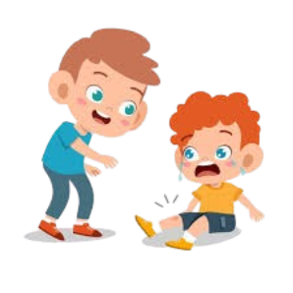


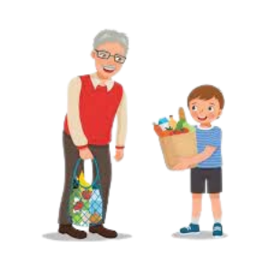
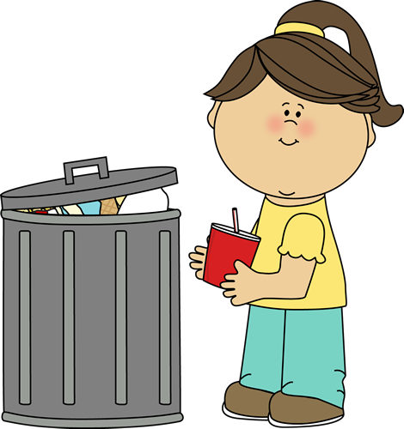
Ways to show integrity:
Helping your friend who got hurt
Sharing and taking turns
Staying on task
Throwing away trash
Helping a community member

Slide 6
Scenarios

Slide 7

How can you show integrity?
When you have a substitute teacher

Slide 8

How can you show integrity?
When you find a classmate’s lost toy/money

Slide 9
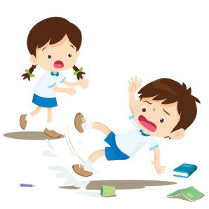
How can you show integrity?
When you accidentally bump into someone and they drop their book

Slide 10
How can you show integrity today?

Slide 11
Integrity Take Home Activity:
Discuss how to show integrity in various places:
Home
Grocery Store
Sports Practice/Events
Restaurants
Create your own

