Slide 1


Integrity
Choosing to do the right thing,
even when no one is watching.
October 2025

Slide 2


Slide 3
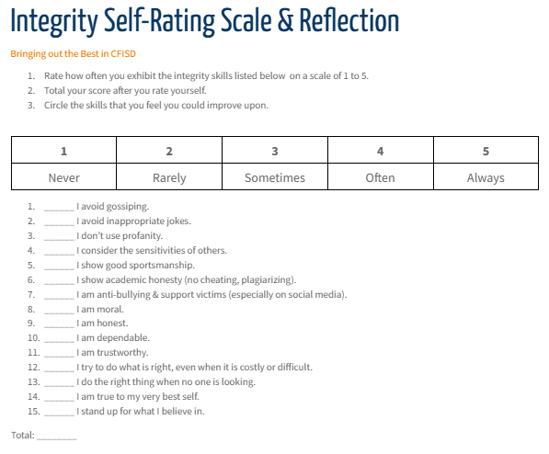
Integrity Rating Scale
Notes:
If possible, have students get a scratch piece of paper so they can complete the Self-Rating Scale. If not, allow the students to rate themselves according to the situations presented.

Slide 4
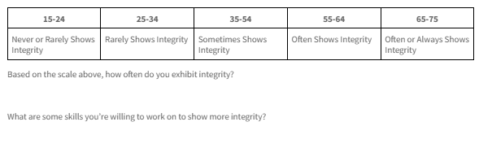
Integrity Rating Scale Results
Notes:
Have students reflect on their individual results. Ask students to share out their thoughts and ideas on integrity.

Slide 5
What would you do?
Scenarios:
You find a wallet in the hallway with $20 inside. No one is around.
A teacher accidentally gives you a higher grade than you earned.
You witness a friend cheating on a test and no one notices.
You see a student bullying someone on social media.
The school rules ban phones, but you could text under the desk during class without being caught.
Notes:
Instructions: Read the scenarios out loud and have the students discuss their answers.
Present 3–5 real-life scenarios (raise hands) where the “right” thing isn't being monitored.
Ask: What would you do? Why?
Debrief with a short discussion on the decisions that reflect integrity vs. convenience.

Slide 6
Why Is Integrity Hard Sometimes?
Peer Pressure
Inconvenience
Selfishness
What other reasons make it difficult to do the right thing?

Slide 7
How Does Integrity Build Trust?
Strengthens Relationships
Shapes Character
Enhances your Reputation
Creates Respect

Slide 8
A Deeper Dive Into Understanding Integrity
Integrity is who you are when no one is looking.
Integrity is doing what you say you’ll do—even if it’s hard or inconvenient.
Integrity is doing what’s right, not what’s easy.
Integrity means keeping your values consistent, no matter the situation.”
Integrity is being honest, trustworthy, and dependable—even when it costs you something.

