Slide 1

Retirement Process for those enrolled in MTRS
The MTRS (Massachusetts Teachers Retirement System) strongly encourages members to start the retirement process well in advance of their intended retirement date. Specifically, the application process recommends planning for retirement at least six months in advance and filing the application three to four months before the actual retirement date.

Slide 2

Chapters
Retiring Takes Work: The Four Big Tasks
Task 1: Deciding When and How to Retire
Task 2: Detaching from Work
Task 3: Building a Provisional Life Structure for Retirement
Task 4: Consolidating a Stable Life Structure for Retirement
The Role of Others in the Retirement Transition
Epilogue: Putting the Lessons to Work

Slide 3
First Steps
Contact MTRS at 617-679-6877
Set a tentative retirement date and request an estimate of retirement allowance
Schedule an appointment with a retirement counselor the Massachusetts Teachers’ Retirement System
Download the Retirement Booklet: Ready for Retirement
Familiarize yourself with the Benefits Options, Survivor Benefits and the Retirement Process
Choose your official retirement date (first day you will no longer be at work), Benefit Option and choose your beneficiaries
Notify your Principal/Department Head and the Superintendent’s office/HR of your intent to retire in writing with your signature
Complete and submit your retirement application to the Essex Regional Retirement System or Massachusetts Teachers’ Retirement System (Part 2 of the application is filled out by the Payroll department and should be sent there for processing).

Slide 4
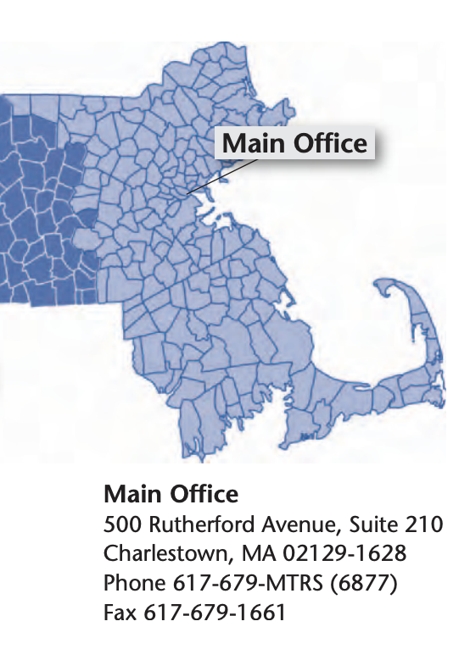

Slide 5
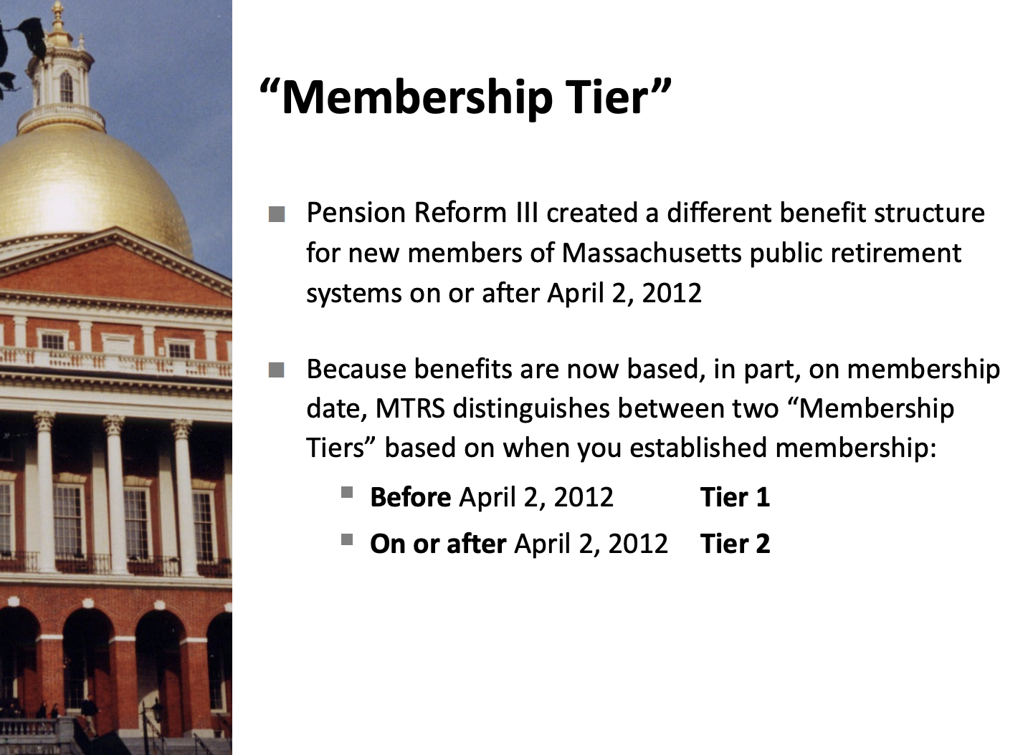

Slide 6
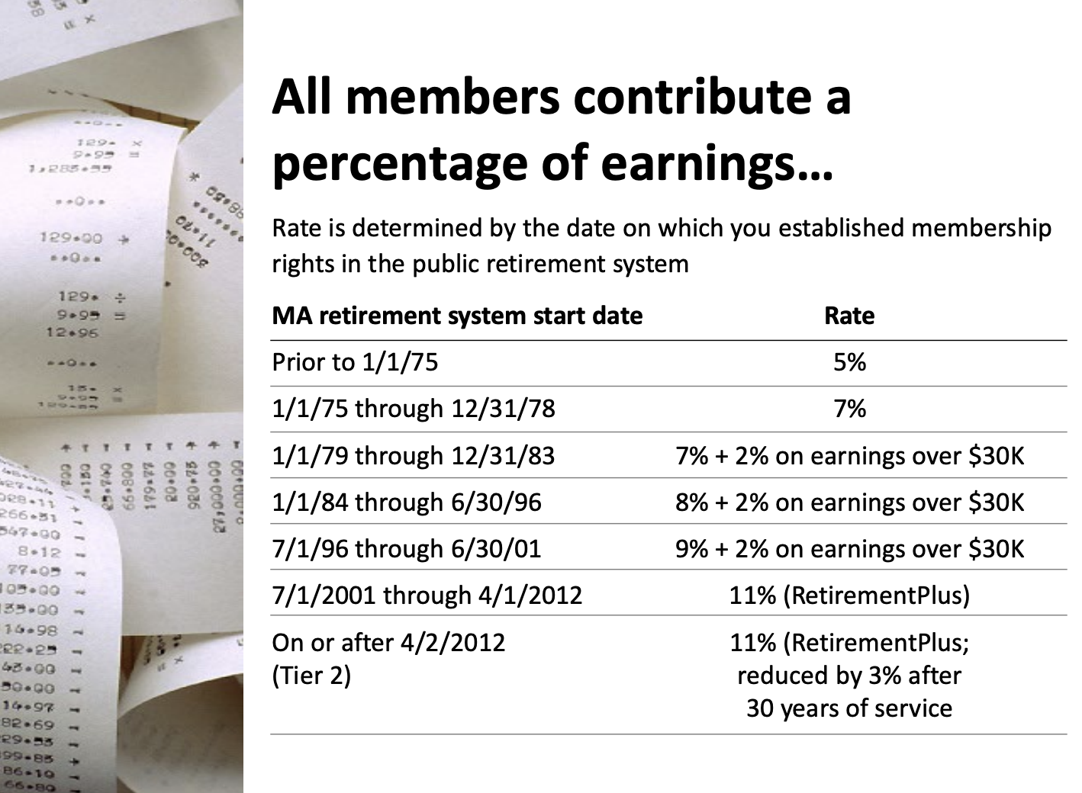

Slide 7
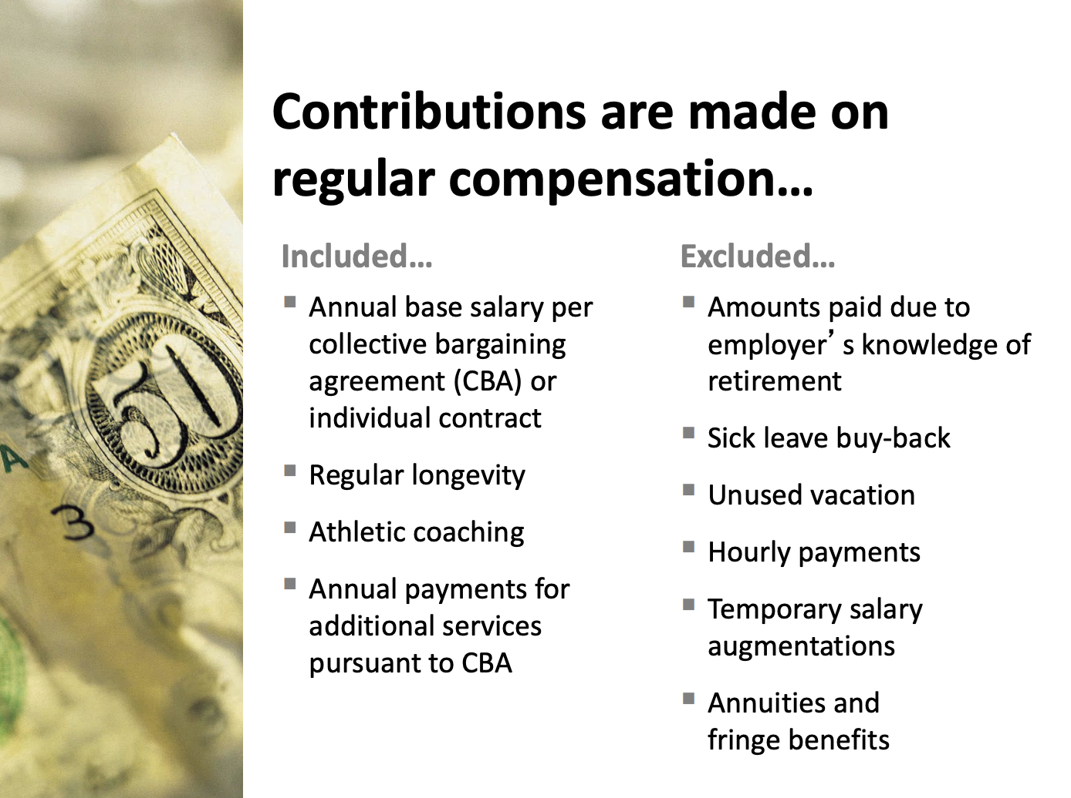

Slide 8
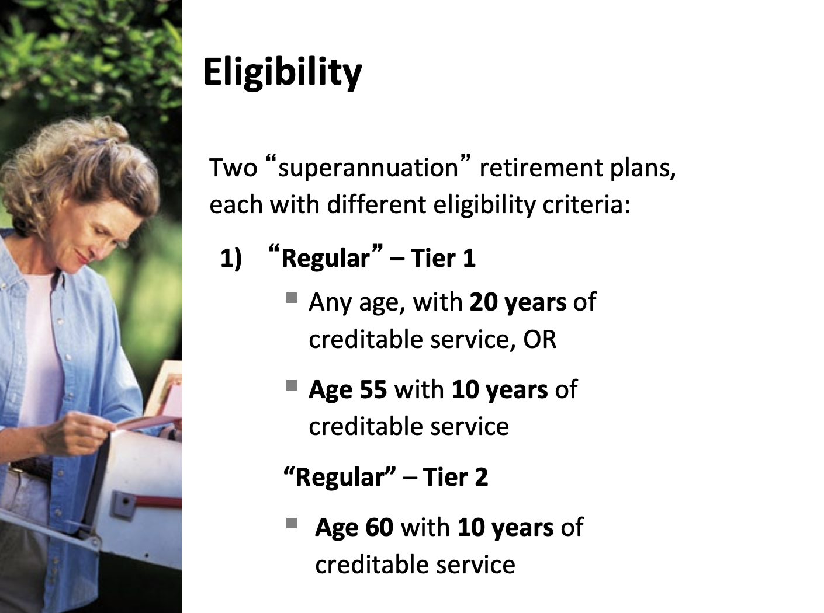

Slide 9
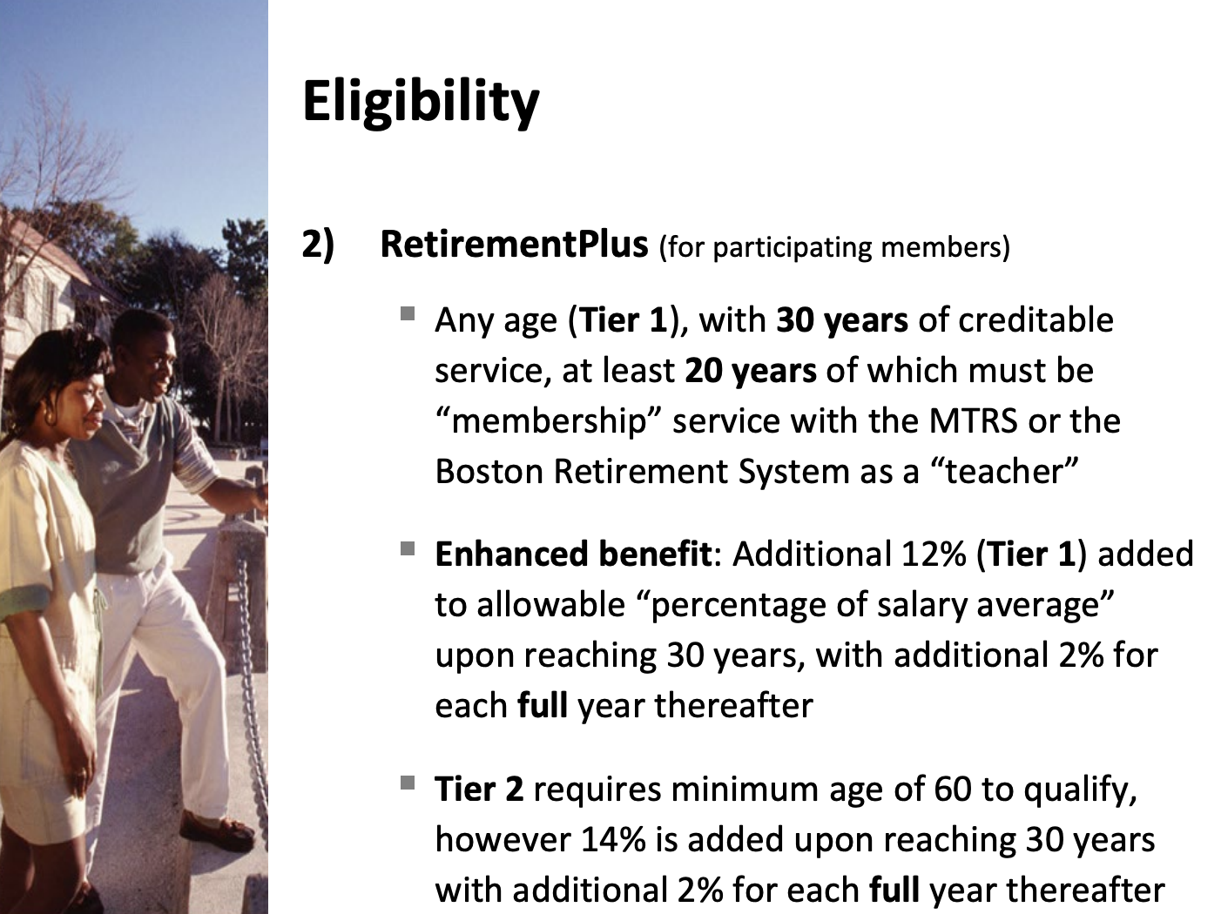

Slide 10
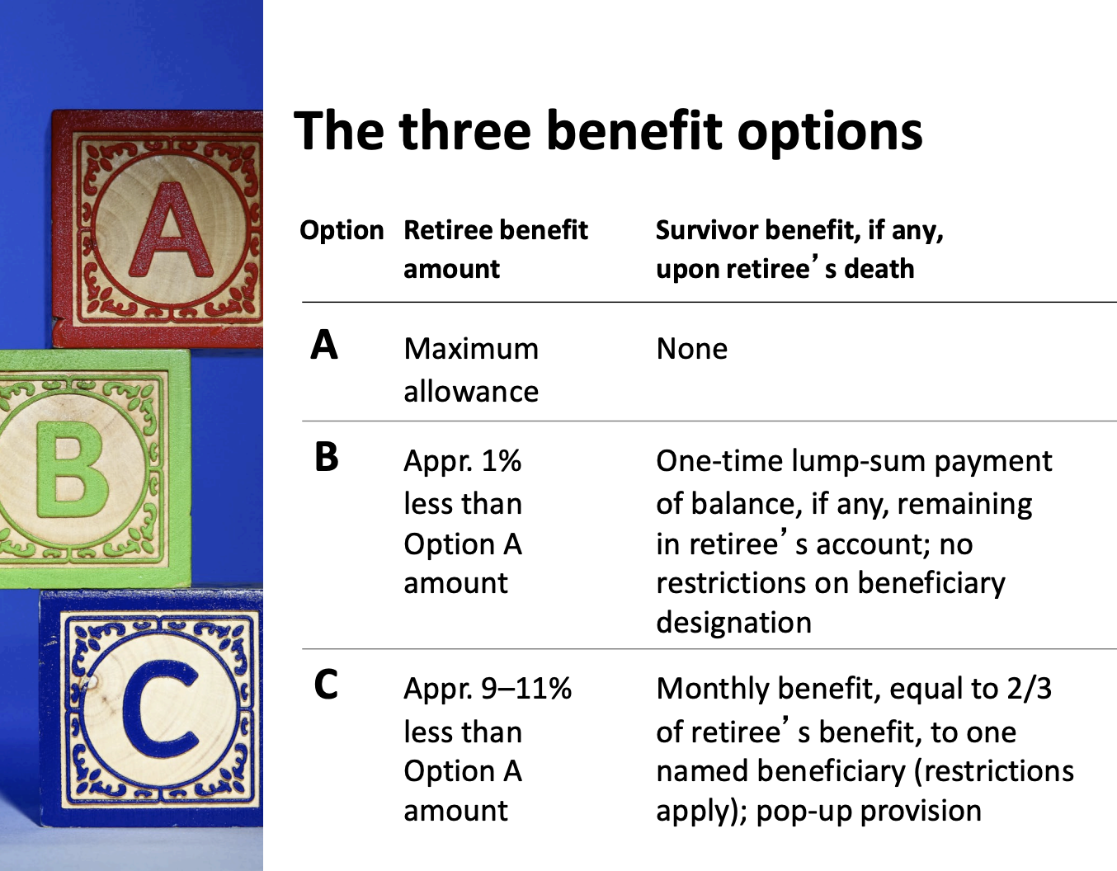

Slide 11
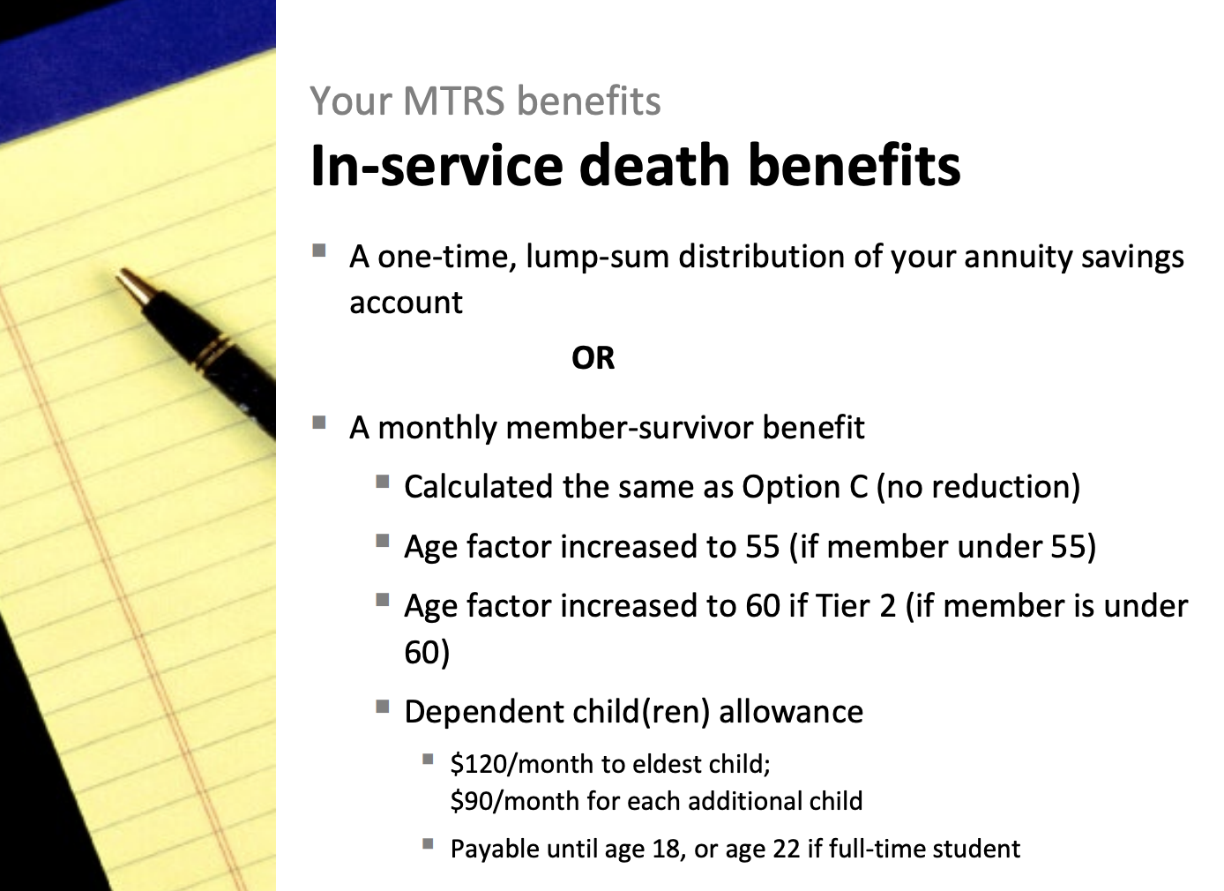

Slide 12
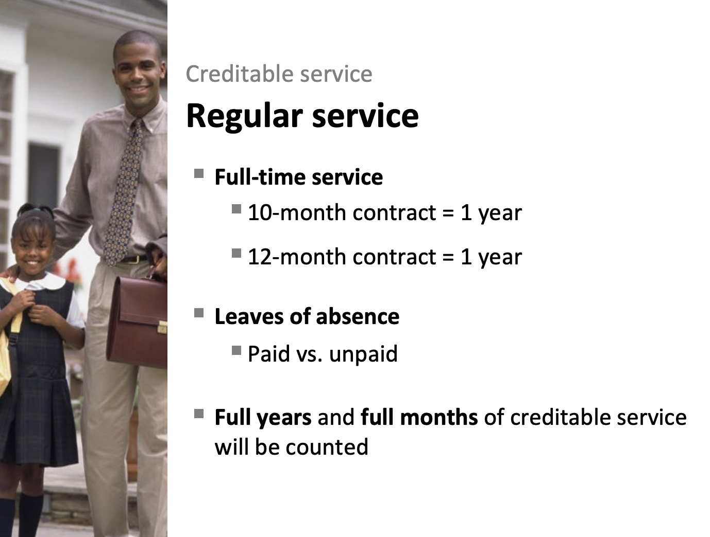

Slide 13
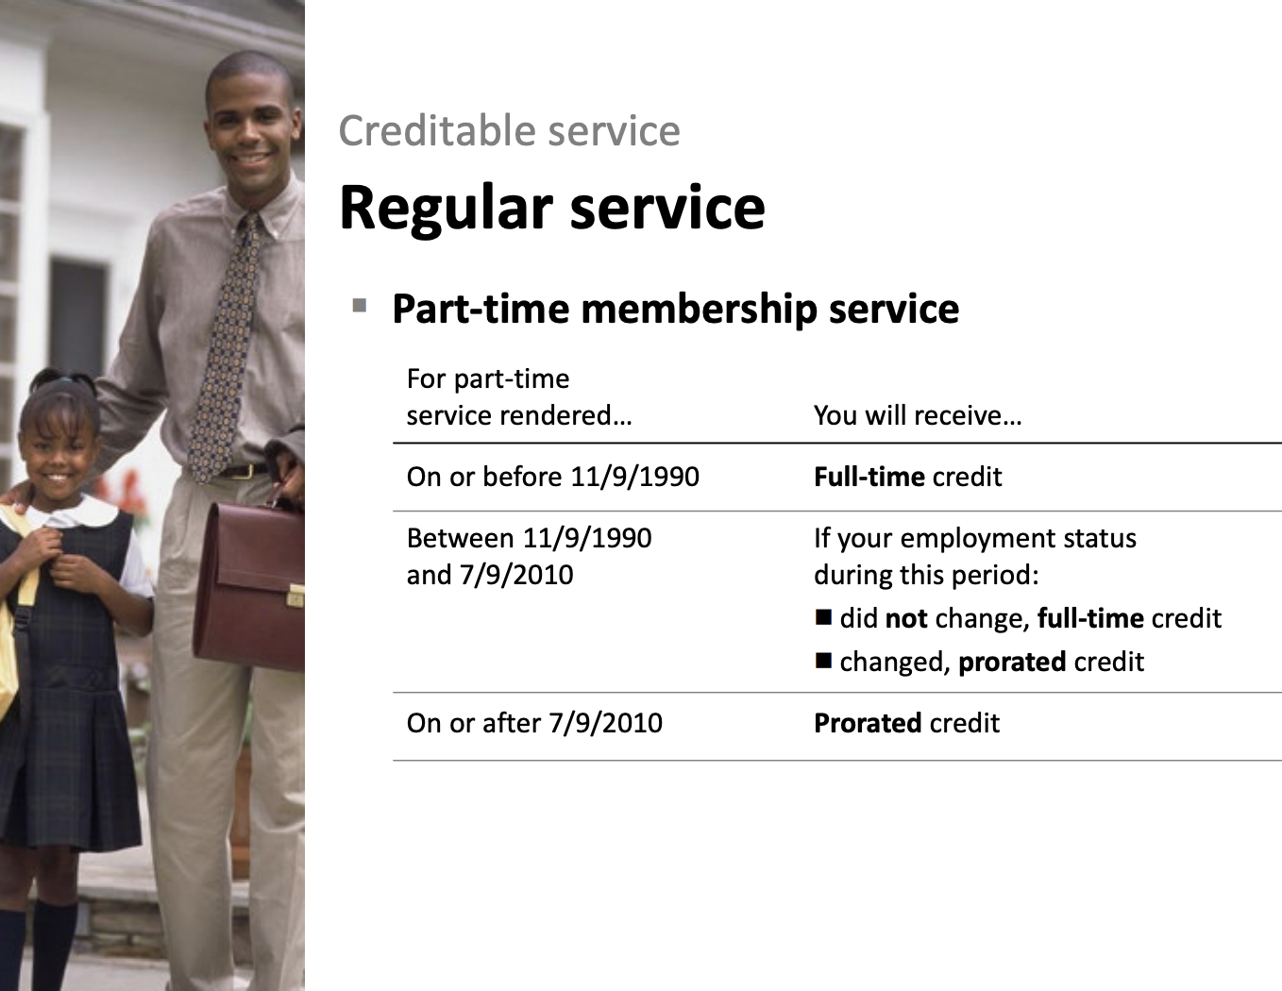

Slide 14
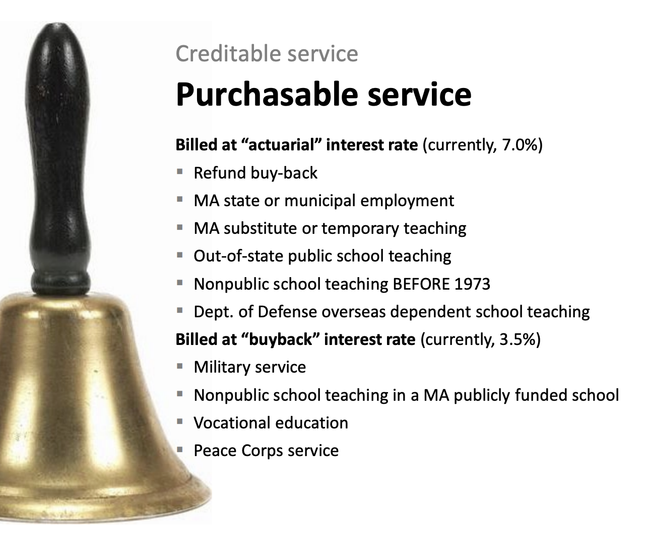

Slide 15
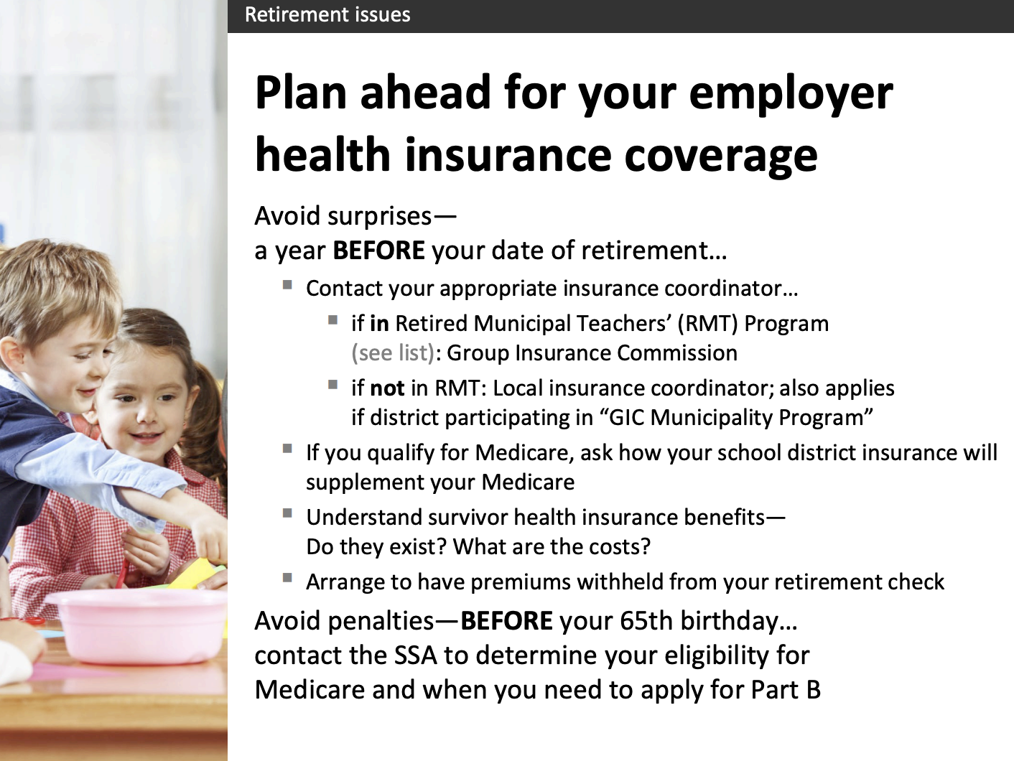
N.M. participates in RMT Program

Slide 16
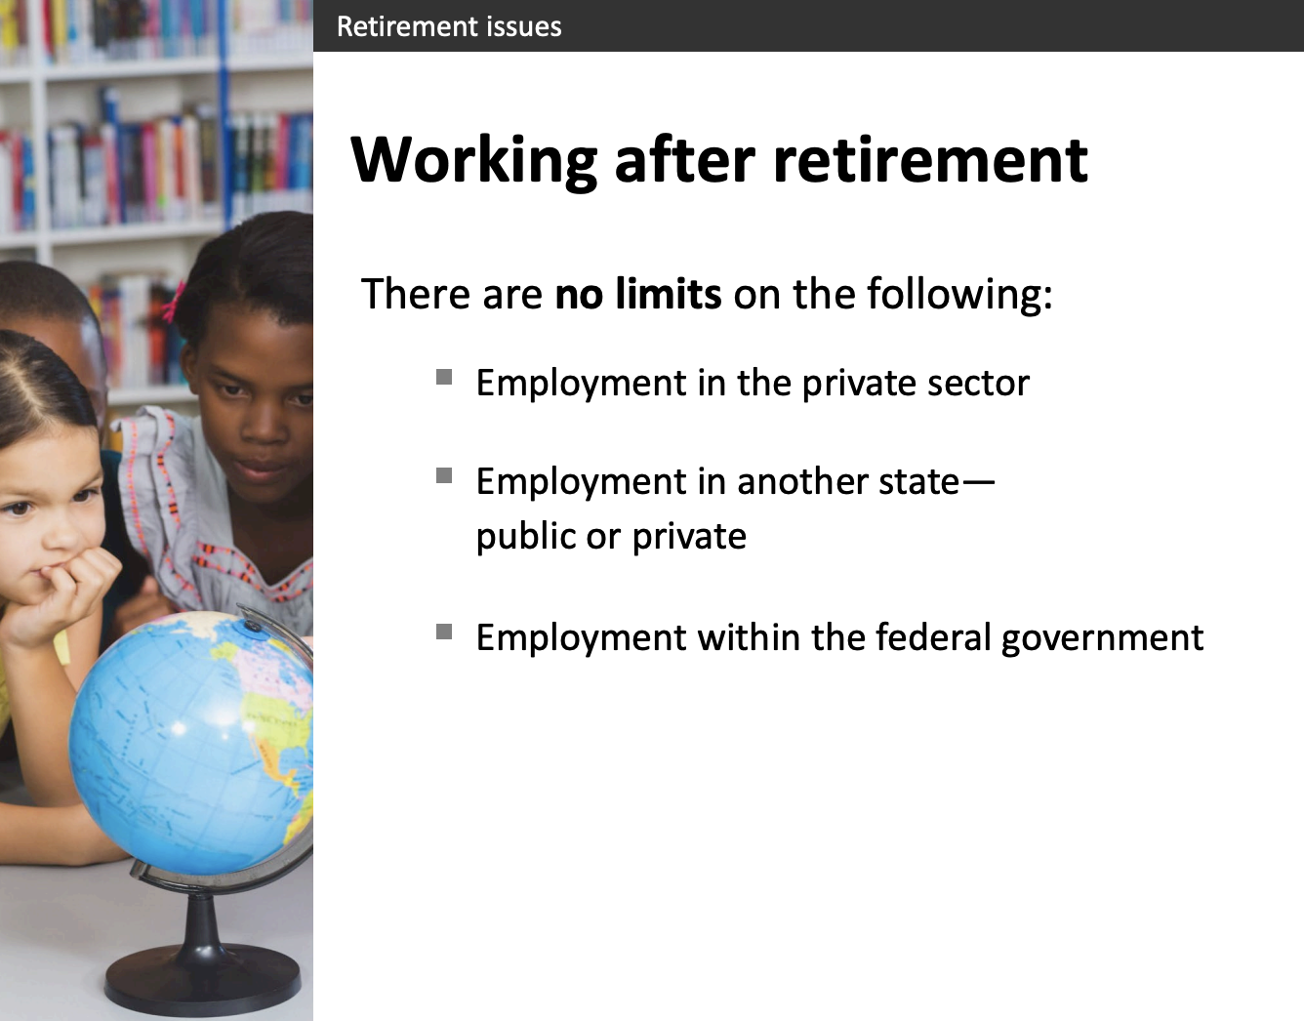

Slide 17
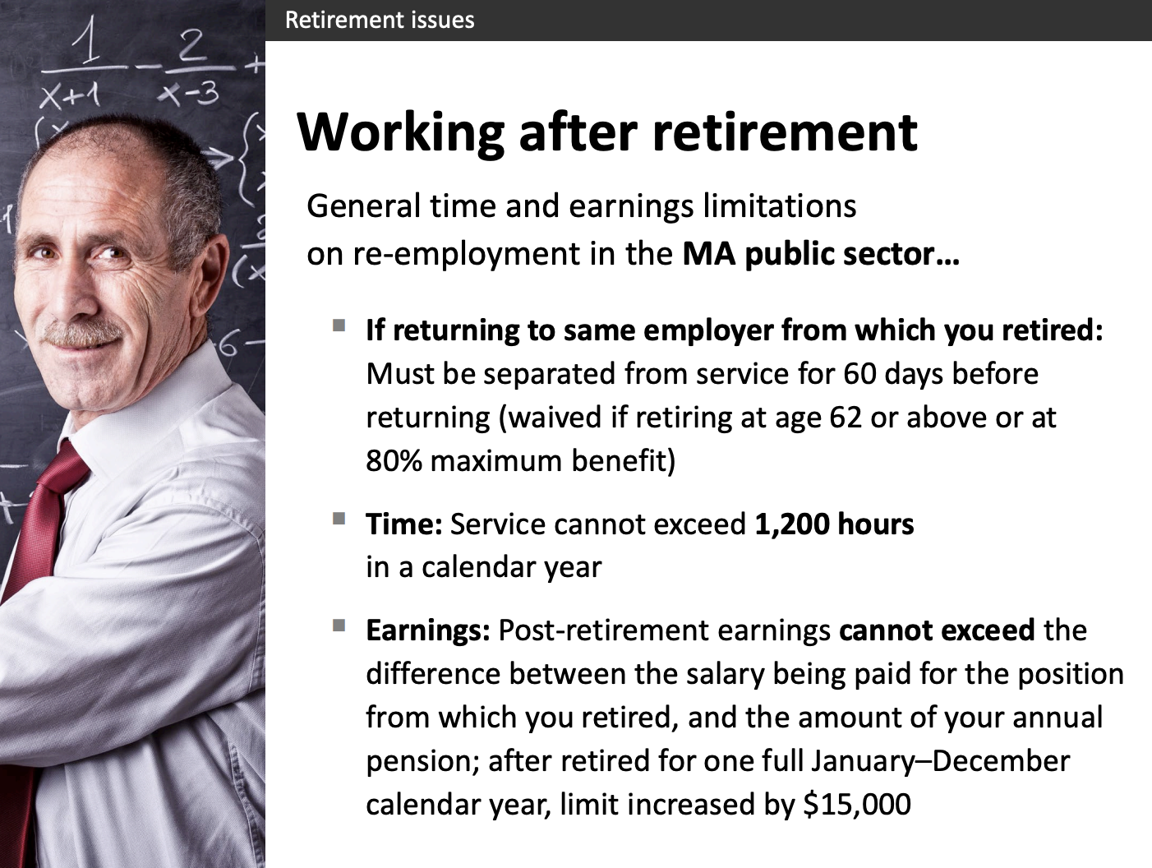

Slide 18
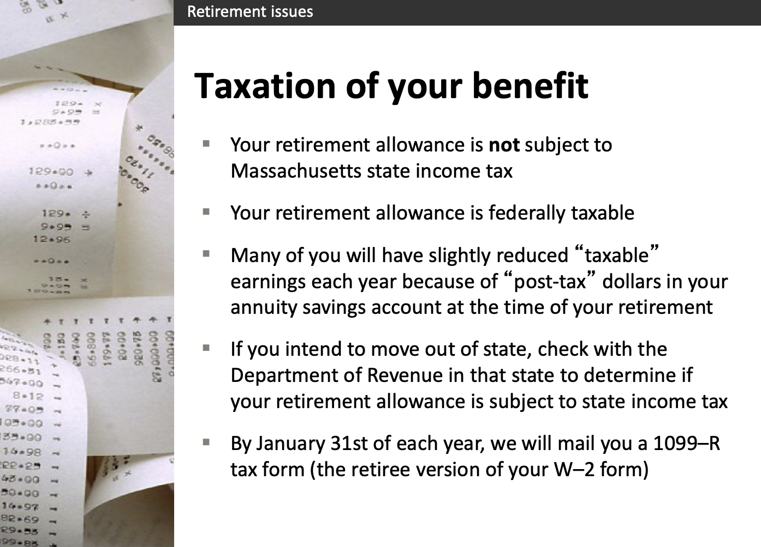

Slide 19
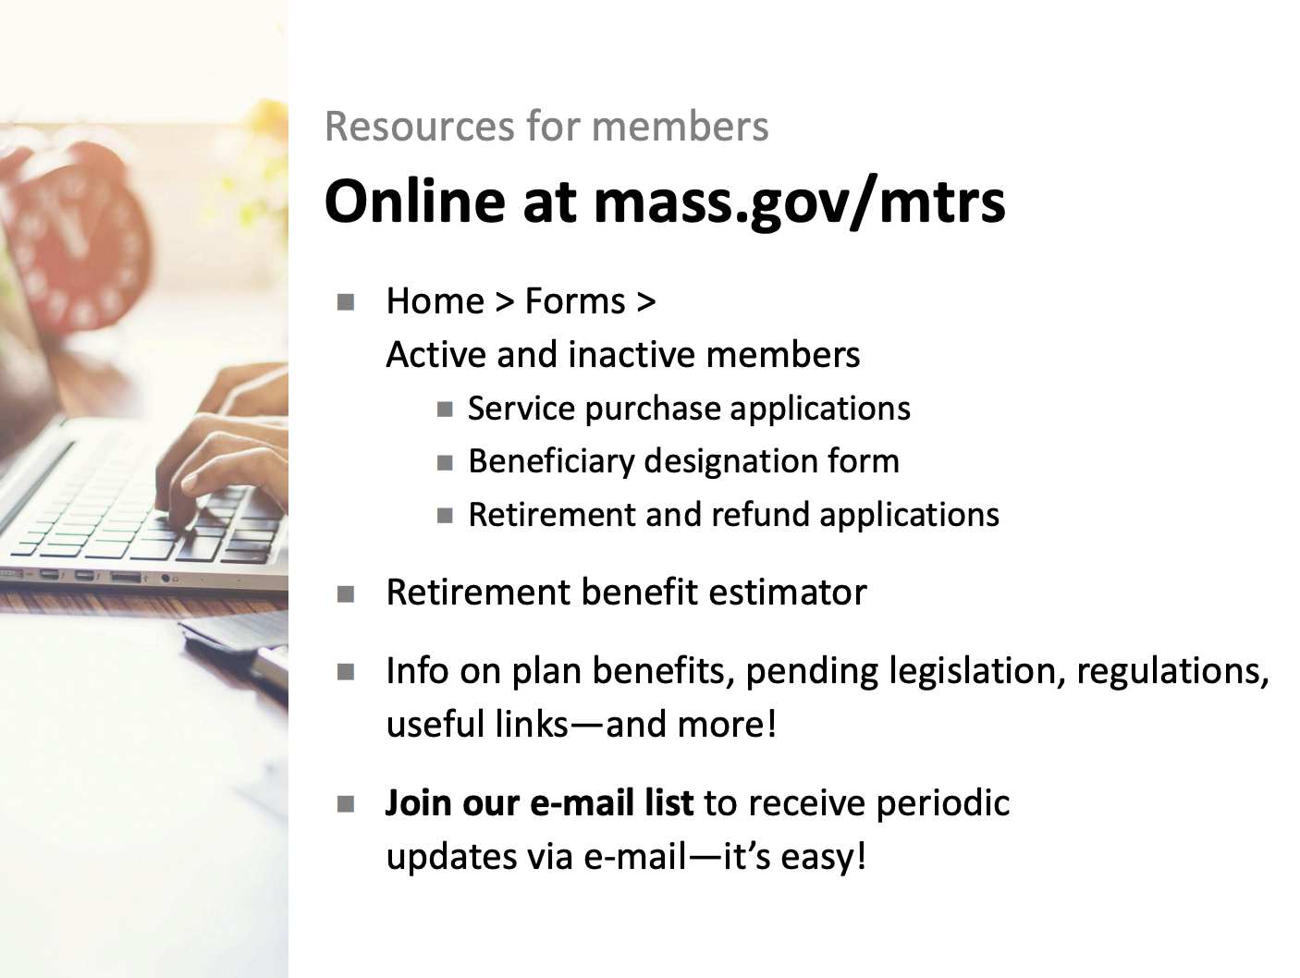

Slide 20
Resources on the MTRS Website
Application
Retirement Application
Videos about the Retirement Process
Apply for Retirement - MTRS
Members - MTRS

Slide 21
Resources and References
MTRS:
https://mtrs.state.ma.us/
Ready for Retirement Book from MTRS:
Ready for Retirement
Group Insurance Commission (G.I.C.) Information:
How to enroll in or change GIC benefits as a GIC Retired Municipal Teacher | Mass.gov

