Slide 1
School Health
Advisory Council
August 25, 2025

Slide 2
Agenda
1. CALL TO ORDER | Summer Crow, Chair
3. REPORTS SHAC Introduction Overview Resources ’24-’25 Review ‘25-’26 Goals Legislative Update Wellness Plan Health Services Overview Counseling Curriculum Alliance for Children | Summer Crow, Chair Bryce Nieman, Chief Communications Officer Jodi Webster, Director of Health Services Jodi Webster, Director of Health Services Kristen Elam, Director of District Counseling Services and CCMR Katia Gonzalez
4. NEW BUSINESS Coordinated School Health Subcommittees | Summer Crow, Chair
5. ADJOURNMENT | Summer Crow, Chair

Slide 3

SHAC Meeting Sign-in
August 25, 2025

Slide 4

Questions?
Please submit using this QR code
Take a picture of this QR code
Use this throughout the night to submit questions.
We will ensure they are routed to the appropriate district contact for answers to your question.
A link to all questions and answers will be provided to SHAC members and appropriate district staff.

Slide 5
SHAC Introduction:
Overview of SHAC Requirements
Texas districts are required to form a School Health Advisory Committee (SHAC)
Texas law (Texas Education Code, Title 2, Subtitle F, Chapter 28, Subchapter A, §28.004)
Districts must consider SHAC recommendations before changing any health education or instruction.
School Health Advisory Committees (SHACs):
  Assist the district in ensuring that local community values are reflected in the district's health education instruction.
  Make recommendations in the following areas:
    Number of hours for health education (K-8th) and yes/no graduation requirement for high school health education.
    Policies, procedures, strategies, and curriculum appropriate for preventing physical health and mental concerns
    Grade levels and methods for human sexuality instruction
    Strategies for integrating the general school curriculum with the coordinated health services program
    Collaborations and partnerships with community organizations
    Strategies to increase parent awareness of drug abuse, prevention, and opioid antagonists
    Grade levels and curriculum for: child abuse, family violence, dating violence, and sex trafficking
  Advise trustees on any course materials and instruction relating to human sexuality, sexually transmitted diseases, or human immunodeficiency virus or acquired immune deficiency syndrome.
  Provide trustees with an annual report of recommendations and council activities.

Slide 6
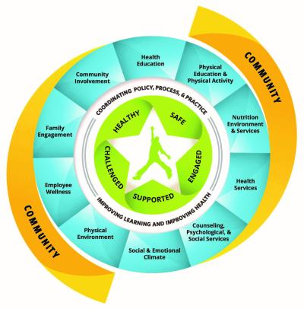
SHAC Introduction:
Overview of Coordinated School Health Programs
Texas Education Agency (TEA):
Eight Components of Coordinated School Health
Health Education
Healthy and Safe School Environment
Counseling and Mental Health Services
Parent and Community Involvement
Staff Wellness Promotion
Health Services
Physical Education
Nutrition Services
CDC: Whole School, Whole Community, Whole Child

Slide 7
SHAC Introduction:
Overview of Recommendation Process
Submit recommendation on Google Form.
Discussion/Q&A
Facilitated, open mic discussion.
Internal discussion
Final go/no-go decision reported.
SHAC member
Applicable Subcommittee
Informal vote to bring to SHAC body.
District reps have visibility.
SHAC Body
No vote.
District
All
Placed on next SHAC agenda
Adaptations/ alternatives discussed
Decision made

Slide 8
SHAC Introduction:
Resources
Keller ISD SHAC Website
  Meeting dates
  Meeting agendas, minutes, and recordings
  Bylaws
  BDF, FFA, and EHAA policies
  https://www.kellerisd.net/departments/health-services/school-health-advisory-council
Texas Department of State Health Services
  SHAC Guidance Packet
  https://www.dshs.texas.gov/texas-school-health/texas-school-health-advisory-committee-tshac/school-health-advisory-councils
Texas Education Code requiring SHAC formation:
  https://statutes.capitol.texas.gov/Docs/ED/htm/ED.28.htm#28.004
Healthier Texas
  https://healthiertexas.org/shac/
Texas SHAC Network
  https://www.txshacnetwork.com/

Slide 9
SHAC Introduction:
2024-2025 Review
Established governance
Review/updated SHAC Bylaws
Outlined SHAC’s Scope (per Education Code 28.004 and local policies)
            Documented and discussed district initiatives within SHAC’s scope
Updated SHAC website to include:
  Texas Education Code 28.004,
  KISD SHAC-Pertinent Policies: BDFLOCAL, EHALEGAL/EHALOCAL, FFALOCAL
  SHAC’s Goals
Wellness Policy
  Recommend a change to FFALOCAL to specify that the district develops the Wellness Policy and SHAC reviews
Subcommittees
  Determined a structure and purpose
  Aligned with TEA’s Coordinated School Health Model
  Met with district representatives

Slide 10
SHAC Introduction:
2025-2026 Goals
Establish a process for SHAC member recommendations
Foster active subcommittees
            Establish and use throughout the year
            Review existing content and activities
            Establish district and community activities to promote
Review/updated Wellness Plan
Review Curriculum and Programs as presented to us
Foster Community Partnerships
Further parent/guardian participation and knowledge by creating opportunities for parents and Keller ISD community education on topics such as drug and alcohol awareness and suicide awareness

Slide 11
Legislative Update
SHAC | Aug. 25, 2025

Slide 12
89th Legislative Session
Regular Session: January 14, 2025-June 2, 2025
9,014 Total Bills Filed (1,482 Public Education)
1,025 Total Bills Passed (103 Public Education)
  88th Session 81 of 1,294 Public Education Bills Passed
Focuses:
  Funding
  Parental Rights
  ESAs
Special Session #1: July 21, 2025-August 15, 2025
Special Session #2: Convened August 15, 2025

Slide 13
SB 12 | Parental Rights
Instruction on Controversial Topics and Human Sexuality
Requires adoption of a discipline policy and procedure for employees and contractors who knowingly violate law when teaching controversial topics and for a copy to be provided to all employees and contractors
Requires superintendents to certify compliance with TEC 28.0022 by September 1, annually, including:
  Board-approved certification with 7-day meeting notice
  Submission to TEA with descriptions of policies and procedures adopted, how notifications were sent to employees, existing policy changes made, and resulting cost savings.
Requires written parent consent for human sexuality instruction and must:
  Be provided at least 14 days in advance of instruction
  Be separate from other notice and consents

Slide 14
SB 12 | Parental Rights
Parental Participation and Required Notices
Directs TEA to create a notice form of parental rights, which districts must post on websites
Parent’s Right to Information about Mental, Emotional, and Physical Health and Health Services
Commissioner required to establish procedures for notifying parents of changes to services provided to or monitoring of their student’s mental, emotional, or physical health or well-being that must:
  Encourage students to talk about their health with parents, or
  Help facilitate the discussion with their parents

Slide 15
SB 12 | Parental Rights
Parent’s Right to Information about Mental, Emotional, and Physical Health and Health Services (cont.)
Prohibits districts from:
  Prohibiting employees from notifying parents about issues related to the student’s mental, emotional, or physical health or well-being
  Encouraging student secrecy
  Restricting parental access to health records
  Discouraging parental involvement in their child’s mental, emotional, and physical health
Allows withholding info only when disclosure would likely result in abuse/neglect
Requires annual notice of available campus health services, including opt-out rights

Slide 16
SB 12 | Parental Rights
Parent’s Right to Information about Mental, Emotional, and Physical Health and Health Services (cont.)
Requires pre-distribution of health screening forms or questionnaires to parents
Directs SBOE/SBEC, by June 30, 2026, to revise:
  School counseling standards
  Educator practices and standards of conduct
  Any other student services staff guidelines

Slide 17
SB 12 | Parental Rights
Consent and Privacy for Psychiatric and Psychological Services or Evaluations
Extends written parental consent requirements to contractors to:
  Administer psychological or psychiatric services or tests
  Disclose private student health information to a third-party
  Disclose student “biometric markers” to a third-party
  Conduct a medical procedure or provide health-care services
Defines “psychological or psychiatric test” to include any way of asking students for information about their attitudes, moods, feelings, opinions, or mental disorders or conditions, even if done as part of a survey, check-in, or classroom lesson
  Asking about general well-being is permitted without prior written parental consent and reporting suspected abuse is not restricted

Slide 18
SB 12 | Parental Rights
Consent and Privacy for Psychiatric and Psychological Services or Evaluations (cont.)
Defines “psychological treatment” as any method or technique designed to affect a person’s behavior, emotion, or attitude
Allows annual consent at the beginning of the year or at the student’s enrollment for routine care services, valid for one year
Requires annual notice to parents detailing what health info will be collected, how it will be stored, and signed consent
  Prohibits data collection if consent is not returned
All of SB 12 effective for 2025-26

Slide 19
SB 25 | Statewide Nutrition, Physical Health Education
Prohibits school districts from taking away recess or PE for students through grade 8
Establishes the Texas Nutrition Advisory Committee to develop nutritional guidelines for Texas residents and outlines specific membership requirements and duties
Requires K-8 health TEKS to include nutrition instruction based on guidelines recommended by the Texas Nutrition Advisory Committee, beginning in 2027-28
Requires districts to offer an elective course for one half credit in nutrition and wellness
Effective September 1, 2025

Slide 20
SB 314 | Food Additives Prohibition
Prohibits districts that provide free meals under the national school breakfast or lunch programs from providing any food that contains any ingredient below, but allows a district so submit a waiver to the commissioner for an exemption:
Effective for 2025-26
Brominated vegetable oil (BVO) Potassium bromate Propylparaben Azodicarbonamide butylated hydroxyanisole (BHA) red 3 | red 40 yellow 5 yellow 6 Blue 1 Blue 2 Green 3 Citrus red 3 Orange B | INS No.A150 c/ammonia caramel (Class III) INSNo.A150d/sulfite ammonia caramel (Class IV) titanium dioxide Any substantially similar additives

Slide 21
SB 865 | CPR Certification, Cardiac Emergency Response
Requires certain positions to maintain certification in CPR from a nationally recognized organization (such as AHA or Red Cross):
Requires full implementation of the cardiac emergency response plan by the first instructional day of the 2027-28 school year
Effective for 2025-26
School Nurses Assistant Nurses Athletic Coaches PE Teachers | Marching Band Directors Cheerleading Coaches Student Athletic Trainers

Slide 22
SB 920 | Administration of Nonprescription Meds
Allows district employees, including nurses, to administer nonprescription medications to students without further authorization from the student’s healthcare provider, if there is a written request from the parent or legal guardian, and the medication is unexpired, in its original container, and property labeled
Provides immunity from civil liability and administrative disciplinary action for damages or injuries resulting from administration of medication
Effective September 1, 2025

Slide 23
SB 1207 | Adoption Education in HS Health Curriculum
Requires the existing parenting and paternity awareness program and associated materials adopted by the SBOE for high school health curriculum to include information about adoption, including:
  The distinction between and process for adoption and foster care
  Adoption as an alternative to becoming a parent
  The process for placing a child for adoption
Allows school districts to include information about adoption in the research-based programs and curriculum materials they develop or adopt for use alongside the required parenting and paternity awareness program
Effective for 2025-26

Slide 24
SB 2398 | Concussions
Requires TEA to develop a list of nonmedical academic accommodations that districts may offer to students diagnosed with a concussion or brain injury
Requires TEA to create a form describing accommodations and make it available online
Requires districts that offer accommodations to provide the TEA form to staff and students after receiving notice of a concussion or upon request
Clarifies that providing academic accommodations is optional
Requires districts to adopt policies for responding to concussions occurring outside of athletics, on school property or at school activities that include immediate removal from activity, parent notification, and a completed concussion protocol before returning
Effective for 2025-26

Slide 25
HB 549 | Airway Clearing Device Availability
Districts required to ensure availability of at least one airway clearance device on each campus
  Only if the campus receives donations or funds specifically allocated or donated for this purpose
  Districts prohibited from soliciting funds
Trained personnel required to be present at each location of a device
Device required to be stored according to the manufacturer’s specifications
District allowed to contract with a vendor to provide medication for respiratory distress and related equipment and applicable training for staff and volunteers
Effective for 2025-26

Slide 26
SB 207 | Excused Absences for Mental Health Appts.
Districts required to excuse absences for students to attend appointments with mental health professionals
Effective for 2025-26

Slide 27
SB 1619 | Updates Terminology to
“Epinephrine Delivery Device”
Replaces all language referring to epinephrine auto-injector with “epinephrine delivery device” and defines that as “a device approved by the US FDA that delivers a dose of epinephrine intended for use to treat anaphylaxis, including an epinephrine auto-injector and an epinephrine nasal spray”
Effective Immediately

Slide 28
HB 1586 | Online Access to Immunization
Exemption Affidavit
Not a District requirement
Requires DSHS to post to its website a printable immunization exemption affidavit online without collecting personally identifiable information
  Does permit the collection of how many requests for the form are received
Effective for 2025-26

Slide 29
Legislative Work Continues
Testing & Accountability [HB 8/SB 9]
Limits on School District (but not Charter) Expenditures [HB 46]
Requirements on Mailing Budget Notices [HB 17]
Prohibitions on Contracting with Associations that Lobby [SB 13]
Restrictions on School Bond Elections
2nd Special Session to Adjourn Sept. 13 (or earlier)

Slide 30
Wellness Plan

Slide 31
Wellness Policy
A written document that guides the district’s efforts to create supportive school nutrition and physical activity environments
Wellness policies were introduced following the Child Nutrition and WIC Reauthorization Act of 2004
Federal Health, Hunger-free Kids Act of 2010 and the Local School Wellness Policy final ruling (2016) required districts to have policies that include:
  goals about nutrition promotion and education, physical activity, and school-based activities that promote wellness
  Nutrition guidelines for foods sold on campus during the school day consistent with federal guidelines
  Policies for food and beverages made available to students (parties, snacks, incentives)
  Policies for food and beverage marketing that meet nutrition standards
  Who can participate in the development
  Who has the authority and responsibility to ensure compliance
  Measure how schools are in compliance at least once every 3 years
FFA - Student Welfare: Wellness and Health Services

Slide 32
KISD Wellness Plan
The Wellness Plan implements Policy FFA Local
SHAC works on behalf of the district to review and consider evidence-based strategies and techniques to develop and implement nutrition guidelines and wellness goals required by federal law
Policy and plan evaluation
  Discuss at regularly scheduled SHAC meetings
  Measure and make available the results of a triennial assessment
  Last update – February 2023

Slide 33
KISD Wellness Plan
Goals for Nutrition Promotion
  GOAL 1: The District’s food service staff, teachers, and other District personnel shall consistently promote healthy nutrition messages in cafeterias, classrooms, and other appropriate settings.
  GOAL 2: The District shall share educational nutrition information with families and the general public to promote healthy nutrition choices and positively influence the health of students.
Goals for Nutrition Education
  GOAL 1: The District shall deliver nutrition education that fosters the adoption and maintenance of healthy eating behaviors.
  GOAL 2: The District shall make nutrition education a District-wide priority and shall integrate nutrition education into other areas of the curriculum, as appropriate.
  GOAL 3: Through the Keller Working on Wellness program (KWOW), the District shall provide opportunities for teachers and other staff responsible to engage in the nutrition education programs so they may exhibit healthy nutrition choices and are adequately prepared to effectively deliver the program.

Slide 34
KISD Wellness Plan
Goals for Physical Activity
  GOAL 1: The District’s food service staff, teachers, and other District personnel shall consistently promote healthy nutrition messages in cafeterias, classrooms, and other appropriate settings.
  GOAL 2: The District shall share educational nutrition information with families and the general public to promote healthy nutrition choices and positively influence the health of students.
Goals for Other School-Based Activities
  GOAL 1: The District shall promote wellness for students and their families at suitable District and campus activities.
  GOAL 2: The District shall promote employee wellness activities and involvement at suitable District and campus activities

Slide 35
Health Services

Slide 36
KISD Health Services
TEA Health Services
Texas Guide to School Health Services
School Nursing
Impact

Slide 37
TEC Chapter 38
Immunization requirements
Availability of AEDs
Traumatic injury response
Maintenance and administration of opioid antagonists
Immunization reporting
Self administration of prescription asthma or anaphylaxis medicine
Dissemination of bacterial meningitis information
Access to medical records
Notice concerning health care services
Coordinated health program for students
Policies for care of students at risk
for anaphylaxis
Response procedures for cardiac arrest
Immunization awareness program
Notice of lice
Seizure management and treatment plan
Seizure recognition and related first aid training
Maintenance and administration of unassigned epinephrine and medication for respiratory distress
Reporting and training for unassigned medications
Screening Programs
Reference: TEC CHAPTER 38. HEALTH AND SAFETY

Slide 38
Coordinated School Health Services
A coordinated system of care from school, to home, to the community. These services are essential for promoting and protecting the well-being of students, which directly impacts their academic performance.
Acute and Emergency Care
Illnesses
Chronic Disease Management
Asthma
Preventative Care
Screenings
Health Education
Injuries
Life threatening emergencies
Diabetes
Epilepsy
Severe allergies
Prevent the spread of communicable disease
Hygiene
Disease prevention
Reference: TEA

Slide 39
19 TAC, Rule 153.1021 – School Nurse
The School Nurse is responsible for implementing the district school health services program in a way that is best suited to the population of the campus.
Caregiver
Illness
Educator
Participate in ARD committees
Injury
Chronic condition management
Ensure health needs are addresses in IEPs
Advocate
Build capacity for adaptation, self-management, self advocacy, and learning
Train staff on student’s specific health needs
Develop IHPs
Reference: 19 TAC

Slide 40



School Nurses
School nursing, a specialized practice of nursing, protects and promotes student health, facilitates optimal development, and advances academic success. School nurses, grounded in ethical and evidence-based practice, are the leaders who bridge health care and education, provide care coordination, advocate for quality student-centered care, and collaborate to design systems that allow individuals and communities to develop their full potential.
Reference: NASN

Slide 41

History
The specialty of school nursing in the United States began in New York City in 1902 as an experiment. School nursing was a response to schools’ chronic truancy problems. The introduction of school nurses into schools resulted in a 50% decrease in absenteeism through health promotion and illness prevention activities.
Reference: OJIN

Slide 42
The Impact of School Health Services
Impact
Reduce absenteeism
Improve academic performance
Promote a safe environment
Build a healthier community
The American Academy of Pediatrics recognizes the important role school nurses play in promoting the optimal health and well-being of school-aged children in the school setting.
Reference: AAP 2023

Slide 43

Counseling Curriculum

Slide 44

Counseling Curriculum

Slide 45

Counseling Curriculum

Slide 46

Counseling Curriculum

Slide 47
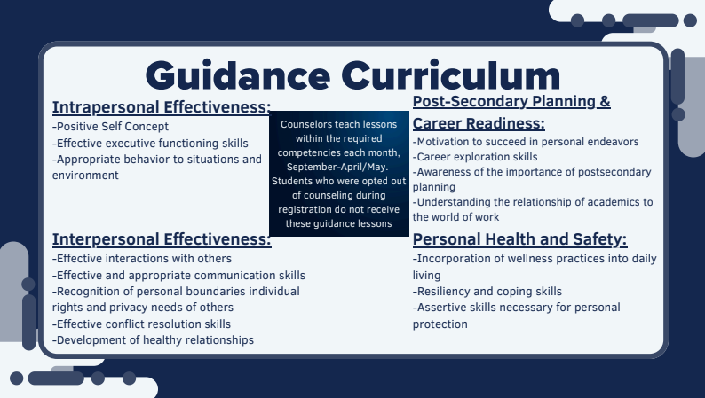
Counseling Curriculum

Slide 48
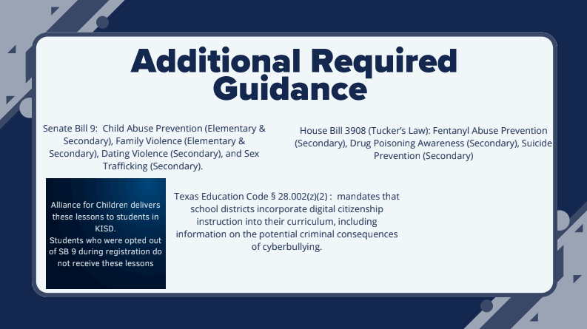
Counseling Curriculum

Slide 49
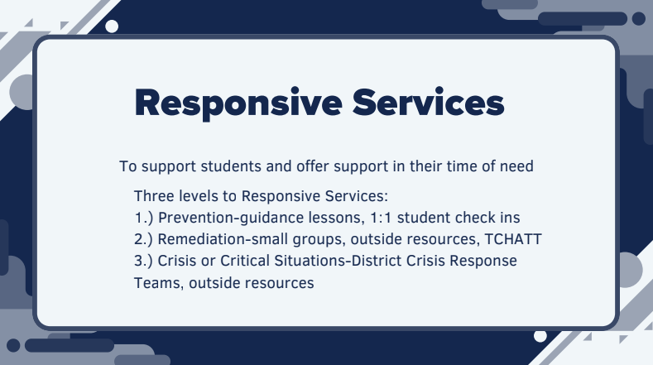
Counseling Curriculum

Slide 50

Counseling Curriculum

Slide 51
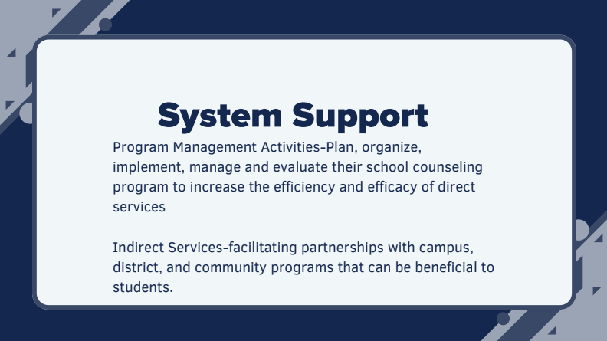
Counseling Curriculum

Slide 52
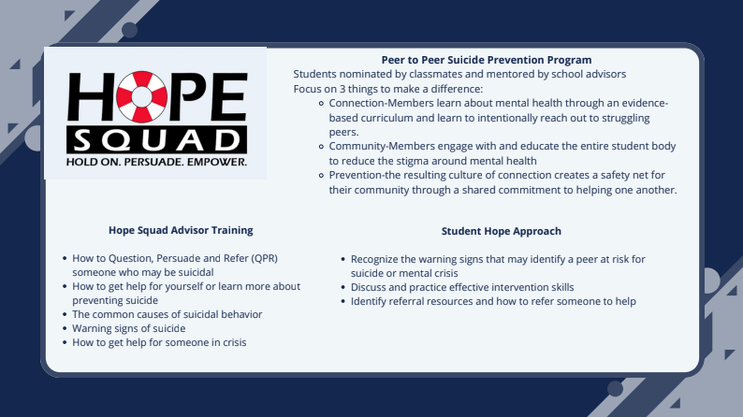
Counseling Curriculum

Slide 53

Counseling Curriculum

Slide 54
Alliance for Children

Slide 55
ALLIANCE
FOR CHILDREN
SERVING TARRANT COUNTY SINCE 1992

Slide 56
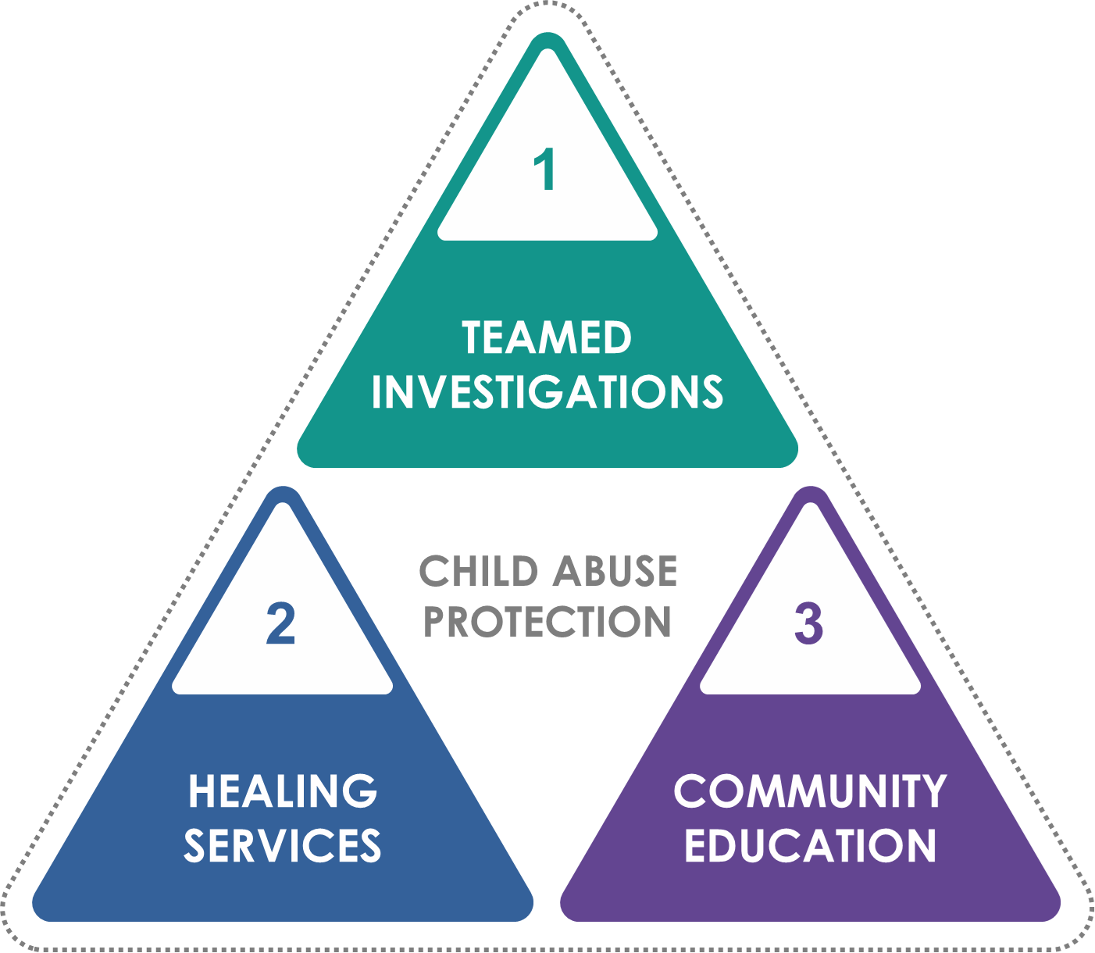
OUR MISSION
The mission of Alliance For Children is to protect Tarrant county children from child abuse through teamed investigations, healing services, and community education.

Slide 57
Community Education
CHILDREN
1
1
PROFESSIONALS
2
PARENTS
3
3
2

Slide 58
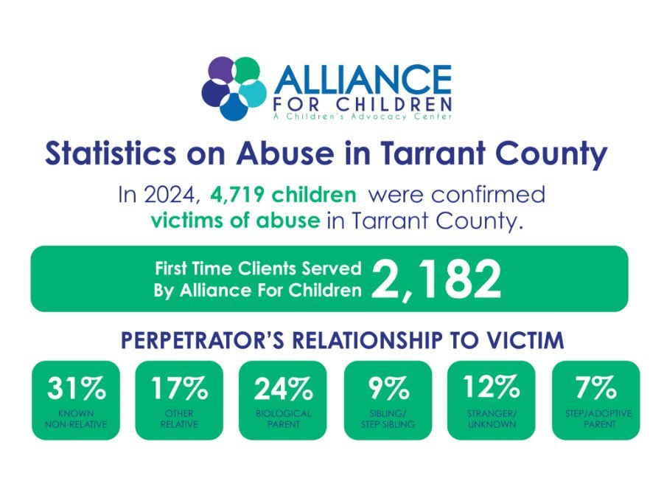

Slide 59
KELLER ISD PARTNERSHIP

Slide 60
P.S. It's My Body
PreK-5th Grade
SB 9 Requirements
30 min curriculum
Elementary School
Netsmartz
PreK-5th Grade
SB 179 Requirements
30 min curriculum
MBF Mental Health
K-5th Grade
Coping skills/drug prevention/suicide prevention
30 min curriculum

Slide 61
P.S. It’s My Body
PreK - 5th Grade

Slide 62

Research shows that children who participate in Personal Body Safety Programs are:
P.S. It’s My Body: Pre-K- 5th Grade
More likely to disclose, or “tell an adult” about their abuse, which increases the likelihood they will receive help.
Less likely to believe the abuse is their fault, which reduces self-blame.

Slide 63

3 R’s of Personal Safety
Recognize
    What is and isn’t okay
    Where private parts are located
Resist
    Say, “NO!” and get away
Report
    Tell a trusted adult

Slide 64

Age Appropriate Presentations
Pre-K/K - Happy Bear
1st-5th Grade - Touch Circles
  1st - Secret vs. Surprise
  2nd – Telling vs. Tattling
  3rd – Frog in My Shoe
  4th/5th – Clay Activity

Slide 65
Netsmartz
PreK-5th

Slide 66


Netsmartz
Rules of Online Safety:
Inappropriate Content - If you see something online that makes you feel sad, scared or confused tell a trusted adult
Oversharing - Don’t give out personal information without asking a trusted adult
Online Predators - Don’t meet face-to-face with anyone from the internet
Cyberbullying - Don’t be mean or rude online

Slide 67
Monique Burr Foundation:
Mental Health
K– 5th Grade

Slide 68

Lesson Topics
Mental Health and Wellness
Healthy vs Unhealthy Choice
Coping Skills
Introduction to Substances (3rd – 5th talks about addiction)
Refusal Skills
Help and Resources

Slide 69
Teen Safety Lesson 2
SB 9 Requirements 55 min curriculum
Teen Safety Lesson 1
SB 179 Requirements
45 min curriculum
6th-12th Grade
MBF Mental Health (L3)
suicide prevention
30 min curriculum
MBF Mental Health (L2)
drug/fentanyl prevention
30 min curriculum

Slide 70
Monique Burr Foundation:
Child Safety Matters
K– 5th Grade

Slide 71


Based on Research
Programs are based on polyvictimization research.
Polyvictimization
When a victim is exposed to multiple types of victimization or maltreatment.
Children who were exposed to even one type of violence, both within the past year and over their lifetimes, were at far greater risk of experiencing other types of violence.
For example, a child who was physically assaulted in the past year would be 5 times as likely to have been sexually victimized and more than 4 times as likely also to have been maltreated during that period.
Finkelhor, Turner, Ormrod, Hamby, and Kracke, 2009
Notes:
What is polyvictimization?
Polyvictimization is when a victim suffers from multiple (or more than one) type of victimization or trauma. It is not multiple events of a single type of trauma or victimization.
For example, a child who is sexually abused at home, later sexually assaulted and bullied at school vs. a child that is assaulted by peers on three different occasions.
That is, children who experience a single kind of victimization, such as bullying or even child maltreatment, look like they are able to recover from it.
The importance of this research is that we don’t need to use a different program for bullying, one for abuse, and one for internet safety. We need to teach children one set of universal safety rules and strategies that they can use in any unsafe situation, like MBF Child Safety Matters.
Source: PREVALENCE OF CHILD VICTIMIZATION, ABUSE, CRIME, AND VIOLENCE EXPOSURE
DAVID FINKELHOR (2011). In, J.W. White, M.P. Koss, & A.E. Kazdin (Eds.), Violence against women and children: Mapping the terrain (pgs. 9-29). Washington, DC: American Psychological Association.

Slide 72
Monique Burr Foundation:
Teen Safety Matters
6– 12th Grade

Slide 73

Teen Safety Lesson 1
Digital Dangers
Safe Adults/Safe Friends
Digital Citizenship
Public and Permanent
Sexting/Sextortion and Sex Trafficking
Cyberbullying
Digital Drama
Online Predators

Slide 74
Teen Safety Lesson 2
Neglect
Physical Abuse
Emotional Abuse
Sexual Abuse
Human Trafficking
Bullying
Relationship Abuse
Sexual Assault/consent

Slide 75
Monique Burr Foundation:
Teen Safety Matters
MENTAL HEALTH LESSONS
6– 12th Grade

Slide 76

Mental Health-
(Lesson 1)
Mental Illness
Reducing Stigma
Mental Health and Wellness
Coping Skills and Resilience

Slide 77
Mental Health-Drug Prevention (Lesson 2)
Unhealthy coping skills
Teen Substance Abuse facts-alcohol, drugs and Tabacco/nicotine
Addiction
Effects of drugs
Recognizing signs
Refusal Skills

Slide 78

Mental Health-Suicide Prevention (Lesson 3)
Self Harm
Suicide Warning Signs
Preventing Suicide
Emotional intelligence-seek help/offer support
Empathy and Compassion
Building Confidence

Slide 79
OUR TEAM

Slide 80




Katia Gonzalez
Director of Training and Team Relations
kgonzalez@allianceforchildren.org
682-382-1454
Jacqueline Palmer
Outreach and Training Supervisor
Jpalmer@allianceforchildren.org
682-382-1453
Tajah Thomas,
Community Educator
Marijah Apple
Community Educator

Slide 81
Subcommittees

Slide 82
Subcommittee Assignments
Health Education & Health Services
        William Bubeck – SHAC Exec Committee
        Jennifer Price – KISD Health Education
        Jodi Webster – KISD Health Services
        Belinda Beck
        Greta Bergman
        Thomas Black
        Amanda Gatlin
        Sanci Hall
        Jill Michener
        Laura Romano
        Ashlea Stickane
        Sandi Walker
        Lisa Webb
Mental Health & Counseling Services
        Stephanie O'Dell – SHAC Exec Committee
        Kristen Elam – KISD Mental Health & Counseling Services
        Courtney Burrus
        Jordan Haefling
        Jaye Lange
        Jennifer Payne
        Karen Rivera
Physical Health Education & Healthy and Safe School Environment
        Adeline Castleberry – SHAC Exec Committee
        Bart Helsley – KISD Physical Education
        Dustin Blank – KISD Healthy & Safe School Environment
        Kimberly Boone
        Lisa Groene
        Colin Hodges
        Melissa Muenzler
        Joshua Phillis
Nutrition Services & Staff Wellness Promotion
        Summer Crow – SHAC Exec Committee
        Stephanie Greving – KISD Nutrition Services
        Sheri Rich – KISD Staff Wellness
        Angela Hall
        Nikki Paris
        Liza Sharkey
        Kirstin Taylor

Slide 83
Subcommittee Flow
Assign a secretary to take notes on flip chart (assign who is responsible if follow-up is needed).
Quickly review the education code listed below that is applicable to SHAC’s responsibilities within this subcommittee.
Review the list of recommendations that came in from the SHAC participant survey (if any are listed below).
Q/A for district representatives pertaining to the education code. Anticipate that some questions may require the representative to follow up after the meeting.
As time allows, brainstorm ideas for KISD (think beyond the classroom to programs/speakers to bring in for KISD community outside of class time).
Assign a speaker to give an overview of key takeaways. If we run out of time for subcommittee reports, have the speaker email Jodi Webster and Summer Crow with the key takeaways.

Slide 84
General Business / Adjournment
Next Steps for SHAC
  Volunteer for coordinating HOPE Squad Sign-ups for Snacks
  Email that will include a link for submitting recommendations
  Continue to review “Alliance for Children” videos and submit feedback
  Upcoming Meetings
    November 3, 2025
    February 9, 2025
    April 20, 2025

