Slide 1
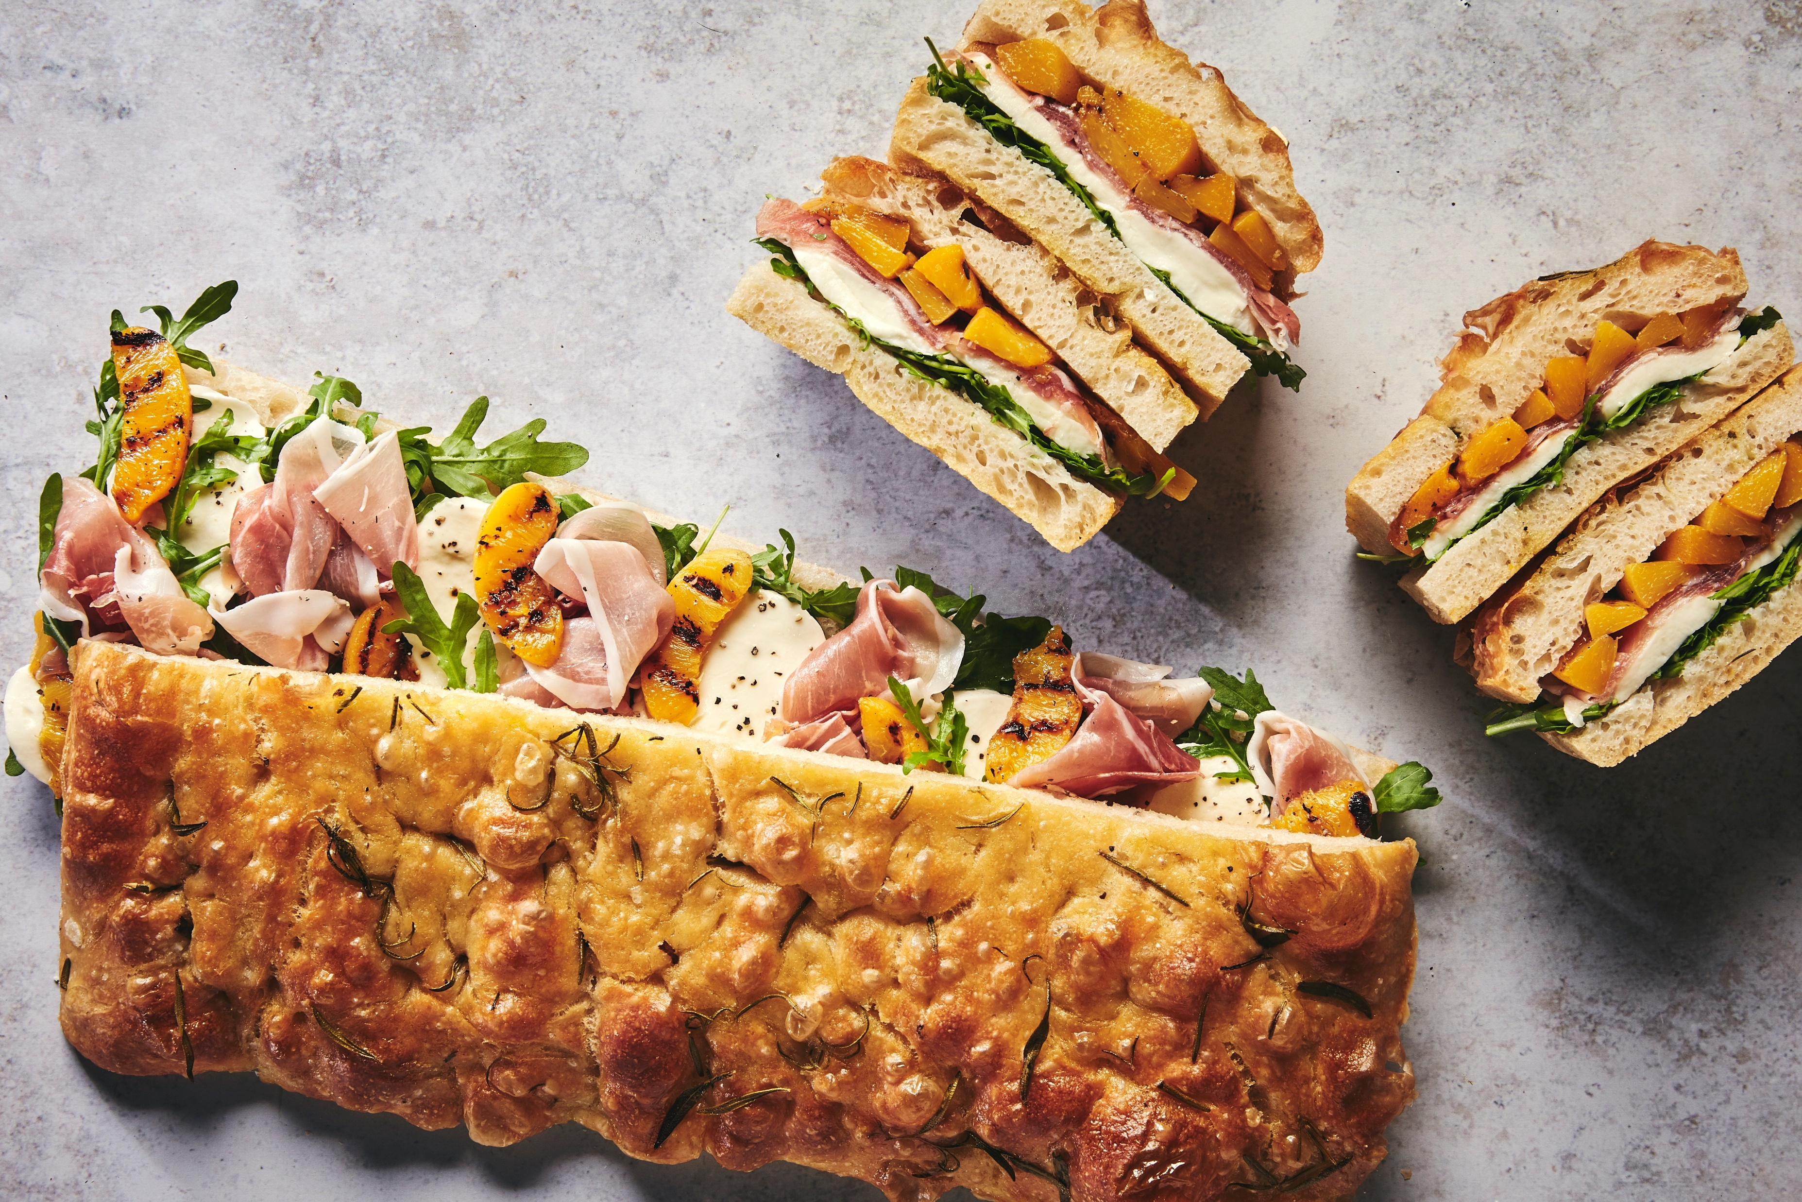
WEEK THREE BREAKFAST
 | MONDAY | TUESDAY | WEDNESDAY | THURSDAY | FRIDAY | SATURDAY | SUNDAY
Main Items Vegetarian Porridge Station Yogurt & Fruit Cereal & Toast | Mackie's Style Bacon & Cheese Muffin | Breakfast Wrap Bacon Scrambled Egg Roast Tomato Breakfast Wrap Mushroom Scrambled Egg Avocado | Waffle House Vanilla Waffle | Classic Danish Pastries | Bagel Ham & Fried Egg | Breakfast Burrito Bar Black Pudding Rice Beans Hash Brown Breakfast Burrito Bar Eggs Rice Beans Hash Brown | Chefs Sunday Brunch A Selection Of Cereals Toast
 | Mackie's Style Egg & Cheese Muffin |  | Maple Syrup Fruit Compote Cream | Classic Danish Pastries | Bagel Avocado & Cream Cheese
 | Porridge, Selection Of Dips & Toppings | Porridge, Selection Of Dips & Toppings | Porridge, Selection Of Dips & Toppings | Porridge, Selection Of Dips & Toppings | Porridge, Selection Of Dips & Toppings | Porridge, Selection Of Dips & Toppings | Hot & Cold Items
 | Fresh Yogurt, Toppings & Sliced Fruit | Fresh Yogurt, Toppings & Sliced Fruit | Fresh Yogurt, Toppings & Sliced Fruit | Fresh Yogurt, Toppings & Sliced Fruit | Fresh Yogurt, Toppings & Sliced Fruit | Fresh Yogurt, Toppings & Sliced Fruit | Juice & Smoothies
 | A Selection Of Cereals & Milk White & Wholemeal Toast Peanut Butter & Jelly Selection | A Selection Of Cereals & Milk White & Wholemeal Toast Peanut Butter & Jelly Selection | A Selection Of Cereals & Milk White & Wholemeal Toast Peanut Butter & Jelly Selection | A Selection Of Cereals & Milk White & Wholemeal Toast Peanut Butter & Jelly Selection | A Selection Of Cereals & Milk White & Wholemeal Toast Peanut Butter & Jelly Selection | A Selection Of Cereals & Milk White & Wholemeal Toast Peanut Butter & Jelly Selection | Fresh Cut Fruit Dessert Pots & Yoghurt Pots
Fruit Juice | Pressed Apple Fresh Orange | Pressed Apple Fresh Orange | Pressed Apple Fresh Orange | Pressed Apple Fresh Orange | Pressed Apple Fresh Orange | Pressed Apple Fresh Orange | Pressed Apple Fresh Orange

Slide 2


MENU WEEK THREE LUNCH MAIN
 | MONDAY | TUESDAY | WEDNESDAY | THURSDAY | FRIDAY | SATURDAY | SUNDAY
CLASSIC | Crispy Bacon Macaroni Cheese | Japanese Chicken Katsu, Lime Scented Rice, Pickled Slaw | Classic Rich Beef Cottage Pie, Creamy Mash Potato Top | Chicken Char Sui Stir Fry | Greek Style Chicken Gyros, Tzatziki | Chefs Choice | Brunch
NOURISH | Mediterranean Roasted Vegetable Lasagne, Crispy Kale | Japanese Sweet Potato Katsu, Lime Scented Rice, Pickled Slaw | Lentil & Butterbean Hotpot | Salt N Pepper Tofu, Hoi Sin Dressing | Butternut, Sweet Potato Smash Burger | Chefs Choice | Brunch
SIDES | Garlic Bread Green Beans Roasted Carrots | Steamed Asian Greens Sesame Roasted Cauliflower | Steamed Corn Buttered Cabbage | Seared Broccoli Egg Noodles Green Beans | Fries Baked Beans Slaw | Chefs Choice | Brunch
SALADS | A Selection Of Salads & Dressings | A Selection Of Salads & Dressings | A Selection Of Salads & Dressings | A Selection Of Salads & Dressings | A Selection Of Salads & Dressings | A Selection Of Salads & Dressings | A Selection Of Salads & Dressings
JACKET OR PASTA | Jacket Potato Baked Beans Pasta Roasted Red Pepper & Tomato Sauce | Jacket Potato Baked Beans Pasta Roasted Red Pepper & Tomato Sauce | Jacket Potato Baked Beans Pasta Roasted Red Pepper & Tomato Sauce | Jacket Potato Baked Beans Pasta Roasted Red Pepper & Tomato Sauce | Jacket Potato Baked Beans Pasta Roasted Red Pepper & Tomato Sauce | Chefs Choice | Brunch
HOT & COLD DESSERT | Dessert Pot Of The Day Oaty Fruit Crumble & Custard | Dessert Pot Of The Day Birthday Sponge | Dessert Pot Of The Day Chocolate Sponge & Chocolate Custard | Dessert Pot Of The Day Jam Roly Poly | Dessert Pot Of The Day Blueberry Crumble Bar | Chefs Choice | Brunch
 | MONDAY | TUESDAY | WEDNESDAY | THURSDAY | FRIDAY | SATURDAY | SUNDAY
CLASSIC | Crispy Bacon Macaroni Cheese | Japanese Chicken Katsu, Lime Scented Rice, Pickled Slaw | Classic Rich Beef Cottage Pie, Creamy Mash Potato Top | Crispy Pork Char Sui Stir Fry | Greek Style Chicken Gyros, Tzatziki Dressing | Chefs Choice | Brunch
NOURISH | Mediterranean Roasted Butternut & White Bean Lasagne, Crispy Kale | Japanese Sweet Potato Katsu, Lime Scented Rice, Pickled Slaw | Mushroom, Lentil & Butterbean Hotpot | Salt N Pepper Tofu, Hoi Sin Dressing | Butternut, Sweet Potato Smash Burger | Chefs Choice | Brunch
SIDES | Garlic Bread Green Beans Roasted Carrots | Steamed Asian Greens Sesame Roasted Cauliflower | Steamed Corn Buttered Cabbage | Seared Broccoli Egg Noodles Green Beans | Feta and Oregano Loaded Fries Baked Beans Greek Salad | Chefs Choice | Brunch
SALADS | A Selection Of Salads & Dressings | A Selection Of Salads & Dressings | A Selection Of Salads & Dressings | A Selection Of Salads & Dressings | A Selection Of Salads & Dressings | A Selection Of Salads & Dressings | A Selection Of Salads & Dressings
JACKET OR PASTA | Jacket Potato Baked Beans Pasta & Sauces | Jacket Potato Baked Beans Pasta & Sauces | Jacket Potato Baked Beans Pasta & Sauces | Jacket Potato Baked Beans Pasta & Sauces | Jacket Potato Baked Beans Pasta & Sauces | Chefs Choice | Brunch
HOT & COLD DESSERT | Dessert Pot Of The Day Baked Vanilla Rice Pudding, Berry Compote | Dessert Pot Of The Day Chocolate Brownie | Dessert Pot Of The Day Jam & Coconut Sponge, Custard | Dessert Pot Of The Day Carrot Cake, Cheesecake Frosting | Dessert Pot Of The Day Sticky Ginger Parkin | Chefs Choice | Brunch

Slide 3
MENU WEEK THREE SUPPER
 | MONDAY | TUESDAY | WEDNESDAY | THURSDAY | FRIDAY | SATURDAY | SUNDAY
STREET EATS | Greek Style Chicken Pittas, Tomato and Red Onion Salad | BBQ Pulled Brisket Bao Bun, Fried Pickle , Ranch Dressing | Sticky Sweet & Sour Chicken | Homemade Tray Baked Pizza Meat Feast | Nepalese Chicken Butterbean Curry, Riata Dressing , Crispy Chickpeas | Chefs Choice | Classic British Roast
NOURISH | Smokey Mushroom and Chickpea Fajitas , Charred Spring Onion Salsa | BBQ Pulled Jackfruit , Fried Pickle , Ranch Dressing | Szechuan Vegetables | Homemade Tray Baked Pizza | Chana Daal Masala , Mango Chutney , Okra Fries | Chefs Choice | Roasted Swede Steak, Pearl Barley Risotto
SIDES | Corn on the Cob Cajun Roasted Cauliflower | Crispy Fried Potatoes Firepit Beans | Egg Fried Rice Sticky Carrots | Courgettes and Aubergines Chopped Salad | Lemon & Coriander Rice Poppadoms and Flat Breads | Chefs Choice | Roast Potatoes Braised Cabbage Stockpot Gravy
SALADS | A Selection Of Salads & Dressings | A Selection Of Salads & Dressings | A Selection Of Salads & Dressings | A Selection Of Salads & Dressings | A Selection Of Salads & Dressings | A Selection Of Salads & Dressings | A Selection Of Salads & Dressings
HOT & COLD DESSERT | Dessert Of The Day & Fruit | Dessert Of The Day & Fruit | Dessert Of The Day & Fruit | Dessert Of The Day & Fruit | Dessert Of The Day & Fruit | Dessert Of The Day & Fruit | Dessert Of The Day & Fruit

