Slide 1
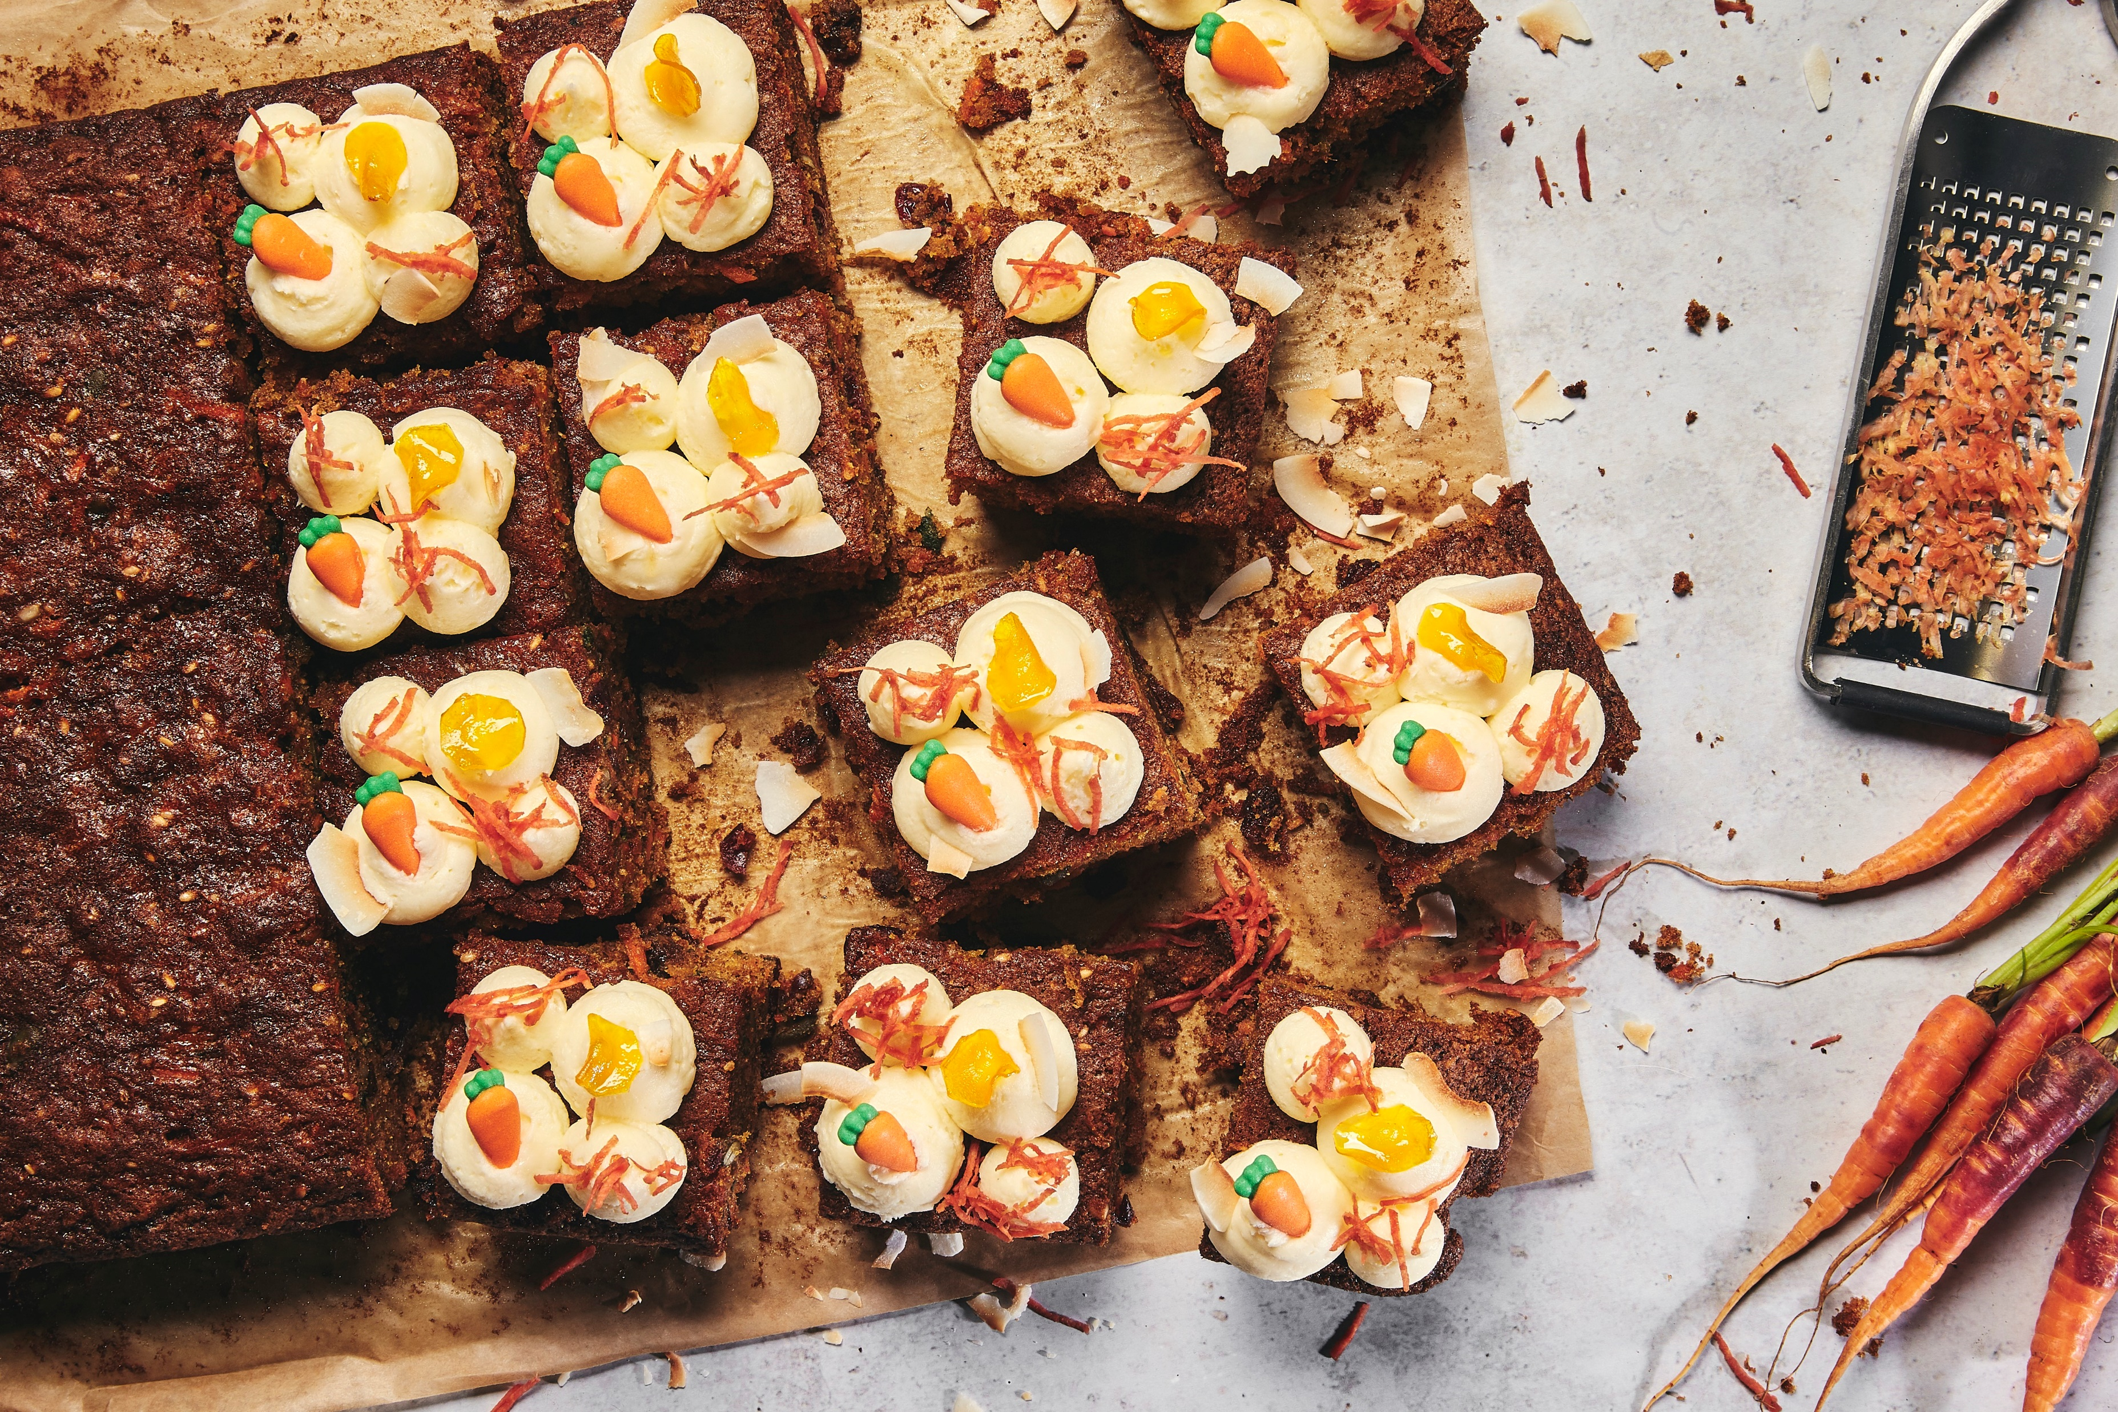
WEEK ONE BREAKFAST
 | MONDAY | TUESDAY | WEDNESDAY | THURSDAY | FRIDAY | SATURDAY | SUNDAY
Main Items Vegetarian Porridge Station Yogurt & Fruit Cereal & Toast | Pan au Choc Ham & Cheese Croissant | Breakfast Wrap Bacon Scrambled Egg Hash Brown Breakfast Wrap Mushroom Scrambled Egg Hash Brown | Buttermilk Pancakes Blueberry Vanilla | Sausage Scrambled Egg Beans | Bagel Bacon & Egg | Breakfast Burrito Bar Sausage Rice Beans Cheese Breakfast Burrito Bar Eggs Rice Beans Cheese | Chefs Sunday Brunch A Selection Of Cereals Toast
 | Cheese & Tomato Croissant |  | Maple Syrup Cream | Roast Tomato Scrambled Egg Plant Based Sausage | Bagel Avocado & Cream Cheese
 | Porridge, Selection Of Dips & Toppings | Porridge, Selection Of Dips & Toppings | Porridge, Selection Of Dips & Toppings | Porridge, Selection Of Dips & Toppings | Porridge, Selection Of Dips & Toppings | Porridge, Selection Of Dips & Toppings | Hot & Cold Items
 | Fresh Yogurt, Toppings & Sliced Fruit | Fresh Yogurt, Toppings & Sliced Fruit | Fresh Yogurt, Toppings & Sliced Fruit | Fresh Yogurt, Toppings & Sliced Fruit | Fresh Yogurt, Toppings & Sliced Fruit | Fresh Yogurt, Toppings & Sliced Fruit | Juice & Smoothies
 | A Selection Of Cereals & Milk White & Wholemeal Toast Jam Selection | A Selection Of Cereals & Milk White & Wholemeal Toast Jam Selection | A Selection Of Cereals & Milk White & Wholemeal Toast Jam Selection | A Selection Of Cereals & Milk White & Wholemeal Toast Jam Selection | A Selection Of Cereals & Milk White & Wholemeal Toast Jam Selection | A Selection Of Cereals & Milk White & Wholemeal Toast Jam Selection | Fresh Cut Fruit Dessert Pots & Yoghurt Pots
Fruit Juice | Pressed Apple Fresh Orange | Pressed Apple Fresh Orange | Pressed Apple Fresh Orange | Pressed Apple Fresh Orange | Pressed Apple Fresh Orange | Pressed Apple Fresh Orange | Pressed Apple Fresh Orange

Slide 2


MENU WEEK ONE LUNCH MAIN
 | MONDAY | TUESDAY | WEDNESDAY | THURSDAY | FRIDAY | SATURDAY | SUNDAY
CLASSIC | Classic Pasta Bolognese | Mediterranean Chicken, Homemade Salsa Fresca | Thyme Roasted Pork Loin with Crackling | Authentic Beef in Black Bean Sauce | Portuguese Chicken Pita, Lime Yogurt, Salsa Fresca | Chefs Choice | Brunch
NOURISH | Smoked Tomato, Chipotle, Spinach Gnocchi | Mushroom Mince Chilli, Lentil & Soybean | Roast Butternut, Sage & Pea Barley Risotto | Chickpea, Sweet Potato, Lentil Dahl | Sweet Pepper & Red Onion Puff Pastry Tartlet, Tomato Pesto | Chefs Choice | Brunch
SIDES | Garlic Foccicia Garden Peas Baked Carrots | Mexican Rice Steamed Corn Green Beans | Creamy Mashed Potato Roasted Swede Savoy Cabbage | Wok Fried Greens Sticky Carrots Coconut Rice | Paprika Chips Baked Beans Spiced Corn | Chefs Choice | Brunch
SALADS | A Selections of Salads & Dressing | A Selections of Salads & Dressing | A Selections of Salads & Dressing | A Selections of Salads & Dressing | A Selections of Salads & Dressing | A Selections of Salads & Dressing | A Selections of Salads & Dressing
JACKET & PASTA | Jacket Potato Baked Beans Pasta & Sauces | Jacket Potato Baked Beans Pasta & Sauces | Jacket Potato Baked Beans Pasta & Sauces | Jacket Potato Baked Beans Pasta & Sauces | Jacket Potato Baked Beans Pasta & Sauces | Chefs Choice | Brunch
CAKE & COLD DESSERT | Dessert Pot Of The Day Apple Berry Crumble | Dessert Pot Of The Day Ginger Flapjack | Dessert Pot Of The Day Shortbread Finger | Dessert Pot Of The Day Lemon Drizzle Cake | Dessert Pot Of The Day Brownie Cookie | Chefs Choice | Brunch

Slide 3
MENU WEEK ONE SUPPER
 | MONDAY | TUESDAY | WEDNESDAY | THURSDAY | FRIDAY | SATURDAY | SUNDAY
STREET EATS | Pulled Garlic & Chilli Chicken Burrito | Korean Bulgogi BBQ Beef Noodle Pot | Salt & Pepper Chicken, Ginger & Coriander Dressing | Taco Thursday South American Pulled Pork Tacos Build Your Own. Pico De Galo, Salsa Fresca | Slow Cooked Beef Rendang Curry | Chefs Choice | Classic British Roast Or Sweet Potato & Butterbean Wellington
NOURISH | Lentil, Spinach & Sweet Potato Burrito | Spiced Tofu Pad Thai | Nasi Goring, Soy, Ginger & Chilli | Taco Thursday South American Jack Fruit Tacos Build Your Own. Pico De Galo, Salsa Fresca | Slow Cooked Channa Dahl | Chefs Choice | Roasted Root Vegetables
SIDES | Tomato Rice Salsa Guacamole Crispy Tortillas | Egg Noodle Stir Fried Vegetables | Sticky White Rice Honey Ginger Carrots | Spiced Cous Cous Mediterranean Vegetables | Bombay Potatoes Seared Cauliflower Baked Pac Choi | Chefs Choice | Crispy Roast Potato Rich Gravy
SALADS | A Selections of Salads & Dressing | A Selections of Salads & Dressing | A Selections of Salads & Dressing | A Selections of Salads & Dressing | A Selections of Salads & Dressing | A Selections of Salads & Dressing | A Selections of Salads & Dressing
CAKE & COLD DESSERT | Dessert Of The Day & Fruit | Dessert Of The Day & Fruit | Dessert Of The Day & Fruit | Dessert Of The Day & Fruit | Dessert Of The Day & Fruit | Dessert Of The Day & Fruit | Dessert Of The Day & Fruit

