Slide 1


Felix Tijerina Elementary
Coffee with the Principal

Slide 2

Two years into HISD's transformation, our students have achieved remarkable academic results across every grade and every measure.

Slide 3
Felix Tijerina Elementary
DATA

Slide 4
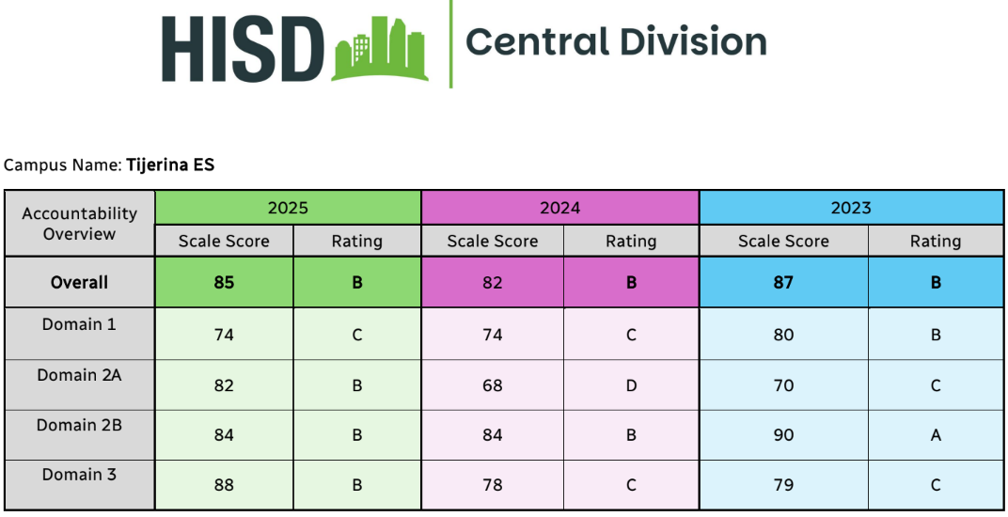

Slide 5
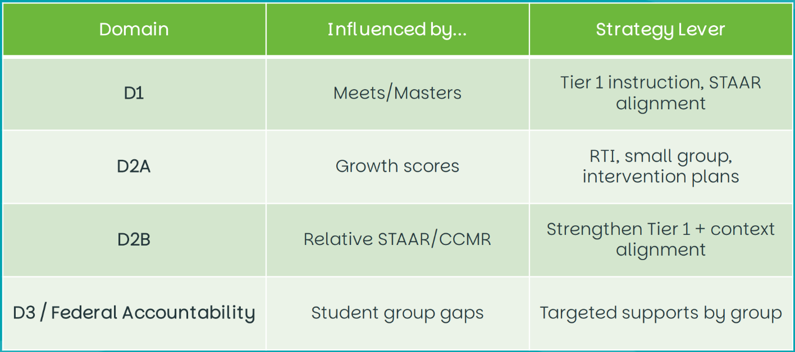

Slide 6
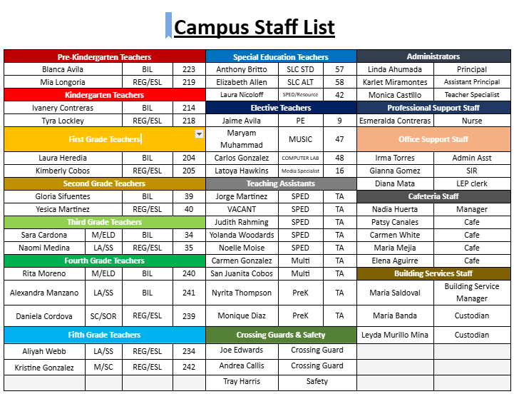

Slide 7
Time | Activity | Details
7:05 a.m. | School Doors Open | Students may enter the building
7:05 – 7:25 | Breakfast (Cafeteria) | Grab-and-go; all students except Pre-K & Kinder
7:05 – 7:45 | Grab-and-Go Breakfast | Students may eat in designated areas
7:05 – 7:25 | Pre-K & Kinder Breakfast | Eaten inside classrooms
7:30 a.m. | Instruction Begins | All students must be in class and ready to learn
10:00 – 10:30 | Lunch – Pre-K & Kinder
10:30 – 11:00 | Lunch – 1st & 2nd Grade
11:00 – 11:30 | Lunch – 3rd & 4th Grade
11:30 – 12:00 | Lunch – 5th Grade & SPED Classes
2:55 p.m. | Dismissal Begins | Prepare for end-of-day transition
3:00 p.m. | School Ends | All students dismissed

Slide 8
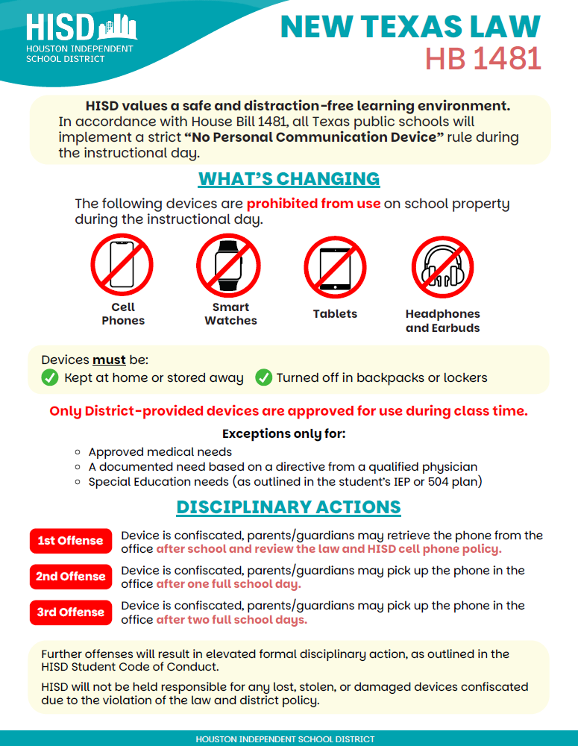

Slide 9
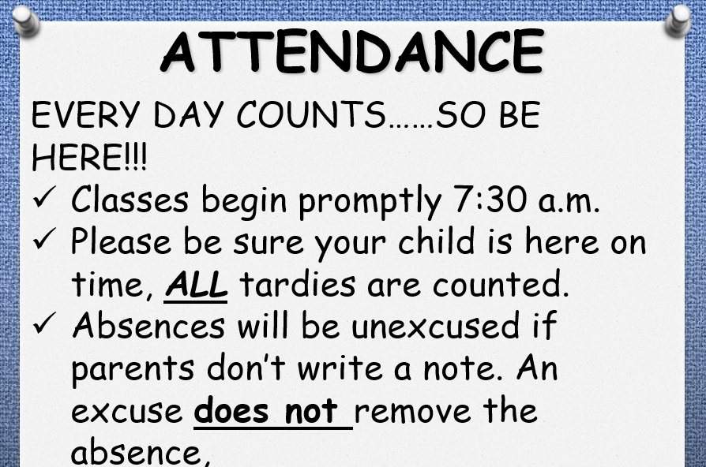

Slide 10
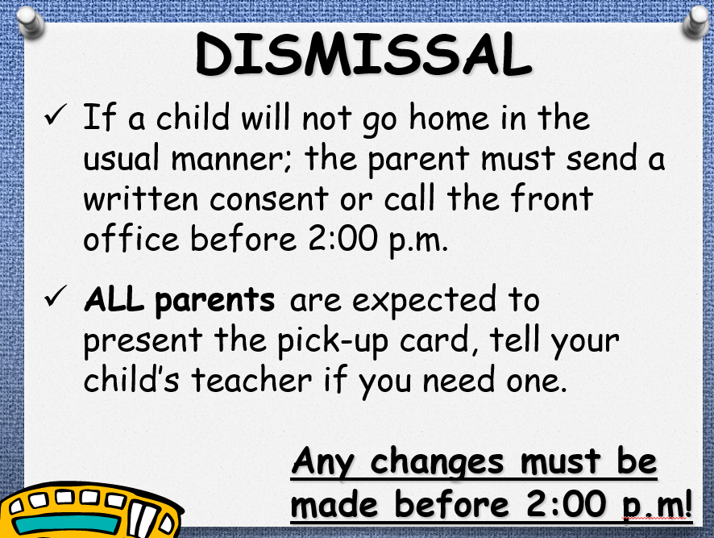

Slide 11
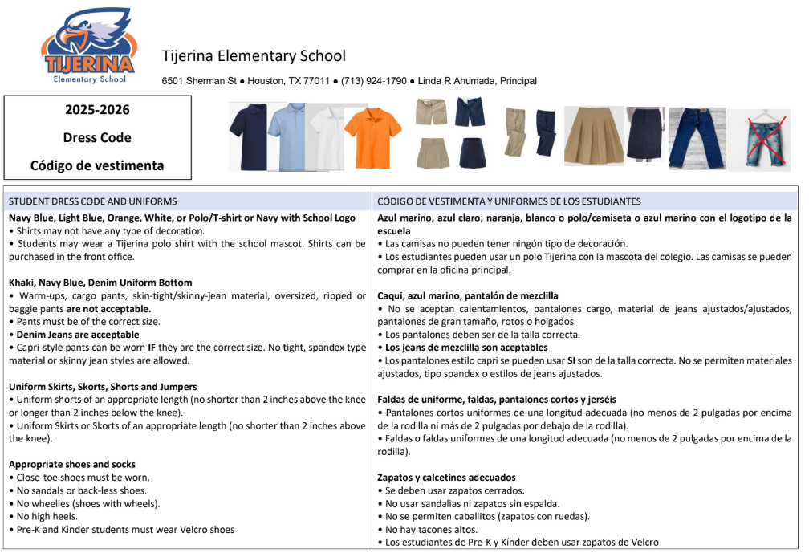

Slide 12
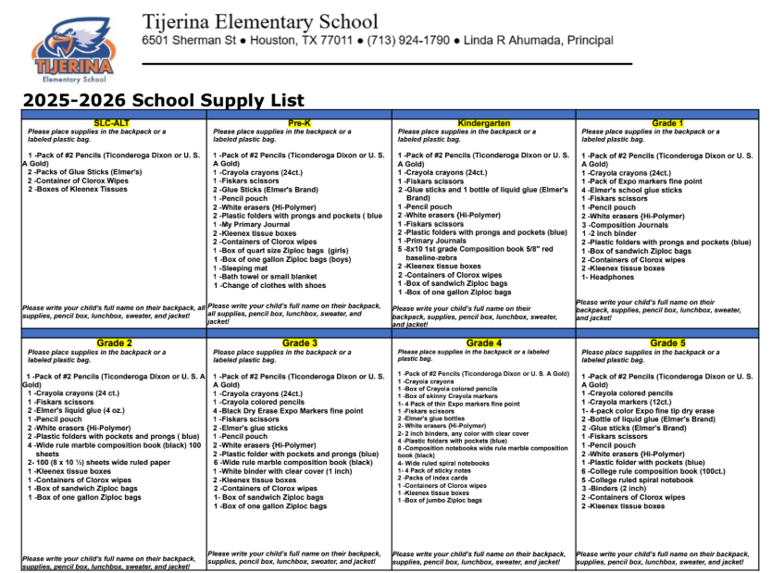

Slide 13
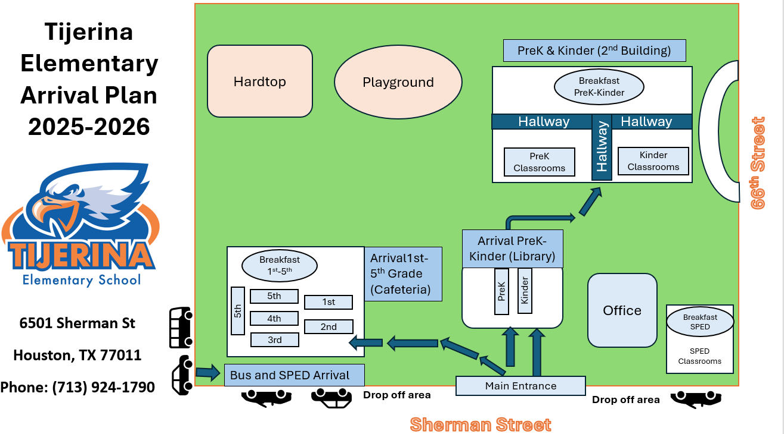

Slide 14
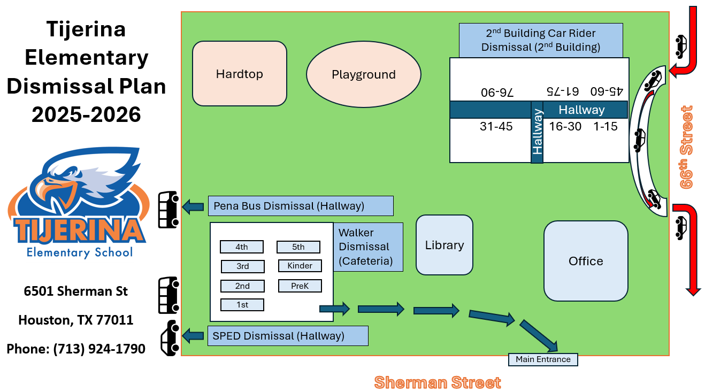

Slide 15

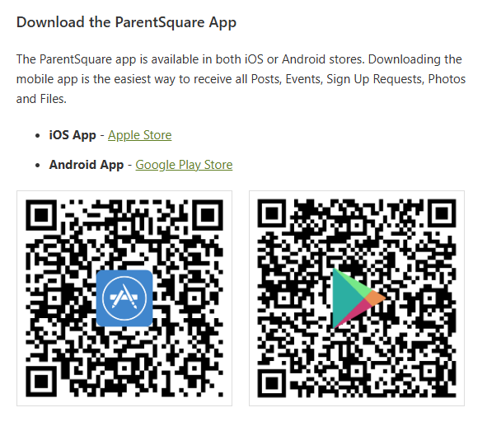

Slide 16
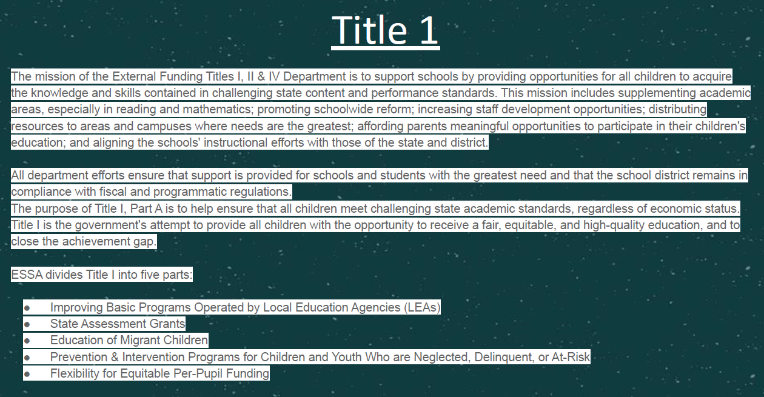

Slide 17
Title 1
Parent/School Compact
Parent/Family Engagement Contract
Campus Contact: Ms. Monica Castillo
Monica.Castillo@houstonisd.org

Slide 18
Thank you

