Slide 1
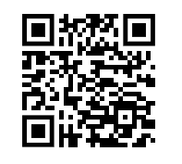
Attendance Verification
Please scan this QR code and fill out the 3 questions so we know who was in attendance this evening. Thank you.

Slide 2

Senior Parent Meeting
Thursday, August 28, 2025
6:30 pm

Slide 3
senior remind
If you have not done so already, please join the Senior Remind. We use this platform to send out updates, news, and announcements.
(please join based on your last name)
Student Join Codes: Parent Join Codes:
Last name A-H, text @b2fefhc to 81010 - Last name A-H, text @3g88ace to 81010
Last name I-P, text @efeefa6 to 81010 - Last name I-P, text @b82fa3 to 81010
Last name Q-Z, text @3h747ba to 81010 - Last name Q-Z, text @4a7kgc to 81010

Slide 4
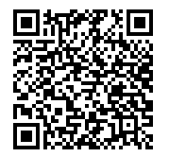
SENIOR DUES
$200 for the year
DEADLINE FOR PAYMENT- FRIDAY NOVEMBR 21, 2025
Dues go up to $225 starting Nov. 22. (late fee added)
Senior Dues covers:
1. Commencement fee (insurance, medical, security, facility rental, program/ticket printing, and any additional cost associated with graduation.)
2. All on campus senior events (4 breakfasts, lanyards, T-shirt, senior week activities, etc.)

Slide 5
Senior dues- continued
Senior dues DO NOT include Cap and Gown fee, or any additional fees associated with 3rd Ascent.
Dues can be paid:
1. Online (Preferred Method- go to school website- OSP link on main page)
2. Cash
3. Check (made out to NSHS with your student’s name on the memo line)
4. Money order
Options 2, 3, and 4 must be brought to Mr. Landreau in A101.
Receipts will be provided for payments made with cash, check or money orders.

Slide 6
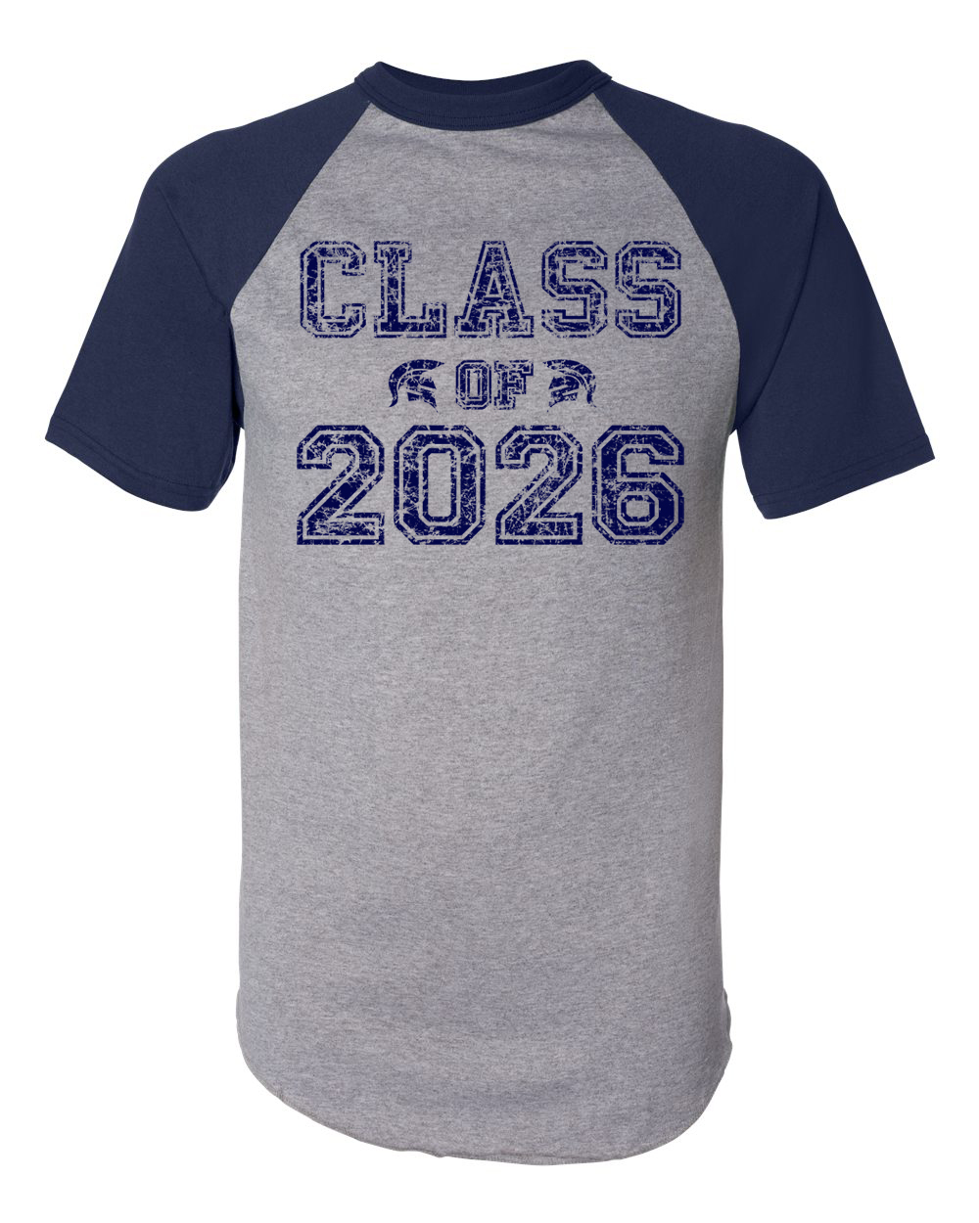
Senior T-Shirt
Included in your senior dues
Shirts will be given as dues are paid! Show Mr. Landreau your OSP receipt and he will give you your shirt. ☺

Slide 7
Cap & Gown
Order your cap and gown directly through 3rd Ascent (www.3rdascent.com)
Cost- $100.00 (Basic Package includes C&G and Diploma Cover)
DEADLINE TO ORDER- December 1, 2025
Late fee added to all orders placed after the deadline.
3rd Ascent representatives will be on campus several times throughout year to assist in ordering C&G and any other senior swag.
Must have our Cap/Gown to walk across stage at Graduation

Slide 8
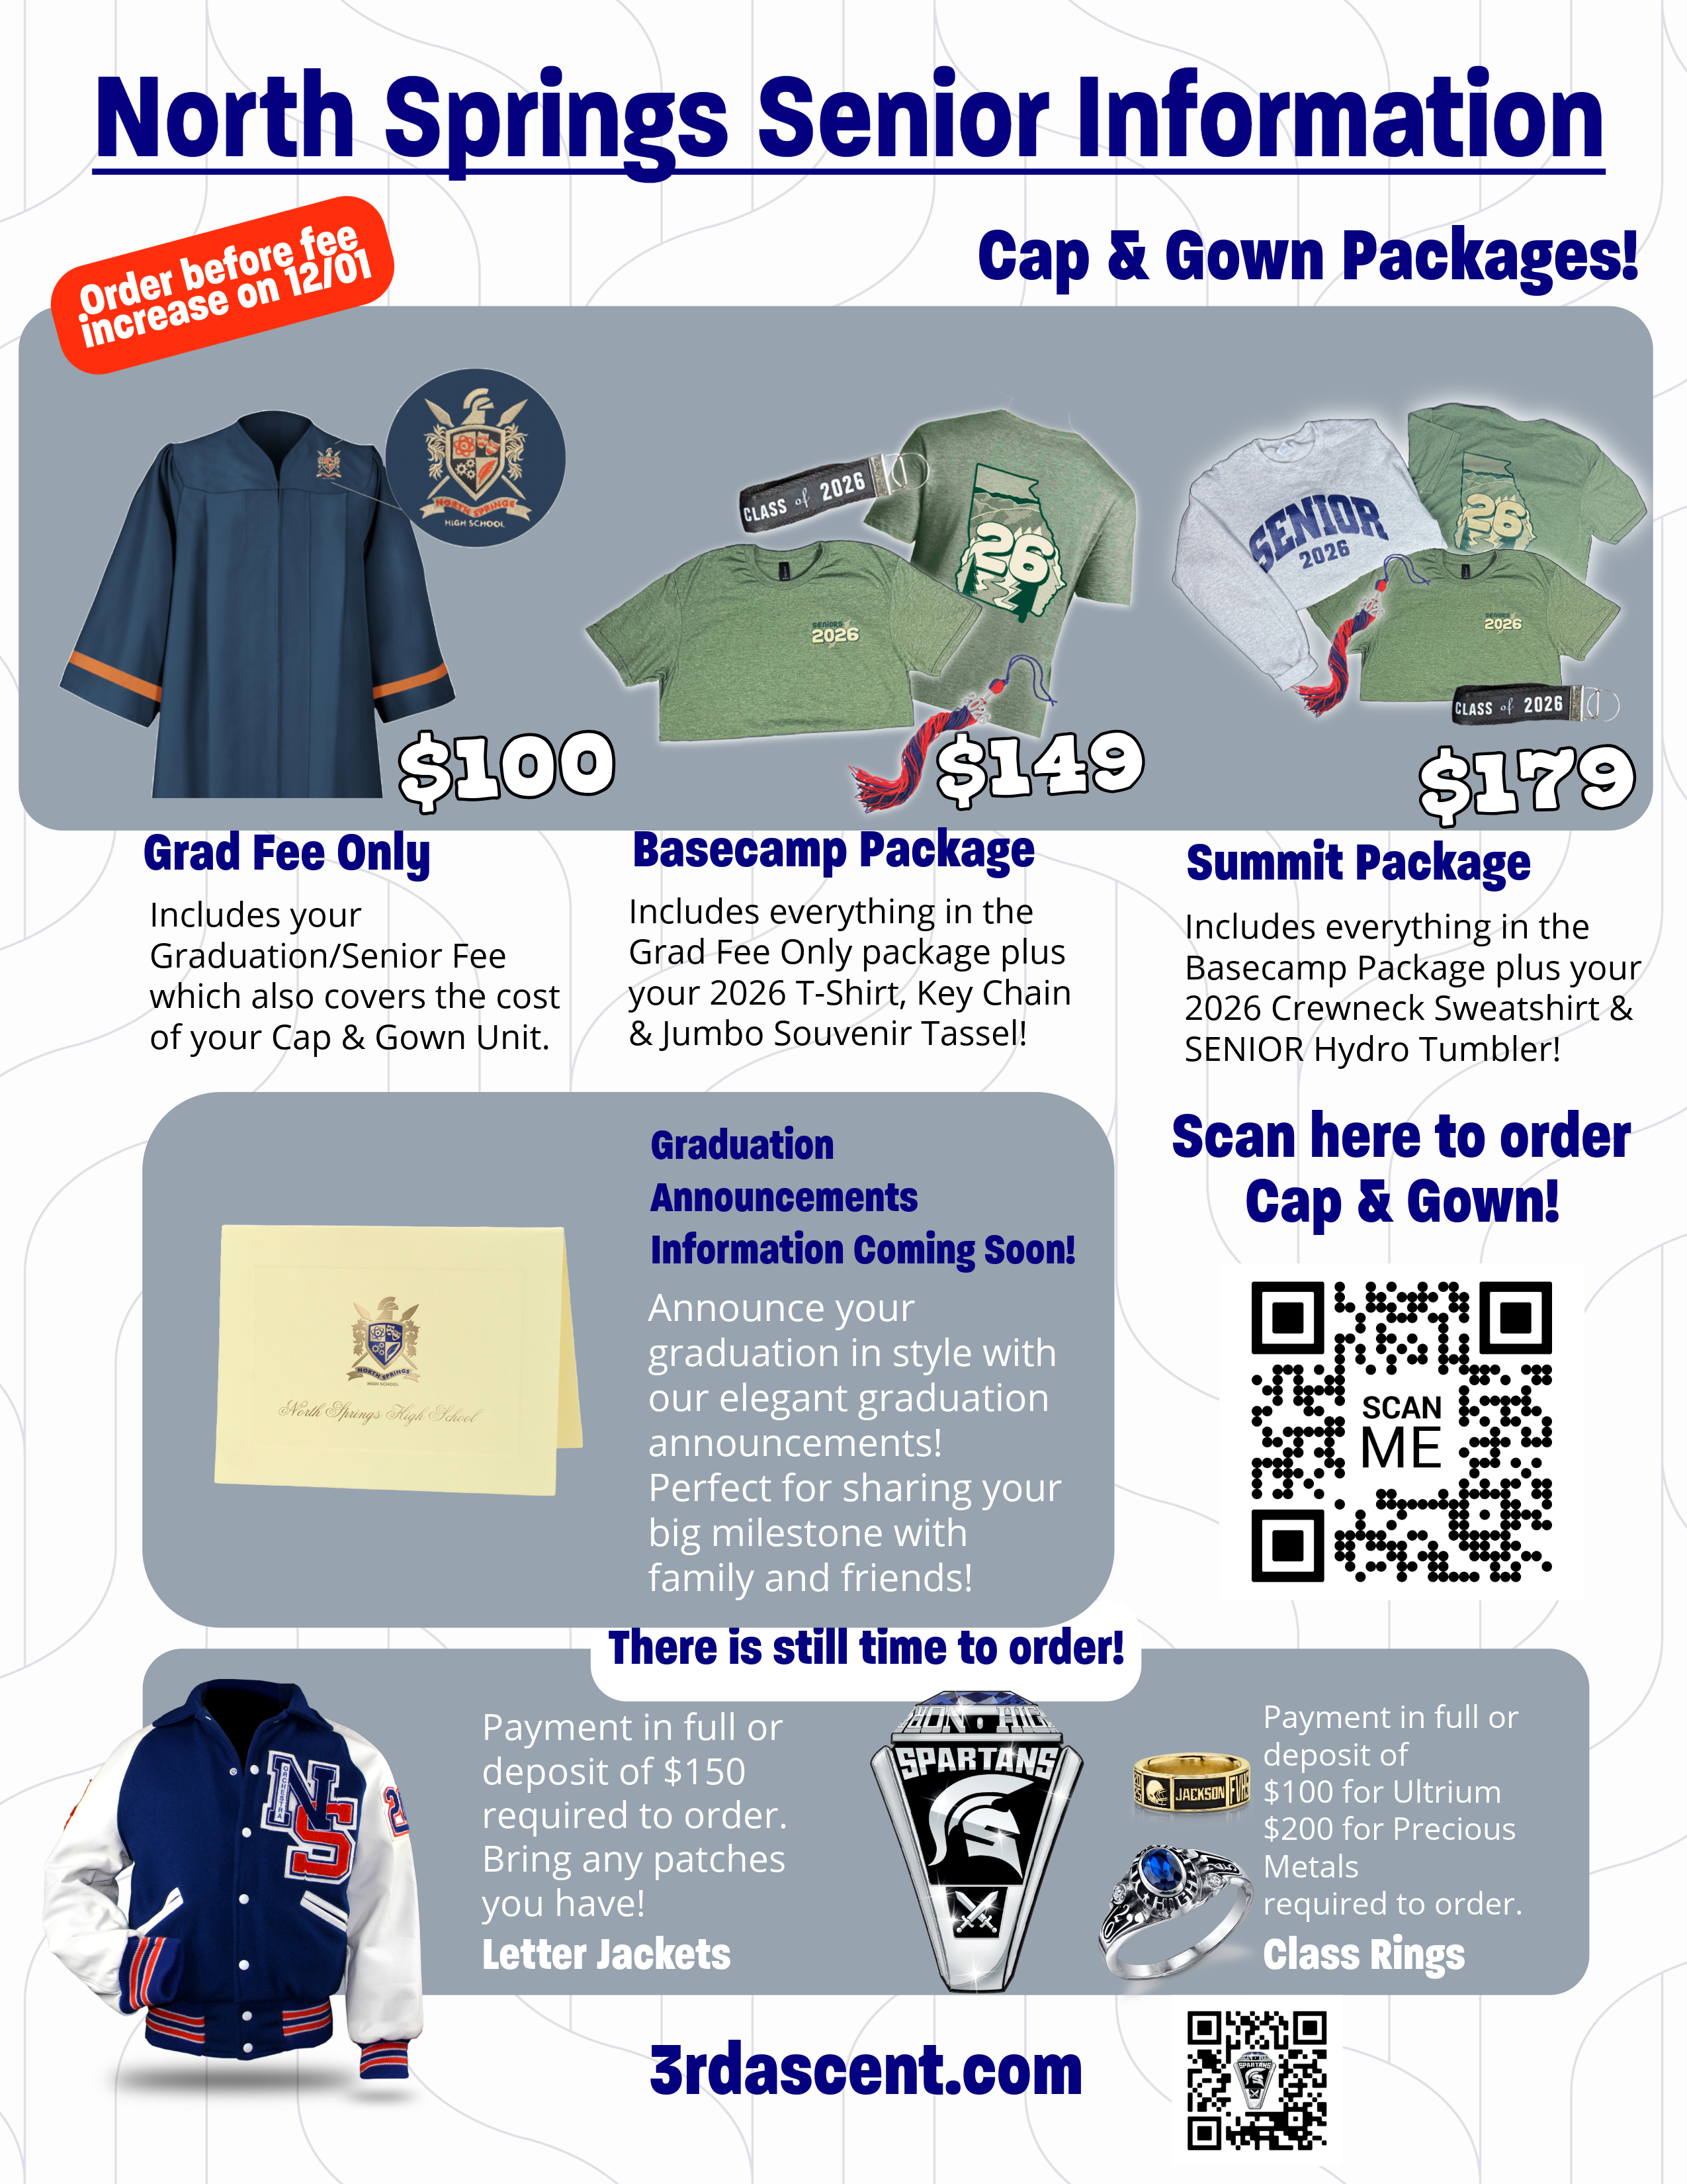
3rd Ascent- Additional Services
Graduation announcements/invitations
Class rings
Senior 2026 Swag
And more……
Visit www.3rdascent.com for more information and options
3rd Ascent handles all fees and payments directly.

Slide 9


Slide 10

SENIOR LANYARDS
Lanyards and ID’s are being given out to seniors (these are included in senior dues)
Seniors must have their lanyards/ID’s with them everyday. This is their pass to the Senior Courtyard.
Needed for all Senior events. No lanyard/ID = no admission!

Slide 11

SENIOR CALENDAR
The 2025-2026 Hot Dates will be posted on the Senior page of the school website and will be sent out in Mr. Hanson’s weekly newsletter. Please check these often for updates and information.
Some important upcoming dates:
- College Fair (with RICS) – October 7, 2025 @ RICS
- Georgia Apply to College Week- Nov. 3- Nov. 7, 2025
- Halloween Fun- Friday, Oct. 31, 2025- BRING YOUR LANYARD in the courtyard (sponsored by the Senior Parent Committee)

Slide 12
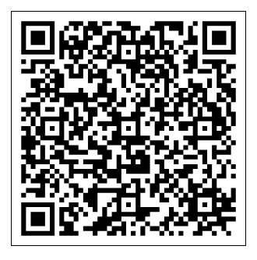
Senior Pictures, quotes, ADS, and yearbook
Please see Mrs. Motahari in D106 (or email at motaharin@fultonschools.org) if you have any questions about Cady studios, senior pictures, senior quotes, and yearbook.
Yearbook and Senior ad prices both go up monthly- your best chance for a great deal is to purchase it now!
The yearbook is currently $90, but price will be increasing on 8/31, ads start at $70 and they also go up 8/31, and both will go up monthly after that. Payment plans are available!
PLEASE NOTE- SENIOR PORTAITS MUST BE TAKEN WITH CADY STUDIOS TO BE INCLUDED IN THE YEARBOOK!

Slide 13
Senior Yearbook Deadlines
-Senior photos- Appointment MUST be scheduled by November 1st- book at cady.com/book. We will be having a Senior Roadshow on October 7th at NSHS for students who cannot make it to a facility. In order to be in the yearbook, students MUST be photographed by Cady.
-Senior Ads- Please create and pay through the Jostens website by December 31st. We will be editing ads for style, so please don't be alarmed when you can't make it pretty. Our graphic designers will be adjusting them as we go.
-Senior Baby photos- please submit to nshsyearbook60@gmail.com with student name in headline by 11/15/25
-Senior Superlatives and quotes-the form will be sent out when we return from Fall break and will be due 11/15.

Slide 14
Updates from Mrs. Zachry
-Homecoming Dance ticket sales will begin on Friday, August 29, 2025, on GO FAN for $20
-Homecoming Dance is on Saturday, September 20, 2024, from 7-11 pm @ NSHS
-All additional Homecoming information will be pushed out on Friday, August 29 via Teachers, school website, and social media platforms.
-Prom is on Friday, April 24, 2026- Tickets will go on sale after Thanksgiving Break.

Slide 15
PSAT DAYS-
Sometime between oct 7-9, 2025
We encourage you to GO VISIT A COLLEGE during these days
You must pick up a PSAT/College visitation form from Mr. Landreau
You must fill out the form, get it signed by a college official at the school you visit
Forms must be turned into Mr. Landreau by end of day on Friday, Oct 10th.
Once forms are collected, attendance will be excused.
MUST USE THE FORM WE PROVIDE FOR ABSENCE TO BE EXCUSED.

Slide 16
SAT DAYS- October TBD
The FREE SAT will be October TBD. Only students who sign up for it will be allowed to take it. Information on how to register will be coming out soon. Please Stay tuned!
If your student does not have a school issued device, they will need to pick one up from IT in order to take the SAT.

Slide 17
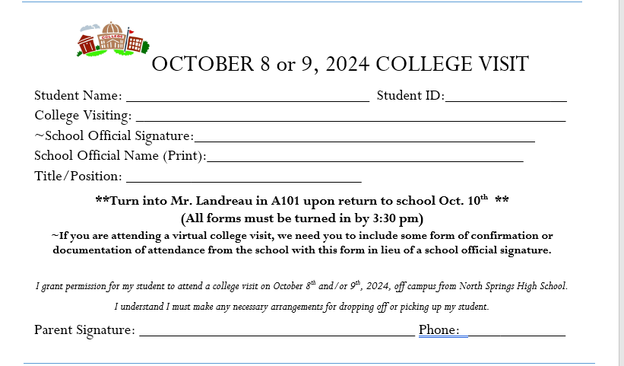
COLLEGE VISITATION FORM
(Below is what The form will look like- THIS IS NOT THE ACUTAL FORM)

Slide 18
Senior parent committee
We have an AMAZING group of volunteer parents that have arranged additional events and treats for you throughout the year. These events are funded by donations from parents for you to have awesome experiences throughout the year.
Students Must have their lanyard and ID card to participate
Several events are planned throughout the year
If you wish to donate to the committee or volunteer, please contact Cassie Templeton at runnercat1995@gmail.com or Wendy Amato at wendyamato1@gmail.com
Please note the Senior Parent Committee is a separate entity that provides additional activities and events for seniors and the funds collected are not the same as senior dues.
Donate funds using Venmo (Cassie-Templeton-1) or CashApp ($NorthSprings26)

Slide 19
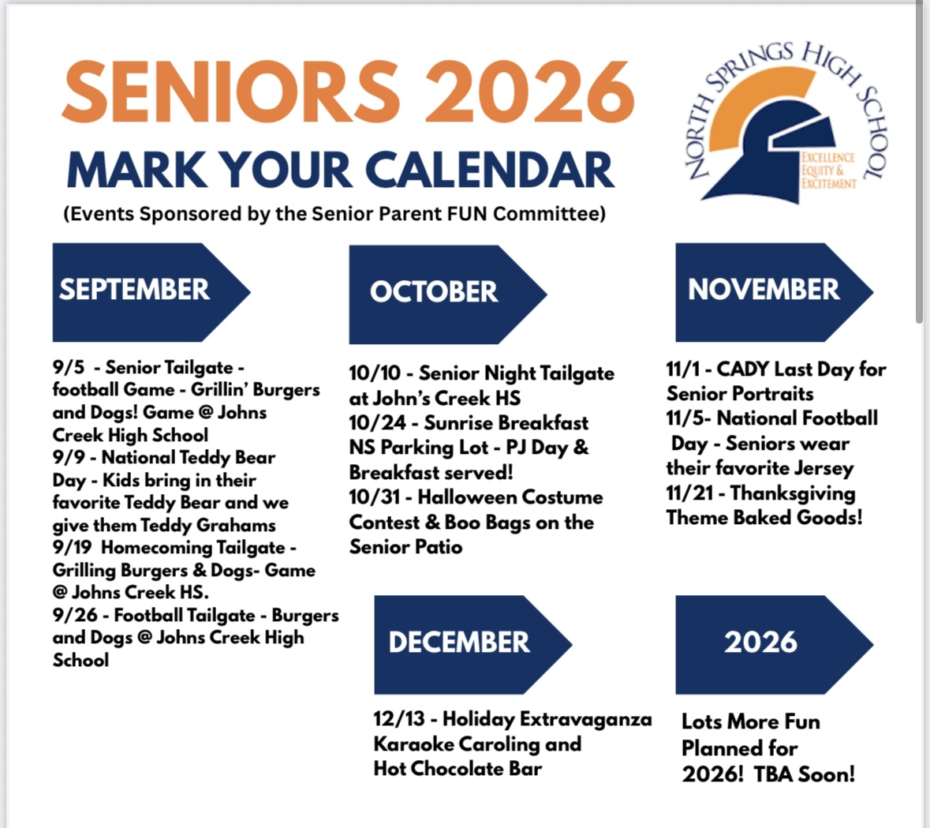

Slide 20


Slide 21
LET’S HAVE A GREAT YEAR SPARTANS!!
CONGRATS CLASS OF 2026!
THE FUN IS JUST BEGINNING!!!

Slide 22
Attendance Verification
Please scan this QR code and fill out the 3 questions so we know who was in attendance this evening. Thank you.

Slide 23
COURTYARD
The courtyard is a senior privilege.
Please help keep it clean.
Please pick up/dispose of your trash.
Respect the space.
Do not let underclassmen in. This is your space that you’ve earned and waited for!
Failure to keep area clean, will result in losing the privilege and the courtyard will be closed.

