Slide 1
North Springs HS
Senior Success: Graduation and Beyond

Slide 2
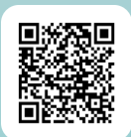
Ask Questions
Please use this QR Code to list any questions you may have
A FAQ will be created from all collected questions

Slide 3

Meet Your School Counselors and Support Staff
25-26 Caseloads
Mr. Ellis, Mrs. Wyche, Ms. Smith and Mrs. Shabazz
Mrs. Yolandria Wyche – A –CLE
Ms. Melanie Smith – Clo-Jack
Mr. Mark Ellis – Jaco-Pri
Mrs. Chanell Shabazz – Pry-Z
Support Staff
Ms. Hazel Morris – School Social Worker
Dr. Tameka Osebutey – Aguedje- 504/MTSS Coordinator
Melanie Binder – School Psychologist
Mrs. Mariam Palacios – Parent Liaison
Ms. Lori Bryan – Registrar
Mrs. Regina Nasz – Prof Assistant

Slide 4
Meeting Objective
Graduation Requirements
Post Secondary Options including College Application Process
Mental Health and Wellness

Slide 5
Infinite Campus
Access to all school information:
  Grades
  Attendance
  Assignments (just list, not details)
  School Announcements
  Unofficial Transcript
  Code of Conduct
Click on Documents and see your current Transcript
Some colleges may allow you to self report and this allows you to submit the transcript yourself

Slide 6

Save the Date – IC Grade Posting
Semester 1
  4.5 Weeks – Progress Report – September 12th
  9 weeks – Progress Report - October 10th
  13.5 weeks – Progress Report – November 21st
  Final S1 – January 16^{th, 2026}
^{Semester 2}
  4.5 Weeks – Progress Report – February 13th
  9 weeks – Progress Report - March 20th
  13.5 weeks – Progress Report – April 27th
  ^{Final S2 – May 29, 2026}

Slide 7
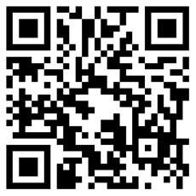
Aspire Tutoring
Tutoring starts 9/9/25
There will be sweep bus to assist students with getting home
The bus will leave at 5:30 pm

Slide 8
Tutoring for ELL Students
Held on Monday and Wednesdays after school
Sandy Springs Mission provides transportation
Jessica Bryant is the contact person for the ELL program

Slide 9
FCS Graduation Requirements
World Language is not a graduation requirement, but 2 or 3 years of the SAME world language may be required for college admission.
* Electronic Personal Fitness Waiver – does not give credit only ensures the Personal Fitness requirement has been satisfied.
Until it is listed on your transcript as waived, do not consider yourself cleared of the requirement.
English – 4 credits
Math – 4 credits
Science – 4 credits
Social Studies – 3 credits
CTAE / Fine Art / Language – 3 credits
Health (.5) & Personal Fitness (.5) – 1 credit
Additional Electives – 4 credits
23 TOTAL CREDITS REQUIRED

Slide 10
Grade Point Average
Fulton County Cumulative Numeric Average
HOPE GPA
4 – point scale
  A=4.0, B=3.0, C=2.0, F=0.0
Academic/Core courses
  (English, Math, Science, Social Studies, and World Language taken in high school and Academic Electives (Ex. Debate, Yearbook, Newspaper, Sociology and Math Support) and some Career Tech classes (Ex. Essentials of Healthcare, AP Comp Sci A, AP Comp Sci Principles)
Unweighted
  (7 honors points are removed before converted to the 4.0 scale, but additional 0.5 quality points added to the AP & DE courses, up to a 4.0)
Calculated by the GA Student Finance Commission at the end of high school. www.gafutures.org must have at least four credits considered rigor courses as defined by GSFC.
100-point scale
All final grades are included (middle school, academic/core, electives, etc.)
Weighted
  (7pts added to final passing grade for each Honors, AP, and DE Courses)
Calculated by Fulton County and posted on the high school transcript
*Colleges do not necessarily remove Honors points from grades before calculating a student’s GPA for admission. Each college has their own policy for how they calculate GPAs for admission.

Slide 11

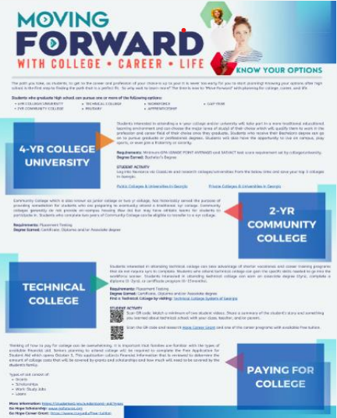
Spartan Post Secondary Options – Pick your path

Slide 12
Road Map to Success
Apprenticeships
Technical Colleges
Gap Year Programs

Slide 13
Road Map to Success
Work/Employment
Military Options
Two and Four Yr Colleges

Slide 14

Trade Talks Tuesday – Coming Soon
Held monthly beginning on
9-22-25 during 3rd period
Sign up – must have a pass to attend
Fill out the MS Form to get a pass
The student must complete the form using their school account
This is specifically for students who are interested in a nontraditional college option

Slide 15
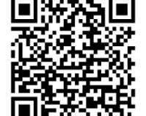
Trade Talk Tuesdays Sign Up and Dates
3rd Period – 9/22/25 rm E107
3RD Period – 10/27/25 rm E107
3rd Period – 11/18/25 rm E107
3rd Period – 1/26/26 rm E107
3rd Period – 2/23/26 rm E107
3rd Period – 3/23/26 rm E107

Slide 16

ASVAB TEST
The ASVAB is the Armed Services Vocational Aptitude Battery.
It is a free 3 hour standardized test. It measures a person’s aptitude in four domains –Verbal, Math, Science & Technical, and Spatial.
It has two main purposes –
  Identifies students who are interested in joining the military,
  Allows any student to receive career exploration tools.
The career planning tools and resources are available to students after taking the ASVAB. This is the true advantage of program participation.
The ASVAB does NOT mean you have to join the military. You can opt out of recruiter contact when you are given the test.

Slide 17
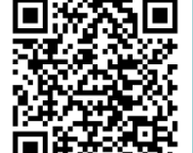
ASVAB DATES AND SIGN UP
November 18, 2025 @ 8:30 in cafeteria
March 10, 2026 @ 8:30 in cafeteria

Slide 18
Most Commonly Used College Application Sites
Common Application – Free online platform that allows students to apply to colleges and universities worldwide. Over 1,000 colleges use Common Application as their application portal. Students can apply to up to 20 schools in Common Application. https://www.commonapp.org/
Ga Futures – Many features, but one part of the website is being able to apply to colleges through their website. They have up to 75 colleges in Georgia as part of their portal. Sometimes redirected to Common App. https://www.gafutures.org/
Common Black College Application – Unique to Historically Black Colleges & Universities (HBCUs). $20 to apply to multiple HBCUs at one time. Student list the top four choices but your application goes to over 50 member institutions. Many of the “big names” are not part of this application – such as Morehouse, Spelman, and Howard – those use Common App. Direct to Institution College Portal – go directly to the college admission page and find the way the college prefers you apply. Look at their admission webpage, specifically – Freshman Admissions – for directions and a step by step guide. https://commonblackcollegeapp.com/

Slide 19
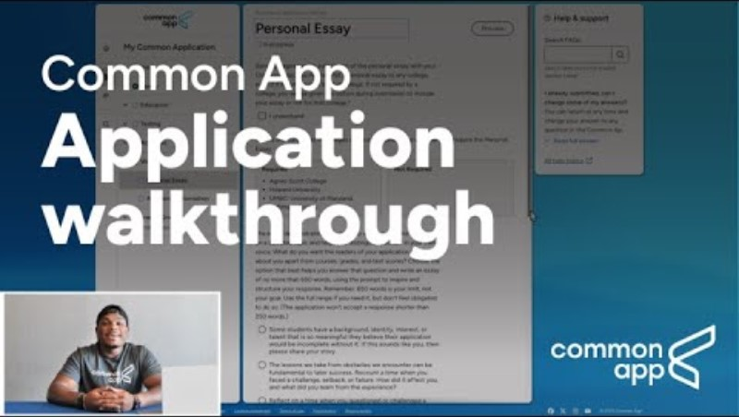
Common App – How to Video

Slide 20
College Application Components
Completed College Application
Official High School Transcript
Official Test Scores if Required

Slide 21
College Application Components
School Report – If Required
Counselor/Teacher Recommendation
Application Fee/Fee Waiver

Slide 22
Test Scores/Test Optional
College Board.org Used for PSAT, SAT and AP Test Scores. All scores must be requested to colleges, if necessary. There is a fee assessed for each score report sent to a school. Students have “score choice” where the student decides what scores to send and where . SAT Superscore FAQ
ACT
Students must officially request these documents to be sent to colleges, if required. There is a fee assessed for each report sent to a school. You cannot send only one section of your ACT score report to colleges. However, some colleges may Superscore – which lets you choose your best section scores from multiple test dates. ACT Superscore FAQ Login to your MyACT account and select the “send your scores” option from the dashboard.
Test Optional – This is the best site for the list of schools who may exempt students from sending ACT/SAT test scores- www.fairtest.org

Slide 23
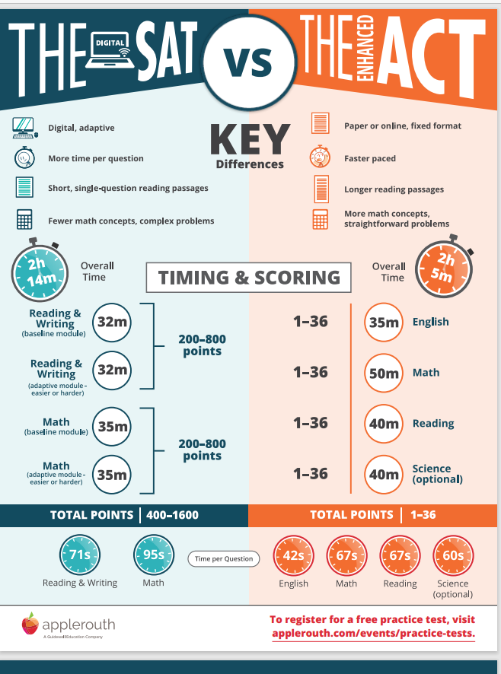
SAT AND ACT Comparison

Slide 24
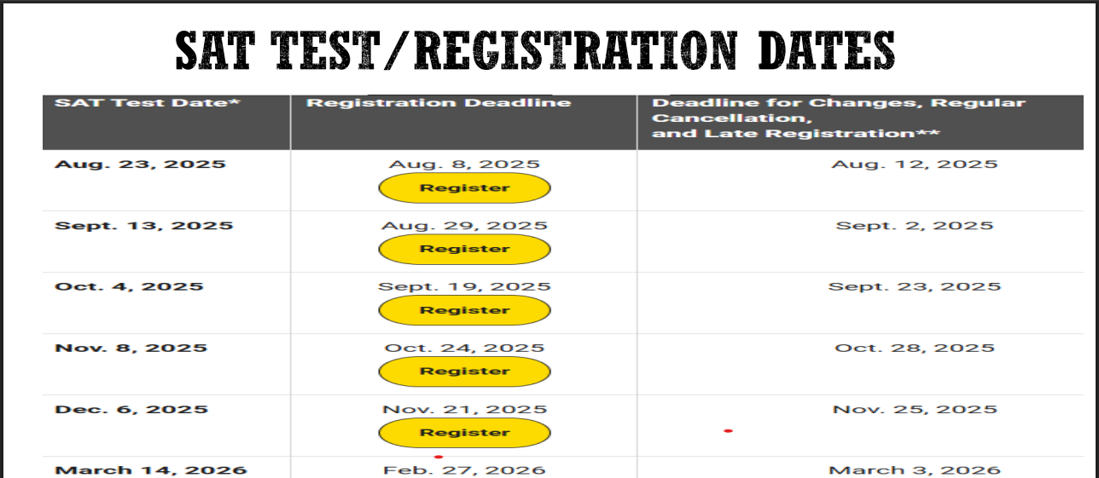
SAT - Collegeboard

Slide 25
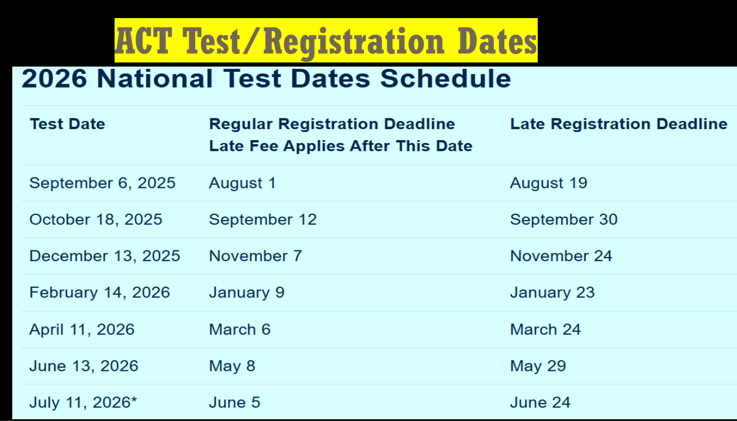
ACT

Slide 26
What is Dual Enrollment?
Georgia’s Dual Enrollment Program provides students enrolled at an eligible public or private high school or home study program in Georgia the opportunity to earn high school and college credit at a participating eligible postsecondary institution in Georgia.
Georgia’s Dual Enrollment Program offers students the opportunity to experience college courses and begin their college academic career while still in high school and provides for standard tuition, mandatory fees and required books.

Slide 27
Dual Enrollment
Review Dual Enrollment Presentation
Fall Deadline for Application and Requirements is November 1, 2025
NSHS Dual Enrollment PPT 2 2025

Slide 28
College Planning Tips for Seniors & Parents
Summer and Early Fall
  Visit Colleges Together: Tour campuses and use a checklist to evaluate each visit.
  Finalize the College List: Help your student compare schools based on fit, cost, and programs.
  Estimate Costs: Use the Net Price Calculator to understand real college costs.
  Start Applications Early: Encourage your student to begin filling out applications now.
  Discuss Early Decision/Early Action: Weigh the pros and cons of applying early.
Fall
  Meet with the School Counselor: Ensure your student is on track with applications and deadlines.
  Create a College Calendar: Track deadlines for applications, tests, and financial aid.
  Prepare for Admission Tests: Many students retake the SAT or ACT in the fall.
  Search for Scholarships: Work with your counselor to find and apply for scholarships.
  Review Applications: Offer to proofread, but let your student’s voice shine through.

Slide 29
College Planning Tips for Seniors & Parents
Winter
  Complete the FAFSA: Opens in December. Use IRS data retrieval for faster processing.
  Apply for Financial Aid: Contact colleges to confirm required forms and deadlines.
  Understand Loan Options: Learn about federal loans and your role in the process.
Spring
  Review College Offers: Help your student compare admission and financial aid packages.
  Accept an Offer: Submit deposits and paperwork by the deadline.
  Prepare for AP Exams: Encourage your student to register and study for AP tests.

Slide 30
College Application Tools and Tips
Be
Be sure to select “UNDERGRADUATE” application and follow steps for Freshman applicants.
Look
Look for the college’s application checklist for easy reference.
Send
Send official test scores directly from the testing agency, if required.
Use
Never use your school email when creating accounts & be sure to use an appropriate email address ☺
Use
Use the numeric GPA that is shown on your transcript in IC to enter into applications.
WRITE
When making accounts or setting up various portals, WRITE EVERYTHING DOWN!
Email used
Usernames/Passwords
PIN assigned
Store this info in your phone in your notes section

Slide 31
Spartan College Bound Athletes
Prospective Student Athletes should:
Access registration materials by visiting the NCAA or NAIA website for initial information.
Submit the Request to Mr. Mark Ellis at Ellisg@fultonschools.org prior to requesting your transcript.
When taking the SAT/ACT, enter 9999 for scores to be sent to NCAA Eligibility Center.
Review the NCAA requirements as they might differ from graduation requirements.
Direct questions to Coach Thomas, Athletic Director
NCAA Eligibility Center -https://web3.ncaa.org/ecwr3/
NAIA – National Association of Intercollegiate Athletics -https://www.naia.org/landing/index

Slide 32
College Application Fee Waivers
Fee Waivers – NEED BASED
If applying Direct to the Institution, then student would need to inquire about the process from the college. The school counselor can sign off on the documents needed or assist the student in obtaining a code. The process for each college may be different, so please inquire if there is a need.
If using Common Application, students can apply directly using that portal. There is a specific question within the profile section of the Common App where a student can check a box that they need a fee waiver. Sometimes students check this box on accident which is why the counselor typically will verify the request.
Students must meet minimum qualifications –
You are enrolled in or eligible to participate in the federal free or reduced-price lunch program (FRPL).* • You have received or are eligible to receive an SAT or ACT fee waiver.
Your annual family income falls within the income eligibility guidelines set by the USDA Food and Nutrition Service.
Your family receives public assistance.
You are enrolled in a federal, state, or local program that aids students from low-income families (e.g., GEAR UP, TRIO such as Upward Bound or others).
You live in a federally subsidized public housing, a foster home or are homeless.
You are a ward of the state or an orphan.
You have received or are eligible to receive a Pell Grant.
You can provide a supporting statement from a school official, college access counselor, financial aid officer, or community leader

Slide 33
Online Lunch Application
https://nutrition.fultonschools.org/FreeAndReducedInfo

Slide 34
Free Application Months and Codes
This is different than a Fee Waiver due to financial need, these are open to anyone!
Ga Futures will typically host a month of free applications for in-state college during NOVEMBER and MARCH.
Most colleges in Georgia participate in these free application periods. Students use the code provided and follow the directions posted on the GA Futures website.
Additionally, many colleges give out free waiver codes to use at different times of the year. These are done by individual institutions and as we find out about these opportunities.
https://www.bestcolleges.com/resources/colleges-without-application-fees/

Slide 35
COLLEGE DEADLINES AND SCHOOL HOLIDAYS
IMPORTANT: The Counseling Office requires at least 10 school days to process Transcript/School Reports/ Recommendation requests.
Reminder of popular application deadlines for colleges:
October 15th deadline – students must submit requests no later than September 26th
November 1st deadline – students must submit requests no later than October 17th
December 1st deadline – students must submit requests no later than November 7th
Deadline in the First week of January – students must submit requests no later than December 5th
UGA’s regular admission deadline is January 1st
Georgia Tech’s regular admission deadline is January 6th
Please Note: student holidays/teacher workdays, and holiday breaks do not count as school days. Counselors will not process or submit college application materials during those times. Remember, major deadlines is a high-volume time. Get organized and plan ahead!

Slide 36
REQUESTING TRANSCRIPTS
Official Initial Transcript Request
Once you add your school counselor in Common Application, the counselor will automatically send.
All other transcript requests must be made through Scrib Order. https://fultonga.scriborder.com/
If a student is under 18, a parent will need to upload a copy of their identification to the portal.
If over 18, the student will need to upload a copy of their identification to the portal.
This is a free service to current students.
If you do not have a Social Security Number, then enter 0000.
An email confirmation goes to the address that was entered in Scrib Order.
Weighted vs Unweighted Transcript
If you want the UNWEIGHTED transcript sent, PLEASE NOTE**UGA requires students to upload an unofficial unweighted transcript that you send on your own after applying.
Common Application Mid Year Report
If your college requires a mid year report, counselors will automatically send as soon as we have first semester grades. These are usually completed in mid-January.
End of Year Final Transcript
All students will request their final official high school transcript in MAY (not before then) using the Scrib Order process above.

Slide 37
OBTAINING COUNSELOR RECOMMENDATIONS
Counselor School Report / Counselor Recommendation
Students must add their school counselor to their Common App AND submit their completed Senior Brag Sheet at least 10 business days (not including holidays/weekends) before the application deadline. Senior Brag Sheet is available in School Links and 12th Grade Canvas Page.
Almost all School Reports are completed through Common Application. Very few are done in other portals.
On the Common App college dashboard, choose one of the colleges that has been added.
Complete the FERPA waiver. It is best to select “waive rights”.
Then, add your school counselor to your portal.
This step is done one time and then automatically gets added for the other colleges.
Please be sure to REMOVE colleges if you decide not to apply.
Counselors will only be writing letters of recommendation if it is required by the college. Letters usually do not start until November 1st deadlines.
For reference, there are no public colleges in Georgia that require a counselor letter of recommendation.
If using a different application portal, please add the counselor email into the website. Keep in mind that if you enter it incorrectly, we will not receive it. Sometimes it goes to our SPAM mail, so please follow up that we have received it.
No letters are given directly to students INCLUDING VIA EMAIL.
ALL Recommendations and Common App requests will begin processing AFTER Labor Day.

Slide 38
ADMISSIONS FACTORS
OBJECTIVE FACTORS
  Grade Point Average
  Test Scores
  Rigor of Courses
Subjective Factors
  College Application Essays
  Letters of Recommendation
  Extracurricular Activities
  Leadership Roles
  Resumes/interviews/Portfolios
  Demonstrated Interest and More Holistic
Common Data Set
  Provides data and metrics in a common format to allow for easy comparison across institutions

Slide 39
USG – University System of GA Info
https://www.usg.edu/announcements/usg_to_extend_temporary_test_optional_admission_for_academic_year_2025_2026
For Academic Year 2025-2026, the 23 remaining institutions will have two options for making admissions decisions:
1. Freshman index: Schools can use a formula that includes the student’s high school grade point average and test scores for either the SAT or ACT.
2. Test-optional: Schools can use the student’s grade point average on the required high school curriculum without a standardized test score at the following minimum grade point averages (GPA):
3.4 GPA for research universities: Augusta University and Georgia State University.
3.2 GPA for comprehensive universities: Kennesaw State University, Georgia Southern University, University of West Georgia and Valdosta State University
3.0 GPA for state universities: Albany State University, Clayton State University, Columbus State University, Fort Valley State University, Georgia Southwestern State University, Middle Georgia State University, Savannah State University and the University of North Georgia.
State colleges: Abraham Baldwin Agricultural College, Atlanta Metropolitan State College, College of Coastal Georgia, Dalton State College, East Georgia State College, Georgia Gwinnett College, Georgia Highlands College, Gordon State College and South Georgia State College will continue to be test-optional in accordance with Board of Regents policy.
Test-optional admission was additionally extended to the Dual Enrollment Program through Academic Year 2025-2026. This program provides Georgia high school students the opportunity to earn college credit alongside their high school diploma.
Test scores will continue to be required to apply for Zell Miller scholarships in accordance with state of Georgia requirements.

Slide 40
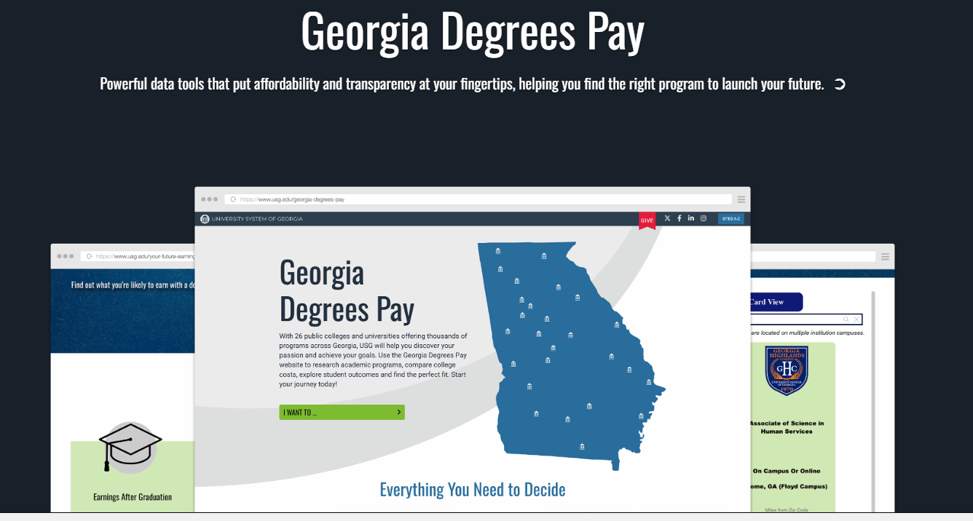
GA Degrees Pay
https://www.usg.edu/georgia-degrees-pay

Slide 41
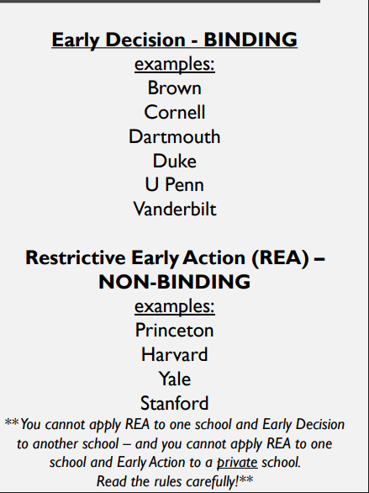
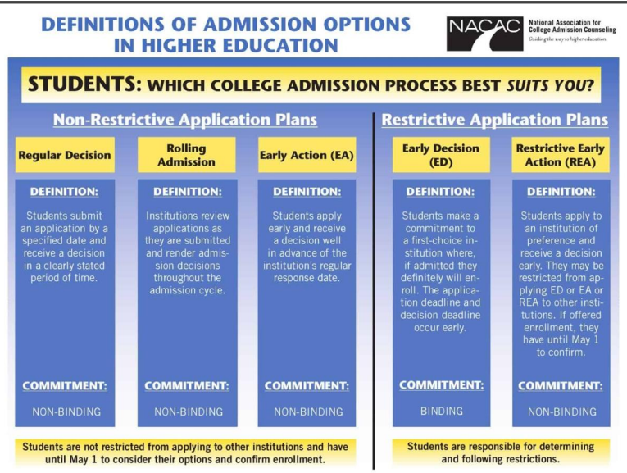
VARIOUS ADMISSIONS OPTIONS

Slide 42

GEORGIA MATCH – GA FUTURES
What is Georgia Match?
GSFC/GAfutures will mail GEORGIA MATCH letters in
October to the current seniors – Class of 2026!
Review the FAQ’s to answer questions and navigate to the GAfutures Student Dashboard to view a PDF of their letter and list of colleges that are on their letter.

Slide 43
College Questions Info Needed for Common App
Total Students in Class of 2026 = 274
Fulton County Schools does NOT report Rank, give percentile, or decile to students, parents or colleges. Choose N/A if asked.
Your Numeric Average is weighted and on a 100-point scale. DO NOT REPORT your GPA to colleges using a 4.0 scale. USE the numeric average listed on your transcript.
We offer 19 Advanced Placement courses and 16 Honors Courses
Only Valedictorian and Salutatorian are reported after 1st semester grades are posted.

Slide 44
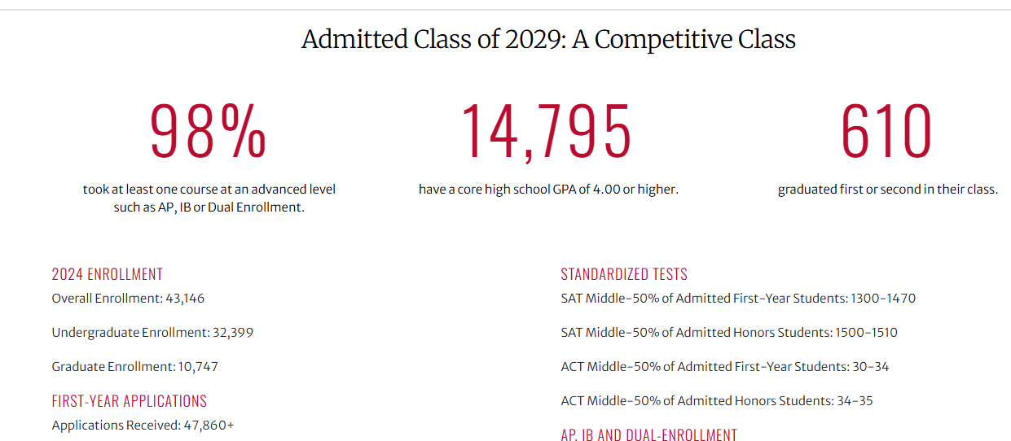
College Freshman Class Profile Ex.

Slide 45



Postsecondary: Colleges Average GPAs for Admissions
College or University | Average GPA & Test Scores
 | GPA: 3.4 SAT: 1060–1250 ACT: 20–26
 | GPA: 4.0+ SAT: 1410–1570 ACT: 32–35
 | GPA: 3.6 SAT: 1080–1340 ACT: 23–31

Slide 46




Postsecondary: Colleges Average GPAs for Admissions
College or University | Average GPA & Test Scores
 | GPA: 3.2 SAT: 1030–1200 ACT: 19–25
 | GPA: 4.0+ SAT: 1410–1570 ACT: 32–35
 | GPA: 3.2 SAT: 900–1050 ACT: 17–20
 | No GPA for Admissions Requirement 2.0 GPA *Test Optional Below 2.0 Placement Scores SAT/ACT or Accuplacer

Slide 47

College and Career Center – E107

Slide 48
College Visits at North Springs
All college visit lists are posted on 10th-12th grade level Canvas page​
Signups for college visits are on School Links app located in ClassLink​
Be sure to sign up at least one day before the college visit.​
Must schedule a SMART Pass in advance to attend​
All college visits are located in the College & Career Center (CCC) located in Room E107

Slide 49
College and Career Center Services
One-on-one college & career counseling meetings
College visits
College application assistance
Job application assistance SAT and ACT testing information and resources
Explore college options
Scholarship assistance
Informational workshops
SAT/ACT Fee Waiver distribution
NCAA Eligibility Center

Slide 50
College and Career Center
Monthly PowerPoint
College and Career Center Information September_2025.pptx

Slide 51
College Fair Preparation Tips
Before the Fair
Research attending colleges and make a list of interests
Prepare questions about majors, campus life, scholarships, etc.
Bring a resume or profile sheet with GPA, test scores, and activities
Register in advance if required (e.g., StriveScan)
Create a professional email address for college communications
During the Fair
Use a map or agenda to prioritize visits
Take notes on impressions and answers
Be open-minded and explore new schools
Ask about financial aid options
Scan QR codes or fill out interest cards

Slide 52
College Fair Preparation Tips
After the Fair
  Organize materials and sort by interest level
  Follow up with admissions reps via email
  Update your college list based on insights
  Start applications using what you learned

Slide 53



UPCOMING COLLEGE FAIRS

Slide 54

GA Probe Fair

Slide 55
On campus college visits
Schedule visits during school breaks when possible.
🗓️ Attend campus tours, info sessions, and meet with admissions.
📸 Take notes and photos to compare schools later.
❓ Prepare questions about academics, housing, and student life.
Attendance Reminder:
📝 Campus visit absences are excused!
📍 Pick up the College Visit Form from Ms. Vega in the Front Office.
📄 Provide documentation from the college (e.g., signed letter or itinerary).

Slide 56
On campus visit – Parent Checklist
Parent Checklist:
✔️ Confirm visit date and time with the college.
✔️ Arrange transportation and accommodations if needed.
✔️ Ensure your student collects the College Visit Form.
✔️ Submit documentation to the school after the visit.
✔️ Discuss impressions and next steps with your student.

Slide 57
Senior Year Prep Tips from GAfutures
Fall Semester
Fall Semester
Create a GAfutures Account: Use it to track HOPE/Zell Miller eligibility, send transcripts, and apply to Georgia colleges.
Check HOPE GPA: Log in to GAfutures.org to monitor your HOPE GPA and ensure you're on track for scholarship eligibility.
Finalize College List: Include in-state and out-of-state options. Use GAfutures’ College Search tool to explore.
Register for SAT/ACT: If not already done, register for fall test dates. Fee waivers may be available.
Request Transcripts: Use GAfutures to send transcripts to Georgia colleges electronically.
Financial Aid & Scholarships
  Complete the FAFSA: Opens in December. Required for HOPE, Zell Miller, and federal aid.
  Apply for Scholarships: Use GAfutures and local scholarship databases. Check with your school counselor for community-based awards.
  HOPE & Zell Miller Scholarships: Understand eligibility requirements and maintain GPA standards.

Slide 58
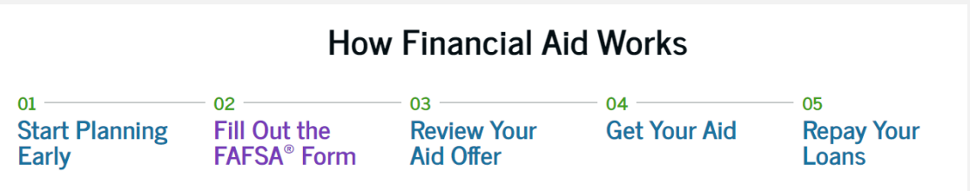
PAYING FOR COLLEGE
First Step is to create an account on studentaid.gov for the 2026 -2027 form.
Anyone who is required to provide info on the FAFSA form needs their own account before accessing
and completing their section of the online form. Best to do this before starting the FAFSA form.
Students are allowed to list up to 20 colleges to receive your information. The order of schools does not matter.
Always check the college Financial Aid webpage for specific guidance for their processes. Some schools require the CSS profile in addition to the FAFSA.
Utilize the net price calculator to get a more accurate calculation of what you may owe in order to
attend.
Save the date – North Springs will host a Financial Aid Night on November 5th, 6:30 – 8:30 pm in the auditorium.

Slide 59
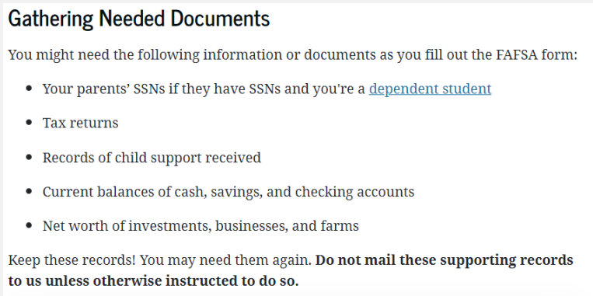
FREE APPLICATION FOR FEDERAL STUDENT AID
FAFSA will open on December 1st this year. This is a FREE form. This is the application students complete to be considered for federal financial aid. Filling out the FAFSA is the only way to apply for federal financial aid.
https://studentaid.gov/apply-for-aid/fafsa/filling-out

Slide 60
SCHOLARSHIPS
Institutional Scholarships - The college may offer scholarships to incoming freshmen based on a given criteria. These can generally be found on the financial aid website for the college/university.
1
Local Scholarships - Provided by local organizations such as employer sponsored scholarships, banks, Boy Scouts, Girl Scouts, church groups, service organizations, etc.
2
National Scholarships - Nation-wide scholarship programs often offer large awards, but they may elicit large numbers of students applying such as Coca Cola, Hispanic Scholarship Fund, Quest Bridge, Gates Foundation, etc.
3
Academic Common Market - Southern Regional Education Board’s (SREB) Academic Common Market has enabled students to pursue out-of-state college degrees at in-state tuition rates, through agreements among the states and colleges and universities. Please click this link for further details on: Academic Common Market Place
4

Slide 61

HOPE AND ZELL MILLER SCHOLARSHIPS
Transcripts are uploaded to Ga Futures in mid-September.
YOU MUST HAVE AN ACTIVE SOCIAL TO CREATE YOUR ACCT
• If you do not see yours, please check your SSN in your profile.
• Please note that only Georgia Student Finance Commission can
calculate HOPE or ZELL GPA, NOT NORTH SPRINGS HS.
• HOPE = Minimum 3.0 GPA + 4 Rigor Course for HOPE – can be
earned once in college as well as right out of HS
• ZELL = Minimum 3.7 GPA +4 Rigor + Test Scores
(HS 1200 SAT min or 26 ACT) submitted to GSFC
• Available to Georgia residents who have demonstrated
academic achievement. Must meet US citizenship or eligible
non-citizen requirements
• An application must be submitted prior to graduation. Either
the FAFSA or the GSFAPP will enter a student into
consideration.
• FINAL transcripts are uploaded the first week of June to GSFC
and the college handles it from there.

Slide 62
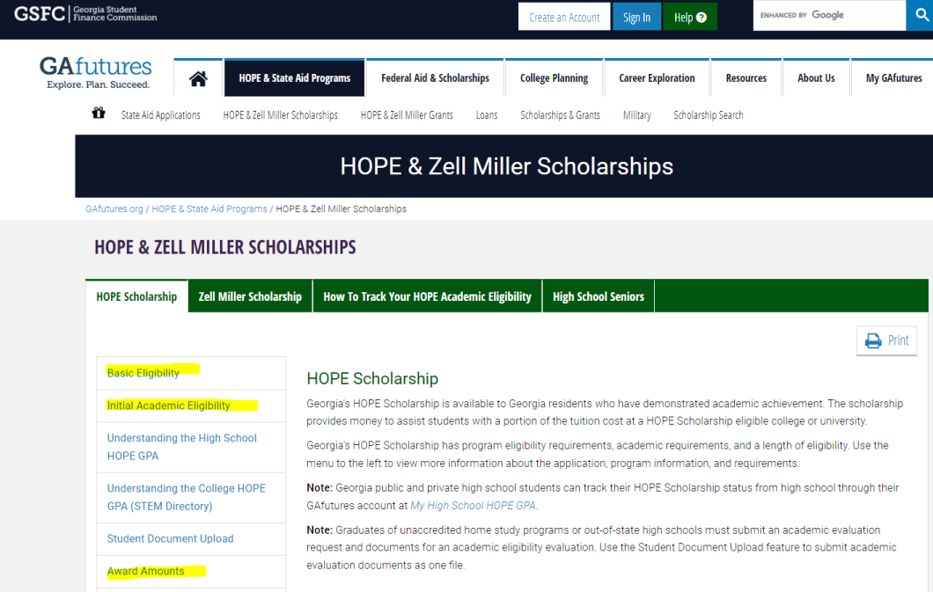
HOPE AND ZELL SCHOLARSHIPS

Slide 63
Scholarship Sites
BigFuture by College Board
GAfutures
Fastweb
Scholarships.com
Going Merry
JLV College Counseling
School Links
Thurgood Marshall College Fund
United Negro College Fund
Bold.org
HBCU Connect Scholarship Directory
HBCU Buzz Scholarship Guide

Slide 64
HOPE RIGOR REQUIREMENTS
To qualify for the HOPE Scholarship, students must complete at least four rigor-designated courses.
Rigor courses include advanced math, science, foreign language, and AP/IB/Dual Enrollment courses.
These courses are intended to ensure students are academically prepared for college-level work.
Students and parents can view the full list of HOPE Rigor courses on GAfutures.
View HOPE Rigor Course List: https://www.gafutures.org/hope/state-scholarships-and-grants/hope-rigor-requirements/

Slide 65
UPCOMING SAVE THE DATES
Senior Status Check Meetings – begin 8/25 –check school email for invitations with your counselor
9/24 – Counselor Chat @ 12pm on Teams
10/7- Combined College Fair @ Riverwoods HS 10-7 @ 6-8PM
11/3 – 11/7 – Apply to College Week
11/5 – FAFSA Night 6:30 – 8:30 pm in Auditorium
11/6 – Apply to College Day Fair

Slide 66

Infinite Scholars College and Scholarship Fair

Slide 67


Mental Health Supports
Calm Room – used for students who may need a short break
CHRIS 180 – school-based therapists – support students who may have social, emotional and or behavioral challenges
  Students must be referred for therapy
Small Groups – based on specific topics
Wellness Events and Activities – sponsored by the Link
Classlink app:

Slide 68
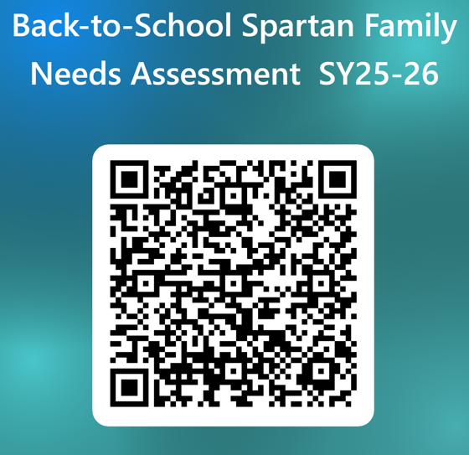
The Link Needs Assessment Survey

Slide 69

Connect with Us
Social media – X - @counselorsNSHS
IG – northspringshighschoolcounseling
Band – QR Code
Book an appointment or send an email
We look forward to connecting with you.

