Slide 1


Sophomore/Junior
Parent Night
Notes:
Mohn

Slide 2
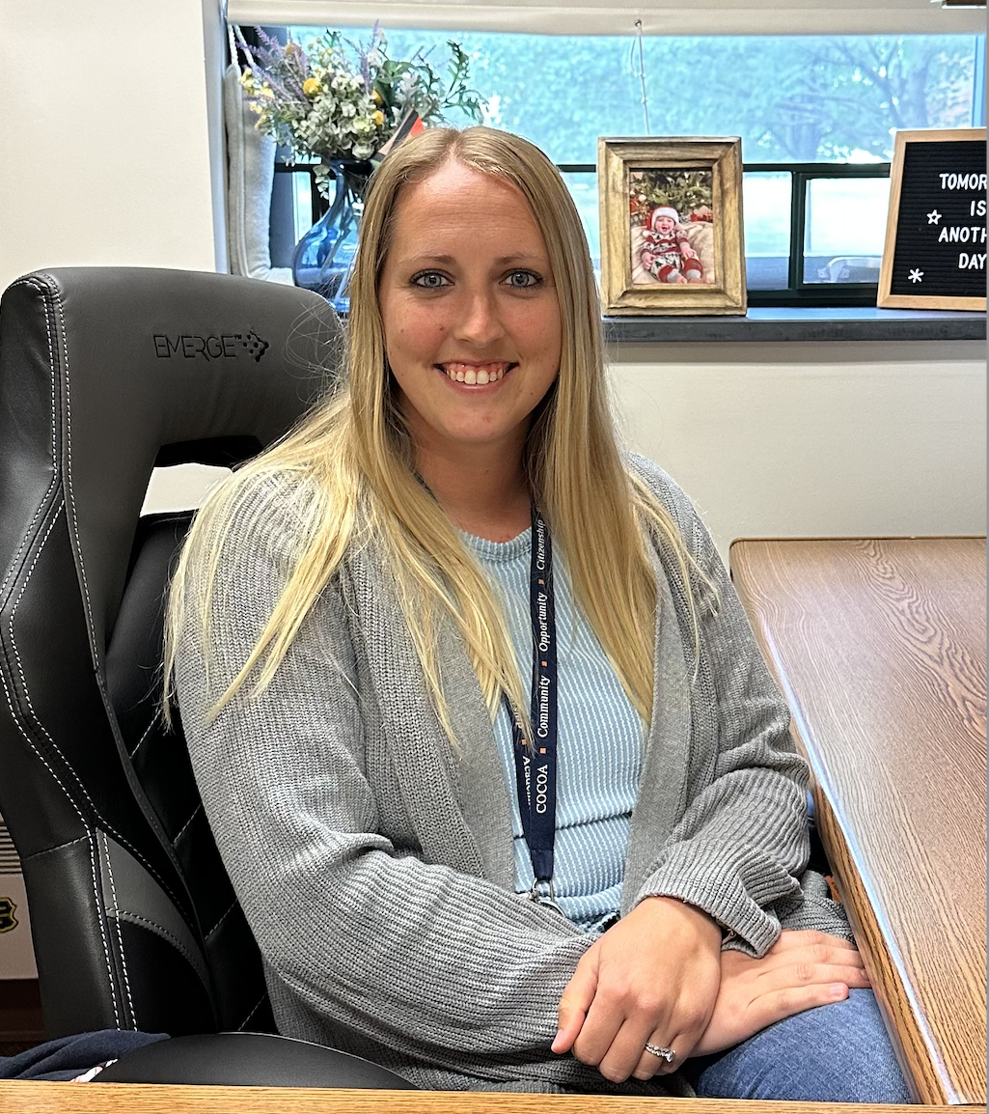
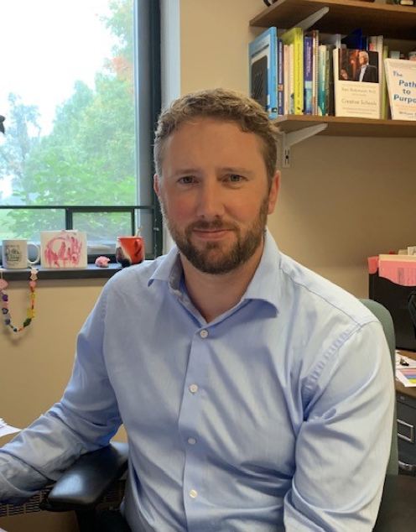
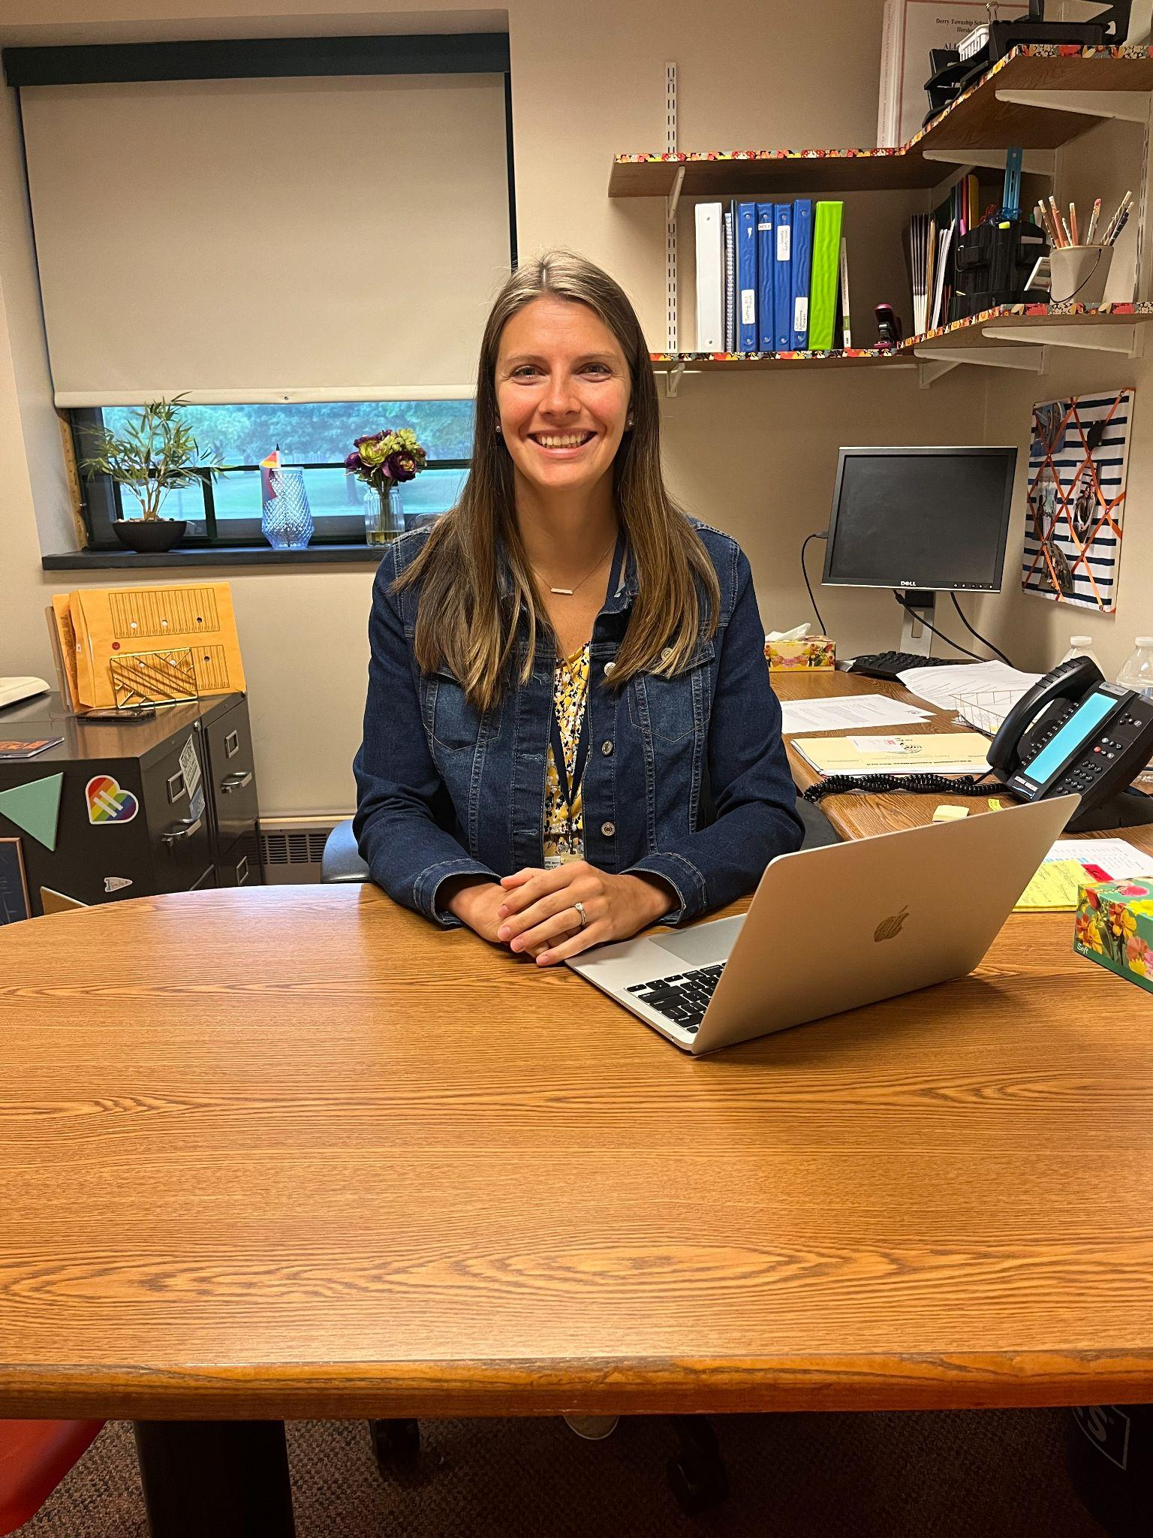
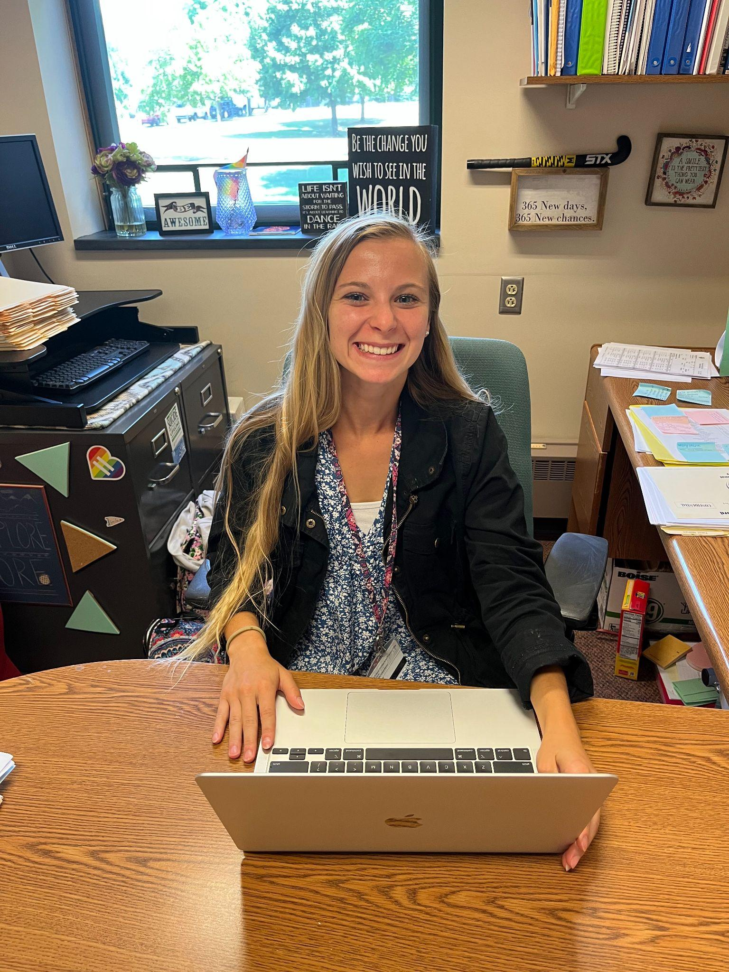
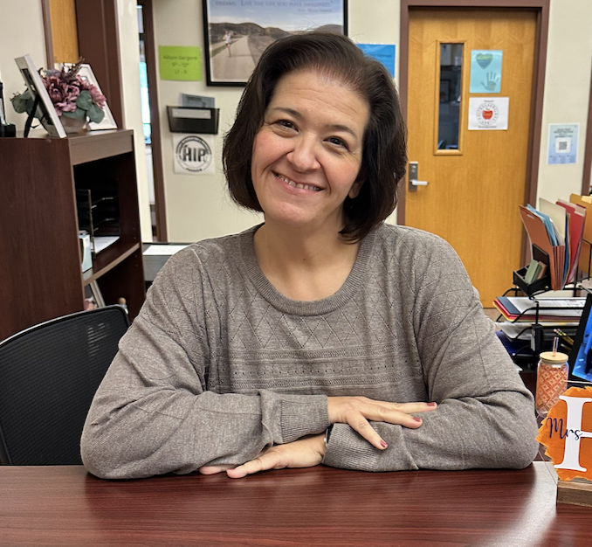
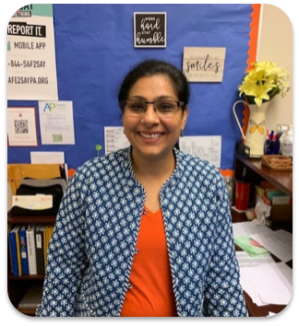
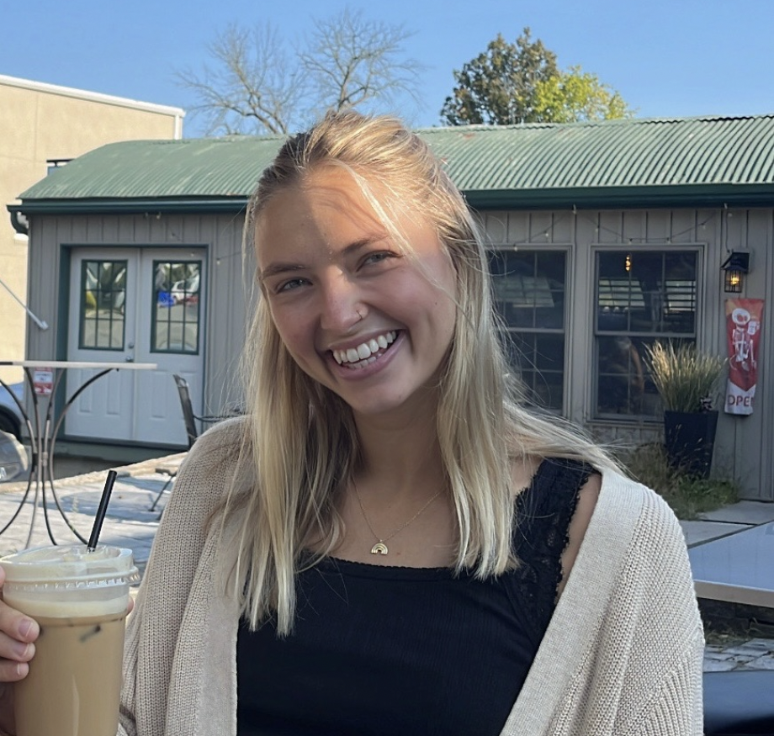
Mrs. Mohn
A - D
Mr. Hensel
E - Le
Mrs. Gergenti
Lf - R
Mrs. Patchen
S - Z
Mrs. Shipper
Administrative Assistant
Mrs. Malik
Administrative Assistant
Ms. Pierson
School Counseling Intern
Notes:
Mohn

Slide 3

Graduation Requirements & Pathways
Graduation Requirements | Pathways Requirements
Successful completion of 25 credits distributed as follows: 4 credits in English 3 credits in Science (Biology, Chemistry, & Physics) 3 credits in Mathematics 3 credits in social studies (American History, World History, & Civics) 1.5 credits in Health, Physical Education, & Highway Safety .5 credits in Personal Financial Literacy Enrollment in Freshman Seminar 2 credits in any combination of Arts, Humanities, Music, World Language 8.5 credits in any electives | Act 158 in Pennsylvania requires all students to meet an identified pathway in order to graduate: Successful completion of Algebra 1, Biology, and English 10 (Literature) Keystone Proficiency on Algebra 1, Biology, and Literature exams If your student does not meet the above pathway requirements, your student’s school counselor will work with them individually to identify an alternate pathway to meet Pennsylvania’s graduation requirement.
Notes:
Mohn

Slide 4
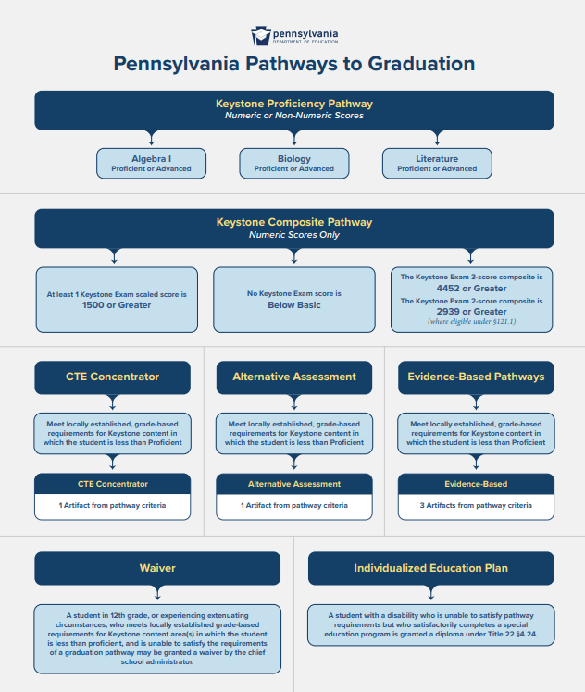
Act 158: Graduation Requirements and Keystone Exams
5 Pathways to Graduation
Keystone Proficiency Pathway
Keystone Composite Pathway
Alternate Assessment Pathway
Evidence-Based Pathway
CTE Pathway
More information can be found on the Pennsylvania Department of Education’s Website.
Notes:
Mohn

Slide 5
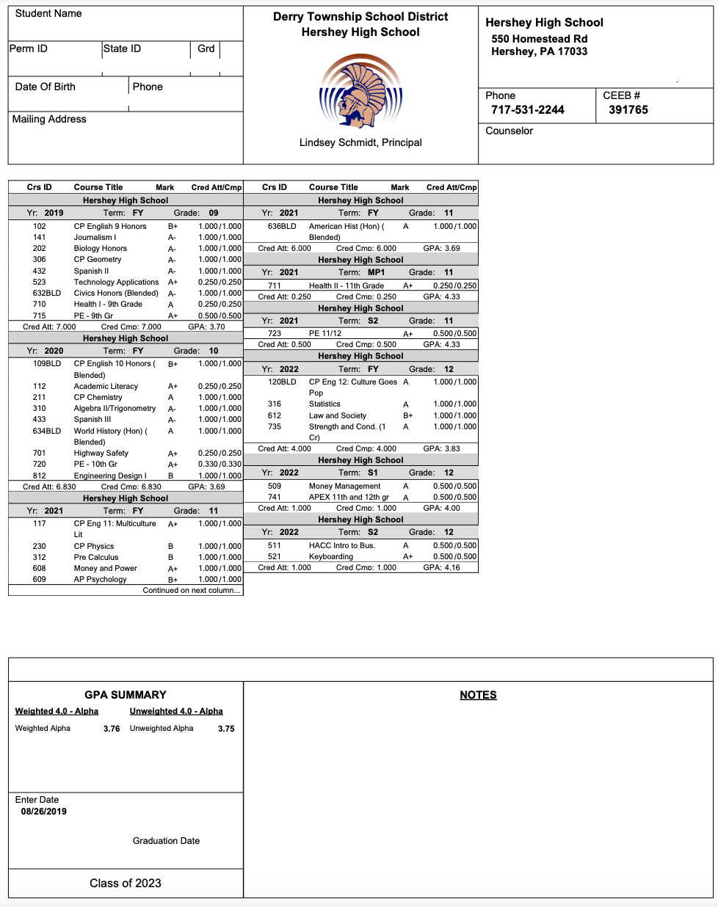
Transcript
Official Record of High School Work
Transcript begins in 9th grade
Cumulative throughout 12th grade
Included on the Transcript:
  Demographic Information
  All courses, final averages, credit earned
  Weighted and Unweighted GPA
Notes:
Hensel

Slide 6

Goals for Sophomore and Junior Year
Achieve academically
Take appropriate standardized tests
Participate in extracurricular activities
Conduct career/college searches
Continue with self-awareness and identifying personal strengths
Attend college fairs/visit colleges
Continue to take rigorous courses
Enjoy the high school experience!
Notes:
Hensel

Slide 7
Counselor Meetings & Presentations
November
Junior classroom presentations regarding career exploration day
December
Junior Career Exploration Day
February → March
Sophomores will be meeting individually with their counselors to review current progress and post-secondary plans
March
10th grade career lesson in classrooms
11th grade post-secondary lesson in classrooms
March → May
Juniors will be meeting individually with their counselors to review plans for senior year, senior timeline, etc.
Notes:
Hensel

Slide 8

Post-Secondary Planning
Post-Secondary options can include:
2 year college
4 year college
Trade or Technical school
Apprenticeship
Military
Employment
Gap Year
Notes:
Hensel

Slide 9
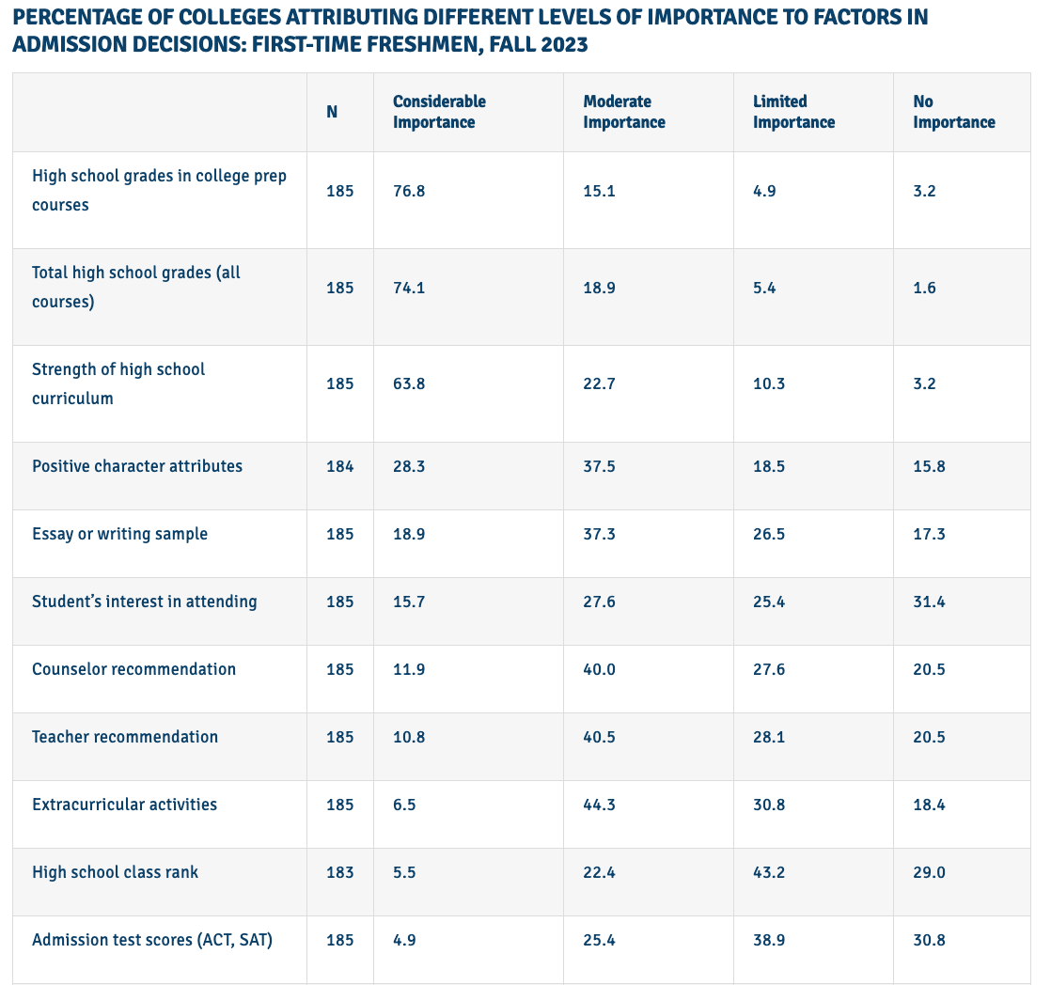
www.nacacnet.org
Notes:
Hensel

Slide 10
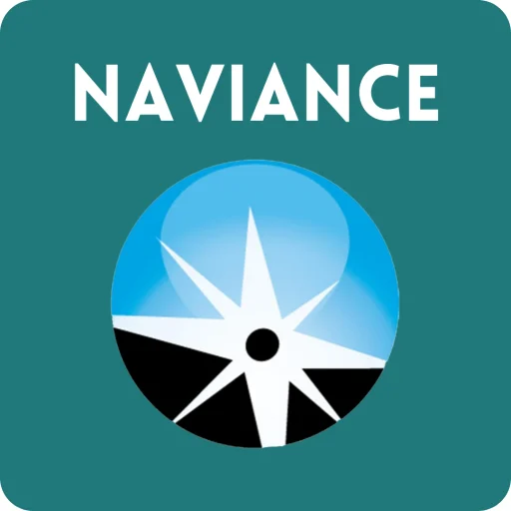
Naviance Student
Computer-based program used to assist students in post-secondary planning
Includes:
  Student access through Clever (already on students
IPAD’s)
  Used each year to help students research potential careers/colleges/post-secondary plans
  Resume builder
  Career and Personality Inventories/assessments
  Scattergrams with individual GPA & test scores
Notes:
Gergenti

Slide 11
Topics Covered in Classroom & Individual Meetings
10th Grade
“Soft Skills to Pay the Bills” - interpersonal skills for the workplace
  Career Jenga: Interview questions
Course Selection
  Interests aligning with elective options
11th Grade
Post-Secondary options and planning
Career Exploration Day in December
ASVAB Information
Course Selection
  Interests aligning with elective options
Notes:
Gergenti

Slide 12

Armed Services Vocational Aptitude Battery (ASVAB)
The Armed Services Vocational Aptitude Battery (ASVAB) is a test that measures skills and strengths in areas like math, English, mechanical comprehension, and electronics.
ASVAB Career Exploration Program (CEP): The CEP helps students identify their skills and interests, explore career pathways, and make a plan for their future. The program encourages students to explore all the pathways they can take to reach their career goals, including education, credentialing, licensure and apprenticeship programs, and the military.
The ASVAB is an excellent tool for students who are not sure of their plans after graduation. Scores and results are not shared with the military unless the student chooses to share them.
Notes:
Gergenti

Slide 13
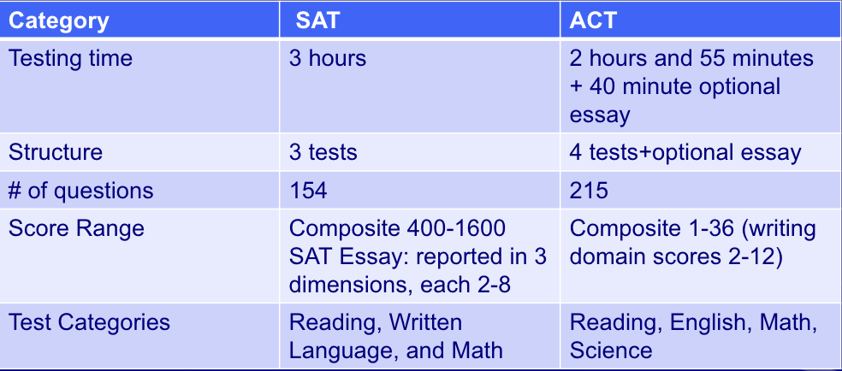
SAT vs. ACT
For more information:
SAT: www.collegeboard.com
ACT: www.act.org
Notes:
Gergenti

Slide 14

Test Optional
If a college or university has a test-optional policy, they do not require students to submit their SAT or ACT scores. Students can choose if they would like to submit their standardized test scores or not.
*For more information and to see a current list of colleges with a test-optional policy, please visit www.fairtest.org
Notes:
Gergenti

Slide 15
Assessment Information
Assessment | Dates
SAT collegeboard.org | August, October, November, December, March, May, June
ACT (not offered at HHS) act.org | September, October, December, February, April, June, July
PSAT | October
ASVAB | Early November
AP | May
Notes:
Patchen

Slide 16

Scholarships
Students can create a free account through Going Merry and have access to thousands of local and national level scholarships! All grade levels are eligible to apply to scholarships, and Going Merry will match you with scholarships based on your eligibility.
Notes:
Patchen

Slide 17

NCAA Eligibility Center
Division 1 or 2 prospective athletes - visit the NCAA Eligibility Center: https://web3.ncaa.org/ecwr3/
Review academic eligibility requirements
Create NCAA eligibility center account
Submit transcript to NCAA eligibility center by the end of junior year
NCAA Lunch & Learns will be held in February during course selection
Notes:
Patchen

Slide 18


Resources to Support Students
Academic Concerns:
  Student VUE (updated every 2 weeks)
  Contact the teacher
  National Honor Society Tutoring
  Academic Literacy
Personal/Social Concerns:
  Contact the school counselor
  Hershey Intervention & Prevention Program (HIP)
    School Based Outpatient Therapy
    Care Solace
  Link Crew Mentors
Available once the SY begins.
Notes:
Patchen

Slide 19
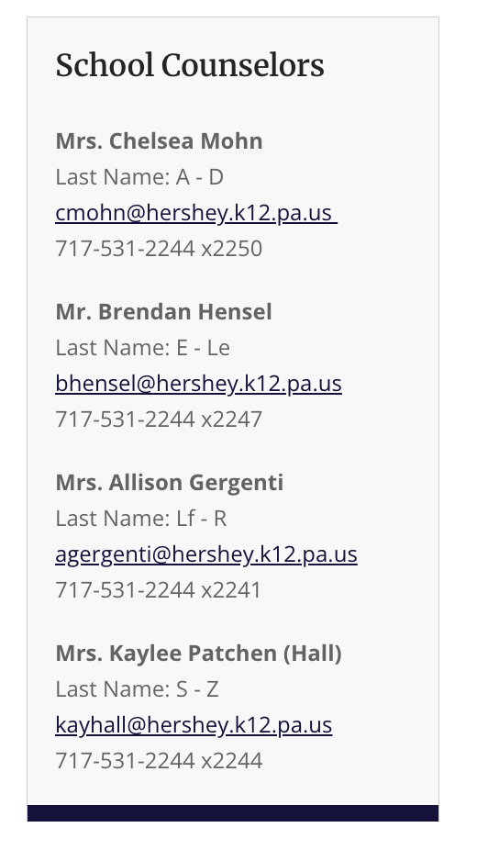
Thank you for attending!
Notes:
Patchen

