Slide 1

Freshmen Parent/Guardian
Night
Hershey High School
Notes:
Hensel

Slide 2
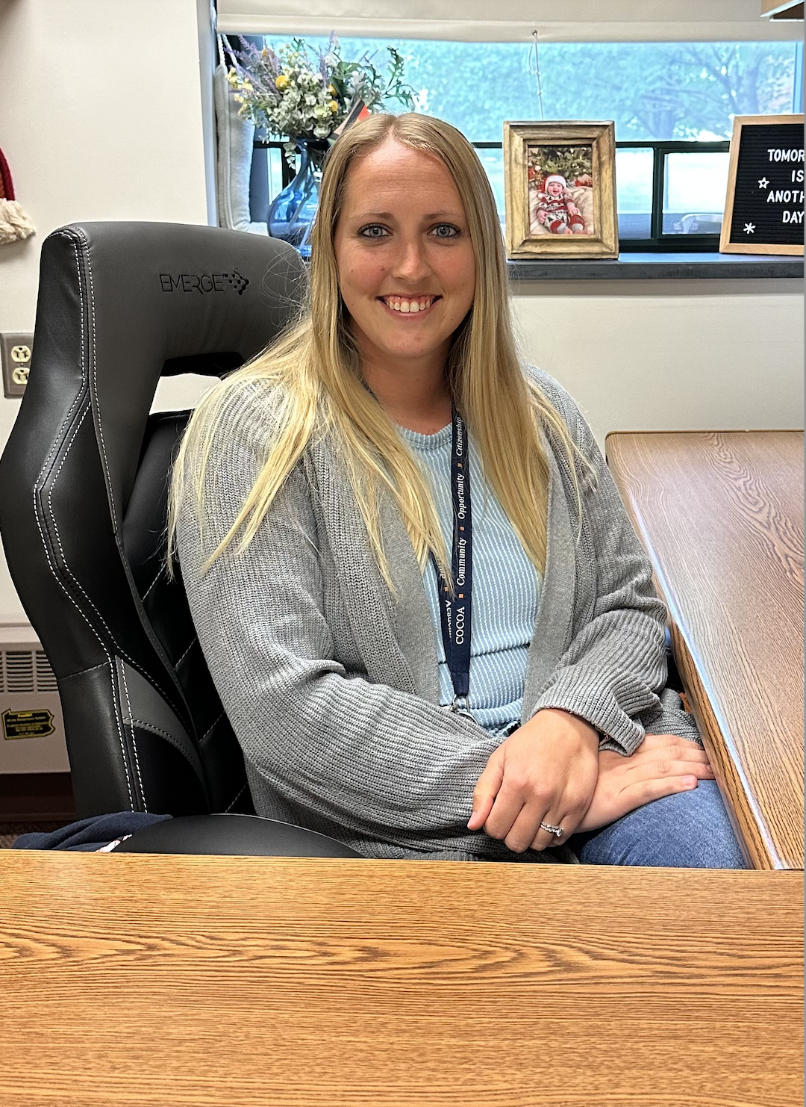
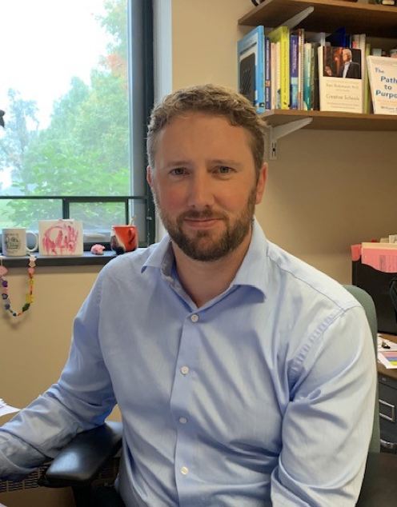
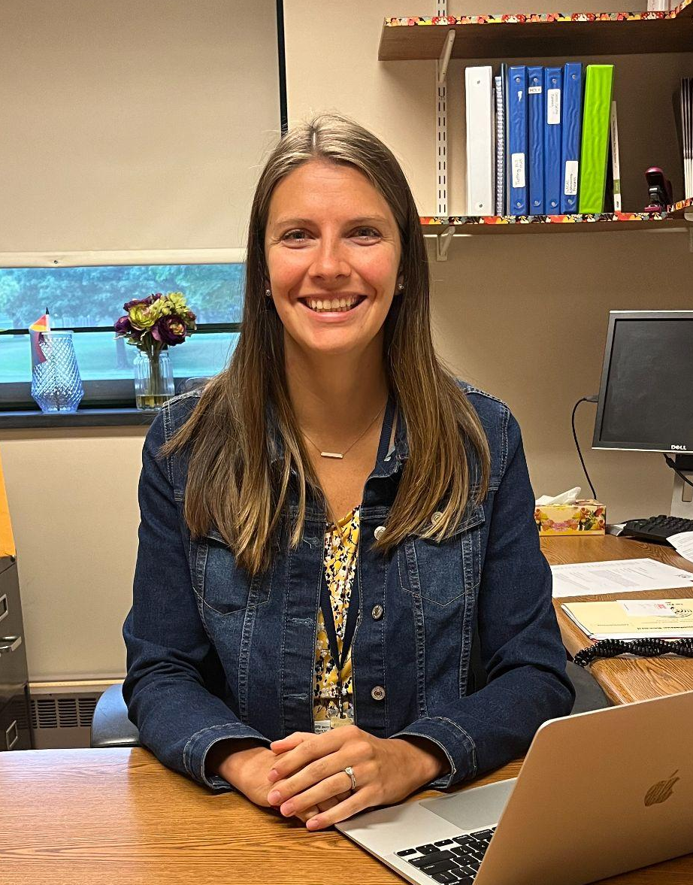
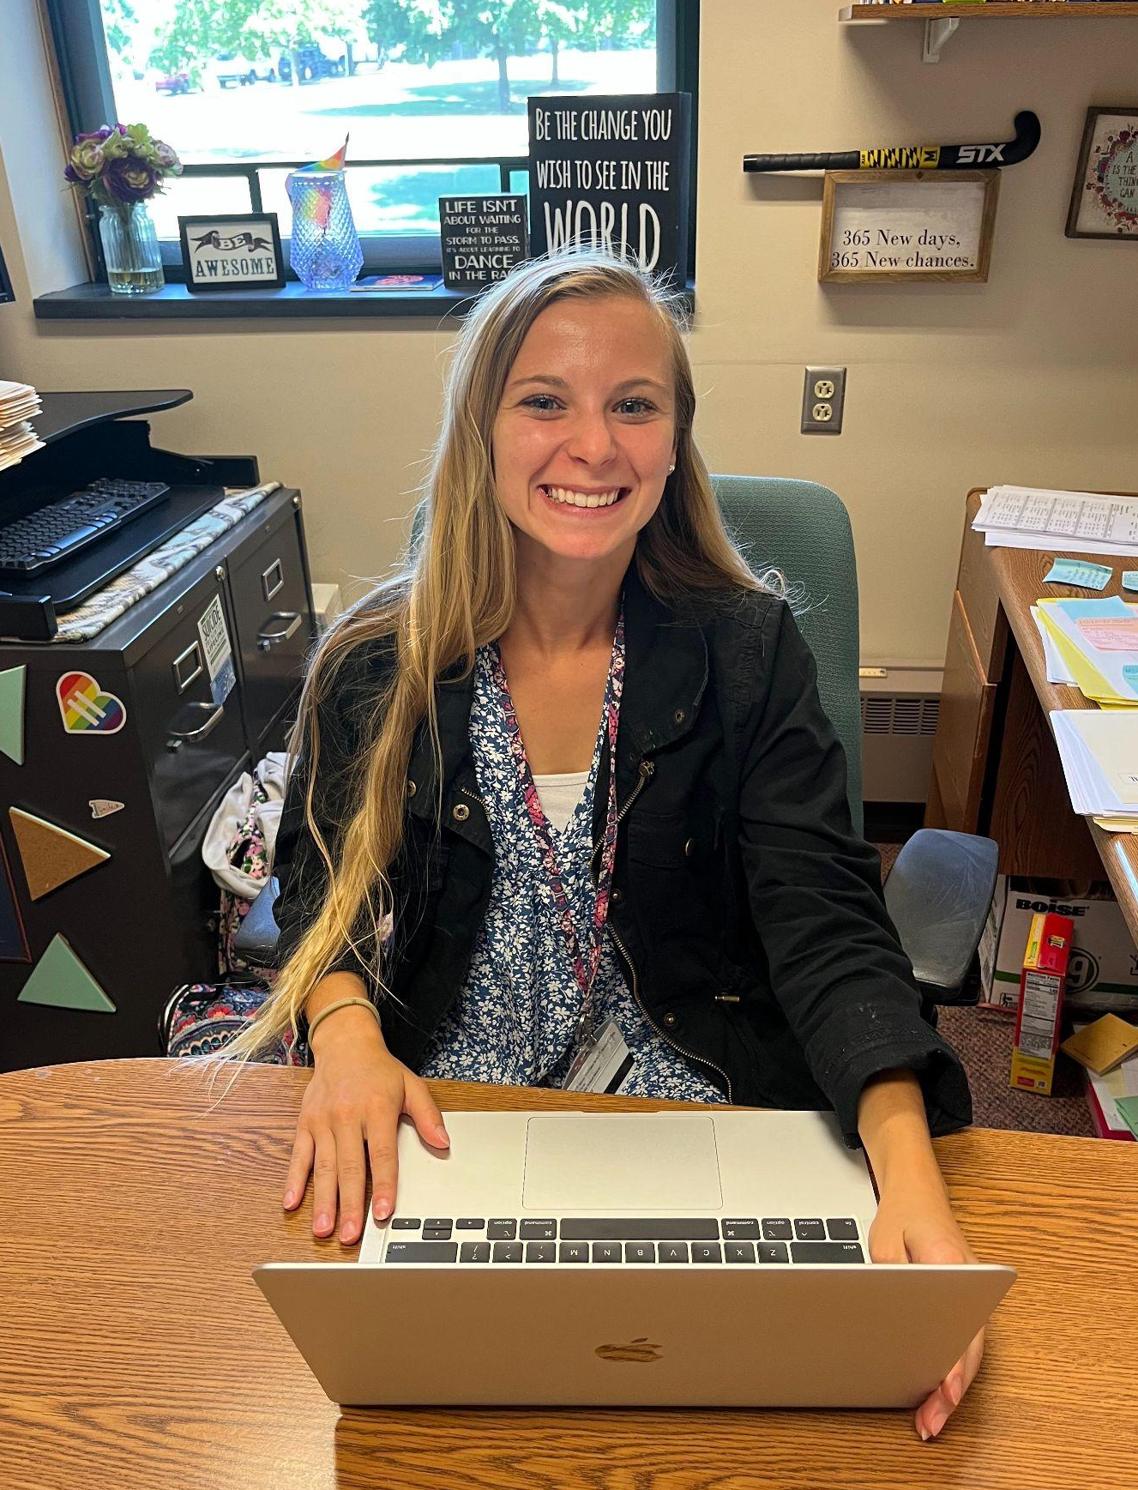
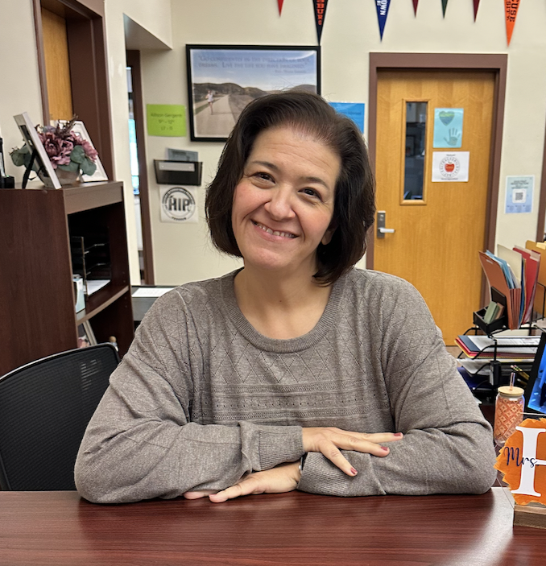
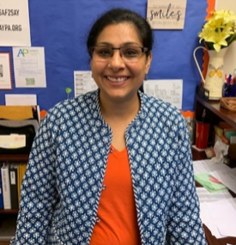
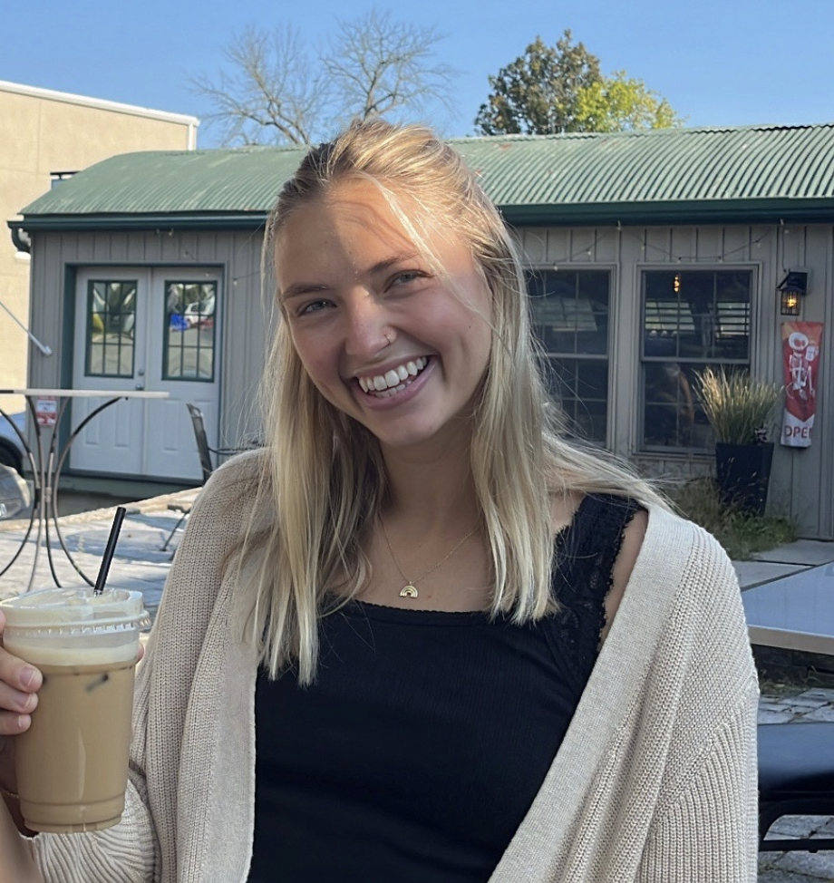
Counseling Office
Mrs. Mohn
A - D
Mr. Hensel
E - Le
Mrs. Gergenti
Lf - R
Mrs. Patchen
S - Z
Mrs. Shipper
Administrative Assistant
Mrs. Malik
Administrative Assistant
Ms. Pierson
School Counseling Intern
Notes:
Hensel

Slide 3

The School
Counselor's Role
Notes:
Hensel

Slide 4
Transition to High School
Characteristics of a Successful Learner
Effective Time Management
Organization skills
Persistence & Resilience
Strong communication skills & ability to collaborate
Differences from MS to HS
More freedom = more responsibility
Ability to self-advocate and accountability
No retakes
New opportunities for students, being willing to try new things. (Safe risks)
Notes:
Hensel

Slide 5
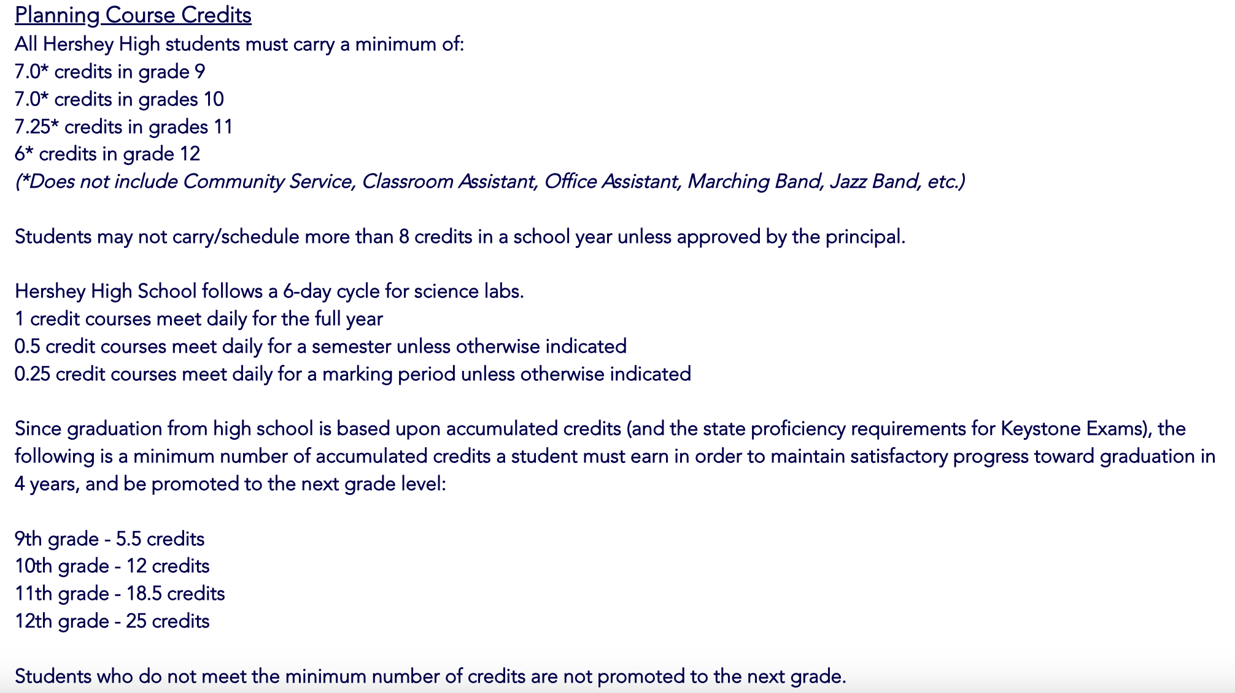
Credit Requirements
Notes:
Hensel

Slide 6
Graduation Requirements & Pathways
Graduation Requirements | Pathways Requirements
Successful completion of 25 credits distributed as follows: 4 credits in English 3 credits in Science (Biology, Chemistry, & Physics) 3 credits in Mathematics 3 credits in social studies (American History, World History, & Civics) 1.5 credits in Health, Physical Education, & Highway Safety .5 credits in Personal Financial Literacy Enrollment in Freshman Seminar 2 credits in any combination of Arts, Humanities, Music, World Language 8.5 credits in any electives | Act 158 in Pennsylvania requires all students to meet an identified pathway in order to graduate: Successful completion of Algebra 1, Biology, and English 10 (Literature) Keystone Proficiency on Algebra 1, Biology, and Literature exams If your student does not meet the above pathway requirements, your student’s school counselor will work with them individually to identify an alternate pathway to meet Pennsylvania’s graduation requirement.
Notes:
Mohn

Slide 7
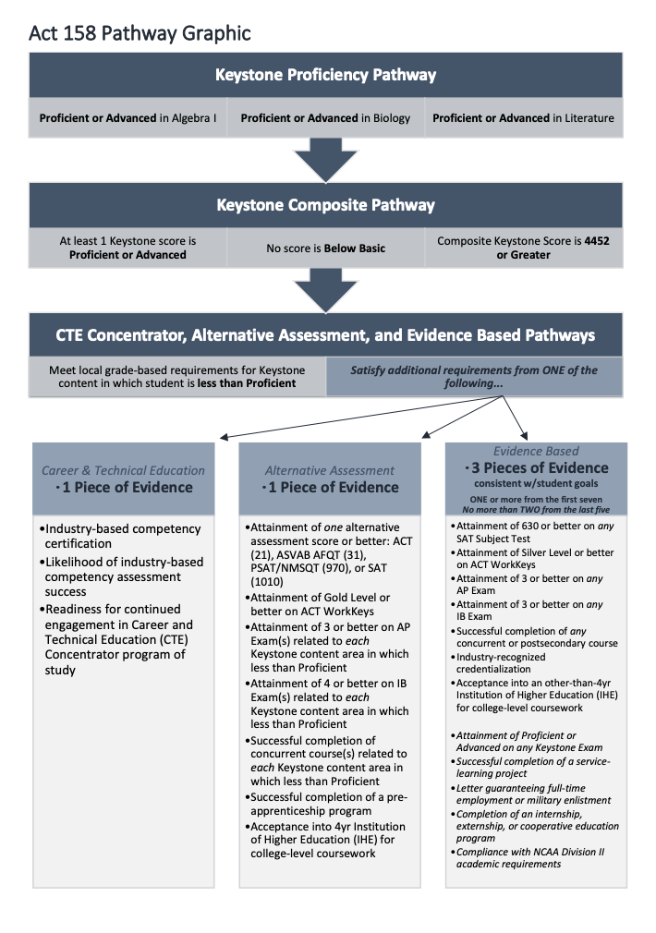
Pathways to Graduation
*more information will be shared and posted to the HHS Counseling Website
Notes:
Mohn

Slide 8
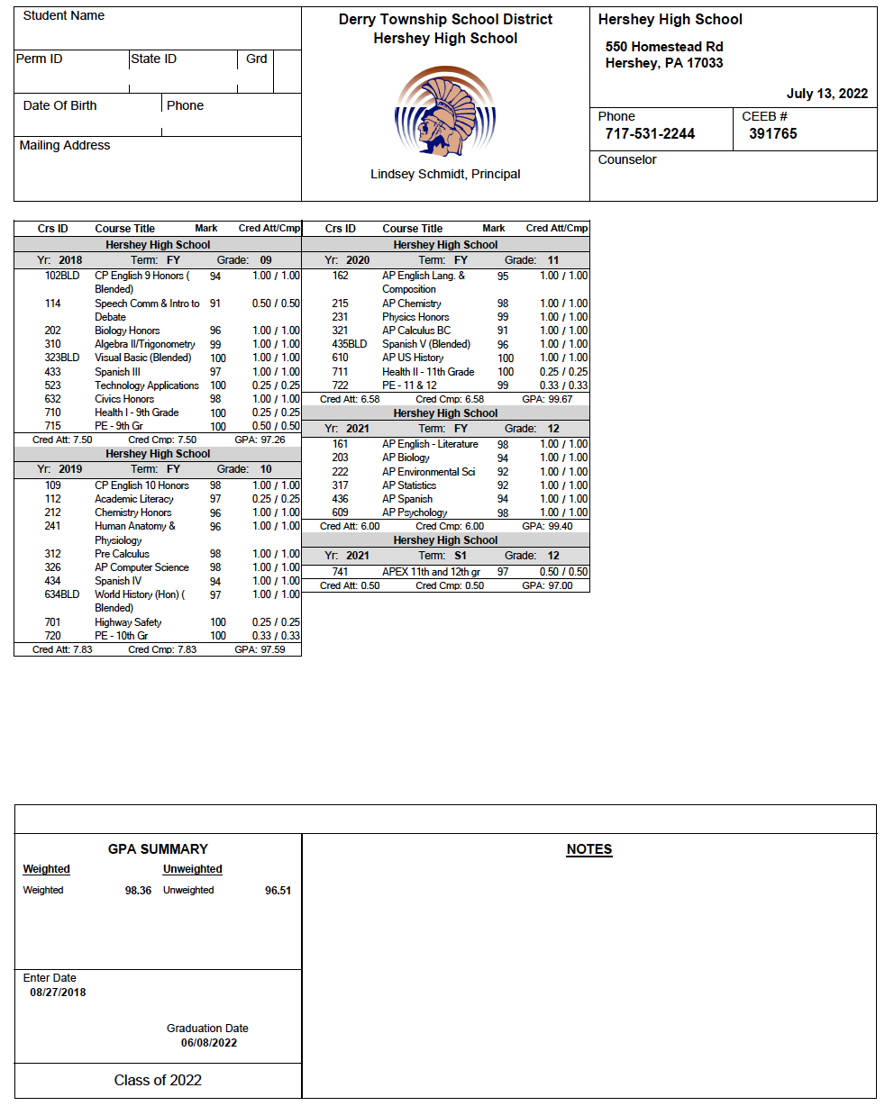
Transcript
Official Record of High School Work
Transcript begins in 9th grade
Cumulative throughout 12th grade
Included on the Transcript:
  Demographic Information
  All courses, final averages, credit earned
  Weighted and Unweighted GPA
Notes:
Mohn

Slide 9
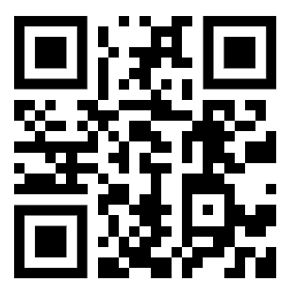
Grading & Resources
Monitor academic progress
  Student VUE & Parent VUE
  Canvas
Final Averages
  Year-long course: Each MP is 2/9 of the final grade
  Semester course: Each MP is 4/9 of the final grade
  Final exams: 1/9 of the final grade
  AP classes are weighted at 1.05
Encourage your student to do their best & select meaningful activities
Contact the teacher if you have specific questions or concerns regarding your student’s academic progress
ParentVue
Setup Directions
Notes:
Mohn

Slide 10

National Honor Society Tutoring
Students can scan the QR code if they are in need of a tutor in any of their classes. A National Honor Society member will reach out to them to arrange a time and a place for tutoring.
If you have any questions or concerns, please feel free to contact the advisors:
Math: Dr. Kirby or Mrs. Barto
Non Math: Mrs. Stuckey
Available once the SY begins.
Notes:
Gergenti

Slide 11

Smart Futures
K-12 career exploration program SmartFutures
8 artifacts must be completed prior to March of Junior Year.
Notes:
Gergenti

Slide 12
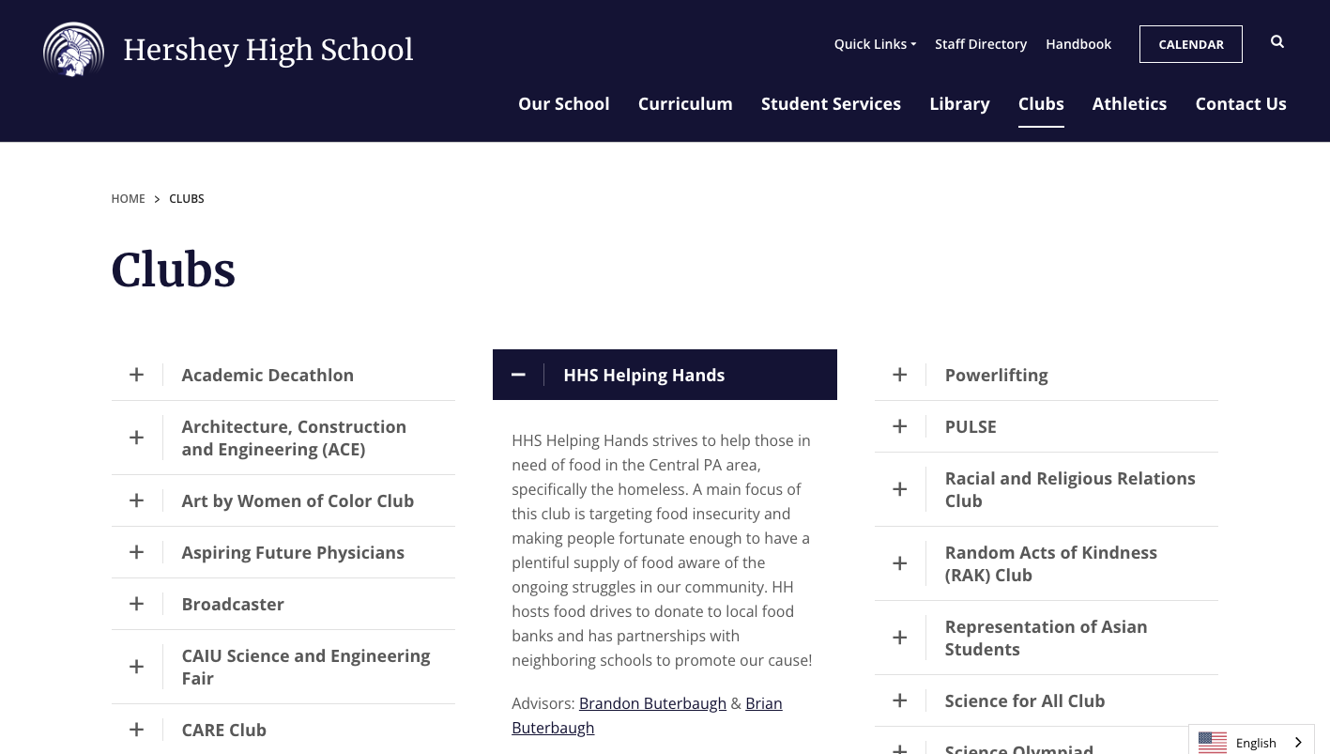
Extracurricular Activities
Athletics, Music, Musical/Drama, Clubs/Organizations, Community Service, and more!
See HHS website for a list of all extracurricular activities!
Notes:
Gergenti

Slide 13
A Look Ahead – Testing Timeline
Keystone Exams
Spring 2025
A requirement for graduation
PSAT
Grades 10 & 11 (*October)
SAT
Grades 11 & 12 (August, *October, November, *December, *March, May, *June)
ACT
Grades 11 & 12 (non-HHS sites)
ASVAB
Grades 10-12 (*November)
*can be taken at HHS
Notes:
Gergenti

Slide 14
A Look Ahead: Post-Secondary
Our role is in helping students understand the relationship between academics and their future goals!
What Post-Secondary Institutions Are Looking For:
A rigorous high school curriculum
Grades that represent strong effort and an upward trend.
Passionate involvement in a few activities
  Demonstrating leadership and initiative.
Out of school experiences
  Work, community service, etc.
An understanding of standardized tests. (SAT, ACT, Test Optional)
Post-Secondary Options
Four-year colleges and universities
Two-year community colleges or junior colleges
Business schools
Technical schools
Military
Employment
Notes:
Patchen

Slide 15

A Look Ahead:
College Athletics & NCAA Eligibility
To be eligible to play a Division I or II sport at the college level, a student must meet the NCAA eligibility requirements.
The eligibility requirements can be found on the NCAA Eligibility Center website : http://www.ncaa.org/student-athletes/future
It’s important to review the requirements now to ensure that a student is taking the necessary courses within the stated timeline.
Notes:
Patchen

Slide 16
Communication:
How to keep up with what’s happening
Morning Bulletins – high school webpage:
  Quick Links – Morning Announcements
District Website
  District Calendar
Counselor Newsletters
  Fall & Spring
District Facebook Page: Derry Township School District
Notes:
Patchen

Slide 17
Resources
For Students & Parents
Hershey Intervention & Prevention Program
Student VUE & Parent VUE
Naviance Student
Smart Futures
NHS Tutors
School Counseling Website
Teachers
School Counselor
School Nurse
Social Worker
School Resource Officer
Intervention Specialist Coordinator
Instructional Coaches
Notes:
Patchen

Slide 18

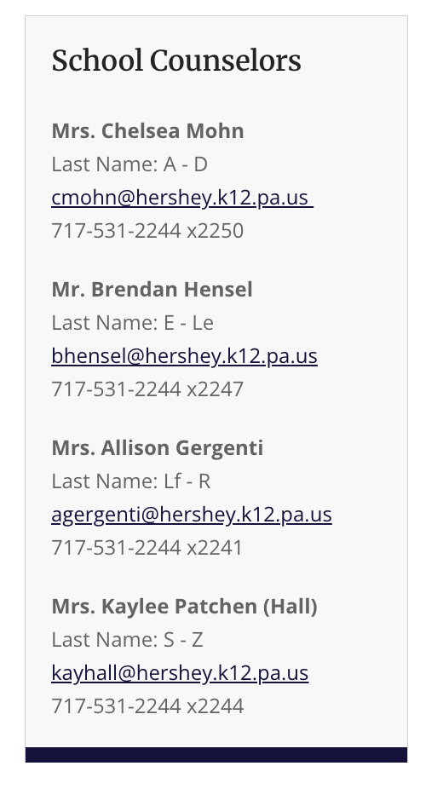
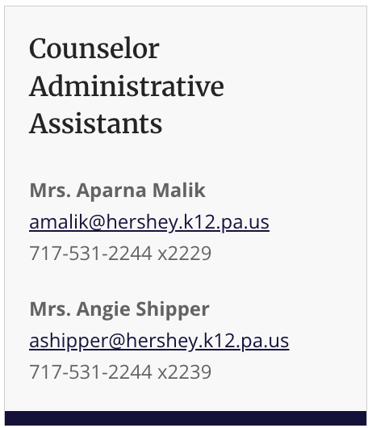
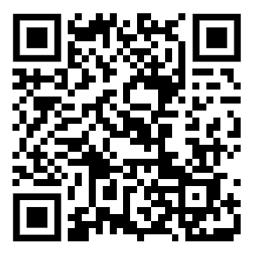
HHS Counseling Office
Contact information
HHS Counselor Website
Notes:
Patchen

