Slide 1


2025-2026 School Suicide Prevention

Slide 2
Kentucky Schools: Comprehensive Approach to Preventing and Addressing Suicide
Schools play a crucial role in students' mental health and well-being, necessitating robust suicide prevention efforts. Key reasons include:
1. Students spend a significant amount of their day at school interacting with staff. Because of these interactions, trained staff may detect signs of distress. Comprehensive strategies create supportive atmospheres that encourage students to seek help.
2. Adolescence is a period of intense emotional growth, increasing vulnerability to stressors such as academic pressure and bullying and heightening suicide risks. Effective prevention includes mental health education, counseling, and crisis support.
3. Addressing suicide requires collaboration among educators, mental health professionals, parents, and students to normalize discussions about mental health and reduce stigma. Essential staff training on recognizing warning signs is crucial.
By prioritizing students' well-being and implementing evidence-based strategies, schools can play a significant role in preventing suicide and promoting mental wellness.

Slide 3

Educators and School Staff Play A Key Role
Why is promoting mental health and well being for students important?
Research shows that students who receive social-emotional, mental, and behavioral health support are more successful academically.
Improves school climate.
Classroom behavior and focus improves when emotional and mental health needs are addressed.
Students become more engaged in learning.
Students experience an increased sense of connectedness and well-being.

Slide 4

Educators and School Staff Play A Key Role
What can educators do in the classroom and schools to support student mental health?
Educate staff, parents, and students on symptoms of and help for mental health problems.
Promote social and emotional competency and build resilience.
Help ensure a positive, safe school environment.
Teach and reinforce positive behaviors and decision-making.
Encourage helping others and good physical health.
Help ensure access to school-based mental health supports.

Slide 5
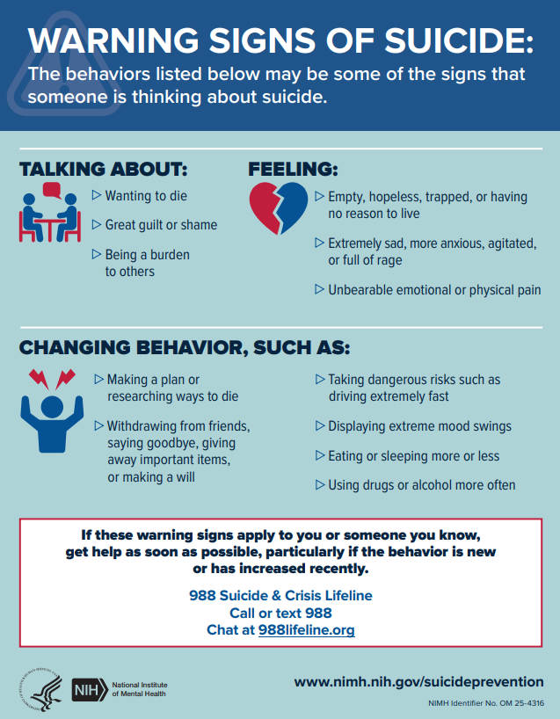
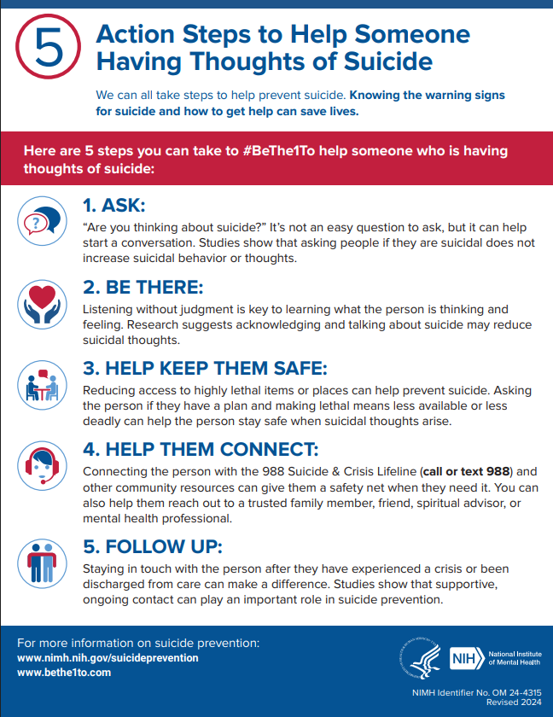
Handout

Slide 6
1. Language Matters – How to Talk About Mental Health and Suicide
2. Assessing Suicide Prevention Efforts – Best Practices for School Suicide Prevention Policies and Procedures
3. Evidence-Based Suicide Prevention for Staff
4. Evidence –Based Suicide Prevention for Students

Slide 7


Slide 8
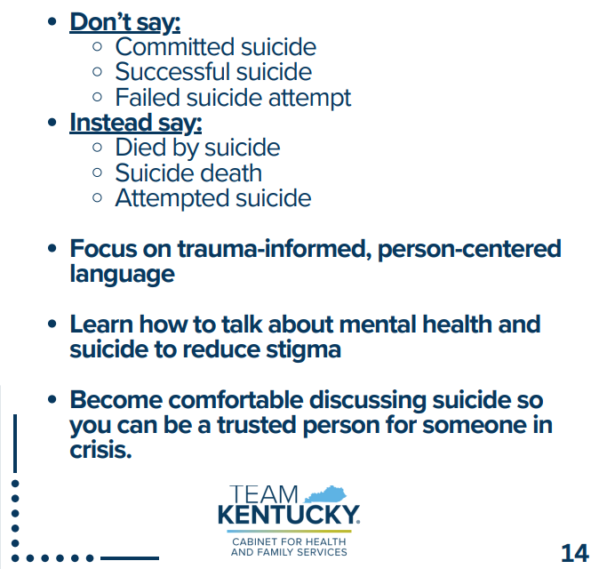
Language Matters

Slide 9
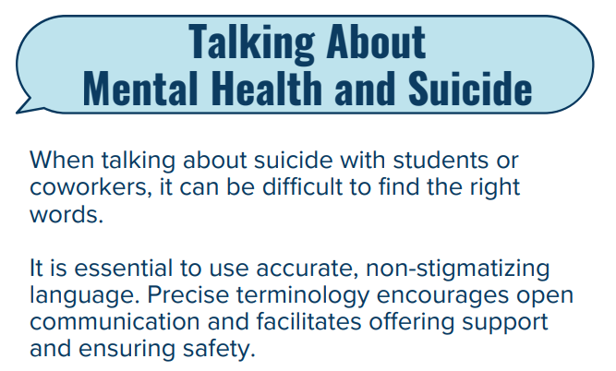

Language Matters

Slide 10
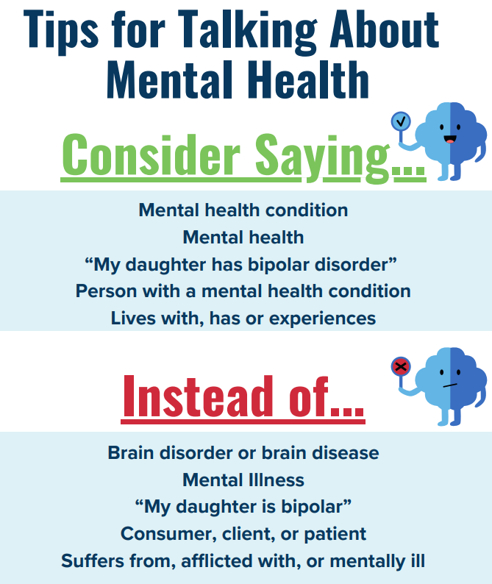
Language Matters

Slide 11
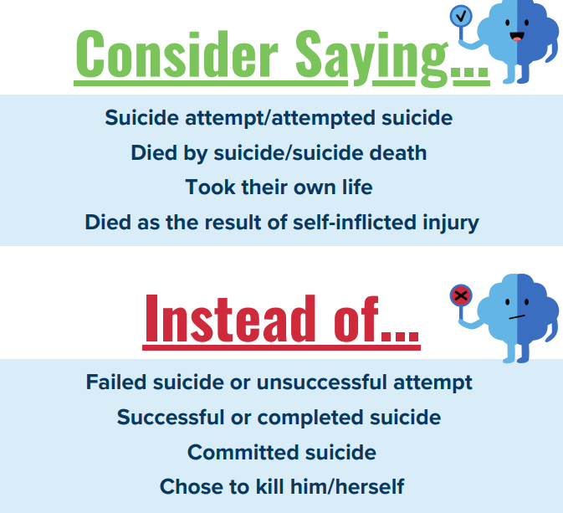
Language Matters

Slide 12
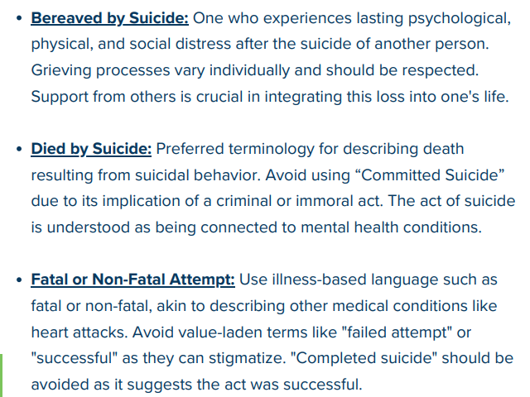
Language Matters
When someone dies by suicide, we often don't know how to talk about it or the words to use to address it. Use the language below when addressing suicide.

Slide 13
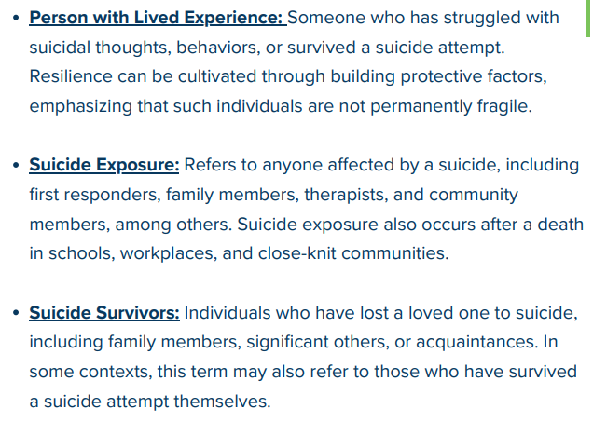
Language Matters
When someone dies by suicide, we often don't know how to talk about it or the words to use to address it. Use the language below when addressing suicide.

Slide 14
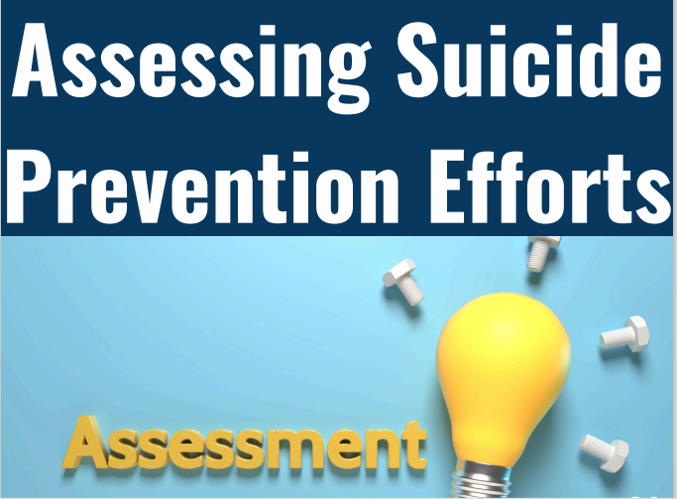

Slide 15
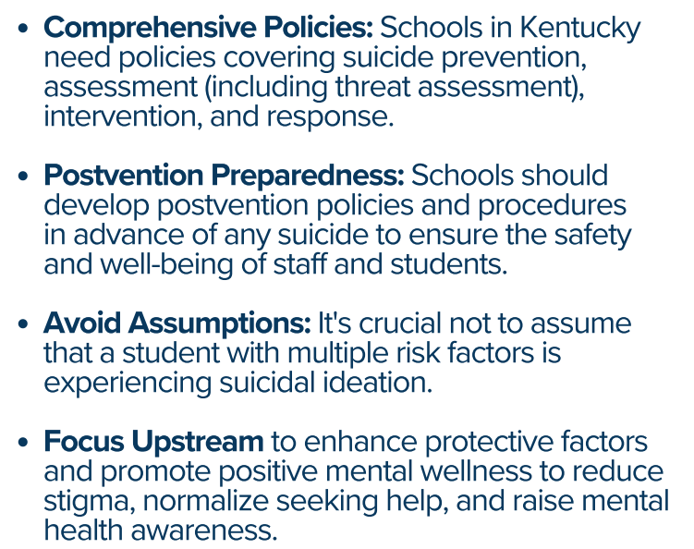

Slide 16
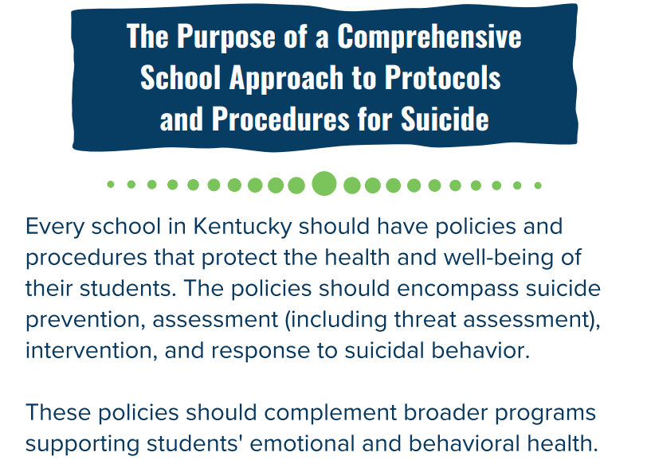

Slide 17
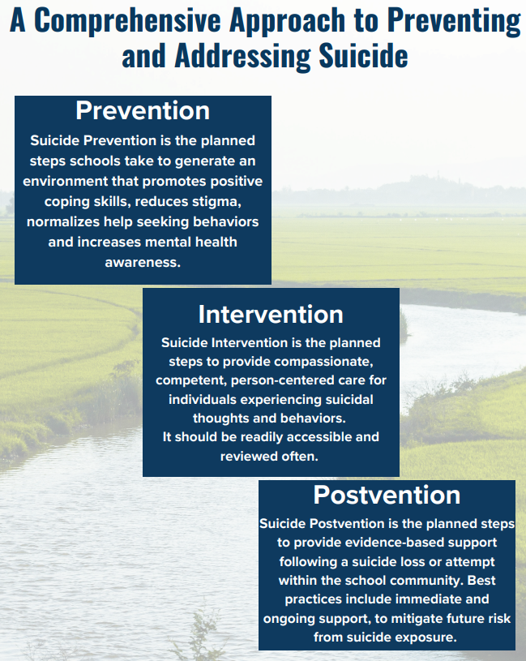
Assessing Suicide Prevention Efforts

Slide 18
Assessing Suicide Prevention Efforts
Risk Factors Defined by SAMHSA: "Risk factors are characteristics at the biological, psychological, family, community, or cultural level that precede and are associated with a higher likelihood of negative outcomes.“
Students at higher risk include, but are not limited to, those who:
  Experience violent altercations (theft, physical attacks, sexual assault/harassment and/or dating violence)
  Do not get enough sleep
  Do not perform well academically
  Overperform academically or in extracurricular activities
  Use substances
  Spend an excessive amount of time on social media
  Experience bullying and do not feel safe at school OR who bully others
  Have access to lethal means (eg: prescription medications, firearms, etc.)
  Have attempted suicide previously
  Have experienced/are exhibiting any significant change in behavior that is beyond average for the student

Slide 19
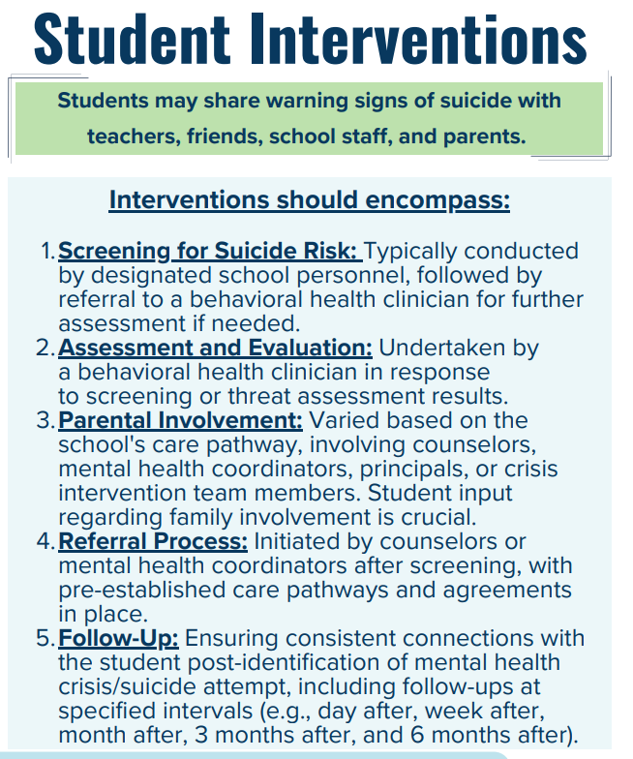
Assessing Suicide Prevention Efforts

Slide 20
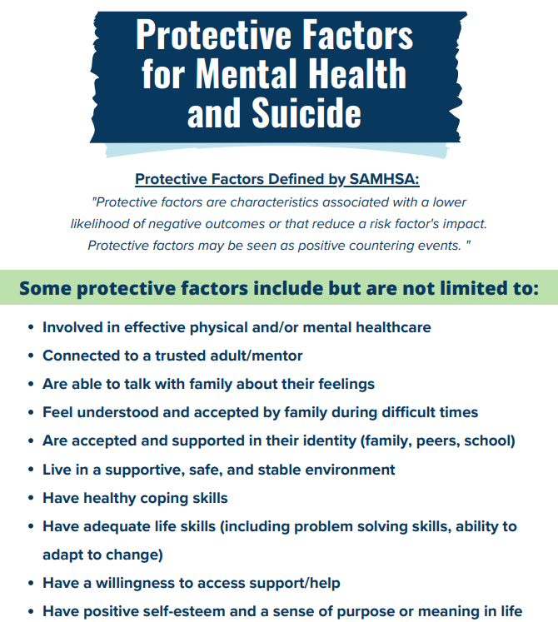
Assessing Suicide Prevention Efforts

Slide 21
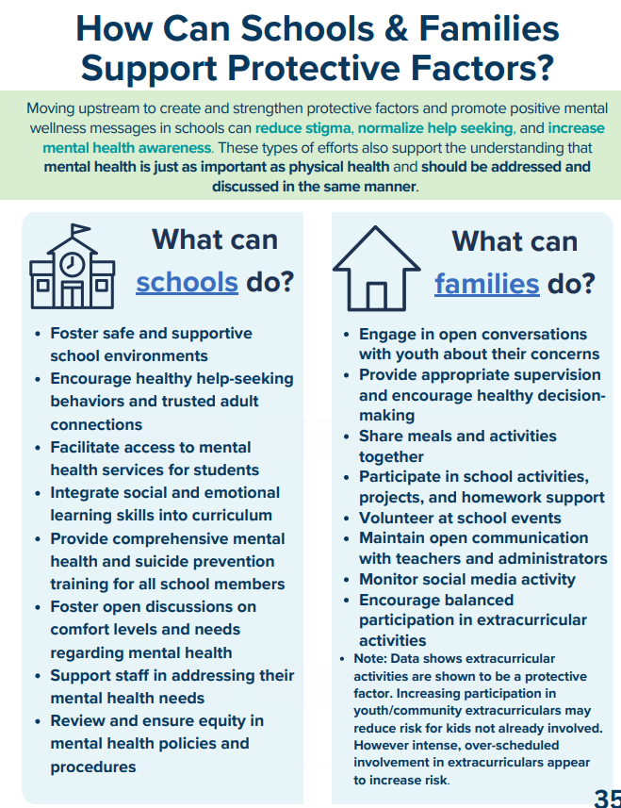
Assessing Suicide Prevention Efforts

Slide 22

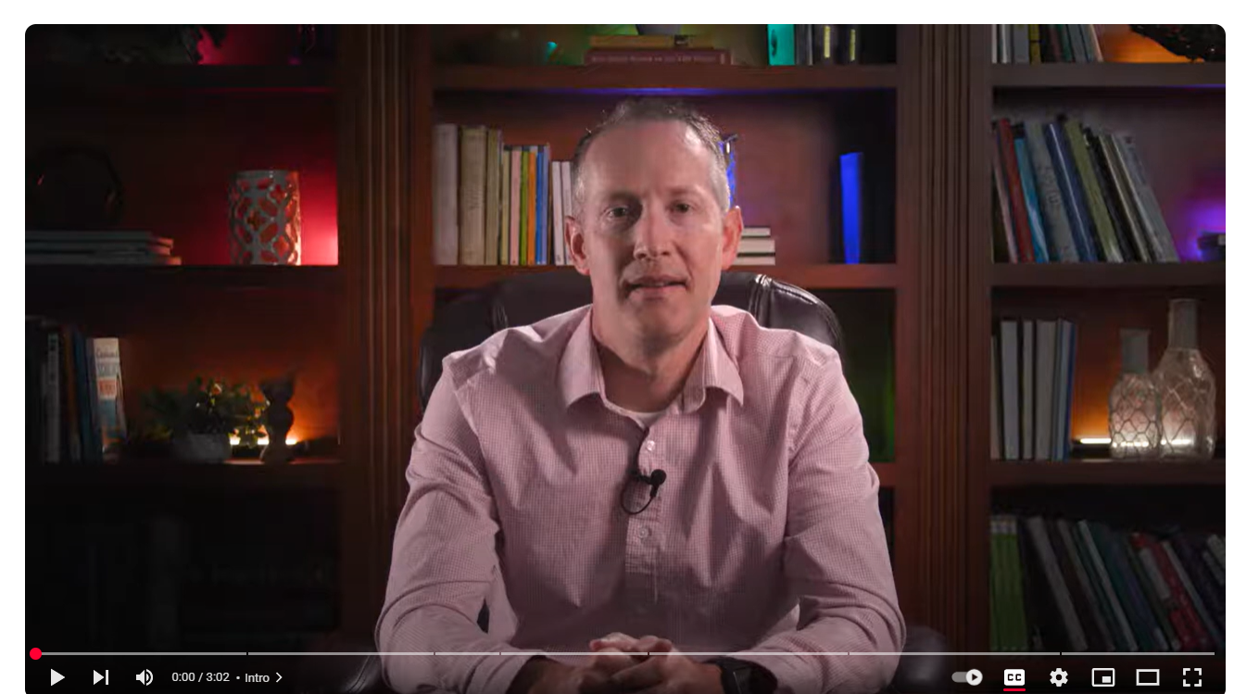
https://www.youtube.com/watch?v=Uqfri5qZjgw

Slide 23
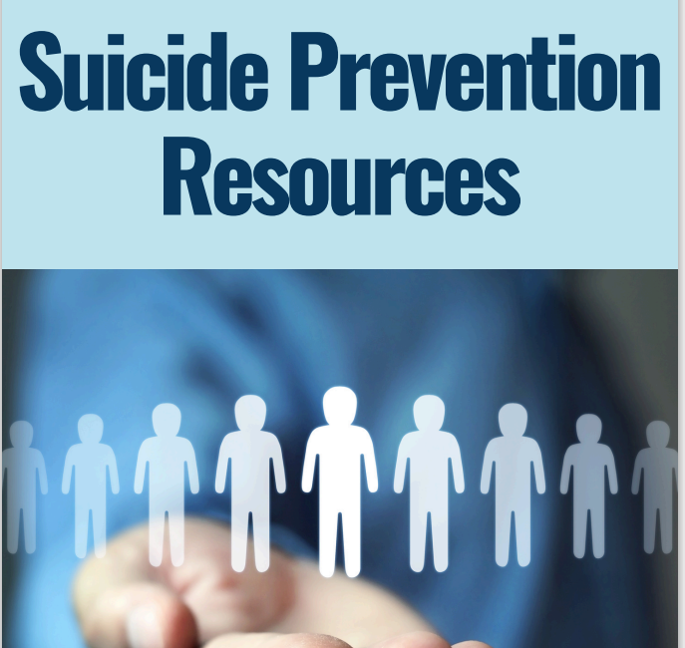

Slide 24
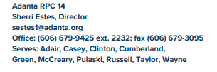
Regional Prevention Center

Slide 25
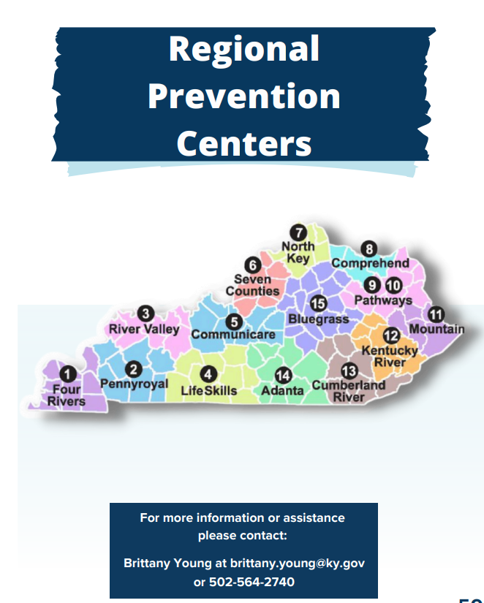
Regional Prevention Center

Slide 26
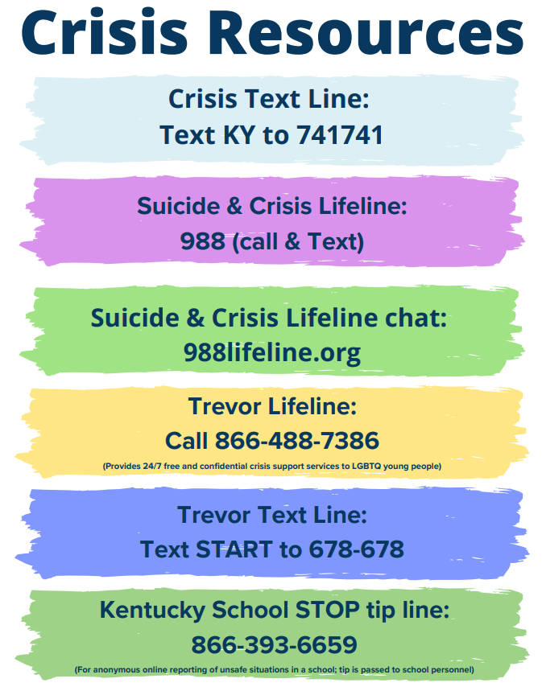


Slide 27


Slide 28


