Slide 2

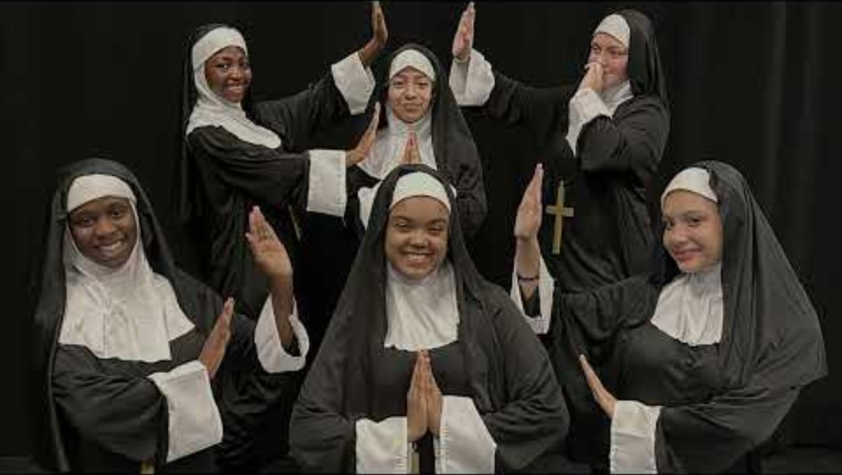

Slide 3


Slide 4
Welcome Class of 2029
August 26, 2025

Slide 5

Dr. Mona Wanis, Principal
Ms. Fatimah Bey, Annex Administrator
Ms. Alexandra Mickens, Vice Principal
Ms. Gabrielle Richa, Vice Principal

Slide 6
Imani Lewars, Guidance
Jameela Abdus-Salaam, Guidance
Natasha Carter, Guidance
Dayana Gil, Guidance
Cindy Goncalves, Guidance
Edson Martinez, Social Worker
YES Program

Slide 7

Our Mission
To inspire young artists to think, learn, achieve, and care.
Notes:
Who here loves the arts? To draw, sing, dance, make music/ videos….
Would you like to attend a high school where your creativity can shine as much as your academics?

Slide 8
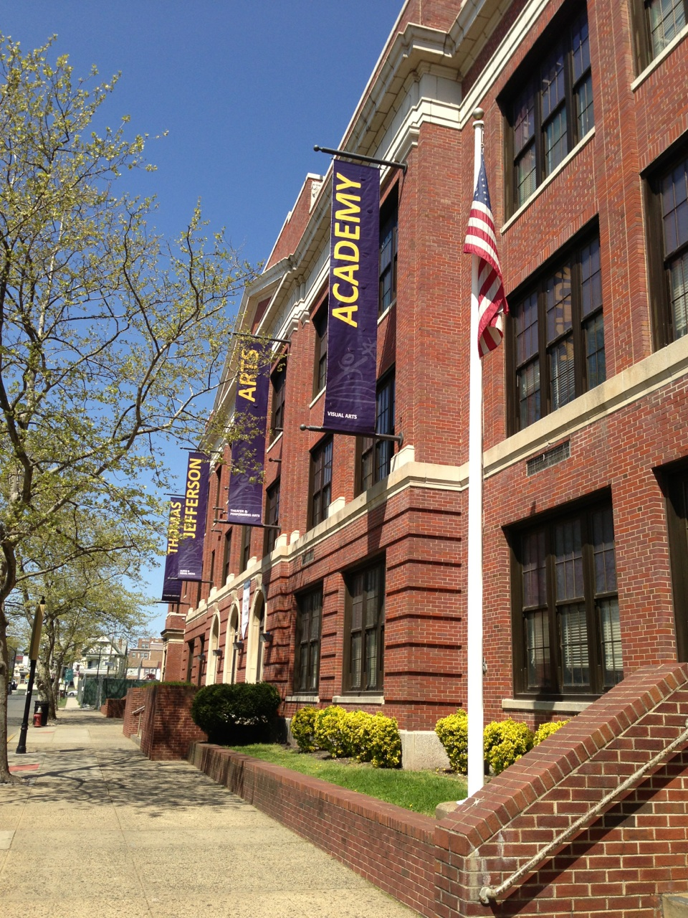
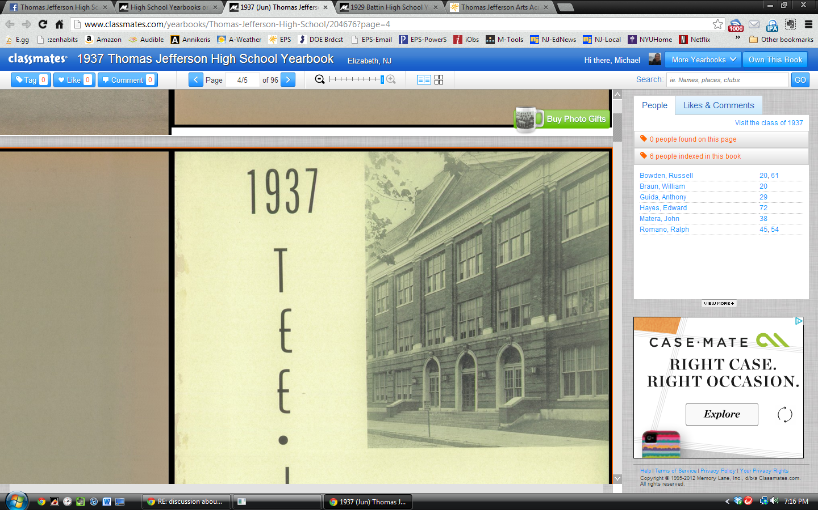
OUR STORY
Thomas Jefferson Arts Academy
INTEGRITY • RESPONSIBILITY • EXCELLENCE
Notes:
Old Jeff to New Jeff
All boys school in 1928 to 66% girls' school
Bringing the Arts to everyone’s life using Integrity, Responsibility, and Excellence as a focus.

Slide 9



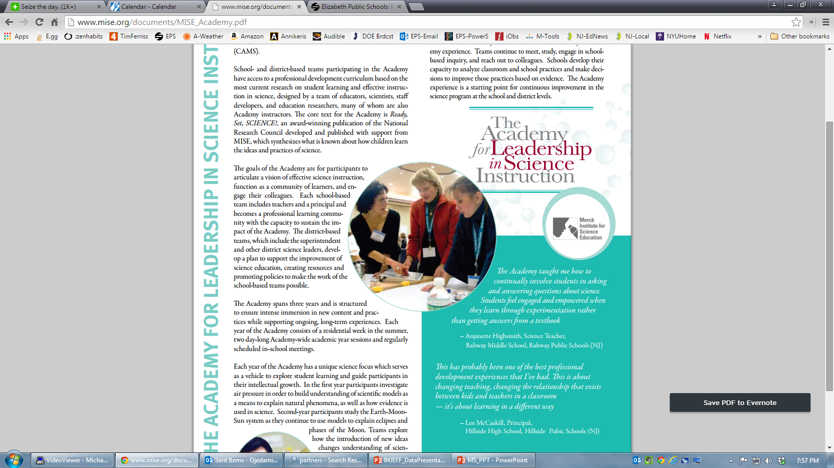







Notes:
Richa
AVID School
YES Program- onsite counseling team and support serves
Elizabeth Youth Theater Ensemble (EYTE) Putting your Arts work to action, from script writing to VR and to the Stage. Bringing your work to live while being paid minimum wage for what you love to do or receiving community service hours.

Slide 10
Thomas Jefferson Arts Academy
Broadcasting Media Production
Produce, edit, direct film/video
Cameras and Lighting
Video Editing
Dance
Vocal
Instrumental
Theater
Performance
Technical Theater
Visual Arts
Drawing, Painting
Sculpture
Commercial Photography
Graphic Design
Digital images
Advertisement
Personalization
Performing Arts
Notes:
Richa
In Summary, How many Strands does Jefferson have? What are they?
How many of you enjoy working on creative projects like painting, acting, singing, or designing?

Slide 11

ADDITIONAL PROGRAMS
Dual Enrollment with Kean University​
  Drama ​
  Dance​
Industry Certification ​
  Graphic Design - Adobe Photoshop ​
  Broadcast Media Production - Adobe Premiere​
Student Workshops​
  Record High Prudential Center of NJ (Music)​
  Kean University Choir/Music Department​
  Carolyn Dorfman Dance Company
THEATER PARTNERSHIPS
Speech & Theater Association of NJ​
NJIT – Rutgers Theater Department​
Two River Theater Red Bank of NJ​
The Theater Project Professional Theater Company​
American Theater Group​
Shakespeare Theater of NJ​
Elizabeth Youth Theater Ensemble
Notes:
Richa

Slide 12

AP Courses
AP World History​
AP US History ​
AP Statistics​
AP Pre-Calculus​
AP Calculus​
AP Biology​
AP English Language
AP English Literature & Composition
AP Spanish Language
AP Studio Art Drawing 3D
AP Studio Art 2D
AP Studio Art Drawing
Classes tend to be fast-paced and cover more material than typical high school honors classes.
Students who do well on AP Exams can earn credit and/or placement into advanced courses in college.
Notes:
Richa

Slide 13

AVID
Focused on preparing students to become college and career ready
AVID 9 – 11 – BigFuture, Upward Bound, etc.
AVID 12 – help Seniors with application, FAFSA, HESAA, scholarships
Closely monitor the students
AVID celebration each marking period
End of the year event
AVID 09
AVID 10
AVID 11
AVID 12
Notes:
Richa

Slide 14










2024-2025 Performance
Notes:
Richa
Samples of this year’s performance, but many more to come. Rock concert, Talent Shows, Masked Signer, and many more

Slide 15




Performances
2025-2026
December 2025
October 2025
Winter & Spring Dance Concerts
Winter and Spring Orchestra, Chorus & Guitar Concerts
March 2026
Notes:
Richa

Slide 16
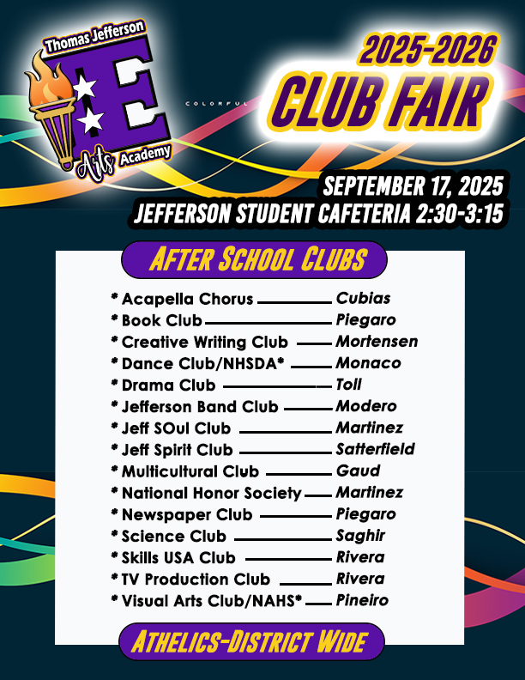
Extracurricular Activities
Afterschool Clubs
A Capella Chorus
Dance Club-NHSDA*
Jefferson Amped Club
Athletics-District Wide
Drama Club
Science Club
Book Club
Creative Writing Club
Visual Arts Club
Yearbook Club
Skills USA Club
TV Production Club
Jeff Spirit Club
Jeff SOuL
National Honor Society
Multicultural
Newspaper
Notes:
Richa
What kind of extracurricular activities or clubs are you excited to join in high school?
At least 14 clubs, list a few Jefferson Amped, Creative writing 8 students work were selected to be published in a magazine, Dance club, art club and many more
Club fair third Thursday in September.

Slide 17
What to Expect in 9th Grade
Transition from middle to high school
More challenging coursework
Introduction to GPA and transcripts
Increased independence and accountability
Notes:
Bey

Slide 18
School Rules & Expectations
Be on time and attend daily
Follow the dress code (if applicable)
Respect school property and others
Academic honesty and integrity
Notes:
Bey

Slide 19


Notes:
Bey

Slide 20
ATTENDANCE MATTERS!
Only 9 unexcused absences are permitted per class.
Exceeding 9 absences will result in possible loss of credits.
We offer Saturday Attendance Recovery for all students.
Students will be required to attend summer school and/or recover the class/es on Saturday or after school.
Notes:
Bey

Slide 21
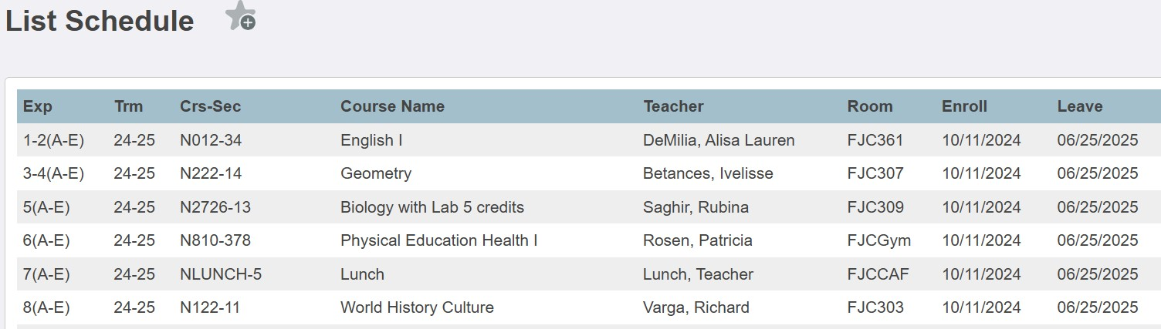
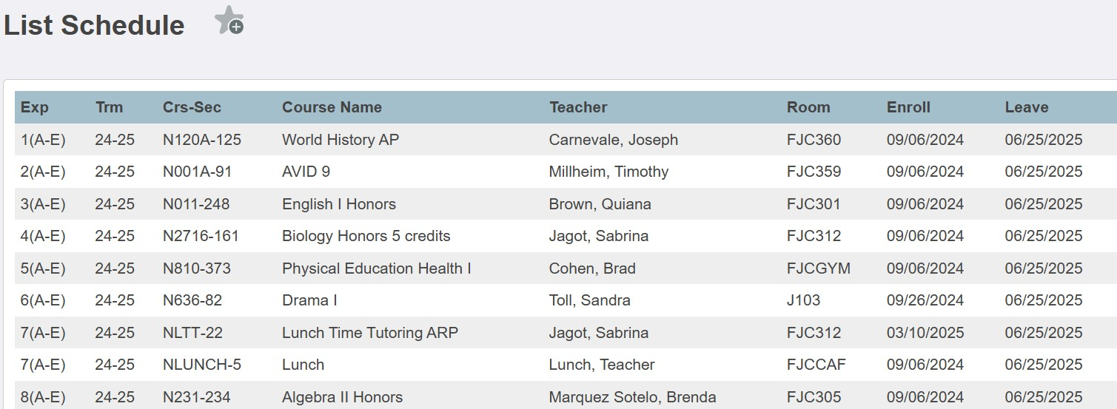
9th Grade Annex
Student Schedules & Expectations
Notes:
Bey
9th Grade Schedules:
Sample Schedules:
Standard – Students will take Blocks of English and Math
Honors-Students who meet the GPA requirement and testing requirement are place in honors/AVID Program
Instructional support students are offered academic tutoring – Lunch and Afterschool
Expectations:
9th Grade Success begins with:
Arriving to school on time. Before 7:45am
Wearing Uniform
Meeting the required graduation credit for each course
Attending school- Do no miss more than 9 days
Completing all assignments (homework, etc)
Asking for help / assistance from teachers, counselor and social work
GET INVOLVED! PLAN TO BE SUCCESSFUL!
I hope to see you at Jeff!

Slide 22


Graduation Requirements
120 Credits
4 Years of English and Physical Education,
3 years Math, Science
3 Years of History
2 Years World Language
1 Year Visual Art
CTE Education
State Assessment
SAT
Personal Finance
60 Community Service Hours
FAFSA
Notes:
Mickens
Review requirements
How important is it to you to have teachers and programs that prepare you for both college and careers?

Slide 23
Graduation Requirements
Cohort Year | Credits | Community Service Hours | Testing
9th | 30 | 20 | NJSLA (ELA & MATH)
10th | 30 | 15 | PSAT
11th | 30 | 15 | NJSLA (SCIENCE) NJGPA SAT
12th | 30 | 10 | SAT NJGPA (if necessary) Portfolios (if necessary)
TOTAL | 120 | 60
Notes:
Mickens
Review credits and community services hours per grade.

Slide 24
College & career readiness
College Visits
Berkley College ​
Kean University​
New Jersey City University​
Rutgers University Newark Campus​
The College of New Jersey​
Montclair State University
Instant Decision Day
Kean University
New Jersey City University​
Bloomfield College of Montclair State University
School Day Trips
Steven Institute of Technology​
Fairleigh Dickinson University​
Drew University​
Rutgers University (Equal Opportunity Fund)​
Rider University​
HBCU College Fair-Raritan Valley Community College​
Classroom Visits
9th | HIB High school expectations
10th | Graduation requirements Attendance, etc.​
11th | Testing Requirements​ College Process​ College Prep Scholars Program​ SEEDS Candidates SCOIR
12th | College/Career Readiness​ Scholarships​ FAFSA/HESAA
Notes:
Mickens

Slide 25

Student Supports
Academic tutoring and help sessions
Counseling and mental health services
ELL and IEP/504 accommodations
Clubs and Activities
Notes:
Mickens

Slide 26
Assess students to determine areas they may require help, counseling, or other services and support
Individual, family, and group counselling sessions for students, parents, teachers, and school faculty
Education for parents and school staff regarding student issues, such as bullying, learning difficulties, and peer pressure challenges
Conduct mediation meetings with students having conflicts with other students, teachers, staff
Refer students and parents to community support services and agencies
Advocate on behalf of the school, staff, students, and parents to community services
What School Counselors &
Social Workers Do
Notes:
Mickens

Slide 27




Social Emotional Learning
Notes:
Mickens

Slide 28

Services Provided
Individual Counseling
Group Counseling
Family Services
Preventative Mental Health
Pregnancy Support
Career Counseling
Learning Support
Seminar Workshops
Life Skills Training
Recreation, Trips, And After School Programs
Summer Program: Recreation and Community Service
Community Linkages: Connecting families to community base services and programs.
YES Program
Individual Counseling ​
Group Counseling ​
Family Services ​
Preventative Mental Health ​
Pregnancy Support ​
Career Counseling ​
Learning Support
Seminar Workshops ​
Life Skills Training
Summer Program: Recreation and Community Service​
Community Linkages: Connecting families to community base services and programs.
Notes:
YES Program

Slide 29
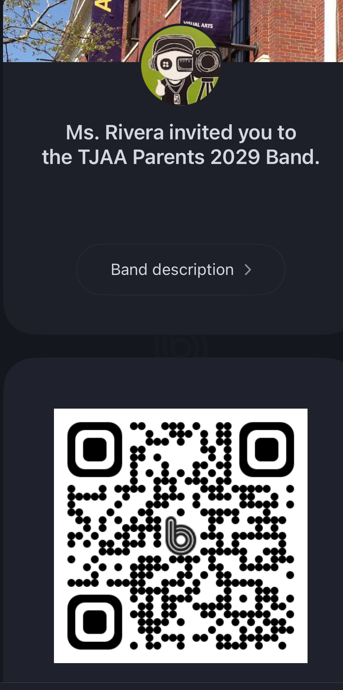
Join The
CLASS OF 2029 PARENTS BAND APP​
The Band APP is our way of communicating News and happenings here at Jefferson.​
Just scan the QR Code and Join.​
LEAVE NOTIFICATIONS ON.​
Get all the news including school closures, special events, and so much more.​
Notes:
Rivera

Slide 30

Join The
CLASS OF 2029
BAND APP
The Band APP is our way of communicating News and happenings here at Jefferson.
Just scan the QR Code and Join.
LEAVE NOTIFICATIONS ON.
Get all the news including school closures, special events, and so much more.

Slide 31







Uniforms
Jeff Merch 2025
Please pick up an order form. All orders due no later than 9/15.
Notes:
Rivera

Slide 32




Uniform Pants
YES
NO
NO
YES

Slide 33
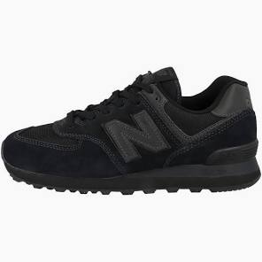

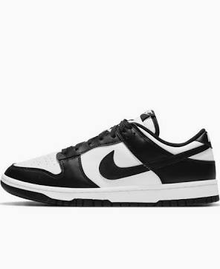


Shoes
YES
YES
YES
NO
NO

Slide 34

Auditions for Freshmen
Friday September 5th
Immediately after school in Rm 22 Main Building
If you would like to be a performer, dancer or singer.
If you would like to be a backstage crew member.
If you would like to work on costumes.
If you would like to work on set design and construction.

Slide 35

Parent Involvement
Join
Join the PTA and attend workshops (see Mrs. Rivera)
Volunteer
Volunteer opportunities
Stay
Stay engaged and informed

Slide 36


Slide 37
Tips for a Successful Freshman Year
Stay organized and plan ahead
Ask for help when needed
Arrive to School on time
Always in Uniform
Make new friends and build connections
Keep a positive attitude

Slide 38
Student Orientation Next Steps
Students transition to Annex/Courtyard
Tour building entrances and key locations
Participate in fun icebreakers with mentors

Slide 39
Parent and Students Next Steps
For Students:
  Exit through the middle doors
  Turn right in the hallway
  Go down one floor
  Exit to the courtyard (main entrance to the annex)
  Participate in fun “Getting to Know You” activities
For Parents:
  Please remain seated for the presentation
  After the presentation, join your child in the courtyard
  You may collect your child and leave from there
Note:
I will be in the back of the theater to answer any questions.
You may also ask questions now while students are exiting.

Slide 40
Q&A / Final Thoughts
Thank you for joining us!
Any questions?
We’re excited to welcome the Class of 2029!

Slide 41
Dr. Mona Wanis, Principal
Thomas Jefferson Arts Academy
wanismo@epsnj.org
Thomas Jefferson Arts Academy
Life, liberty, and the pursuit of happiness made real for every student through academic and creative excellence.
Notes:
What questions do you have about Jefferson Arts Academy and how we can help you grow?
What’s one thing you’re most excited about for high school next year?

