Slide 1

Welcome to
BCM RUSK EAGLES Parent Teacher Organization
(PTO)

Slide 2
What is PTO?
Parent Teacher Organization (PTO) = partnership between parents, teachers, and staff
Focus: supporting students, school programs, and building community
Independent parent-led group

Slide 3
Why Join PTO?
Be
Be involved in your child’s education
Have
Have a voice in school activities & events
Support
Support teachers and staff
Build
Build a stronger school community

Slide 4
What PTO Does
Fundraisers (spirit wear, food sales, etc.)
Events (family nights, meet-the-teacher, field trips)
Teacher appreciation & support
Student incentives & awards

Slide 5
Recent PTO Highlights
Sponsored supplies for students
Supported Teacher Appreciation Week
Provided resources for student field trips & science fairs
Helped organize community-
building events

Slide 6
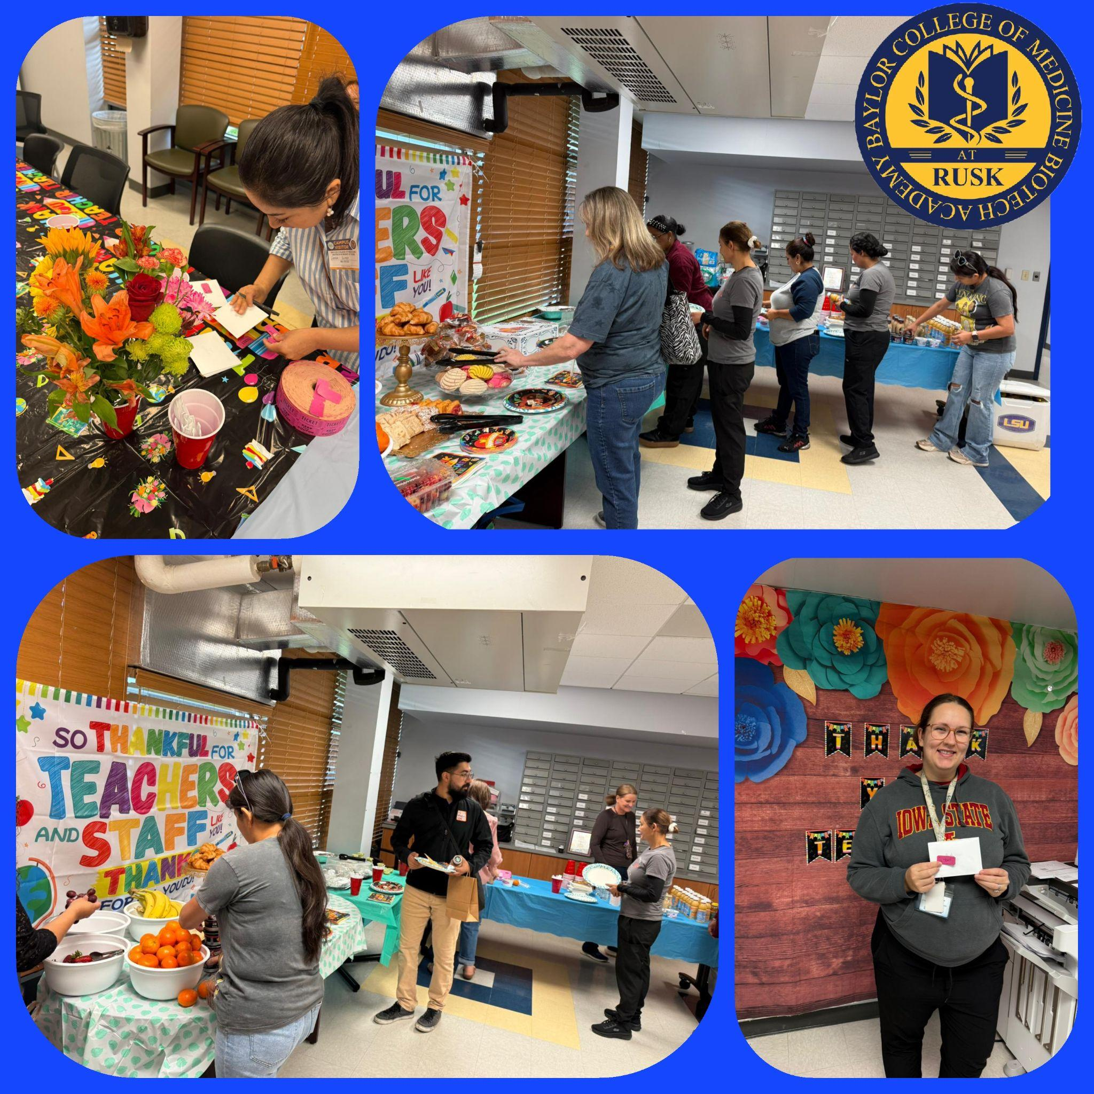
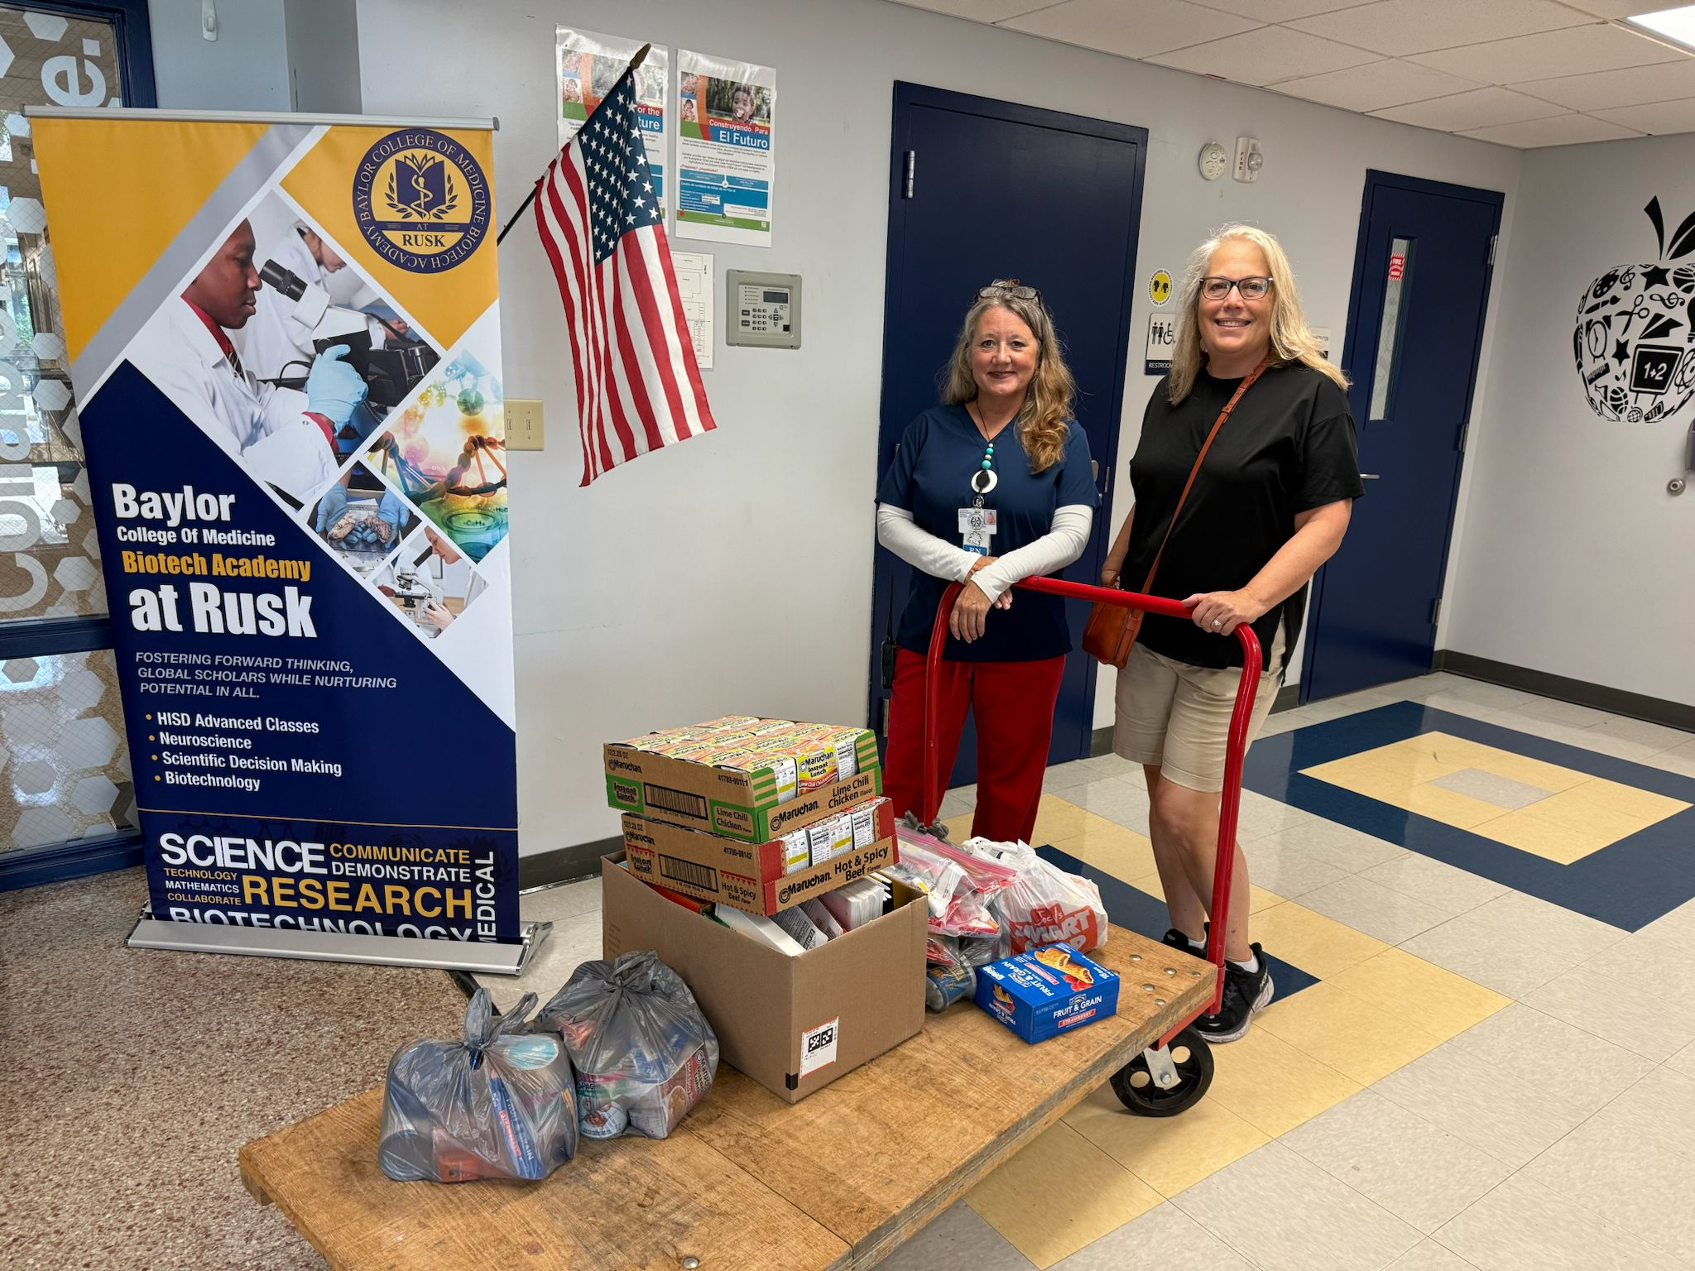
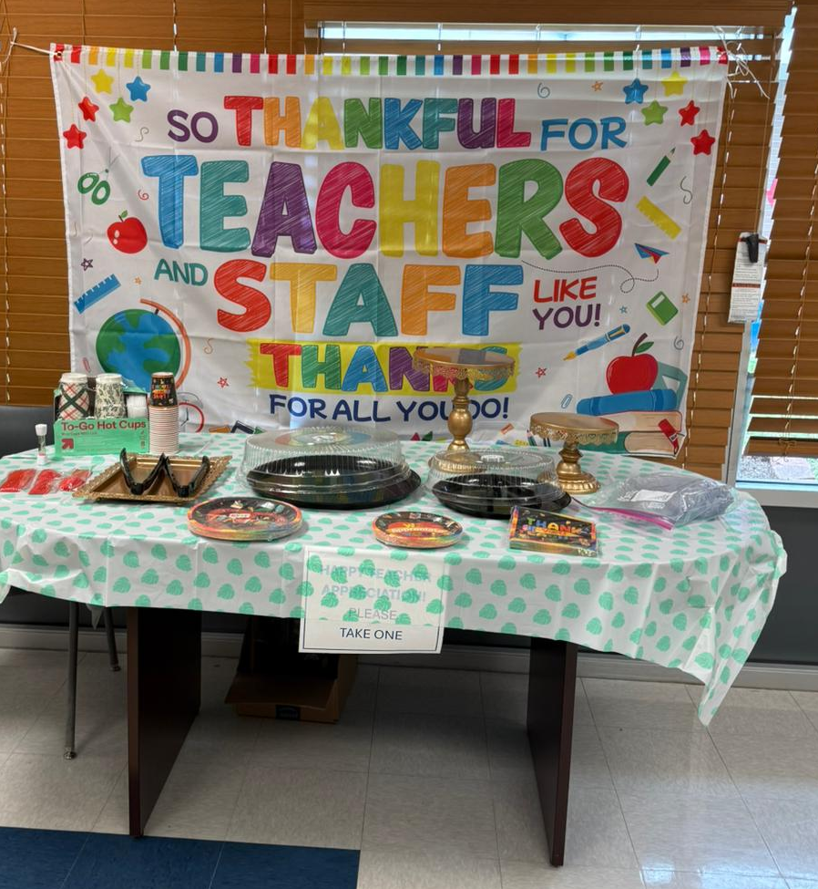
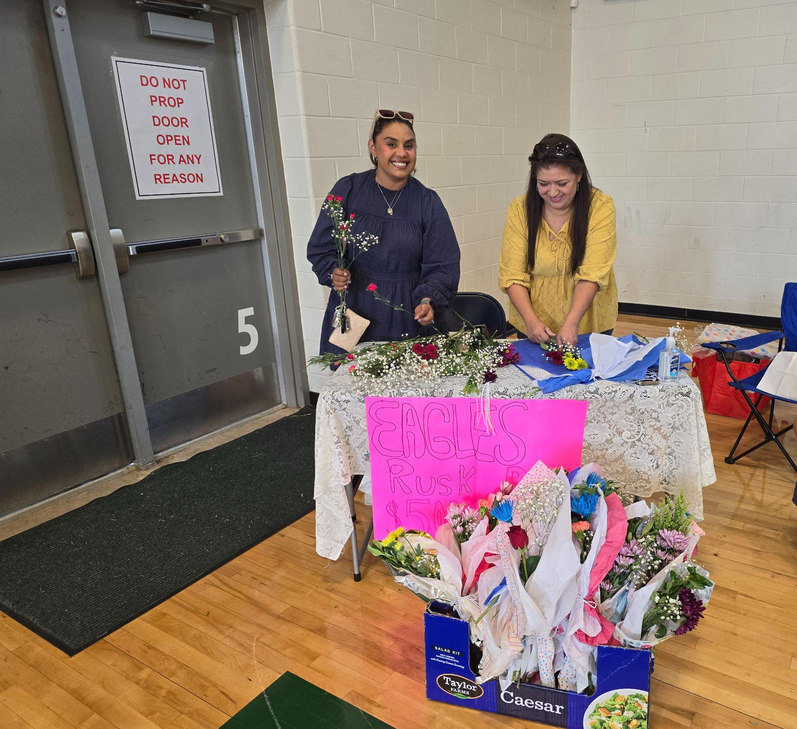
Recent PTO H

Slide 7




How PTO Uses Sponsor Support
CLASSROOM SUPPLIES & EQUIPMENT
STUDENT PROGRAMS & ACTIVITIES
FAMILY EVENTS & CELEBRATIONS
SUPPORTING SCHOOL INITIATIVES

Slide 8
How Parents & Sponsors Can Get Involved
1
2
3
4
Attend PTO meetings
Volunteer at events
Become a PTO sponsor (individual or business)
Share ideas and feedback

Slide 9

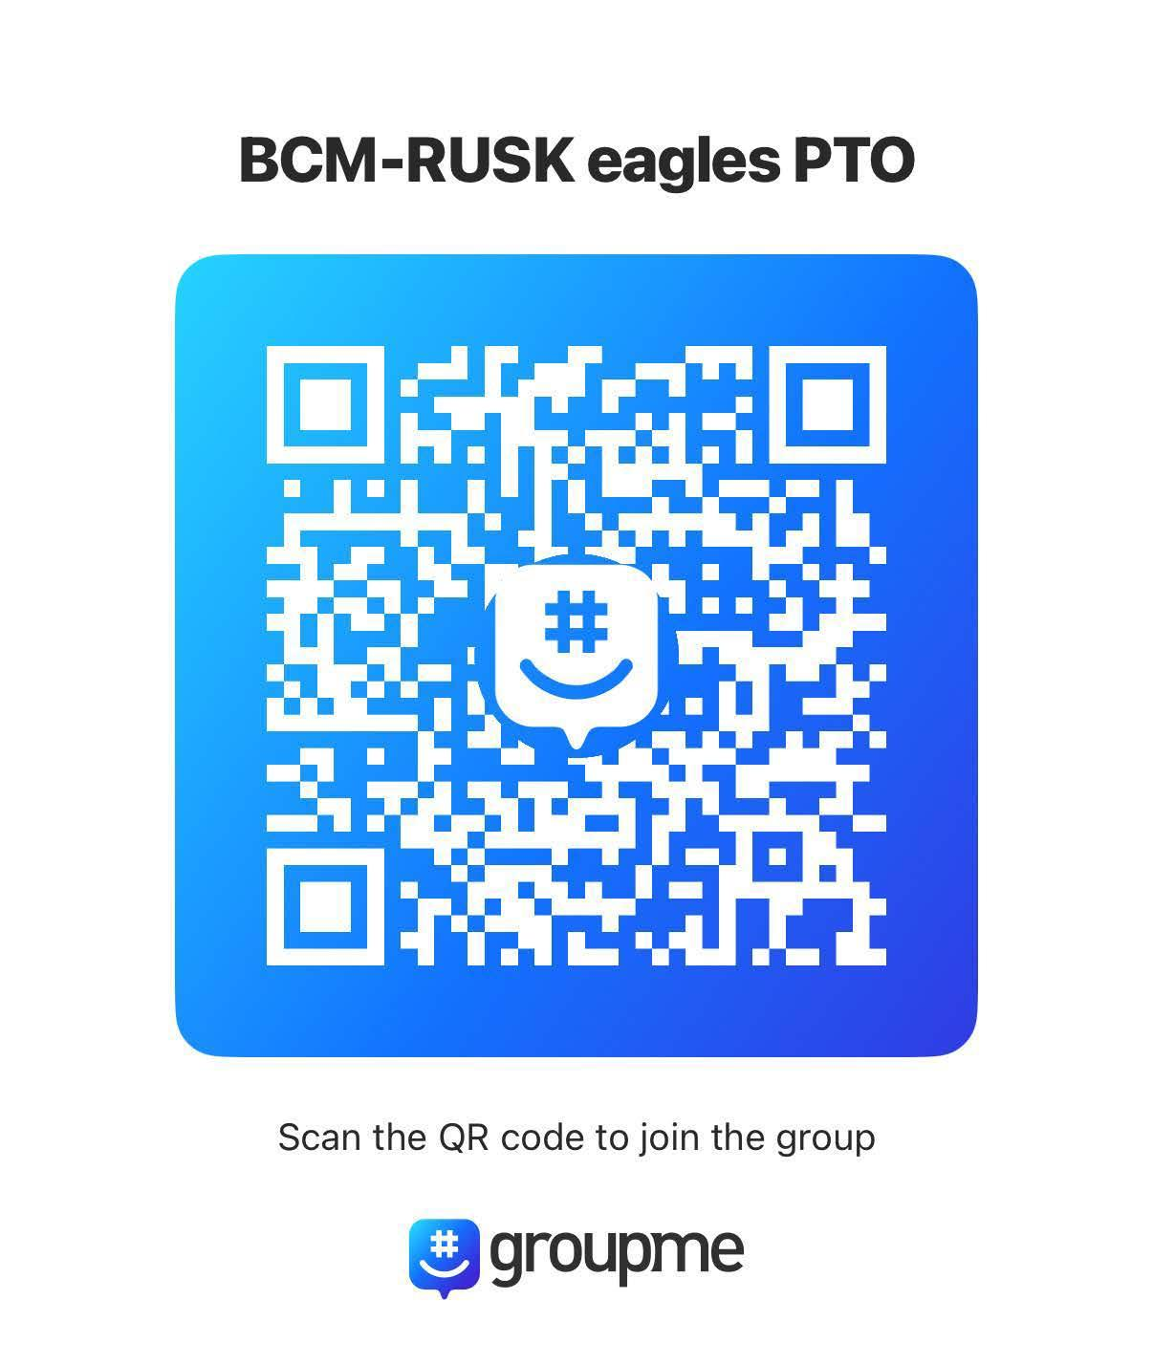
Meeting Information
PTO Meetings:
After: “Coffee with the Principal” ☕
Contact: ptoeaglesbcmrusk@gmail.com Instagram
Groupme

Slide 10

HISD Volunteer Requirement (VIPS)
In order to volunteer in any school activity, everyone must register in VIPS.
This applies to all parents, guardians, and community volunteers.
Registration helps keep our students safe and ensures compliance with HISD guidelines.

Slide 11



Call to Action
JOIN US AS A PTO
TO MAKE BCM BIOTECH ACADEMY AT RUSK THE BEST IT CAN BE!
QR CODE OR LINK FOR PTO SIGN-UP / SPONSOR FORM

Slide 12



Thank You!
CLOSING MESSAGE
CONTACT INFO AGAIN
EMAIL OR GROUPME
“TOGETHER WE ACHIEVE MORE.”

