Slide 1


Welcome to Dreher
Briefing from the Dreher Counseling Department

Slide 2

Welcome to Dreher!
We are excited that you are here! We hope that this presentation will be helpful as you orient yourself to high school and give you some information to help you be successful!

Slide 3
Meet Your Counselor
I am here to help you navigate your first year at Dreher! I can answer questions about course schedules, graduation requirements, college/career planning, and personal/social concerns. Do not hesitate to reach out!
Mrs. Nicole Hill. My office is Room 305, my email is nicole.hill@richlandone.org

Slide 4
Your GPA Matters
  For every high school credit class you take, that grade becomes a part of your GPA (Grade Point Average)
  The state of South Carolina uses a Uniform Grading Scale in order to calculate GPAs
  By taking an honors, AP, or a dual enrollment course you can earn extra credit (or weight) to your GPA
  To calculate your GPA, you use the GPA chart to find the corresponding number of GPA points for each final average you make in a class; then you calculate the average of all the corresponding GPA points

Slide 5
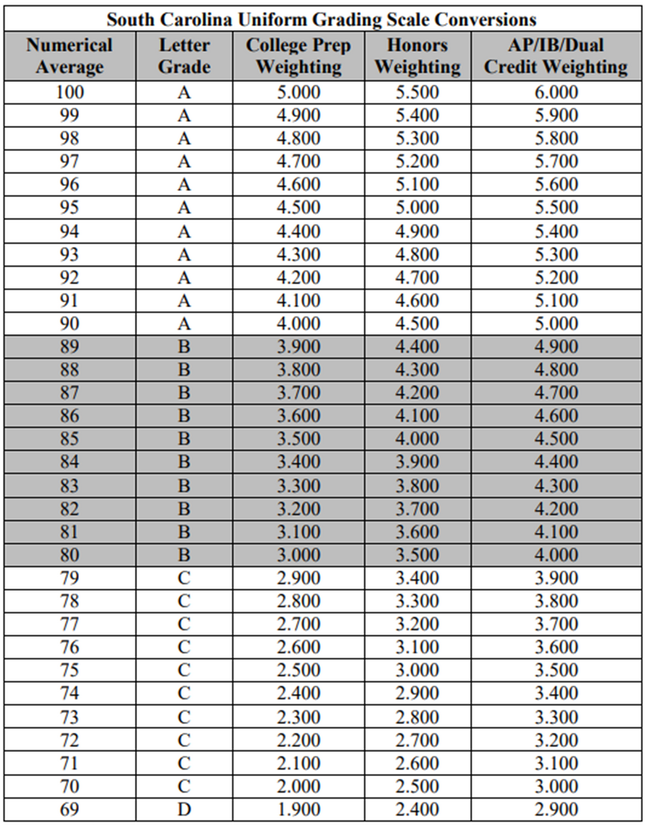
SC Uniform Grading Scale
Determines how GPAs are calculated for all public schools in South Carolina

Slide 6
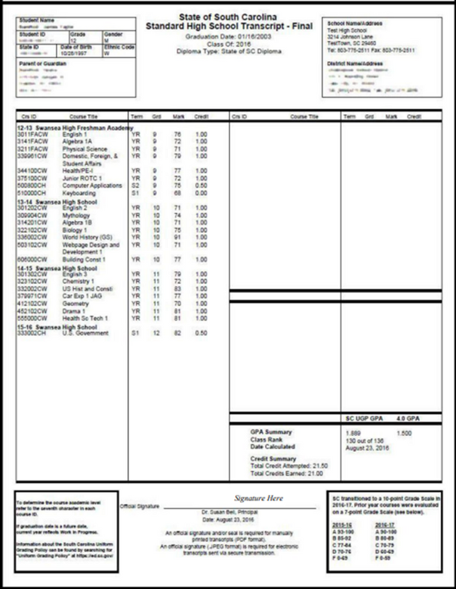
Start Off Strong
  It is important to have a strong start to your high school years.
  Each course you take and each grade you earn becomes a part of your high school transcript and calculates into your Grade Point Average (GPA)
  Your transcript follows you through high school, when you are a senior, colleges will ask for your transcript that includes grades from every class you've taken
  Work hard all year and ask for help so that you can start off strong!

Slide 7
Graduation Requirements
  English- 4 units
  Mathematics- 4 units
  Science- 3 units
  US History- 1 unit
  US Government- .5 unit
  Economics- .5 unit
  Other Social Studies- 1 unit
  PE or JROTC- 1 unit
  Personal Health- .5 unit
  Computer Science- 1 unit
  World Language or CTE- 1
  Person Finance- .5
  Electives- 6 units
TOTAL OF 24 UNITS!!

Slide 8
Promotion Requirements
  TO BE PROMOTED TO SOPHOMORE STATUS FOR NEXT YEAR, A STUDENT MUST HAVE:
  6 total credits, including:
      1 English credit
      1 Math credit
      4 additional credits

Slide 9
Get Involved!!!
  In ninth grade, you should start to become involved in extracurricular activities, including clubs, fine arts programs, sports, and service organizations that interest you.​
  When you become a senior, colleges will ask about your extracurricular involvement, so it is important to begin early.​
  In addition, activities are a way to make friends, learn about high school, and have fun!

Slide 10
ASK FOR HELP!!!
  Your counselor and teachers are always willing to help you make the most of your high school experience. Do not hesitate to reach out if you have questions or if you are struggling with coursework.​
  We also have a full-time tutor, Ms. Maureen McConaghy Thunell. She is available to help students in Media Center Lab 2 before school, after school, and during lunch.​
  All of us at Dreher want to help you succeed!

