Slide 1
Issaquah School District Athletics & Activities
Parent Information Night
August 11th, 2025

Slide 2
Presenters
Lorna Gilmour – Family Partnership Specialist (Teacher on Special Assignment TOSA)

Slide 3
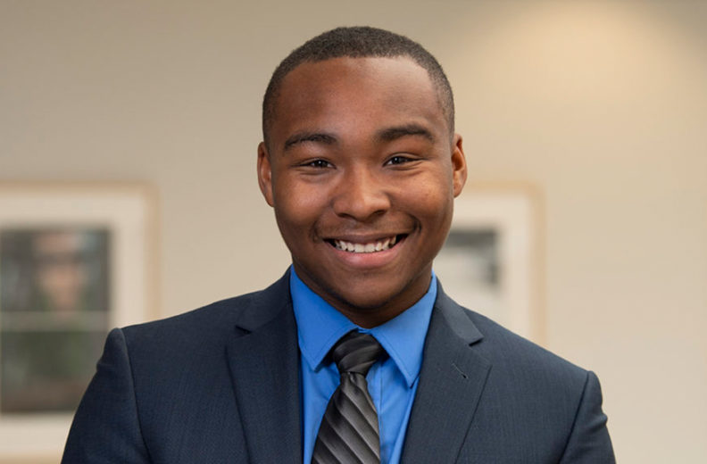
Introduction
Jordan Frost
Proud WSU Graduate (BA, MIT)
District Athletics & Activities Director | Title IX Coordinator
Previous
  District Office
    Assistant Director of Student Interventions
  Issaquah High School
    Athletic Director
    Activity Coordinator
    Psychology & World History Teacher

Slide 4
Objectives
Help parents and/or caregivers learn more about participating in athletics and activities in the Issaquah School District.
Provide resources for families on where to learn more information.

Slide 5
Vision
The Issaquah School District Athletics and Activities Department provides a transformational education-based athletics and activities program where students have positive experiences, build meaningful relationships, and develop skills for life.

Slide 6
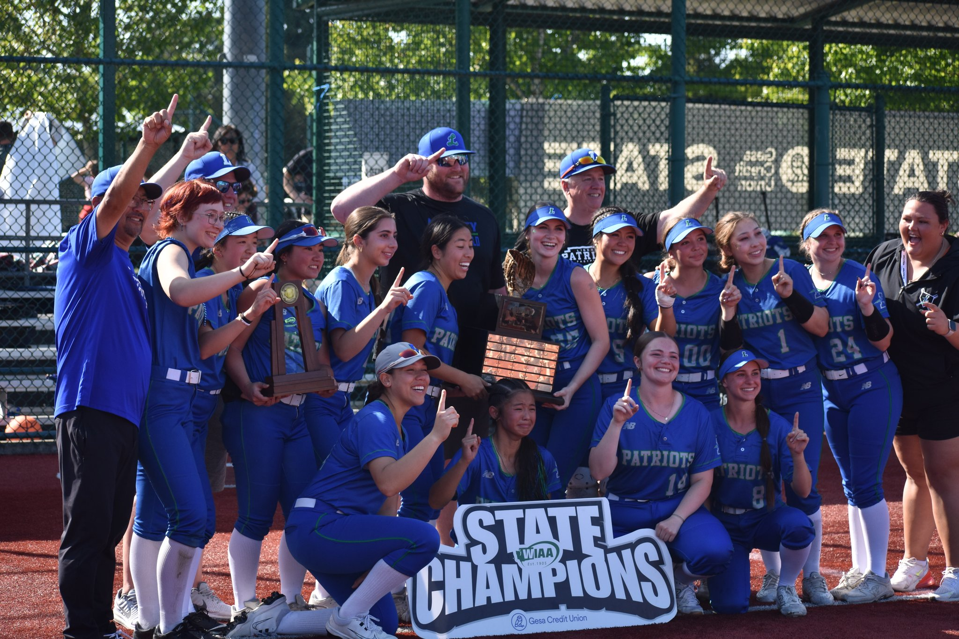
Our Department By the Numbers (10,052 secondary students)
169 athletic programs (5200+ students)
300 activities and counting (3500+ students)
600+ athletic contests, club events, and school events
300+ field trips
400+ coaches and activity advisors

Slide 7
What do we offer?
Activities (Student-led Clubs & Performing Arts)
  Performing Arts: Musical, Choir, Band, Orchestra
  Civic Engagement: Mock Trial, Debate, ASB
  Career and Technical Education: DECA, Sports Med, FCCLA, Robotics, Woodshop, Engineering, Game Design
  Interest-Based: Neuroscience, Sandy Hook Promise, Sustainability, Fighting Hunger, Baking, Be Bold Girls, Literature
  Cultural: Black Student Union, Indian Culture, Latinx, Korean
  Cheerleading
  Dance/Drill
Athletics (*offered at middle school)
  Girls Badminton
  Baseball
  B/G Basketball*
  Cross Country*
  Fastpitch
  Football
  Flag Football
  B/G Golf
  Special Olympics
  B/G Soccer*
  B/G Swim & Dive
  Track & Field*
  B/G Tennis
  Unified Sports
  Volleyball*
  Wrestling*

Slide 8
Associated Student Body (ASB)

Slide 9
What is ASB?
ASB stands for Associated Student Body – which means it is a collection of all students in the school. ASB is the official representative of students at each school.
The state requires ASB to exist to ensure student money is managed by and for students.
Student body government that makes decisions for all activities such as clubs and sports that are outside of the classroom.

Slide 10
ASB Leadership at school
Elected and appointed officers
  The process and eligibility is slightly different by school – each school has an ASB Advisor/Activities Coordinator that can give more details.
Vote on the use of student money (collected through the ASB fee and fundraisers).
Plan all school events (assemblies, dances, recognition months, and other student activities).
Engage in professional development (public speaking, planning, budgeting, human resources, etc,.)
Build Leadership skills – helps for scholarships, college applications, & job applications

Slide 11
What does the ASB fee pay for?
Students are ASB members automatically by enrolling – but cannot get full membership without paying the fee.
Full membership? A student gains all the benefits of ASB membership by paying a fee of $60 at high school or a fee of $35 at middle school.
The ASB fee pays for
  Grants to support student clubs and student sports teams
  Upgrades to student facilities and school improvement
  Cost of running programs (referees, game workers, league dues)

Slide 12
Membership Benefits
The ability to participate in sports and clubs.
  ASB fees help to pay for referees for games, game workers, membership in state organizations, and other fees required for clubs and sports to operate.
Free admission to all home sports games and select events.
Discounted admissions at away sports games and events.

Slide 13
How to Join ASB Leadership?
In the Spring applications will go out – check school bulletins and ASB Instagram pages (high school only).
There are multiple levels of involvement -
  Executive Officers – must run in a school-wide election (posters, a speech, interview).
  Class Officers – must run in a grade-wide election (posters, speech, interview).
  Leadership Class (Elective class) – must apply (written response, interviews, group activity).
Notes:
Student leaders may need to be in the elective Leadership class. Will impact class selection depending on the school.

Slide 14
Athletics
Issaquah School District

Slide 15
Athletics – Agenda
Who to Contact?
Registration (FinalForms)
  Forms to complete
Costs and payment
Physicals
Seasons (cut vs. non-cut, dates)
Eligibility, tryouts, turnouts
General Expectations
Transportation

Slide 16
High School Contact Information
Contact the Athletic/Activities Coordinator for general questions.
Each school has an Athletics Director.
Visit the Athletics page – Who’s who for contact information and coach contacts
Skyline High School
Liberty High School
Issaquah High School

Slide 17
Middle School Contacts
Contact the Assistant Principal at the middle school for questions
For more information, visit the school website below.
Issaquah Middle School
Pine Lake Middle School
Maywood Middle School
Beaver Lake Middle School
Cougar Mountain Middle School
Pacific Cascade Middle School

Slide 18
3 Steps to play sports
Sign up on FinalForms
Have a current physical on file
All fees must be paid before the first day of practice/tryouts.

Slide 19
When to register for sports?
Registration for all sports opens May 15th for high school and June 1st for middle schools. Registration must be completed before students can attend tryouts/turnouts.
Entering 6th graders will have to wait until August to fully register, once they have access to student email.
New students to the system may have a delay in registering until their enrollment is finalized.
See registration information here – Registration Website

Slide 20

Registration
To participate in a sport, parents/caregivers and students must login to FinalForms and sign forms.
These forms are all required and must be fully completed (green) before students can participate in a sport.
The forms give coaches and athletic staff important safety information, and give permission for students to participate fully in sports.

Slide 21
FinalForms
Issaquah-wa.finalforms.com
Also, linked on the district Athletics & Activities web page.
All students who have a Skyward account also have a FinalForms account.
Parents also need to create a password and complete steps in FinalForms
Contact Athletic Department at school for questions or help with forms.

Slide 22
Sport Costs and Payment
Students must have an ASB membership to play sports in schools.
Sports Fee - $200 High School/$50 Middle School (this money goes to the district office to help pay for busses and coaches pay).
  If a student participates in three sports (Fall, Winter, Spring), they do not have to pay for the third sport.
Program Costs – these costs may vary by program depending on what equipment is necessary or if field trips are taken. Head Coaches can provide this information.
Intramurals – Middle School intramurals do charge a fee, that is $20

Slide 23
Offseason Programs – High School
Offseason Programs (HS only) – these costs may vary by program. Head coaches can provide this information.
The best way to get emails and updates is to join the sport in FinalForms – coaches will use that list to email communications about the offseason.
Some sports offer students the chance to continue practicing and developing their skills during the offseason.
Ask the Head Coach of your program if there is an offseason program and when it will take place.

Slide 24
Financial Assistance
Students who qualify for free/reduced lunch will pay $0 for ASB membership and participation in athletics/activities.
Families must have given “Consent to Disclose” on the Free and Reduced lunch application for financial aid for sport fees, activities and other supports.
For families who do not qualify for Free and Reduced lunch – contact your ASB Bookkeeper, Counselor, or Principal/Assistant Principal for more support.

Slide 25
Physicals
Current physical must be on file – valid for two years.
  The physical must indicate “fully cleared for participation in athletics” for us to accept it.
Physicals can be dated at any time during the year – but must cover the entire sports season.
Tip for parents – take a ISD Physical form with you to doctors appointment to save having to get it completed at a later time (charge for completing form)
FinalForms has the form available for print – you can get a print version from the school athletic secretary if needed.
If you have trouble finding a provider, your school nurse can help you with options.

Slide 26
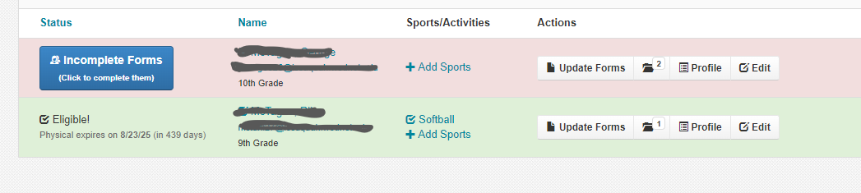
How do I know I am cleared?
When your student is “green” in FinalForms you have completed all of the requirements.
Unsure? You can ask the athletic secretary at the building or your building athletic director.

Slide 27
Sport terms and definitions
Varsity: The highest level of sports competition.
JV (Junior Varsity): A moderate level of sports competition, to prepare for Varsity.
C-team: A developmental team, to grow skills and prepare for JV/Varsity.
Cuts sports: Sports where students may be “cut” from the team after a tryout.
Intramurals: Sports focused on participation and development.
Tryouts: Students must demonstrate skills during a defined time.
Turnouts: Students must attend, but will not be cut.

Slide 28
Cut Sports
Students must qualify based on skill.
It is appropriate to ask coaches before tryouts – what skills they are evaluating and what your student can work on to prepare for tryouts.
Cuts are final and cannot be overturned unless there is a legitimate claim of an unfair process/evaluation.

Slide 29
Intramurals
For students looking to try a new sport and meet new friends
There will be no competing or travelling against other schools.
This is a great way to explore different sports without the pressure of competition!

Slide 30
Sports By Season – High School
Season | Fall | Winter | Spring
DATES: | August – November | November – February | February - June
Cut – a tryout is required, and students may be cut. | Girls Soccer Girls Volleyball Boys Tennis Boys Golf | Boys Basketball Girls Basketball | Boys Baseball Girls Fastpitch Girls Tennis Girls Golf
No Cut – all students will be accepted | Football Cross Country (co-ed) Girls Swimming | Wrestling (co-ed) Boys Swimming Girls Flag Football | Track & Field Girls Badminton

Slide 31
Sports By Season – Middle School
Season | Season 1 | Season 2 | Season 3 | Season 4
DATES: | September – October | November – January | January – March | April - May
Cut – a tryout is required, and students may be cut. | B Soccer G Volleyball | G Basketball | G Soccer B Basketball
No Cut – all students will be accepted | Cross Country (co-ed) | Wrestling (co-ed) |  | Track & Field
Intramurals – in building only | G Volleyball B Soccer | G Basketball | G Soccer B Basketball

Slide 32
Intramurals – Middle School
Schools may choose to offer new sports based on survey responses from their student body.
For example, Maywood MS offers Badminton and Flag Football as an intramural, but Pacific Cascade may not.

Slide 33
General Expectations
Attend all practices and games during the season – a calendar should be given by the coach at the start of the season (sometimes this includes during school breaks).
Accept coaches' decisions on playing time, game planning, and in-game decisions.
Commit time in the summer and “offseason” to continue developing for the season (HS specific).

Slide 34
Transportation for ISD sports
ISD provides transportation to most away contests. In some instances, the team may decide to self-transport, which the coach will clearly communicate in advance.
To drive your student home, you must “check-out” with the coach so that they know your student is being safely transported.
To have someone else take your student home you must sign an authorization form that is available in the Athletics office.
After school activity buses are available for middle school sports.

Slide 35
Clubs & Activities
Issaquah School District

Slide 36
High School Contact Information
Contact the Athletics/Activities Coordinator for general questions.
Each school has an Activities Coordinator.
Visit the Activities page for contact information and advisor contacts. You can also find a list of clubs here.
Issaquah High School Activities Website
Liberty High School Activities Website
Skyline High School Activities Website

Slide 37
Middle School Contact Information
Contact the Assistant Principal at the middle school for questions
For more information, visit the school website below. You can also find a list of clubs here.
Issaquah Middle School
Pine Lake Middle School
Maywood Middle School
Beaver Lake Middle School
Cougar Mountain Middle School
Pacific Cascade Middle School

Slide 38
Clubs – Two ways to participate
Students can join an existing club simply by attending the club meeting.
  Schools have information in the "Activities" section of their website, postings on social media, and/or flyers on bulletin boards.
Students can start their own club – for ANYTHING!
  Each school has a slightly different process – overall students must find at least 5 other interested students, an advisor and complete paperwork.
  There are deadlines – contact the school Activities Coordinator/ASB Advisor for the exact process at your school.
  *Students must purchase an ASB membership to participate.

Slide 39
Cheer/Dance
Cheer/Dance operate like sports teams – they compete in local, state, and national competition.
They also operate like clubs – they operate year-long.
Students interested may participate in just sideline (supporting at assemblies, games, and events) and/or competition (competing against other schools, engaging in high-level skills).
Program fees vary. You must purchase ASB membership to participate.

Slide 40
Transportation for Clubs and Activities
After school bus is available for some clubs and activities.
You can find the activity bus schedule here: Activity Bus Route Link

Slide 41
Open to questions!

