Slide 1
Deferred Action for Childhood Arrivals (DACA)
SSFUSD Resources

Slide 2
For students and workers:
For students and workers:
The University of California Immigrant Legal Services Center, based in UC Davis, offers legal representation and advice.
University of California Undocumented Student Services: Individual UC campuses also have resource teams and programs for students who came into the country without legal permission, listed on this page.
The California State University system lists campus-based support resources for students and employees as well as legal support services throughout California, by county.
UCLA law lecturer Victor Narro suggests the website Informed Immigrant, where organizers are compiling information.
For parents of Dreamers:
We are one L.A. Unified: Standing with immigrant families: Los Angeles Unified School District has published immigration guides in both Spanish and English, directing families to many low-cost legal resources and attorneys around L.A.
For help in multiple languages:
A number of organizations, including CHIRLA and CARECEN, offer services in Spanish
Asian Americans Advancing Justice-Los Angeles offers legal aid in six Asian languages.

Slide 3
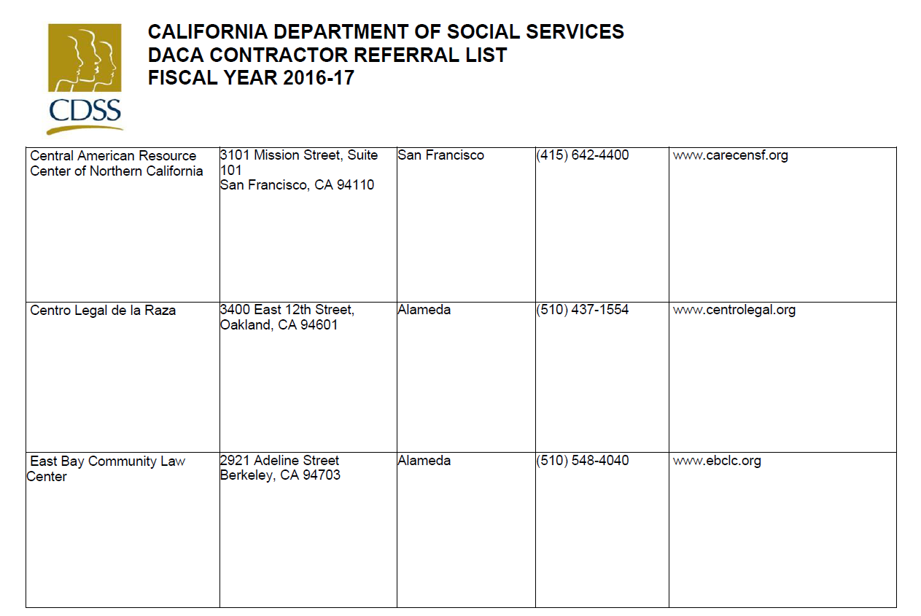
Resources - Bay Area

Slide 4
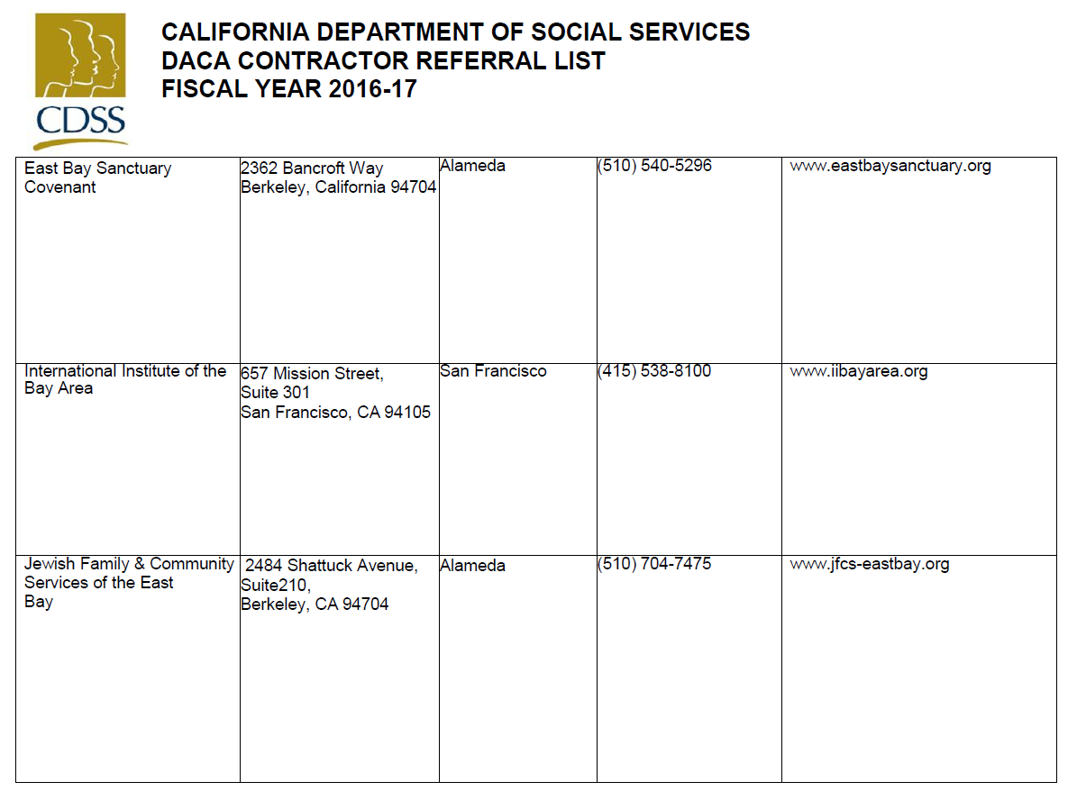
Resources - Bay Area

Slide 5
Resources
Educators for Fair Consideration (E4FC)
· What We Know Now
· What Our Community Can Do Now
Immigrant Legal Resource Center (ILRC)
· Post-Election Resources for Schools
· Post-Election Talking Points and Resources (also available in Spanish)
· DACA and California Driver’s Licenses
National Immigration Law Center (NILC)
· New Questions and Answers About DACA Now That Trump Is President-Elect (also available in Spanish)
TheDream.US
· Despite Election Results, TheDream.US Offers Scholarships for College-Bound Dreamers
· Statement on Election Results
United We Dream
· 5 Important Things You Need to Know About DACA During a Trump Presidency
Notes:
Leticia

Slide 6
Additional Resources
Undocumented Students and Families: The Facts ( ACSA
Legal Aide Society of San Mateo County - http://www.legalaidsmc.org/
Healthy Kids - Health Plan of San Mateo
San Mateo County Mental Health
  http://sanmateo.networkofcare.org/mh/services/index.aspx
Notes:
Jason to share

