Slide 1

Putnam is Open for Business!
Some Available Commercial Properties
AUG – OCT 2025 - Updated 8-18-25
Town of Putnam
Economic & Community Development Department
Mary Ann Chinatti, Director 860-963-6800 x200
Maryann.chinatti@putnamct.us

Slide 2
Featuring:
#1 – 7 Providence Pike
#2 – 62 Providence Pike
#3 – 97 Providence Pike
#4 – 6-14 Pomfret St.

Slide 3
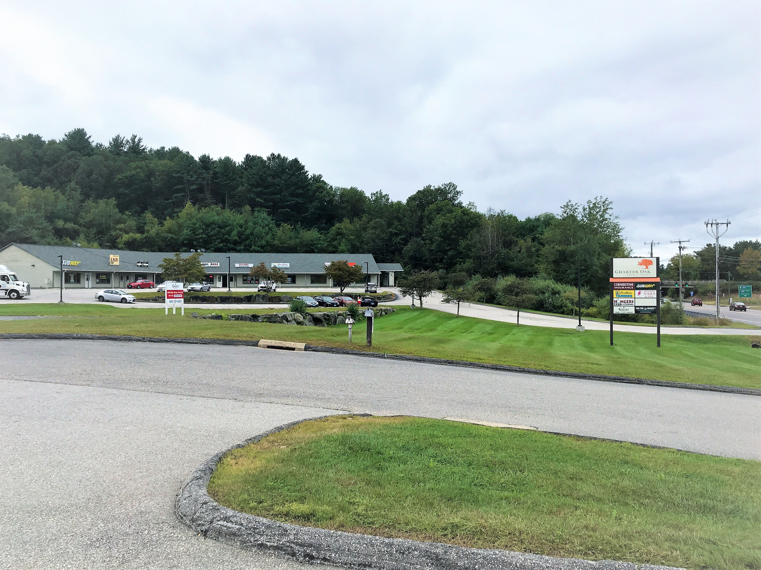
7 Providence Pike
Zone: HC
Listed by: Galaxy Development
Contact: Carlee Schettino 603-276-9654
Jack O’Brien, 508-721-0005 x210
FOR LEASE
STONEWALL COMMONS
3 SPACES AVAILABLE
SPACE 2 – 1000SF - $12/SF/MO
SPACE 5 – 1500SF - $12/SF/MO
PAD SITE – 1 AC W/DRIVE-THRU AVAILABLE - CONTACT FOR RATE
DIRECTLY OFF OF I-395
ADT +/-15,000
EXIT 47 OFF OF I-395 ON RT. 44
#1

Slide 4
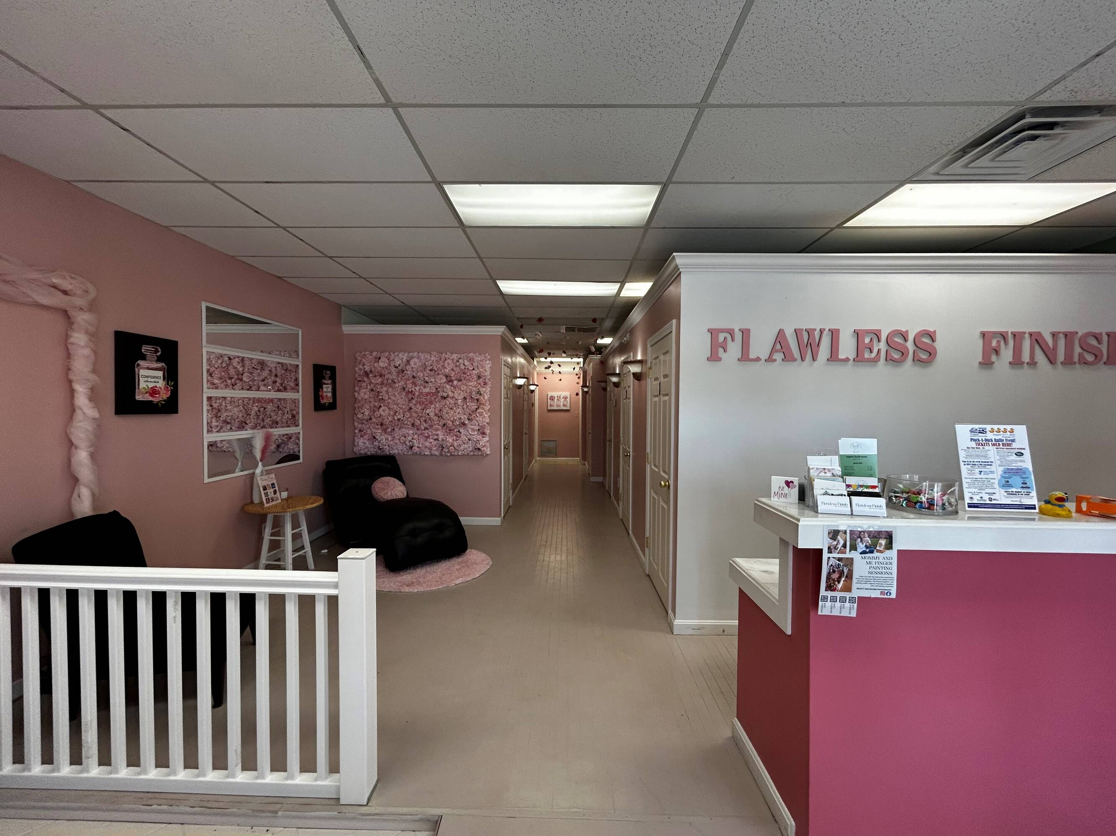
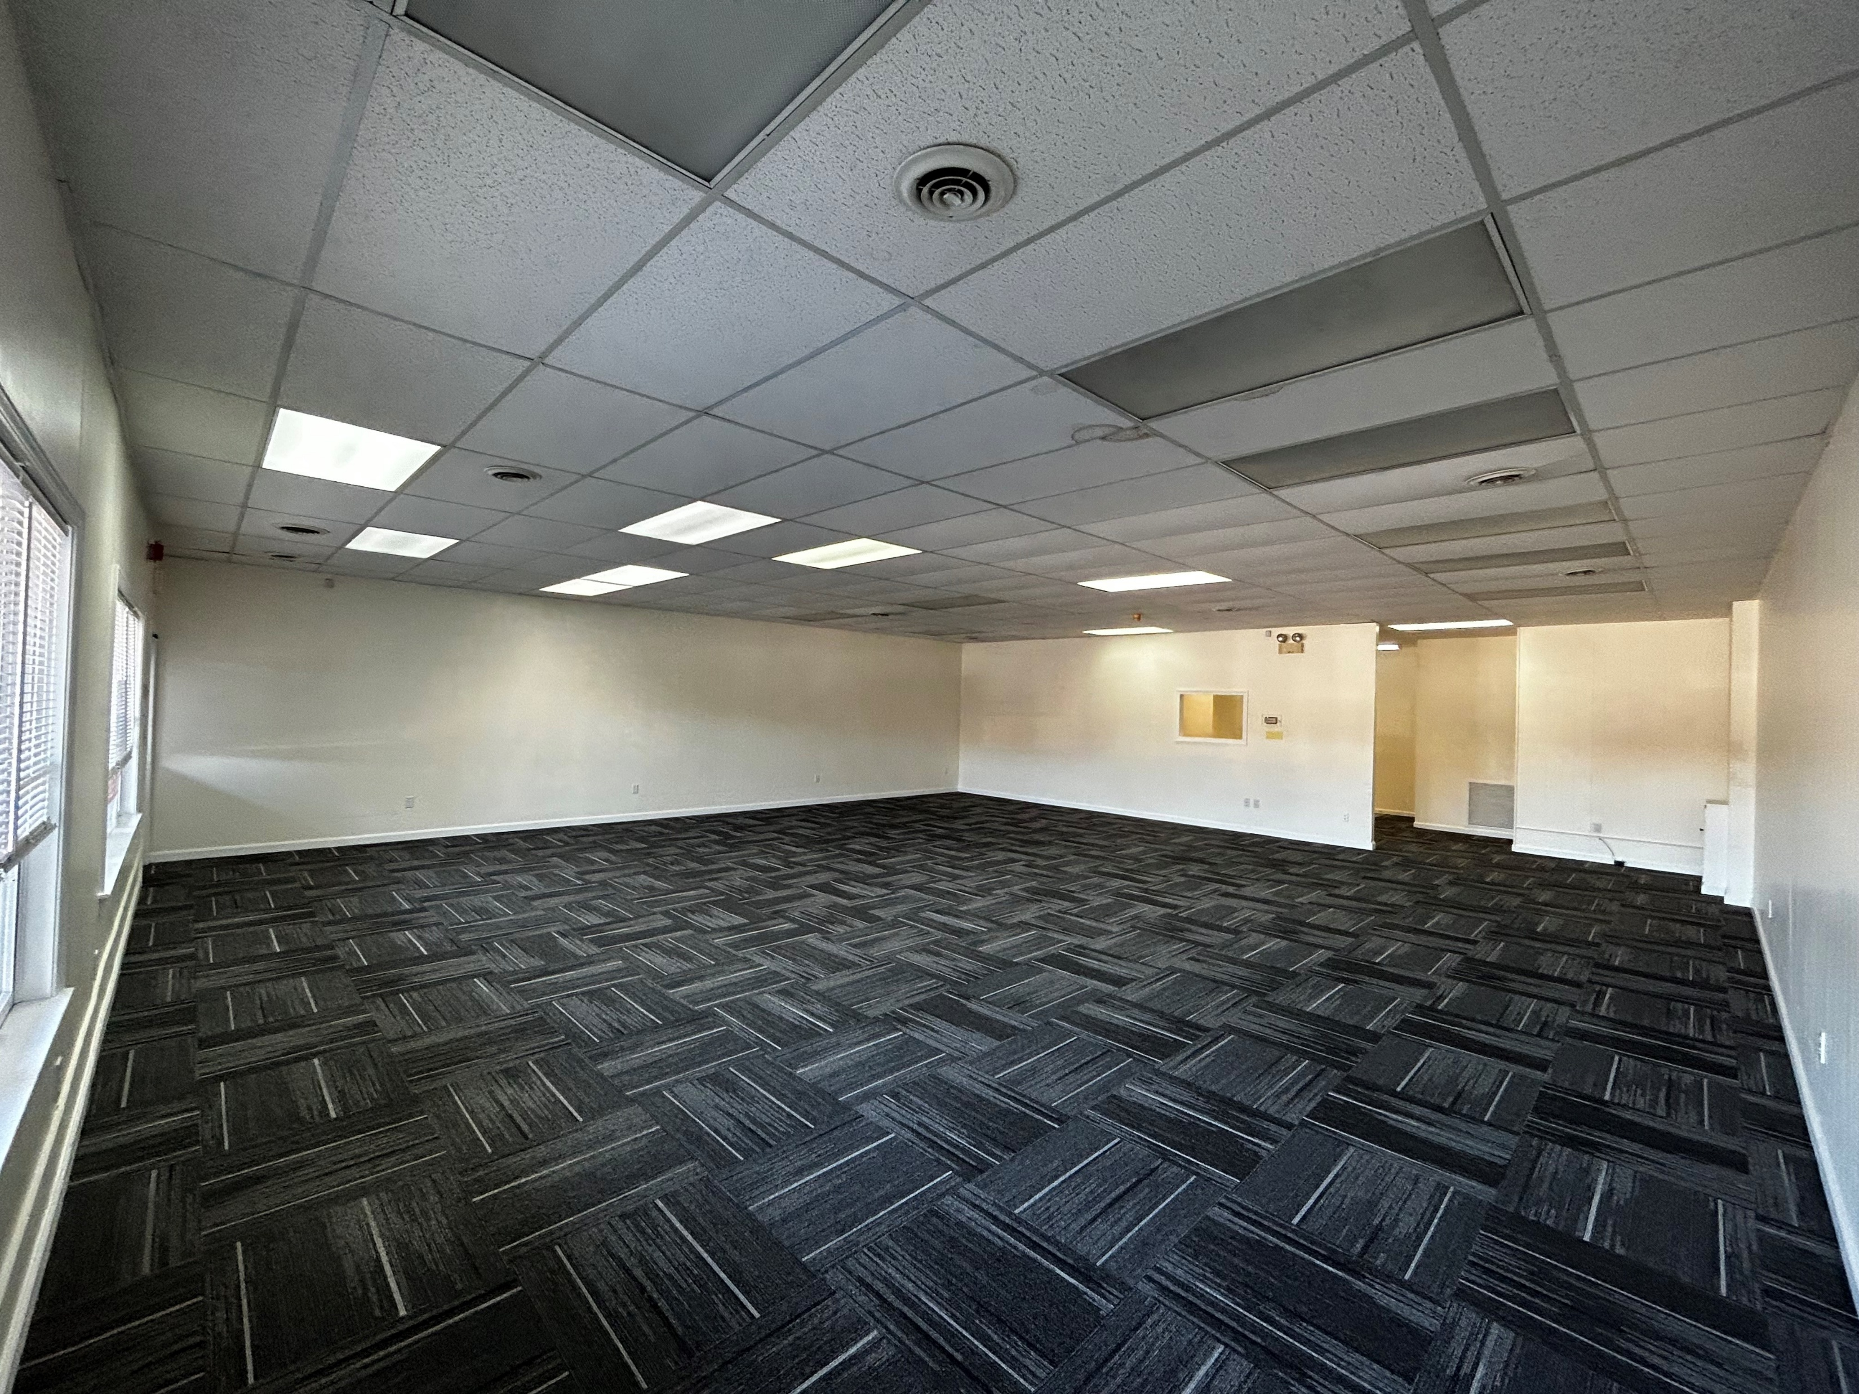
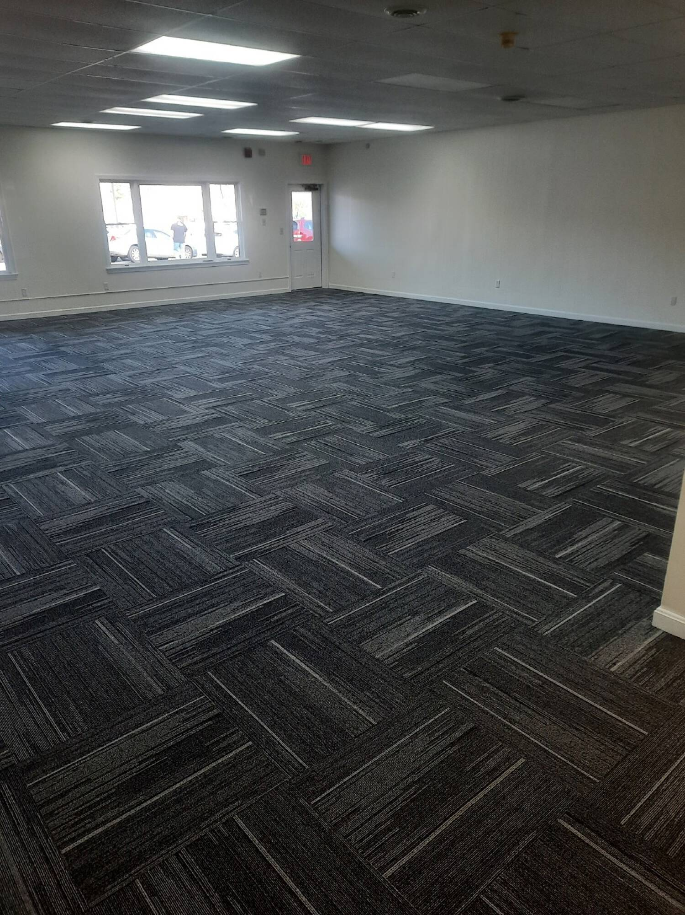
SPACE 2 - 1000 SF
SPACE 5 - 1500 SF
#1

Slide 5
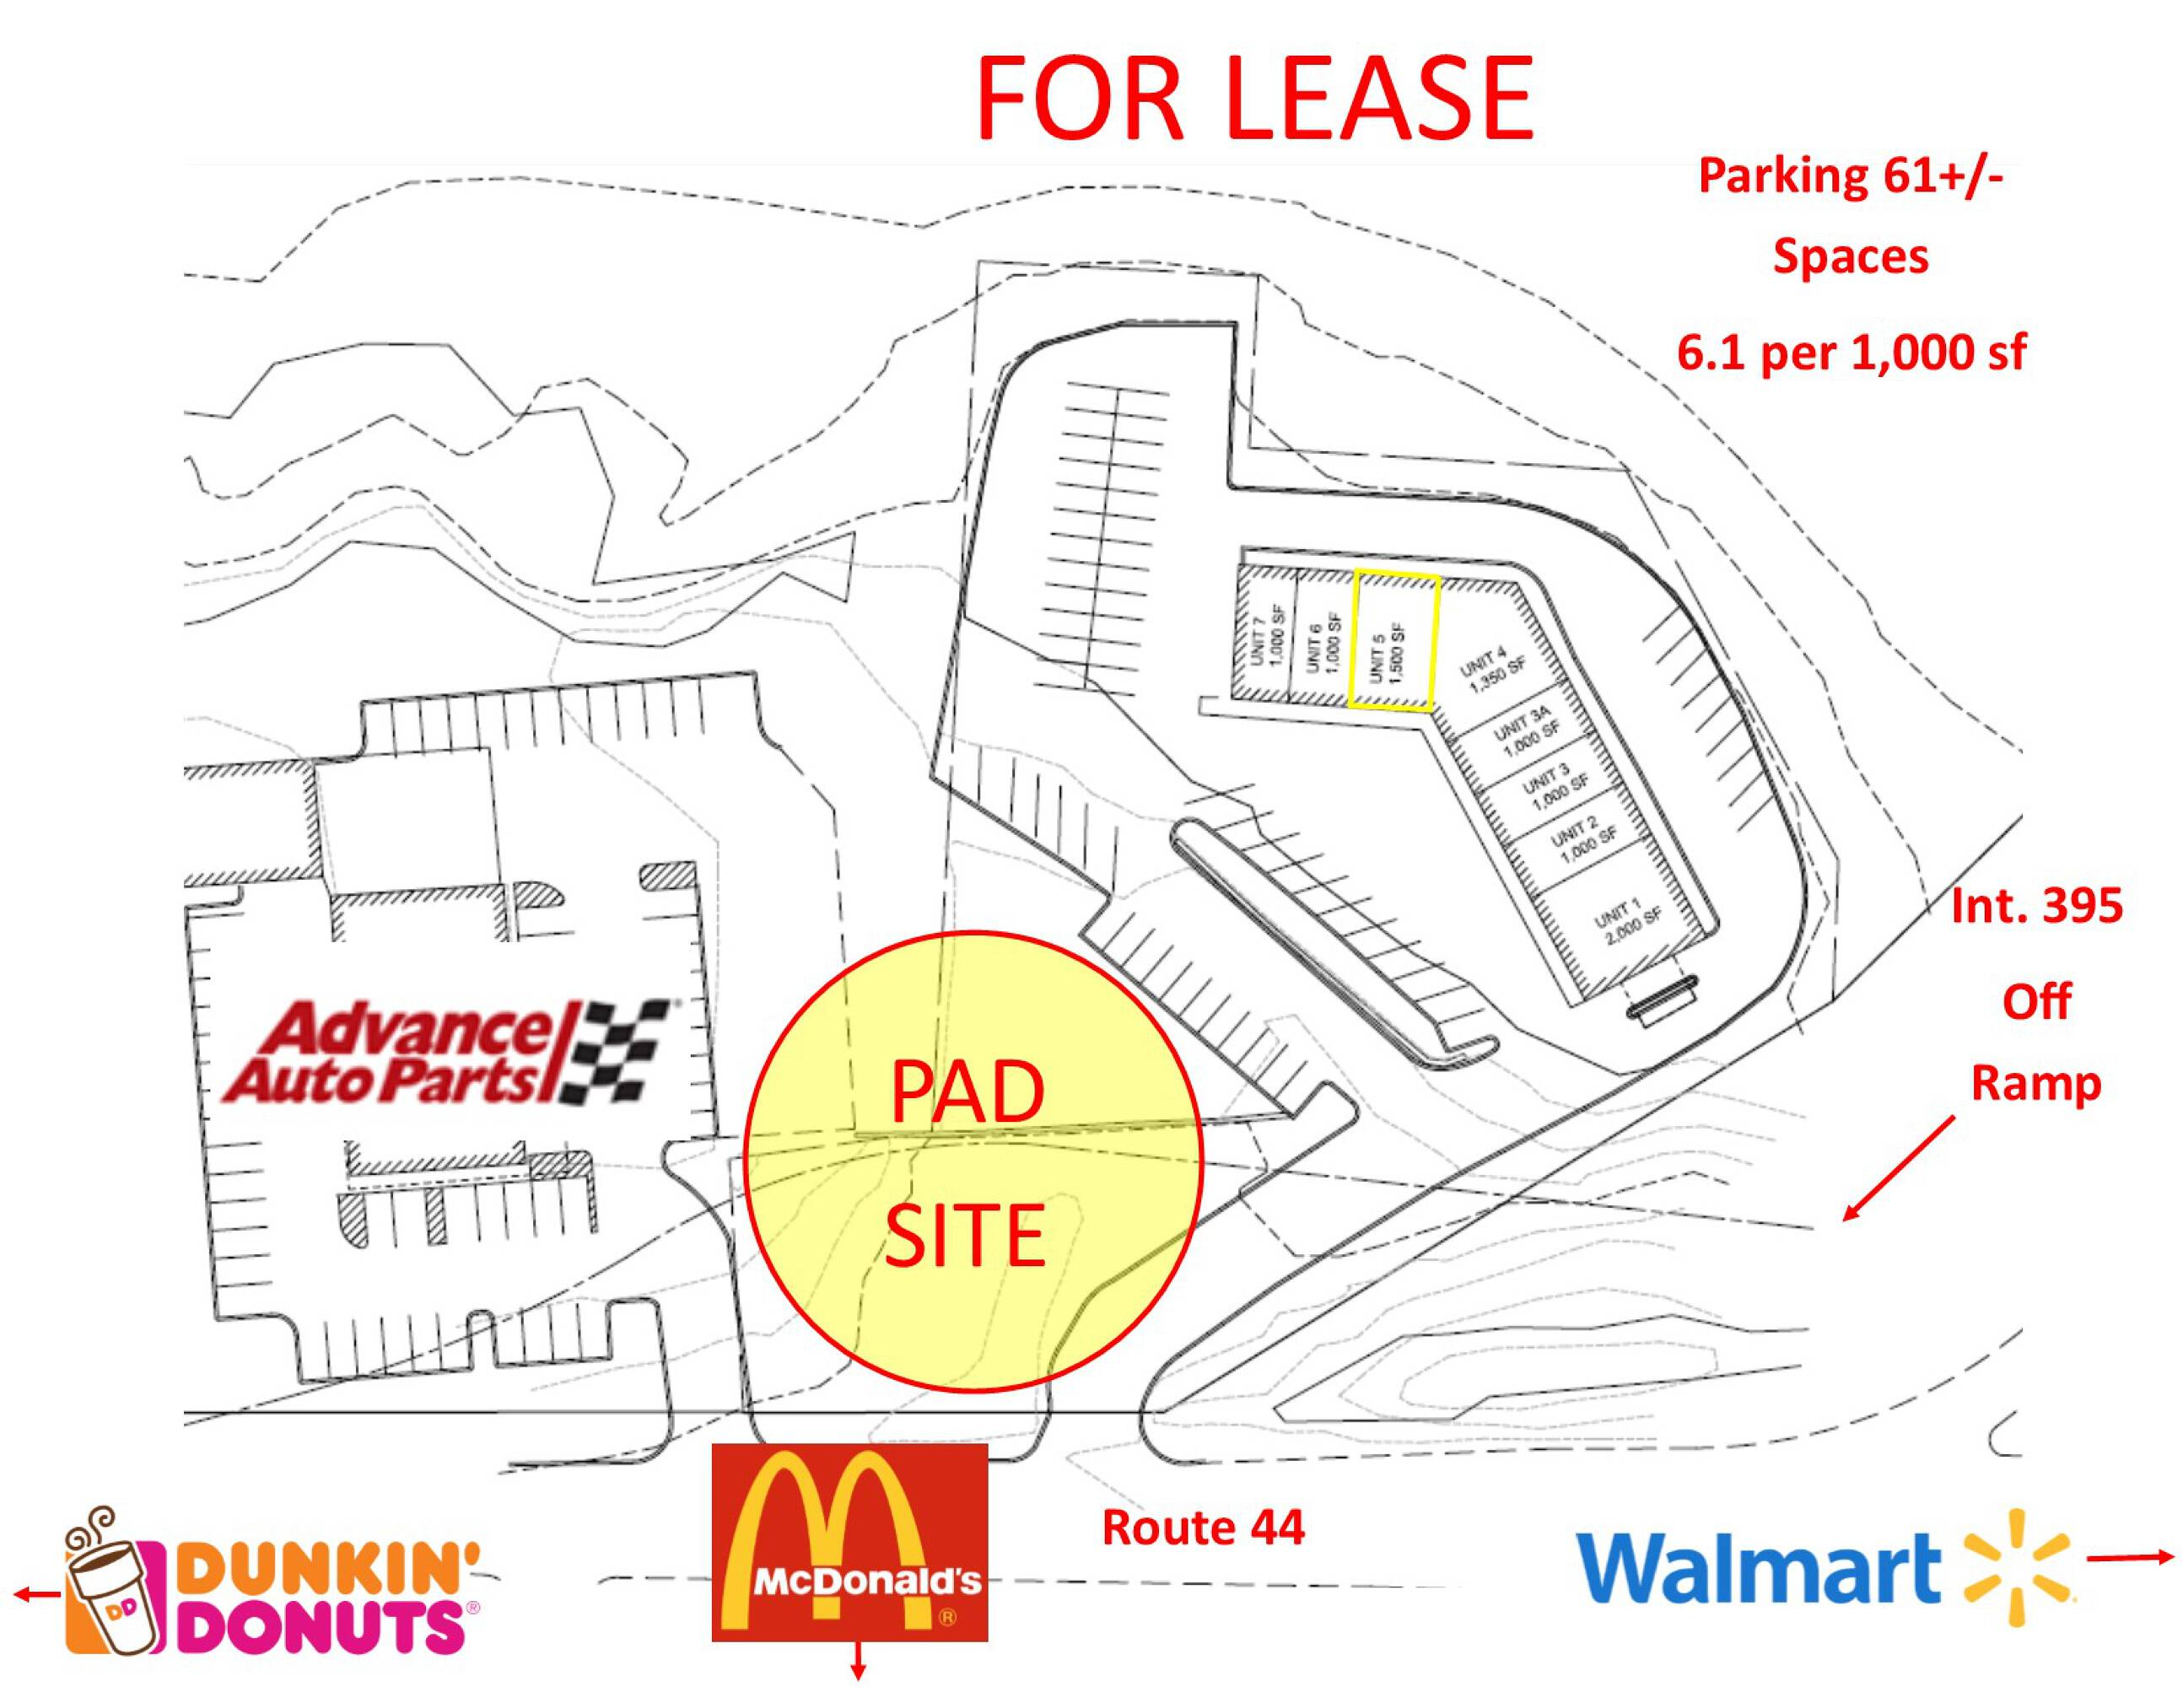
#1

Slide 6
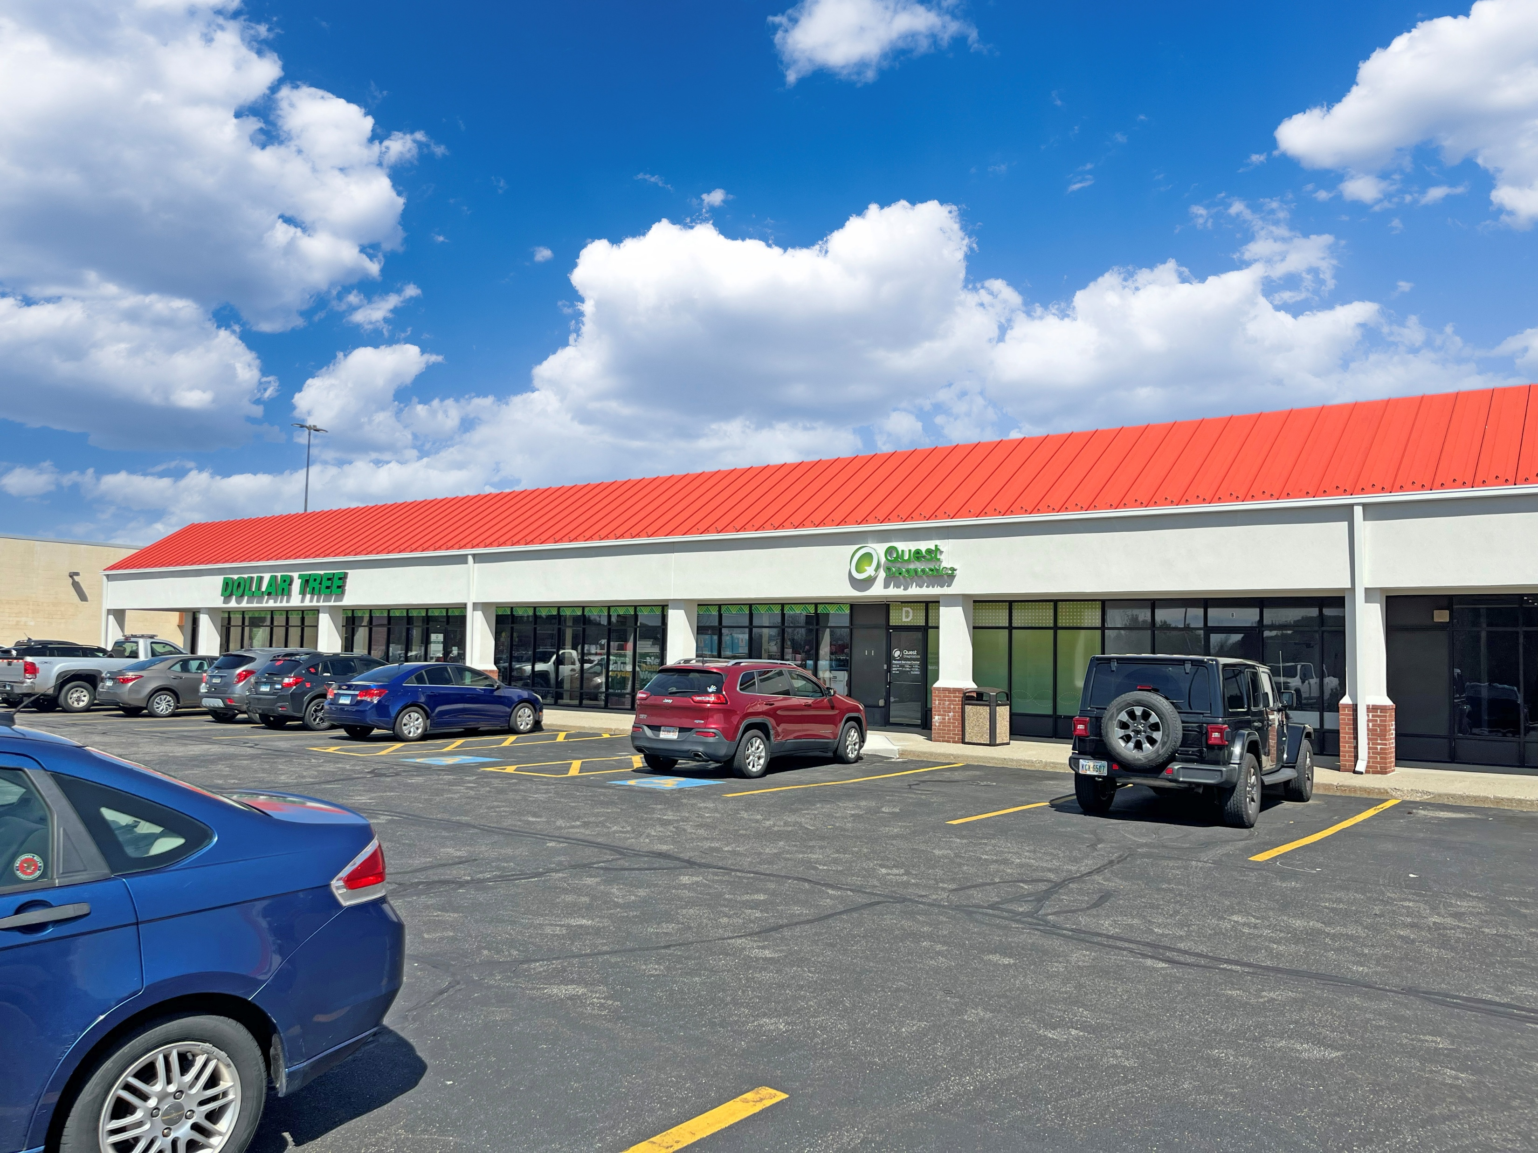
62 Providence Pike
Zone: HC
Listed by: SRS Real Estate Partners
Contact: Christian Janelle
857-263-3812
FOR LEASE
SHOPPES AT PUTNAM
4 SPACES AVAILABLE:
UNIT D – 1767SF
UNIT D2 – 2300SF
UNIT H – 1433SF
2 AC PAD SITE
CONTACT LISTING AGENT FOR RATES
EXIT 47 OFF OF I-395 ON RT. 44
ADT 15,000
#2

Slide 7
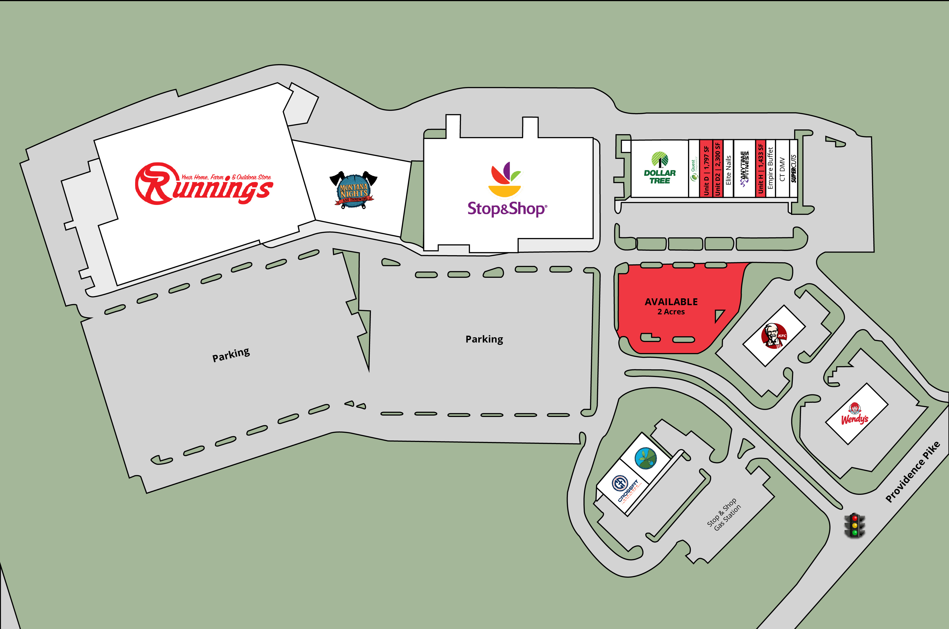
#2

Slide 8
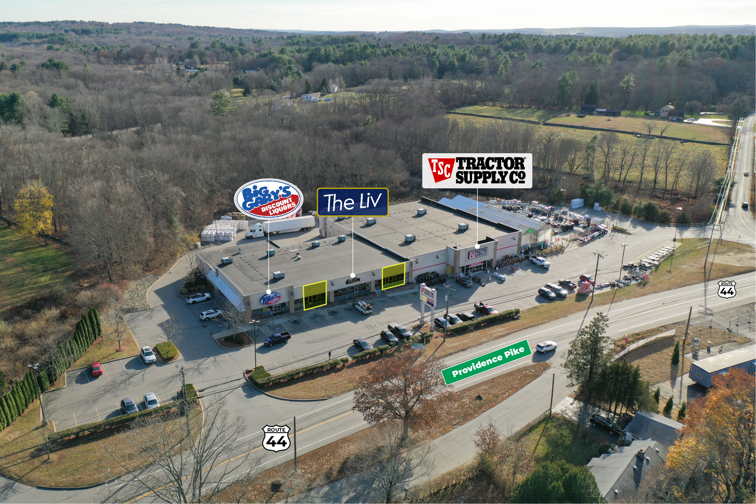
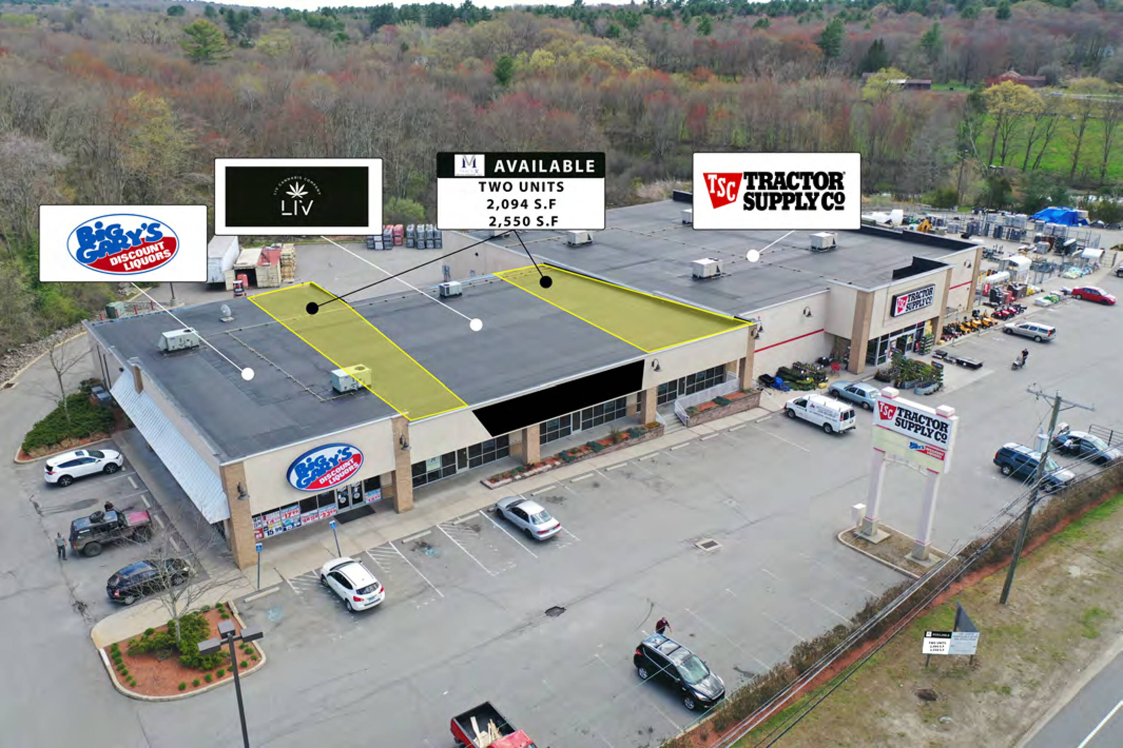
97 Providence Pike
Zone: HC
Listed by: New England Retail Properties
Contact: Matt Halprin
860.529.9000 X 105 halprinm@newenglandretail.com
FOR LEASE
TWO UNITS AVAILABLE:
Unit 2 - 2,096SF
Unit 4 - 2,550SF
HIGH TRAFFIC AREA
HIGH VISIBILITY
IMMEDIATE OCCUPANCY
Contact Listing Agent for
Rates
EXIT 47 OFF OF I-395 ON RT. 44
ADT 15,000
#3

Slide 9
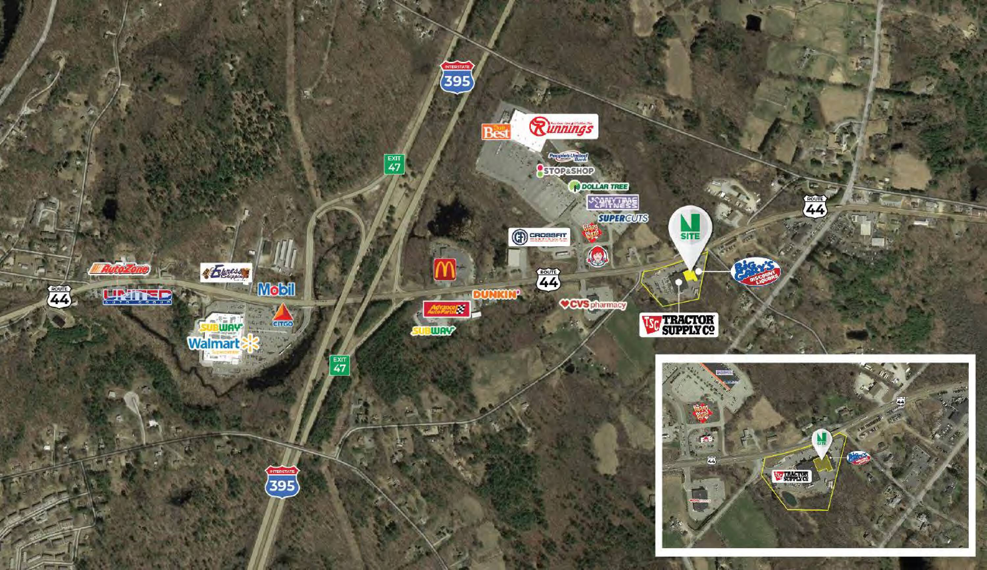
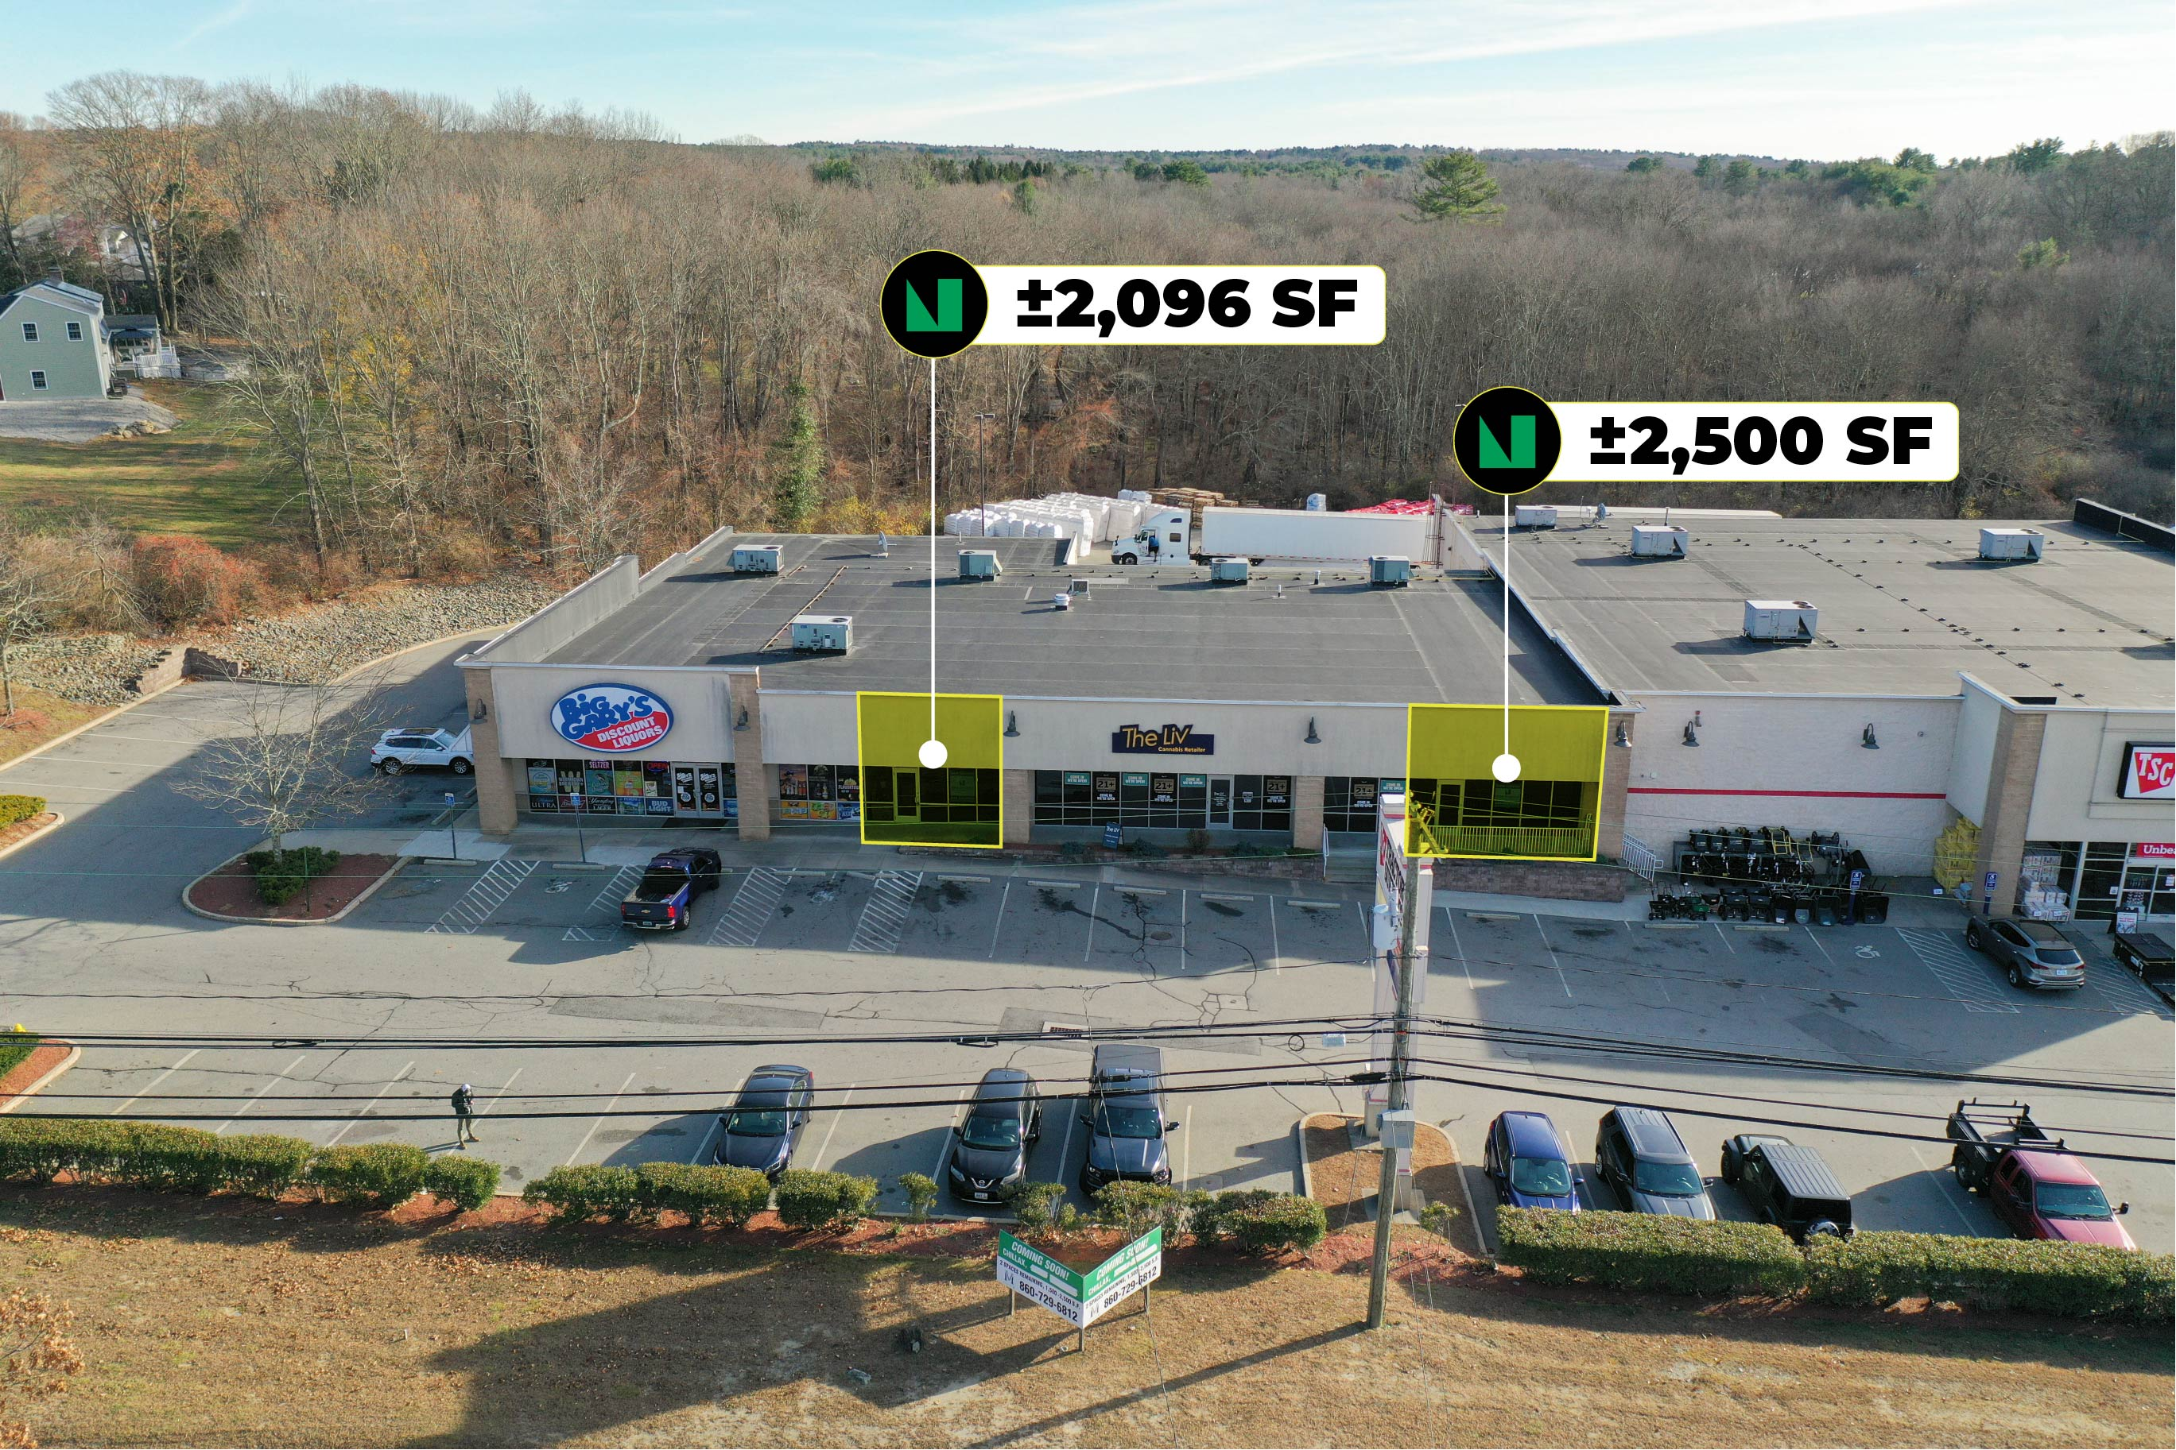
#3

Slide 10


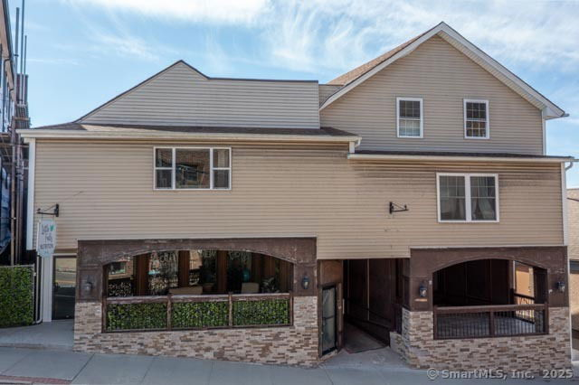



6-14 Pomfret St.
Zone: PD (Putnam Downtown)
Listed by: Kazantzis Real Estate
Contact: Jennifer Lehto
860-230-6679
For Sale: $850,000
Mixed Use Property
High Visibility, Income Producing
2 Residential Units
2 Commercial Units
Fully Rented
#4

Slide 11
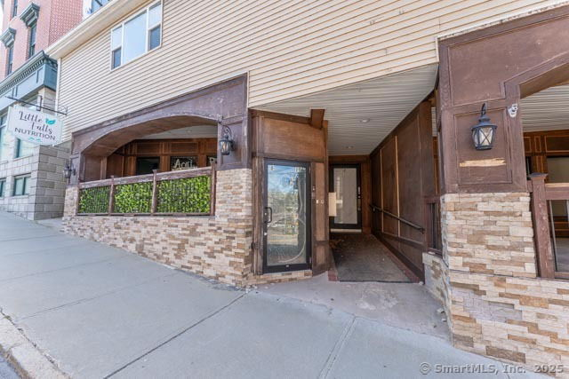
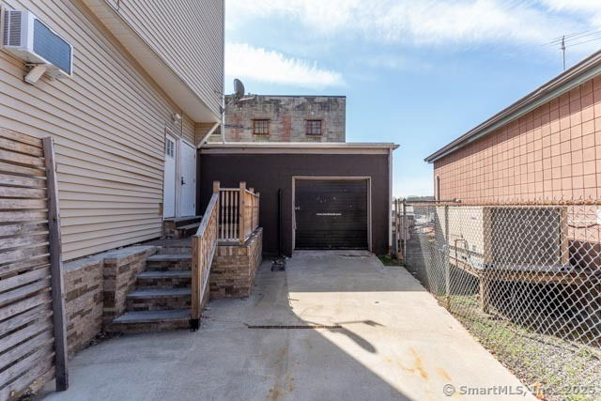
#4

Slide 12
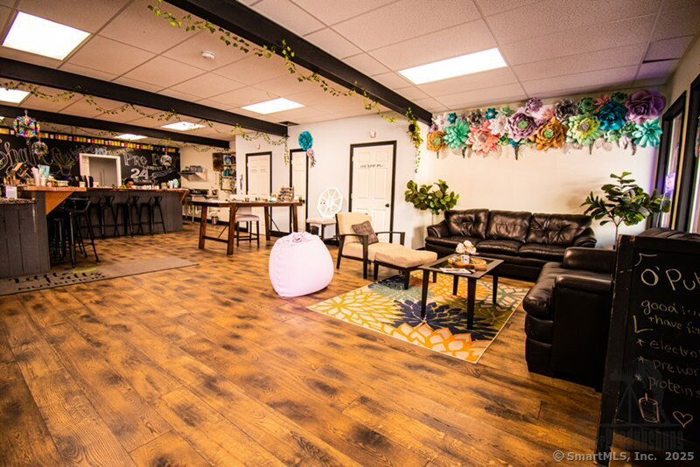
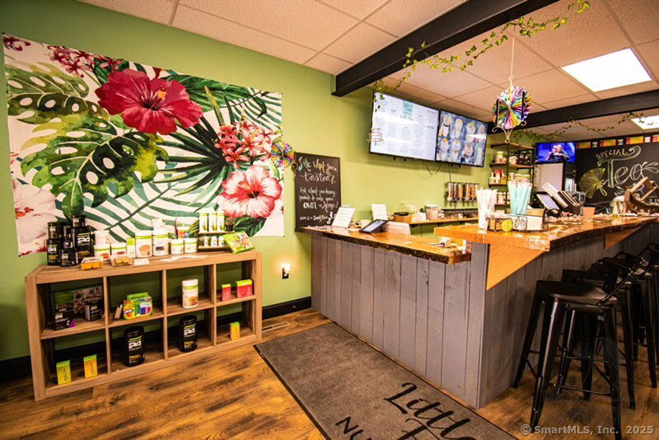
#4

Slide 13
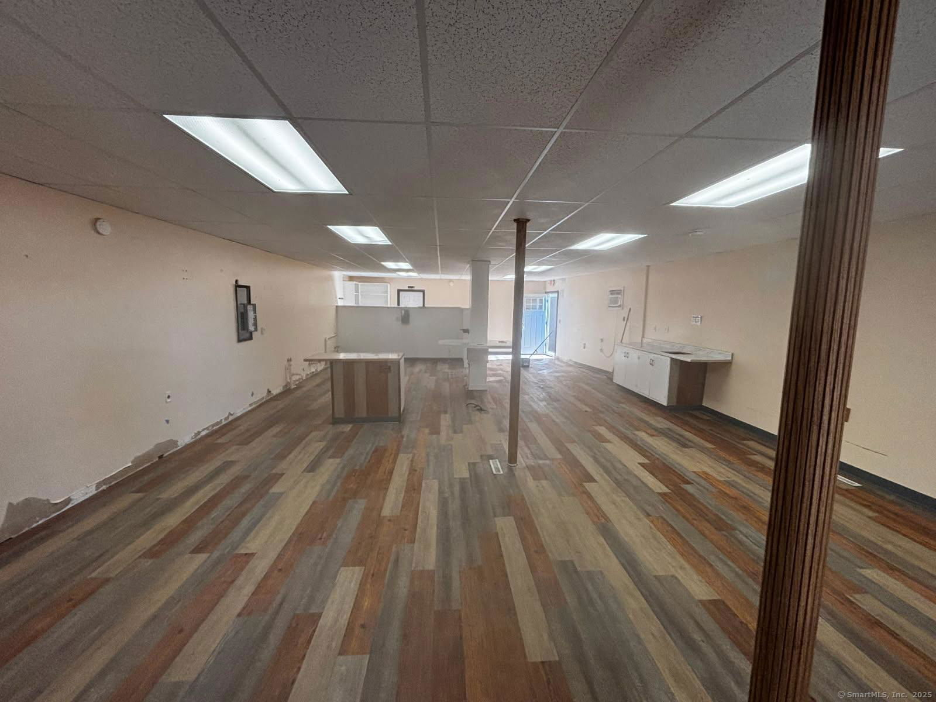
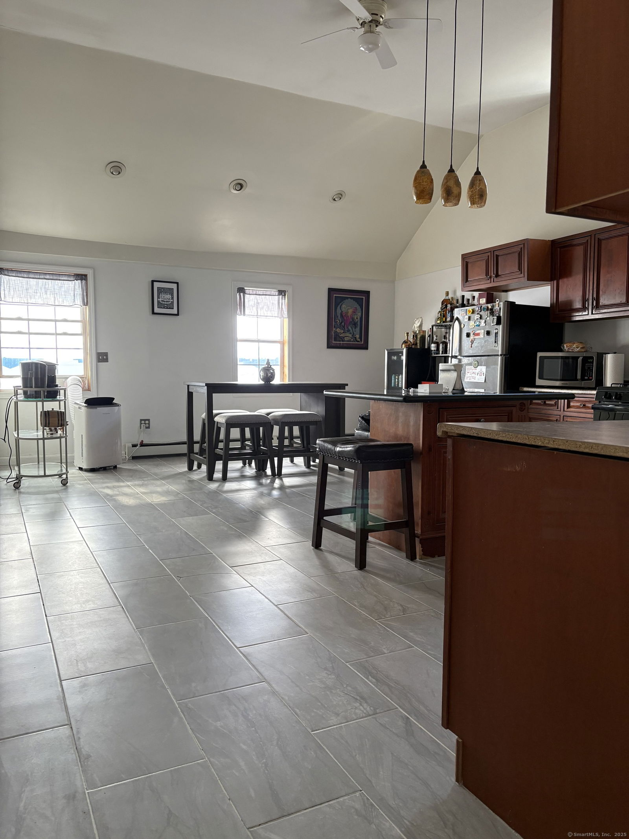
#4

Slide 14
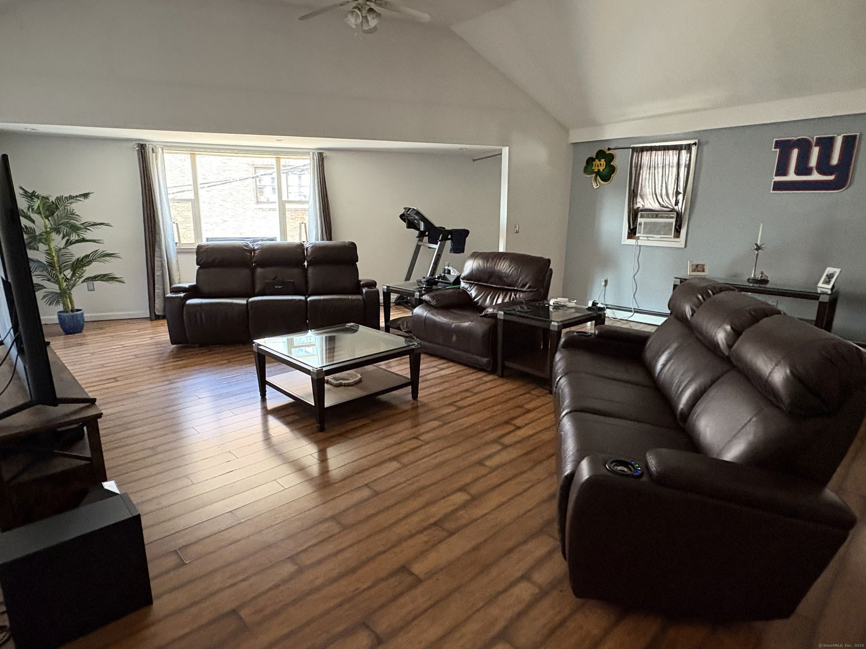
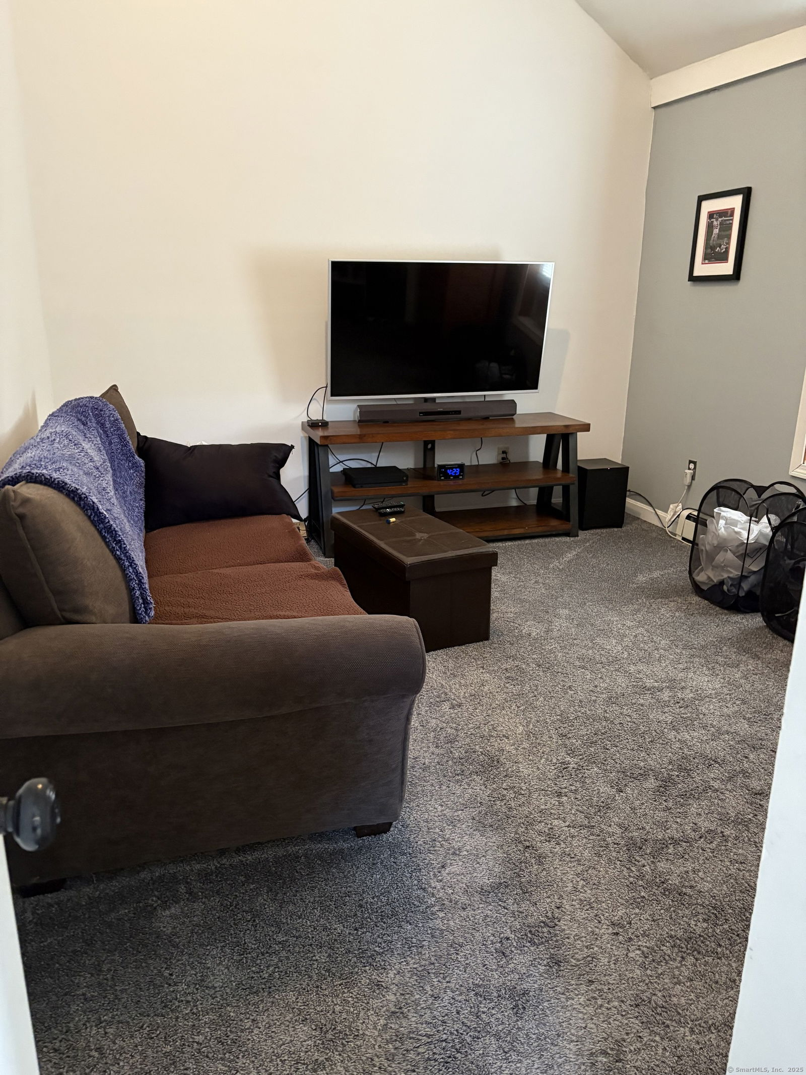
#4

Slide 15
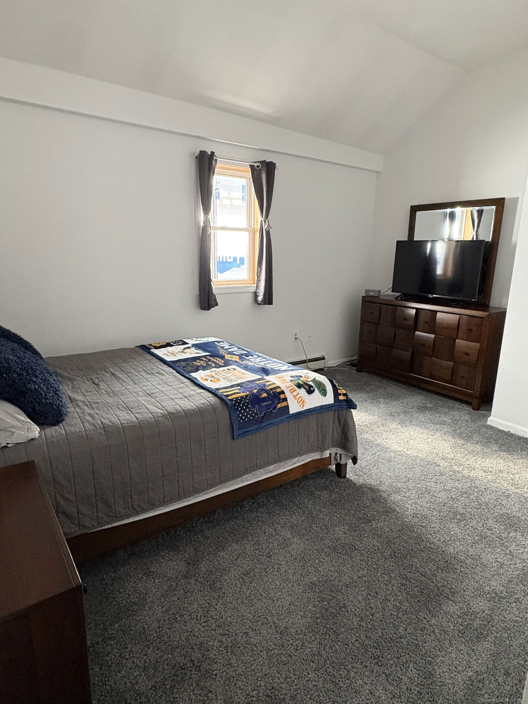
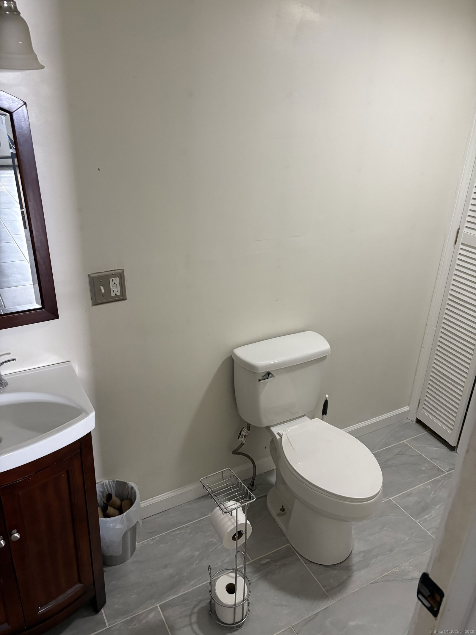
#4

Slide 16
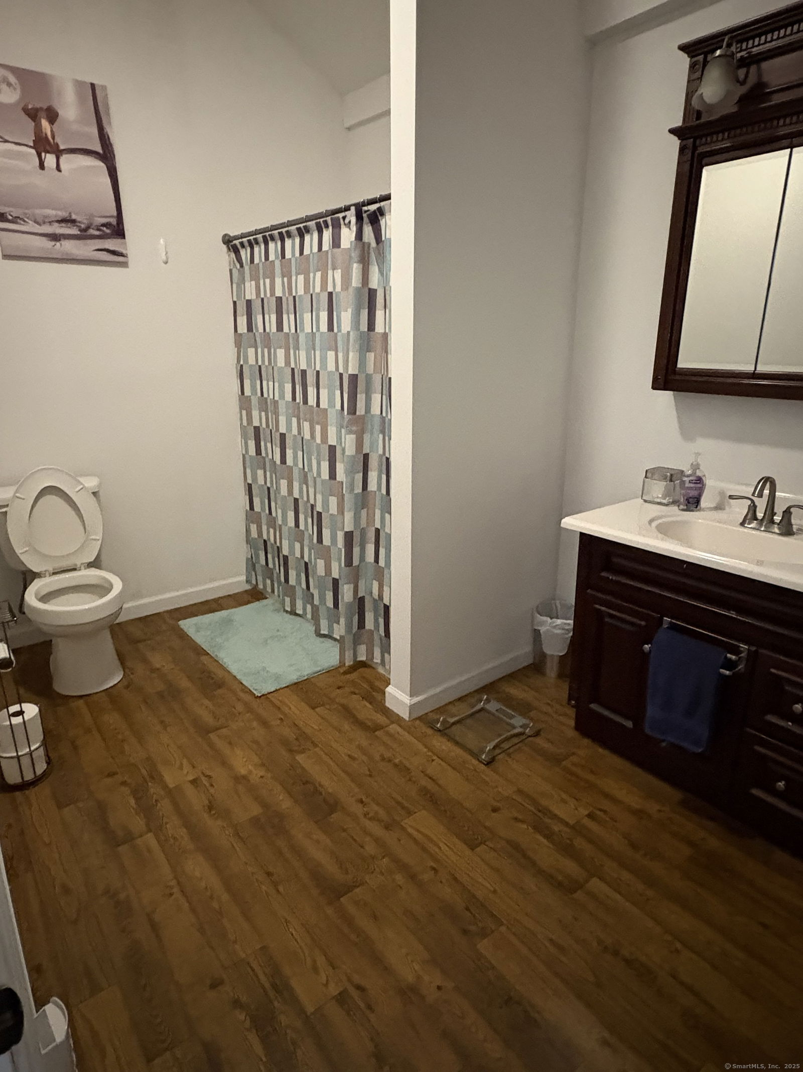
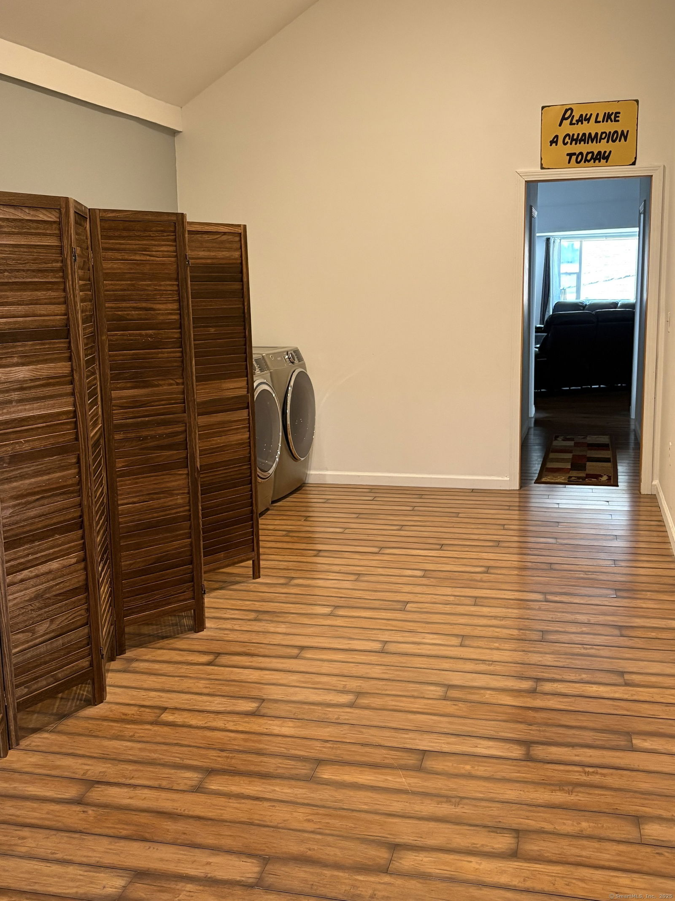
#4

Slide 17
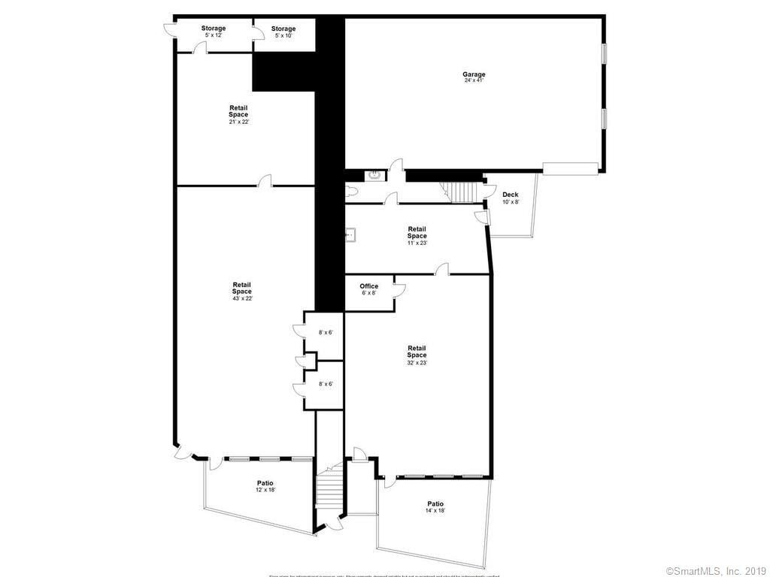
#4

Slide 18
If you’re interested in any of these properties, contact directly the agents listed, or the Putnam Economic & Community Office (contact info on the cover page of this presentation), and we’re happy to help you bring your business to town or expand your existing Putnam business.
More featured properties coming soon!

